Slide 1
Tollezanz
A game about tolerance
Aaron Segal, David Wang, Eric Benson and Jezz Lucena
Worcester Polytechnic Institute
IMGD 4600 – Serious Games
C-Term 2015

Slide 2
Needs Analysis
Problem Statement
It can be tough to know what religious intolerance is, since most of the time those things are brought up associated to moral concepts
Media portrays them in a way that hides the truth
It’s hard to treat every individual as a different human being when you grow up in a society that culturally dehumanizes all diverse religious, racial and cultural groups

Slide 3
Needs Analysis
Learning Objectives
How to separate an individual from a misleading defined stereotype
How to act when you witness discrimination and how to act when you being discriminated

Slide 4
Target Users
Teenagers (12~17) from the USA
America has a great diversity of races, religions, and cultures
Teenagers are still building their concepts about diversity

Slide 5
Delivery Platform
PC and Mac Systems - First Stage
iOS and Android Tablets - Second Stage

Slide 6
User Interface
The game is split into 2 different parts
First part: Simulation
Second part: Point ’n Click

Slide 7
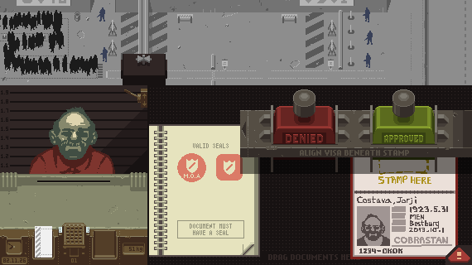
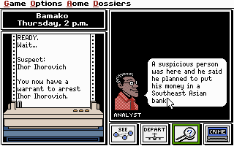
User Interface
Main inspirations: "Papers, Please” and “Carmen Sandiego”

Slide 8
Gameflow / Narrative
The Judging Phase
The Main Character is a Customs Officer who is pushed into judging characters in an immigration line
The player can talk to NPCs selected for searching
Players can learn about NPCs by looking at their record and passport information
By talking to the NPCs, the player learns information about them that humanizes them.

Slide 9
Gameflow / Narrative
The Judged Phase
The Main Character moves to a neighbor country and needs to find a job and interact with people who are going to prejudge him/her
The player interacts with the inhabitants of a foreign country while visiting and is subject to being treated poorly due to cultural misconceptions
NPCs, such as a grocery-store clerk, will generalize and assume things about the player solely based on generalizations and prejudice

Slide 10
Assessment
In-game Pre/Post Questionaries (one before the game starts, one after the first part, one after the second part)
Use of non-obvious-to-answer and ethically ambiguous questions for the target audience
The player should be able to learn and change opinions after realizing prejudgement is a wrong habit

Slide 11
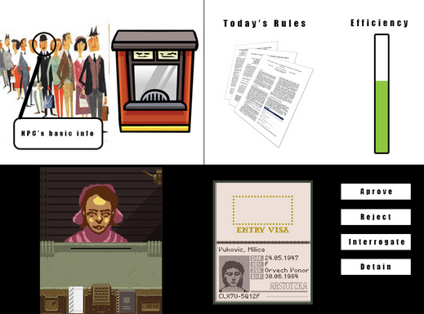
Concept Art

Slide 12
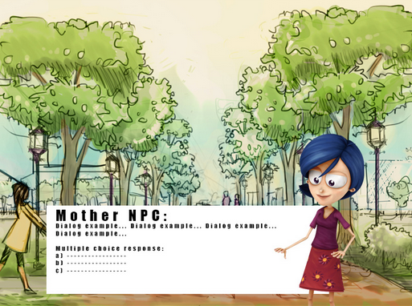
Concept Art

Slide 13
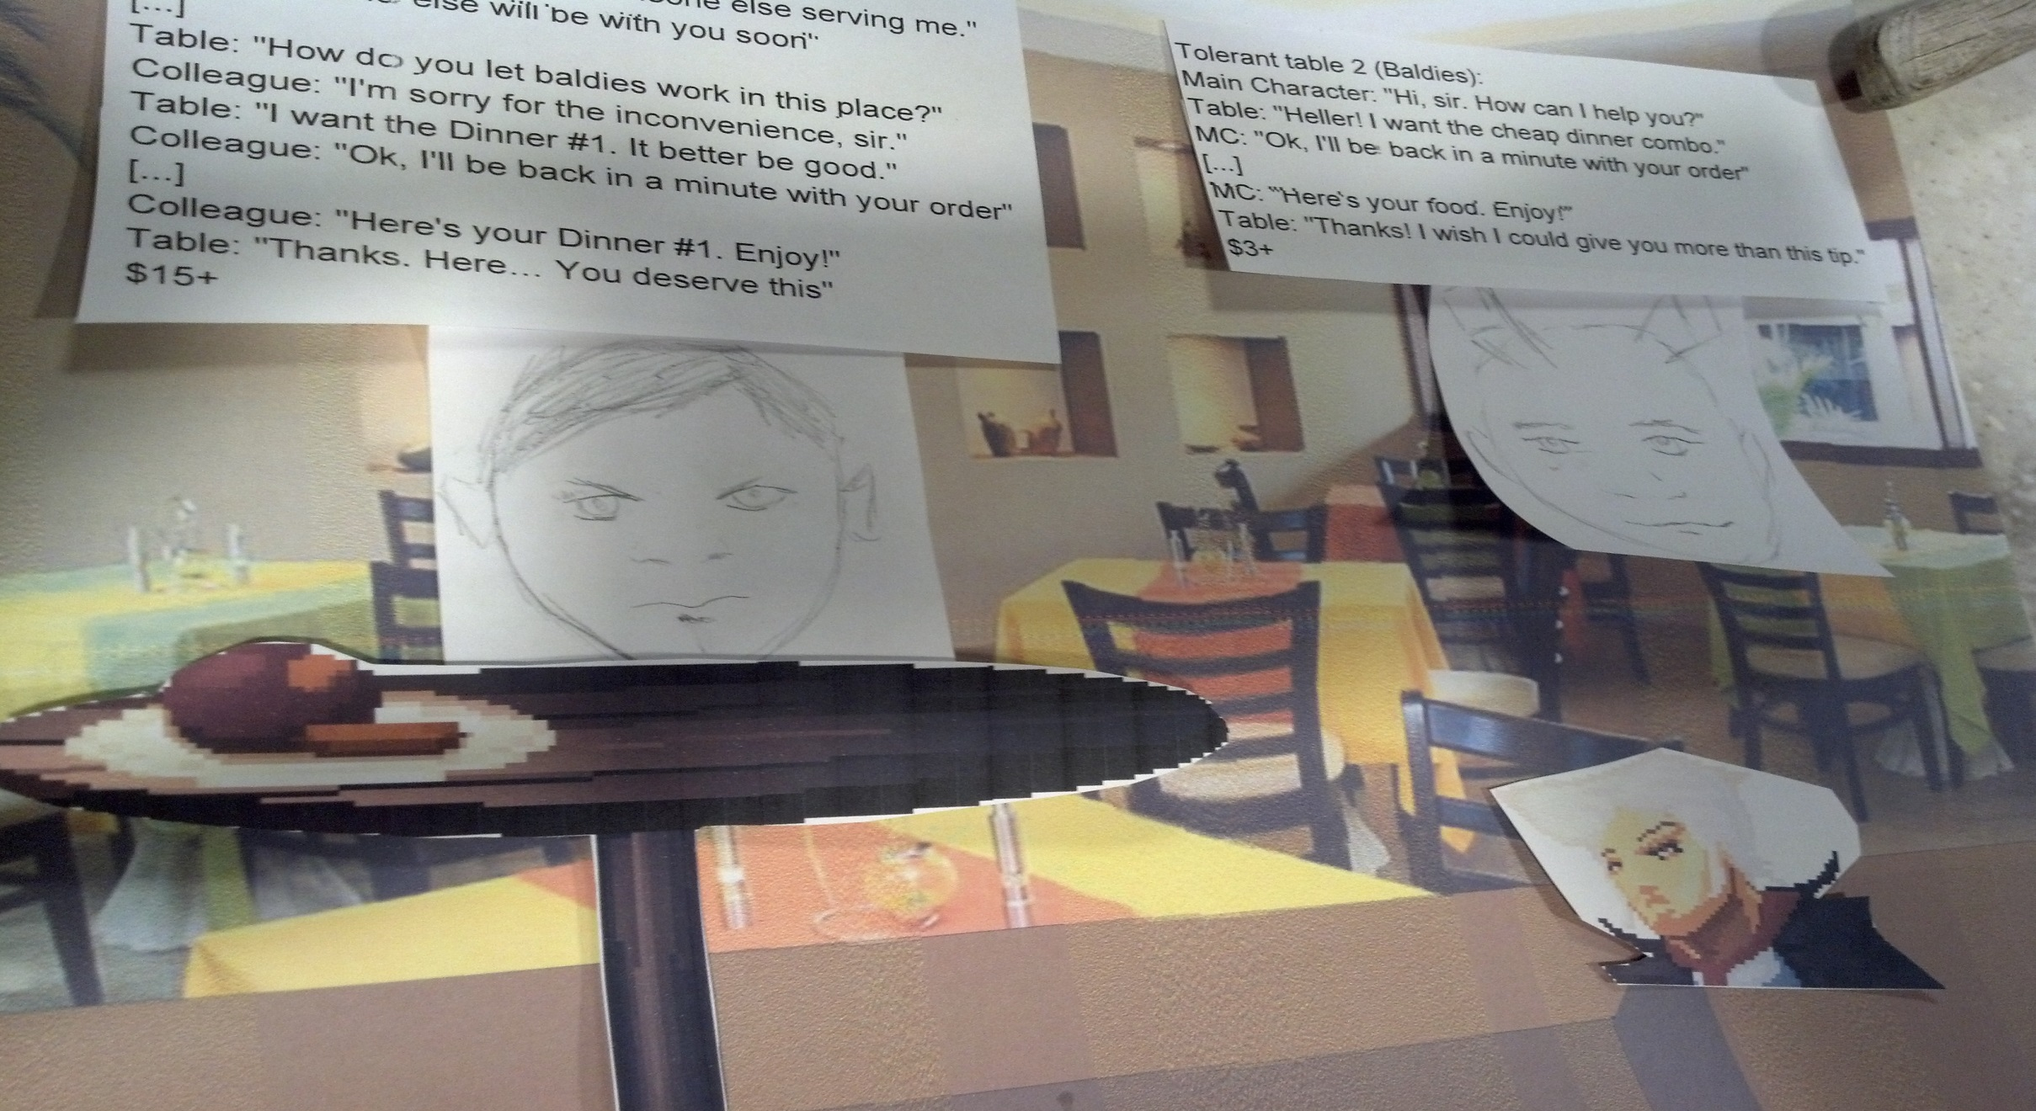
Prototype
Restaurant area
Player needs to wait on customers to get paid

Slide 14
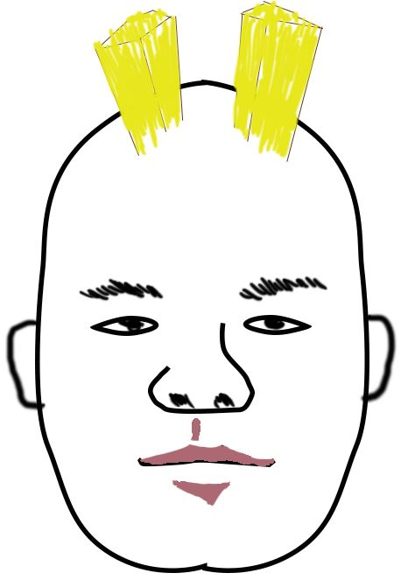
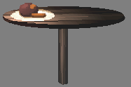
Prototype Analysis
Good:
Voice overs
Conversations
Maneuverability

Slide 15
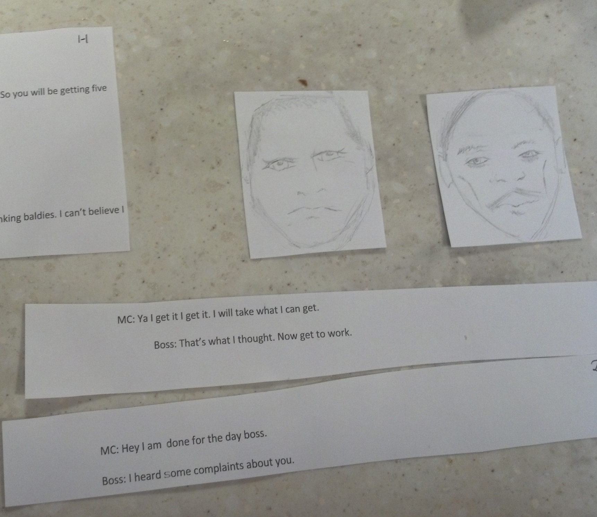
Prototype analysis
Cons
Thrown into the story
Slightly boring
Dialog trees

Slide 16
Questions
?

