Slide 1
Urban Coexistence: Human-Wildlife Management in New Zealand
Gavin Ford, Connor Jason,
Hunter Maher, Luke McQuillan

Slide 2
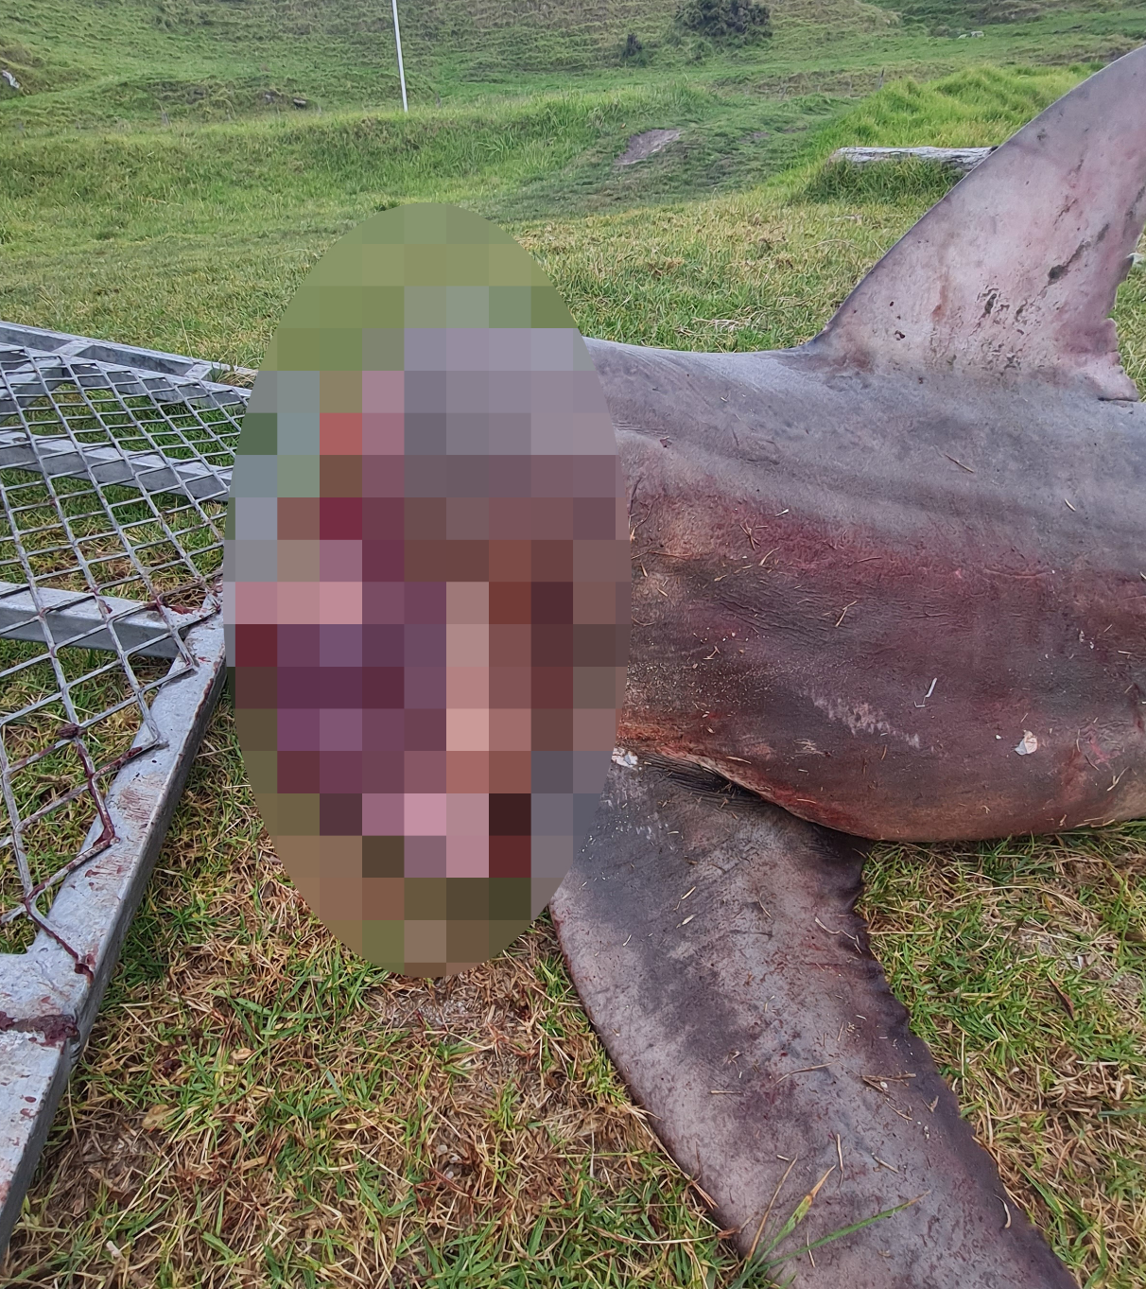
Archival Research
Deliberate Harm
Conservation Sabotage
Gross Negligence

Slide 3
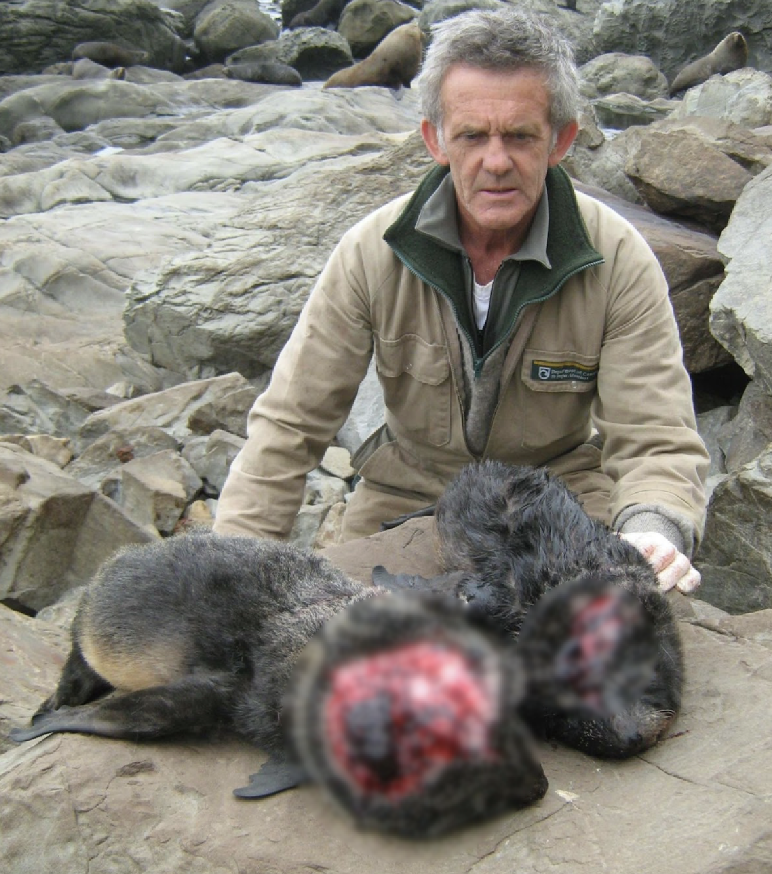
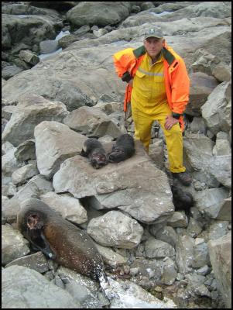
Deliberate Harm
DOC rangers with some of the 23 fur seals clubbed to death at Ohau Point near Kaikōura. Scoop, 2010.

Slide 4
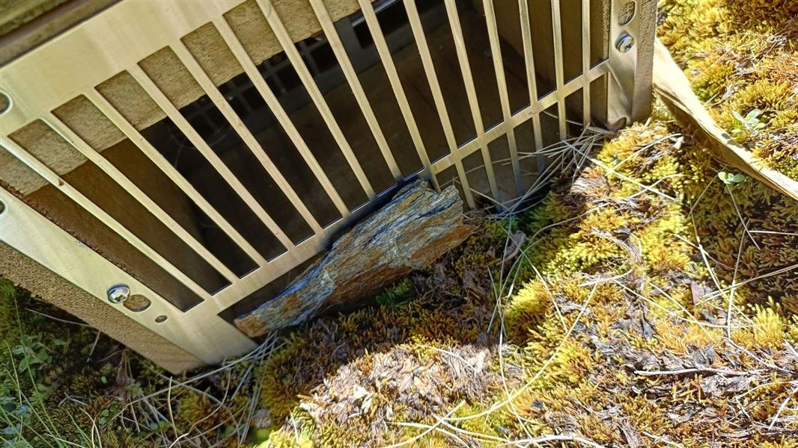
Conservation Sabotage
One of over 150 predator traps deliberately blocked with rocks, putting endangered native species at greater risk. Department of Conservation, 2025.

Slide 5
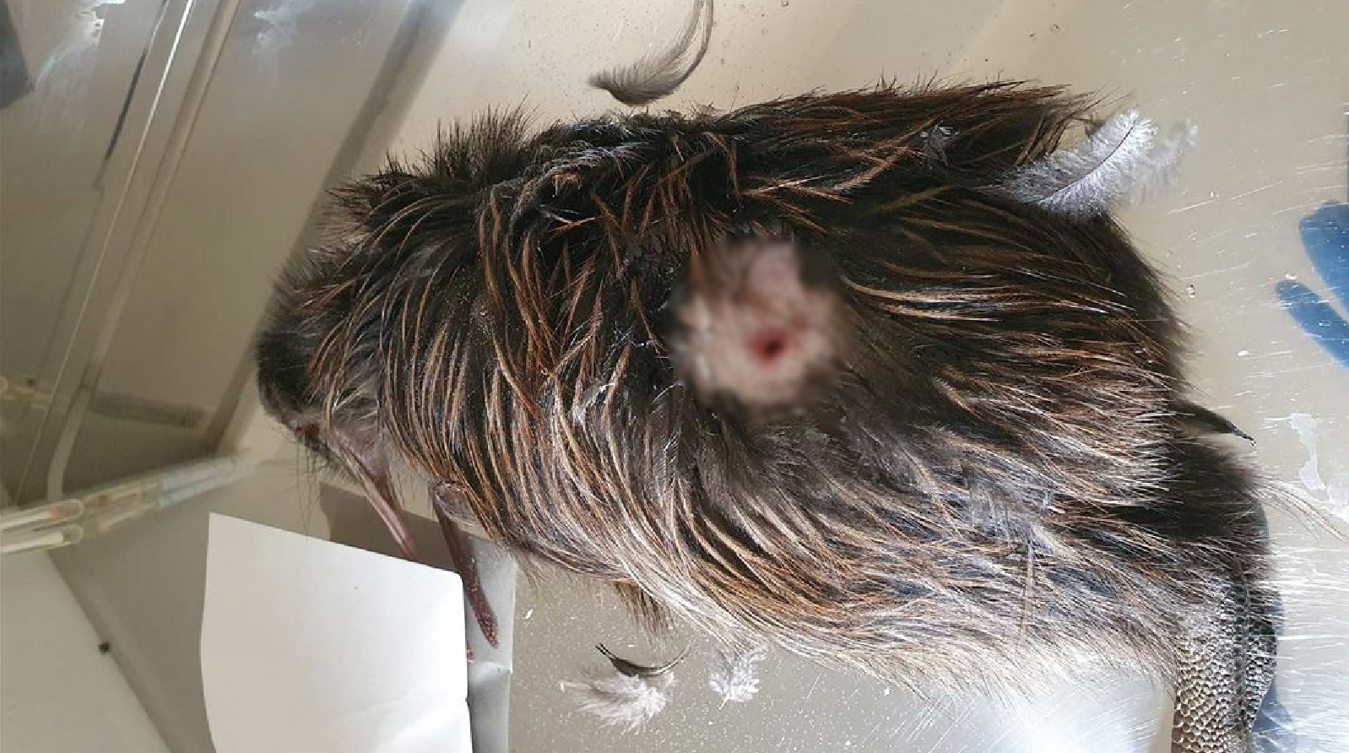
Gross Negligence
A kiwi found with bite injuries, killed in suspected dog attacks in Northland. Department of Conservation, 2025.

Slide 6
The Department of Conservation
Te Papa Atawhai
“We are the government agency charged with conserving New Zealand’s natural and historic heritage.”

Slide 7
Mission
To identify, address, and diminish harmful human-wildlife interaction in Aotearoa New Zealand

Slide 8
Outline
Mission
Objectives
Archival Research
Methods
Interviews
Surveys
Deliverable

Slide 9
Interviews
“Many people see nature as their own space, and wildlife is considered the intruder when that couldn't be further from the truth.”
— Professor Bruce Robertson
Kelly Eaton, Supervisor, Department of Conservation
Bruce Robertson, Professor, University of Otago
Brenda Lee, Executive Director, Colorado Bear Coalition
Dr. Ox Lennon, Conservation Manager, Wellington Zoo Trust

Slide 10
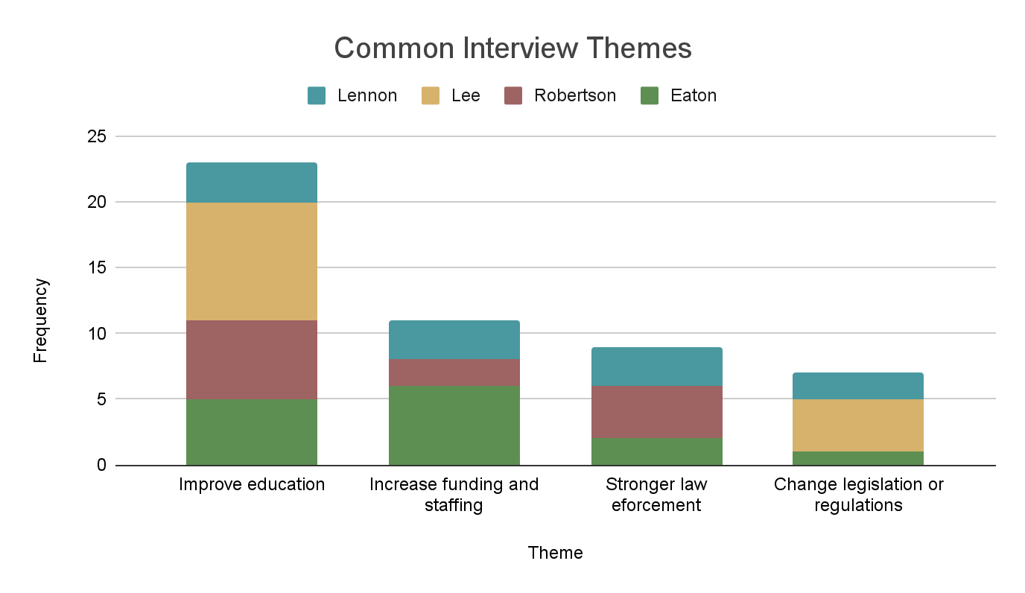

Slide 11
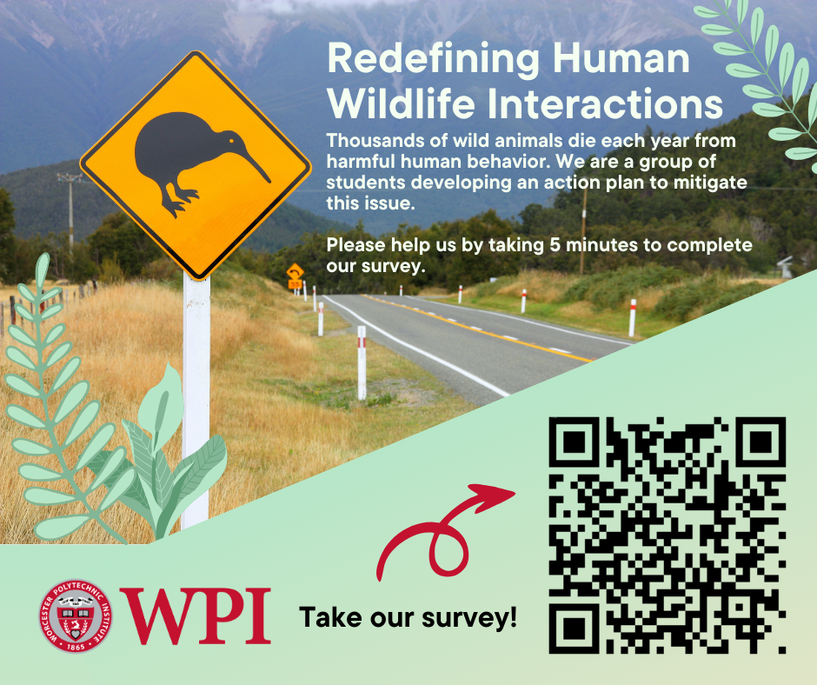
Surveys
Victoria University (In-person)
N=12
Online Groups
N=100
DOC Social Media
N=2305
Total completed
N=1990

Slide 12
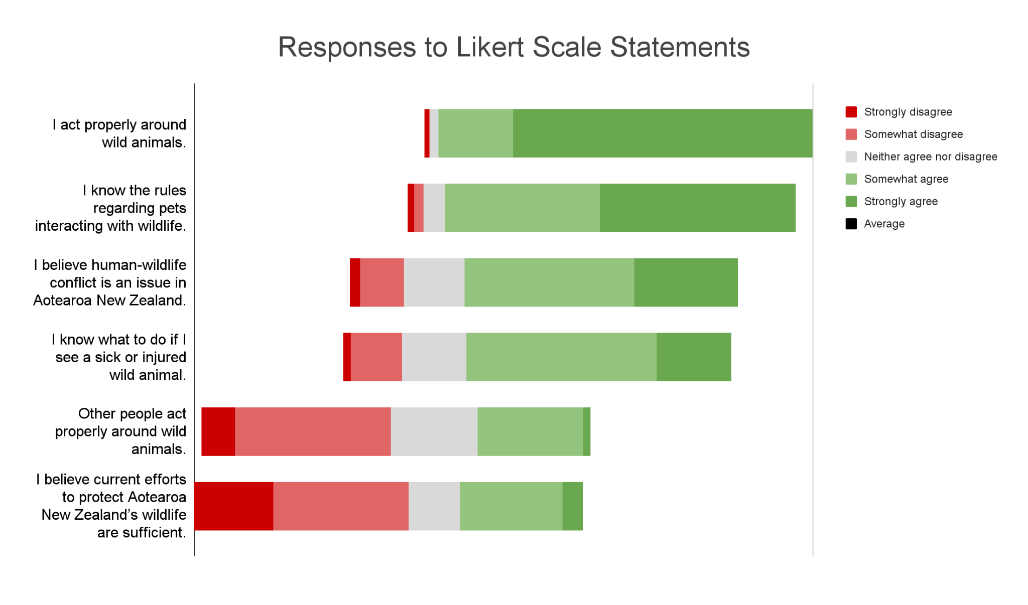

Slide 13
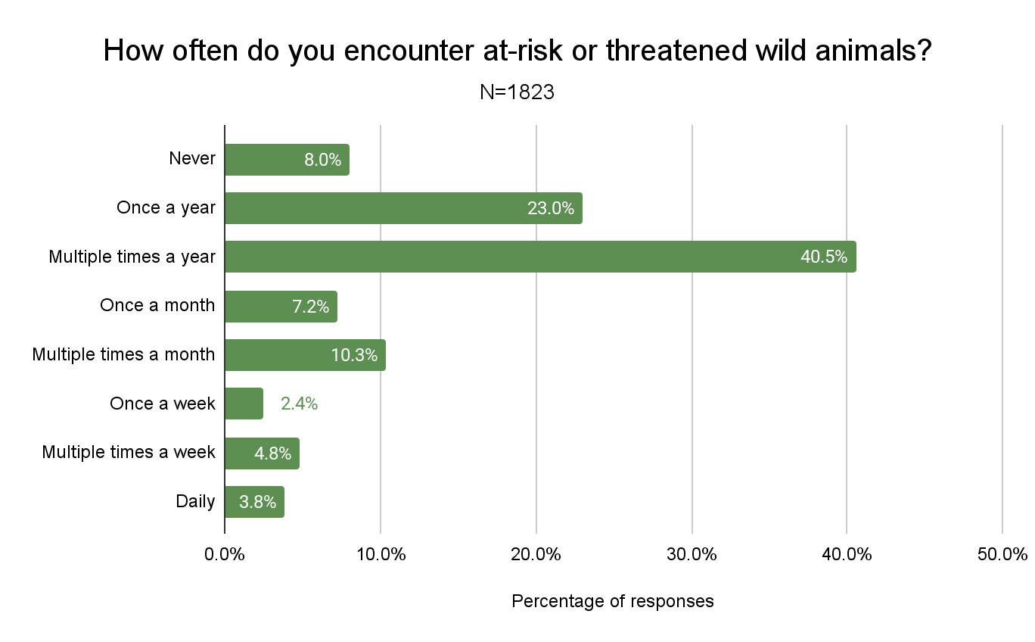
11%

Slide 14
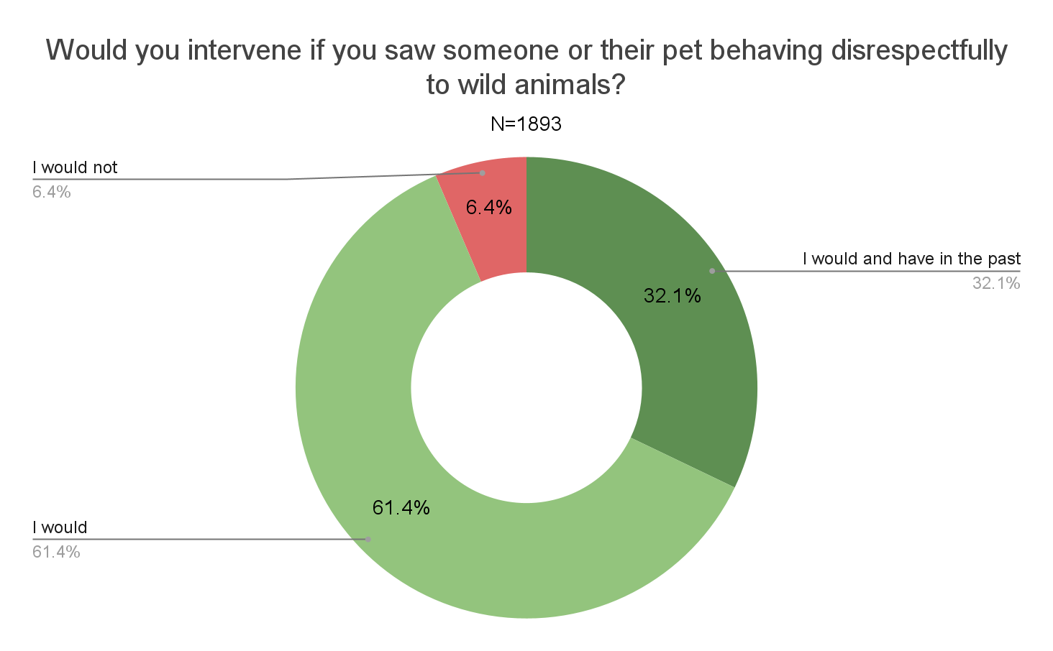

Slide 15
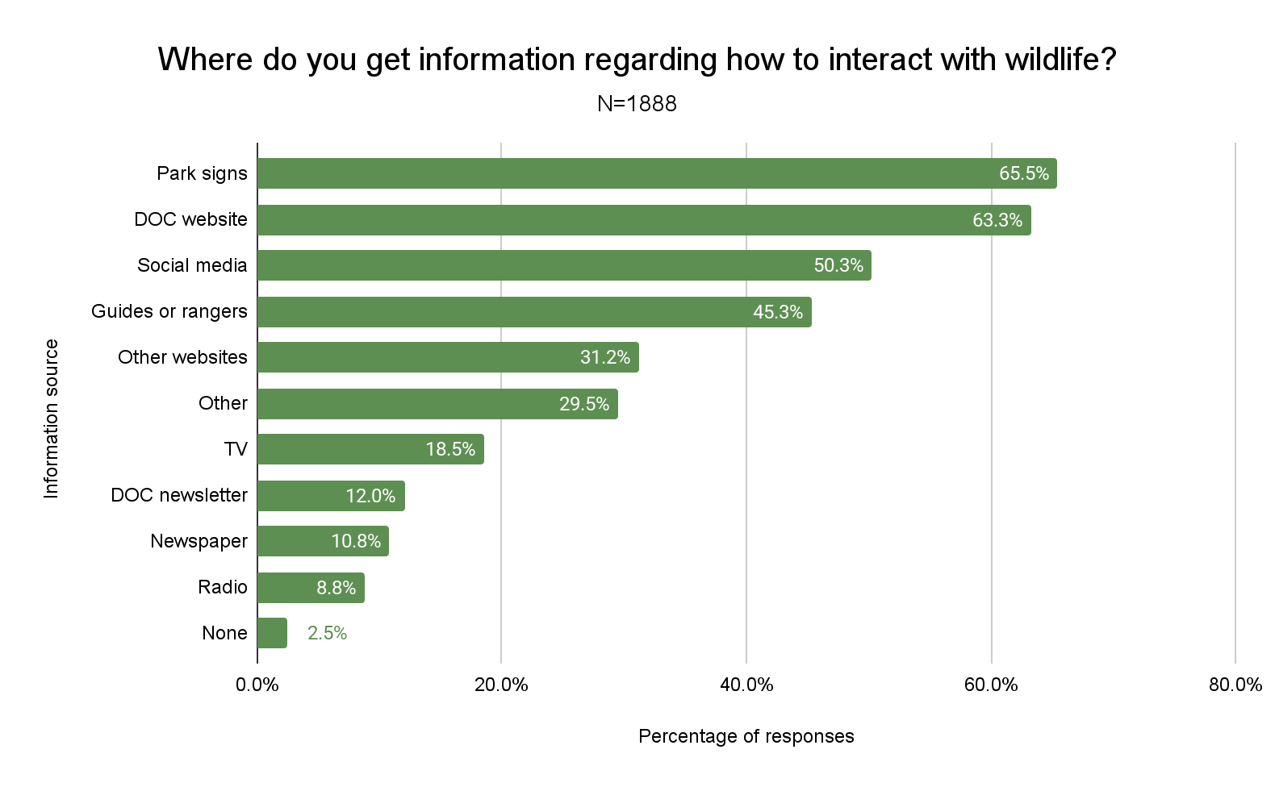

Slide 16
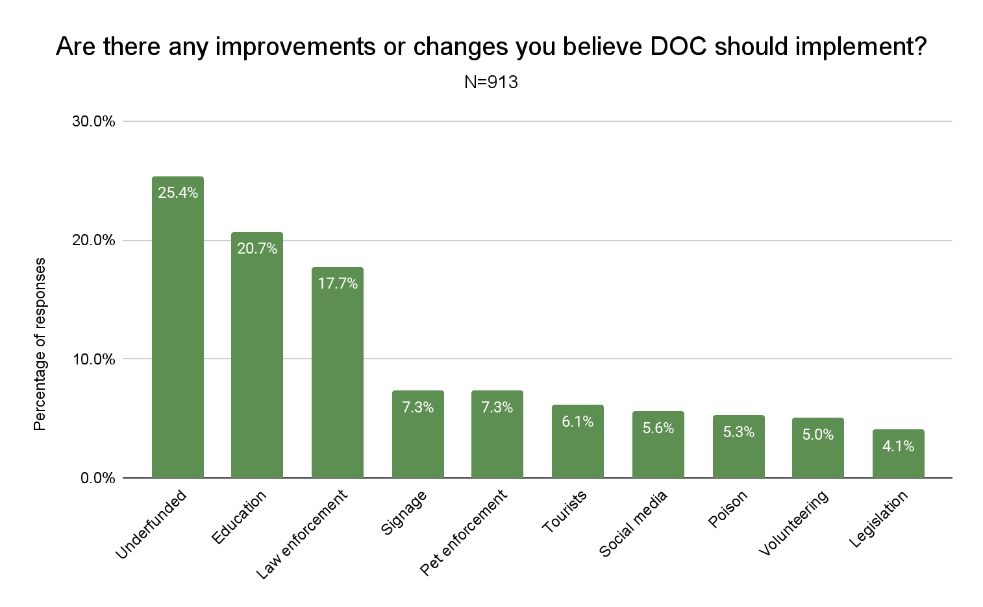

Slide 17
“Some people hold their pet's freedoms higher than the well-being of other animals, and this bothers me.”
— A Survey Respondent

Slide 18
Recommendations
Enhance Educational Programs
Improve Law Enforcement
Increase Funding

Slide 19
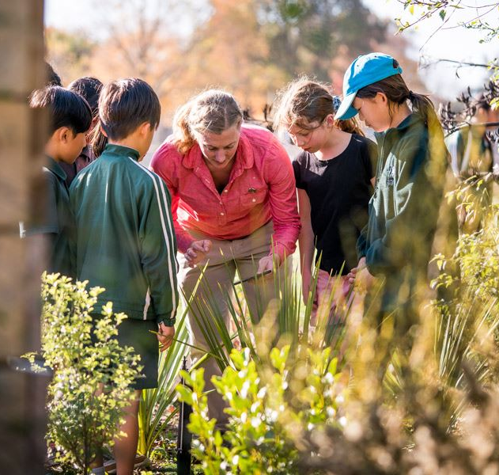
Enhance Educational Programs
Increase in School Educational Programs
Design and Deploy Improved Signage
Backyard Trapping Volunteer Program

Slide 20
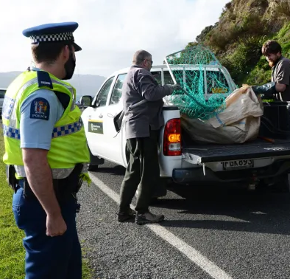
Improve Law Enforcement
Promote New Legislation
Increase Patrolling Rangers
Train New Cross-Jurisdictional Rangers

Slide 21
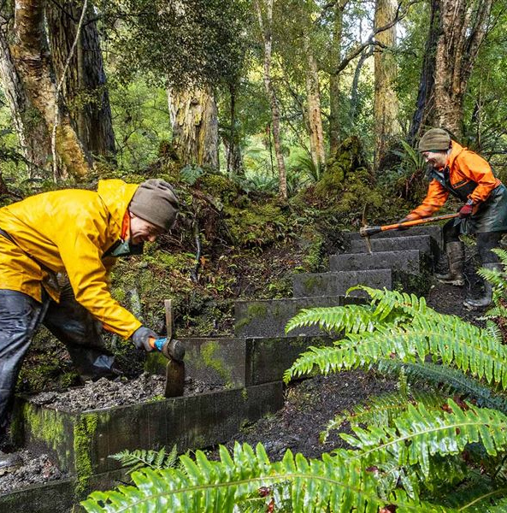
Increase Funding
Advocate for Increased Government Funding
Increase International Visitor Levy
Develop Corporate Partnership Opportunities

Slide 22
Expected Benefits
[12]
Reduced Human-Wildlife Conflict
Increased Wildlife-Related Prosecution Rates
Expanded Conservation Capacity
Reduced Wildlife Predation

Slide 23
Acknowledgements
Thank you to our Advisor, Robert Kinicki, and our sponsor the Department of Conservation Te Papa Atawhai, with special thanks to Brían Vayndell for his continued efforts and collaboration.

Slide 24
Image References
[1] SBS News. Retrieved April 2, 2025, from https://www.sbs.com.au/news/article/kiwi-comeback-the-plan-to-reintroduce-new-zealands-national-bird-to-wellington/1yty603ar
[2] The New Zealand Herald. Retrieved April 23, 2025, from https://www.nzherald.co.nz/nz/man-in-mahia-fined-600-after-decapitating-a-great-white-shark-and-keeping-the-head/4IJ2FJUAE5C2DPJCOPI73DNTWQ/
[3] Scoop. “23 Seals Brutally Clubbed to Death on the Kaikoura Coast,” December 6, 2010. https://www.scoop.co.nz/stories/AK1012/S00144/23-seals-brutally-clubbed-to-death-on-the-kaikoura-coast.htm.
[4] Department of Conservation. Native species compromised by trap vandals. Retrieved April 23. 2025, from https://www.doc.govt.nz/news/media-releases/2025-media-releases/native-species-compromised-by-trap-vandals/
[5] Department of Conservation. DOC urges dog owners to act after nine kiwi killed. Retrieved April 23, 2025, from https://www.doc.govt.nz/news/media-releases/2025-media-releases/doc-urges-dog-owners-to-act-after-nine-kiwi-killed/
[6] Department of Conservation: Department of Conservation Te Papa Atawhai. Miranda’s migratory birds. Retrieved April 2, 2025, from https://www.doc.govt.nz/nature/native-animals/birds/birds-a-z/mirandas-migratory-birds/
[7] Whittet, David. David’s Keynotes – Photos. Retrieved April 23, 2025, from https://davidwhittet.com/davids_keynotes/photos-2/files/page6-1027-full.html
[8] McClure, Tess. “This Article Is More than 1 Year Old ‘Bird Killing Machines’: New Zealand Cools on Cats to Protect Native Wildlife.” The Guardian, August 18, 2023. https://www.theguardian.com/world/2023/aug/19/bird-killing-machines-new-zealand-cools-on-cats-to-protect-native-wildlife.
[9] Department of Conservation. Conservation education. Retrieved April 23, 2025, from
https://www.doc.govt.nz/get-involved/conservation-education/
[10] Department of Conservation. (2015, July 30). Fur seal – Shelly Bay, Wellington, from
https://blog.doc.govt.nz/2015/07/30/fur-seal-shelly-bay-wellington/
[11] Department of Conservation. Seasonal recruitment. Retrieved April 23, 2025, from
https://www.doc.govt.nz/careers/seasonal-recruitment/
[12] Lieselot “Kiwis for kiwi: an inspirational story!” (October 20, 2015) from
https://theworldisacircus.com/2015/10/kiwis-for-kiwi-an-inspirational-story/

Slide 25
Thank You!
Do you have any questions?

Slide 26
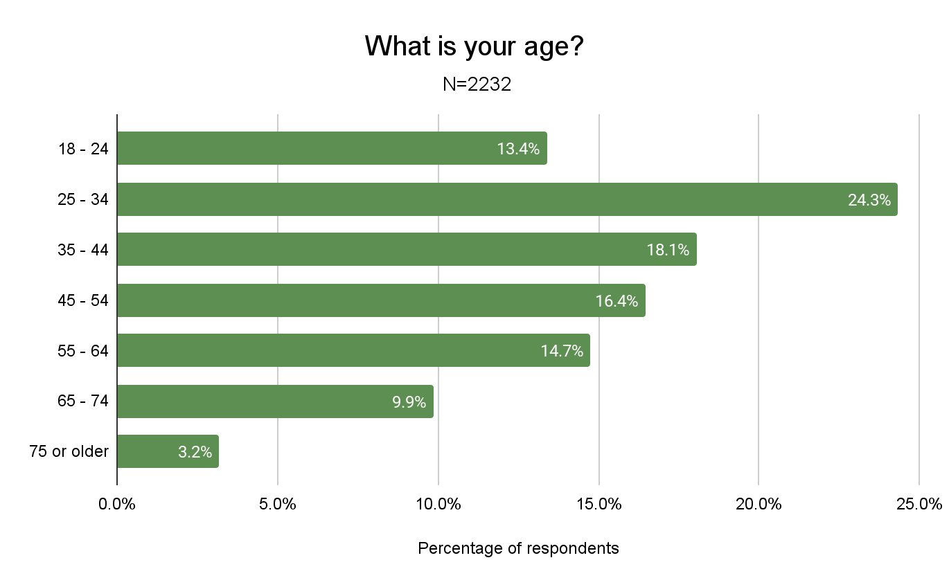

Slide 27
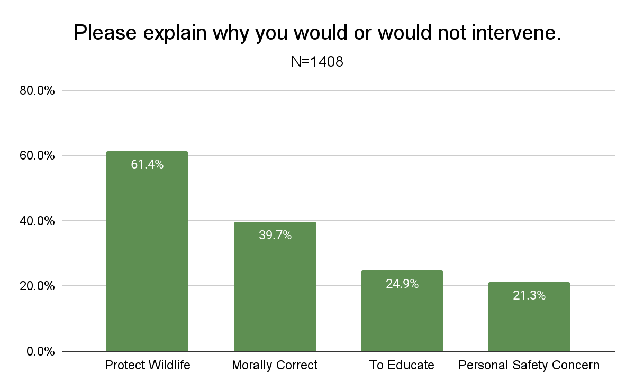

Slide 28
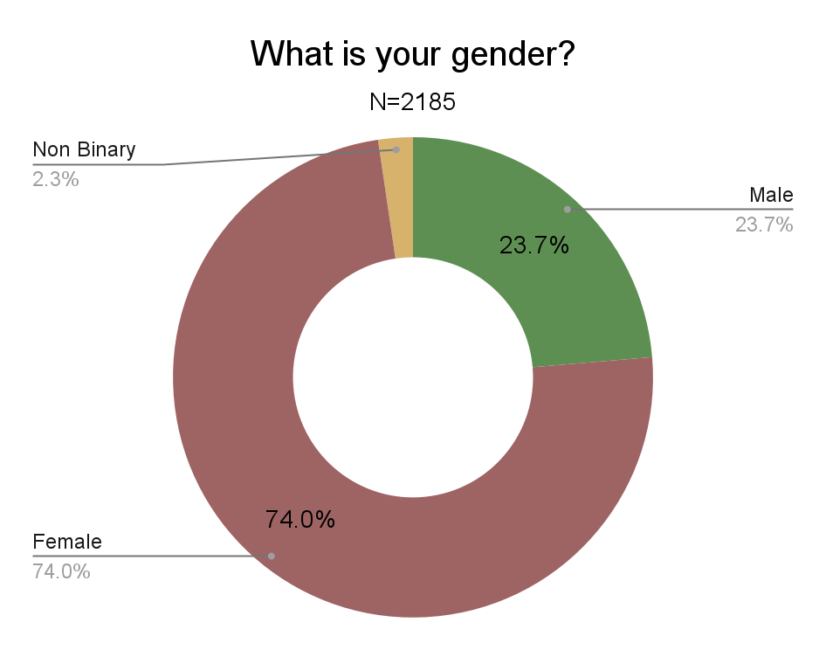

Slide 29
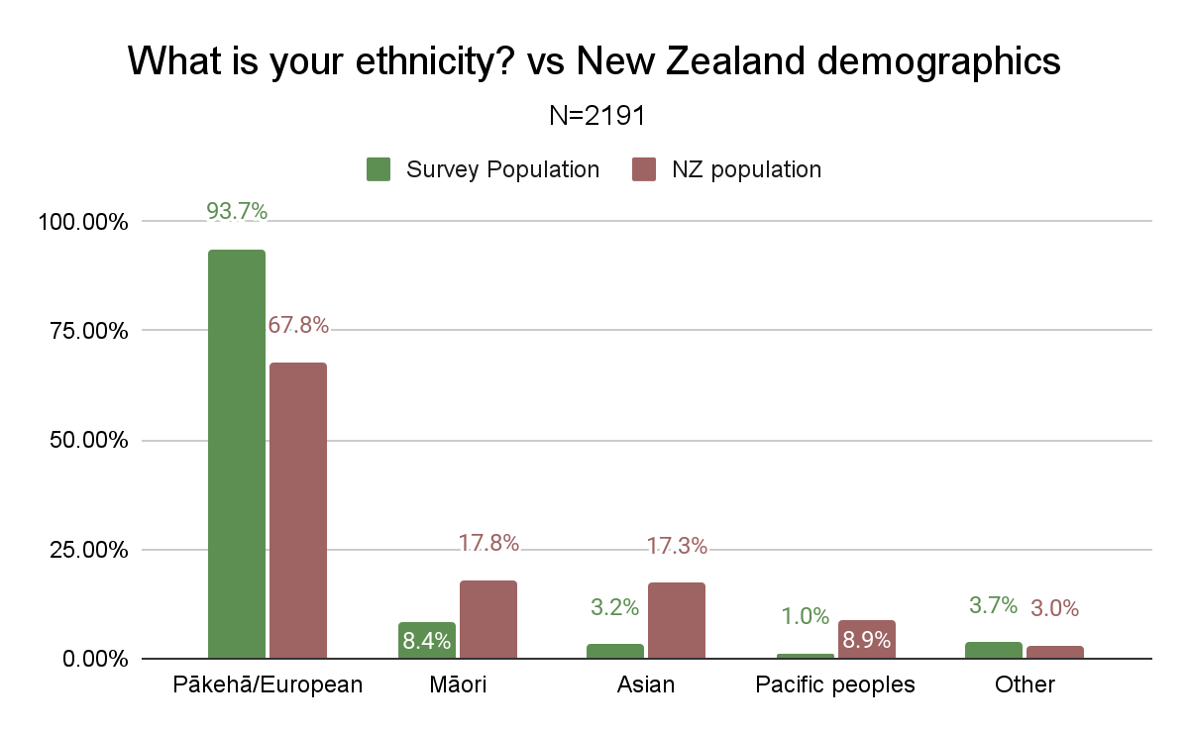

Slide 30
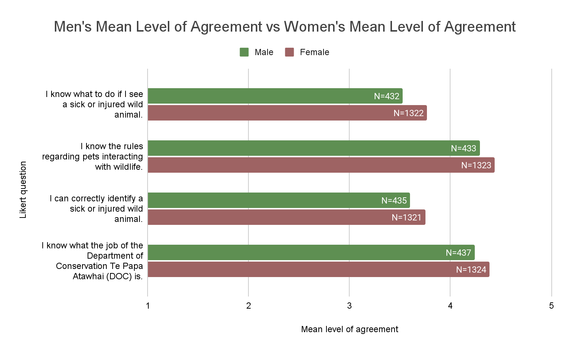

Slide 31
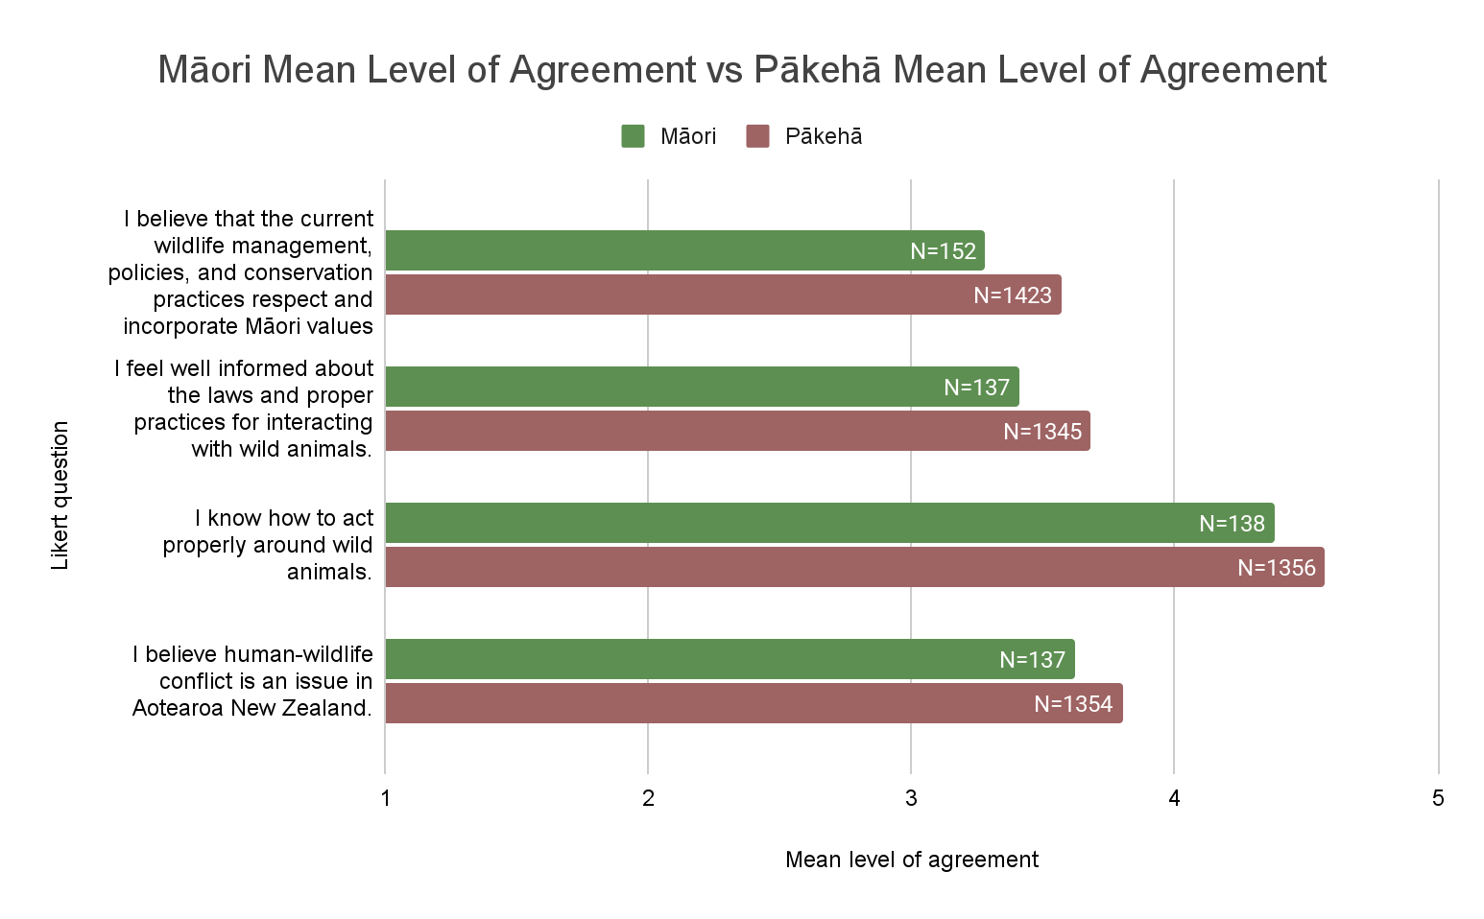

Slide 32
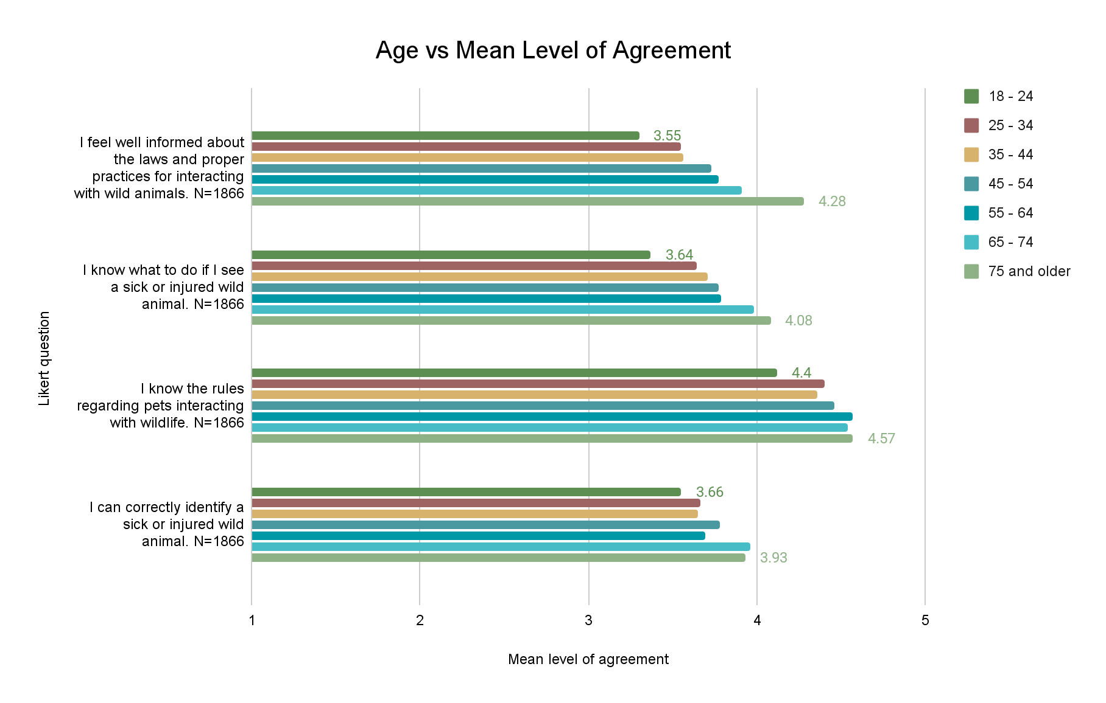

Slide 33
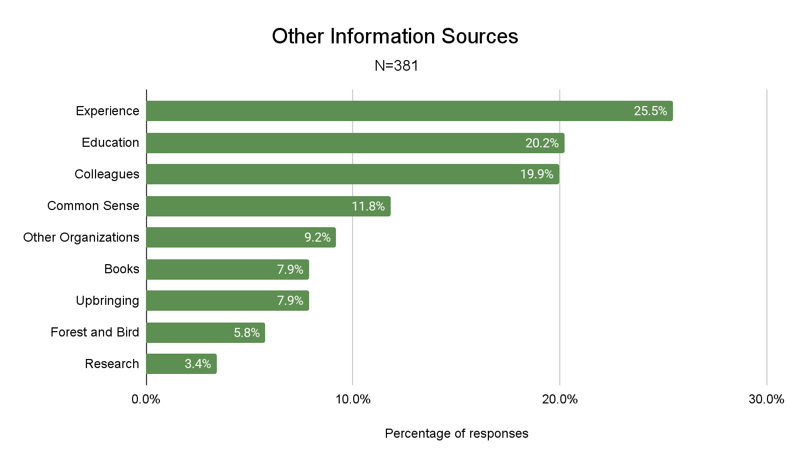

Slide 34
Effect Size of information sources. N=1881 | Social media | DOC newsletter | DOC website | Other websites | Guides or rangers | Park signs | TV | News paper | None
I know how to act properly around wild animals.
I can correctly identify a sick or injured wild animal.
I know what to do if I see a sick or injured wild animal.
I know the rules regarding pets interacting with wildlife.
I know what the job of the DOC is.
I feel well informed about the laws and proper practices for interacting with wild animals.

