Slide 1
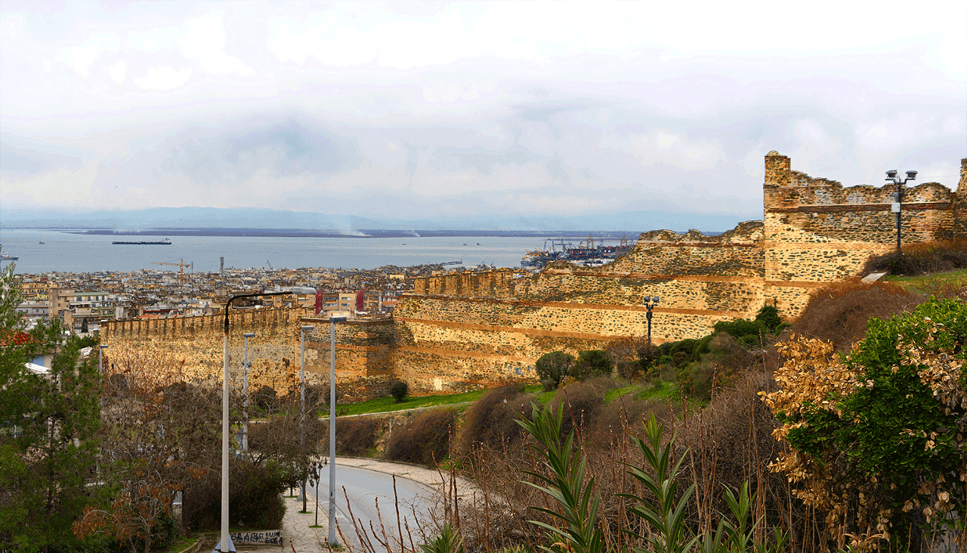



Developing Gamified Gardening Resources for Schools in Thessaloniki, Greece
March 2nd, 2026
Nikolai Margolin, Ryan Orris, Ciera St Pierre, Joseph Tully
[1]
1

Slide 2
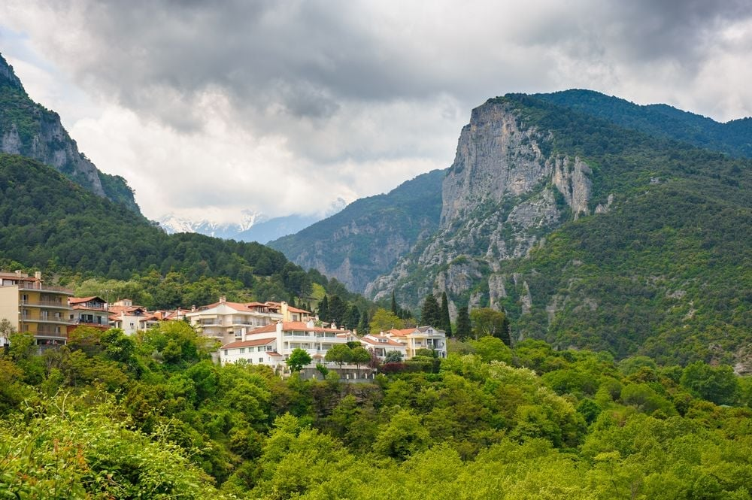
[2]
“The purpose of Environmental Education is to make students aware of the relationship between humans and their natural
and social environment, to become aware of the problems associated with it and to … contribute towards a general effort to face them”
Hellenic Republic,
Law 1892/1990, Art. 111
2
Notes:
Nikolai

Slide 3
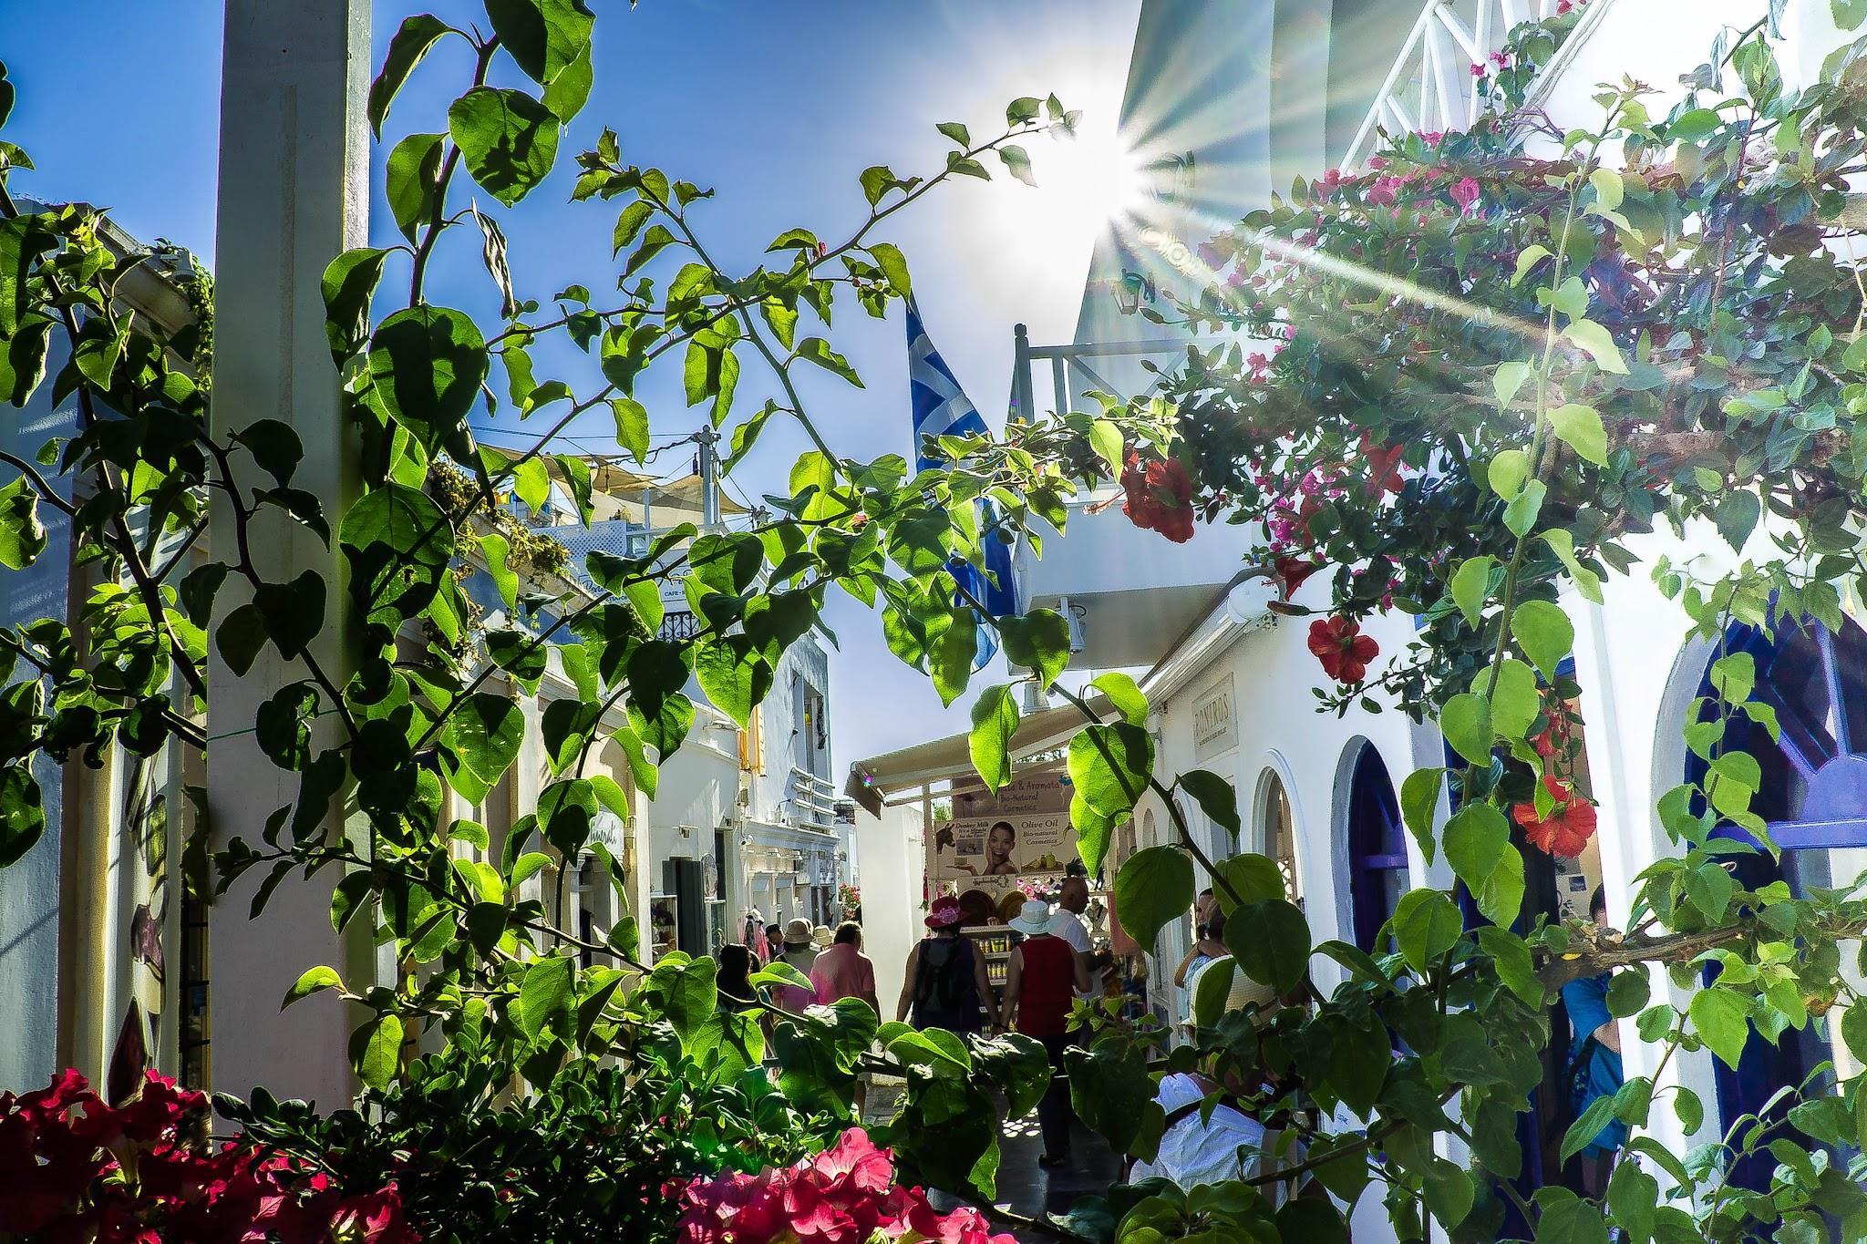
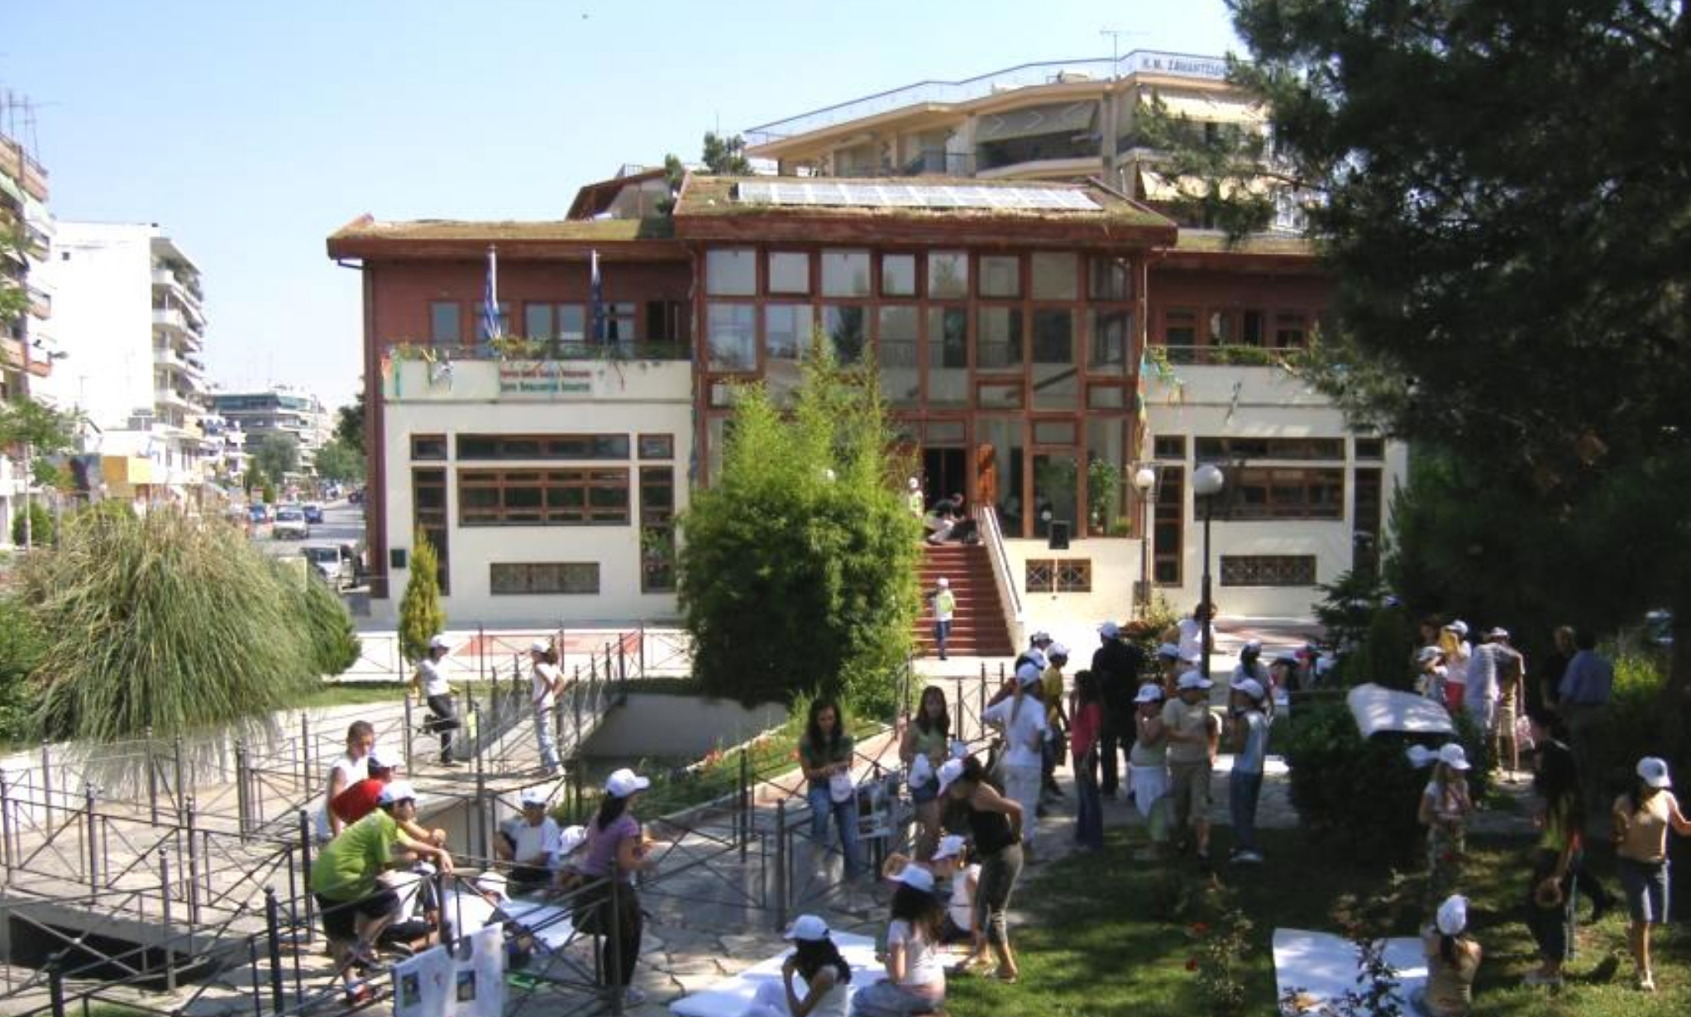
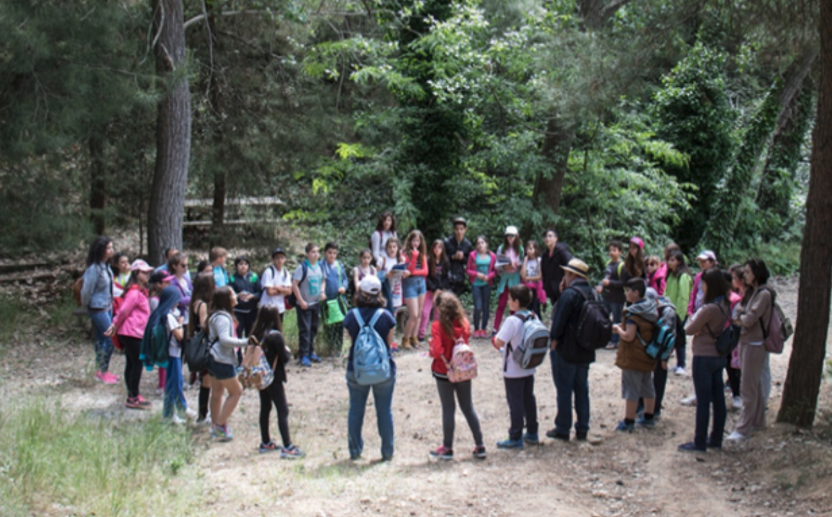
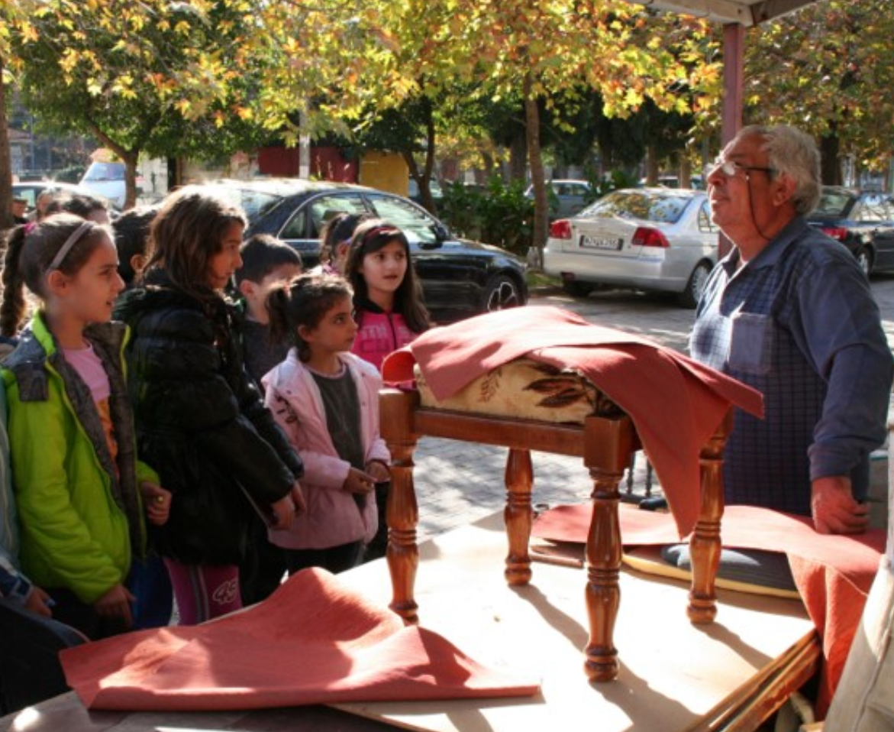
Environmental Education (EE) Programs in Thessaloniki
[4]
[5]
[3]
3
Notes:
Nikolai

Slide 4
EE is Non-Mandatory
Educational
Limitations
Curricular Fragmentation
Rigid Bureaucracy
[6]
4
Notes:
Nikolai
Schools observed an increases in environmental literacy and student engagement, while also fostering social-emotional skills such as responsibility, self-reliance, and self-care (Christian et al., 2014; Howarth et al., 2020)

Slide 5
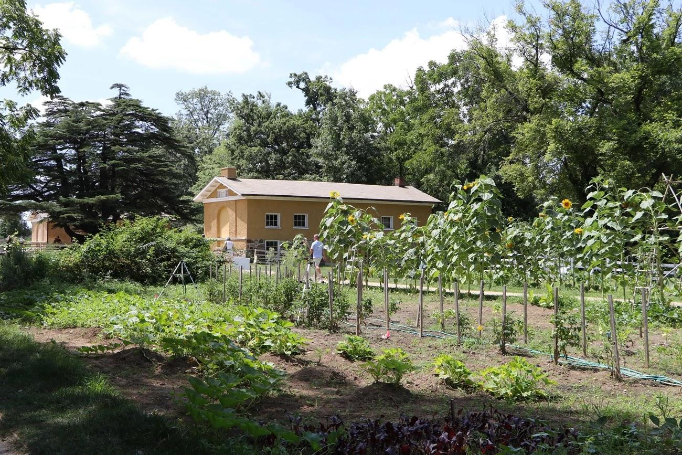
[7]
School
Gardening
5
Notes:
Joe

Slide 6
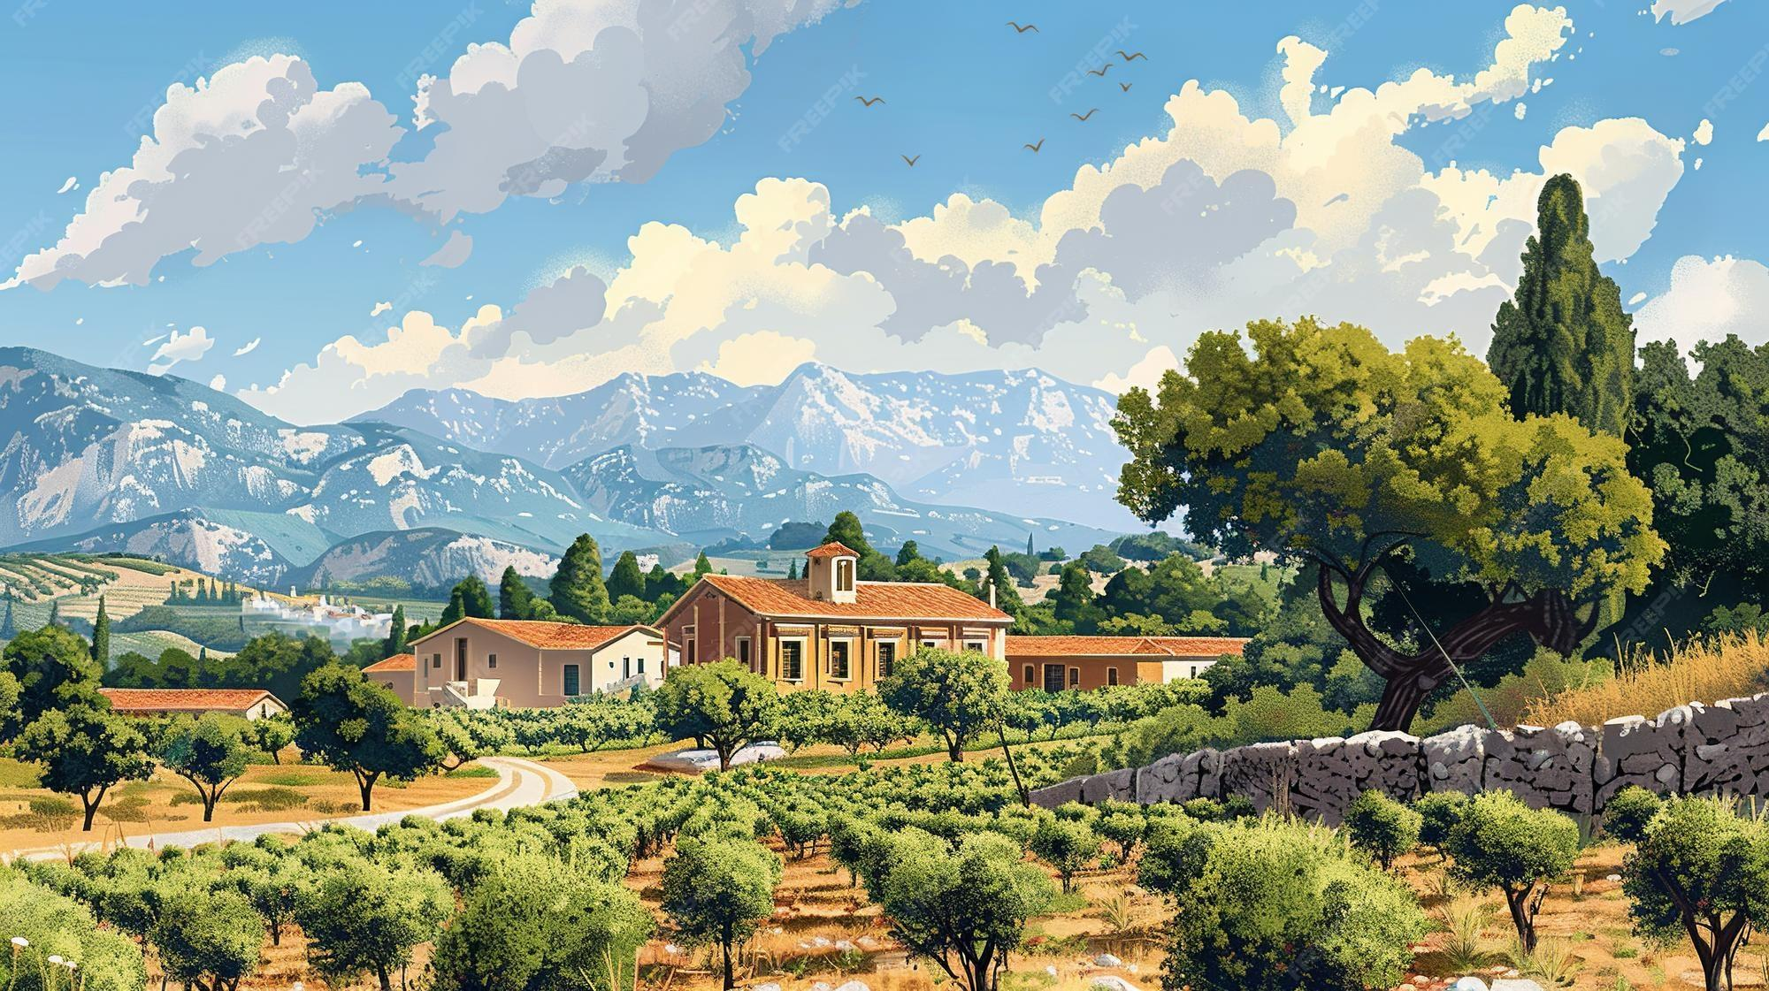
[8]
Gamification
6
Notes:
Ryan https://img.freepik.com/premium-photo/ancient-greece-agriculture-essence_818261-57386.jpg?w=2000
The chinese are stealing your data gamification will forvever protect you!!!!!

Slide 7
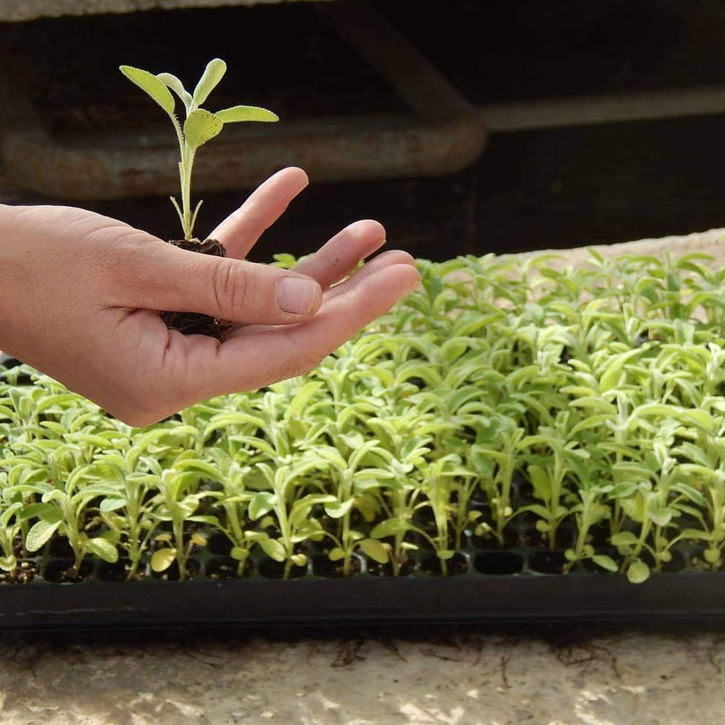

[9]
Our Sponsor - SHPP
Self-Help Promotion Program
Rehabilitative Care
Trelí Rodiá Farming Collective
  Plant Database
Community Education
  School Outreach
7
Notes:
Ciera

Slide 8
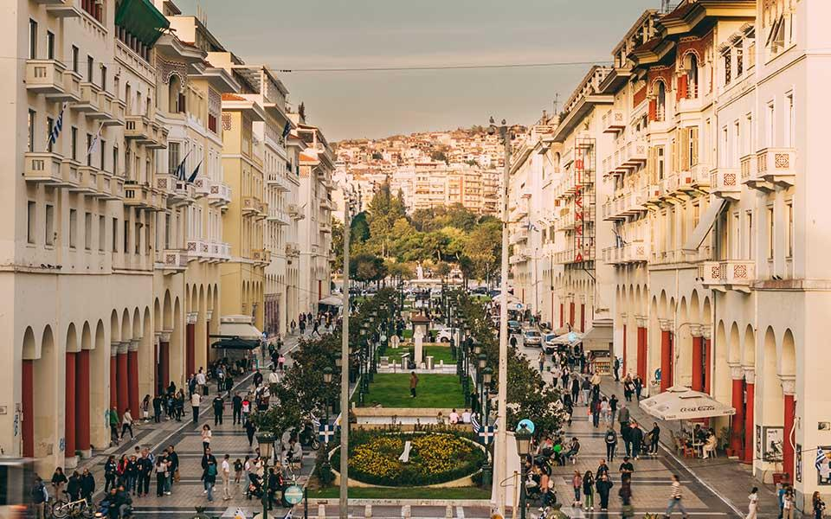

[10]
Our Goal
Develop a gamified educational app supporting primary and secondary school sustainability and gardening initiatives.
8
Notes:
Ciera

Slide 9
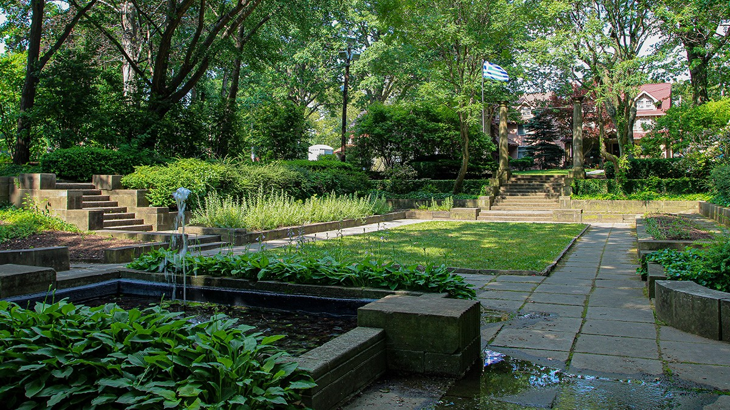
[11]
Project Objectives
Evaluate the integration of sustainability and gardening materials within school curricula
Analyze student engagement in current pilot gardening initiatives
Gather insights from Treli Rhodia workers for gamification and app design
Design, develop, and test a functional prototype of the application
9
Notes:
ciera

Slide 10
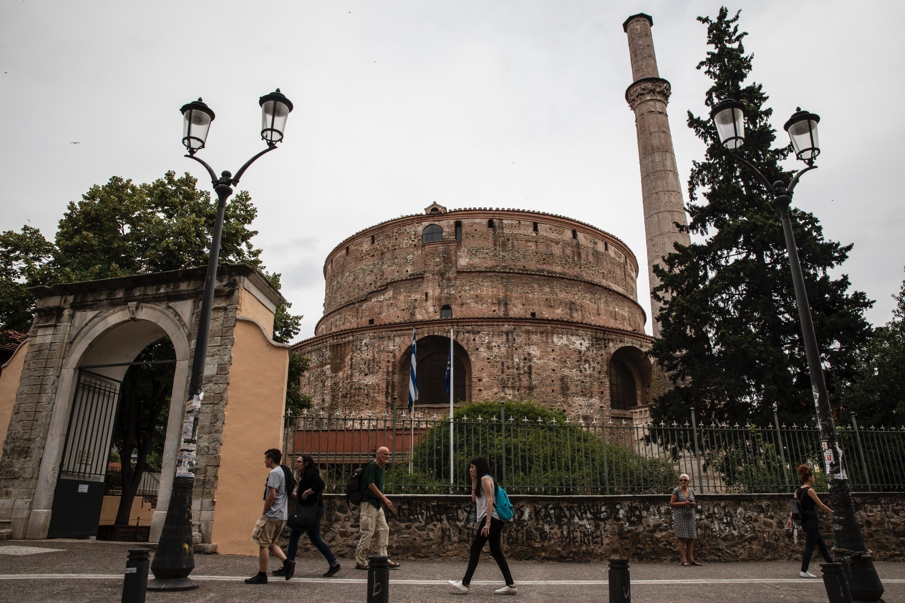
[12]
1
Evaluate the integration of sustainability and gardening materials within school curricula
Teachers
Preliminary Surveys
Inform app development within culturally sensitive and feasible classroom contexts
10
Notes:
Nikolai

Slide 11
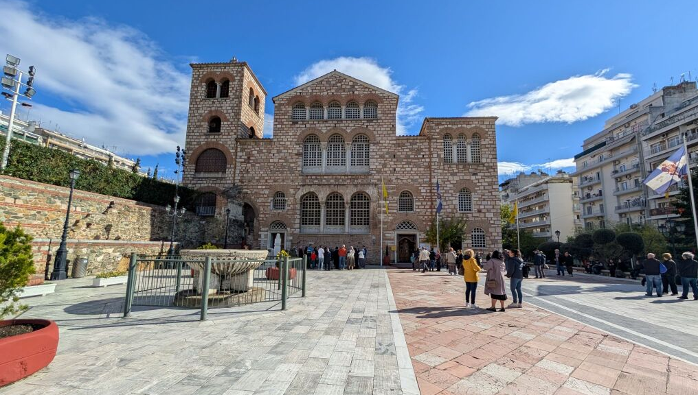
[13]
2
Analyze student engagement in current pilot gardening initiatives
School Observation
Garden Tours
Identify patterns of student collaboration, engagement, and learning challenges during gardening activities
11
Notes:
Nikolai

Slide 12
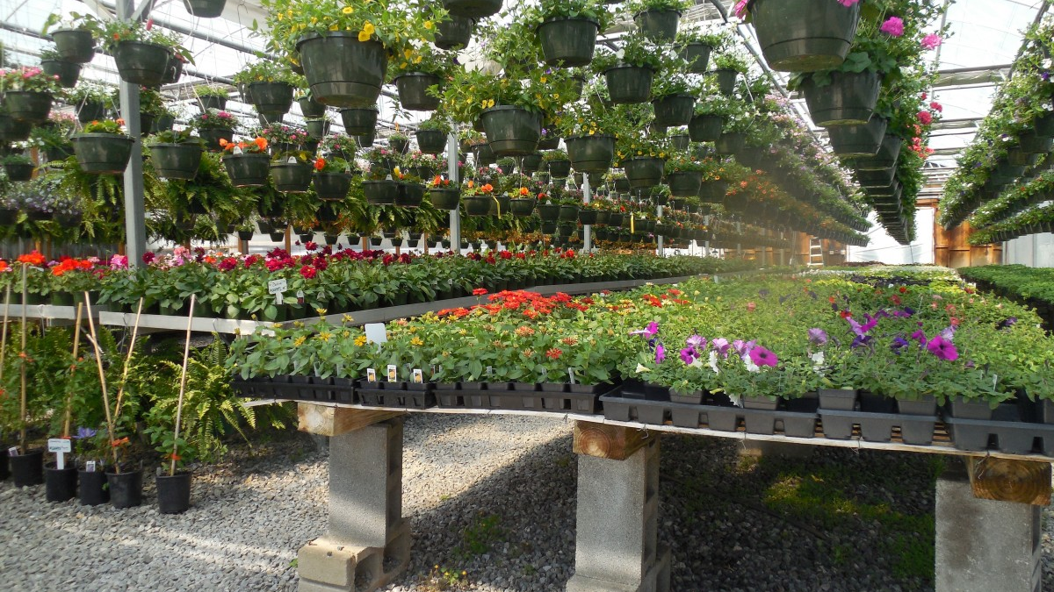
3
Gather perspectives from Treli Rhodia workers for gamification and app design
Green House Visits
Focus Groups
Participatory Observation
Develop beginner friendly and educationally inclusive app features
[14]
12
Notes:
Ciera

Slide 13
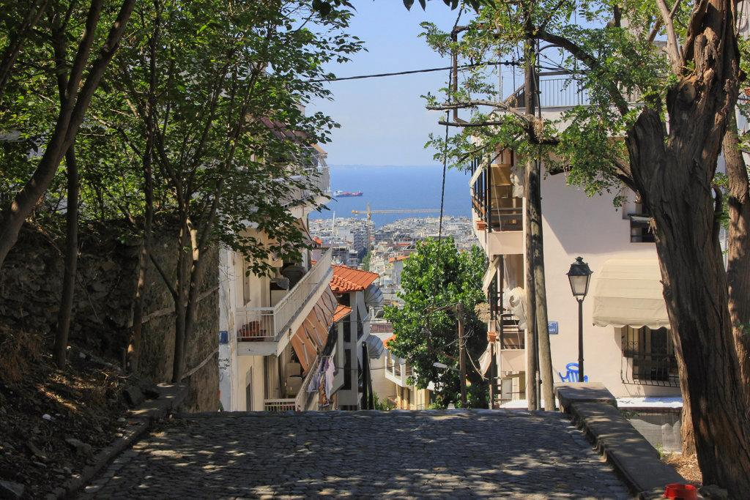
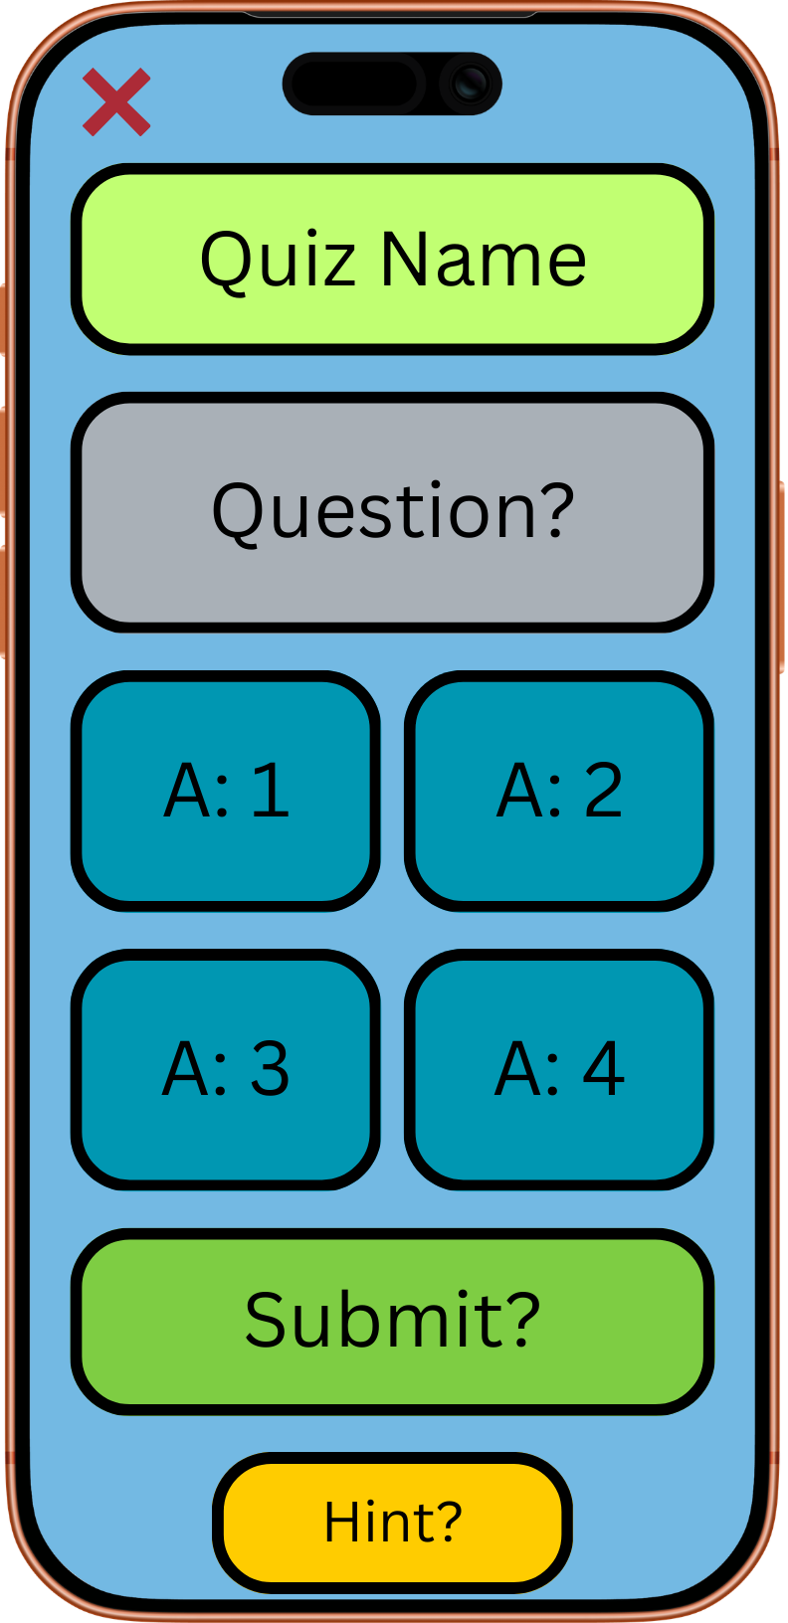
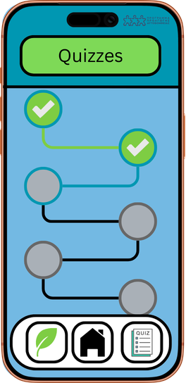
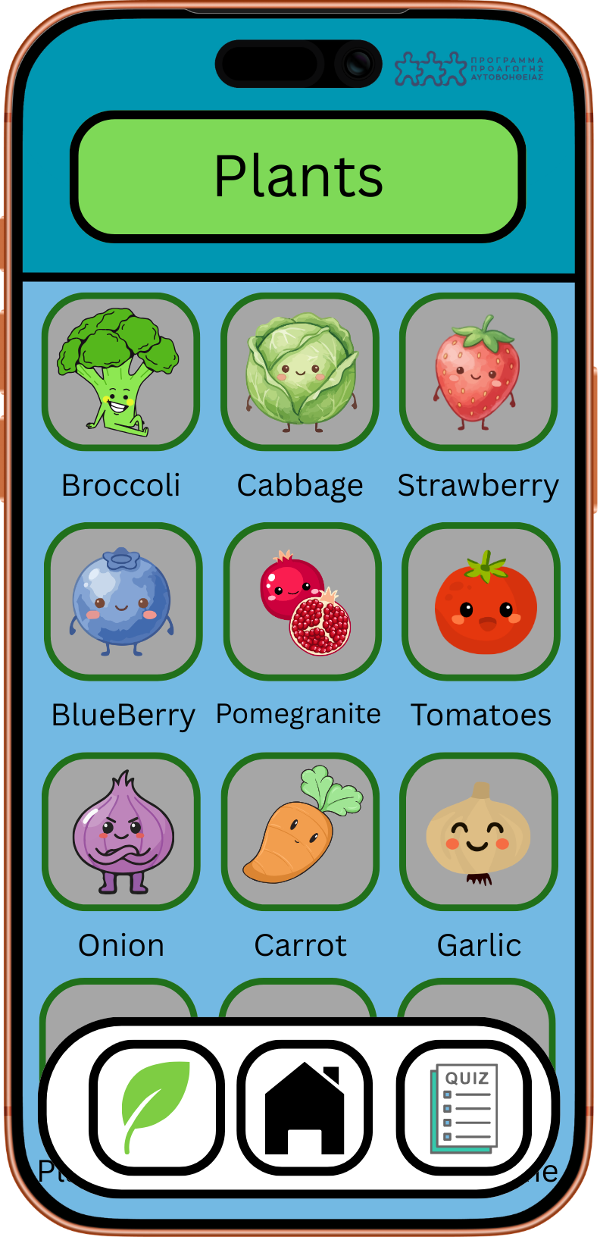
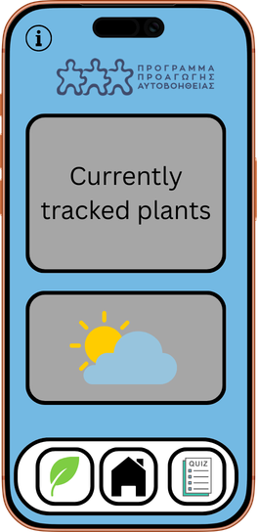
[15]
4
Design, develop, and test a functional prototype of the application
13
Notes:
Joe & Ryan

Slide 14
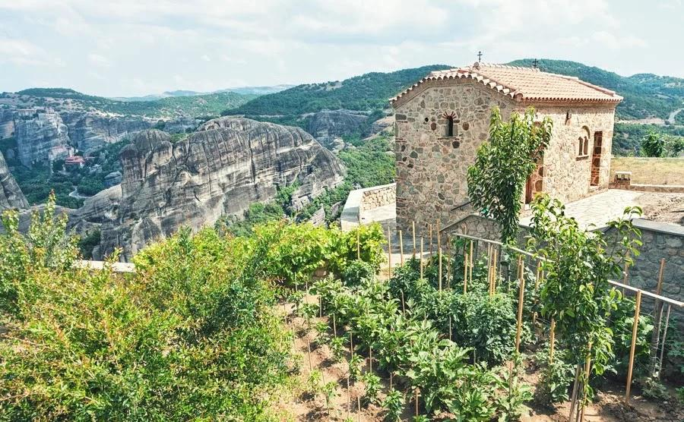
4
Design, develop, and test a functional prototype of the application
SHPP and Our Team
Teachers
Internal Testing
End of Project Surveying
Finalization of the app design ensuring readability in english and greek as well as intuitive user interfaces.
[16]
14
Notes:
Ryan

Slide 15
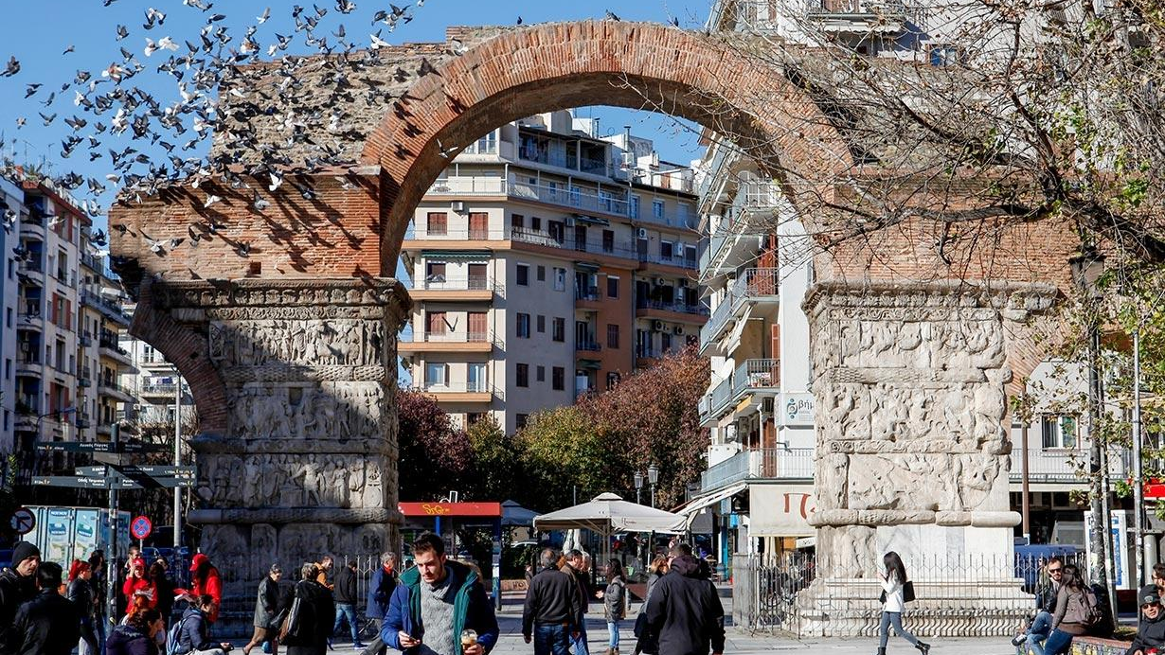
[17]
Our Desired Impact
Create a scalable app that assists and enriches the permaculture literacy of students in Greek primary and secondary schools.
15
Notes:
The desired impact for our project is to inspire students in Thessaloniki to take proactive roles in their communities sustainability efforts by enriching their school curriculum and connecting them with the resources of thessaloniki.

Slide 16
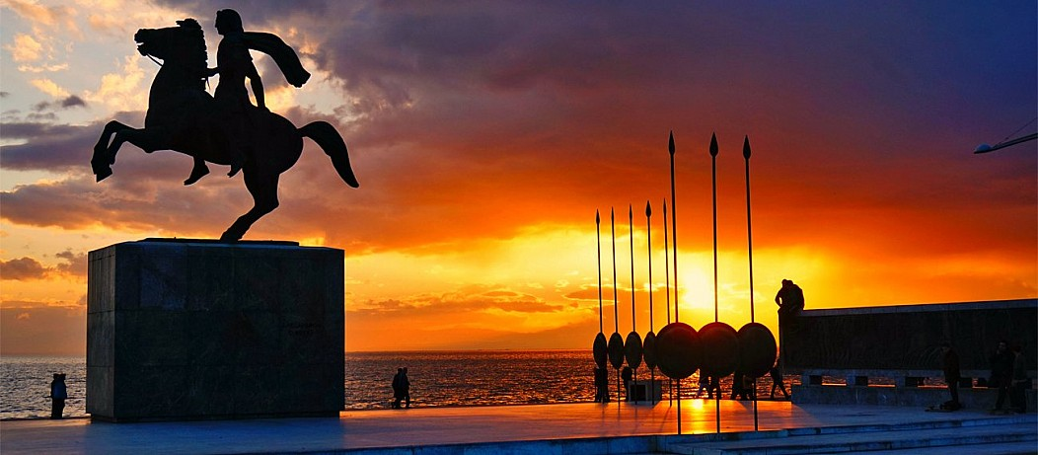
[18]
Special Thanks To…
Anastasia Hamalidou - Sponsor
Dr. Sotiris Lainas - Sponsor
Professor Butler – IQP Advisor
Professor Kinicki – IQP Advisor
16
Notes:
Ryan

Slide 17
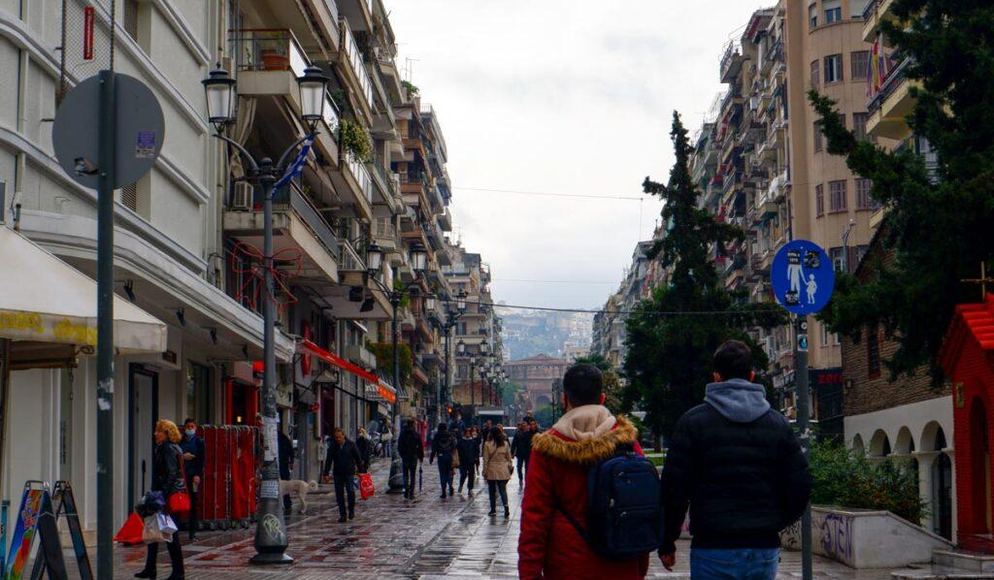

[19]
Σας Ευχαριστώ!
Questions?
17

Slide 18
References
OECD - OECD. (2025). Education at a glance 2025: Greece. OECD Publishing. https://www.oecd.org/en/publications/education-at-a-glance-2025_1a3543e2-en/greece_30092c7f-en.html
Ntona, E., Georgopoulos, A., Malandrakis, G., & Ragkou, P. (2024). Teachers’ barriers dealing with environmental education programs’ implementation in Greek secondary schools. Environmental Education Research, 30(5), 700–719. https://doi.org/10.1080/13504622.2023.2182257
Christian, M. S., Evans, C. E., Nykjaer, C., Hancock, N., & Cade, J. E. (2014). International Journal of Behavioral Nutrition and Physical Activity, 11(1). doi:10.1186/s12966-014-0099-7 https://link.springer.com/article/10.1186/s12966-014-0099-7

Slide 19
Images
[1] https://www.thessalonikitourism.gr/images/2019/02/17/byzantinewalls8.png
[2] https://www.muchbetteradventures.com/magazine/content/images/2024/10/litochoro-climb-mount-olympus.jpg
[3] https://img.freepik.com/premium-photo/greece-flag-greek-flag-waving-observation-deck-kalabaka-greece_454608-792.jpg
[4] https://www.kpe-thess.gr/el/
[5] https://www.kpe-thess.gr/el/
[6] https://www.cleveland.com/resizer/v2/D2JGXRQTPZGLTMWZK4HOGRDHL4.JPG?auth=8d6d012901a4ee9b4907e07d87c1ed57372b0dd87f83cc2ede7f595024fd2ded&width=1280&smart=true&quality=90
[7] https://openfarm.gr/event/open-farm-days-2024-treli-rodia-koinsep_29-9/
[8] https://img.freepik.com/premium-photo/ancient-greece-agriculture-essence_818261-57386.jpg?w=2000
[9] https://trelirodia.gr/
[10] https://www.greece-is.com/wp-content/uploads/2025/05/Thessaloniki.jpg

Slide 20
Images
[11] https://www.tclf.org/landscapes/greek-cultural-garden
[12] https://iadsb.tmgrup.com.tr/8362bf/0/0/0/0/1814/1210?u=https://idsb.tmgrup.com.tr/2018/05/30/thessalonikis-turks-have-no-place-to-worship-or-bury-their-dead-1527633083935.jpg
[13] https://nikana.gr/images/6849/crkva-i-katakombe-svetog-dimitrija-u-solunu-duhovna-i-istorijska-znamenitost-grke-thessaloniki-thessaloniki-16.jpg
[14]https://c.pxhere.com/photos/af/c2/flowers_greenhouse_garden_plant_green_gardening_horticulture_spring-735032.jpg!d
[15] https://onedayitinerary.com/wp-content/uploads/2023/07/Ano-Poli-Thessaloniki.jpg
[16] https://www.propertyguides.com/greece/news/gardening-greek-sun/
[17]https://thessaloniki.travel/wp-content/uploads/2021/08/7586bcdd7a745d843a3897512742ccdb_XL.jpg
[18] https://www.reddit.com/r/europe/comments/dxalw3/alexander_the_great_statue_thessaloniki_greece/
[19] https://i0.wp.com/goallovertheplace.com/wp-content/uploads/2022/07/ThessalonikiStreets-1.jpg?w=1200&ssl=1

