Slide 1
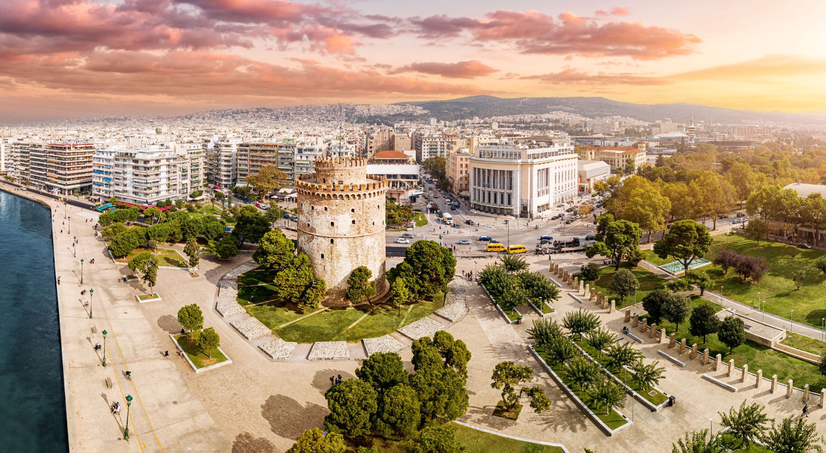


Assessing Accessibility and Inclusion: A Neighborhood Study Surrounding the SFA Community
Aaron Green, John McDermott, Sammy Scampoli, and Hailey Zembrzuski
March 2nd, 2026
Notes:
Aaron

Slide 2

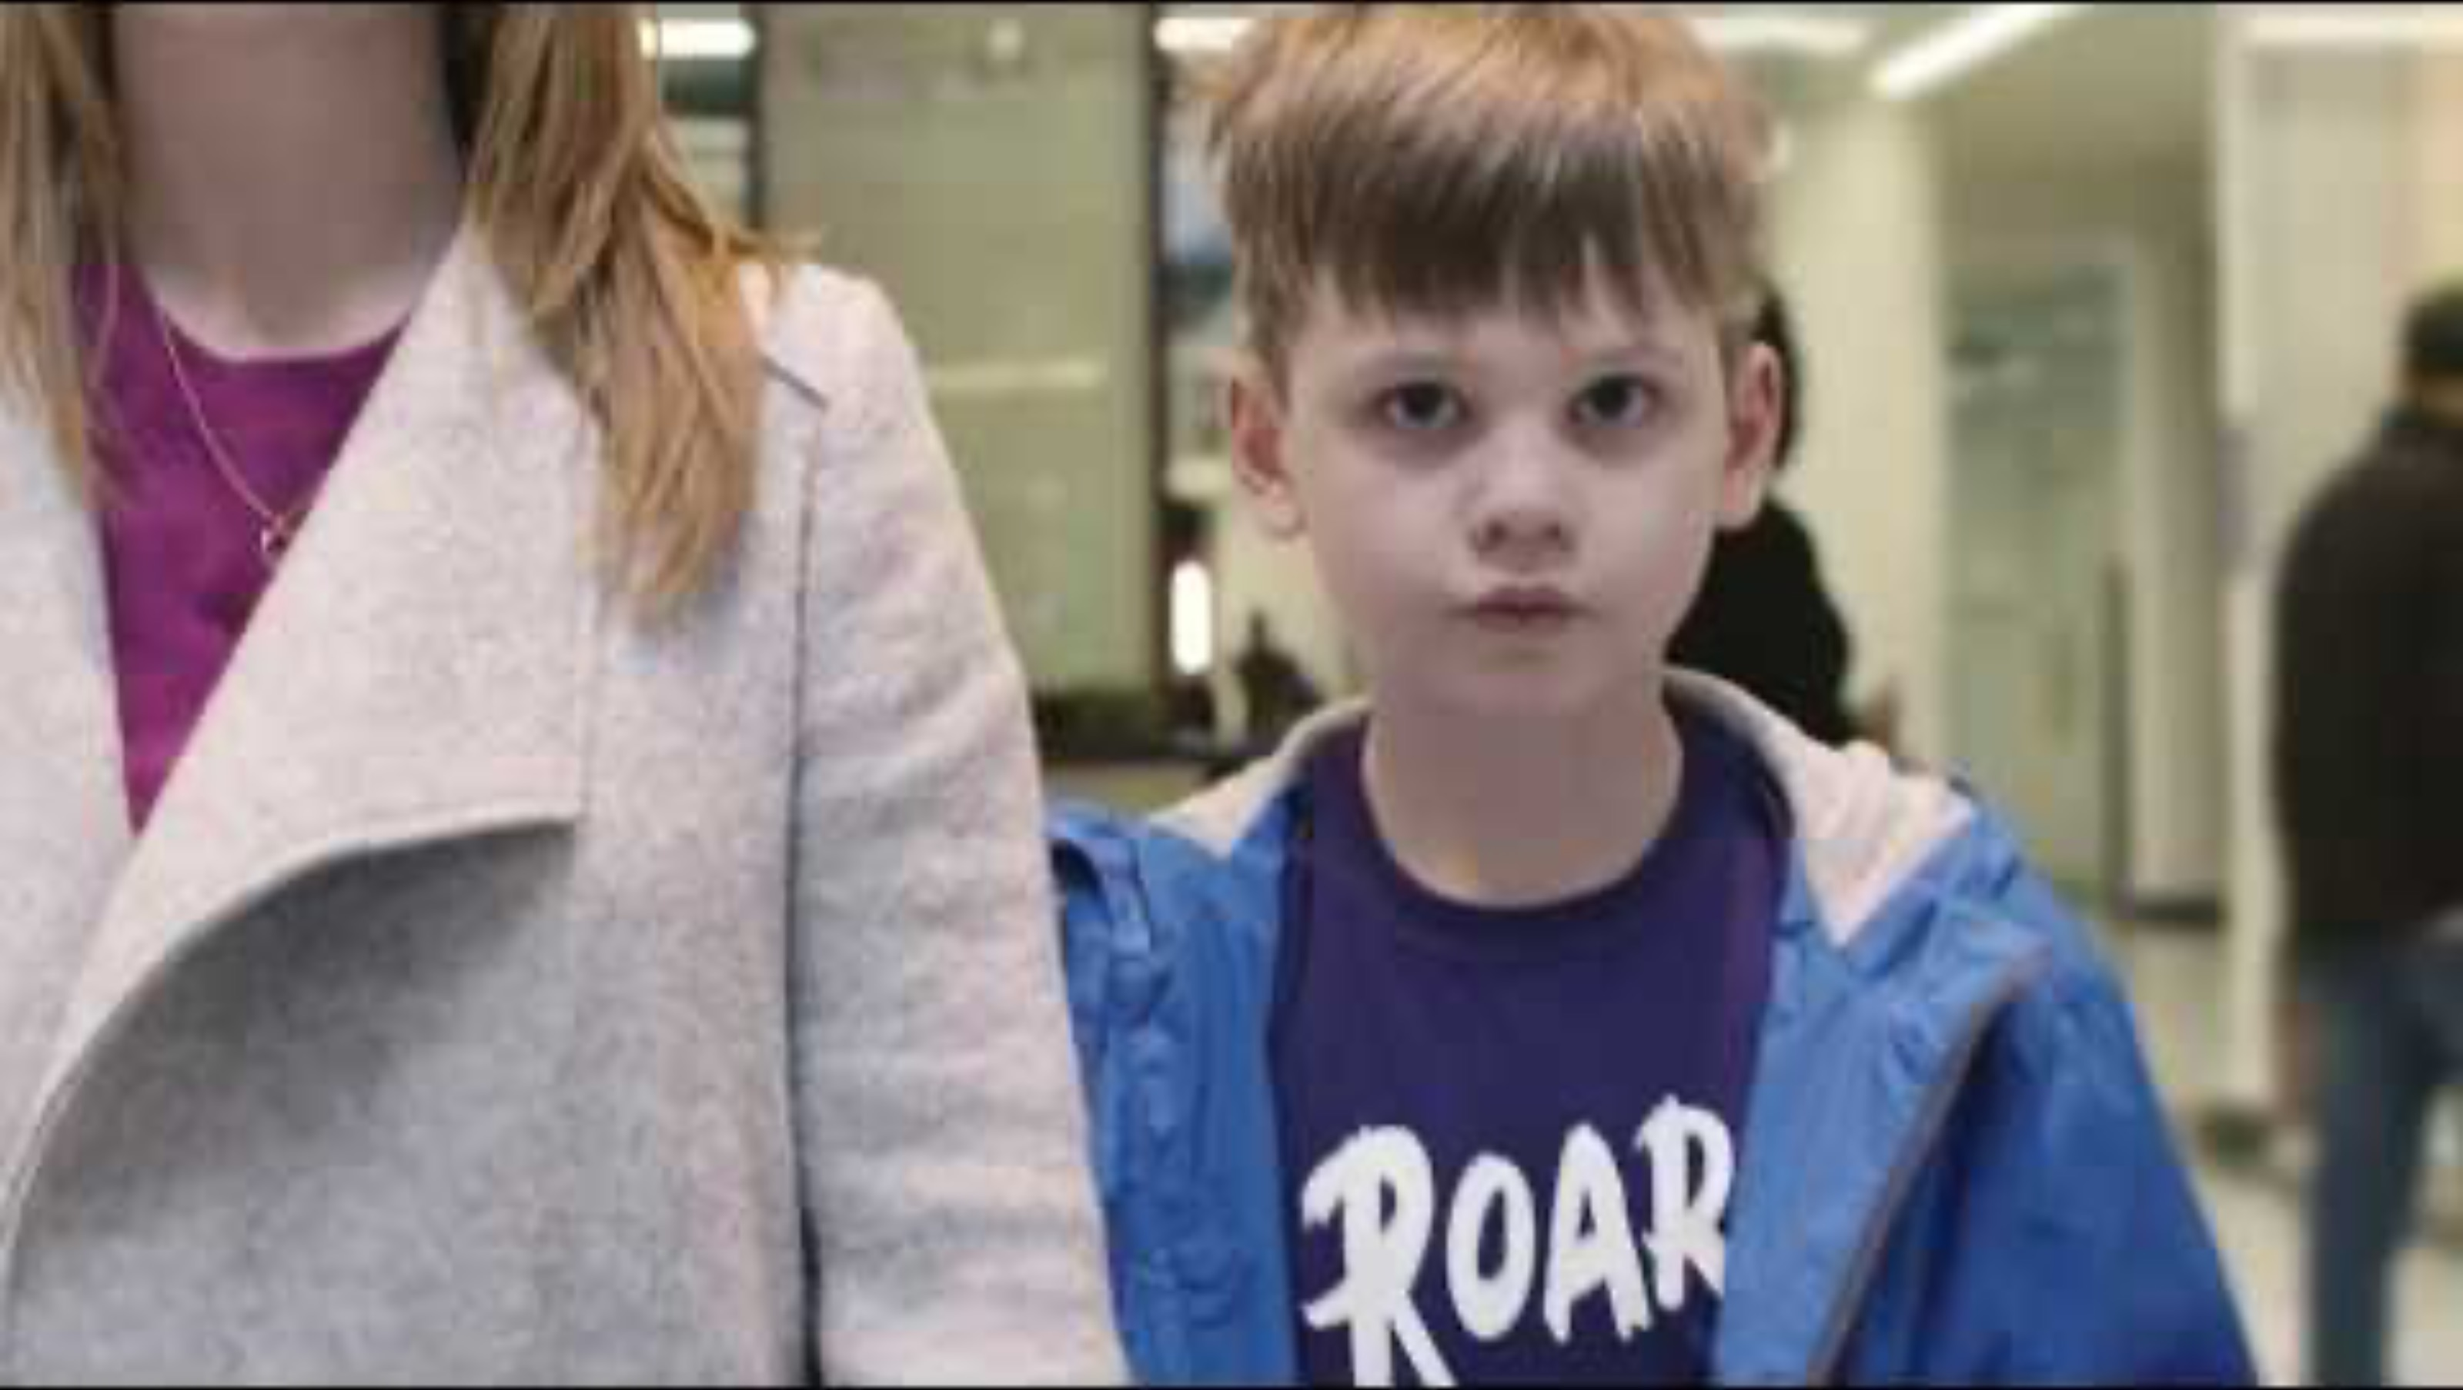
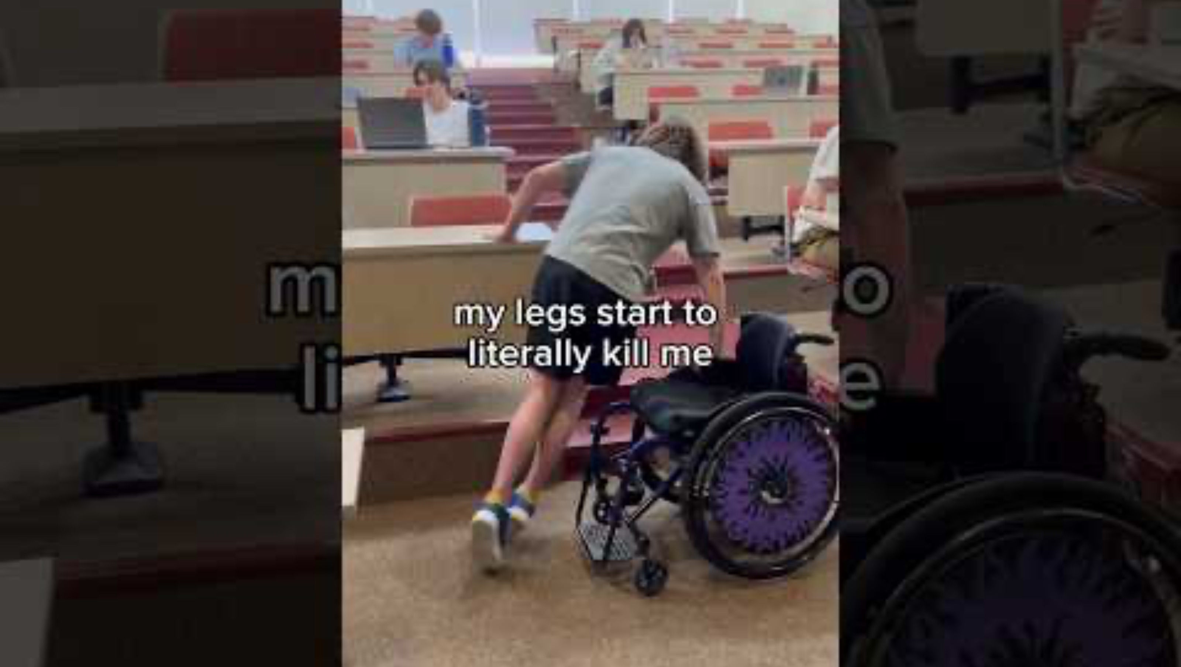
Societal Lack Of . . .
Inclusivity
Accessibility
Sense of Belonging
Example of life with a cognitive disability
Example of life with a physical disability
Notes:
hailey

Slide 3
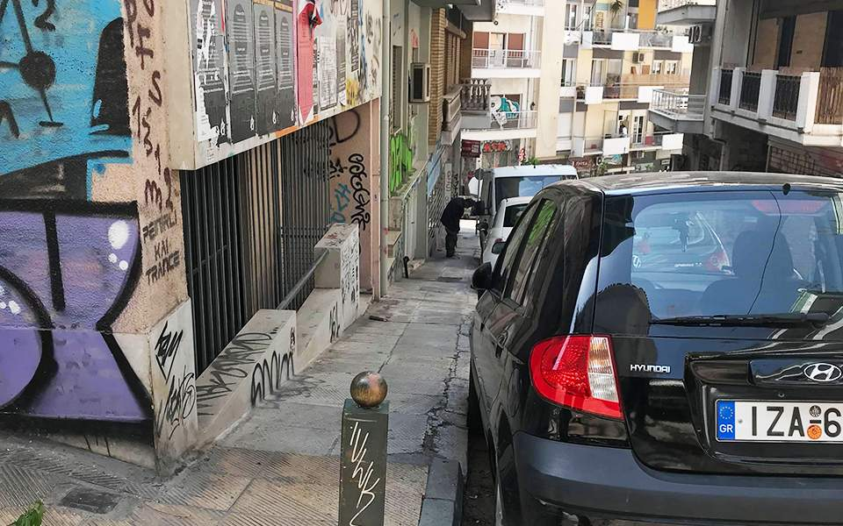
Policies and Designs are Unadaptive
18.2% of the Greece population has some form of disability
1990’s implementation period of active policies regarding all types of disabilities
Resistance to be changed or added too by the government
Street in Greece that is unadaptive …
- Physically (broken sidewalks)
- Cognitively (no signs and narrow / limited space)
Urban Design Limitations Causing Physical Restraints
Lack of Knowledge Around Cognitive Disabilities
Notes:
Hailey
In the 1990’s Policies implemented services for people with disabilities including vocational training programs, actions facilitating accessibility and rehabilitation in the labor market, subsidizing of employment providing the employers with specific motives so that the employment of disabled people will become easier, and incentives for business entrepreneurship with subsidies to young professionals who set up small businesses or formed partnerships (Magnoulious, 2012)

Slide 4
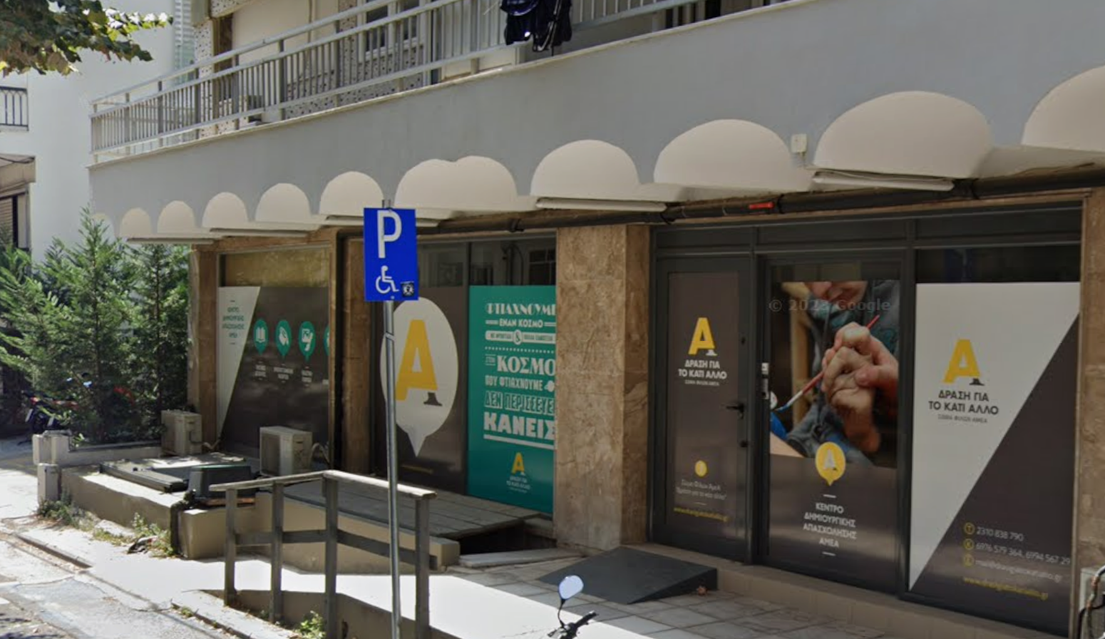
Drasi Gia to Kati Allo (SFA)
Social Skills
Cognitive Skills
Artistic Expression
Pre Vocational Training
Drasi Gia to Kati Allo Creative Center for Disabilities
Notes:
Sammy

Slide 5
The goal of this project is to conduct a neighborhood assessment to assist Drasi Gia to Kati Allo (SFA) to address the lack of inclusivity and accessibility and belonging for individuals with disabilities.
1. Identifying physical obstacles and communication barriers
2. Investigate alternative communication methods
3. Create informative materials outlining general accessibility
Notes:
Sammy

Slide 6
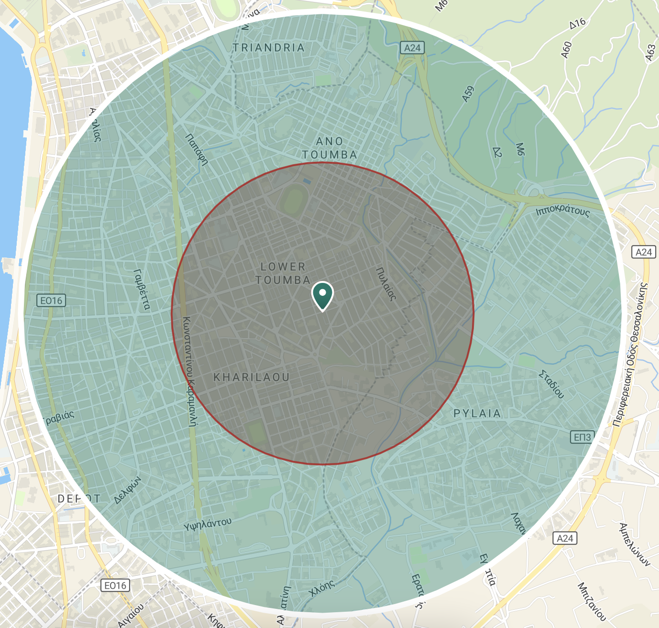
1-2 kilometer radius around Drasi Gia to Kati Allo Center
Notes:
Sammy

Slide 7
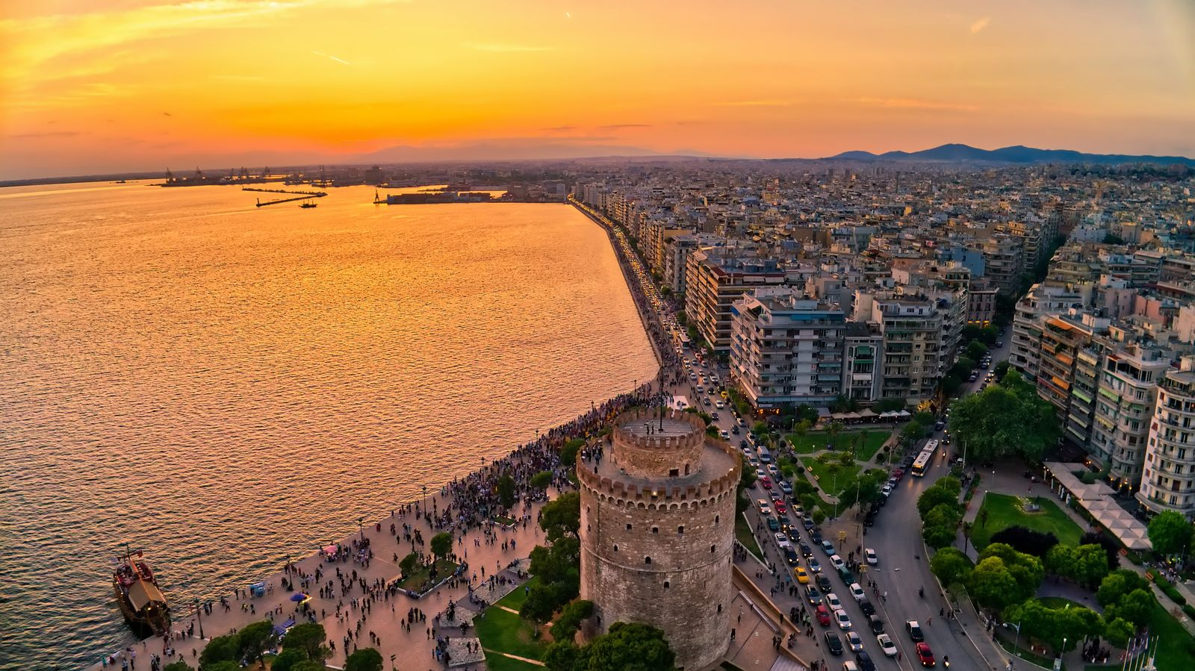
Physical Obstacles and Communication Barriers
Observation
Interactions with local businesses and infrastructure
360 Camera
Assessment
Building and Pedestrian Infrastructure
Frequently visited locations
Survey
Residents, Volunteers, SFA Community
Identify neighborhood obstacles
Notes:
John
Introduce as first objective
Conduct observations- hoping to accompany SFA participants and caregivers on their field trips within the city
Gain observations through field notes about communicative barriers and interactions with built environment
Use 360 camera to capture physical obstacles as we are walking around
Since we are walking around we will conduct building assessments and pedestrian infrastructure assessment (talk shortly about each)
Hoping to get a list of locations from eva, but also want to survey locations that aren't already welcoming
Want to survey employees, residents of the neighborhood, volunteers (clarify these aren’t SFA participants)
Surveys purpose is to ask if people have obstacles in the neighborhood(communicative or physical) and where they’ve seen them
Also will ask general questions for better data, all multiple choice

Slide 8
Objective 2 - Investigate Alternative Communication Methods
Observation
Local Business Interactions
Visual Displays
Braille
Interview
Business Owners
Employers
Participants / Board
Notes:
Aaron

Slide 9


Objective 3 - Create informative Materials Outlining Accessibility
Content Analysis
Surveys
Interviews
360 Camera
Feedback
Surveys
Volunteers
Employees
Notes:
hailey

Slide 10
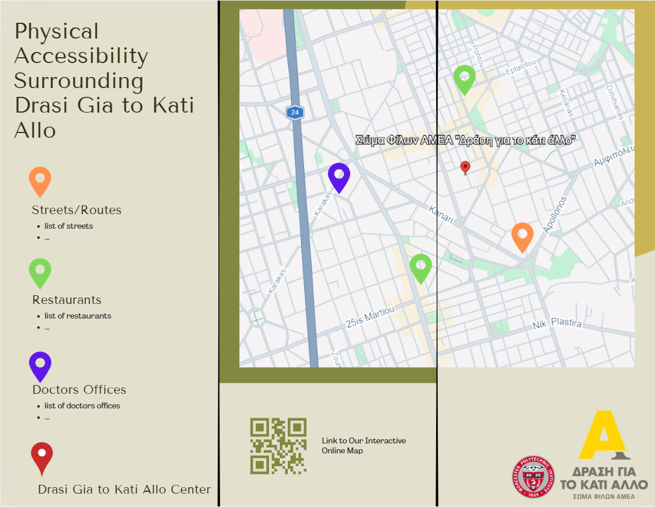
Informative Pamphlet
Bring awareness to the neighborhood about disability to improve belonging
Provide the SFA community with current information about accessible spaces
Example informative pamphlet for physical accessibility.
Notes:
Aaron

Slide 11
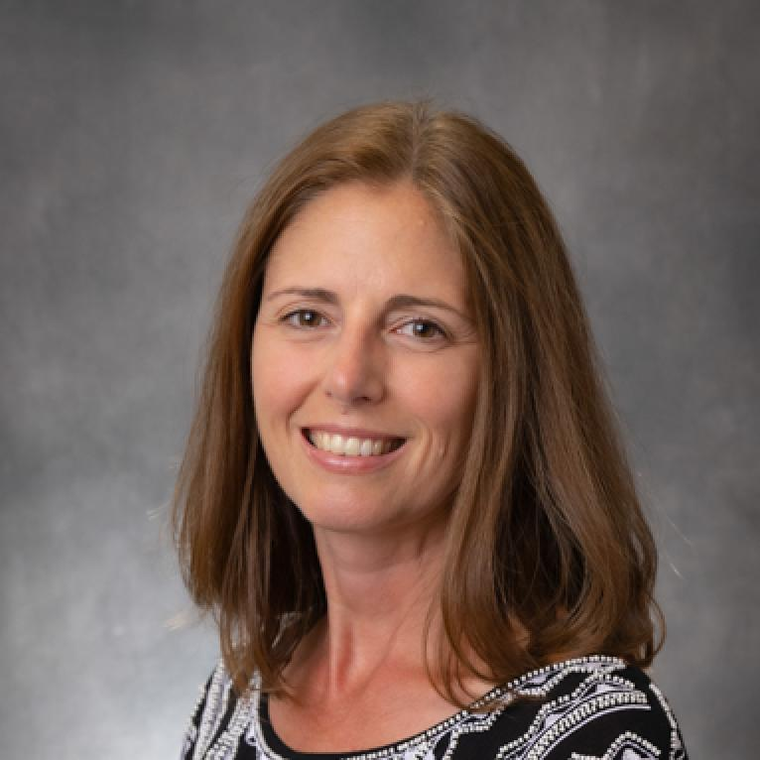
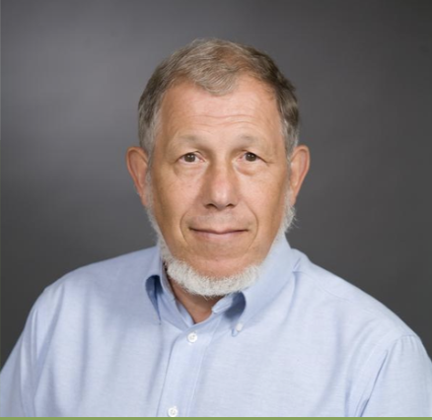
Acknowledgements
Melissa Butler
(Project Advisor)
Robert Kinicki
(Project Advisor)
Drasi Gia to Kati Allo
(Partner Organization)
Notes:
John

Slide 12
Image Sources
1. https://www.expedia.com/Thessaloniki-Old-Town-Thessaloniki.dx6335980
2. https://www.youtube.com/watch?v=aPknwW8mPAM
2. https://www.youtube.com/shorts/TyMd_wuyAmw?feature=share
3. https://www.travel.gr/en/the-guides-en/guide-to-thessaloniki/
6. https://mapme.com/features/create-a-map-with-pins/
7. https://visit-centralmacedonia.gr/en/where-to-go/55/1-thessaloniki/6/historic-center-of-thessaloniki
9. https://www.flaticon.com/free-icon/pamphlet_3010037
9 and 10. canva.com
11.https://thessdiktio.gr/en/organizations/%CF%83%CF%89%CE%BC%CE%B1-%CF%86%CE%B9%CE%BB%CF%89%CE%BD-%CE%B1%CE%BC%CE%B5%CE%B1-%CE%B4%CF%81%CE%B1%CF%83%CE%B7-%CE%B3%CE%B9%CE%B1-%CF%84%CE%BF-%CE%BA%CE%B1%CF%84%CE%B9-%CE%B1%CE%BB%CE%BB%CE%BF/ 11.https://www.wpi.edu/academics/global-school/faculty-staff

Slide 13
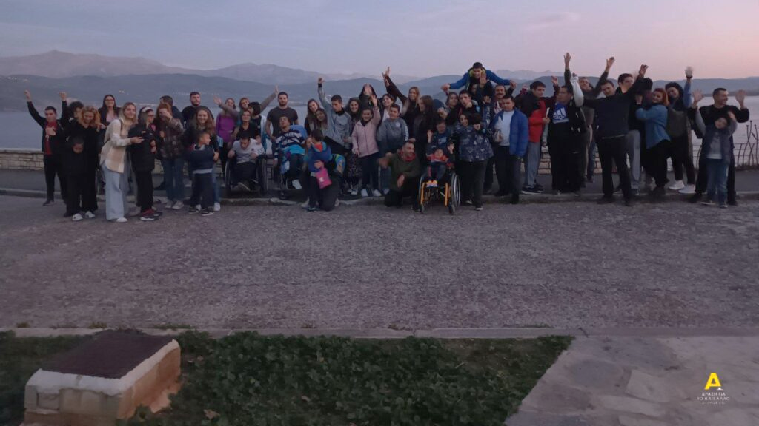
Σας ευχαριστώ
(Thank You)

