Slide 1
Sustainable Energy Awareness: Communicating the Benefits of Electrification in New Zealand
Andreas Keating, Tue Lac & Ben Marsh
Notes:
(Andreas)
Good afternoon everyone, thank you for being here with us today, my name is Andreas Keating….
We have worked in collaboration with Rewiring Aotearoa and AraAke to raise awareness on sustainable energy by communicating the benefits of electrification in New Zealand

Slide 2
Presentation outline:
Motivation
Sponsors
Goal
Results
Website
User Study
2
Notes:
(Andreas)
This is the outline of our presentation.

Slide 3
Emission Motivations
Emission Motivations
Ember. (2024). Global Electricity Review 2024.
3
Notes:
(Andreas)
One of our primary motivators behind our project is the urgent need to reduce greenhouse gas emissions not only in NZ but worldwide.
As illustrated here in this pie chart published by Ember,
NZ's electricity generation in 2023 was comprised of almost - 60% hydroelectricity,
- 17% from other renewables such as geothermal,
- and about 8% from wind power.
So over 80% of NZ's grid is powered by clean renewable sources.
This strong foundation enables NZ to further capitalize on household electrification. And to further maximize the use of its clean energy resources.

Slide 4
Emission Motivations
Household electrification on a large scale can save 10 million tonnes of emissions in New Zealand by 2040.
– (Rewiring Aotearoa, 2024)
4
Notes:
(Andreas)
Rewiring Aotearoa has stated that,
Household electrification on a large scale can save 10 million tonnes of emissions in New Zealand by 2040.

Slide 5
Economic Motivations
5
Notes:
(Andreas)
The second motivator behind our project. Is the economic impact
As depicted in this graph published by Rewiring, petrol and gas prices in New Zealand have been notably volatile, with a significant upward trend in recent years.
This is especially a problem for NZ since it has to import most of its fossil-fuels.
____________________________________
This volatility not only affects household budgets but also underscores NZ's dependence on imported fossil fuels.

Slide 6
Economic Motivations
Large-scale electrification could save New Zealand around $10.7 billion per year by 2040
– (Rewiring Aotearoa, 2024)
6
Notes:
(Andreas)
In fact, Rewiring Aotearoa has also stated that large-scale electrification could save NZ around $10.7 billion per year by 2040.

Slide 7
Our Sponsors
“Our mission is to electrify millions of fossil fuel machines in New Zealand by 2030 and create the world's most electric economy”
“Ara Ake exists to advance New Zealand’s energy sector to a sustainable future.”
7
Notes:
(Andreas)
We worked on this project in collaboration with our two sponsors: Rewiring Aotearoa and Ara Ake.
Rewiring Aotearoa:
...is a non-profit group focused on clean energy, climate solutions, and electrification.
...in their own words they state:
“Our mission is to electrify millions of fossil fuel machines in New Zealand by 2030 and create the world's most electric economy”.
Their support for our project aligns with their mission to motivate and make electrification more accessible to individuals accross New Zealand
Ara Ake:
...Is a government-funded organization “Ara Ake exists to advance New Zealand’s energy sector to a sustainable future.”.
They focus on developing new energy technologies, connecting experts, and supporting projects like ours.

Slide 8
Goal
To design a website that communicates motivating information about electrification to the New Zealand public
8
Notes:
(Tue Lac)
Our goal for this project was:
"To design a website that communicates motivating information about electrification to the New Zealand public."

Slide 9
1.
Investigate and research methods to convey the benefits of electrification.
Project Objectives
2.
Develop a website that motivates people to take action on electrification.
3.
Gather feedback on how effectively the website motivates the public.
9
Notes:
(Tue)
To achieve that goal, we divided our project into 3 key objectives:
Our 1st objective was to investigate and research methods to convey the benefits of electrification.
Our 2nd objective was to:
Develop a website that motivates people to take action on electrification.
Last but not least, our 3rd objective was to gather feedback on how effectively the website motivates the public .

Slide 10
Investigate and research methods to convey the benefits of electrification
Interviews
Surveys
Case Study
Investigate Five Websites
Data visualization
User experience
Engagement strategies
Identify motivational topics
Select engaging website design features
10
Notes:
(Tue)
To dive into obj 1 results, we conducted a total of 16 interviews that took approximately an hour each.
We also collected 50 community survey responses.
From these interviews and surveys, we were able to identify the topics and website design features that would best motivate the NZ public.
We also conducted a case study on five international energy-related websites. Which provided insight on: Data visualization, User Experience, and Engagement Strategies to apply to our website.

Slide 11
Interview Motivations
11
Notes:
(Tue Lac)
We coded the interview and recorded the frequency of each motivational topic. From 14 experts and 2 non experts Cost Savings was mentioned the most, followed by interest in New Technologies.

Slide 12
A Representative Expert Interview Quote
“For people to be interested in climate change, it starts with financials… That’s the key thing for me—showing the financial benefit of shifting, then all the other benefits follow along.”
- Mark Unwin, Business Development Manager, Marlborough Power Lines, Director, Cordall
12
Notes:
(Tue Lac)
Mark Unwin, a business development manager for the Marlborough Power Lines, stated:
“For people to be interested in climate change, it starts with financials… That’s the key thing for me—showing the financial benefit of shifting, then all the other benefits follow along.”
This quote stood out as a strong example of the opinon of experts

Slide 13
Interview Results
Cost savings is the most influential topic, and clear visuals are the best design feature.
13
Notes:
Tue Lac
From the interviews, cost savings was the most influential topic, making it a key motivator in electrification.
Clear visuals were the most mentioned feature in design after coding results, reinforcing the importance of visual clarity for public engagement.

Slide 14
Community Survey
13 Online
37 In-Person
14
Notes:
Tue Lac
We successfully gathered 50 community responses, 13 online and 37 in person. This flyer was distributed across local areas; you can find it near Cuba Street and the waterfront area.
These responses helped us understand community perspectives on motivation, challenges, and website preferences without any bias.

Slide 15
Motivating Electrification
(Strongly Disagree)
(Disagree)
(Neutral)
(Agree)
(Strongly Agree)
15
Notes:
Tue Lac
When asked what would most motivate them to electrify, participants ranked environmental impact and long term cost savings highest. These motivators guided how we framed website messages.

Slide 16
Motivating Electrification
(Strongly Disagree)
(Disagree)
(Neutral)
(Agree)
(Strongly Agree)
16
Notes:
Tue Lac

Slide 17
Website Design
17
Notes:
Tue Lac
Then we ask them what would encourage them to explore a website? Side-by-side comparisons, clear visuals and step by step guides top the list, showing that users want both clarity and hands-on explanations to help them take action.

Slide 18
Website Design
18
Notes:
Tue Lac

Slide 19
Website Design
19
Notes:
Tue Lac

Slide 20
Survey Results
Reducing emissions is the most influential topic, side-by-side comparisons are the best design feature, and upfront cost is the biggest concern by far.
20
Notes:
Tue Lac
Our survey revealed three key results:
First, reducing emissions was the most influential motivator.
Second, side-by-side comparisons stood out as the top design feature.
And finally, upfront cost was the biggest concern for most participants."

Slide 21
Case Study
Country | Highlights
India (India Climate & Energy Dashboard) | Interactive charts and hoverable elements
Germany (Clean Energy Wire) | Clear layout
New Zealand (Energy Efficiency and Conservation Authority) | Consumer-focused testimonials
Regional Dashboard (International Energy Agency (IEA)) | Page animations
Australia (Climate Momentum Monitor) | Intuitive navigation
21
Notes:
Ben
We reviewed five international dashboards to guide our design.
India’s ICED had detailed data and interactive charts, which are great for layered content.
Germany’s Clean Energy Wire was well-organized but lacked clear graph explanations.
New Zealand’s EECA Insights shared relatable stories but needed more interactivity.
The IEA dashboard was used hoverable elements and made global comparisons easy.
Australia’s Momentum Monitor stood out with clean visuals and plain language, which, later on, you will see we based our design heavily on.

Slide 22
Case Study Results
Simplicity and clarity
User interactivity
Brand alignment
22
Notes:
Ben
Ultimately, our design focused on three principles: clarity, interactivity, and alignment with the Rewiring Aoteora website. These principles ensured that our website would motivate everyday Kiwis by being not just informative, but engaging and useful

Slide 23
Develop a website that motivates people to take action on electrification
Use Wireframing to Develop Prototype
Design wireframe
Create prototype
23
Notes:
Ben
For our second objective, we focused on identifying the most suitable design strategies for our dashboard by analyzing case studies of five international platforms related to energy and electrification.
Our next step is to create wireframes using Canva to visualize the structure and layout of our dashboard. Once we receive approval from our sponsors, we’ll move forward with building the interactive prototype.
Since we currently only have results from the case study, we’ll focus on sharing those findings today.

Slide 24
24

Slide 25
25

Slide 26
26

Slide 27
27

Slide 28
28

Slide 29
29

Slide 30
30

Slide 31
Gather feedback on how effectively the website motivates the public
Website User Study
Pre Survey
Experience the Website
Post Survey
31
Notes:
(Andreas)
For our third objective:
In order to asses the effectiveness of our product.
We carried out a website user study in the form of pre and post surveys.
Participants first fill out the Pre-Survey.
Where they were asked questions that determined what their current level of motivation and knowledge regarding electrification.
Participants were then offered a link and asked to review our website before proceeding to the Post-Survey.
In the Post-Survey.
They were then primarily asked the same questions as in the Pre-Survey regarding their level of motivation and knowledge on elecrification after having browsed through our website.

Slide 32
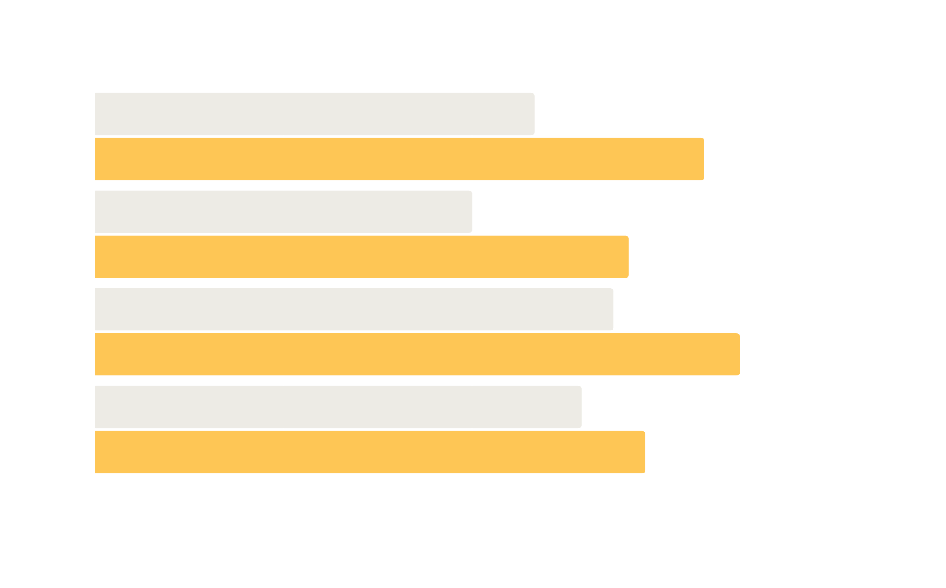
Pre and Post Survey Results
N = 14
Website Content Effectiveness
Pre-Survey Responses
Please indicate how much you agree or disagree with each statement.
Post-Survey Responses
3.33
0.90
I feel motivated to adopt electrification in my own home.
4.23
3.00
0.83
I intend to replace fossil-fuel machines with electric alternatives.
3.83
3.75
0.67
I understand the potential cost savings my household could achieve by electrifying.
4.42
3.58
0.34
I feel knowledgeable about residential electrification.
3.92
(Strongly Disagree)
(Disagree)
(Neutral)
(Agree)
(Strongly Agree)
32
Notes:
(Andreas)
We then compared the pre and post survey results with eachother in order to determine the change that our website had on user motivation and understanding.
This graph shows the average level of agreement that the 14 users recorded for each statement.
They were given the choice to select:
"Strongly Disagree"
"Disagree"
"Neutral"
"Agree"
"Strongly Agree"
The WHITE bars are the reults gathered from the Pre-Survey.
And the YELLOW bars are the results gathered from the Post-Survey.
The statements on the Y-axis of the graph are organized top to botom from largest to smallest change.
Our website had a bigger impact on user Motivation and intention to adopt. With a notable increase of (0.90) and of (0.83)
Although not as large, the website still had a positive change on user Knowledge and Understanding.
Specifically, our survey recorded a positive change of (0.67) and (0.34).

Slide 33
Post Survey Results
N = 14
Website Design Effectiveness
After exploring the website, please indicate your level of agreement with each statement.
The website was easy to navigate.
4.27
The website's overall design was visually appealing.
4.17
The graphs, charts, and diagrams were clear and easy to understand.
4.00
(Strongly Disagree)
(Disagree)
(Neutral)
(Agree)
(Strongly Agree)
33
Notes:
(Andreas)
We also included a question that was exclusive to the Post-Survey. Were we asked participants to rate the website's:
Navigability,
Visual Appeal,
and Clarity of its content.
This question was structured in the same way as our previous questions.
Where users were able to rate the statements from "Strongly Disagree" to "Strongly Agree"
This graph shows the average of the recorded user responses,
Ranked from highest to lowest.
Out of the 14 survey responses collected we found that our website design was highly effective.
User's rated the website's navigability was it's strongest feature.

Slide 34
Conclusion
Our research highlighted design and content features that boost motivation to electrify. We hope aspects of our website and results help our sponsors improve their ability to electrify
New Zealand.
34
Notes:
"Our research highlighted design and content features that boost motivation to electrify. While our website still has room for improvement, we hope our findings help our sponsors improve the impact of their own websites"

Slide 35
Acknowledgements
We sincerely thank our IQP advisor, Robert Kinicki, for his invaluable guidance.
Special Thanks to Jenny Sahng of Rewiring Aotearoa and Daniel Gnoth of Ara Ake
35
Notes:
We sincerely thank our IQP advisor, Robert Kinicki, for his invaluable guidance.
Special Thanks to Jenny Sahng of Rewiring Aotearoa and Daniel Gnoth of Ara Ake

Slide 36
Image Credits
MBIE (New Zealand). (June 13, 2024). Residential electricity consumption in New Zealand from 2014 to 2023 (in 1,000 gigawatt hours) [Graph]. In Statista. Retrieved February 28, 2025, from https://www-statista-com.ezpv7-web-p-u01.wpi.edu/statistics/717221/new-zealand-residential-electricity-consumption/
https://www.rewiringamerica.org/research/pace-of-progress-home-electrification-transition
Griffith, D. S., Ellison, J., Pawson, M., & Conway, P. (2024). Investing in Tomorrow: The Electrification Opportunity. Ara Ake.
https://newsroom.co.nz/2024/08/28/an-engineers-plan-to-rewire-nz-and-save-money-doing-it/
https://www.meridianenergy.co.nz/public/Uploads/Certified-Renewable-Energy-Sales-Brochure.pdf
https://www.qantas.com/us/en/travel-guides/new-zealand/north-island/wellington.html
https://www.qantas.com/us/en/travel-guides/new-zealand/north-island/wellington.html
https://www.reddit.com/r/newzealand/comments/zg67uv/ny_times_36_hours_in_wellington_new_zealand/
https://www.nbr.co.nz/business/generation-ramps-up-at-lodestones-third-solar-farm/
Ember. (August 20, 2024). Distribution of electricity generation in New Zealand in 2023, by source [Graph]. In Statista. Retrieved March 03, 2025, from https://www-statista-com.ezpv7-web-p-u01.wpi.edu/statistics/1237529/new-zealand-distribution-of-electricity-production-by-source/
https://images.unsplash.com/photo-1707163044321-fb8ade156d95?fm=jpg&q=60&w=3000&ixlib=rb-4.0.3&ixid=M3wxMjA3fDB8MHxzZWFyY2h8Nnx8aW5kdXN0cmlhbCUyMHBvbGx1dGlvbnxlbnwwfHwwfHx8MA%3D%3D
https://img.freepik.com/fotos-premium/gluehbirne-hd-8k-wallpaper-stock-fotobild_890746-28909.jpg
36
Notes:
(Andreas)
Here are our Image Credits

Slide 37
Thank you for listening!
Any questions?
37
Notes:
(Andreas)
Thank you very much for your time and for tuning in.
We are more than happy to answer any questions.

Slide 38
Interview Website Design
38
Notes:
To guide our Website design, we coded the 16 interviews on what features they think would be best.
Both experts and non-experts agree that Clear Visual is the most effective.
Experts highlight simple explanations and clear visuals.
While non-experts valued testimonial stories and Videos.
This helped us shape a layout that’s both informative and relatable.

Slide 39
Concerns & Challenges
39
Notes:
On the other hand, we also asked about barriers. Unsurprisingly, upfront cost was by far the biggest concern, followed by worries about a lack of information and performance. These insights showed us where the website needed to address doubts directly.

Slide 40
Concerns & Challenges
40
Notes:
On the other hand, we also asked about barriers. Unsurprisingly, upfront cost was by far the biggest concern, followed by worries about a lack of information and performance. These insights showed us where the website needed to address doubts directly.

Slide 41
41

Slide 42
42

Slide 43
43
Notes:
Ben
We conducted a case study for five international dashboards to guide our design. They all have great features that we consider adding to add into our website. However, the one that inspired us the most is Australia's Momentum Monitor. It breaks down key sectors and uses engaging visuals, plain language, and intuitive navigation, elements we tried to mirror in our own prototype for the New Zealand context.

Slide 44
Community Interview Insights
“ I just got a new kind of bumper sticker that says, “Support Kiwi, not OPEC.” ” – Steve Charles
“Huge opportunity to save money for the country.” – Steve Charles
“Control of the energy equation is in my hands.”
– Tony Stephens
44
Notes:
Interviewed 15 experts from the Construction, Farming, and Energy sectors.
Interviews included both general and field-specific electrification questions
Cost-benefit was the most commonly cited motivational metric:

Slide 45
Country | Highlighted
India (India Climate & Energy Dashboard) | Offers detailed national/state data and many interactive charts
Germany (Clean Energy Wire) | Clear layout and labeling, lacks graph explanations
New Zealand (Energy Efficiency and Conservation Authority) | Consumer-focused stories, limited interactivity
Regional Dashboard (International Energy Agency (IEA)) | Mobile-responsive, clear regional comparisons
Australia (Climate Momentum Monitor) | Clean visuals and plain language, highly engaging layout
45
Notes:
We reviewed five international dashboards to guide our design.
India’s ICED had detailed data and interactive charts, great for layered content.
Germany’s Clean Energy Wire was well-organized but lacked clear graph explanations.
New Zealand’s EECA Insights shared relatable stories but needed more interactivity.
The IEA dashboard was mobile-friendly and made global comparisons easy.
Australia’s Momentum Monitor stood out with clean visuals and plain language, which, later on, you will see we based our design heavily on.

