Slide 1


Systemic Barriers and Digital Solutions
Supporting Roma Student Inclusion Through the REVMA Hub

Slide 2
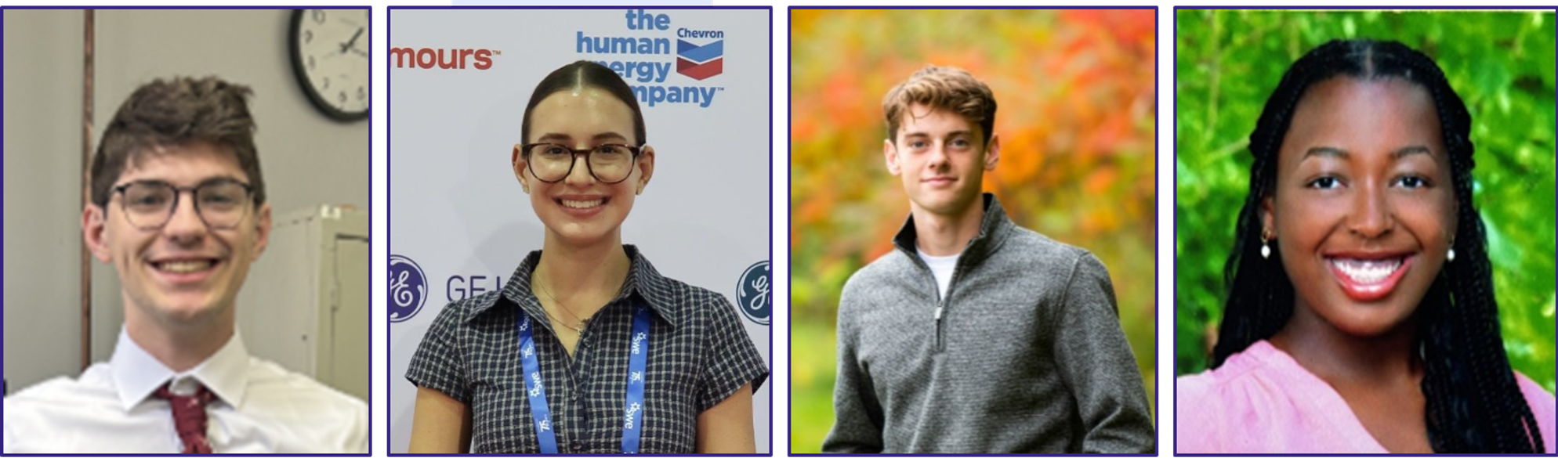
Meet the Team
Liam Laidlaw
Zhyan Noble
Peter Story
Ava Waddell
2
2

Slide 3
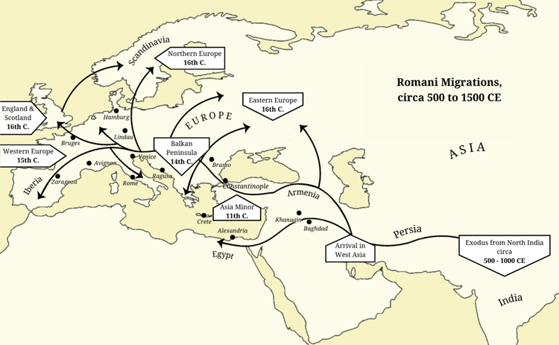
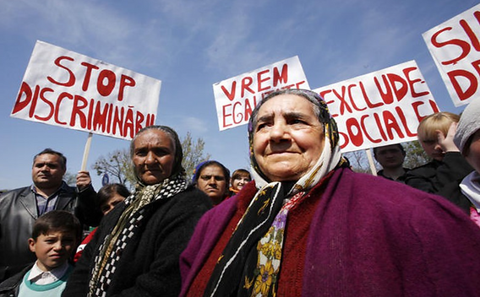
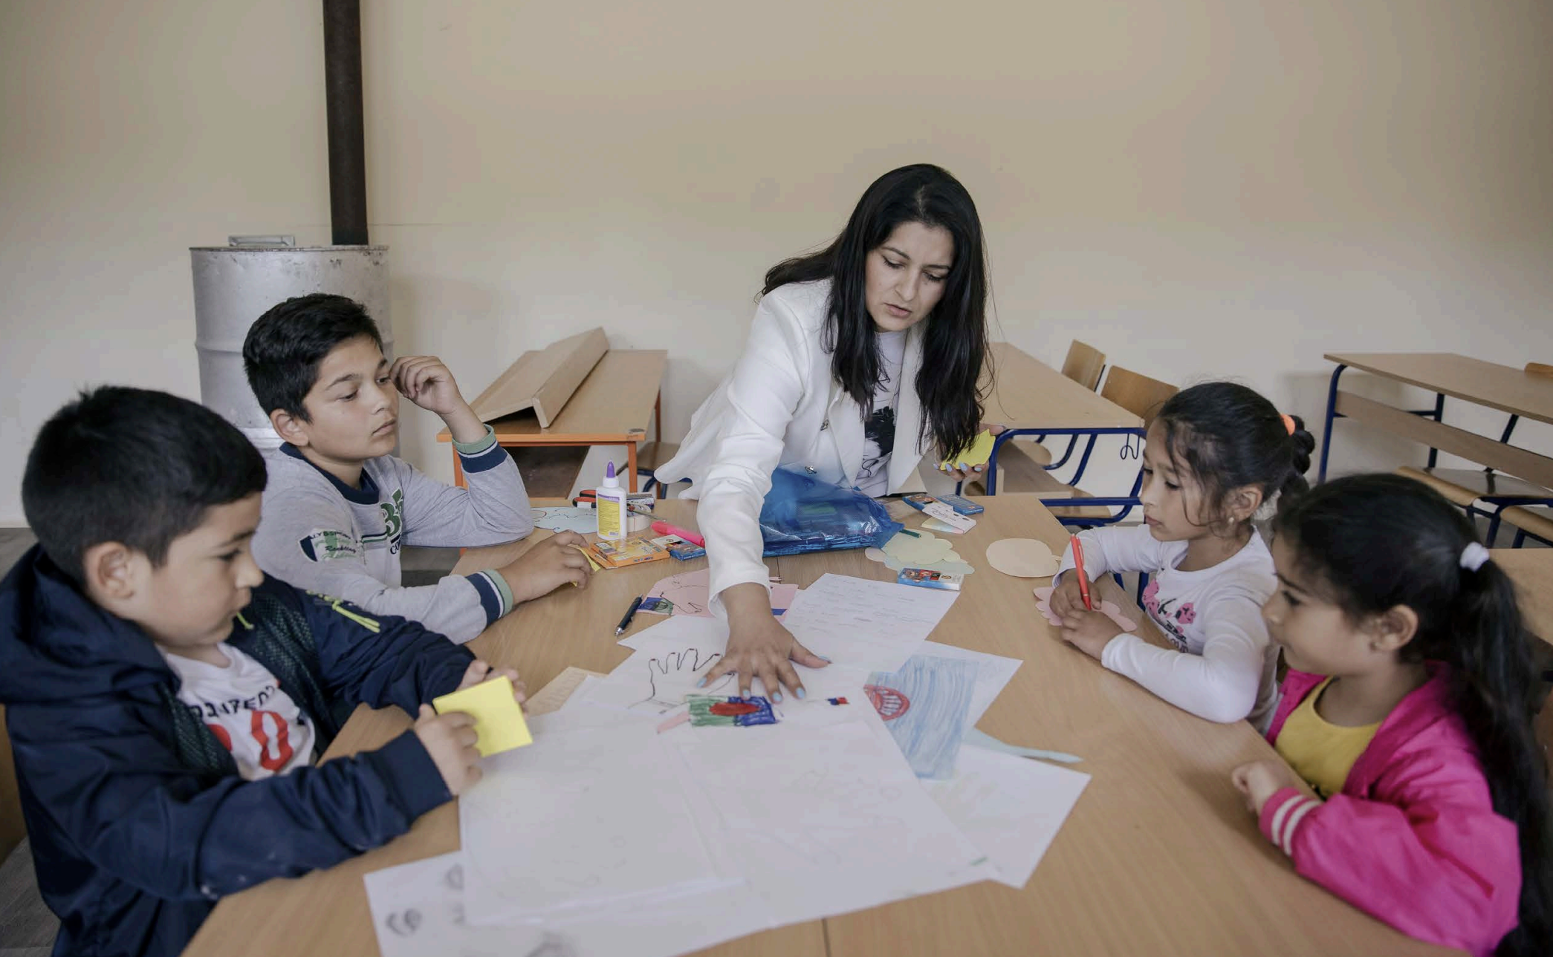
Background
[1]
[2]
[3]
Roma
Discrimination
Greek-Roma
Education
Roma History
3
Notes:
https://athenslivingmuseum.com/ancient-greek-education-system/
https://www.genocidewatch.com/single-post/country-report-the-roma-in-Romania
https://www.worldhistory.org/image/16922/map-of-romani-migration-in-the-middle-ages/
Notes:
Roma People: Ethnic group that migrated from India to different parts of the Europe
Roma Discrimination: The Roma faced discrimination for centuries, heavily affecting Q.O.L.
Greek-Roma Education: Roma early-childhood education is at a very low rate, alongside a high dropout rate

Slide 4
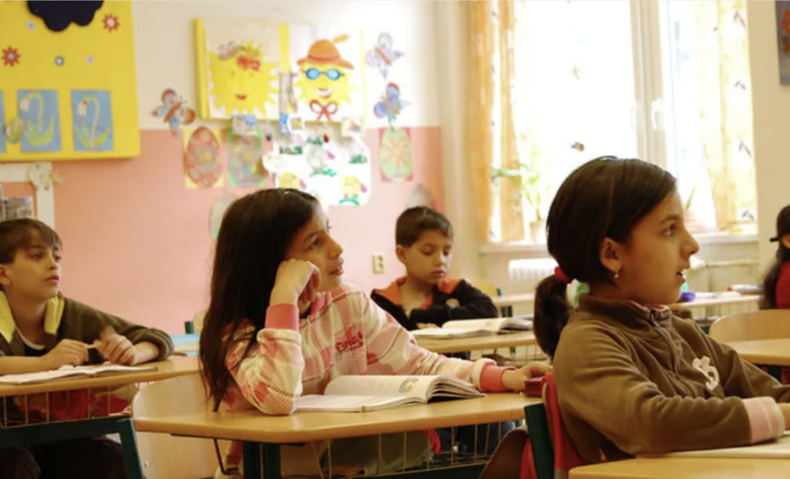
Across Europe…
https://www.europarl.europa.eu/topics/en/article/20200918STO87401/roma-what-discrimination-do-they-face-and-what-does-eu-do
68%
of Roma students left school early
18%
of Roma children transit to higher levels of education
63%
of young Roma are not in education, employment, or training
4
[4]

Slide 5
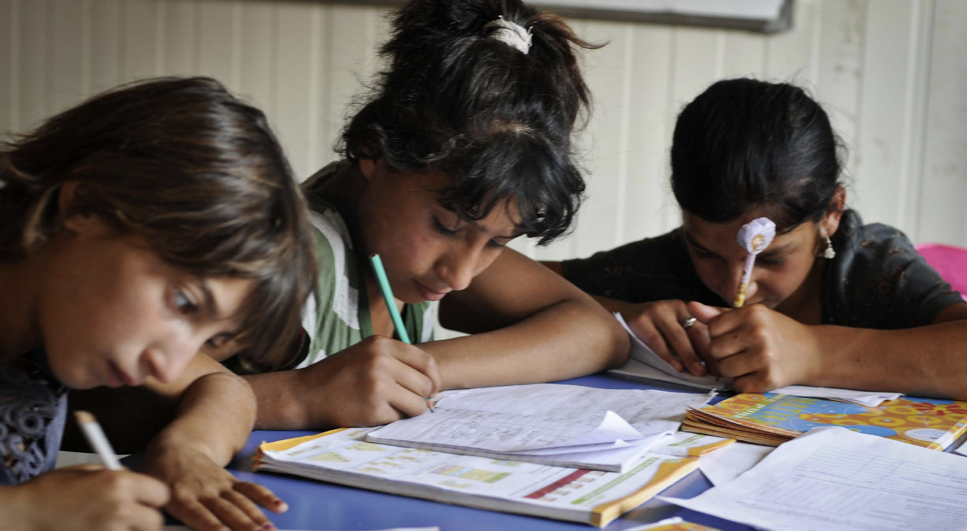
In Greece…
https://fra.europa.eu/sites/default/files/fra_uploads/fra-country_data-roma_survey-greece.pdf
Greek Students
Greek-Roma Students
69%
attending early childhood education
22%
attending early childhood education
96%
completed at least upper-secondary education
2%
completed at least upper-secondary education
5
[5]

Slide 6

Project Sponsor
Founded in 2021 as a non-profit, women-led NGO.
Focused on advancing the rights & well-being of the Greek Roma Community through education & empowerment initiatives.
[6]
6

Slide 7
Project Goal
To strengthen the REVMA Hub by developing culturally responsive digital teaching resources and improving the existing platform’s accessibility and usability.
7

Slide 8
Project Objectives
Assess the digital literacy and educational needs of educators teaching Roma students.
01
Evaluate the current cultural responsiveness, accessibility, and usability of the REVMA Hub and its existing resources.
02
Develop culturally responsive digital resources and implement improvements to address identified gaps.
03
04
Evaluate the effectiveness of implemented improvements through educator feedback and usability testing.
8

Slide 9

Objective 1: Assess the digital literacy and educational needs of educators teaching Roma students.
Surveys
Length→ 15 Questions
Why? → To Explore Educators:
Digital Proficiency
Experiences with Roma Students
When? → Immediately After/Before School Day
Interviews
[7]
Type → Semi-Structured, Optional
Why? → To allow educators to elaborate on their survey answers.
When? → After/Before School Day
9
Notes:
State how you plan on choosing teachers (get them all!)
https://www.istockphoto.com/photos/market-research-interview

Slide 10
Objective 2: Evaluate the cultural responsiveness, accessibility, and usability of the REVMA Hub and its existing resources.
Document Review
Review of appropriateness of existing materials on REVMA Hub & similar websites Utilizing standardized usability testing tool.
Think-Alouds
One-on-one with teachers to benchmark usability of existing REVMA Hub.
10
[8]

Slide 11
Objective 2: Evaluate the cultural responsiveness, accessibility, and usability of the REVMA Hub and its existing resources.
Document Review
Think-Alouds
Internal sessions with the team
Cultural responsiveness & accessibility
Pre-cursor to Think-Alouds
Standardized usability testing tools
One-on-one sessions with Educators
Usability of the REVMA Hub
Conducted after interviews
Flexibility in protocol
VS
11

Slide 12
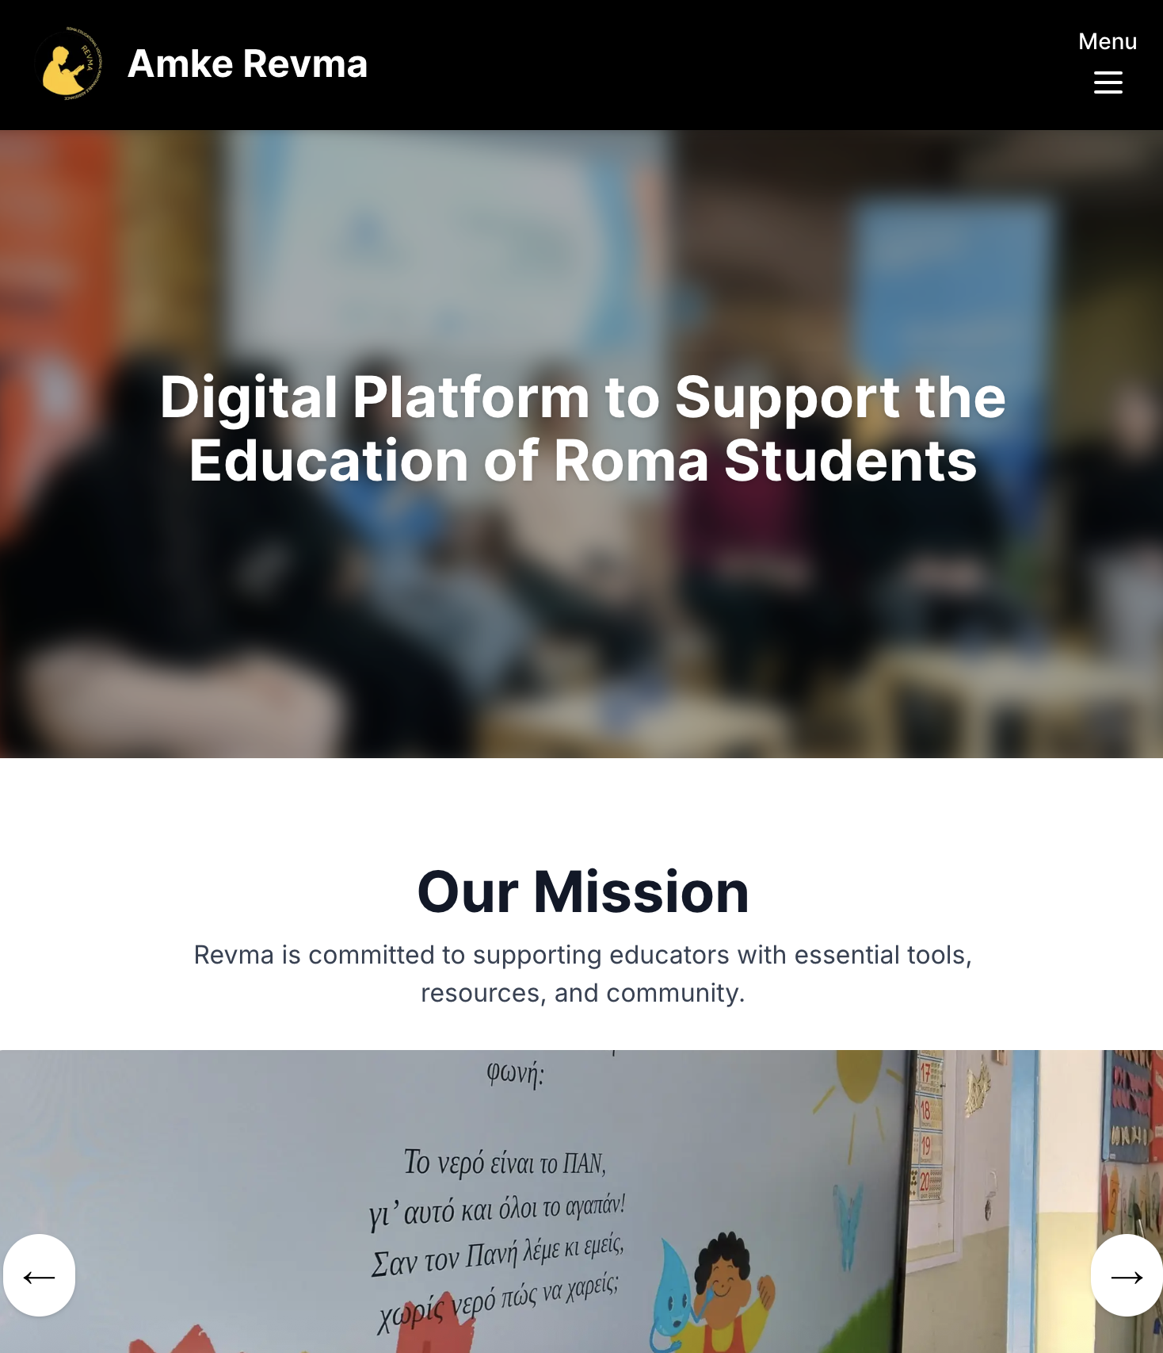
Objective 3: Develop culturally responsive digital resources and implement improvements to address identified deficiencies.
Methodology
Synthesize data collected in Objective 1 & Objective 2
Analyse & identify website deficiencies
Focus on resource organization, improving navigation & implementation of new resources
13
[6]

Slide 13
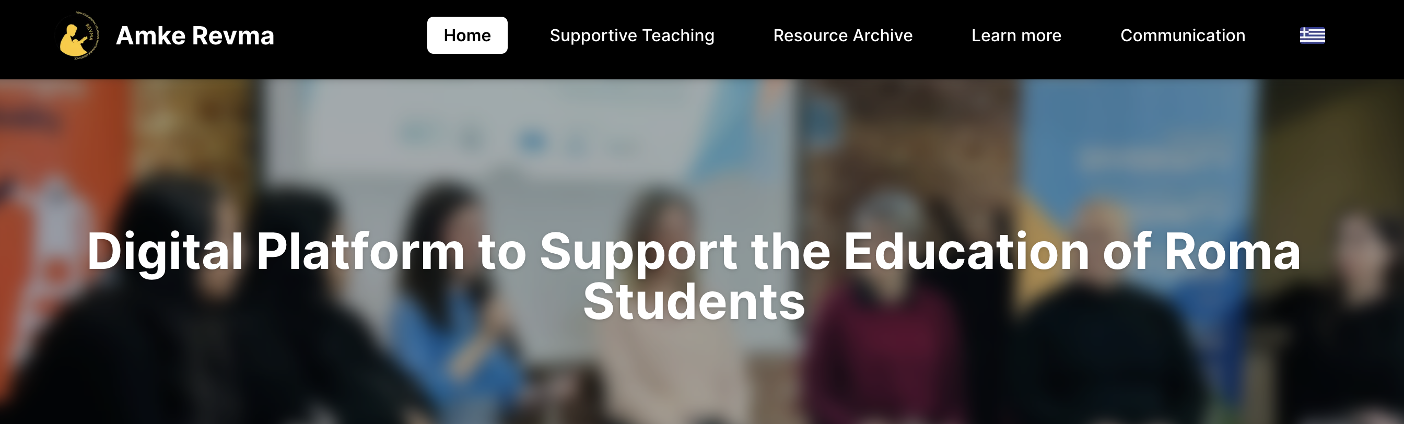
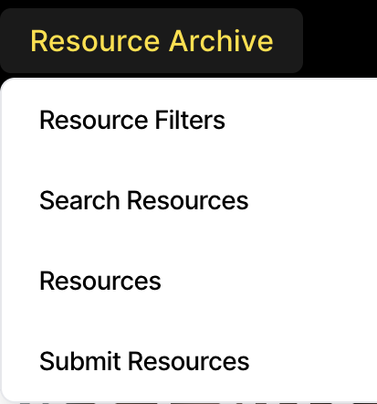
Objective 3: Develop culturally responsive digital resources and implement improvements to address identified deficiencies.
[6]
14

Slide 14
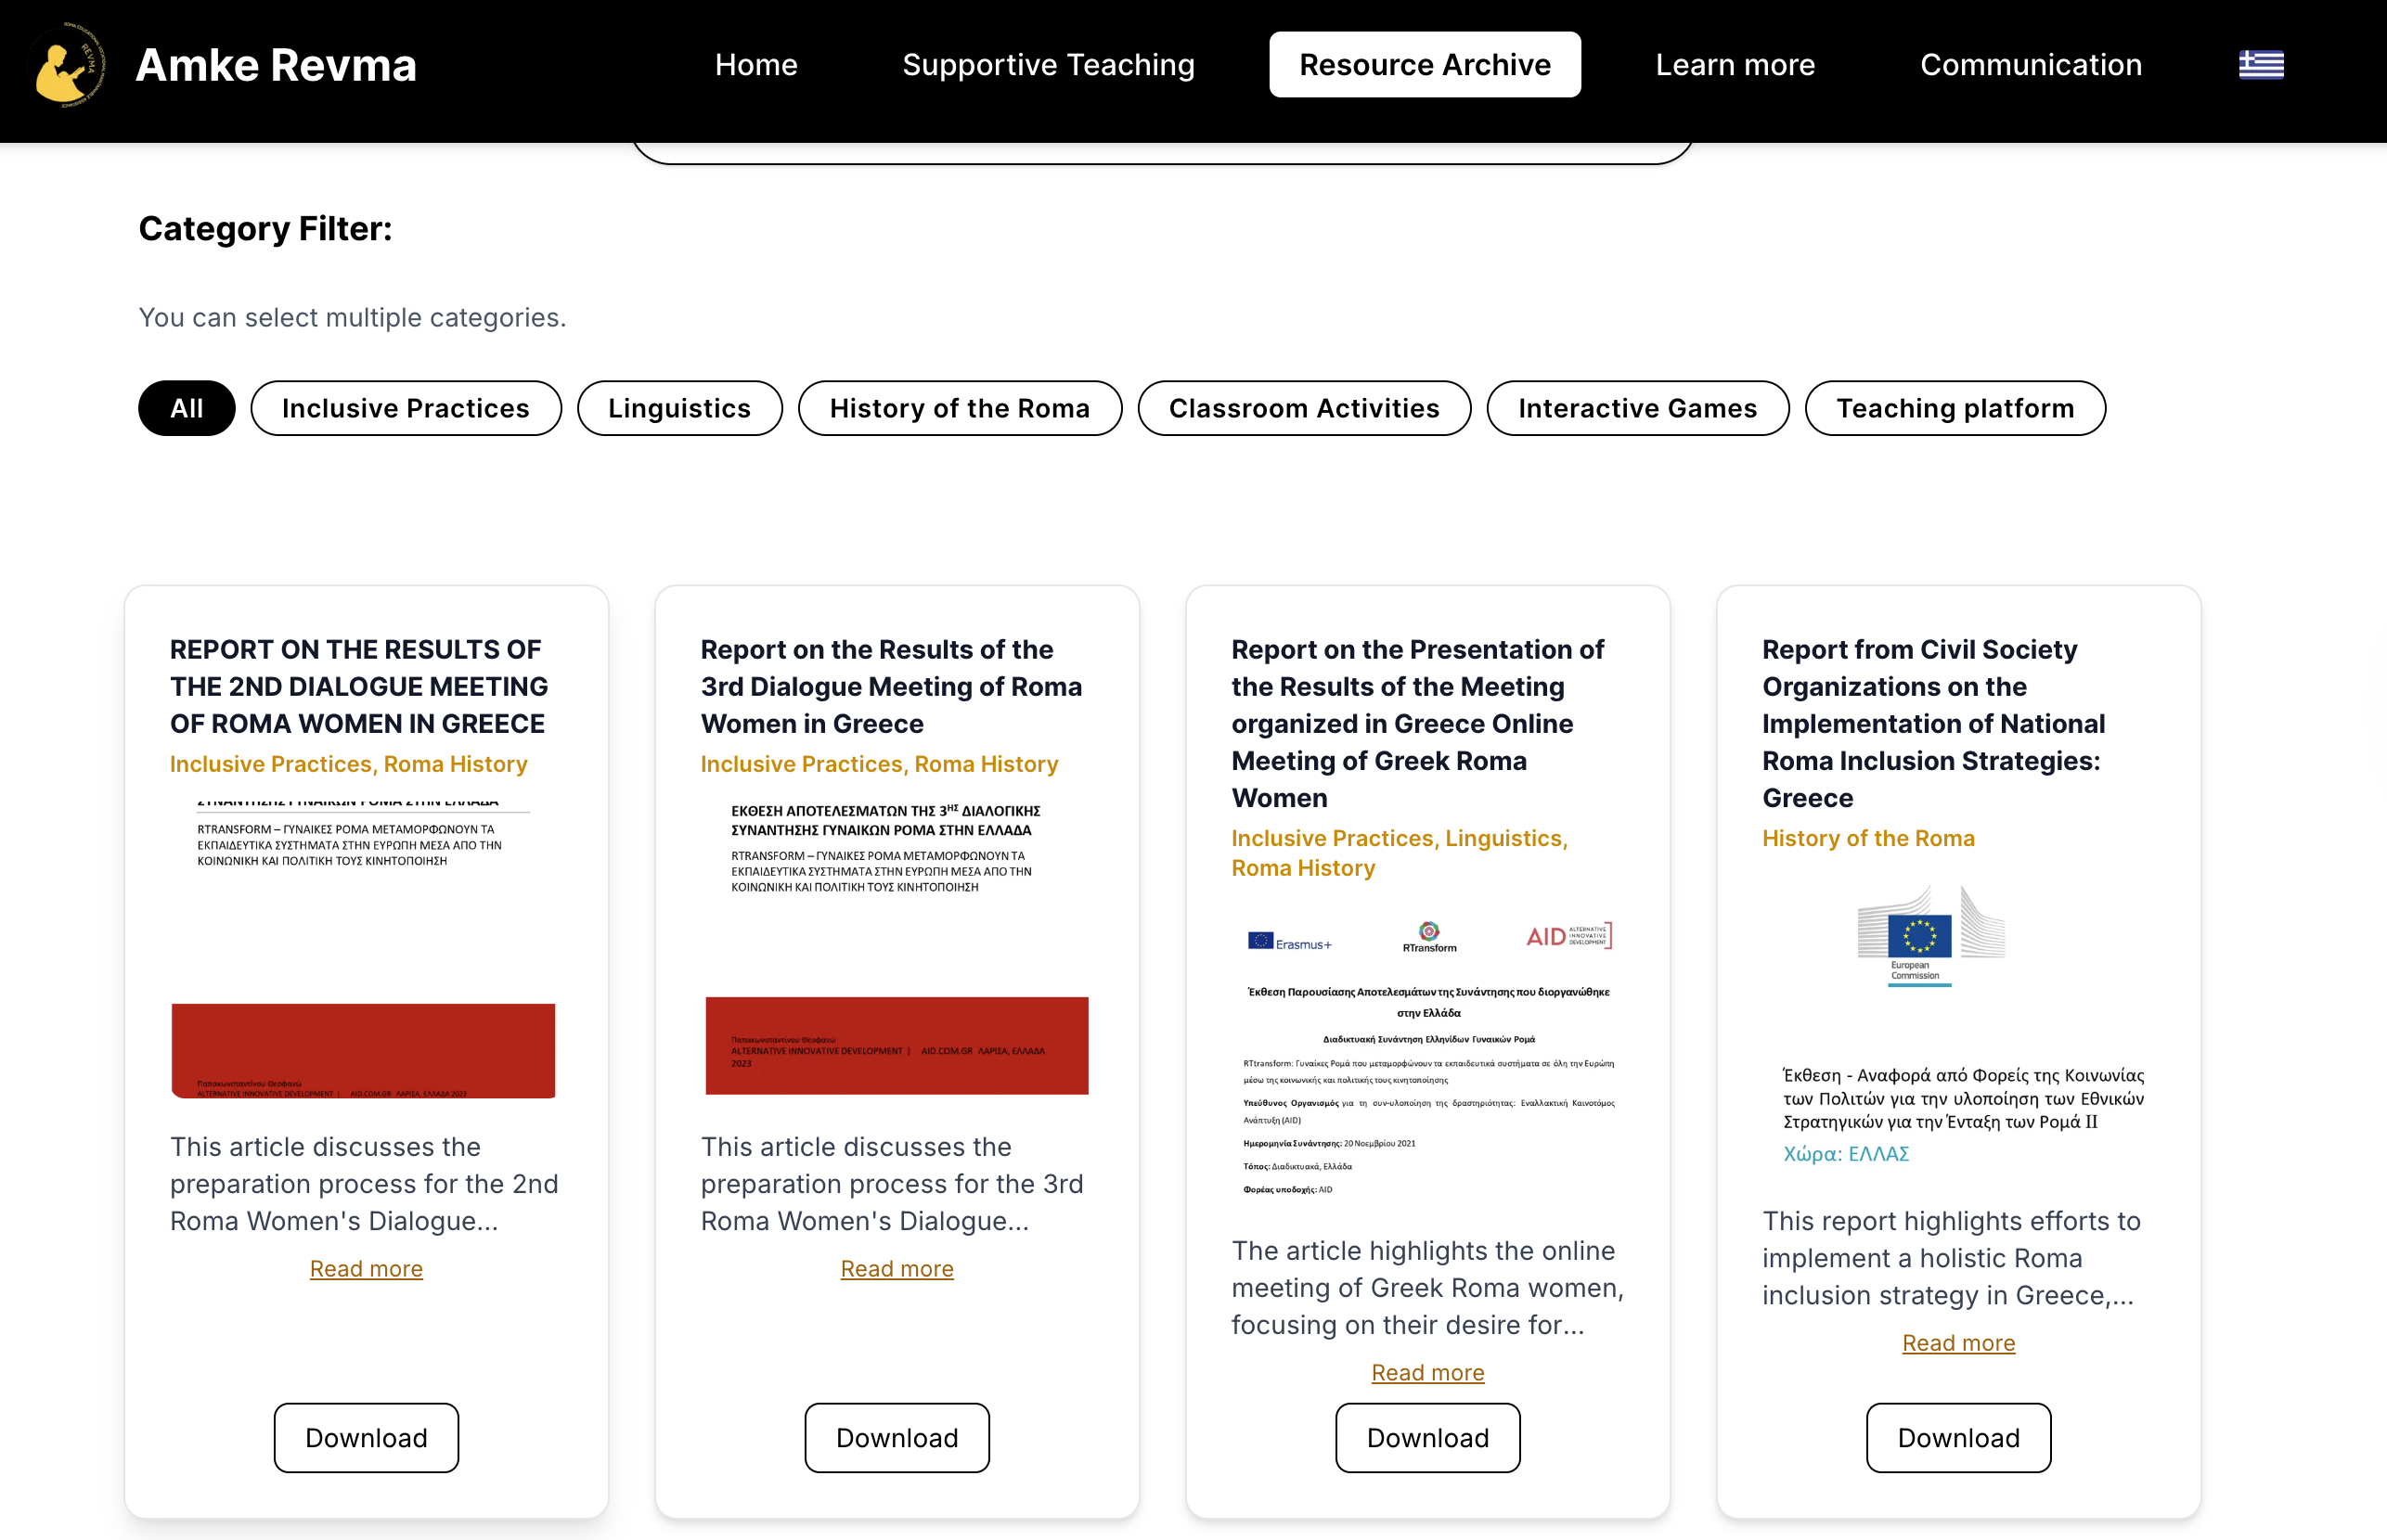
Objective 3: Develop culturally responsive digital resources and implement improvements to address identified deficiencies.
15
[6]

Slide 15
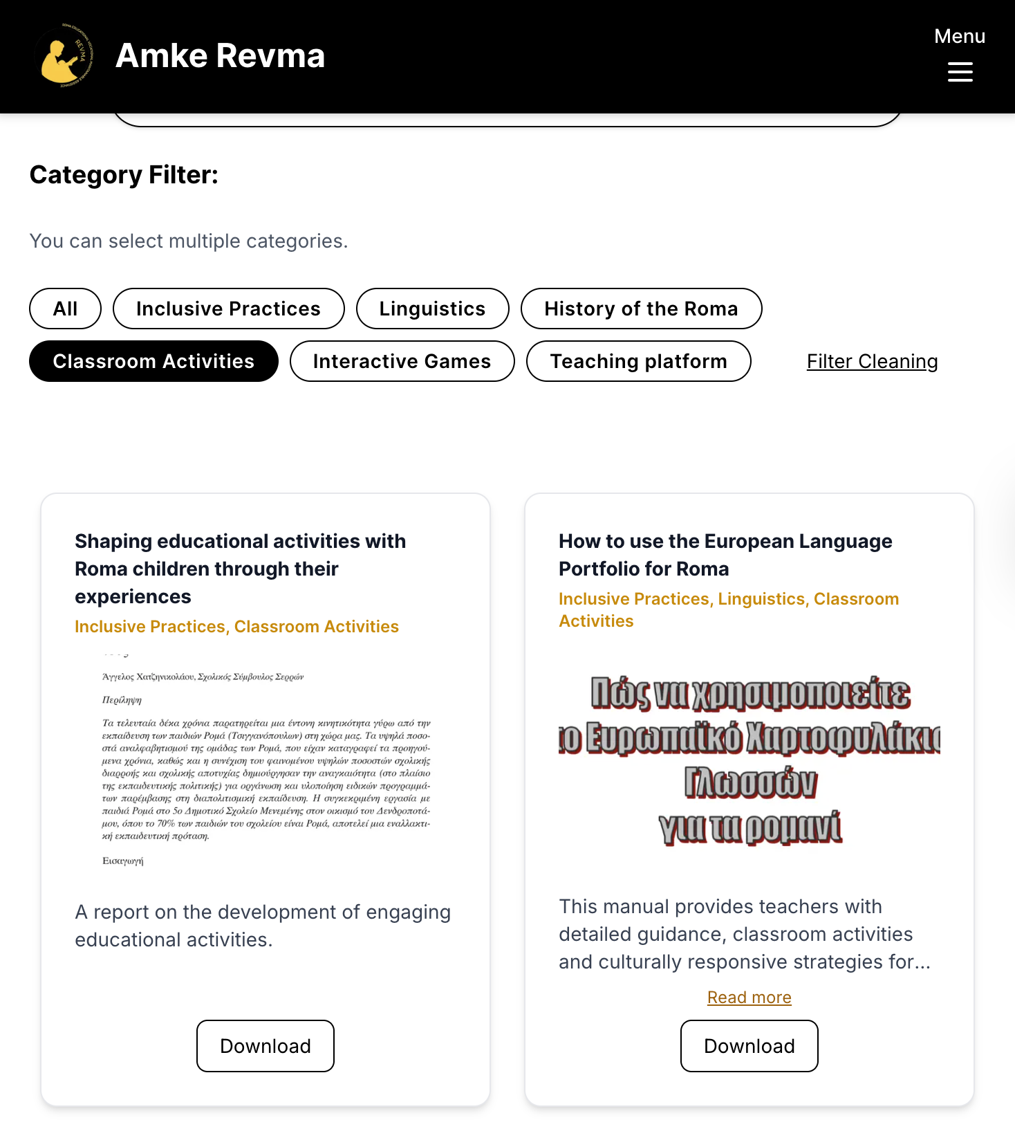
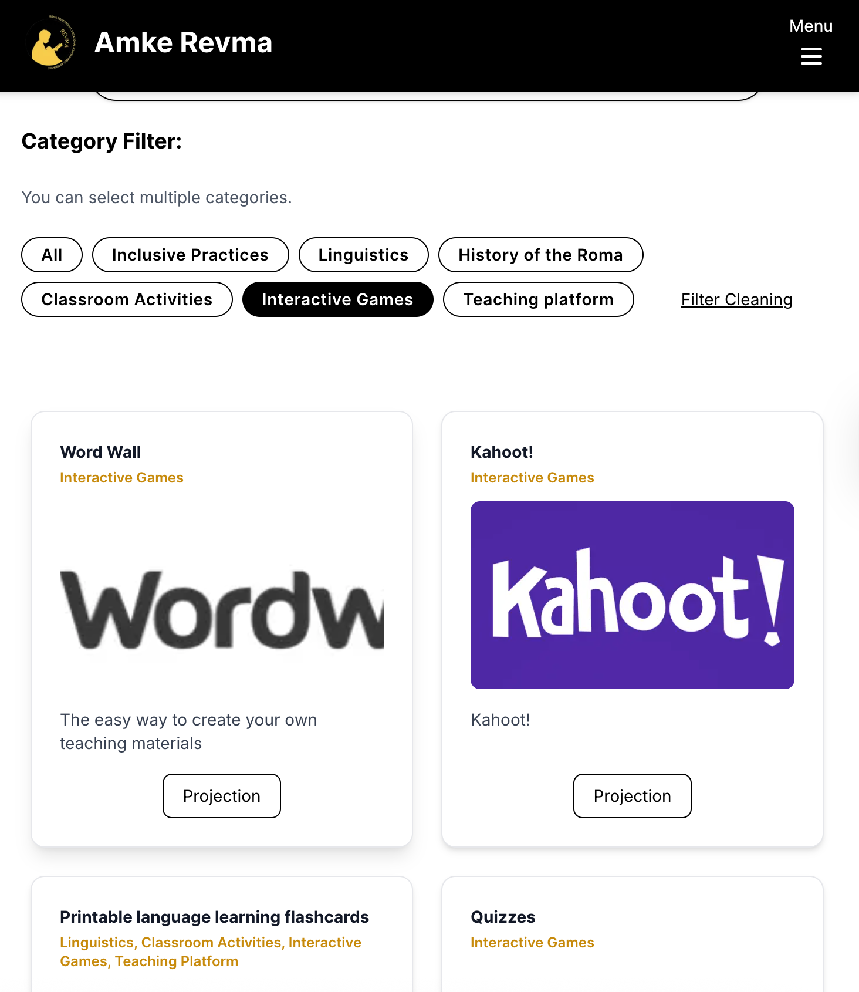
Objective 3: Develop culturally responsive digital resources and implement improvements to address identified deficiencies.
16
[6]
[6]

Slide 16
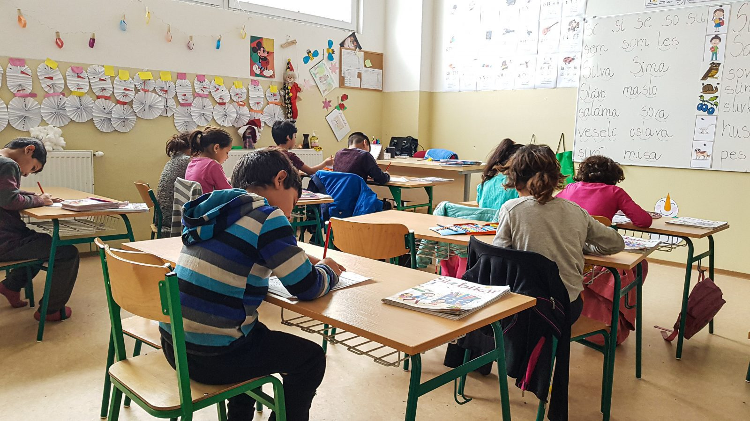
Objective 4: Evaluate the effectiveness of implemented improvements through educator feedback and usability testing.
Survey
Section 1: REVMA staff + educators evaluating the REVMA hub updates
Section 2: Educators evaluating the intercultural education materials
Evaluated with System Usability Scale (SUS)
17
[9]

Slide 17
Impact
Deliverables
Stakeholders
18
Notes:
Points to hit:
Educational Resources
The hub itself
Who Benefits:
Roma Students
Teachers who use the hub
REVMA as an organizition

Slide 18
Acknowledgements
Our Sponsors
Georgia Kalpazidou
Akrilenia Kappou
Our Advisors
Professor Melissa Butler
Professor Robert Kinicki
19

Slide 19
Image Credits
Roma Migration: https://www.worldhistory.org/image/16922/map-of-romani-migration-in-the-middle-ages/
Roma Discrimination: https://www.genocidewatch.com/single-post/country-report-the-roma-in-Romania
Teacher and Students around table: https://www.unicef.org/eca/reports/education-pathways-roma-settlements-understanding-inequality-education-and-learning
Side view of students in classroom: https://www.aljazeera.com/opinions/2015/5/8/why-roma-kids-dont-fit-in-at-czech-schools
Students doing homework: https://www.unicef.org/eca/reports/education-pathways-roma-settlements-understanding-inequality-education-and-learning
Revma Hub https://revma-hub.vercel.app/el/resources
Interview: https://www.istockphoto.com/photos/market-research-interview
Adult helping students in home: https://www.undp.org/eurasia/blog/data-can-make-difference-roma-inclusion
Faceless portrait of students in class: https://coface-eu.org/opinion-ethnic-segregation-of-roma-children-in-europes-schools-demands-real-action/
20

Slide 20
Σας ευχαριστώ
Any Questions?
21

Slide 21
Objective 2: Evaluate the cultural responsiveness, accessibility, and usability of the REVMA Hub and its existing resources.
Team Document Reviews (Weeks 1 & 2)
Think-Alouds with Educators (Weeks 2 & 3)
Analysis of Document Feedback (Weeks 3 - 5)
Implementation of Feedback (Weeks 4 – 6)
12

