Slide 1
Stakeholder Study in Wairarapa Moana
Natalie Diltz, Jena Mazzucco, Austin Scott, Jeffrey Sirocki
March 2nd, 2016
WPI IQP

Slide 2
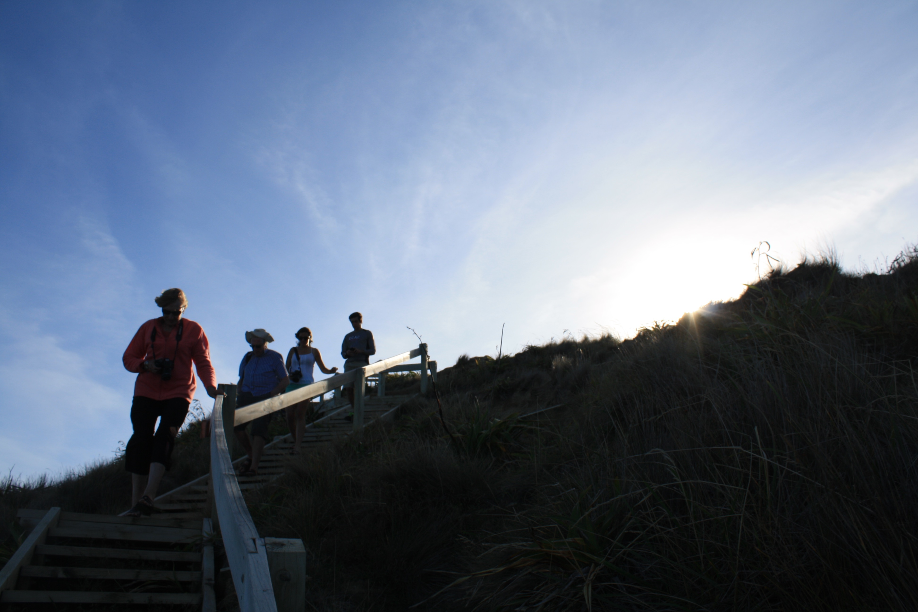
Kāhore taku toa i te toa takitahi, he toa takitini
We cannot succeed without the support of those around us
1

Slide 3
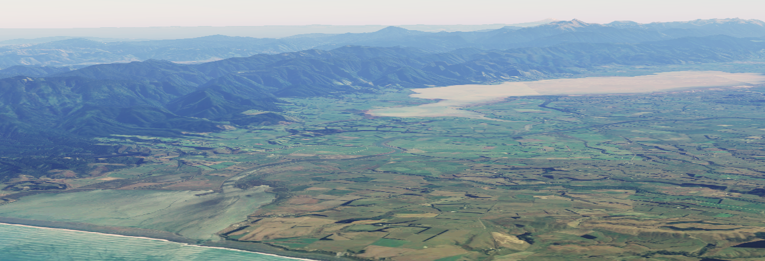
Wairarapa Moana
Lake Wairarapa
Dynamic Water System Prone to Flooding
Ruamahanga River
Lake Onoke
Onoke Spit

Slide 4
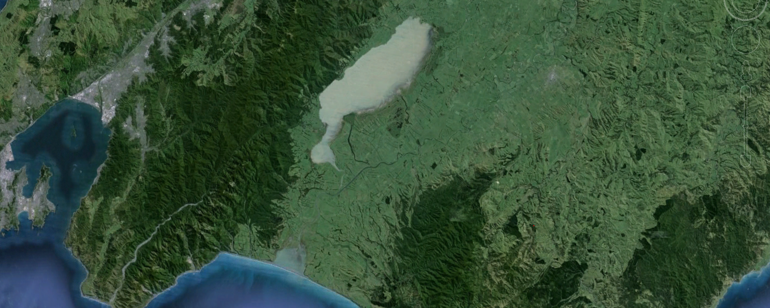
Pre Lower Wairarapa Valley Development Scheme
Ruamahanga River
Lake Wairarapa
Lake Onoke

Slide 5
Post Lower Wairarapa Valley Development Scheme
Ruamahanga River
Lake Wairarapa
Cutoff
Barrage Gates
Diversion
Lake Onoke

Slide 6
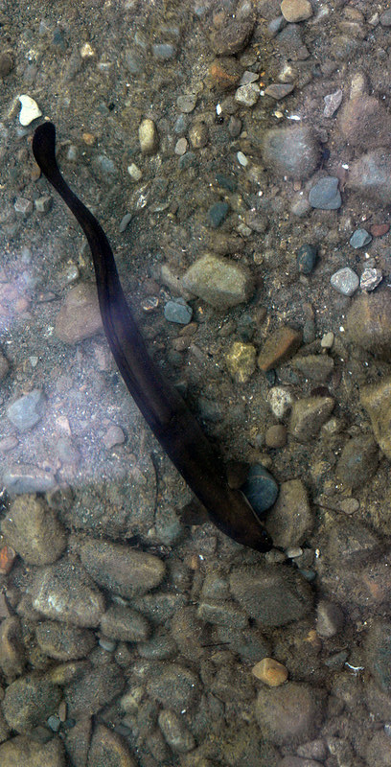
History of Conflict
Maori
Pakeha
Intrinsic Value
Economic Value
Fish
Sheep
Natural Flooding
Flood Prevention
Treaty Settlement
2014
Gifting of Wairarapa Moana
Waitangi Tribunal
Treaty of Waitangi
1840
1896
1975
1840
1855
1870
1885
1900
1915
1930
1945
1960
1975
1990
2005
2019
Today
Notes:
mention farming

Slide 7
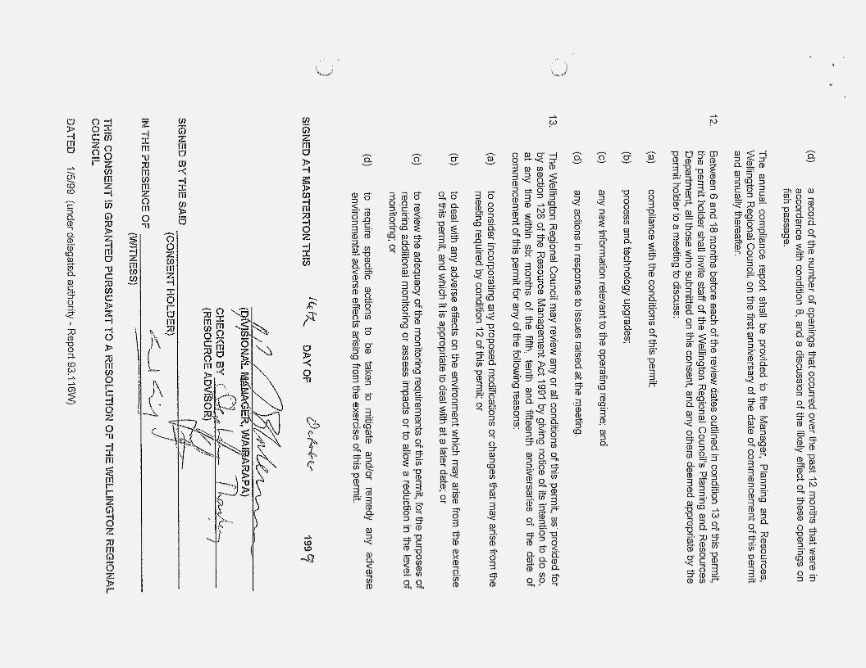
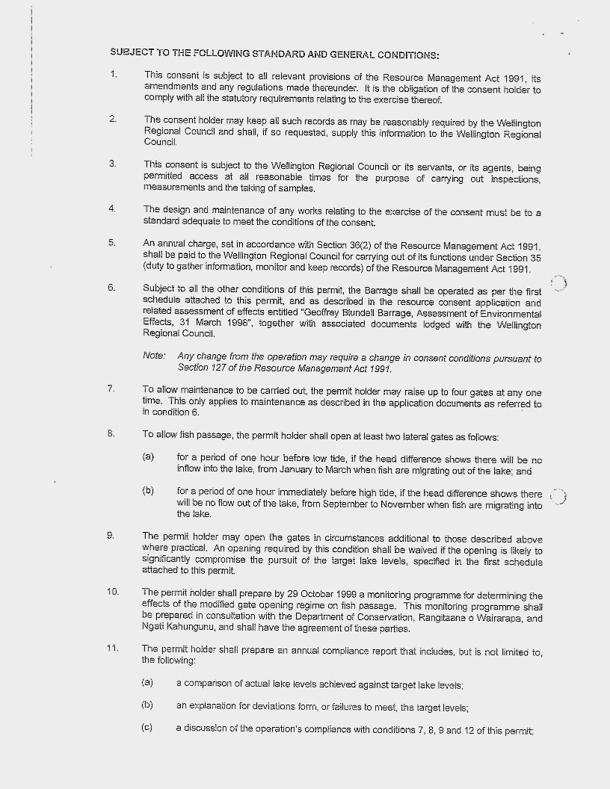
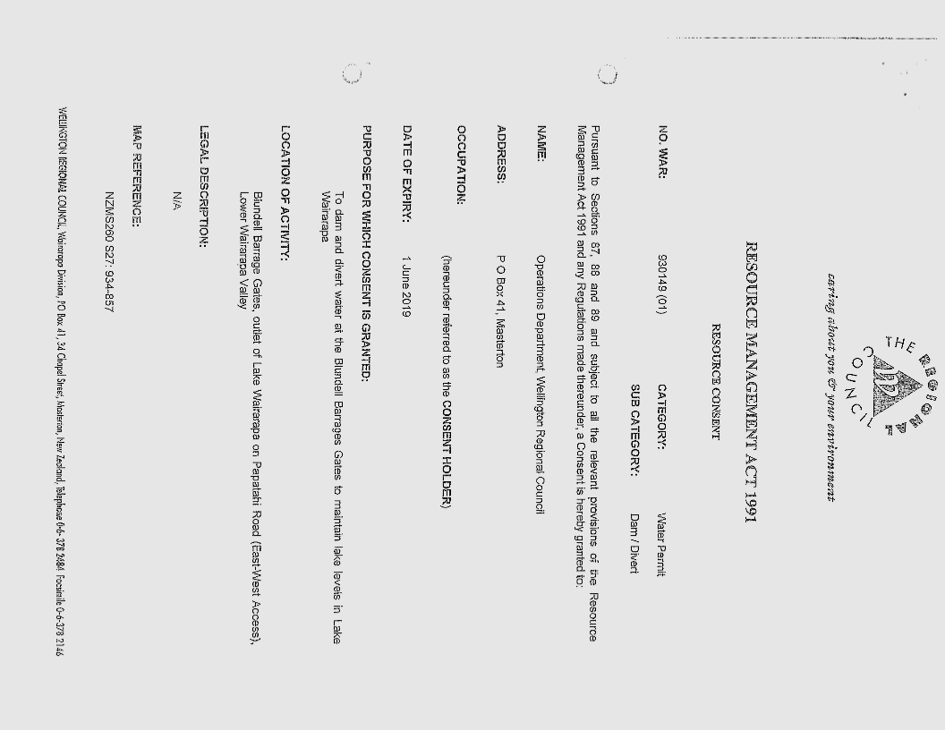
Resource Consent

Slide 8
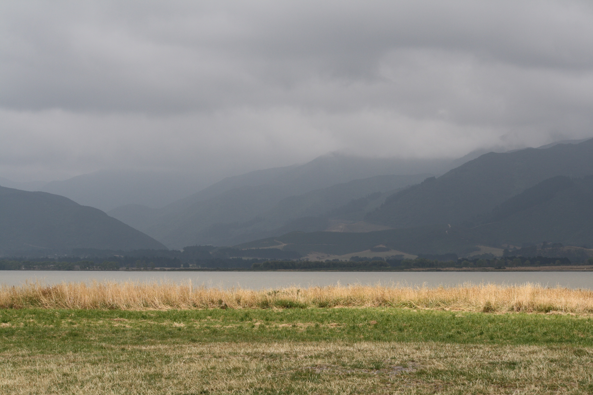
Our Project

Slide 9
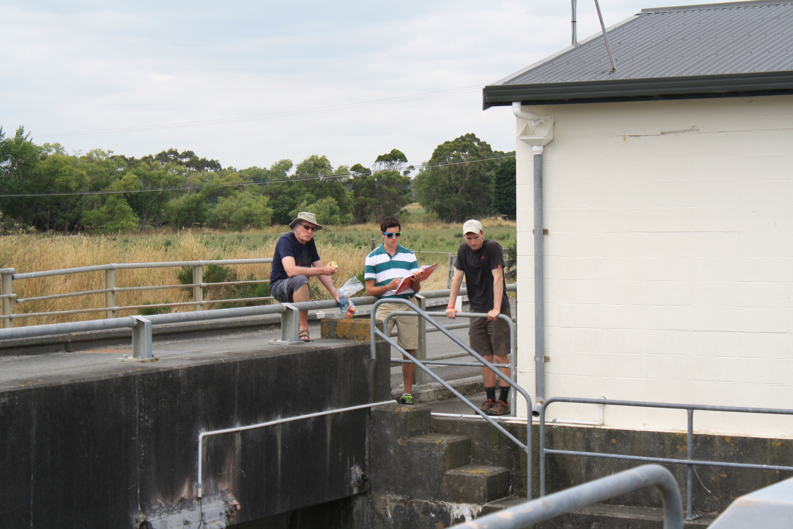
Mission Statement
This project’s focus is to detail the points of view of each stakeholder and build consensus within the Wairarapa Moana community regarding the management of Lake Wairarapa.

Slide 11
Objectives
To observe and gain understanding of the current
political, ecological, economic, and cultural situation in Wairarapa Moana
1
To identify the perspectives and needs of each stakeholder
group regarding the management of Lake Wairarapa
2
To determine common interests, concerns and major
differences by highlighting recurring themes regarding
the Blundell Barrage Gates
3

Slide 12
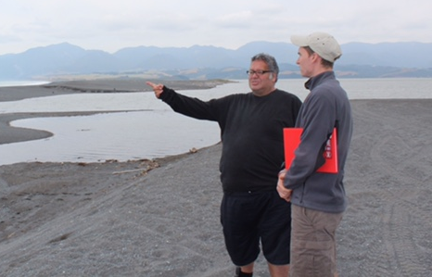
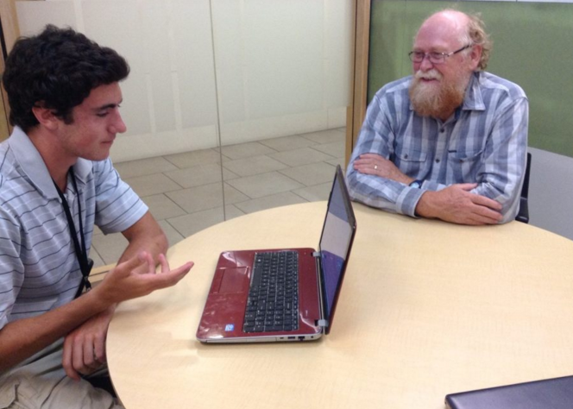
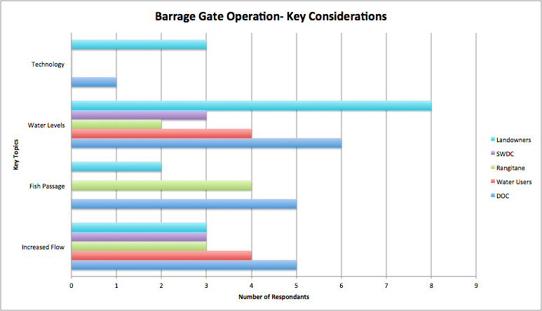
Methods
Participant Observation
Stakeholder Interviews
Coding Transcriptions

Slide 13
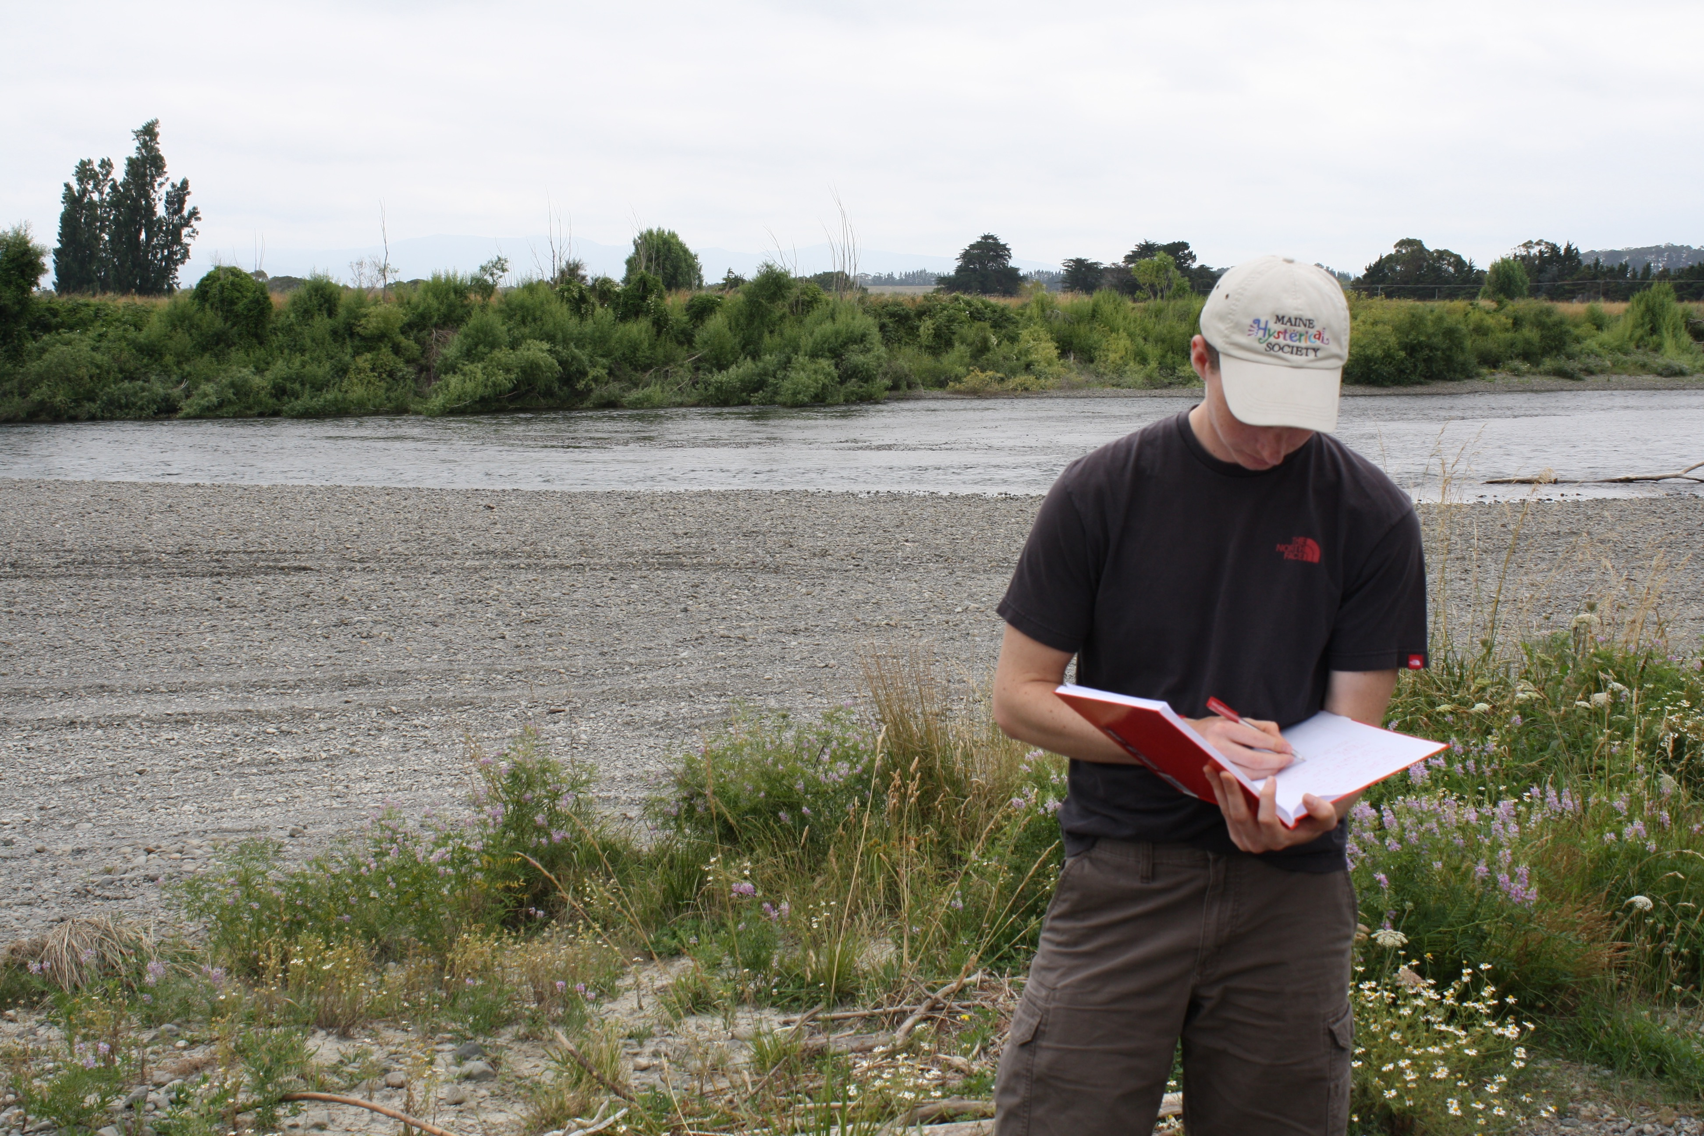
Participant Observation
Political
Wairarapa Moana Coordinating Committee
Ecological
Tour of Wairarapa Moana
Economic
Interview of David Boone
Cultural
Kohunui Marae
Notes:
The Region has Differing Opinions
Communication Issues
Productive Land
Benefit of Flood Protection
Poor Fish Passage
Degraded Wetlands
Disconnections
Progress with the Treaty Settlement

Slide 14
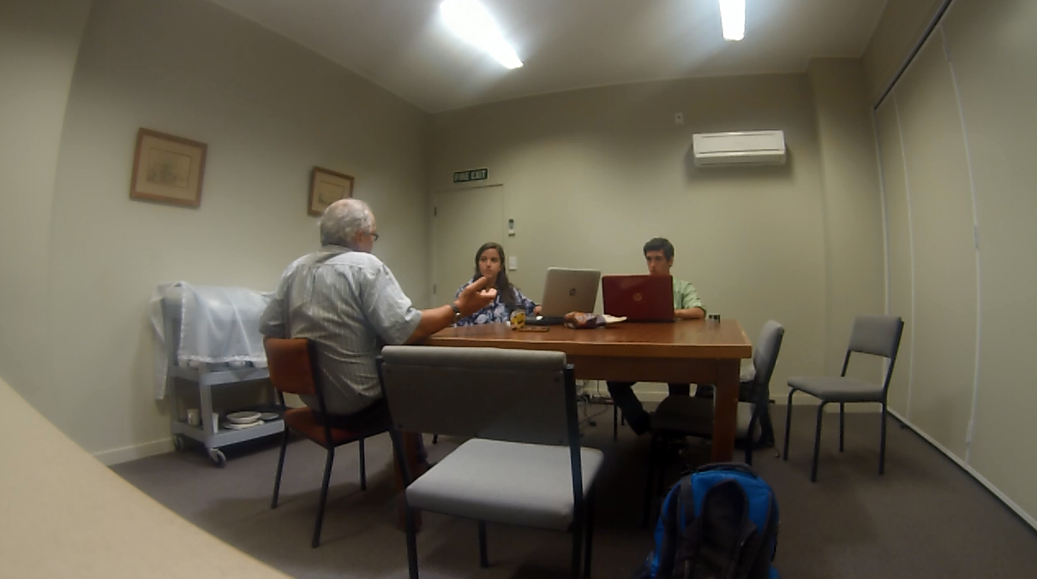
Interview Protocol
Interviewee
Interviewer
Note Taker
Recording Device
Biscuits

Slide 15
Our Results

Slide 16
Landowners
Primary Concern
Secondary Needs
Flood Protection
Improved Community Relations
Informed Management
Improved Flow Throughout System

Slide 17
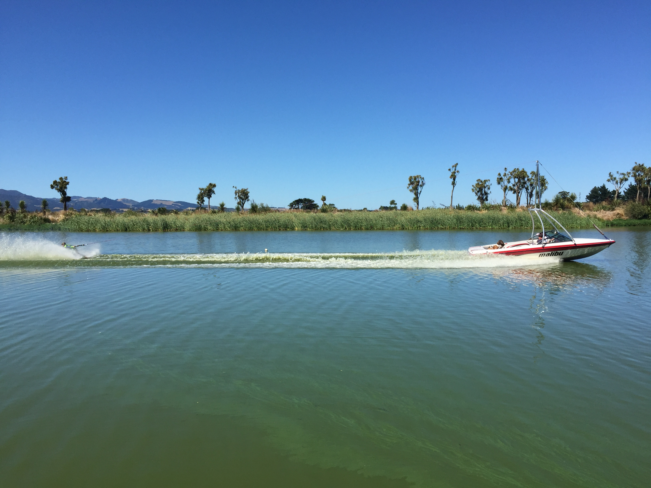
Recreational Water Users
Primary Concern
Secondary Needs
Maintain Cutoff Water Levels
Better Water Quality
Exclusive Use of Cutoff

Slide 18
Rangitane o Wairarapa
Primary Concern
Secondary Needs
Natural Flow
Rubbish Cleanup
Improved Fish Passage
Better Water Quality
Co-Management

Slide 19
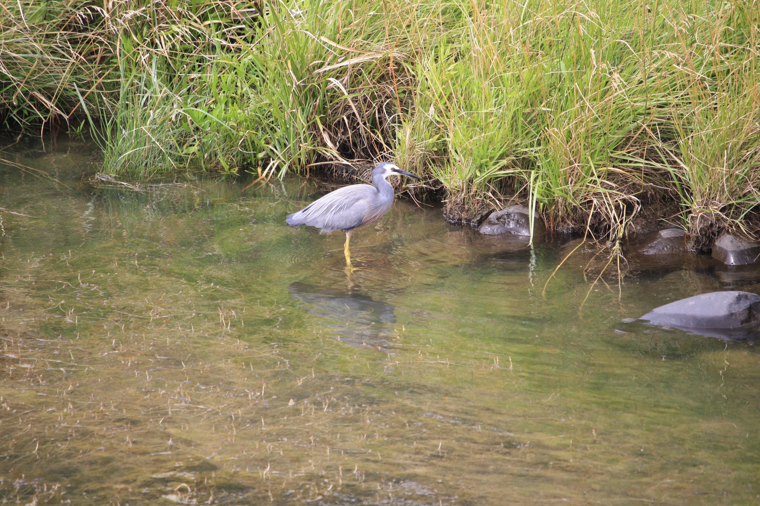
Department of Conservation
Primary Concern
Secondary Needs
Protecting Native Wildlife
Improved Fish Passage
More Scientific Research

Slide 20
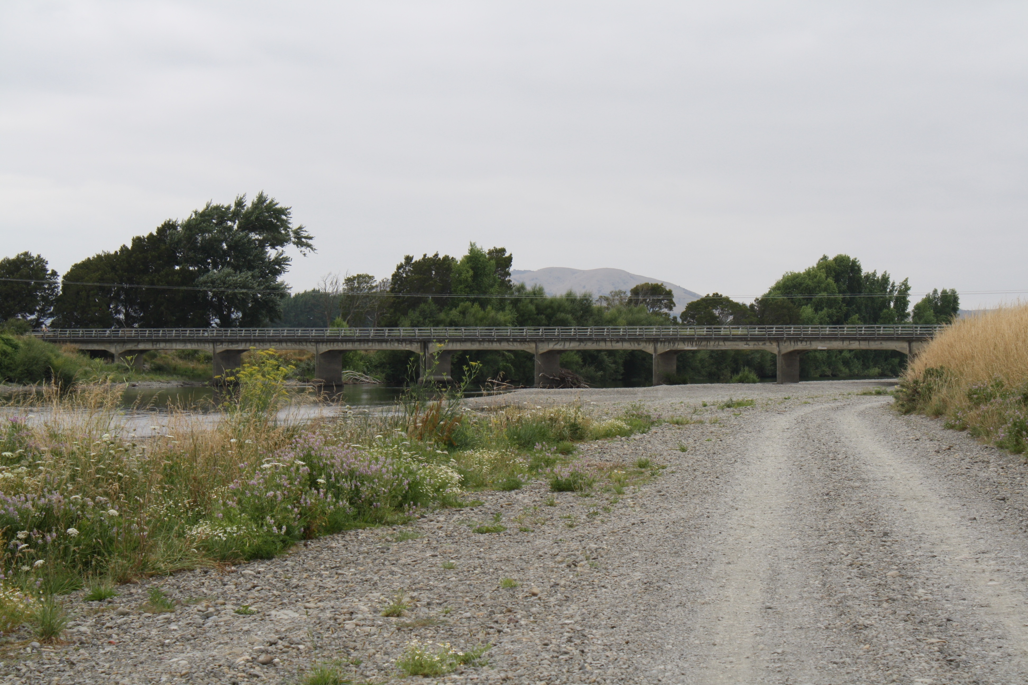
South Wairarapa District Council
Primary Concern
Secondary Needs
Tourist Appeal
Accessibility of Roads
Environmental Preservation
Protection of the Regional Economy

Slide 21
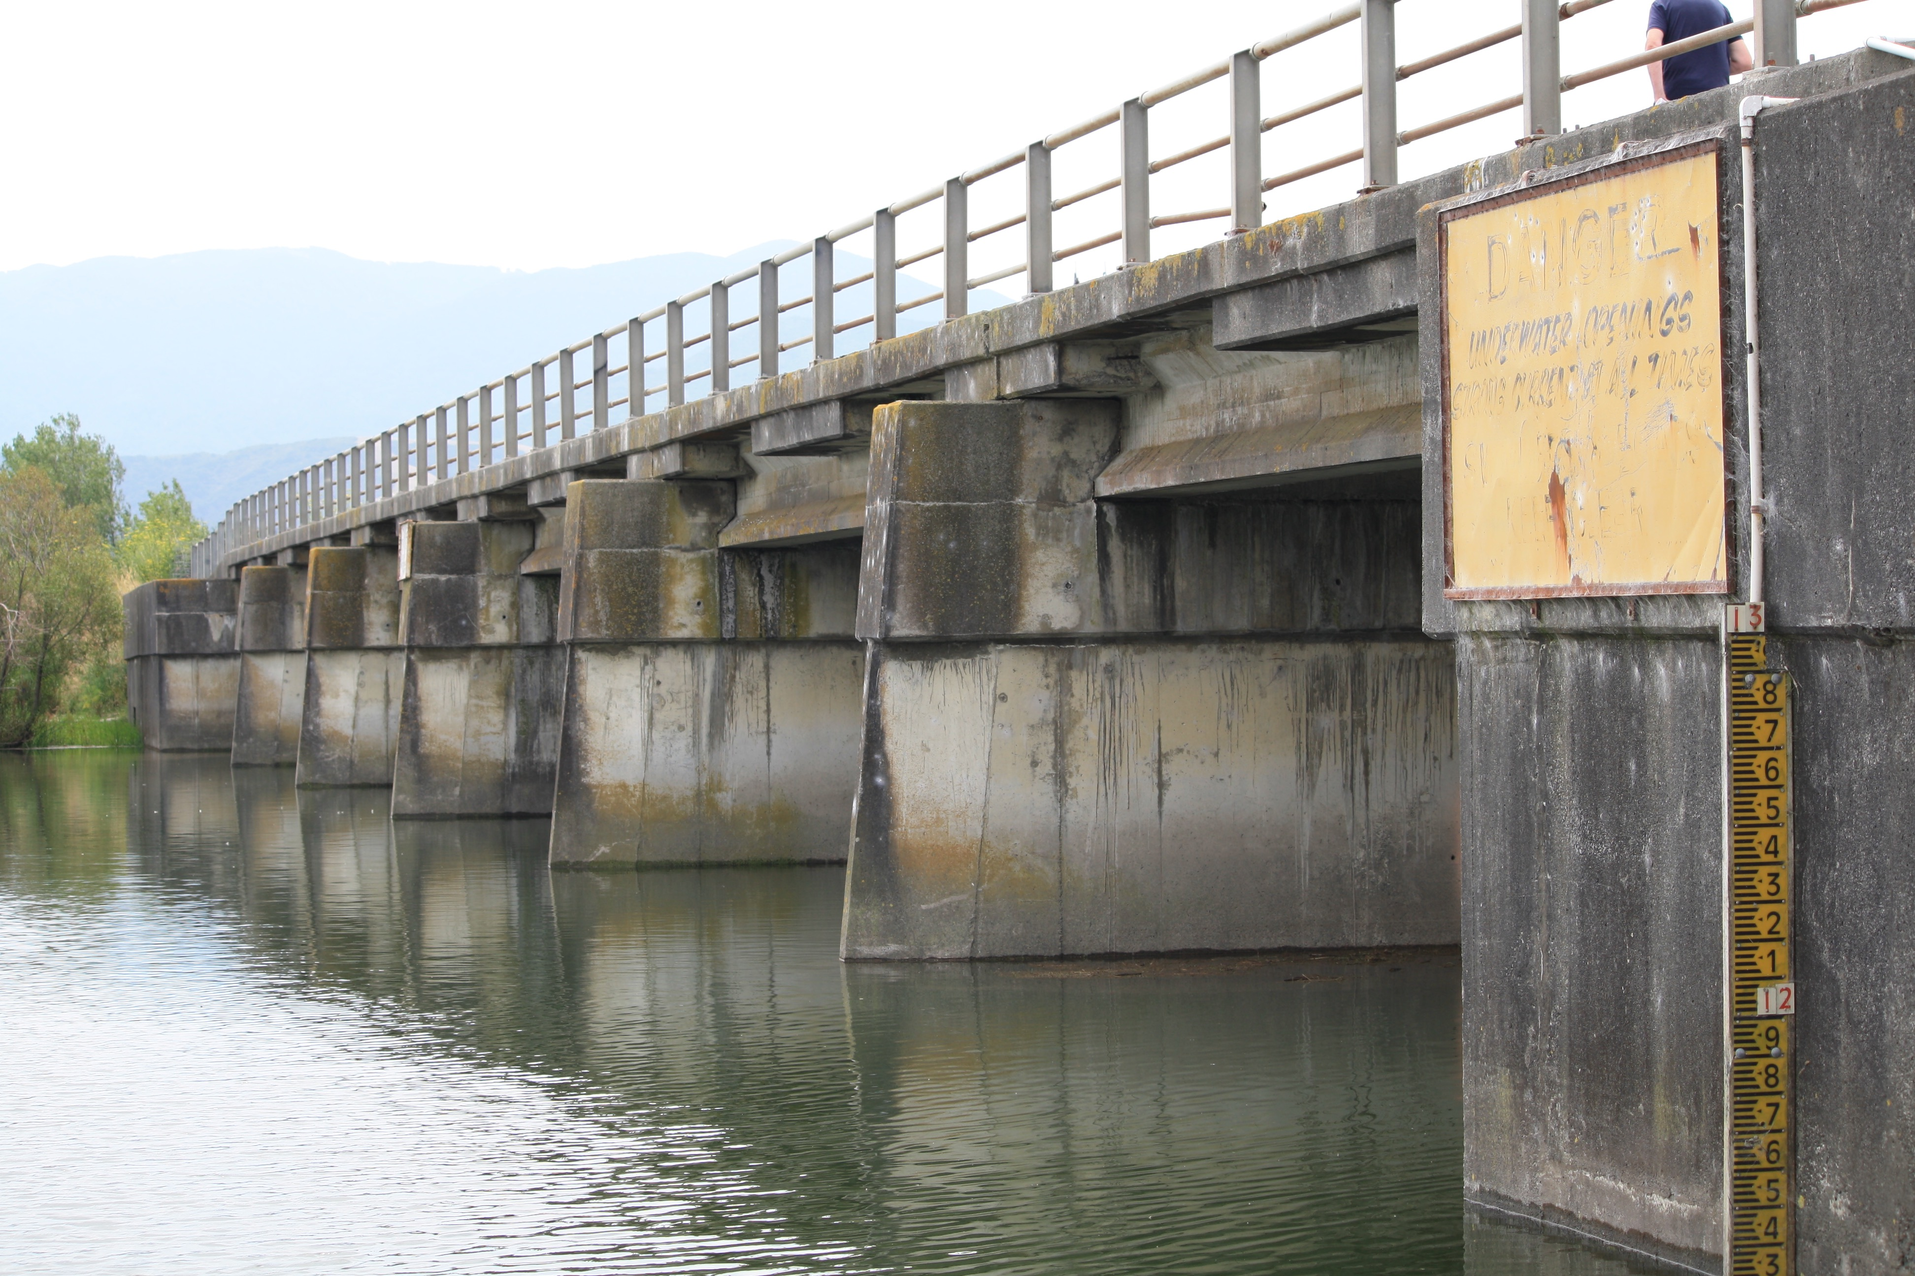
Flood Management
n=29

Slide 22
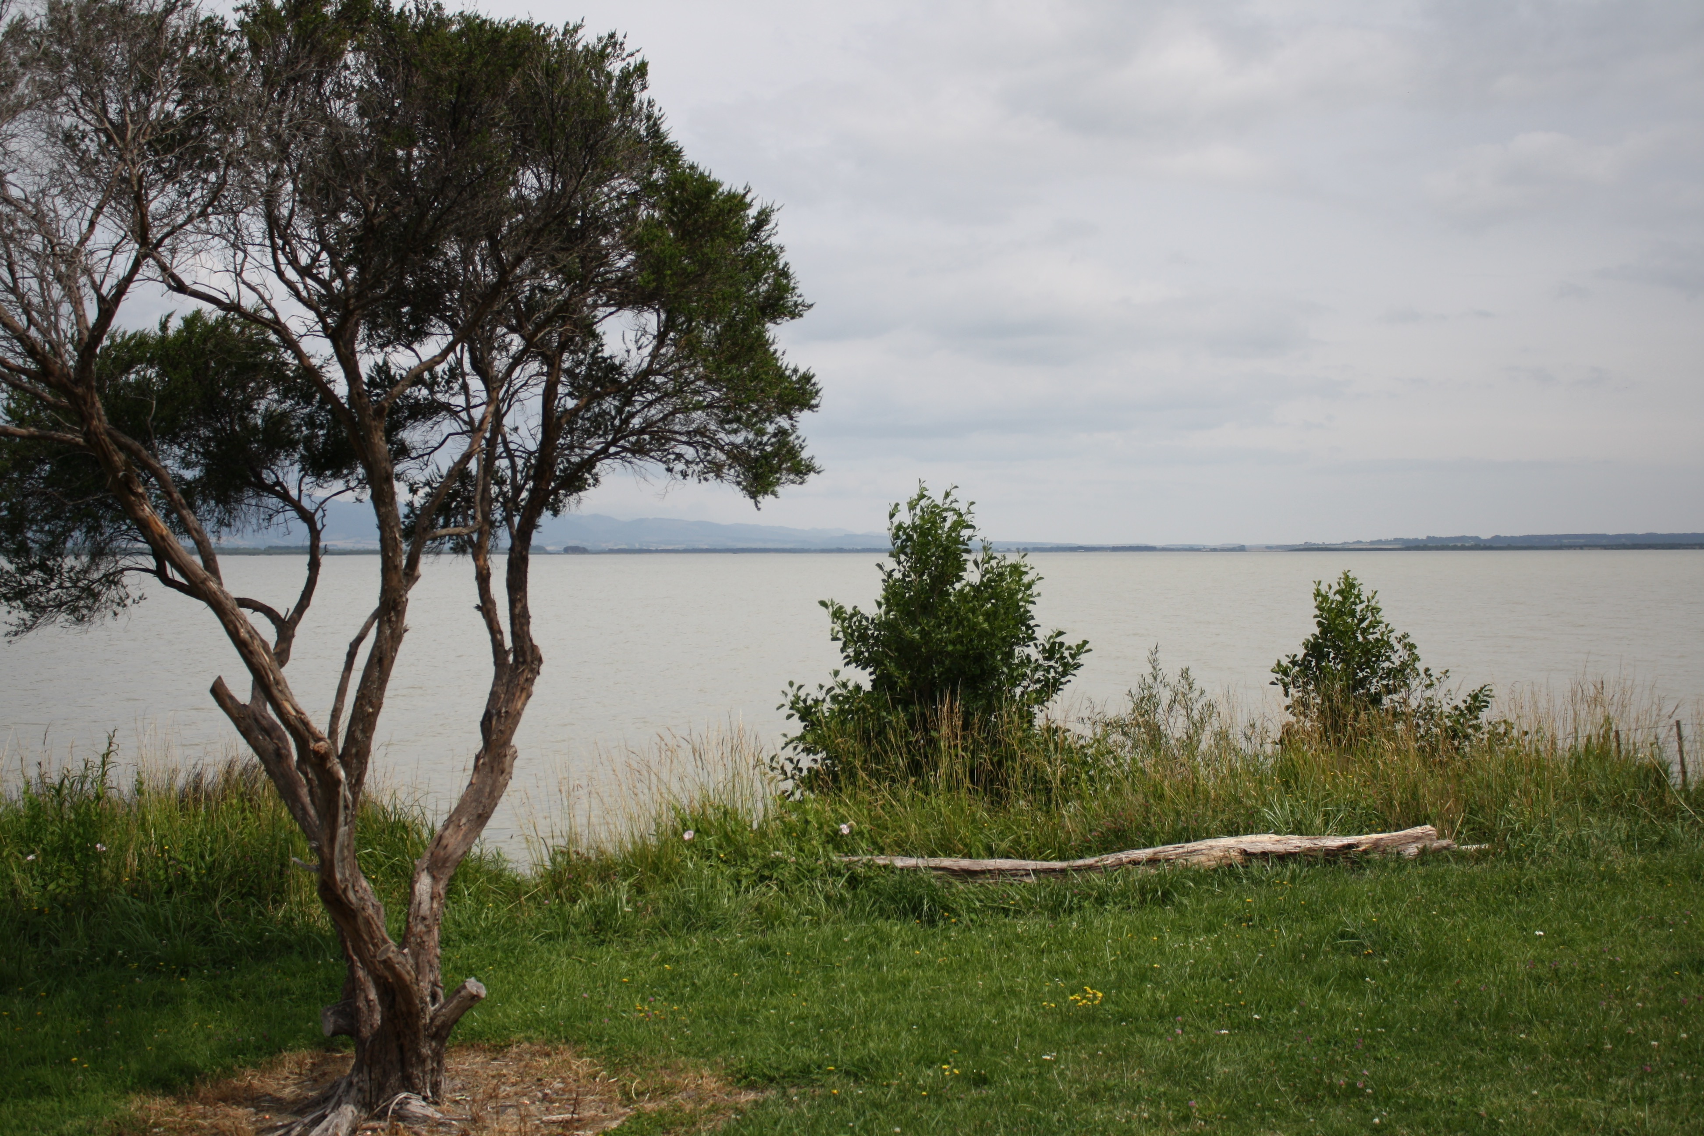
Management Suggestions
n=29

Slide 23
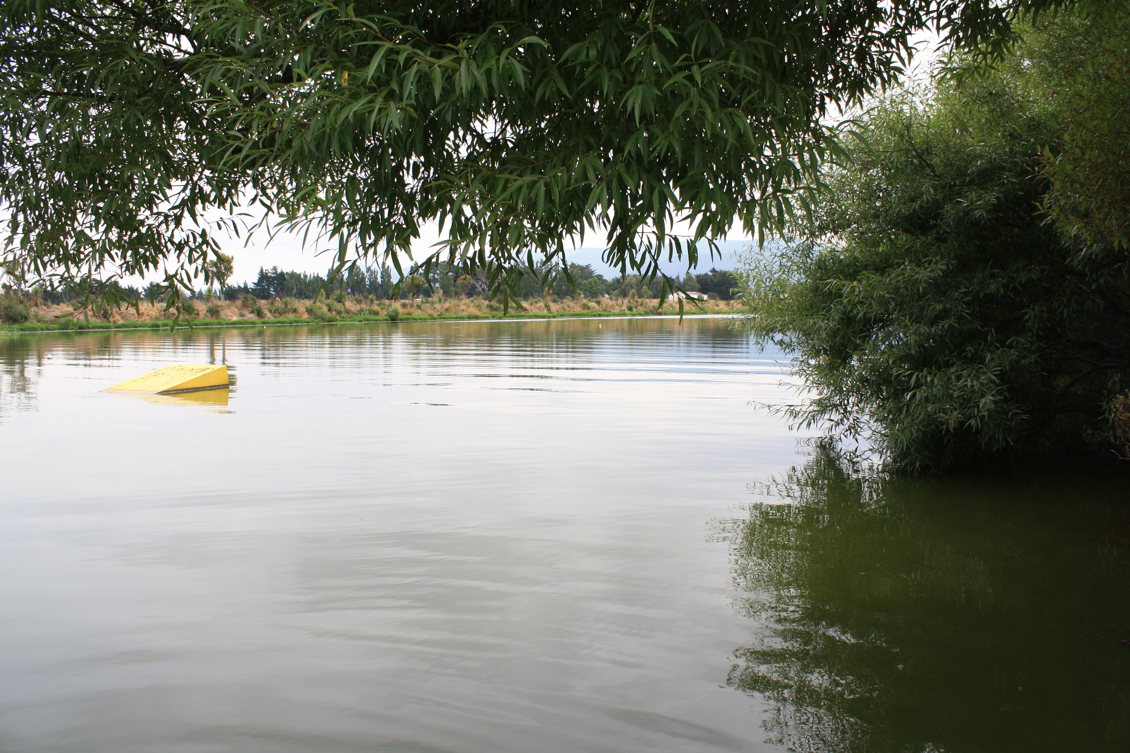
Perception of Water Quality
n=29

Slide 24
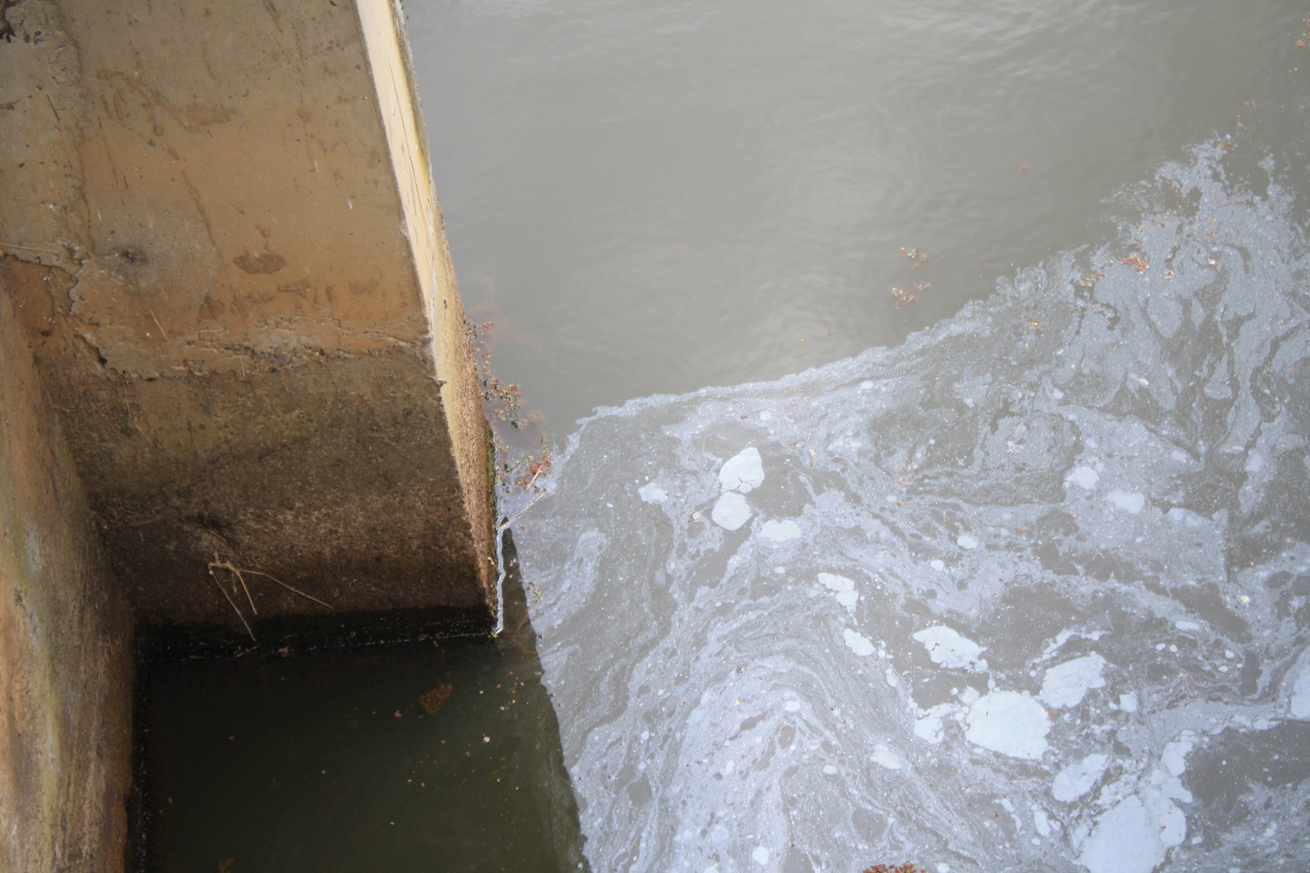
Water Quality Factors
DOC
Water Users
Rangitane
Landowners
SWDC
Farming Practices* |  |  |  | Farming Practices |  |  |  | Farming Practices*
Reduced Flow |  | Reduced Flow* |  | Reduced Flow*
 |  |  |  | Wastewater |  | Wastewater*
 |  |  |  | Muddy/ Shallow Lake |  | Muddy/ Shallow Lake
n=29

Slide 25
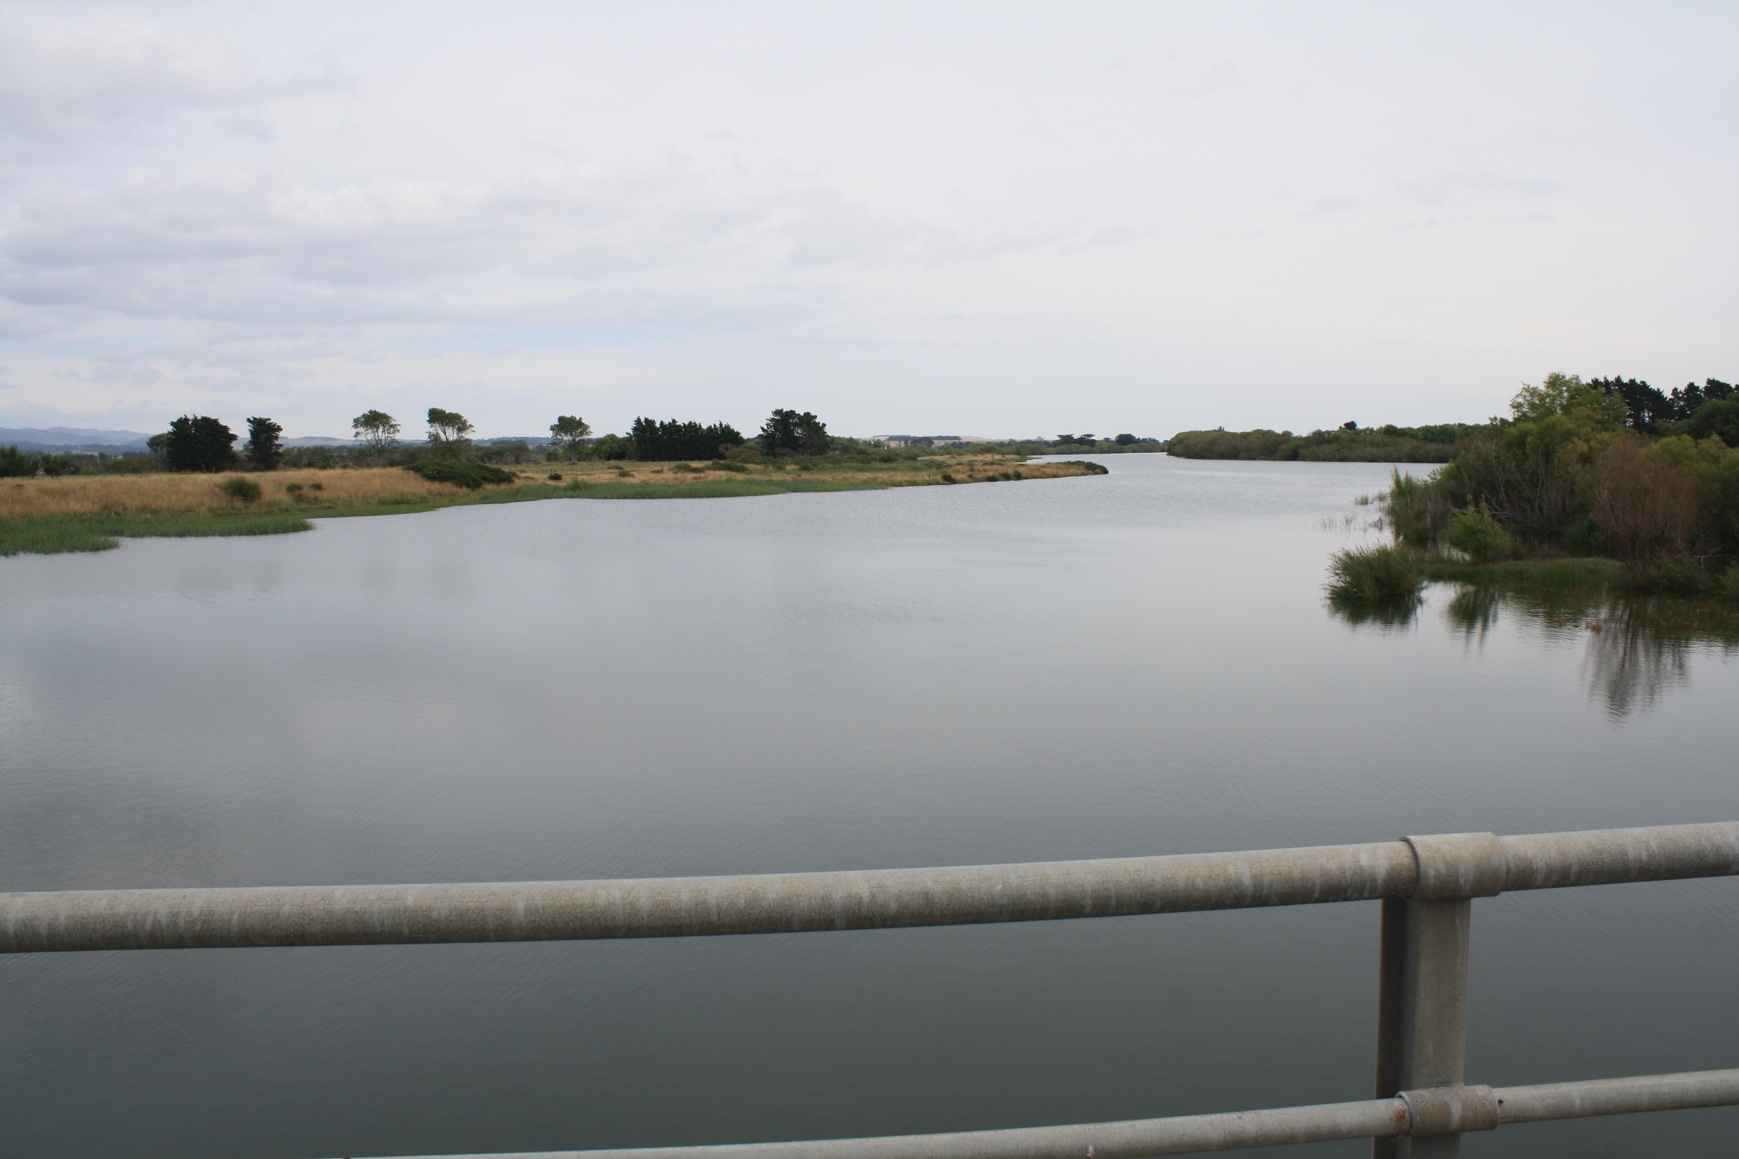
Considerations for Future Operation
n=29

Slide 26
Priorities When Determining Water Levels
n=29

Slide 27
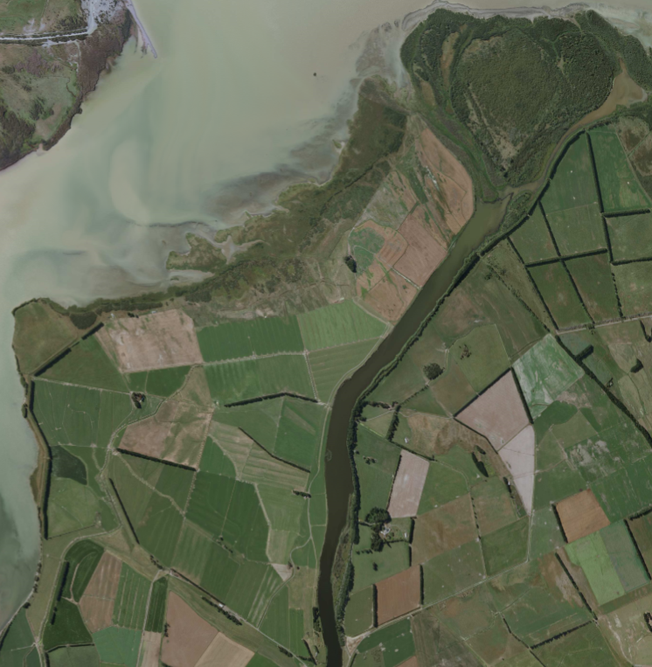
Current Cutoff Conflict
Barefoot Waterskiers
Need High Water Levels
Farmers
Need Clean Water
Barrier keeps cutoff levels high
Barrier prevents flushing
Cutoff
Lake Wairarapa

Slide 28
Areas for Improvement
Communication
Within Stakeholders
From the GWRC
Collaboration
Maori Consideration
Local Organizations
Education
More Research
Within the Community

Slide 29
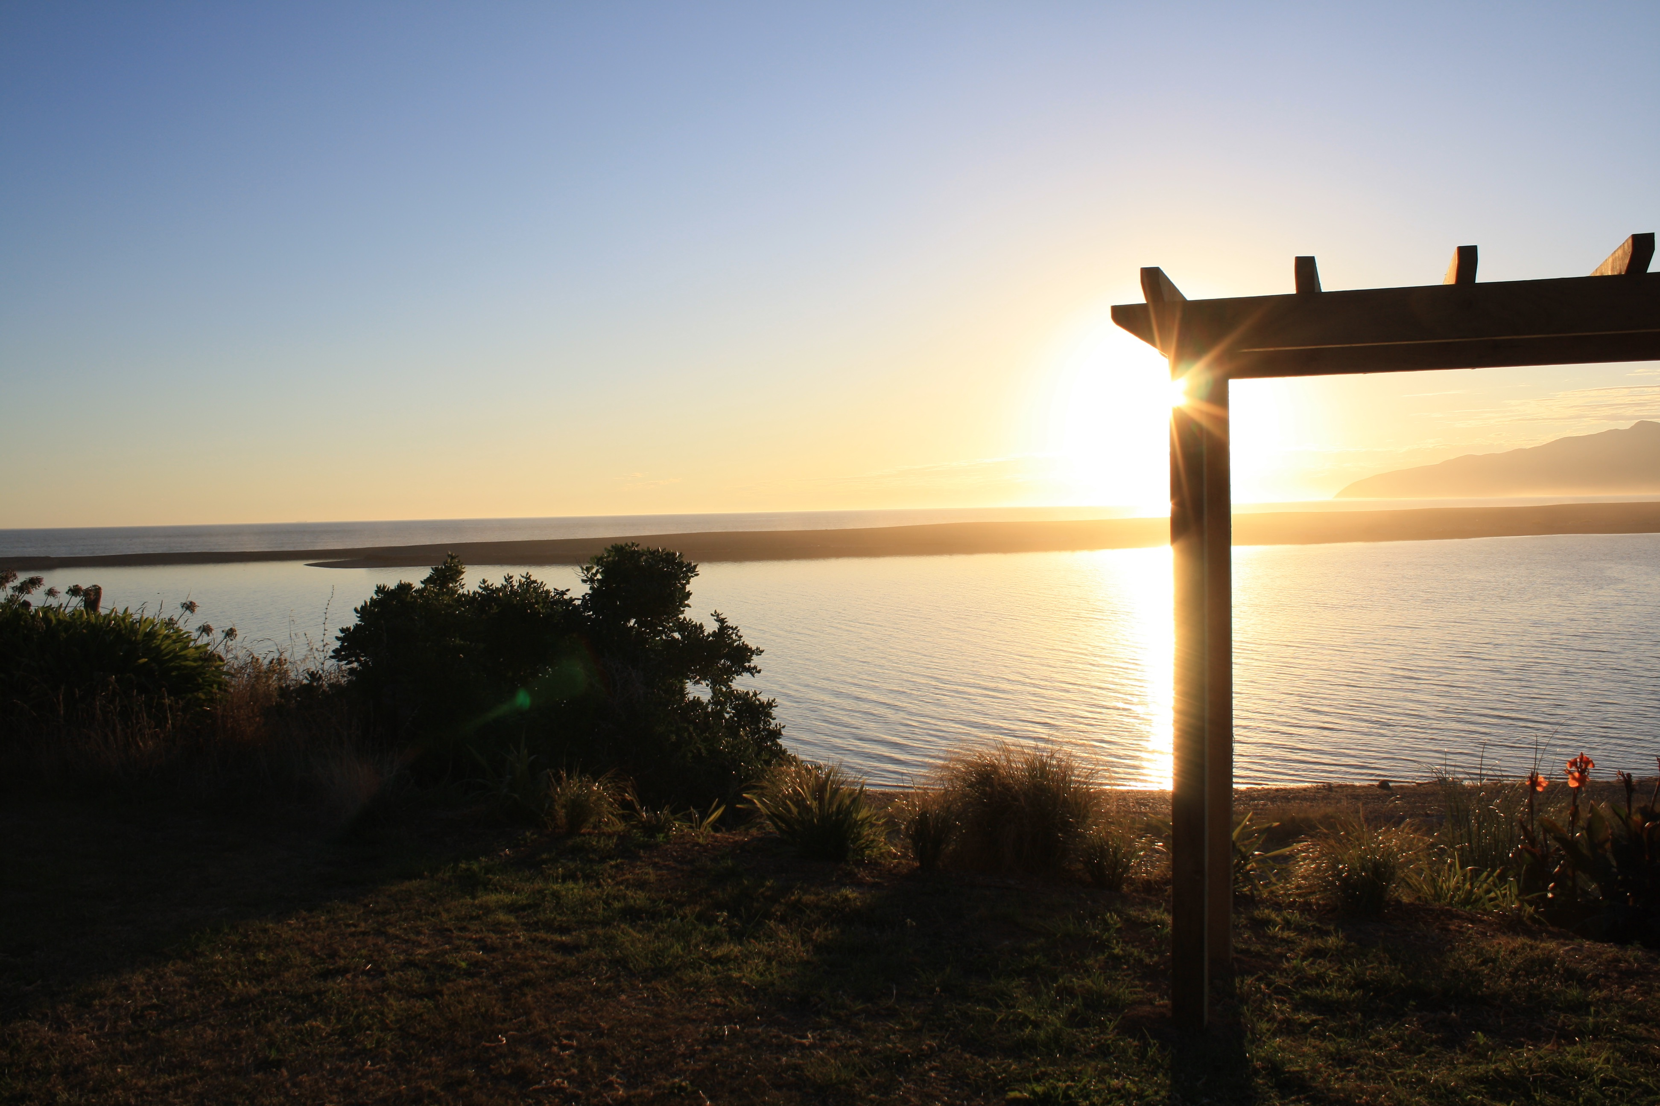
“It’s a big water store in times of flood so it’s got its role as part of the lower valley and central valley’s flood protection systems… It’s got its role as a recreational asset, fishing, shooting, birdwatching. It’s got its role as a natural asset. Different people in the community will latch onto one of those. But when you talk to them, you’ll find that they recognize all of them. For Wairarapa people, Wairarapa Moana really is the heart of the whole place and if you identify with Wairarapa, one of the first things you’ll identify with is that body of water.”
~Tony Silbery

Slide 30
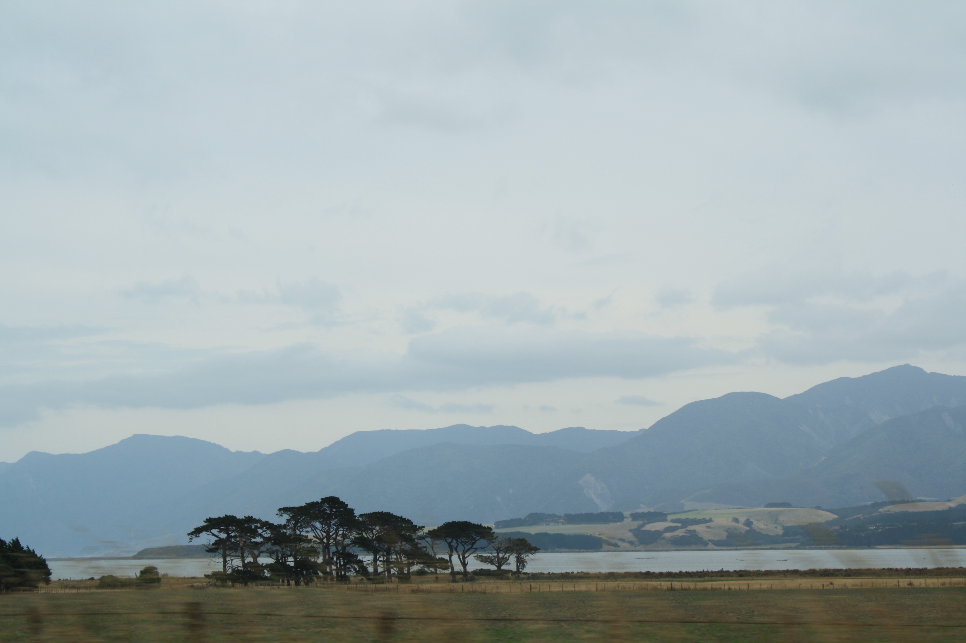
Acknowledgements
Ian Gunn & Jean Gunn- Sponsor
Professor Kinicki- Advisor
Professor Eddy- Advisor
Professor McCauley- Research Advisor
David Boone- Section Leader of the Department of Flood Protection, GWRC
Sean Andrewartha- Resource Consent
Ra Smith- GWRC, Ngati Kahungunu ki Wairarapa
Laura Hanlan- Librarian
Interviewees: Paora Amundsen, Ian Bill, Murray Buchanan, Anna Burrows, Ted Colton, Neville Davies, Fraser Donald, Mark Ellingham, Garry Foster, Ann Gray, Noel Gray, Ed Handyside, Joe Hansen, Russell Hooper, Brian Jephson, Daniel Kawana, Mike Kawana, Russell Kawana, Bevan Kelly, Chris Lester, Ross Linten, Robin McConachy, Mike McGreary, Colin Olds, Joseph Potangaroa, Horipo Rimene, Hugh Robertson, Tony Silbery, and Adrienne Staples

Slide 31
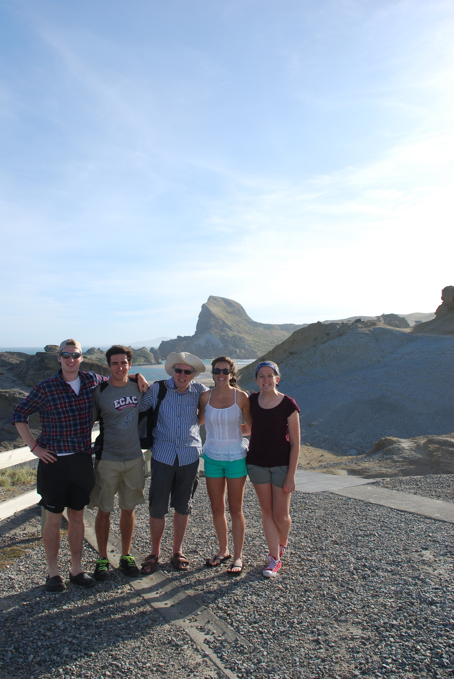
Questions?

Slide 35
Rangitane o Wairarapa
“…from a cultural perspective anything that is put in place to hinder those veins, to stop the lifeblood running through them, affects us culturally.
“We get a memorandum partnership and a memorandum of understanding… Memorandum partnership, there’s only one partner and that’s the council so where’s the partnership?
“Fish don’t time migratory patterns according to people.”

Slide 36
South Wairarapa District Council
“If we can create an environment down there where we have tourists come into our area specifically to look at bird life or wetlands or aquatic species, then that’s a real good outcome for this district.”
“The economics is a major part of it.”
“Roadways is probably another issue. We’ve got a lot of roads that go under water all the time.”
“Just purely the environmental aspect that it is.”

Slide 37
Landowners
“This whole area would be unfarmable without it pretty much so it’s huge, huge benefit to this area financially, yeah. It is very important for us that it’s maintained.”
“Politically the issues are going to come from you’ve got the people that are farming the land and making the food for the world, a small group, and the people that are having the bigger say in the cities that don’t always realize what is required to actually do what you have to do to get the food.”

Slide 38
Landowners
“Definitely if we can get a culvert, it could potentially be controlled but a fish passage under the road into the backwater of the lake would just increase the water quality of the backwater.”
“I guess, it’s modeling, it’s a thing of technology. The more we understood that with the gates there, the more we could model and control things.”

Slide 39
Department of Conservation
“I think there’s problems when the whitebait migrate they tend to follow the banks and they tend to follow at a certain height below the surface and of course the water levels are always fluctuating so you are depending on one little slot, one little gate in order to allow fish passage. That’s pretty hit and miss.”
“more resources put into it and understanding how the natural processes work and what part the barrage gates can play in improving those natural processes to be operated in a sophisticated way, raise and lower the gates in a sophisticated way as according to nature's processes and what nature requires. Also, acknowledging that they are there to protect farmland and it has got to achieve that as well..”

Slide 40
Recreational Water Users
“If our level was dictated completely by the lake and the barrage gates, and it went down a lot lower than what it has done in the past, that’s a problem for us.”
“finding an optimal amount of water flow that achieves the best we can in terms of cleaning out the pollution and nutrients but gives certainty to the other users”

Slide 41
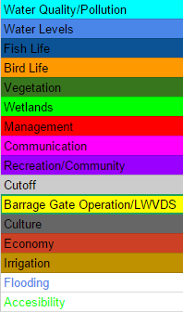
Coding Categories
Developed Categories as we Coded
Common discussion topics
Tried to encompass a number of aspects of the problem
Coding Protocol
One person codes
Another person goes over the code
Original person sorts the coded interview
Notes:
As we begin to analyze our data, we will do two types of analysis.
Quantitative analysis involves coding the interviews by reading through the data to understand exactly what the key issues are commenting on the topic of each statement as you go. Once you find the key issues, these can be defined into coding categories. Once you have a series of categories, its important to also categorize the responses to the questions and sort them that way.
Qualitative analysis is basically going through each interview and understanding the main ideas of what each interviewee is trying to say. Many times each individual will have unique ideas that can’t be accurately quantitatively analyzed that can still be important. Anything deemed important or unique should be considered. This also helps point out any trends not accurately captured by the quantitative analysis.

Slide 42
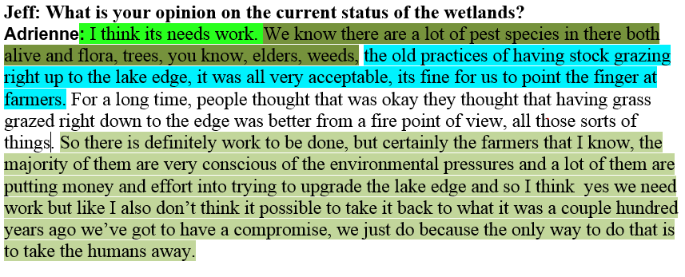
Coding Examples
Wetlands
Vegetation
Water Quality
1.
Ecology
Recreation
2.
Fish
Notes:
To start coding we need to go through the interviews and start commenting on the responses based on their response type. We can then go back through and identify the most common responses and the main issues.
After determining the issues we can use the open coding to examine the statements which are able to build an idea of how each respondent feels regarding the issue.

Slide 43
Sorting Data
Summary of responses with each person based on topic
Used to categorize responses
Analysis based on this
Notes:
Once we understand how each person feels on each specific issue, we can categorize them based on their responses. The type of graph shown is an example of how we will sort through the responses for each issue. Each issue has responses that can be broken down into different categories and we decided to also note a more specific summary of each response. This way we can note any specific responses as we begin our analysis.

Slide 44
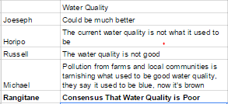
Preliminary Quantitative Analysis
Example
We are still developing our quantitative analysis
Concrete data is important to support any qualitative analysis we make
Notes:
As we analyze the data, we need to consider each issue by stakeholder because we want to consider each stakeholders opinion equally. Its important to note general trends that we hear when talking to a certain issue among a stakeholder and we also need to have the quantative data that can show us the overall outlook of how people feel regarding the issue.

