Slide 1
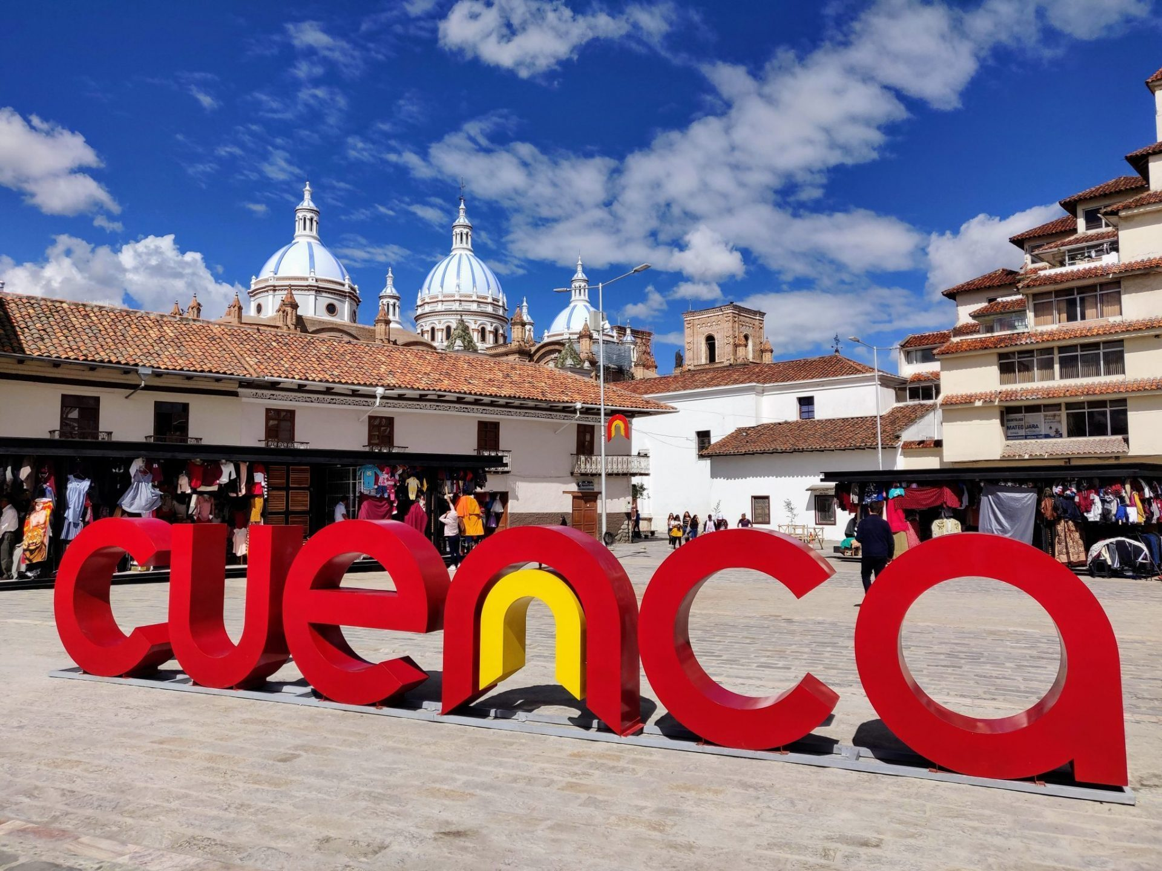
IMPROVING STREET-LEVEL ACCESSIBILITY IN CUENCA, ECUADOR
Sam Curtis, Gachau Kabuga, Cambria Pomeranz, Gio Ramirez, Ilana Whittaker
[1]
Notes:
Ilana

Slide 2
UN’s Accessibility Guidelines
Convention on the Rights of Persons with Disabilities (CRPD)
Article 9- Accessible infrastructure
[2]
Notes:
(Sam)
UN → moral argument that ppl deserve to participate/feel welcome in their communities; CRPD guarantees accessible infrastructure
Ecuador signed the CRPD, so should uphold it

Slide 3
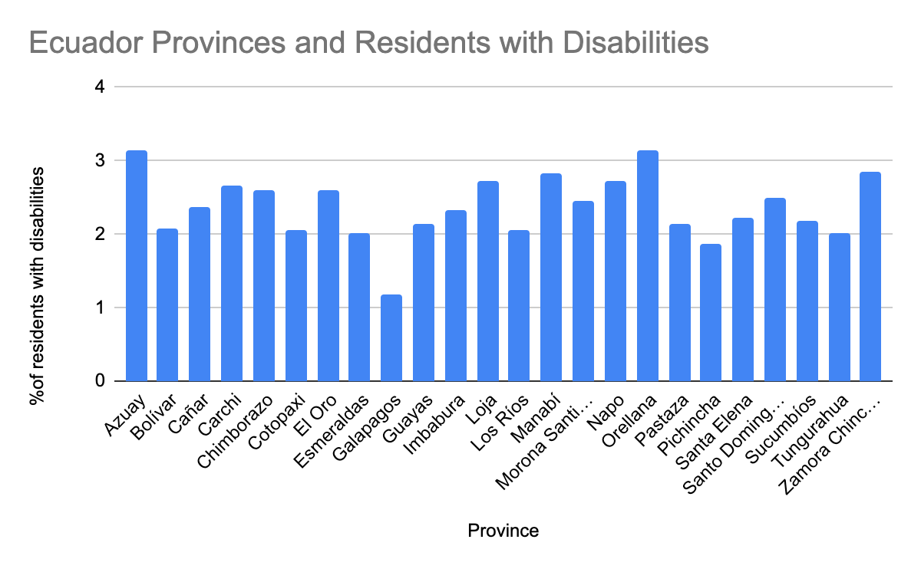
FUTURE
Notes:
(Sam)
Azuay Province, which contains the city of Cuenca, has the highest number of residents with disabilities per capita
Also talk about # of older people**

Slide 4
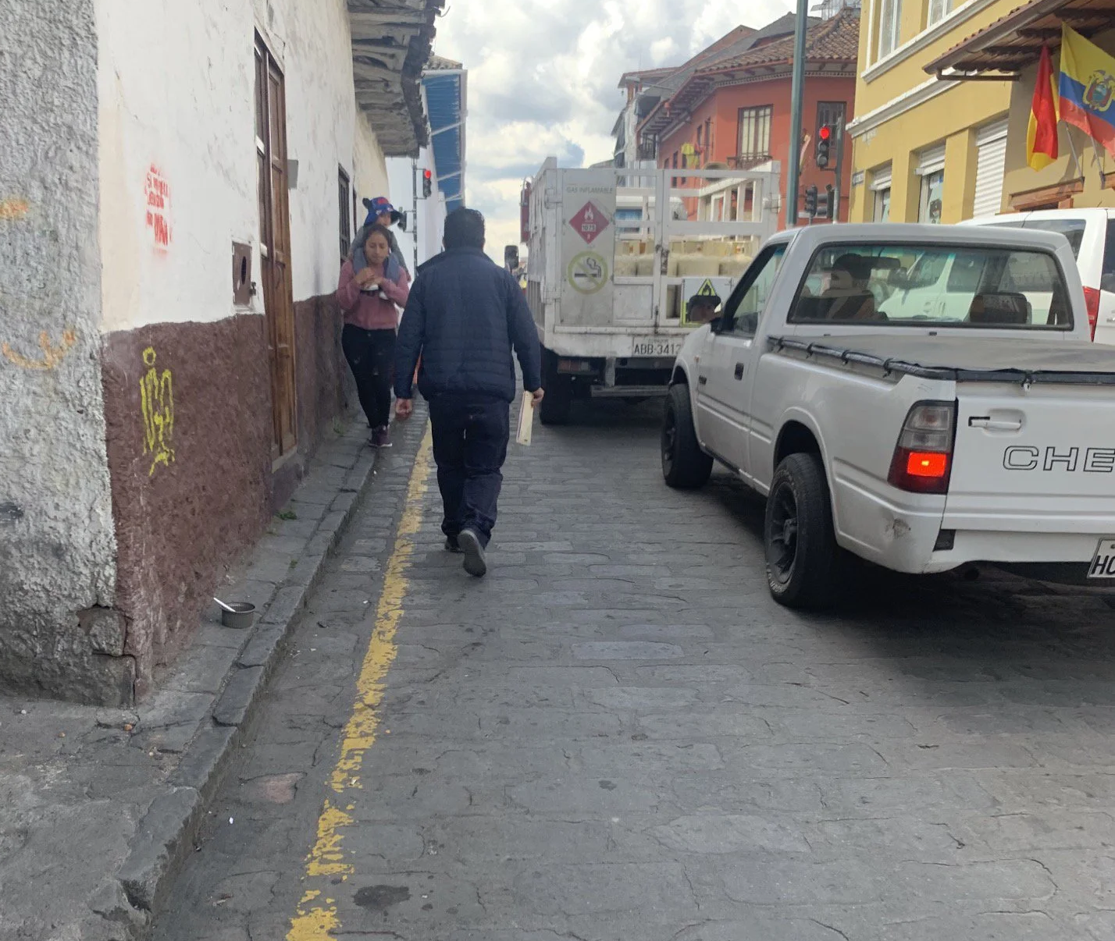
Accessibility Challenges in Cuenca
[3]
[4]
Notes:
(Sam)
Examples of inaccessible infrastructure Idue to traditional architecture/rapid development) = narrow/uneven sidewalks, large potholes or blockages, lack of accommodations for blind/deaf → say these areas are “hotspots”
U of Cuenca study → had people pushing strollers and in wheelchairs test various street segments. In most cases, people were unable to overcome obstacles

Slide 5
Our Sponsor
Empresa Pública de Movilidad, Tránsito y Transporte de Cuenca
Promotes city inclusivity
Organizes license and vehicle registration
Notes:
Introduce Sponsor - Ilana
Small government agency with less than 250 Employees
Similar to a DMV
Accountability reports from every year
Cuenca Public Corporation of Mobility, Traffic, and Transportation

Slide 6
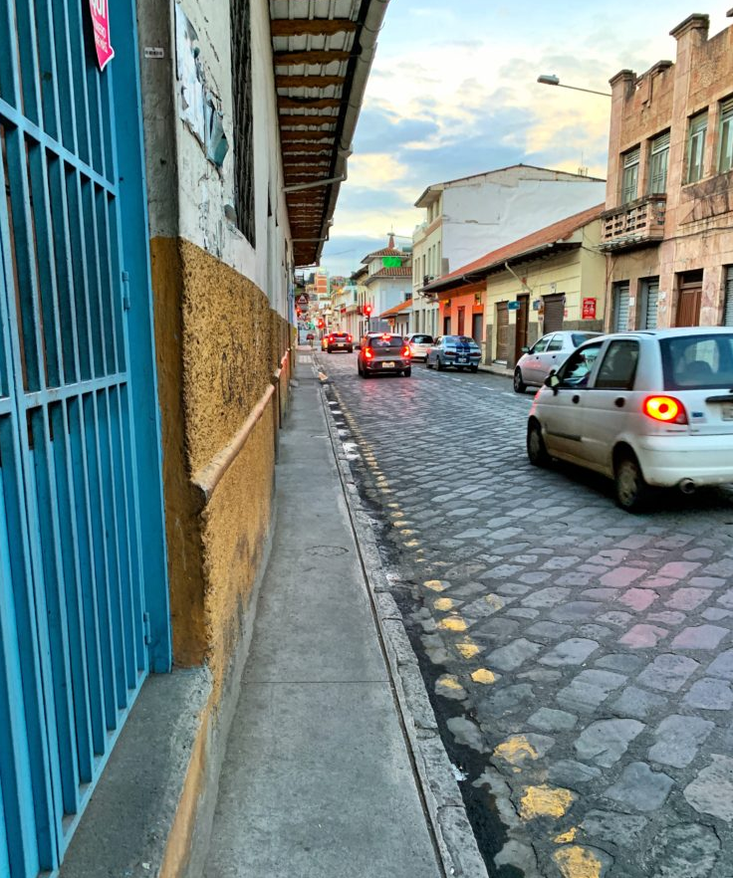
Project Goal
Assist EMOV EP in their efforts to address street-level accessibility in Cuenca by exploring low-cost solutions and assessing their feasibility
[5]
Notes:
cam

Slide 7
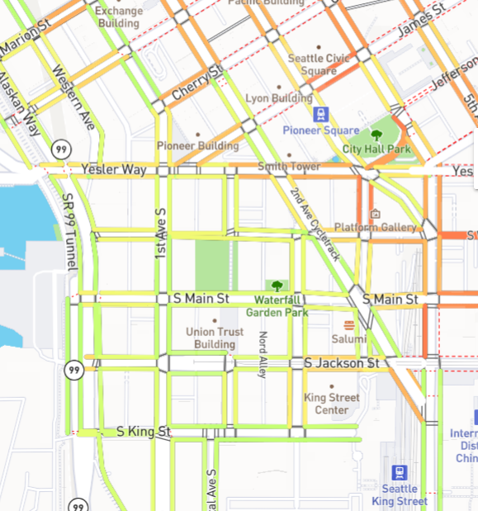
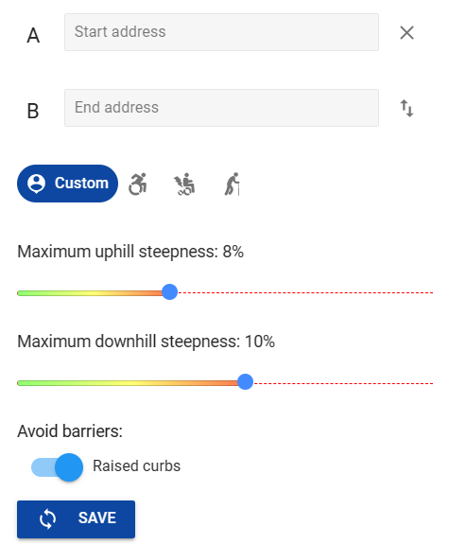
Access Maps
Display accessible and inaccessible areas for people with mobility impairments
Provide safer, more accessible routes
[6]
Notes:
Gio-Talk about how it works as well using crowdsourcing from project sidewalk to pinpoint areas or streets that lack sufficient infrastructure
Explain each picture, the Seattle access map made from university of washington, green represents flat slopes red represents slopes of 10 percent or more, inaccessible for wheelchair users
Wheelmap, app that shows accessible and inaccessible areas, has been implemented in Cuenca but very little compared to europe where it originated
Mention crowd4access in ireland, similar to project sidewalk
AccessMap finds routes that avoid common pitfalls for those with limited mobility | TechCrunch

Slide 8
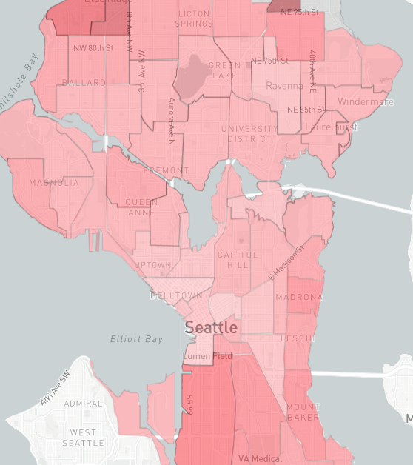
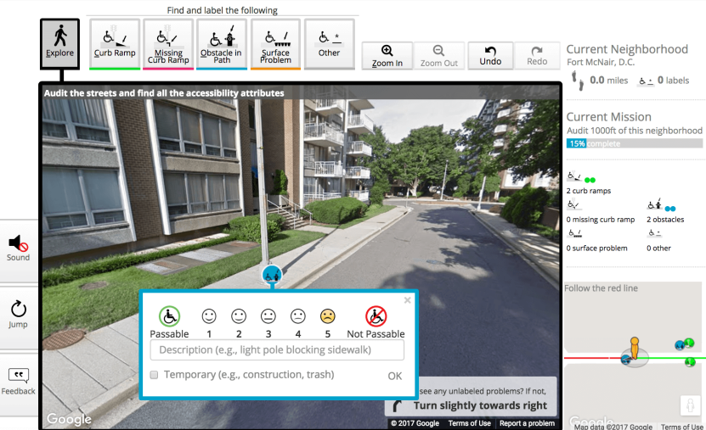
Project Sidewalk
Enables online crowdworkers to label pedestrian-related accessibility problems
Utilizes the data from crowdsourcing to build-accessibility aware mapping tools
[8]
[7]
Notes:
Talk about how it’s based off of crowdsourcing
Last thing to say: based on our research, other solutions are major, expensive infrastructure changes. Access mapping seems like the most feasible solution, the objectives will tell us for with more clarity if this solution is realistic

Slide 9
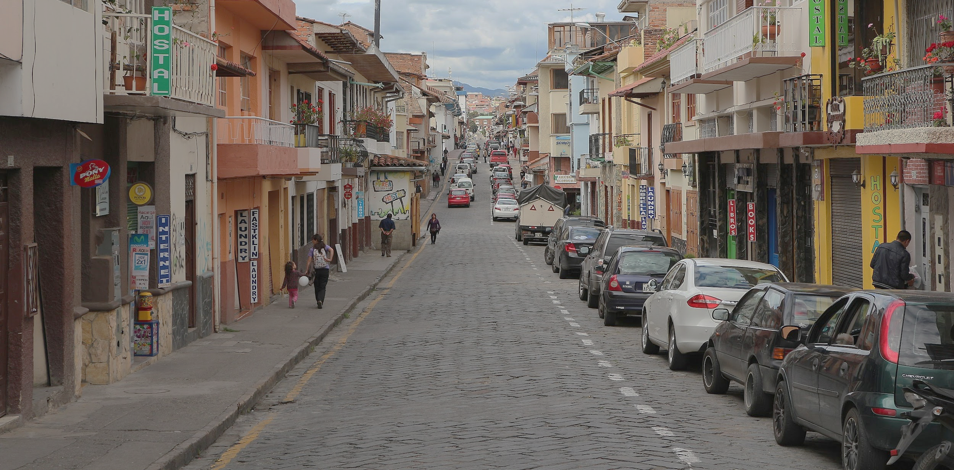
Objectives
Identify, categorize, and map hotspots of inaccessibility
Understand how the community interacts with inaccessible infrastructure
Determine the feasibility of implementing access mapping in Cuenca
[9]
Notes:
ilana

Slide 10
Identify, categorize, and map hotspots of inaccessibility
1
Archival analysis of CONADIS data
Map the hotspots through GIS
Categories:
too narrow
uneven surfaces
blocked
Non-existent
no auditory cues
no truncated domes
no data
Visual representation of all hotspots for which there is data
[10]
Notes:
https://www.gannett-cdn.com/-mm-/50878fe39e5edbc73a21ad9293997cda7ae894bc/c=0-470-7078-4469/local/-/media/2016/01/28/USATODAY/USATODAY/635895779112473589-Cuenca-4.jpg?width=3200&height=1808&fit=crop&format=pjpg&auto=webp
cam

Slide 11
2
Understand how the community interacts with inaccessible infrastructure
Systematic observation
Find similarities in how the community reacts to inaccessible infrastructure
[11]
Notes:
https://www.liveandinvestoverseas.com/wp-content/uploads/2020/02/cuenca-ecuador.jpg
-is a method of close examination of some phenomena to obtain reliable unbiased data from the observe
-unobtrusive observations of hotspots (“fly on the wall” technique)
-observing human-street interactions during rush hour
- stratified random sampling to select 2 hotspots from each category, a total of 14 observations
-data will be recorded on a the same worksheet at all the hotspots to keep our data consistent and unbiased as possible
-population will be categorized by mobility impairment while notes will be taken on their responses to the surrounding environment
-notes will also be taken on some of the surroundings (drivers, traffic/pedestrian signs, and surrounding buildings)
-once observations are done, all the wkshts will be compared to analyze the frequency of behaviors observed and characteristics of each hotspot (finding the correlation)

Slide 12
Experts, government officials
Community members
3
Determine the feasibility of implementing access mapping in Cuenca
Semi-structured Interviews
Learn obstacles to implementing access mapping
[12]
Notes:
(Gachau)
https://d2v9ipibika81v.cloudfront.net/uploads/sites/38/ecu_cuenca_shutterstock_1163090866-1200x800-c-center-1140x684.jpg
-semi structured interviews with 2 groups (6 from each groups, total of 12) will do less if we reach data saturation
-will use expert and snowball sampling to obtain the participants for the first set of interviews
-for the second set of interviews, will use a combo of convenience and snowball sampling to obtain community member participants
-ask experts about their experiences of working in the field, past accessibility initiatives, and if they think access mapping is feasible for Cuenca
-ask community members about experiences they’ve had with inaccessible infrastructure and whether or not they would use an access mapping app on their phone
-Coding and content analysis from interview transcripts to find common themes in people’s responses in order to learn obstacles to implementing access mapping

Slide 13
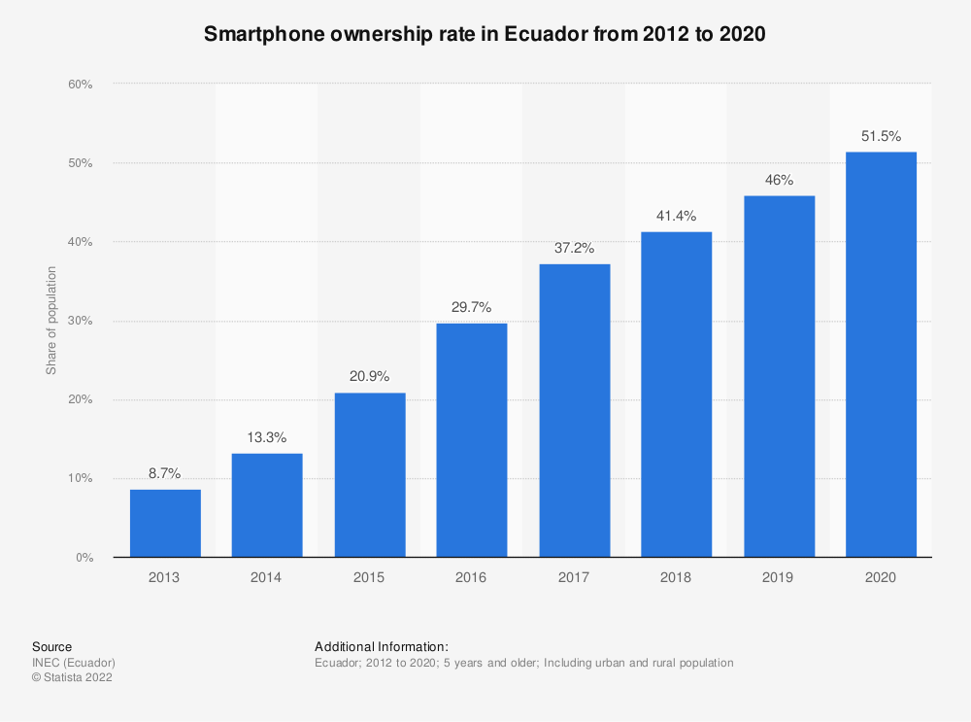
[13]
Notes:
Ilana - :)
Rate for all of Ecuador: we expect Cuenca’s to be higher because it is such a densely populated city
This is from 2020 and the percentage has been steadily increasing each year. In recent years, the percentage has increased by roughly 5 percent per year so by 2023, we could expect this number to be around 65%

Slide 14
We hope that our project allows the people of Cuenca to feel safer traveling around the city by becoming aware of inaccessible areas and having access to multiple route options.
[14]
Notes:
Connect objectives back to project goal - Gio

Slide 15
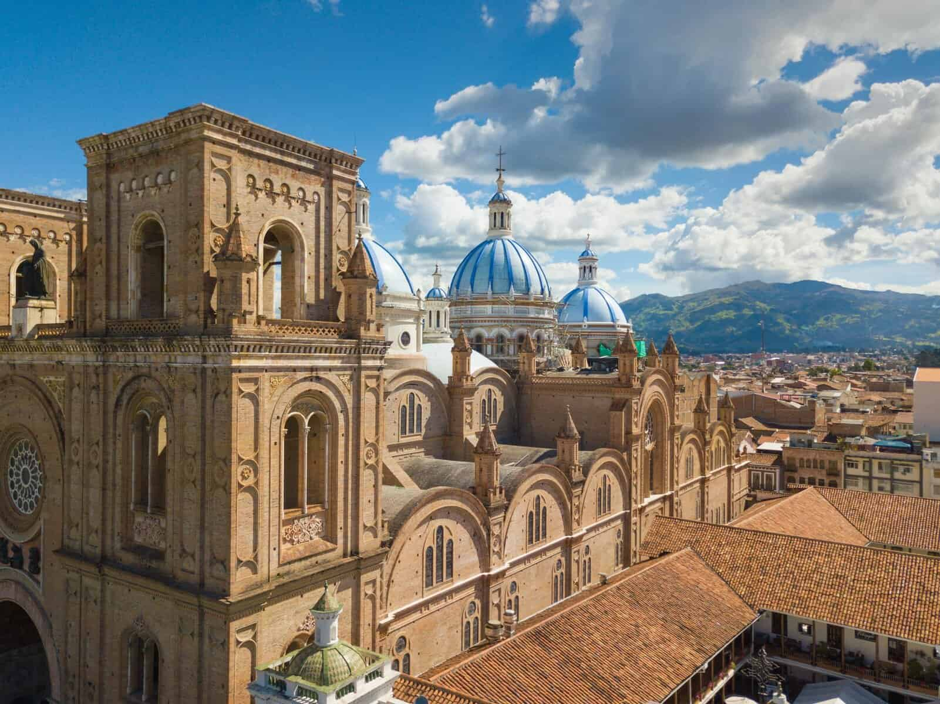
Special Thanks to…
Professor Kurlanska
Processor Kinicki
Professor Pollice
[15]
Notes:
https://www.google.com/url?sa=i&url=https%3A%2F%2Fwww.mommytravels.net%2F20-things-to-do-in-cuenca-ecuador%2F&psig=AOvVaw2xu3RSSWcfwuiEtc3qQEiP&ust=1677611785326000&source=images&cd=vfe&ved=0CA8QjRxqFwoTCKC9s4a1tv0CFQAAAAAdAAAAABAR

Slide 16
Thank you
[16]
Notes:
https://www.google.com/url?sa=i&url=https%3A%2F%2Fwww.kuodatravel.com%2Fcuenca-ecuador-the-history-athens-of-the-andes%2F&psig=AOvVaw05hSQ1mHeDMMqccu6ZBvyZ&ust=1677613476806000&source=images&cd=vfe&ved=0CA8QjRxqFwoTCMjikK27tv0CFQAAAAAdAAAAABAO

Slide 17
References
Langsten , J. (2017, February 1). New route-finding map lets Seattle pedestrians avoid hills,
construction, accessibility barriers. UW News.
https://www.washington.edu/news/2017/02/01/new-route-finding-map-lets-seattle-pedestrians-avoid-hills-construction-accessibility-barriers/
Orellana, D., Bustos, M.E., Martí-Palacios, M., Cabrera-Jara, N., & Hermida, M.A. (2020). Walk n’ roll: Mapping street-level mobility conditions in Cuenca, Ecuador. Journal of Transport and Health 16(1). https://doi.org/10.1016/j.jth.2020.100821
United Nations. (2006, December 13). Convention on the Rights of Persons with Disabilities (CRPD)- Article 9 – Accessibility. UN: Department of Economic and Social Affairs. https://www.un.org/development/desa/disabilities/convention-on-the-rights-of-persons-with-disabilities/article-9-accessibility.html
Venter, C. J., Bogopane, H., Rickert, T., Camba, J., Venkatesh, A., Mulikita, N., ... & Stone, J. (2002).
Improving accessibility for people with disabilities in urban areas. Proceedings: CODATU X. Lome.
https://www.codatu.org/wp-content/uploads/Improving-accessibility-for-people-with-disabilities-in-urban-areas-C.-VENTER-H.-BOGOPANE-T.-RICKERT.pdf
Notes:
You also MUST reference every photo or Figure in your presentation. The usual scheme is a bracketed number [1], [2] ... down in the bottom right of each photo and Figure. Then at the end your list of references includes where you got the photo from using the numbers. Any photo or Figure NOT referenced is assumed to be your work.

Slide 18
Images
[1]https://www.google.com/url?sa=i&url=https%3A%2F%2Fwww.roamingaroundtheworld.com%2Fbest-things-to-do-in-cuenca-ecuador-travel-guide%2F&psig=AOvVaw2mwOQgh3EfpsMx2RnfZhIs&ust=1677625269413000&source=images&cd=vfe&ved=0C
A8QjRxqFwoTCNC92aTntv0CFQAAAAAdAAAAABAE
[2] https://encrypted-tbn0.gstatic.com/images?q=tbn:ANd9GcScyb7wZcmGy6T7Hv2sczu6TfSQXmfkrisK4Zwk1RNB7ETtBPDx&s
[3]https://www.google.com/url?sa=i&url=https%3A%2F%2Fwww.reddit.com%2Fr%2Ffuckcars%2Fcomments%2Fxktsof%2Fcuenca_ecuador_beautiful_town_with_2_lanes_of%2F&psig=AOvVaw3CxZgJZfH7-UVjLOHq7_UW&ust=
1677526489072000&source=images&cd=vfe&ved=0CA8QjRxqFwoTCIDyp6b3s_0CFQAAAAAdAAAAABAJ
[4]https://www.google.com/url?sa=i&url=https%3A%2F%2Fameliaandjp.com%2Fmirador-de-turi-ecuador%2F5-Sidewalk-Gap-Cuenca-Ecuador%2F&psig=AOvVaw3CxZgJZfH7-UVjLOHq7_UW&ust=1677526489072000&source=i
mages&cd=vfe&ved=0CA8QjRxqFwoTCIDyp6b3s_0CFQAAAAAdAAAAABAZ
[5]https://www.google.com/url?sa=i&url=https%3A%2F%2Fwww.seniorswithlatitude.com%2Fwalking-in-cuenca-hazards-and-beyond%2F&psig=AOvVaw2ENojiBfF3VTSuUCogBCj9&ust=1677625379458000&source=images&cd=vfe&ved=0CA8QjRxqFwoTCPCx8tjntv0CFQAAAAAdAAAAABAE
[6]https://www.accessmap.io/dir?lon=-122.3318371&lat=47.6052965&z=15.31
[7]https://www.accessmap.io/dir?lon=-122.3318371&lat=47.6052965&z=15.31
[8]https://sidewalk-sea.cs.washington.edu/audit
[9]https://sidewalk-sea.cs.washington.edu/results
[10]https://www.gannett-cdn.com/-mm-/50878fe39e5edbc73a21ad9293997cda7ae894bc/c=0-470-7078-4469/local/-/media/2016/01/28/USATODAY/USATODAY/635895779112473589-Cuenca-4.jpg?width=3200&height=1808&fit=crop&format=pjpg&auto=webp
[11]https://www.liveandinvestoverseas.com/wp-content/uploads/2020/02/cuenca-ecuador.jpg
[12]https://d2v9ipibika81v.cloudfront.net/uploads/sites/38/ecu_cuenca_shutterstock_1163090866-1200x800-c-center-1140x684.jpg
[13] https://www.statista.com/statistics/1081753/smartphone-owners-ecuador/
[14]https://www.google.com/url?sa=i&url=https%3A%2F%2Fcommons.wikimedia.org%2Fwiki%2FFile%3AStreet_in_Cuenca%2C_Ecuador.jpg&psig=AOvVaw0fZuFyX2-NDVZP1LToZJ1C&ust=1677625717265000&source=images&cd=vfe&ved=0CA8QjRxqFwoTCKDP9Pnotv0CFQAAAAAdAAAAABAE
[15]https://www.google.com/url?sa=i&url=https%3A%2F%2Fwww.mommytravels.net%2F20-things-to-do-in-cuenca-ecuador%2F&psig=AOvVaw2xu3RSSWcfwuiEtc3qQEiP&ust=1677611785326000&source=images&cd=vfe&ved=0CA8QjRxqFwoTCKC9s4a1tv0CFQAAAAAdAAAAABAR
[16]https://www.google.com/url?sa=i&url=https%3A%2F%2Fwww.kuodatravel.com%2Fcuenca-ecuador-the-history-athens-of-the-andes%2F&psig=AOvVaw05hSQ1mHeDMMqccu6ZBvyZ&ust=1677613476806000&source=im
ages&cd=vfe&ved=0CA8QjRxqFwoTCMjikK27tv0CFQAAAAAdAAAAABAO
Notes:
You also MUST reference every photo or Figure in your presentation. The usual scheme is a bracketed number [1], [2] ... down in the bottom right of each photo and Figure. Then at the end your list of references includes where you got the photo from using the numbers. Any photo or Figure NOT referenced is assumed to be your work.

Slide 19
