Slide 1
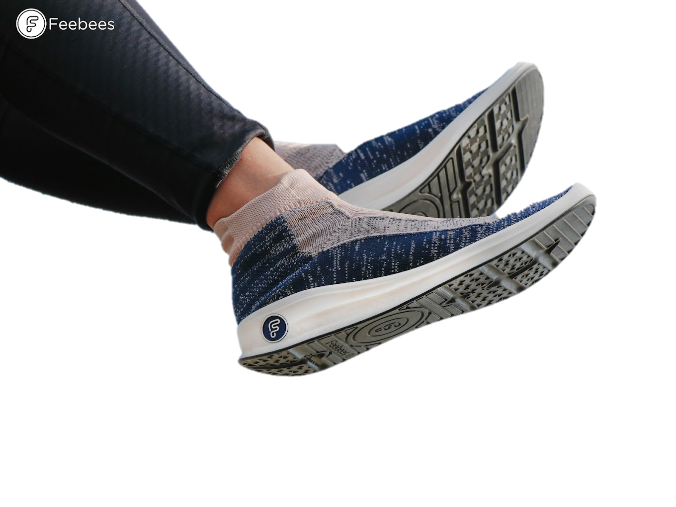
Expanding the Market of Recyclable Shoes in Taiwan
[1]
Roey Chen
Brian Chung
Willa Royce-Roll
Benjamin Skarnes

Slide 2
[2]
Global shoe industry contributes
8%
of global
CO₂ emissions
148
mega tons of
waste by 2030
2

Slide 3
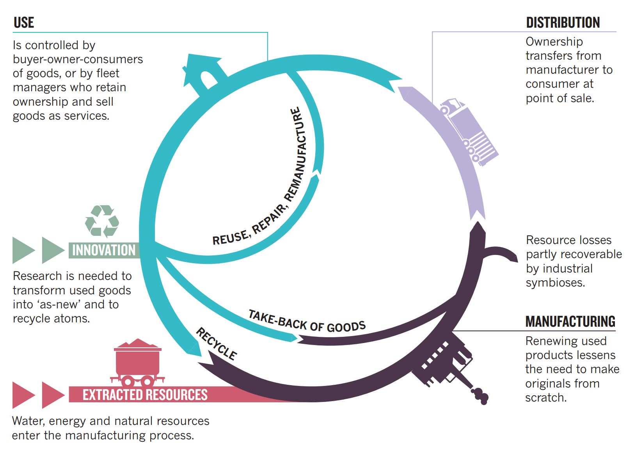
Circular Economy
Repurposing & repairing products to achieve an end of waste
[3]
3

Slide 4
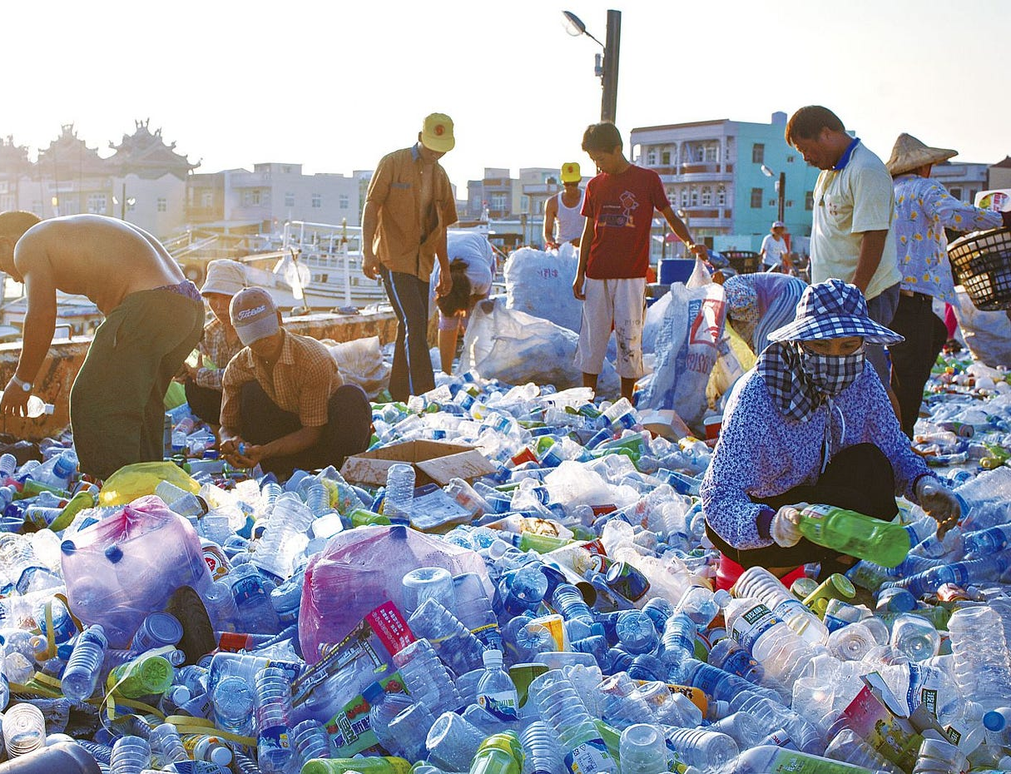
A Greener Taiwan
[4]
(1984-2024)
Invested government & companies
Strengthened environmental awareness
Expanded sustainability market
4

Slide 5
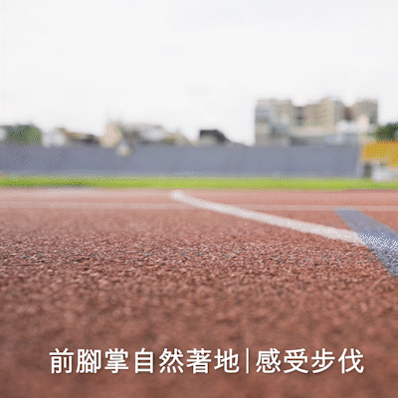
Feebees
Upper knit
sock
[6]
[5]
Lower molded
PU
5

Slide 6
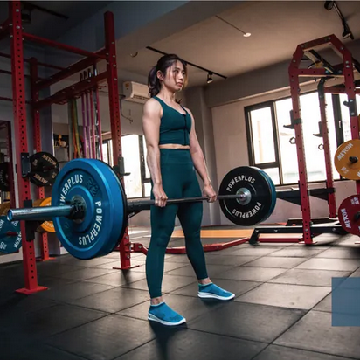
Current Branding
[8]
Focused on young adults
Highlights aerobic exercise
Minimized focus on recycling
[9]
6

Slide 7
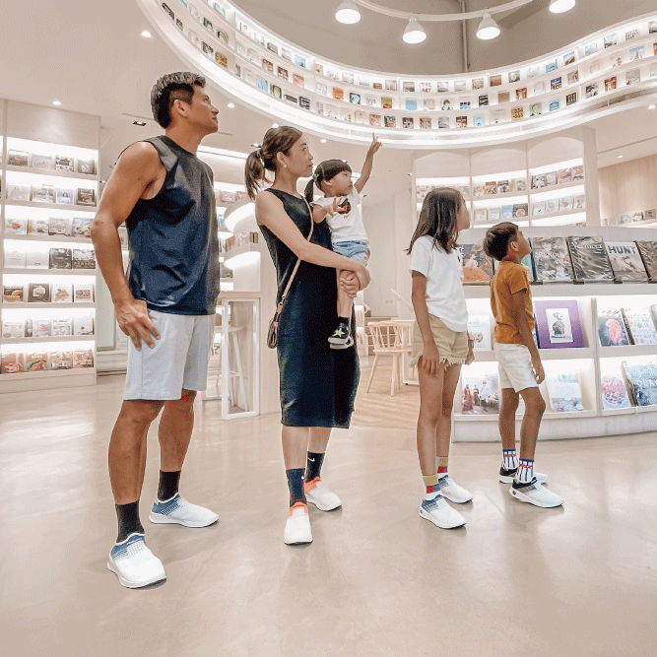
Problem Statement
[7]
Analyze how Feebees brands itself and how they could change their branding and marketing to draw in a greater audience
7

Slide 8
[10]
Investigate
factors between sneaker brands
Determine
views on sustainable branding
Project
Objectives
Assess
sneaker preferences of Taiwanese public
8

Slide 9
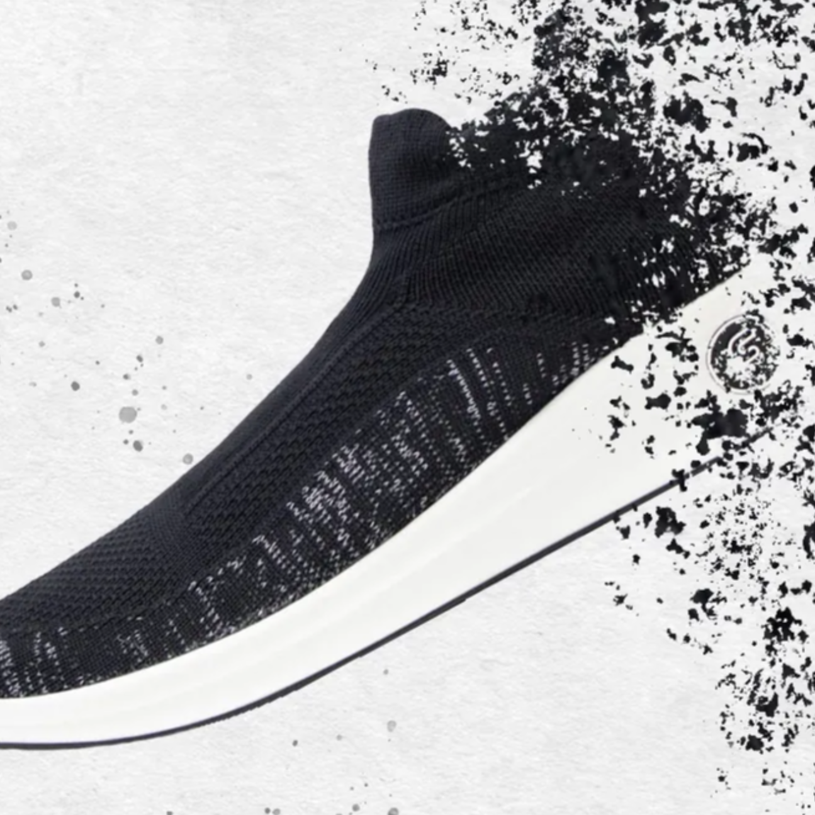
Investigate
Themes
Design
Design
Keywords
Content Analysis
Themes
Keywords
[14]
9

Slide 10
Assess
Survey Consumers
Interview Distributors
Assess buying habits and sneaker brand opinions
Assess sneaker market and verify survey
10

Slide 11
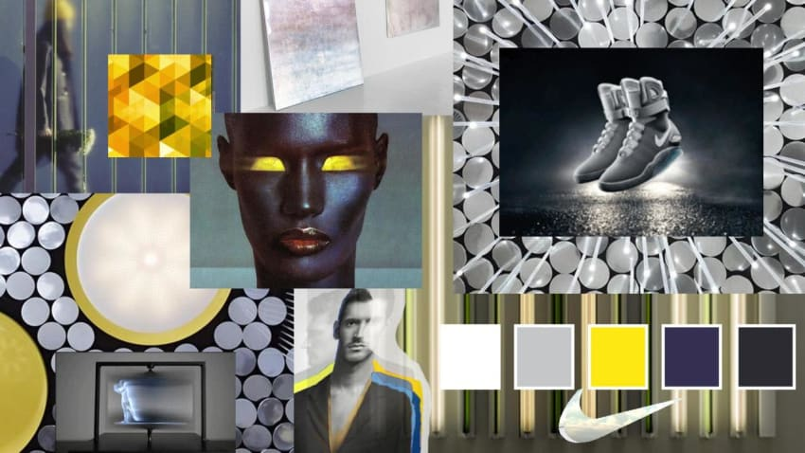
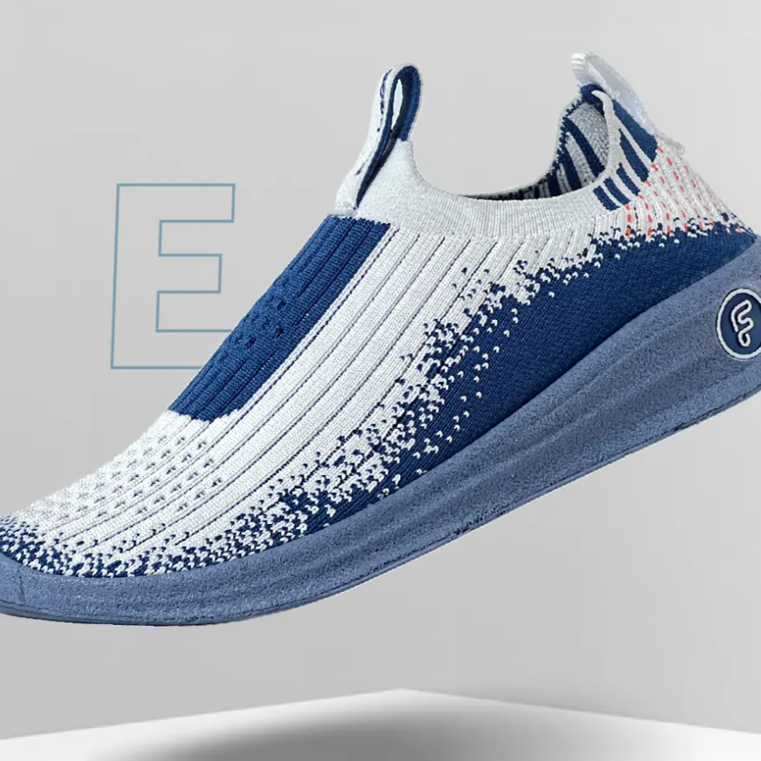
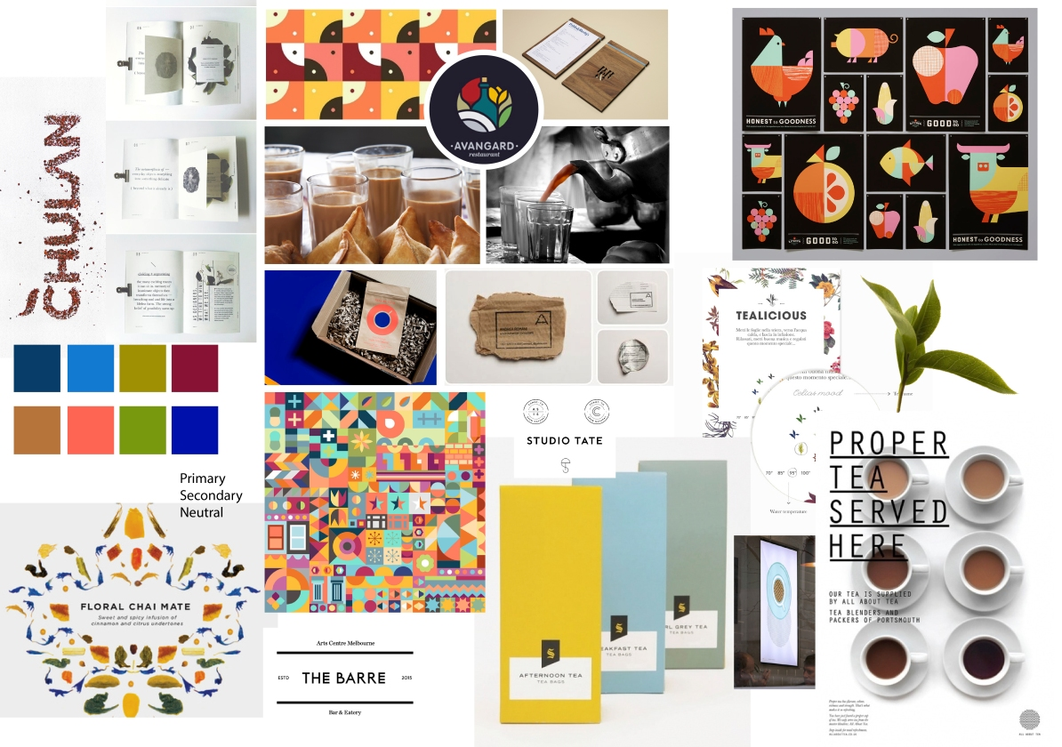
[12]
Determine
Themes
Design
Brand Testing
Moodboards
[13]
Keywords
[15]
11

Slide 12
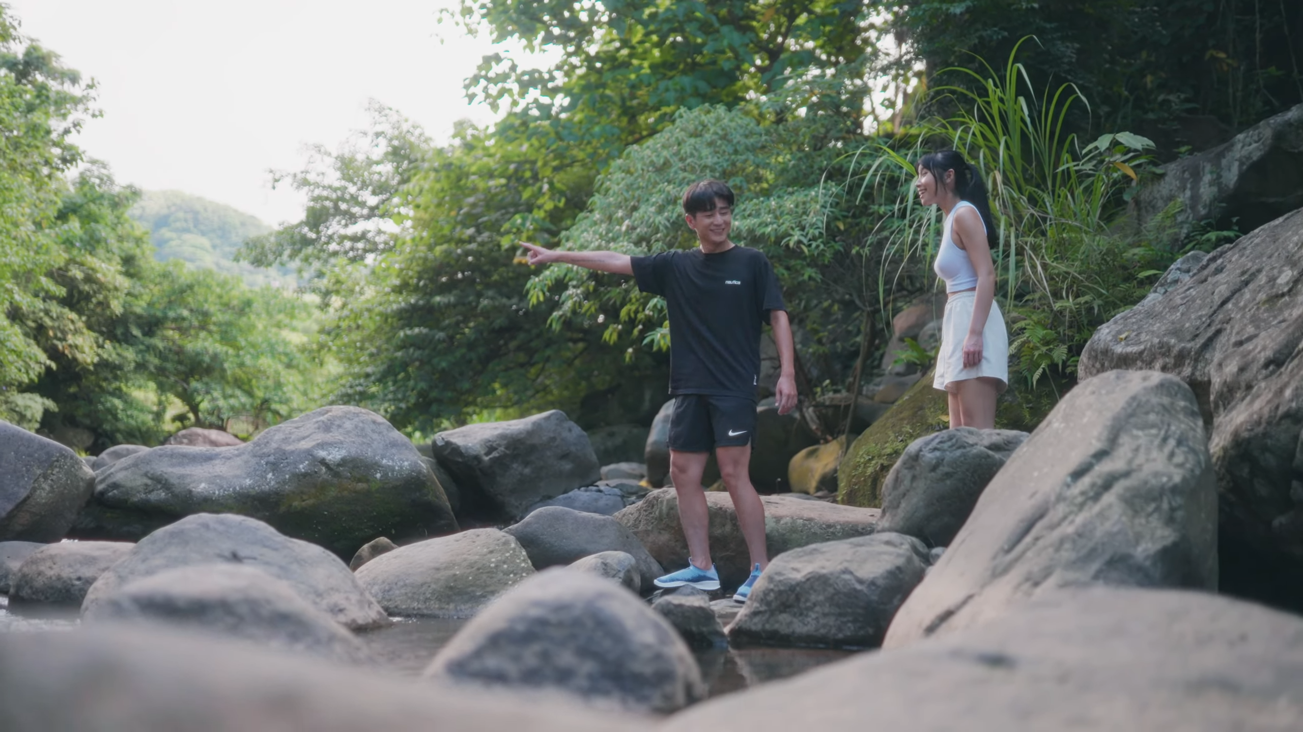
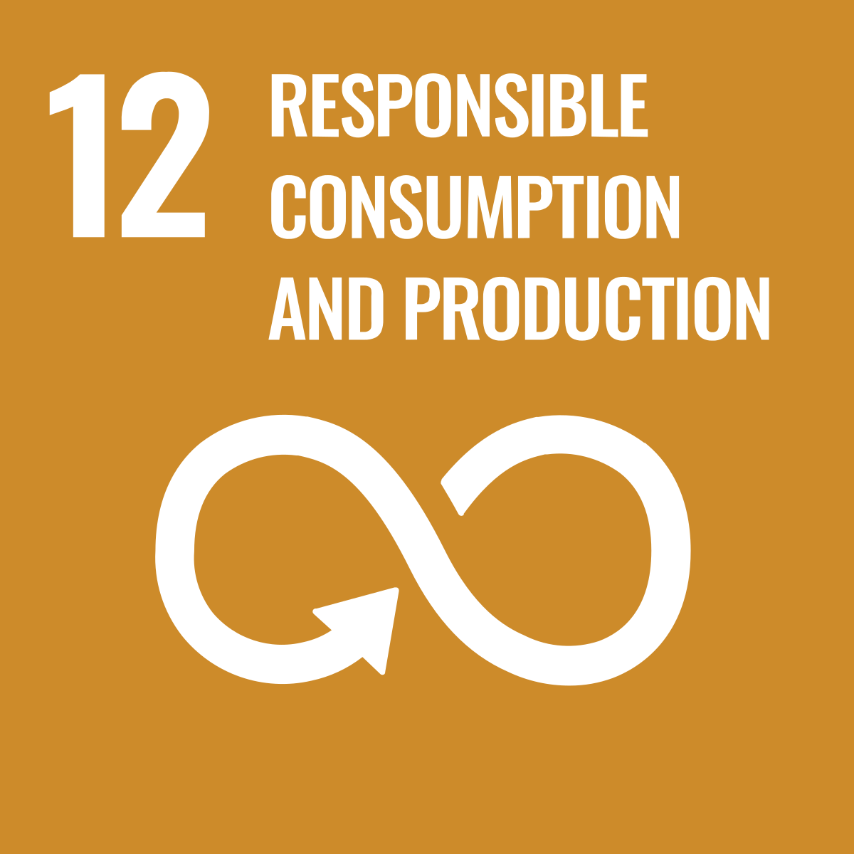
[16]
Impact
12

Slide 13
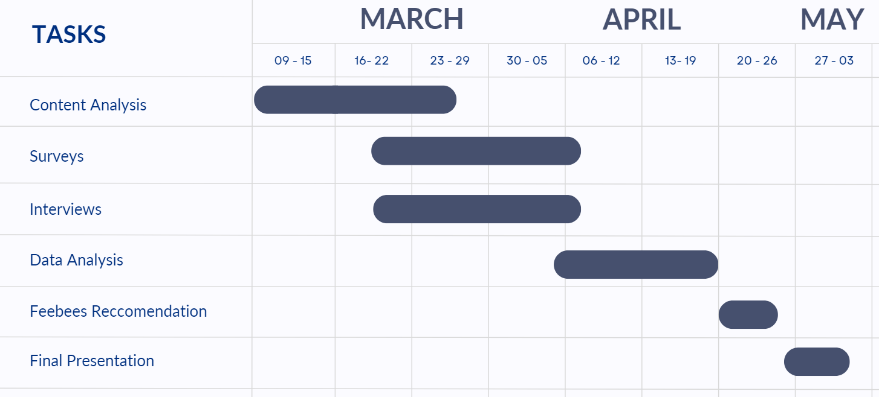
Next Steps
13

Slide 14
Acknowledgements
Thanks to Professor Wen-Hua Du, Robert Kinicki, & Amanda Wittman
Special thanks to:
Mr. Kuming Chen
Feebees International
Professor Joseph Sarkis
Worcester Polytechnic Institute
14

Slide 15
Image Sources
[1] Feebees Google Review Photos https://lh3.googleusercontent.com/p/AF1QipMqyVLfaSn0ncqBX5OsbHX-fOTTl5GDXIB_qmwl=s1360-w1360-h1020
[2] https://english.cw.com.tw/article/article.action?id=3252
[3] https://www.nature.com/articles/531435a
[4] https://medium.com/tzu-chi-culture-communication-foundation/a-history-of-environmental-action-d323775d4ac4
[5] https://www.feebees.com.tw/pages/feebees-features-1
[6] https://en.pinkoi.com/product/pqULRwm5
[7] https://en.pinkoi.com/product/BUfy9Qzn
[8, 9, 14, 15] https://www.feebees.com.tw/
[10] https://www.facebook.com/photo/?fbid=957445035749767&set=pcb.957450085749262
[11] https://www.feebeeshop.com.tw/ecommerce/%E9%98%B2%E6%BD%91%E6%B0%B4%E6%87%B6%E4%BA%BA%E9%81%8B%E5%8B%95%E8%A5%AA%E9%9E%8B-1.html
[12] https://contra.com/p/cNgLeQBm-art-direction-nike-mag-mood-board
[13] https://vsblt.wordpress.com/2015/11/28/moodboard-for-a-brand-identity-project/
[16] https://www.youtube.com/watch?v=o6rqhJXpcBs
15

Slide 16
謝謝！ Questions?
[11]
16

Slide 17
APPENDIX
17
Notes:
PRESENT ONLY IF NECESSARY (otherwise this should stay hidden)

Slide 18
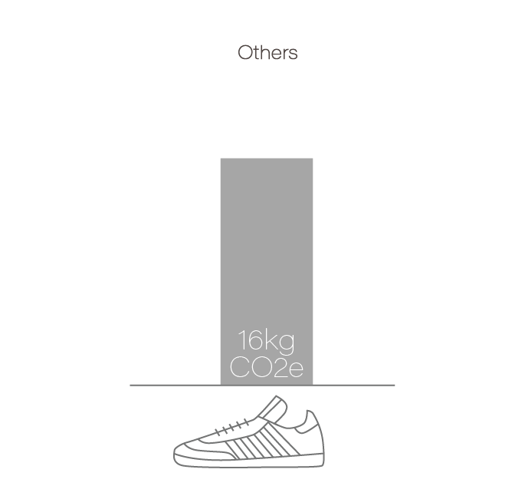
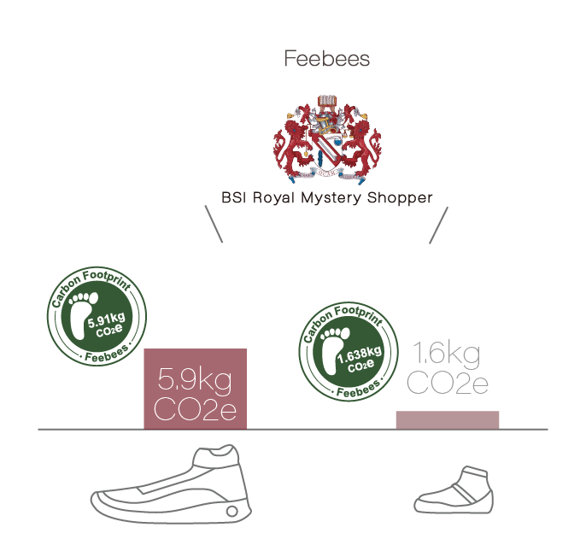
(Worldwide)
(Adult)
(Kids)
Source: https://www.feebees.com.tw/pages/feebees-features-1
18
Notes:
iF Design Award
Hype 6th
Golden Pin Design Award
Ministry of Economic Affairs Innovative Research Award
TOG Annual Award & Global

Slide 19
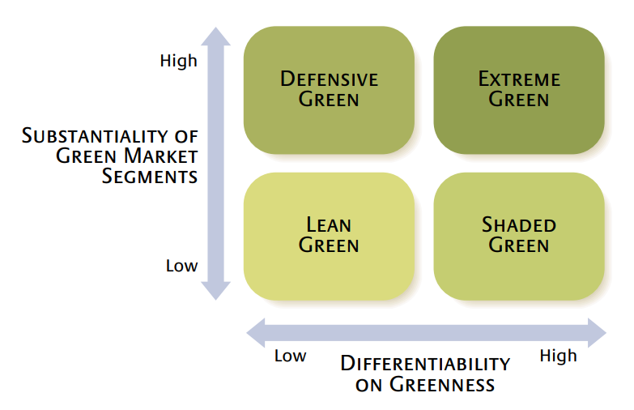
Source: https://sloanreview.mit.edu/article/choosing-the-right-greenmarketing-strategy/
19
Notes:
WHAT IS GREEN MARKETING
The “Lean Green” strategy does not prioritize sustainability in their company mission and branding
“Extreme Green” fully integrates environmental issues into every aspect of their company
“Defense Green” and “Shaded Green” fall between these two extremes where perceived “greeness” is either used to enhance brand image but its initiatives are not actively promoted or it is used as a secondary goal because other attributes can bring a company more money (Ginsberg et al., 2004)

