Slide 1
Safer, Cleaner, Greener.
Identifying Opportunities to Reduce Chemical Risk in the Dry Cleaning Industry
Kyle Dituro, Ann Jicha, and Melissa Sherwood
Notes:
We will be working with the environmental center for development, education and networking also known as EDEN Center. It is a non profit located in Tirana, Albania

Slide 2
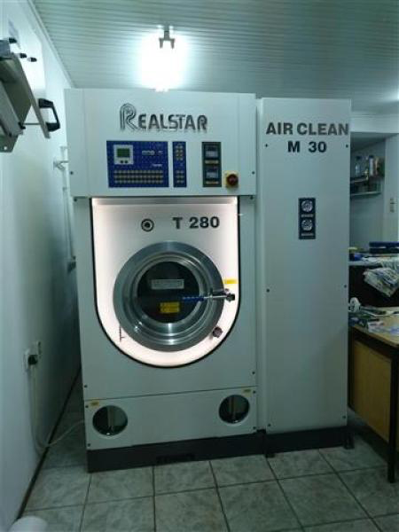
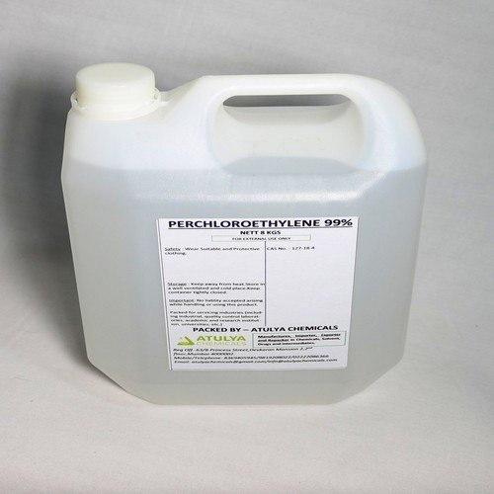
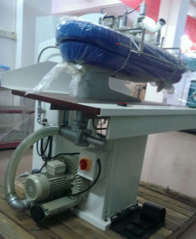
Typical Dry Cleaning Process
Receive clothes and inspect stains
Wash clothes in solvent
Distill Solvent
Steam press
Notes:
Melissa

Slide 3
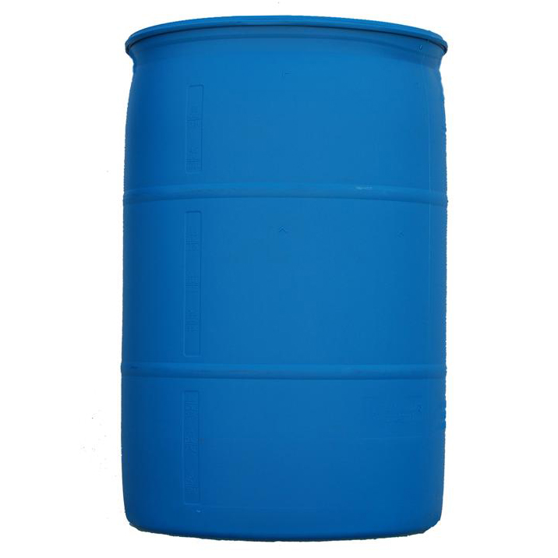
Perchloroethylene “Perc”
Most commonly used solvent because it is extremely effective
Most common exposures are by fumes from machine and direct contact
Health effects:
Carcinogenic
Reduced fertility
Birth defects
Groundwater, air, and soil are easily contaminated
Notes:
Kyle

Slide 4
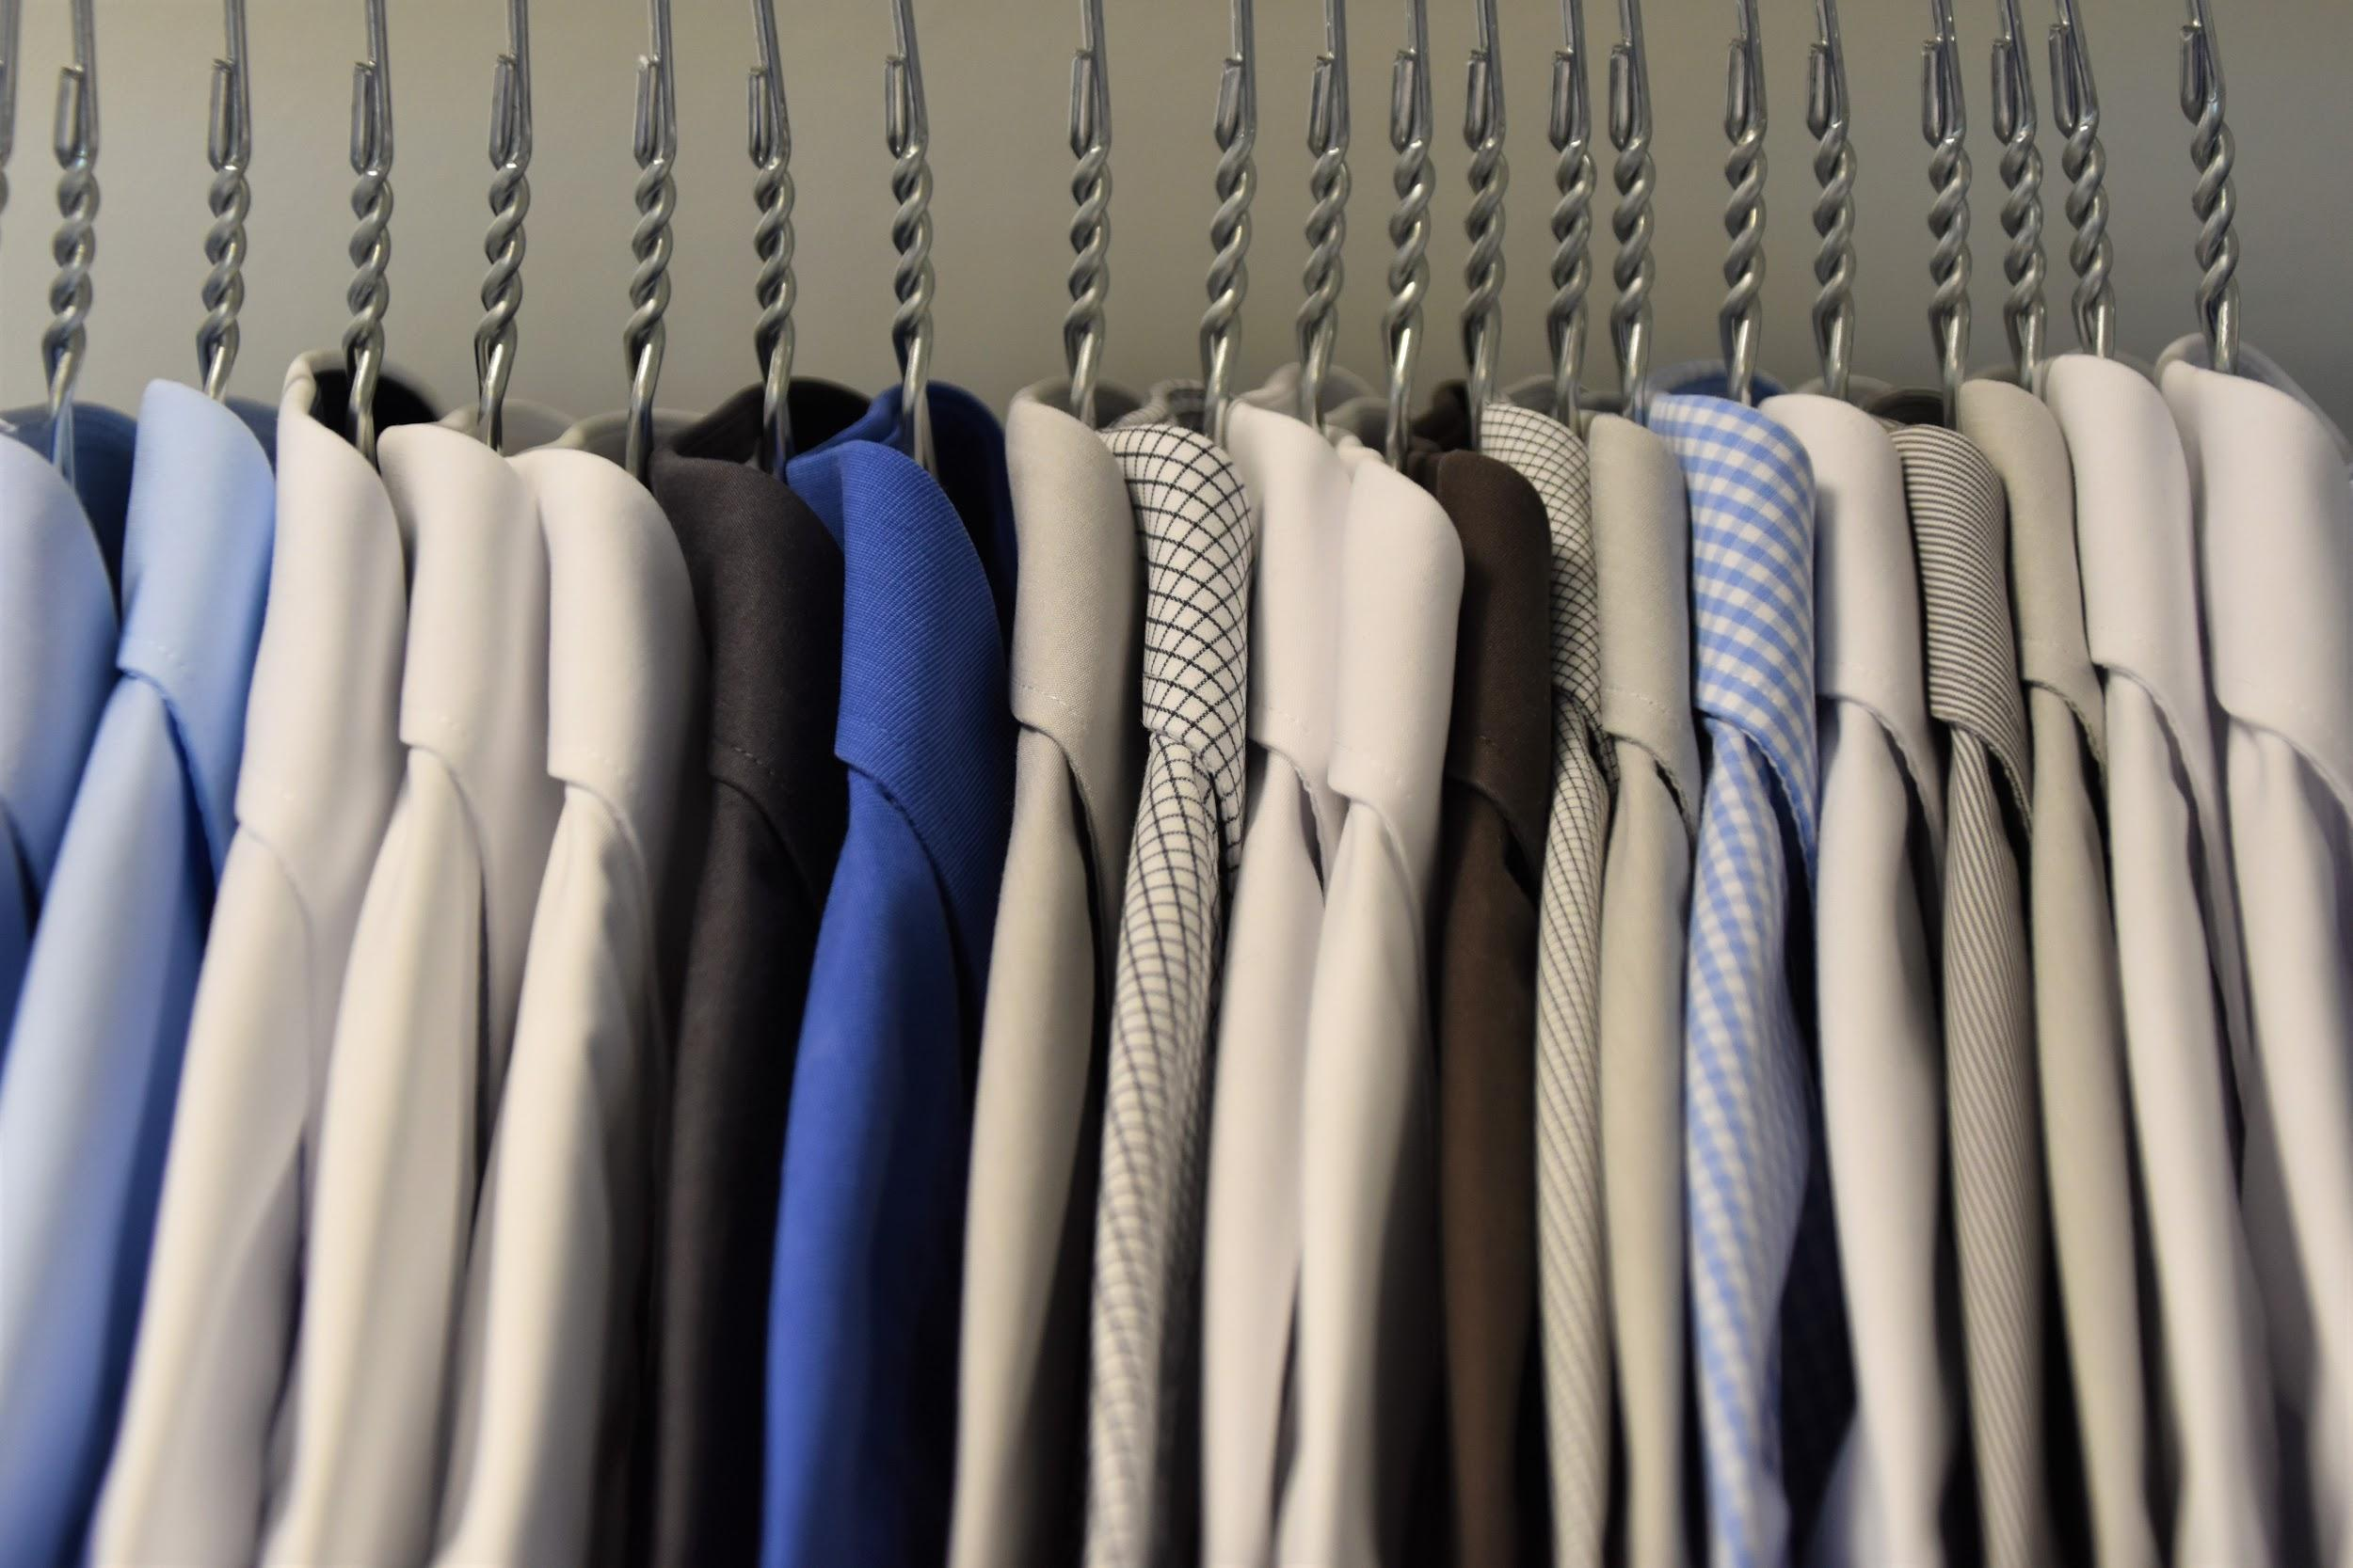
Best Practices
Inspection & Maintenance
Ventilation
Training
& Handling
Employees should be taught how to properly manage chemicals, as well as on personal protective equipment
Inspection and maintenance should happen regularly to prevent employees from being exposed via leaks.
Ventilation should be used to prevent vapor from concentrating in an area of the shop
Notes:
Ann

Slide 5
Green Alternatives
Wet Cleaning
Alternative Solvents
Alcohol Based
Solution, not solvent
Water Based
Water and detergent
Petroleum-based
High flash hydrocarbon solvent
Notes:
Melissa
There are many green alternatives to the solvent perchloroethylene, we decided to focus on the one we thought were most feasible to implement in Tirana. Some alternatives include wet cleaning, which can either be alcohol based or water based. These options include either a solution or water and detergent instead of a solvent which eliminated the hazards that a solvent causes.
There are also alternative petroleum-based solvent to perchlorethylene, which is a synthetic solvent. These solvent reduce the potential health risks is can cause. One specific example are high flash hydrocarbon solvents that are cheap in america and reduce the health risks.

Slide 6
Mission Statement:
The goal of this project was to identify opportunities to reduce risks to dry cleaning employees, the public, and the environment from the chemicals used in the dry cleaning businesses of Tirana, Albania.
Notes:
Kyle

Slide 7
Project Objectives:
Map
Dry Cleaners In Tirana
Identify
Current Dry Cleaning Practices
Determine
Public Perspectives
Dry Cleaner Perspectives
Provide
Green Alternatives
Notes:
Melissa
Map dry cleaners currently operating in Tirana
Identify the current dry cleaning practices within Tirana
Determine the perspectives of dry cleaners on adopting greener practices
Determine the perspectives of the public on greener dry cleaning practices
Provide recommendations for safer practices and alternatives to hazardous chemicals

Slide 8
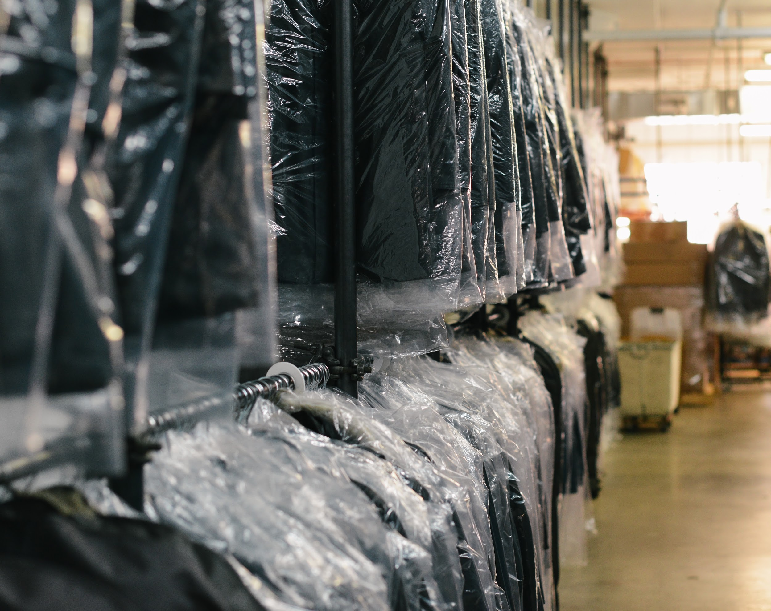
Methods
Dry Cleaners
Regulators
Public
Locating
Semi-Structured Interview
Online Survey
Surveys
Interviews
Notes:
Ann

Slide 9
Regulation
Environmental Permit
Self Regulation
Inspection
Notes:
Ann: Our responsibility is: Firstly there is a specific inspectorate which identifies the places carrying out the activity. Then they check if the businesses are provided with a license. They are tasked with obtaining an environmental permit. In the moment they are licensed there is legislation with specific conditions on how it is monitored following their activity. They should perform specific analysis every 6 months.

Slide 10
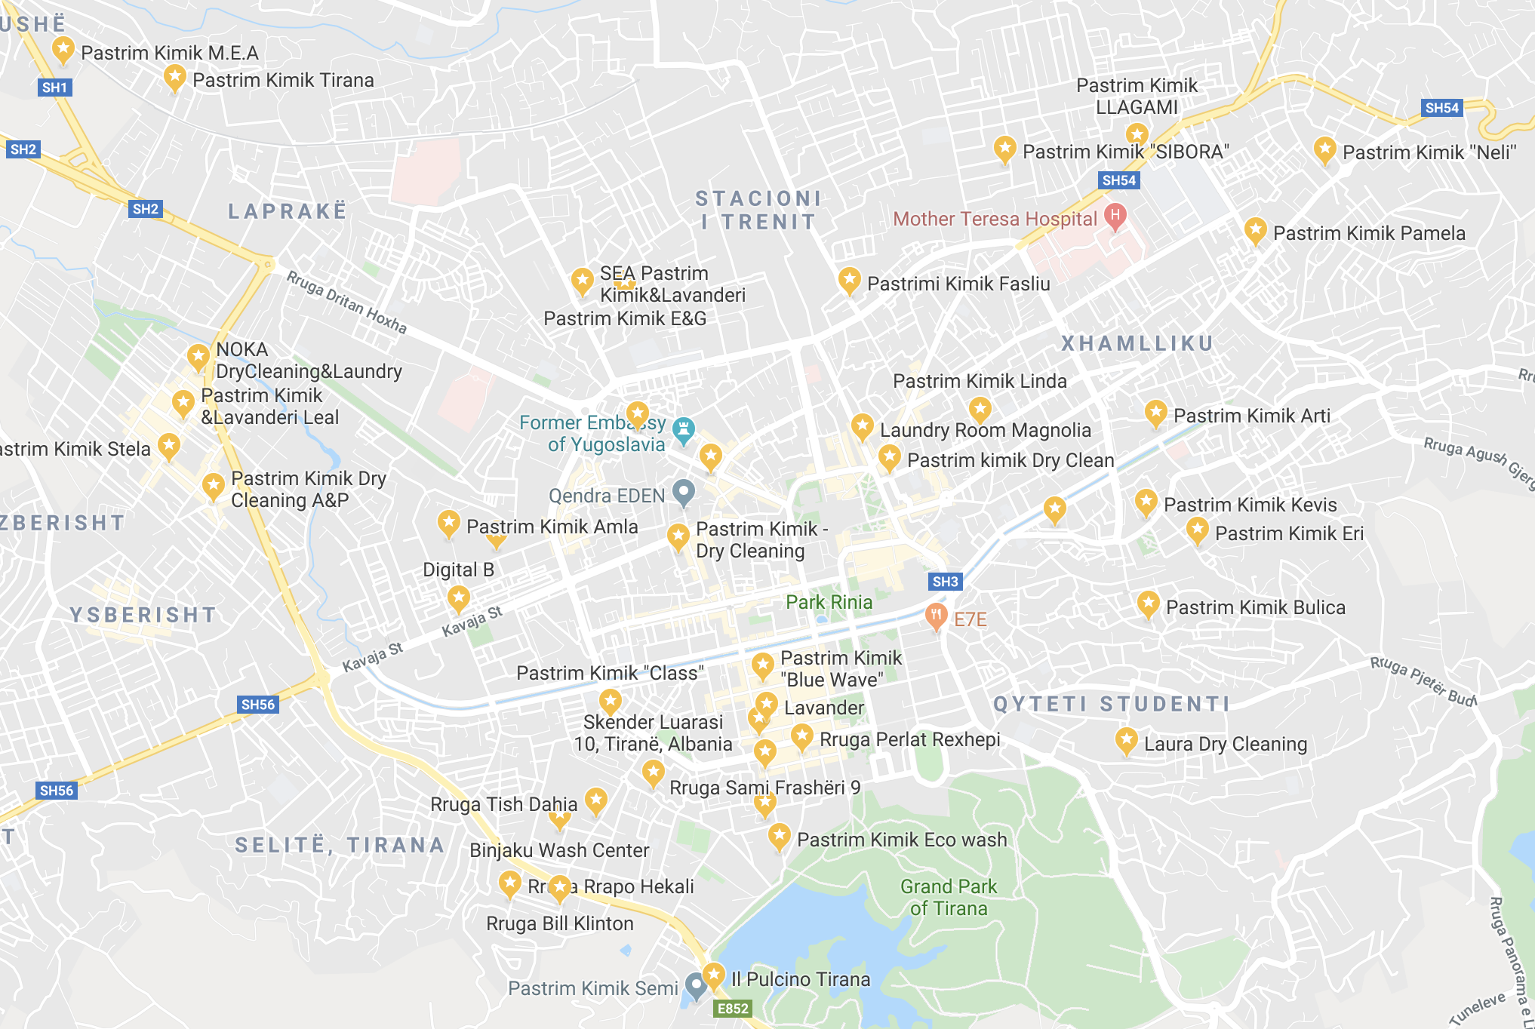
Map of Dry Cleaners
Notes:
Melissa
The first unit we mapped was unit 5 where we found a total of 14 dry cleaners
Next we had four dry cleaners in unit 6 and three in unit 1
As you can see, the density of dry cleaners is the greatest in unit 5, due to the population density of the neighborhoods in this unit

Slide 11
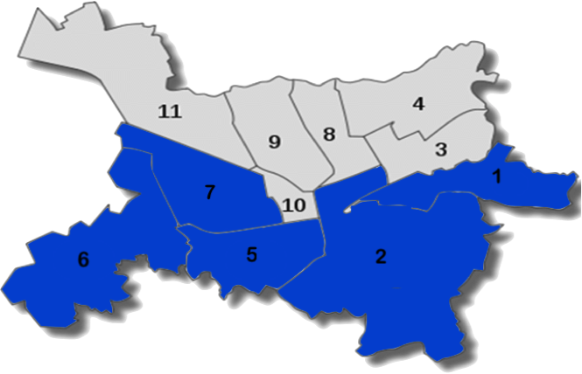
1 Surveyed
3 Visited
3 Surveyed
8 Visited
8 Surveyed
14 Visited
1 Surveyed
1 Visited
2 Surveyed
4 Visited
Overall: 15 surveyed out of 30 visited
Notes:
Kyle

Slide 12
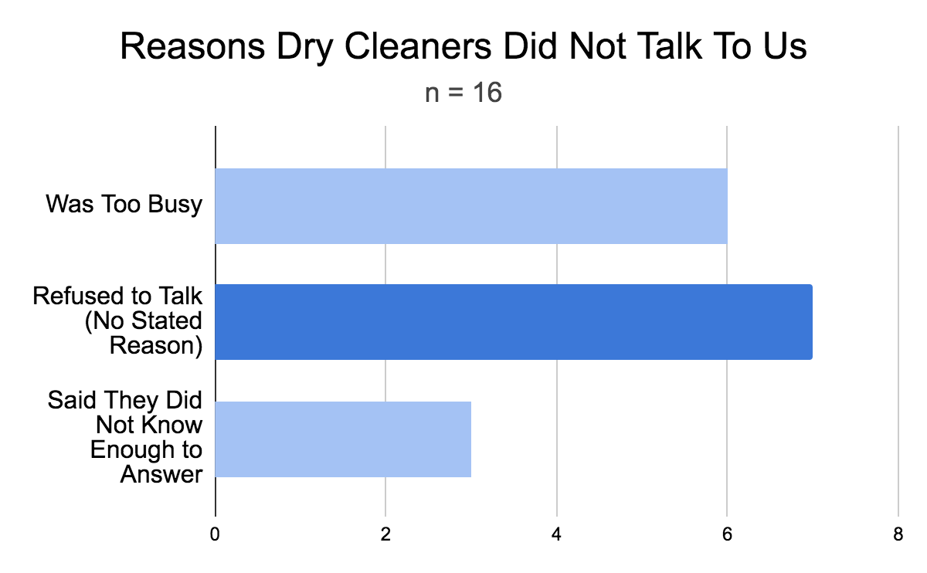
Dry cleaners were skeptical of our project.
Notes:
Melissa
When we did not receive surveys from dry cleaners, we often got responses such as, they were too busy, were employees and did not have enough information to answer our questions, or just did not want to talk to us. The number of dry cleaners who refused to talk with no reason was greater than any of the other reasons and gives us reason to believe that they were generally very skeptical of our team coming in and asking them questions

Slide 13
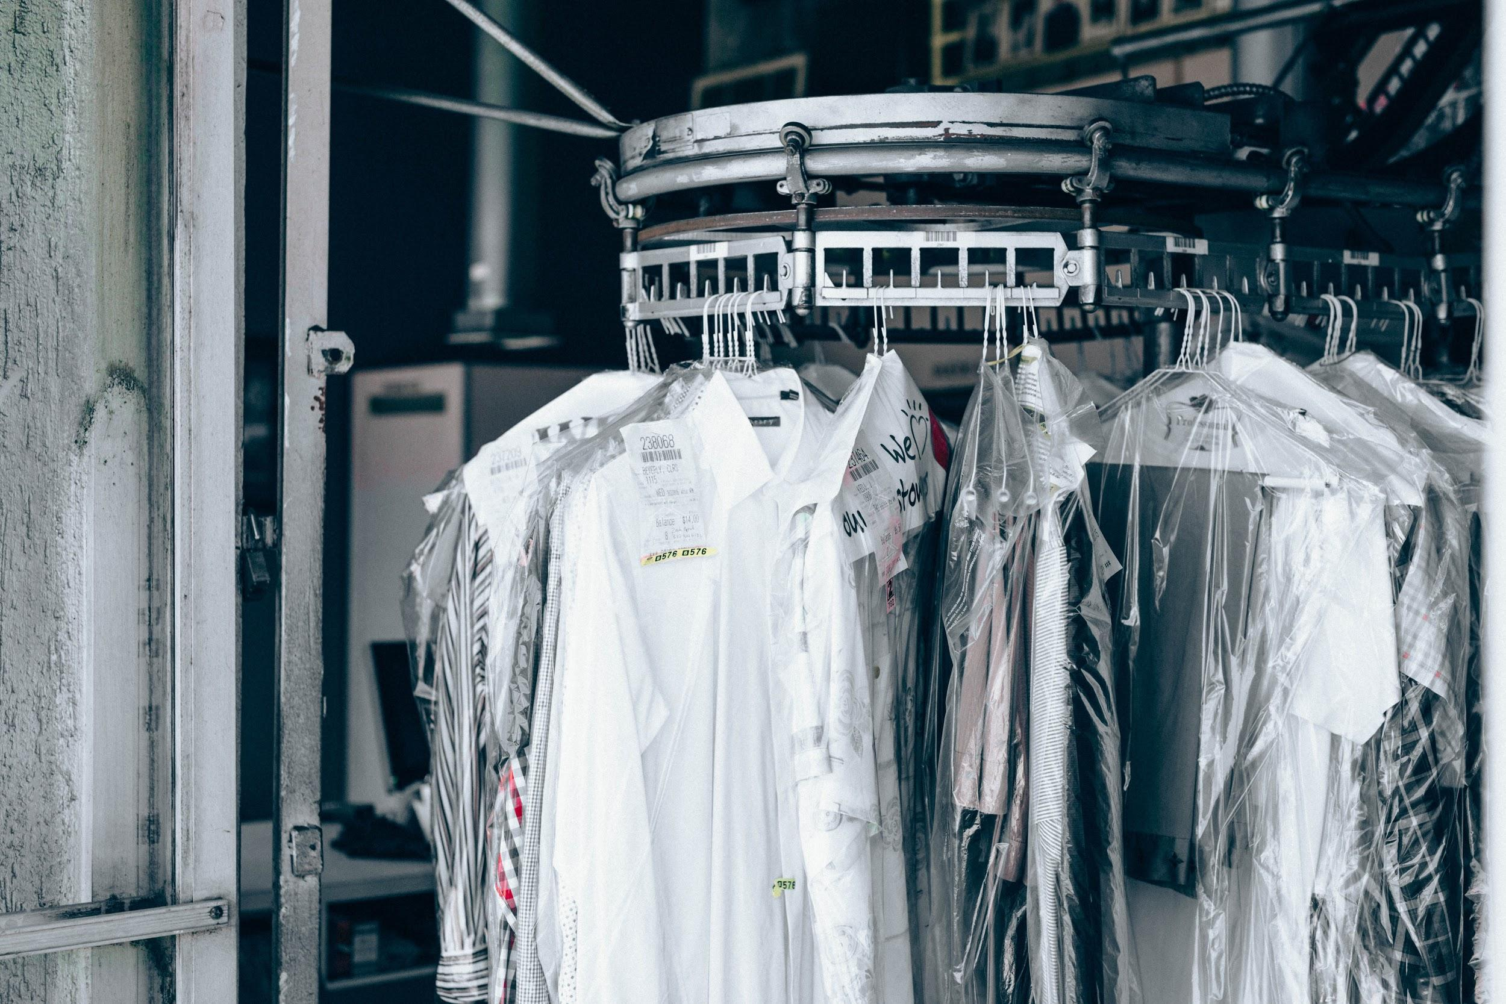
Dry Cleaner Practices in Tirana
Perchlorethylene Training
Protective Equipment
Replacement of Machine
High Cost of New Machinery
Notes:
Kyle
On Perchlorethylene:
Only received from packaging labels
On Protective Equipment
Limited knowledge
Only replace once they break down
High cost of machines discourages dry cleaners from buying a more ecologically friendly machine

Slide 14
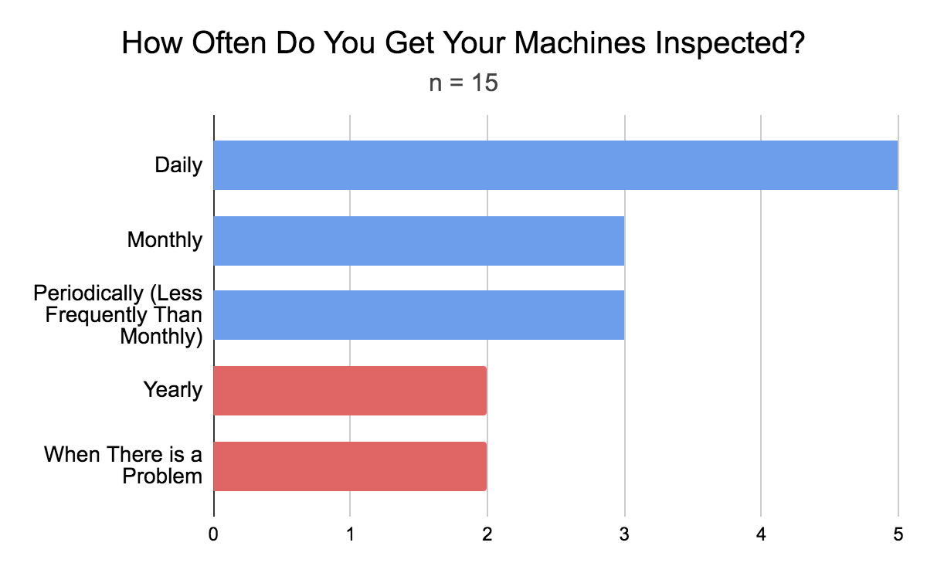
A concerning minority of dry cleaners do not inspect their machines as often as the Albanian government requires.
Notes:
Ann
Continue off of the previous slide on best practices

Slide 15
Dry cleaners do not usually take further measures to manage perchlorethylene beyond taking it out of the box and into the machine.
10%
20%
70%
Notes:
Ann

Slide 16
Public Survey
Knowledge
Pay More
Take Action
Notes:
Melissa
How much they know
That they are willing to pay a bit more
That there may be some action

Slide 17
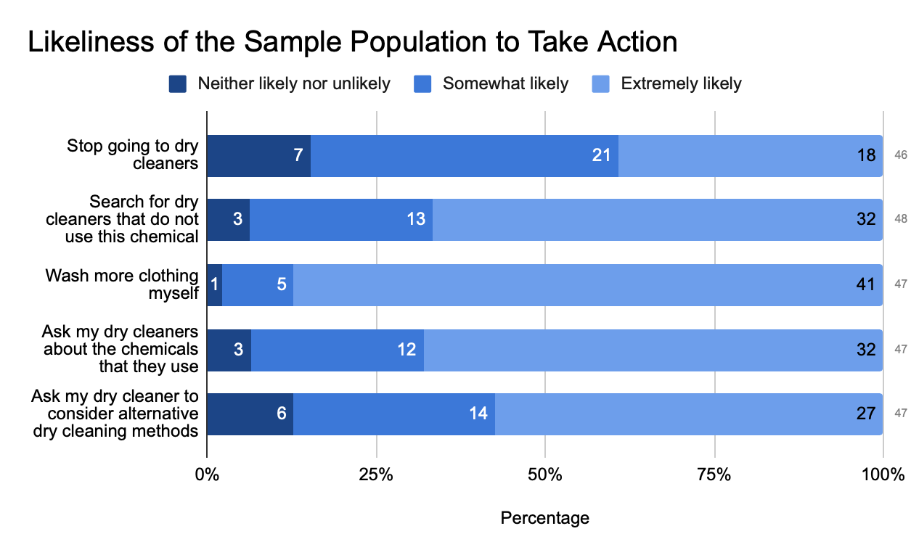
Notes:
Melissa

Slide 18
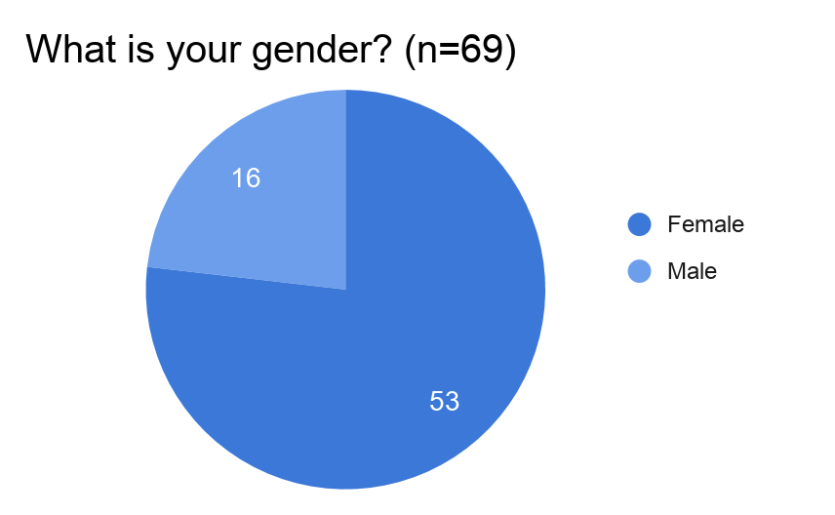
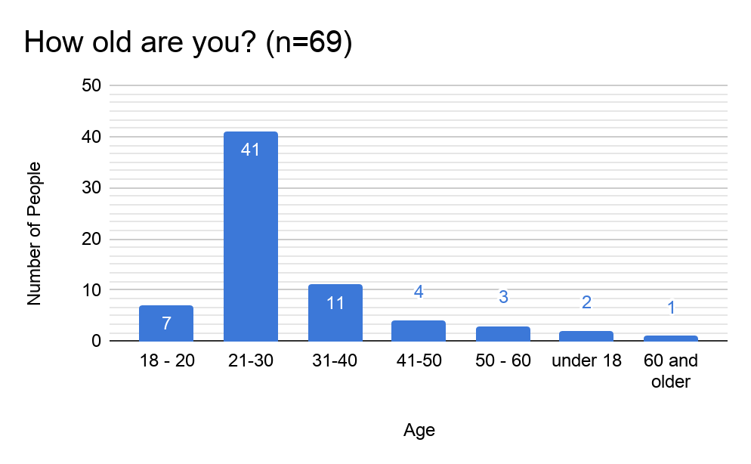
Limitations
Notes:
Kyle

Slide 19
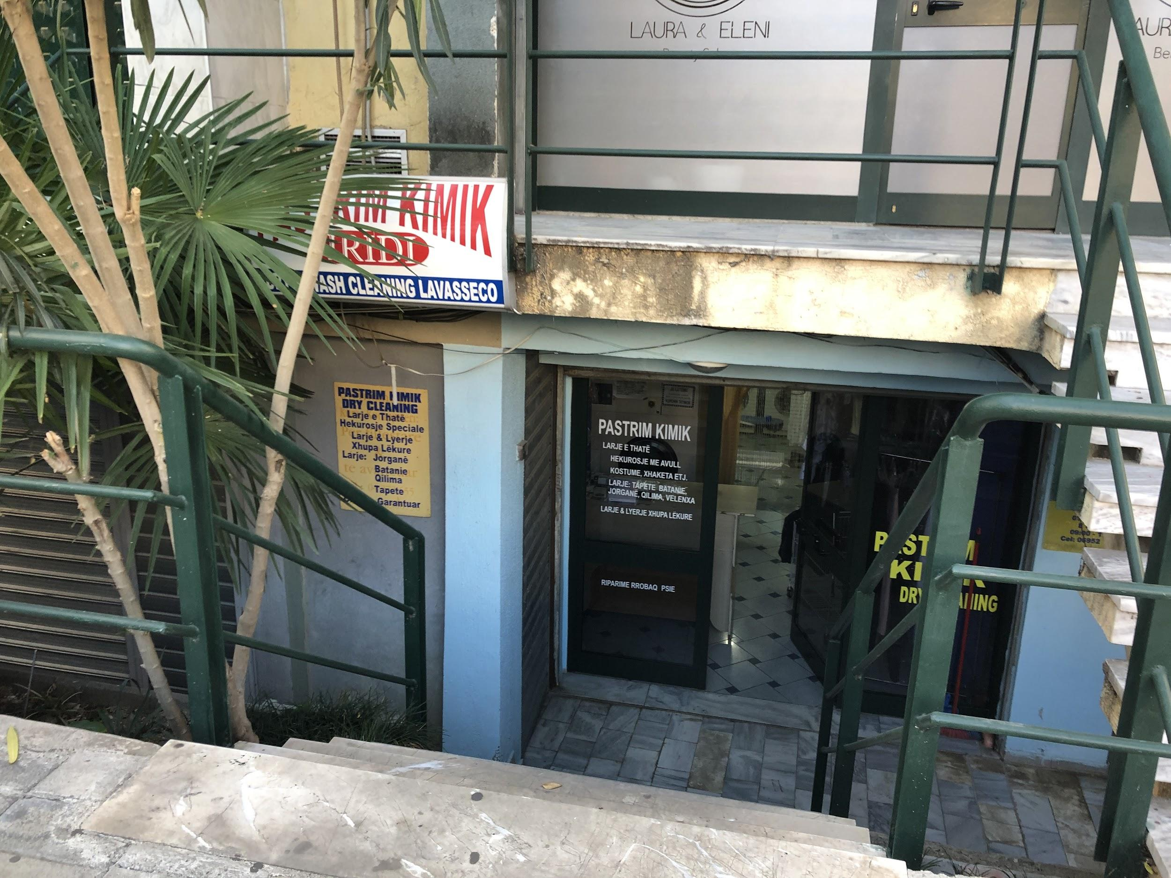
Recommendations
Dry Cleaners:
Public:
Regulators:
Regular machine maintenance
Proper venting
Detailed training
Education of practices
Environmental campaign
Require increased training
Continue to adopt EU standards
Notes:
Ann

Slide 20
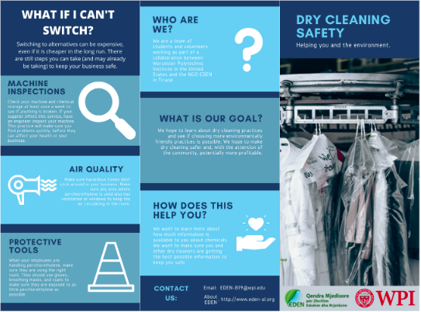
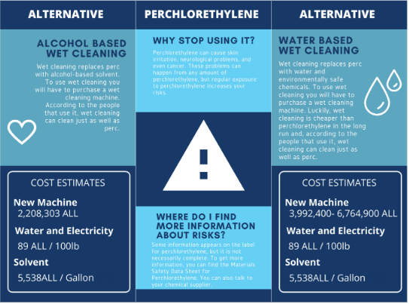
Deliverables
Notes:
Melissa
Our deliverables consist of a pamphlet for dry cleaners and educational material for the public. The pamphlet which includes information on perchlorethylene, alternatives to perchlorethylene, ways to mitigate risk without switching and information on our project and our team. This pamphlet was created to help inform dry cleaners of other options to reduce hazardous risk
We created multiple flyers for an awareness campaign to educate the public about current practices about the dry cleaning industry so they can make informaed choices

Slide 21
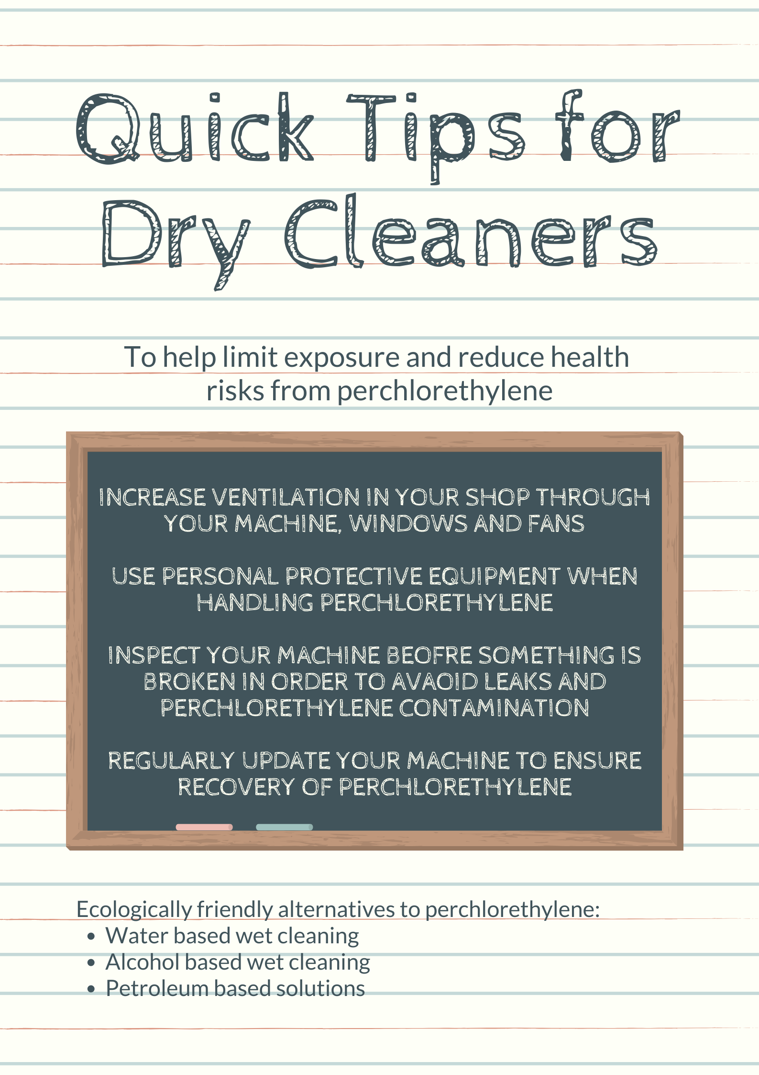
Notes:
Melissa

Slide 22
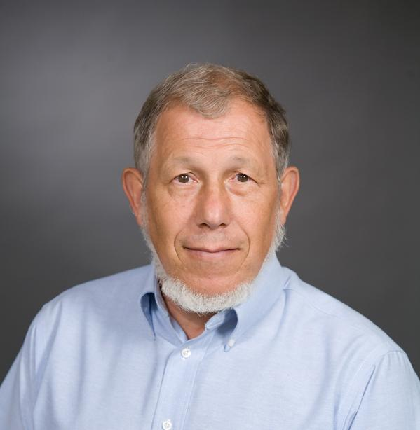
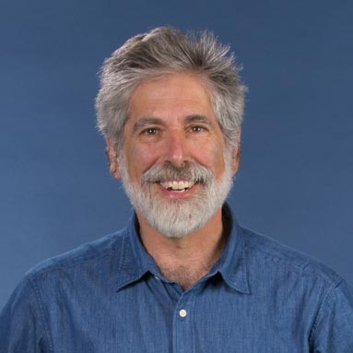
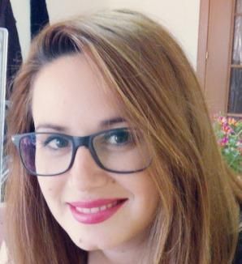
Acknowledgements
Thanks To Robert Hersh, Robert Kinicki, Jonida Mamaj, the EDEN Center Staff, and EDEN Center Volunteers
Special Thanks to Hera Kamani
Notes:
Kyle

Slide 23
Questions?
DRY CLEAN ONLY

Slide 24
Image Credits
https://commons.wikimedia.org/wiki/File:Pastrim_Kimik_-_shop_-_Pristina.JPG , http://drycleanauthority.blogspot.com/
https://www.sigmaaldrich.com/catalog/product/sigald/16211?lang=en&region=AL , https://www.amazon.com/3M-Paint-Project-Respirator-Small/dp/B001G8WRLU, https://www.mannlakeltd.com/chemical-resistant-disposable-gloves
Photo by Nathan Dumlao on Unsplash
Photo by Waldemar Brandt on Unsplash
Photo by Conrad Marshall on Unsplash
https://www.netmaps.net/?attachment_id=292
https://simple.wikipedia.org/wiki/Dry_cleaning#/media/File:Dry_clean_rack.jpg
https://www.ec21.com/product-details/Industrial-Steam-Press-Iron-for--10010058.html
http://www.peshkuiarte.com/show?cid=110616
https://www.indiamart.com/proddetail/perchloroethylene-or-tetrachloroethene-20691059433.html
Photo by Papaioannou Kostas on Unsplash
Photo by Timon Studler on Unsplash

Slide 25
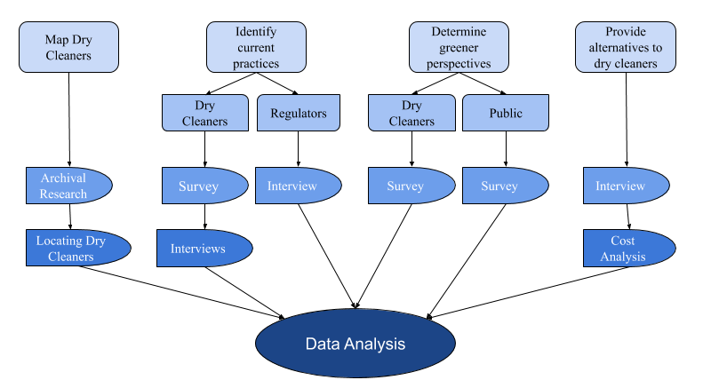

Slide 26
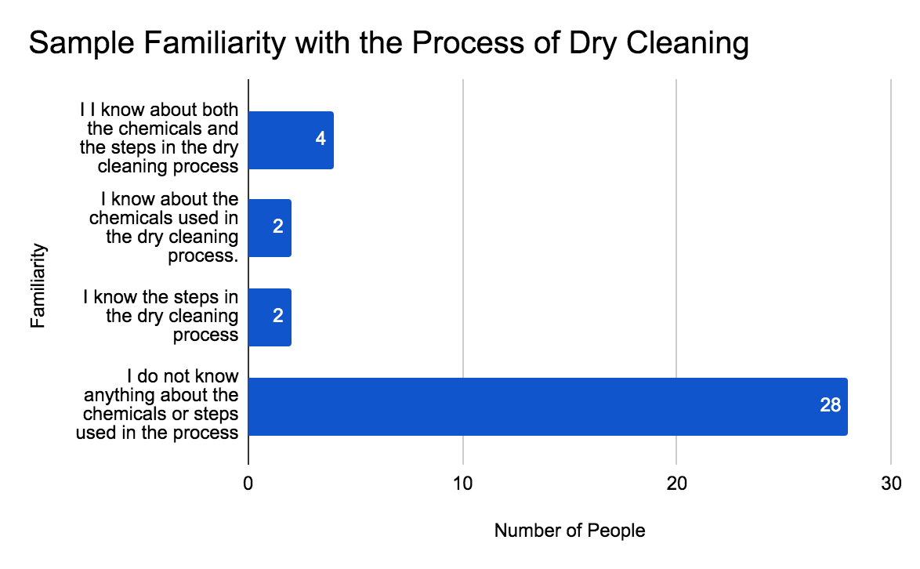
Notes:
Proximity

