Slide 1
Autism Education in the Czech Republic
Vishnu Priya Dendukuri, Ryan Dieselman,
Demetre Doherty, and Sydney Gardner
Notes:
Vishnu
Hello everyone thank you so much for joining us today for this IQP Proposal Presentation! We are excited to present this research opportunity about Autism Education in the Czech Republic. I am Vishnu, Ryan, Sydney, Demetre. To give some context to this project we are going to start by talking about Autism Spectrum Disorder.

Slide 2
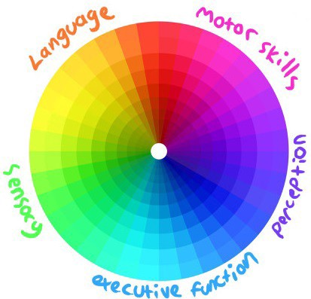
What is Autism Spectrum Disorder?
Developmental disability
Different symptoms and severity levels
[1]
Notes:
Vishnu
So what is Autism?
Autism Spectrum Disorder (ASD) is a developmental disability which hinders a person’s communication, social, and emotional skills as well as behavioral development.
Developmental psychologists and pediatricians diagnose the children when they are about 2 to 3 yrs old.
Children with ASD can experience a spectrum of symptoms that can affect their day to day life. This includes but is not limited to language, motor skills, perception, executive functions and sensory feeling.
Experienced symptoms and severity levels make every autistic child unique, and therefore the therapy necessary is also unique for every individual.
Autism Spectrum Disorder (ASD) is a developmental disability which hinders a person’s communication, social, and emotional skills as well as behavioral development.
Autism causes difficulty in both verbal and non-verbal communication, social interaction with other people, and in some cases causes repetitive behavior which makes it difficult for them to react to the people and situations they face in day-to-day life. Experienced symptoms and severity levels make every ASD diagnosis unique, and therefore the treatment necessary is also unique for every individual. A majority of children with ASD have trouble communicating and have problems with expressing themselves using words and gestures. They may struggle understanding other people’s facial expressions, and tone of their voice. They tend to be withdrawn and spend their time alone.
repetitive actions such as spinning continuously, clicking flapping.
Developmental psychologists and pediatricians diagnose the children when they are about 2 to 3 yrs old.

Slide 3
Applied Behavior Analysis Therapy
Positive Reinforcement
Flexible & Adaptive
[2]
Notes:
Demetre
Applied Behavior Analysis therapy is the main therapy used worldwide today to treat Autism and is also the main therapy used by our sponsor Abaceda
ABA therapy focuses on positive reinforcement by a therapist towards the child
The therapist gives a command to the child and if the child responds with the desired behavior then the therapist will provide positive reinforcement that acts like a reward
When the child displays the undesired behavior the therapist will not give reinforcement and will try and help the child by demonstrating the desired response and will start the exercise again
The idea behind this is that if the child is rewarded for displaying desired behavior they will continue this behavior in the future
Since no two cases of Autism are alike the therapists will create a unique therapy plan that fits the child’s needs.
For example if a child is really struggling with communication skills then the therapist will make sure to focus on improving communication skills
ABA therapy is also very reliant on the caregivers because they need to continue this practice with the child while they are at home.
Because of this caregivers also need to be trained on how to properly care for their child at home by the therapists

Slide 4
Autism in the
Czech Republic
100,000 – 200,000 people with ASD
Limited number of therapy centers
[3]
Notes:
Sydney
ABA therapies are available worldwide, but our location of interest is the czech republic
ABA Centrum, a therapeutic center and organization that work with children with developmental disabilities estimated that there are approximately 100,000-200,000 people with ASD within the cz. Some studies argue this number is higher.
Despite this significant population, however, there are very few therapy centers, ABA or otherwise.
Ones that do exist often have years-long waiting lists, which leaves many families without necessary help or resources.

Slide 5
Sponsor: Abaceda
“Pro ni není její práce prací, ale poslaním.”
“For her, her work is not a job, but a mission”
Caregiver testament regarding sponsor
[4]
Notes:
Ryan
One organization providing therapy services to the families of autistic children in the Czech Republic is the sponsor of this project, Abaceda. Abaceda is a shared therapeutic center based in Prague that specializes in Applied Behavior Analysis Therapy. Abaceda is run by these 5 therapists pictured here, and lead by one of the founders, Mgr. Kateřina Čížková, BCBA pictured in the middle here. She is our direct sponsor, and we’ve gotten the privilege of meeting with her multiple times to discuss her vision for this project. Abaceda works with very young children on mostly ABA therapy programs, and also works closely with the child’s primary caregiver, whether that's a parent or other guardian. The work with the caregivers is important, and focused on teaching the caregivers how to work with their children. Mgr. Čížková stressed to us that the
child can only prosper if the parent is doing well, and has the proper tools to raise their child. However, Abaceda’s reach is limited. Long wait times, as well as geographic and financial factors, limit how many families they can help. They are hoping to broaden their reach and spread their information online so more families around the Czech Republic can access it.

Slide 6
Project Goal:
Develop an educational video
to assist Abaceda in their mission
to educate caregivers on how to
raise children diagnosed with ASD.
[5]
Notes:
Ryan
This is where we come in. The goal for this project is to develop an educational video to assist Abaceda in their mission to educate caregivers on how to raise children with Autism Spectrum Disorder. This video will help Abaceda broaden their reach, and make this crucial information more accessible.

Slide 7
Methodology
Identify
Essential topics and methods
Assess
Effectiveness of Methods for each Topic
Develop
Storyboard outline for the Educational Video
Produce
Final Educational Video
Notes:
Demetre
Now we will go over the methodology which consists of the objectives and deliverable of the project
first we will identify topics and methods through therapists individual interviews
next we will assess the effectiveness of the methods for each topic through caregiver surveys
Then we will develop a storyboard outline for the educational video we will create
During this stage we will also generate a script for the video
Finally we will produce our educational video on these methods and topics
The process of creating this video can be split into two steps
First we will the video recording that will be the main part of our video
Then lastly will be the editing of the video and any small details that need to be fixed

Slide 8
Objective 1:
Therapist Interviews
Individual Interviews
Analyze the Transcript
-Different methods of training
-Transcribe interviews
-Two-pass content analysis
-Generate reference document
[6]
Notes:
Demetre
Individ interviews
First conduct a practice interview with an Abaceda therapist to make sure our interview questions are clear and to get an outline of what the interview will look like
Then we will conduct semi structured interviews with 3-5 of the Abaceda therapists and will learn the different topics they teach
These topics consist of what the child goes through on a day to day basis like eating and dressing
Then we will go one step further into the training methods the caregivers are taught to assist their child in these topics
After we feel that we have received enough information from the therapists we will transcribe their interviews so that we can start our analysis
Analysis
Once we have received this data we will analyze it using a 2-pass content analysis
Content analysis is a research technique where you make inferences by systematically evaluating the text.
The first pass will be to find the topics the therapist found most important
The second pass will be to find the corresponding methods that are used for each topic
From this analysis we will generate a reference document.
A reference document is a document that holds key details on a subject matter that as a group we can consult at any time
The reference document will contain the most important topics and the methods that are used for each topic that we found from the content analysis we did

Slide 9
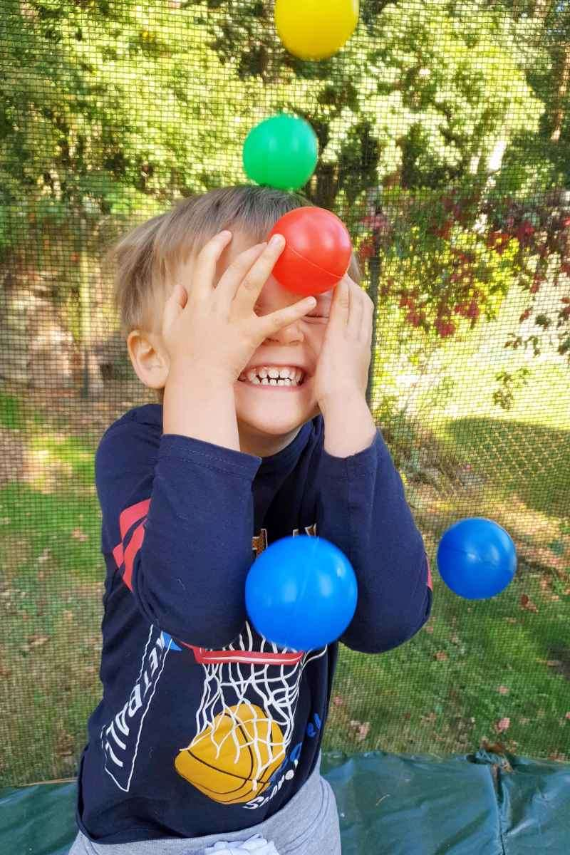
Objective 2:
Caregiver Surveys
Caregiver Surveys
Analyze the Data
WPI Qualtrics
Effectiveness and Frequency of use
Average Likert Scale Values
Rank methods for each topic
[7]
Notes:
Ryan
Once we have our list of topics and methods, we will aim to assess the these methods in the eyes of the caregivers by utilizing an online survey with the WPI licensed program Qualtrics. During our discussions, Mgr. Čížková explained that Abaceda has sent out questionnaires to caregivers in the past when they wanted feedback, so they would be able to help send our survey out. We cannot assume that all the caregivers speak english, and Mr. Cizkova said that Abaceda would also be able to help with translating the survey to Czech. The survey will ask the parents for each topic, how often do you use a particular method, and how effective do you find that method to be. We will use this data to determine which methods we highlight in our educational video.

Slide 10
Objective 3:
Develop Storyboard
Create Scripts and Storyboards
Feedback and Review
Based on reference document
Revise
Gather Feedback from Abaceda
[8]
Notes:
Vishnu
Once we complete creating reference documents, our team will develop a preliminary script and storyboard together so that the team has access to both written and visual representation of the video prepared. our aim is to gather anywhere from 2-5 of the therapists at any given time for a review of our storyboard. After the preliminary storyboards have been reviewed, the team will work to incorporate feedback into the script and storyboards. the animatic and script will be presented to the Abaceda therapists in focus groups a second time, using the same discussion guide as in the first informal focus groups. This iterative process allows the team as well as the sponsor to ensure that the content is accurate and represents what the caregivers need. The outcome of this process will be the refined storyboards that will be the guide for recording and developing the final educational video.

Slide 11
Deliverable Part 1:
Video Recording
“Interview-like” style involving Sponsor
Includes:
Live Footage
Visual assets
Voice Over
[9]
Notes:
Sydney
After everything is finalized on our end and has undergone one final review by our sponsor and advisors, we can begin video production.
Our team is prepared to bring our own video-making equipment with us to allow us to actually create this video.
At this current moment in time we do not have the specific visual style confirmed, but we have been allowed to proceed under the presumption that it will be an “interview-like” style in which we have a therapist, likely mgr cischkova, speaking to the camera with some small additional graphics to emphasize key points.
To do this type of video, we would set aside a few days to record the live footage, as well as develop any drawn visual assets or even voiceover work if needed.

Slide 12
Deliverable Part 2: Editing
Compile materials
Review by Sponsor
Final mastering and polishing
[10]
Notes:
Sydney
Another few days would be dedicated towards bringing all these materials into editing software to make it cohesive.
Again, the team has prepared to bring the necessary video softwares with us to Prague.
After the editing process we will take it for one final polishing review for any small changes the sponsor wishes to make
Then the video will be completed and this project concluded.

Slide 13
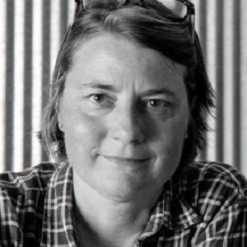
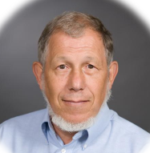
Acknowledgements
Professor Carol Stimmel
ID2050 Instructor
Professor Robert Kinicki
IQP Advisor
Mgr. Kateřina Čížková, BCBA
Founder of Abaceda
Notes:
With that said, the team wants to thank our advisors.
Prof. Stimmel for her support through the ID 2050 course and the proposal writing process.
Prof. Kinicki, our iqp advisor, who will be traveling and working with us in prague.
Magistrate Cizkova, the founder of Abaceda and the sponsor for this project.

Slide 14
References
[1] Burgess, R. (2019, March 5). JPEG. The Art of Autism.
[2] Apara Autism Center. (2021). Sugar Land and Katy. ABA Therapy Services. Retrieved from
https://aparaautism.com/aba-therapy-services/
[3] Prague Castle. (n.d.). lonely planet. Retrieved from https://www.lonelyplanet.com/czech-republic/prague. 78
[4] Klambotski, P. (n.d.). Místo setkávání, přijetí A rozvoje. ABACEDA. Retrieved October 9, 2021, from
https://www.abaceda.cz/.
[5] Klambotski, P. (n.d.). ABACEDA. Retrieved October 9, 2021, from https://www.abaceda.cz/.
[6] Interview. (n.d.). Adobe Stock. Retrieved from https://stock.adobe.com/search?k=business+interview+vertical.
[7] Klambotski, P. (n.d.). ABACEDA. Retrieved October 9, 2021, from https://www.abaceda.cz/.
[8] Storyboard. (2021). Magnas Media. Retrieved from https://magnasmedia.com/how-to-storyboard-your-presentation/.
[9] McAniff, P. (n.d.). Adobe Blog. Retrieved from https://blog.adobe.com/en/publish/2018/02/26/6-tips-still-photographers-learning-shoot-video.html#gs.cvox47.
[10] Stumf, P. (n.d.). Video Editing. Unsplash. Retrieved from https://unsplash.com/photos/yk9VXp4W5-Q.
Notes:
We also want to briefly acknowledge and reference the pictures and data used in this presentation.

Slide 15
Thank you!
Děkuji!
Questions?
Additional Questions can be sent to:
gr-PragueB21-AutismAwareness @wpi.edu
Notes:
And finally, thank you, or dekuji, to everyone here for listening to our presentation. We would love to answer any questions you might have.

