Slide 1
Characterization of 802.11 Wireless Networks in the Home
M. Yarvis. K. Papagiannaki and W. Conner
Intel Research
Presenter - Bob Kinicki
rek@cs.wpi.edu
The First Workshop on Wireless Network Measurements (WiNMee) Trentino, Italy, April 2005
Notes:
Today, Prof Bob Kinicki and I are going to present our paper “Application, Network, and Linklayer measurements of Streaming video over a wireless Campus Network”.
Before I start the presentation, I want to introduce the people from WPI Wireless streaming research group.
They are our group members.
Prof Claypool, prof Kiniki, Mingzhe,Huahui, and Ashishi

Slide 2
Outline
Introduction
Experimental Environment
Results
Conclusions

Slide 3
Introduction
Little was known about the properties of home wireless networks in 2005.
Conjecture is that wireless home behavior will be similar to enterprise wireless network behavior.
The goal was to specifically examine the impact of transmission rate and transmission power on the quality of home wireless links.

Slide 4
Experimental Environment
Experimental Setup
Methodology
Validation

Slide 5
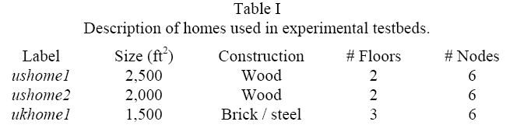
Experimental Setup
Measurements in Three Homes
Six wireless nodes inside each home
Ad Hoc communication (No AP)

Slide 6
Experimental Methodology
Data link layer retransmissions disabled.
300 1024-byte UDP probe packets sent every 500 ms (150 seconds).
No simultaneous transmissions.
Experiments run during the night to avoid interference from moving people.
Allows quantifying loss rate observed by each wireless link.

Slide 7
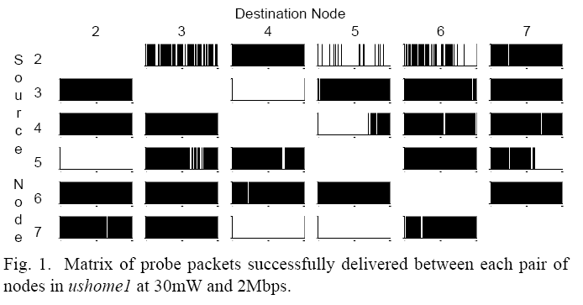
ushome1 Experiments
Link asymmetry

Slide 8
Methodology Validation
Duplicated results
Experimental length
Time of day variability

Slide 9
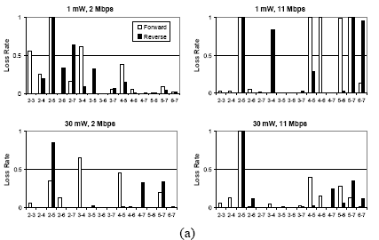
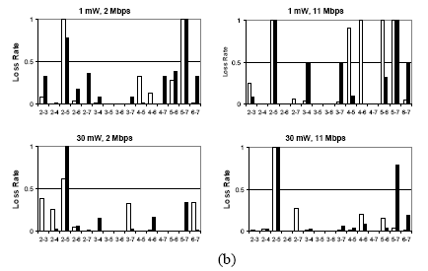
Link performance does not change significantly.

Slide 10
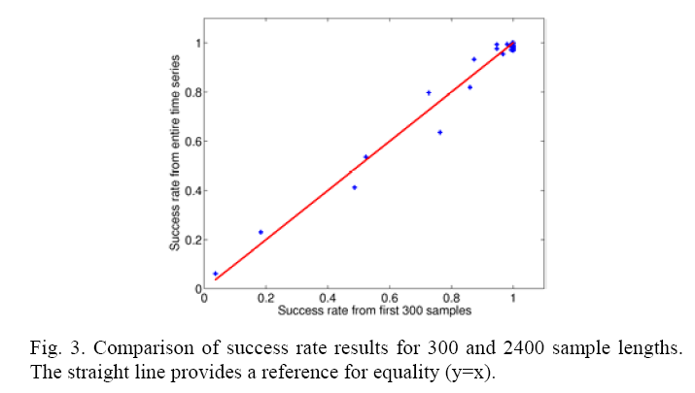
Experiment Length ?

Slide 11
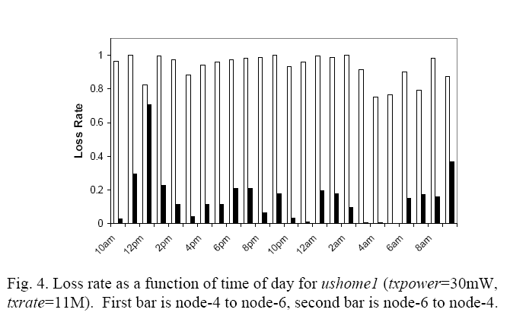
Time of Day Effect ?
Good link remains good, bad link remains bad.

Slide 12
Results
Evaluates the home wireless environment along six dimensions:
Transmission rate (txrate)
Transmission power (txpower)
Node location
House type
External interference
Physical layer

Slide 13
Overall Characteristics
Link loss rates were higher when the encoding rate was higher.
Link loss rates were lower when the power level increased.
Wireless connectivity is NOT omnipresent.
Several asymmetric links were observed.
In most experiments, at least one node pair had 30% loss.

Slide 14
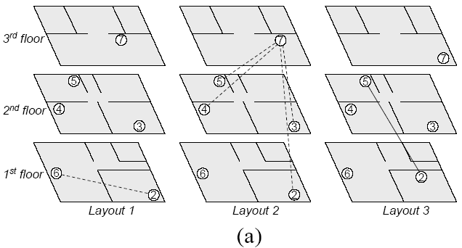
ukhome1

Slide 15
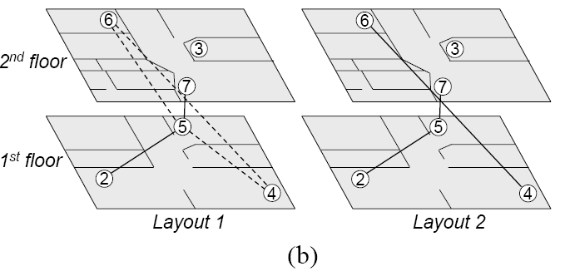
ushome1

Slide 16
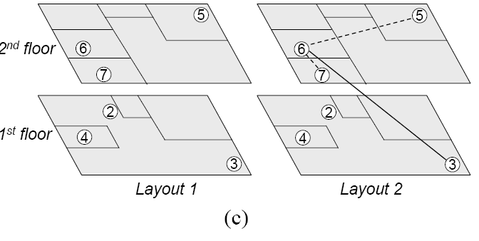
ushome2

Slide 17
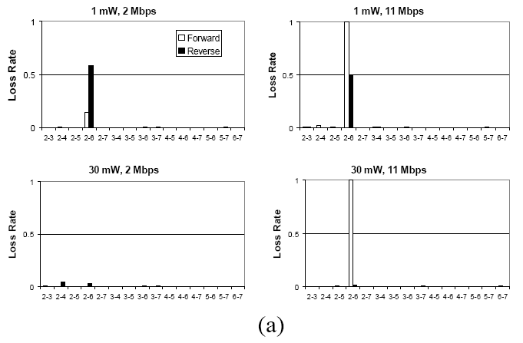
Figure 5
Loss Rates Layout1 ukhome1

Slide 18
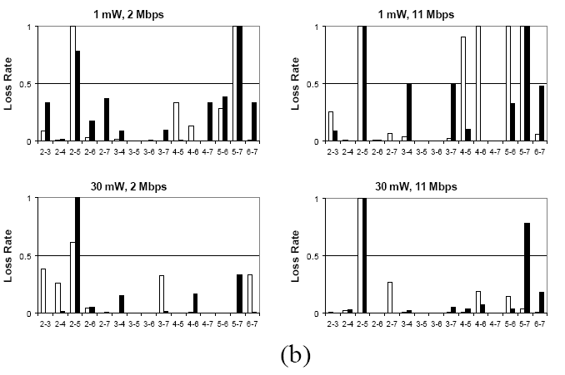
Figure 5
Loss Rates Layout1 ushome1

Slide 19
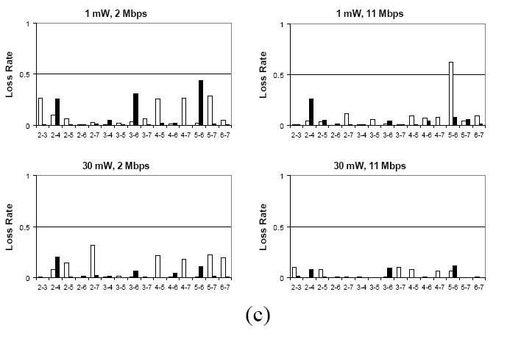
Figure 5
Loss Rates Layout1 ushome2

Slide 20
Small changes in antenna orientation and location
For layout2, layout1 nodes are translated a few inches and antennas are rotated to face another direction.
Conclusion:: exact node placement is a key contributor to performance.

Slide 21
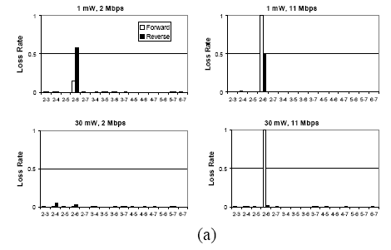
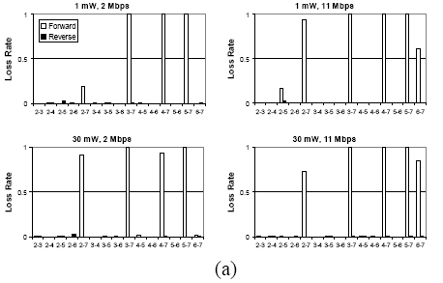
Figure 5a
ukhome1
Layout1
Figure 6a
ukhome1
layout2

Slide 22
ukhome1

Slide 23
Large changes in node placement
For ukhome1 nodes 2 and nodes 7 were moved to a different location within the same room from layout1 to produce layout3.
The other nodes were moved slightly from their layout1 positions.

Slide 24
ukhome1

Slide 25
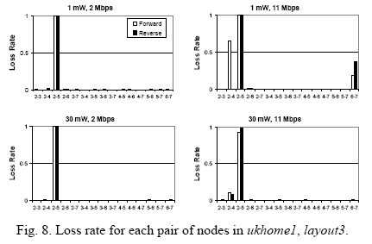
Figure 5a
ukhome1
Layout1
Figure 8
ukhome1
layout3
More significant loss in links and quality

Slide 26
Link quality and distance relationship
Results in Figure 9 for layout2 for all three homes show there is no correlation between physical distance and wireless link quality.
This result holds across homes and across txrate and txpower settings.

Slide 27
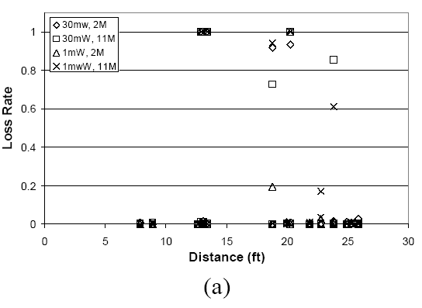
Link quality and distance relationship layout2
Figure 9: ukhome1

Slide 28
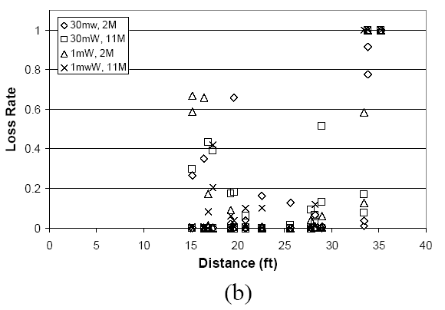
Link quality and distance relationship layout2
Figure 9: ushome1

Slide 29
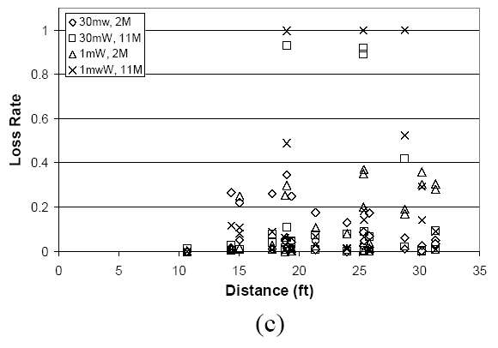
Link quality and distance relationship layout2
Figure 9: ushome2

Slide 30
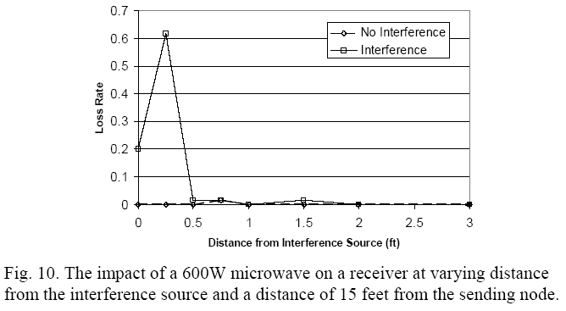
Microwave Oven Interference

Slide 31
Between home comparisons
Small home (ukhome1) had better results sometimes (layout1), but worse performance under layout2.
Precise node location is more important than home size or distance.

Slide 32
IEEE 802.11a Experiments
Results were quite similar to 802.11b results!
802.11a yielded slightly better performance.
Although 802.11a results were more ‘binary’, namely either good or very bad.

Slide 33
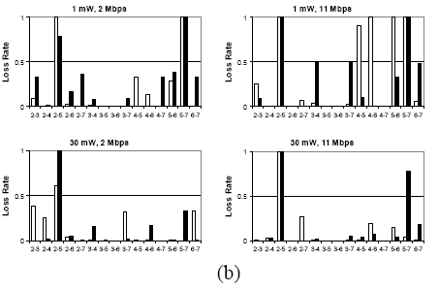
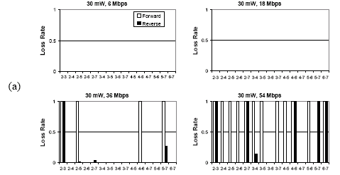
Layout1 ushome1
Figure 5b
802.11b
Figure 11a
802.11a

Slide 34
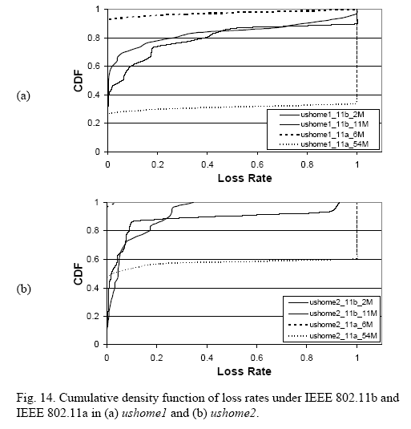
IEEE 802.11a Experiments

Slide 35
Conclusions
Wireless links inside homes tend to be stable over time, highly asymmetric and highly variable from one link to the next.
Precise node location is probably the single most important factor.
Distance has no impact on quality of the wireless links.
Small changes in antenna orientation and node location can dramatically change individual link performance.

Slide 36
Conclusions (cont.)
802.11a performed slightly better in homes.
But for both 802.11a and 802.11b the highest allowable rate may not be possible due to high loss.
Home networks face similar problems to larger networks.
Results imply the location of the AP will have a significant impact on overall performance.

Slide 37
Characterization of 802.11 Wireless Networks in the Home
Thank You!
Questions ??
Notes:
Today, Prof Bob Kinicki and I are going to present our paper “Application, Network, and Linklayer measurements of Streaming video over a wireless Campus Network”.
Before I start the presentation, I want to introduce the people from WPI Wireless streaming research group.
They are our group members.
Prof Claypool, prof Kiniki, Mingzhe,Huahui, and Ashishi

