Slide 1
CS4516: Medical Examiner Client/Server
Evan Frenn (ejfrenn@cs.wpi.edu)

Slide 2
Overview
Objective: Implement both a client and concurrent server with an overlay network emulating four layers of the TCP/IP stack.
    Application Layer: Medical Examiner functionality (Messages)
    Network Layer: Converts messages to packets; Handles sequencing (Packets)
    Data Link Layer: Go Back N sliding window; Error Detection (Frames)
    Physical Layer: Handles sockets and error creation

Slide 3
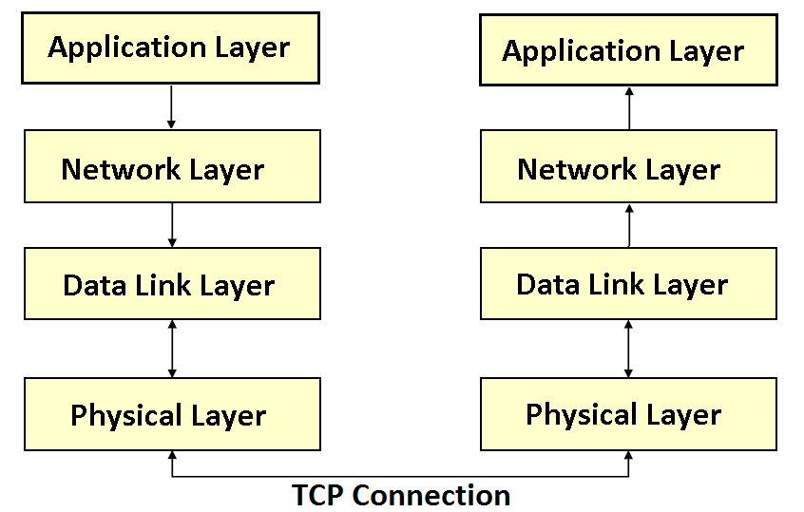
System Structure
Client
Server

Slide 4
Application Layer
Minimum of six client request types. Must include: Input of a photo
Must include message to distinguish user type (authoritative vs. query only)
It is optional to implement application layer separately or as part of the network layer

Slide 5
Network Layer
App Layer
App Layer
Packets
Network Layer
Network Layer
Msg Payload Size <=256 Bytes
dl_send(packet)
dl_rcv(packet)
dl_send(packet)
dl_rcv(packet)
Packet Structure
2 Byte Seq #
Message Payload
Note: The NL may pass packets to the DLL until the sliding window is full

Slide 6
Data Link Layer
Network Layer
Network Layer
Frame
Data Link Layer
Data Link Layer
Msg Payload Size <=150 Bytes
pl_send(frame)
pl_rcv(frame)
pl_send(frame)
pl_rcv(frame)
Frame Structure
Payload
2 Bytes Sequence #
2 Byte Error Detection
1 Byte End-of-Frame
1 Byte Frame Type
Sliding Window >= 4
ARQ
Go-Back N
ACK or NACK?
Piggyback the ACK?

Slide 7
Go-Back N ARQ
Timeout Occurs for frame 3 !!
4 outstanding frames
so go back 4
Go-Back-4:
fr
0
fr
1
fr
2
fr
3
fr
4
fr
5
fr
6
fr
3
fr
4
fr
5
fr
6
fr
7
fr
8
fr
9
time
A
B
ACK1
ACK2
ACK3
Out-of-sequence frames
ACK4
ACK5
ACK6
ACK7
ACK8
ACK9
error
ACKing next frame expected
Leon-Garcia & Widjaja:
Communication Networks

Slide 8
Physical Layer
Data Link Layer
Data Link Layer
Data
Physical Layer
Physical Layer
recv(sockfd,data, len, …)
send(sockfd, data, …)
recv(sockfd,data, len, …)
send(sockfd, data, …)
Forced Single Bit Error
Every 6th data frame
Every 8th ACK frame

Slide 9
Concurrent Server
Server must be able to process multiple clients in parallel
A few ways to achieve concurrency:
    Use fork() – separate processes, no shared memory
    Use threads (pthreads)

Slide 10
Concurrent Server (using fork)
pid_t pid, id;
int listenfd, connfd;
/* 1. create a socket socket() */
if ((listenfd = socket(AF_INET, SOCK_STREAM, 0)) < 0 ){
perror("Error creating socket");
exit(1); }
/* 2. fill in sockaddr_in{ } with server's well-known port */
…
/* 3. bind socket to a sockaddr_in structure bind() */
bind (listenfd, ...);
/* 4. specify the backlog of incoming connection requests listen() */
listen (listenfd, 5);
while(1){
connfd = accept(listenfd, ... );
if(( pid = fork()) == 0){
close(listenfd); /* child closes listening socket */
doit(connfd); /* process the request. this is where the work is done. */
close(connfd); /* done with this client */
exit(0);
}
close(listenfd); /* parent closes the socket */
exit(0);

Slide 11
Data Link Layer: dl_send(packet,…)
Split packet into frame payloads
Go-Back N
Create frame (set params then EC)
Start a timer
Timeout Handler
pl_send(frame)

Slide 12
Frame Structure
Datafield
1. Compute Seq Number,
Frame Type and
End-Of-Frame (EOF)
bytes
Seq
FT
EOP
Datafield
2. Error-Detection (ED)
bytes
(XOR on Seq + FT + EOF + Data)
Seq
FT
EOP
Datafield
ED
2 Bytes
1 Byte
1 Byte
<= 150 Bytes
2 Bytes
EOF: End of Frame ED: Error Detection
FT: Frame Type Seq: Sequence Num

Slide 13
Data Link Layer: Frame Reception
Compute Error Detection value
No
ED Ok?
Return
Yes
ACK
ACK/FRAME
Update window/timer
Frame
No
SEQ Right?
Drop Packet
Yes
pl_send(ACK frame)
Reassemble Packet (store for dl_recv())

Slide 14
Timers
Timers will be used by the data link layer to detect frame loss.
    DLL sets a timer when transmitting a frame
    When the timer expires, DDL handles retransmit of send window up to lost frame
    With Go Back N, it is possible to use a single timer and keep track of time intervals between transmission of frames.
Two options for timers:
    Select
    Signals and Timers

Slide 15
Example Using select()
Can be used to both send/recv at same time and/or as a timer for the data link layer
int select(int nfds, fd_set *readfds, fd_set *writefds, fd_set *exceptfds, struct timeval *timeout);
int main(void)
{
fd_set rfds;
struct timeval tv;
int retval;
/* Watch stdin (fd 0) to see when it has input. */
FD_ZERO(&rfds);
FD_SET(0, &rfds);
/* Wait up to five seconds. */
tv.tv_sec = 5;
tv.tv_usec = 0;
retval = select(1, &rfds, NULL, NULL, &tv);
if (retval == -1)
perror("select()");
else if (retval)
printf("Data is available now.\n");
else // retval == 0 here
printf("No data within five seconds.\n");
exit(EXIT_SUCCESS); }

Slide 16
Signal Example
#include <signal.h>
#include <time.h>
timer_t timer_id;
void timeout(int signal_number){
printf("\n SIGNUM: %d\n", signal_number);
exit(0);
}
void start_timer(){
struct itimerspec time_val;
signal (SIGALRM, timeout);
timer_create(
CLOCK_REALTIME,
NULL, &timer_id);
/* set timeout to 1 second */
time_val.it_value.tv_sec = 1;
time_val.it_value.tv_nsec = 0;
time_val.it_interval.tv_sec = 0;
time_val.it_interval.tv_nsec = 0;
timer_settime(timer_id, 0,
&time_val, NULL);
}
main(){
start_timer();
while(1);
}

Slide 17
Send/Recv “concurrently”
One option mention earlier is to use select()
Another option is to use fcntl() to have the socket not block during recv()
int fcntl(int s, int cmd, long arg);
    Example:
    #include <sys/unistd.h>
    #include <sys/fcntl.h>
    fctnl(socketFD, F_SETFL, O_NONBLOCK);

Slide 18
Questions?

