Slide 1
Fast Ethernet and Gigabit Ethernet
Advanced Computer
Networks

Slide 2
Fast/Gigabit Ethernet Outline
Fast Ethernet
100 BASE T4
8B/6T encoding
100 BASE TX
100 BASE FX
Collision domains
Gigabit Ethernet
1000 BASE SX
8B/10B encoding
Fiber Channel

Slide 3
Fast/Gigabit Ethernet Outline
Gigabit Ethernet (continued)
1000 BASE LX
1000 BASE T
Carrier Extension
Frame Bursting
Buffered Distributor
10 Gbps Ethernet
100 Gbps Ethernet

Slide 4
High-Speed LAN Characteristics
DCC 9th Ed.
Stallings
Notes:
Stallings DCC9e Table 16.1 Characteristics of Some High-Speed LANs

Slide 5
100 Mbps Fast Ethernet
Fast Ethernet concept facilitated by 10Mbps/100Mbps Adapter Cards
DCC 9th Ed.
Stallings
Notes:
Fast Ethernet refers to a set of specifications developed by the IEEE 802.3 committee to provide a low-cost, Ethernet-compatible LAN operating at 100 Mbps. The blanket designation for these standards is 100BASE-T. The committee defined a number of alternatives to be used with different transmission media.
Stallings DCC9e Table 16.3 summarizes key characteristics of the 100BASE-T options. All of the 100BASE-T options use the IEEE 802.3 MAC protocol and frame format. 100BASE-X refers to a set of options that use two physical links between nodes; one for transmission and one for reception. 100BASE-TX makes use of shielded twisted pair (STP) or high-quality (Category 5) unshielded twisted pair (UTP). 100BASE-FX uses optical fiber.
In many buildings, any of the 100BASE-X options requires the installation of new cable. For such cases, 100BASE-T4 defines a lower-cost alternative that can use Category 3, voice-grade UTP in addition to the higher-quality Category 5 UTP. To achieve the 100-Mbps data rate over lower-quality cable, 100BASE-T4 dictates the use of four twisted-pair lines between nodes, with the data transmission making use of three pairs in one direction at a time.
For all of the 100BASE-T options, the topology is similar to that of 10BASE-T, namely a star-wire topology.

Slide 6
Fast Ethernet (100BASE-T)
How to achieve 100 Mbps capacity?
Media Independent Interface
provides three choices.
LLC
Data Link
Layer
MAC
Convergence Sublayer
MII
Physical
Layer
Media Independent Interface
Media Dependent Sublayer

Slide 7
Fast Ethernet Details
UTP Cable has a 30 MHz limit
Not feasible to use clock encoding (i.e., NO Manchester encoding)
Instead use bit encoding schemes with sufficient transitions for receiver to maintain clock synchronization.

Slide 8
100 BASE T4
Spec says can use four separate twisted pairs of Cat 3 UTP (now Cat 5e).
Utilize three pair in both directions (at 33 1/3 Mbps) with other pair for carrier sense/collision detection.
Three-level ternary code is used 8B/6T::
Prior to transmission each set of 8 bits is converted into 6 ternary symbols.

Slide 9
100 BASE T4
The signaling rate becomes
100 x 6/8
------------ = 25 MHz
3
Three signal levels : +V, 0, -V
Codewords are selected such that line is d.c. balanced.
All codewords have a combined weight of 0 or 1.

Slide 10
100 BASE T4
3⁶ = 729 possible codewords.
Only 256 codewords are requires, hence they are selected:
To achieve d.c. balance
Assuming all codewords have at least two signal transitions within them (for receiver clock synchronization).
To solve d.c. wander, whenever a string of codewords with +1 are sent, alternate codewords (inverted before transmission) are used.
To reduce latency, ternary symbols are sent staggered on the three lines.

Slide 11
100 BASE T4
Ethernet Interframe gap of 9.6 microseconds becomes 960 nanoseconds in Fast Ethernet.
100 m. max distance to hub; 200 meters between stations.
Maximum of two Class II repeaters.

Slide 12
100 BASE TX
Uses two pair of twisted pair, one pair for transmission and one pair for reception.
Uses either STP or Cat 5 UTP.
Uses MTL-3 signaling scheme that involves three voltages.
Uses 4B/5B encoding.
There is a guaranteed signal transition at least every two bits.

Slide 13
100 BASE FX
Uses two optical fibers, one for transmission and one for reception.
Uses FDDI technology of converting 4B/5B to NRZI code group streams into optical signals.

Slide 14
Fast Ethernet Repeaters and Switches
Class I Repeater – supports unlike physical media segments (only one per collision domain)
Class II Repeater – limited to single physical media type (there may be two repeaters per collision domain)
Switches – to improve performance can add full-duplex and have autonegotiation for speed mismatches.

Slide 15
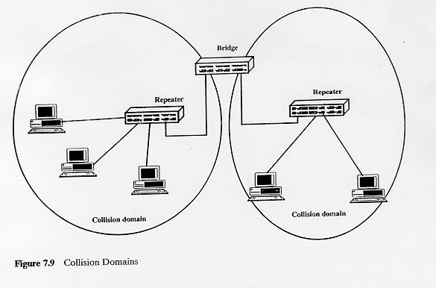
Collision Domains
DCC 6th Ed.
Stallings

Slide 16
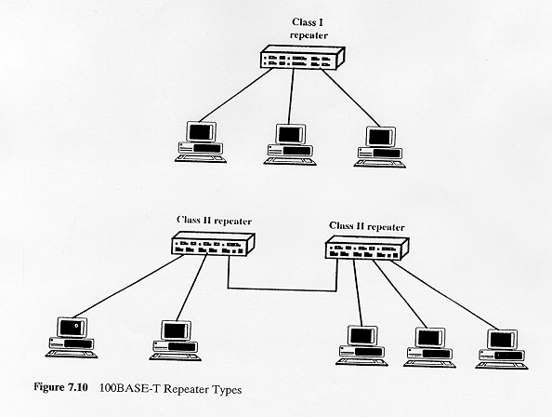
DCC 6th Ed.
Stallings

Slide 17
Full Duplex Operation
Traditional Ethernet is half duplex.
Using full-duplex, a station can transmit and receive simultaneously.
100 Mbps Ethernet (in full-duplex mode) gives a theoretical transfer rate of 200 Mbps.
Stations must have full-duplex adapter cards
Stations must use switching hub.
Notes:
A traditional Ethernet is half duplex: a station can either transmit or receive a frame, but it cannot do both simultaneously. With full-duplex operation, a station can transmit and receive simultaneously. If a 100-Mbps Ethernet ran in full-duplex mode, the theoretical transfer rate becomes 200 Mbps.
Several changes are needed to operate in full-duplex mode. The attached stations must have full-duplex rather than half-duplex adapter cards. The central point in the star wire cannot be a simple multiport repeater but rather must be a switching hub. In this case each station constitutes a separate collision domain. In fact, there are no collisions and the CSMA/CD algorithm is no longer needed. However, the same 802.3 MAC frame format is used and the attached stations can continue to execute the CSMA/CD algorithm, even though no collisions can ever be detected.

Slide 18
Gigabit Ethernet History
In February 1997 the Gigabit Ethernet Alliance announced that IEEE802.3z Task Force met to review the first draft of the Gigabit Ethernet Standard.
According to IDC by the end of 1997 85% of all network connections used Ethernet.
Higher capacity Ethernet was appealing because network managers can leverage their investment in staff skills and training.
1000 BASE X (IEEE802.3z) was ratified in June 1998.

Slide 19
Gigabit Ethernet (1000 BASE X)
Provides speeds of 1000 Mbps (i.e., one billion bits per second capacity) for half-duplex and full-duplex operation.
Uses Ethernet frame format and MAC technology
CSMA/CD access method with support for one repeater per collision domain.
Backward compatible with 10 BASE-T and 100 BASE-T.
Uses 802.3 full-duplex Ethernet technology.
Uses 802.3x flow control.
All Gigabit Ethernet configurations are point-to-point!

Slide 20
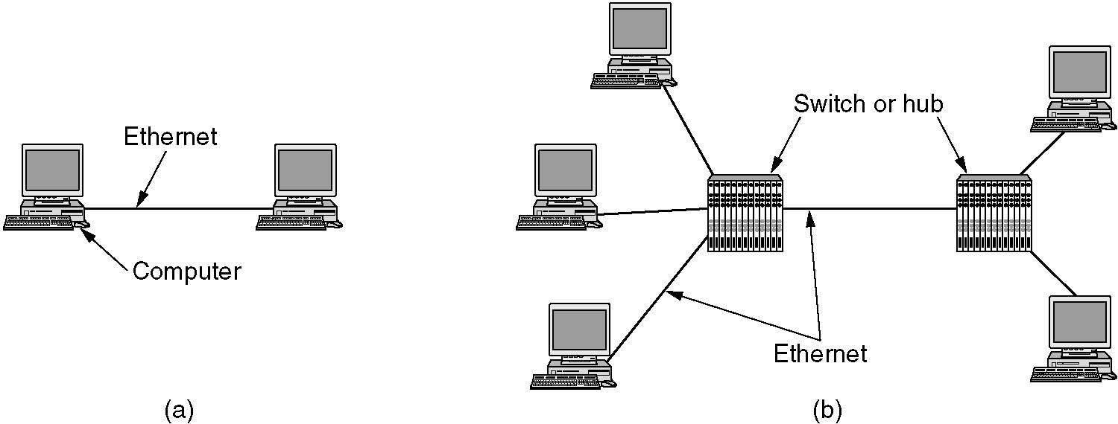
Gigabit Ethernet
Figure 4-22. (a) A two-station Ethernet.
(b) A multistation Ethernet.
Tanenbaum

Slide 21
Gigabit Ethernet Architecture Standard
Source - IEEE
Media Access Control (MAC)
full duplex and/or half duplex
Gigabit Media Independent Interface (GMII)
(optional)
1000 Base – X PHY
8B/10B auto-negotiation
Unshielded twisted pair
IEEE 802.3ab
1000 Base T
PCS
1000 Base-LX
Fiber optic
transceiver
1000 Base-SX
Fiber optic
transceiver
1000 Base-CX
Copper
transceiver
1000 Base T
PMA
transceiver
Single Mode or
Multimode Fiber
Multimode
Fiber
Shieled
Copper Cable
IEEE 802.3z

Slide 22
Gigabit Ethernet Technology
Figure 4-23.Gigabit Ethernet cabling.
1000 BASE SX fiber - short wavelength
1000 BASE LX fiber - long wavelength
1000 BASE CX copper - shielded twisted pair
1000 BASE T copper - unshielded twisted pair
Based on Fiber Channel physical signaling technology.

Slide 23
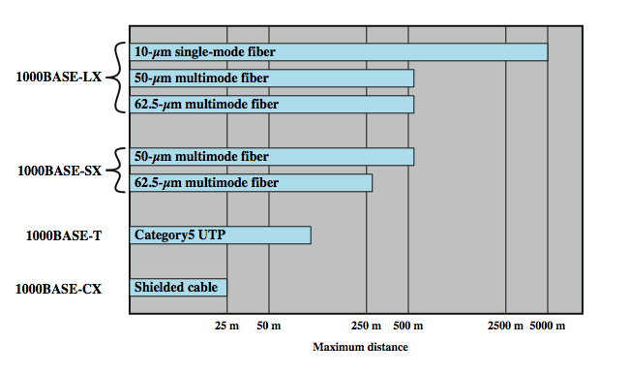
Gigabit Ethernet – Physical
DCC 9th Ed.
Stallings
Notes:
The current 1-Gbps specification for IEEE 802.3 includes the following physical layer alternatives (Stallings DCC9e Figure 16.5):
1000BASE-SX: This short-wavelength option supports duplex links of up to 275 m using 62.5-µm multimode or up to 550 m using 50-µm multimode fiber. Wavelengths are in the range of 770 to 860 nm.
1000BASE-LX: This long-wavelength option supports duplex links of up to 550 m of 62.5-µm or 50-µm multimode fiber or 5 km of 10-µm single-mode fiber. Wavelengths are in the range of 1270 to 1355 nm.
1000BASE-CX: This option supports 1-Gbps links among devices located within a single room or equipment rack, using copper jumpers (specialized shielded twisted-pair cable that spans no more than 25 m). Each link is composed of a separate shielded twisted pair running in each direction.
1000BASE-T: This option makes use of four pairs of Category 5 unshielded twisted pair to support devices over a range of up to 100 m, transmitting and receiving on all four pairs at the same time, with echo cancelation circuitry.
The signal encoding scheme used for the first three Gigabit Ethernet options just listed is 8B/10B, which is described in Appendix 16A. The signal-encoding scheme used for 1000BASE-T is 4D-PAM5, a complex scheme whose description is beyond our scope.

Slide 24
Gigabit Ethernet (1000 BASE-T)
LLC
Data Link
Layer
GMII
MAC
Gigabit Media Independent Interface
Physical Layer
Media Dependent Interface
Medium

Slide 25
Gigabit Media Independent Interface (GMII)
Allows any physical layer to be used with a given MAC.
Namely, Fiber Channel physical layer can be used with CSMA/CD.
Permits both full-duplex and half-duplex.

Slide 26
1000 BASE SX Short wavelength
Supports duplex links up to 275 meters.
770-860 nm range; 850 nm laser wavelength
(FC) Fiber Channel technology
PCS (Physical Code Sublayer) includes 8B/10B encoding with 1.25 Gbps line.
Only multimode fiber
Cheaper than LX.

Slide 27
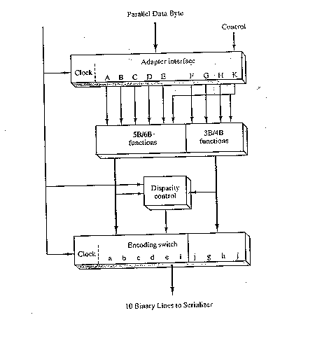
8B/10B Encoder
DCC 6th Ed.
Stallings

Slide 28
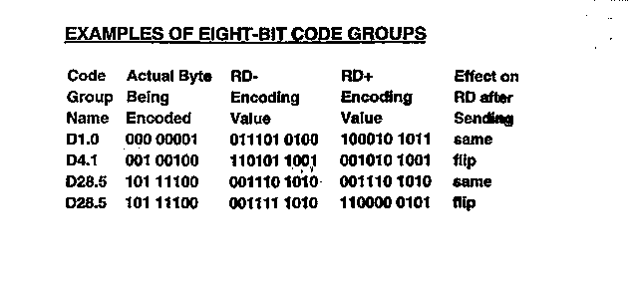
8B/10B Encoding Issues
When the encoder has a choice for codewords, it always chooses the codeword that moves in the direction of balancing the number of 0s and 1s. This keeps the DC component of the signal as low as possible.

Slide 29
1000 BASE LX Long wavelength
Supports duplex links up to 550 meters.
1270-1355 nm range; 1300 nm wavelength using lasers.
Fiber Channel technology
PCS (Physical Code Sublayer) includes 8B/10B encoding with 1.25 Gbps line.
Either single mode or multimode fiber.

Slide 30
1000 BASE CX ‘Short haul’ copper jumpers
Shielded twisted pair.
25 meters or less typically within wiring closet.
PCS (Physical Code Sublayer) includes 8B/10B encoding with 1.25 Gbps line.
Each link is composed of a separate shielded twisted pair running in each direction.

Slide 31
1000 BASE T Twisted Pair
Four pairs of Category 5 UTP.
IEEE 802.3ab ratified in June 1999.
Category 5, 6 and 7 copper up to 100 meters.
This requires extensive signal processing.

Slide 32
Gigabit Ethernet compared to Fiber Channel
Since Fiber Channel (FC) already existed, the idea was to immediately leverage physical layer of FC into Gigabit Ethernet.
The difference is that fiber channel was viewed as specialized for high-speed I/O lines. Gigabit Ethernet is general purpose and can be used as a high-capacity switch.

Slide 33
Gigabit Ethernet
Initially viewed as LAN solution while ATM is now a WAN solution.
Gigabit Ethernet can be shared (hub) or switched.
Shared Hub
Half duplex: CSMA/CD with MAC changes:
Carrier Extension
Frame Bursting
Switch
Full duplex: Buffered repeater called {Buffered Distributor}

Slide 34
Gigabit Ethernet
Figure 4-22. (a) A two-station Ethernet.
(b) A multistation Ethernet.
Tanenbaum

Slide 35
Carrier Extension
Frame
RRRRRRRRRRRRR
Carrier Extension
512 bytes
For 10BaseT : 2.5 km max; slot time = 64 bytes
For 1000BaseT: 200 m max; slot time = 512 bytes
Carrier Extension :: continue transmitting control
This permits minimum 64-byte frame to be handled.
Control characters discarded at destination.
For small frames, LAN throughput is only slightly better than Fast Ethernet.
Based on Raj Jain’s slide

Slide 36
Frame Bursting
Frame
Extension
Frame
Frame
Frame
512 bytes
Frame burst
Source sends out burst of frames without relinquishing control of the network.
Uses Ethernet Interframe gap filled with extension bits (96 bits).
Maximum frame burst is 8192 bytes.
Three times more throughput for small frames.
Based on Raj Jain’s slide

Slide 37
Buffered Distributor
Hub
Based on Raj Jain
slide and Vijay
Moorthy discussion
A buffered distributor is a new type of 802.3 hub where incoming frames are buffered in FIFO queues.
Each port has an input FIFO queue and an output FIFO queue.
A frame arriving at an input queue is forwarded to all output queues, except the one on the incoming port.
CSMA/CD arbitration is done inside the distributor to forward the frames to the output FIFOs.

Slide 38
Buffered Distributor
Hub
Based on Raj Jain
slide and Vijay
Moorthy discussion
Since collisions can no longer occur external to the distributor on the links, the distance restrictions no longer apply.
Since the sender can flood an input FIFO, 802.3x frame-based flow control is used to handle congestion between the sending station and the input port.
All links are full-duplex.

Slide 39
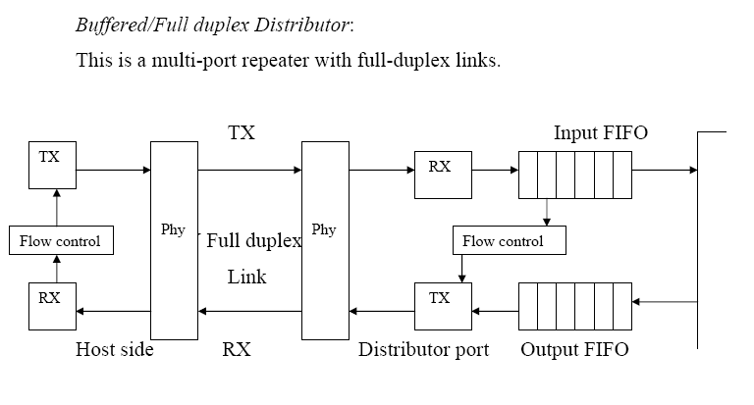
Buffered Distributor
White Paper
By
McIntyre and Arora

Slide 40
10 Gbps Ethernet
Growing interest in 10 Gbps Ethernet.
high-speed backbone use
future wider deployment
Provides an alternative to ATM and other WAN technologies.
Viewed as a uniform technology for LAN, MAN, or WAN.
advantages of 10 Gbps Ethernet
no expensive, bandwidth-consuming conversion between Ethernet packets and ATM cells.
IP and Ethernet together offers QoS and traffic policing approach ATM.
have a variety of standard optical interfaces.
DCC 9th Ed.
Stallings
Notes:
With gigabit products still fairly new, attention has turned in the past several years to a 10-Gbps Ethernet capability. The principle driving requirement for 10 Gigabit Ethernet is the increase in Internet and intranet traffic. A number of factors contribute to the explosive growth in both Internet and intranet traffic:
An increase in the number of network connections
An increase in the connection speed of each end-station (e.g., 10 Mbps users moving to 100 Mbps, analog 56-kbps users moving to DSL and cable modems)
An increase in the deployment of bandwidth-intensive applications such as high-quality video
An increase in Web hosting and application hosting traffic
Initially network managers will use 10-Gbps Ethernet to provide high-speed, local backbone interconnection between large-capacity switches. As the demand for bandwidth increases, 10-Gbps Ethernet will be deployed throughout the entire network and will include server farm, backbone, and campuswide connectivity. This technology enables Internet service providers (ISPs) and network service providers (NSPs) to create very high-speed links at a low cost, between co-located, carrier-class switches and routers.
The technology also allows the construction of metropolitan area networks (MANs) and WANs that connect geographically dispersed LANs between campuses or points of presence (PoPs). Thus, Ethernet begins to compete with ATM and other wide area transmission and networking technologies. In most cases where the customer requirement is data and TCP/IP transport, 10-Gbps Ethernet provides substantial value over ATM transport for both network end users and service providers:
No expensive, bandwidth-consuming conversion between Ethernet packets and ATM cells is required; the network is Ethernet, end to end.
The combination of IP and Ethernet offers quality of service and traffic policing capabilities that approach those provided by ATM, so that advanced traffic engineering technologies are available to users and providers.
A wide variety of standard optical interfaces (wavelengths and link distances) have been specified for 10-Gbps Ethernet, optimizing its operation and cost for LAN, MAN, or WAN applications.

Slide 41
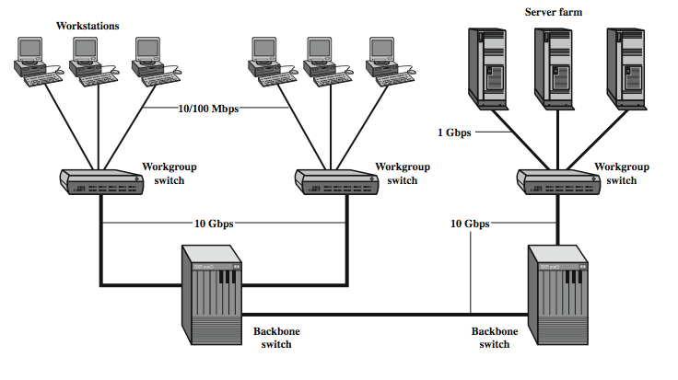
10Gbps Ethernet Configurations
DCC 9th Ed.
Stallings
Notes:
Stallings DCC9e Figure 16.6 illustrates potential uses of 10-Gbps Ethernet. Higher-capacity backbone pipes will help relieve congestion for workgroup switches, where Gigabit Ethernet uplinks can easily become overloaded, and for server farms, where 1-Gbps network interface cards are already in widespread use.
The goal for maximum link distances cover a range of applications: from 300 m to 40 km. The links operate in full-duplex mode only, using a variety of optical fiber physical media.
Four physical layer options are defined for 10-Gbps Ethernet (Figure 16.7). The first three of these have two suboptions: an "R" suboption and a "W" suboption. The R designation refers to a family of physical layer implementations that use a signal encoding technique known as 64B/66B, described in Appendix 16A. The R implementations are designed for use over dark fiber, meaning a fiber optic cable that is not in use and that is not connected to any other equipment. The W designation refers to a family of physical layer implementations that also use 64B/66B signaling but that are then encapsulated to connect to SONET equipment.

Slide 42
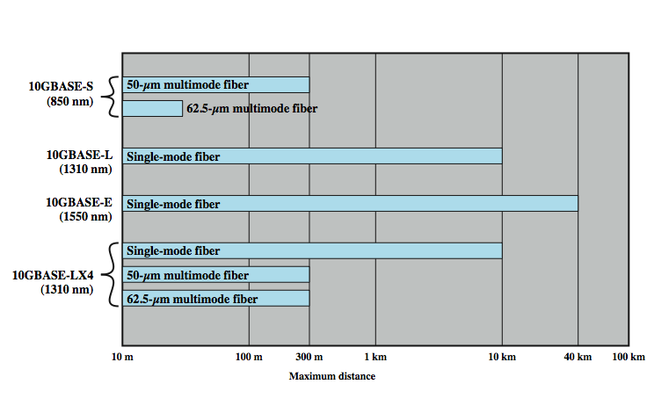
10Gbps Ethernet Options
DCC 9th Ed.
Stallings
Notes:
The four physical layer options are
10GBASE-S (short): Designed for 850-nm transmission on multimode fiber. This medium can achieve distances up to 300 m. There are 10GBASE-SR and 10GBASE-SW versions.
10GBASE-L (long): Designed for 1310-nm transmission on single-mode fiber. This medium can achieve distances up to 10 km. There are 10GBASE-LR and 10GBASE-LW versions.
10GBASE-E (extended): Designed for 1550-nm transmission on single-mode fiber. This medium can achieve distances up to 40 km. There are 10GBASE-ER and 10GBASE-EW versions.
10GBASE-LX4: Designed for 1310-nm transmission on single-mode or multimode fiber. This medium can achieve distances up to 10 km. This medium uses wavelength-division multiplexing (WDM) to multiplex the bit stream across four light waves.
The success of Fast Ethernet, Gigabit Ethernet, and 10-Gbps Ethernet highlights the importance of network management concerns in choosing a network technology. Both ATM and Fiber Channel, explored later, may be technically superior choices for a high-speed backbone, because of their flexibility and scalability. However, the Ethernet alternatives offer compatibility with existing installed LANs, network management software, and applications. This compatibility has accounted for the survival of a nearly 30-year-old technology (CSMA/CD) in today's fast-evolving network environment.

Slide 43
100 Gbps Ethernet
preferred technology for wired LAN.
preferred carrier for bridging wireless technologies into local Ethernet networks
cost-effective, reliable and interoperable
popularity of Ethernet technology:
availability of cost-effective products
reliable and interoperable network products
variety of vendors
DCC 9th Ed.
Stallings
Notes:
Ethernet is widely deployed and is the preferred technology for wired local area networking. Ethernet dominates enterprise LANs, broadband access, data center networking, and has also become popular for communication across metropolitan and even wide area networks. Further, it is now the preferred carrier wire line vehicle for bridging wireless technologies, such as WiFi and WiMAX, into local Ethernet networks.
This popularity of Ethernet technology is due to the availability of cost-effective, reliable, and interoperable networking products from a variety of vendors. The development of converged and unified communications, the evolution of massive server farms, and the continuing expansion of VoIP, TVoIP, and Web 2.0 applications have driven the need for ever faster Ethernet switches. The following are market drivers for 100-Gbps Ethernet:
Data center/Internet media providers: To support the growth of Internet multimedia content and Web applications, content providers have been expanding data centers, pushing 10-Gbps Ethernet to its limits. Likely to be high-volume early adopters of 100-Gbps Ethernet.
Metro-Video/Service Providers: Video on demand has been driving a new generation of 10-Gbps Ethernet metropolitan/core network buildouts. Likely to be high-volume adopters in the medium term.
Enterprise LANs: Continuing growth in convergence of voice/video/data and in unified communications is driving up network switch demands. However, most enterprises still rely on 1-Gbps or a mix of 1-Gbps and 10-Gbps Ethernet, and adoption of 100-Gbps Ethernet is likely to be slow.
Internet exchanges/ISP (Internet Service Provider) core routing: With the massive amount of traffic flowing through these nodes, these installations are likely to be early adopters of 100-Gbps Ethernet.

Slide 44
100 Gbps Ethernet
DCC 9th Ed.
Stallings
Notes:
An example of the application of 100-Gbps Ethernet is shown in Stallings DCC9e Figure 16.8, taken from [NOWE07]. The trend at large data centers, with substantial banks of blade servers, is the deployment of 10-Gbps ports on individual servers to handle the massive multimedia traffic provided by these servers. Such arrangements are stressing the on-site switches needed to interconnect large numbers of servers. A 100GbE rate was proposed to provide the bandwidth required to handle the increased traffic load. It is expected that 100GbE will be deployed in switch uplinks inside the data center as well as providing interbuilding, intercampus, MAN, and WAN connections for enterprise networks.
The success of Fast Ethernet, Gigabit Ethernet, and 10-Gbps Ethernet highlights the importance of network management concerns in choosing a network technology. The 40-Gbps and 100-Gbps Ethernet specifications offer compatibility with existing installed LANs, network management software, and applications. This compatibility has accounted for the survival of 30-year-old technology in today's fast-evolving network environment.

Slide 45
Fast/Gigabit Ethernet Summary
Fast Ethernet
100 BASE T4
8B/6T encoding
100 BASE TX
100 BASE FX
Collision domains
Gigabit Ethernet
1000 BASE SX
8B/10B encoding
Fiber Channel

Slide 46
Fast/Gigabit Ethernet Summary
Gigabit Ethernet (continued)
1000 BASE LX
1000 BASE T
Carrier Extension
Frame Bursting
Buffered Distributor
10 Gbps Ethernet
100 Gbps Ethernet

