Slide 1
Point-to-Point Network Switching
Advanced Computer Networks

Slide 2
Network Switching Outline
Circuit Switching, Message Switching, Packet Switching, Cell Switching
Connection-Oriented versus Connectionless Protocols
Virtual Circuit versus Datagram Networks
External/Internal Subnet Abstractions

Slide 3
Circuit Switching
Seeking out and establishing a physical copper path from end-to-end [historic definition] .
Circuit switching implies the need to first set up a dedicated, end-to-end path for the connection before the information transfer takes place.
Once the connection is made, the only delay is propagation time.

Slide 4
Circuit Switching
Figure 2-38. (a) Circuit switching. (b) Packet switching.
Tanenbaum

Slide 5
Store-and-Forward Networks
Intermediate processors (IMPS, nodes, routers, gateways, switches) along the path store the incoming block of data.
Each block is received in its entirety at the router, inspected for errors, and retransmitted along the path to the destination.
This implies buffering at the router and one transmission time per hop.

Slide 6
Store-and-Forward Routers

Slide 7
‘Cut Through’ Routers

Slide 8
Message Switching
A store-and-forward network where the block of transfer is a complete message.
Since messages can be quite large, this can cause:
buffering problems at the router
high mean delay times.

Slide 9
Packet Switching
A store-and-forward network where the block of transfer is a complete packet.
A packet is a variable length block of data with a fixed upper bound.
**Using packets improves mean message delay.

Slide 10
Cell Switching
53 bytes
A network where the unit of transfer is a small, fixed-size block of date (i.e., a cell).
ATM (Asynchronous Transfer Mode) networks use 53-byte cells.

Slide 11
Packet Switched Networks
Connection-Oriented Protocols
A setup stage is used to determine the end-to-end path before a connection is established.
Data flow streams are identified by some type of connection indicator (e.g. OSI, X.25, SNA, ATM).

Slide 12
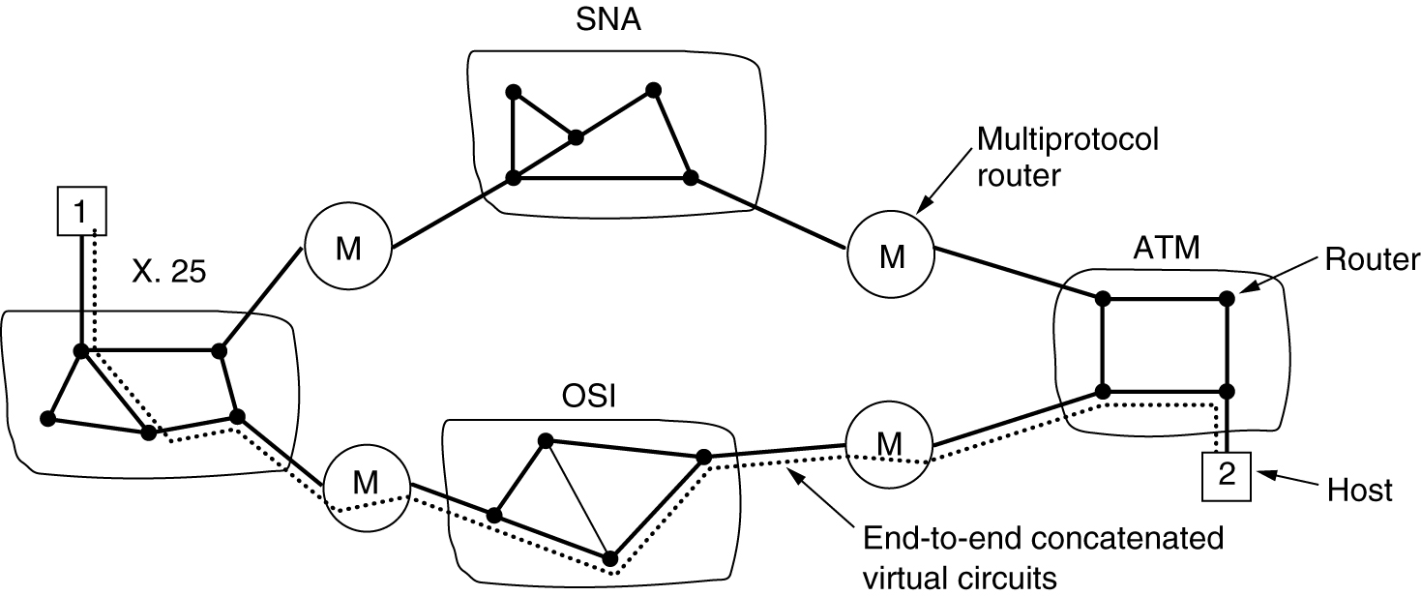
Connection-Oriented Virtual Circuits
Figure 5-45.Internetworking using concatenated
virtual circuits.
Tanenbaum

Slide 13
Packet Switched Networks
Connectionless Protocols
No set up is needed.
Each packet contains information which allows the packet to be individually routed hop-by-hop through the network.
Bifurcated and adaptive routing techniques are possible.

Slide 14
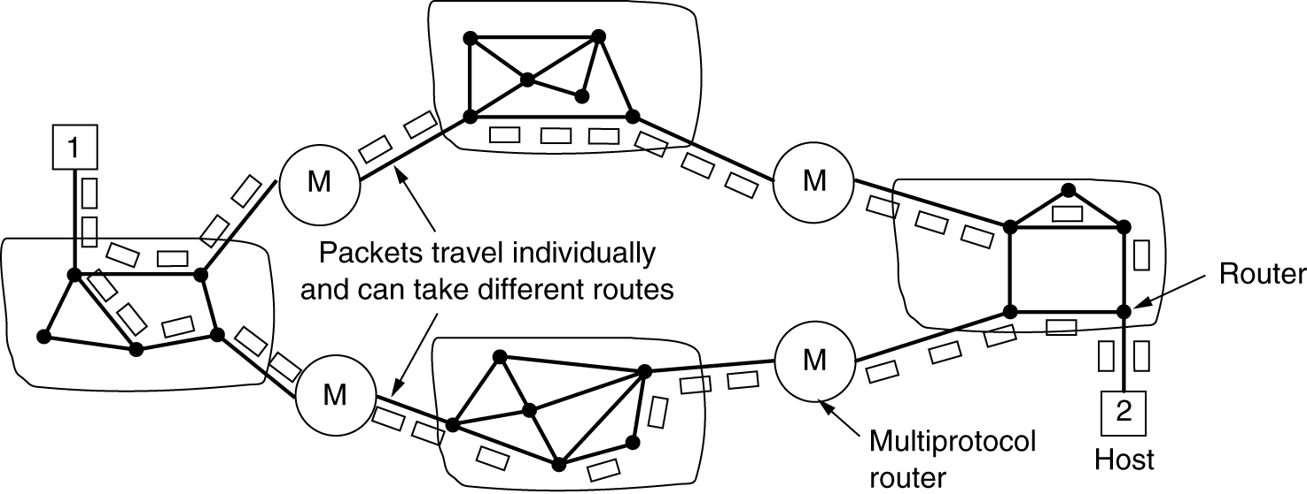
Connectionless Internetworking
Figure 5-46. A connectionless internet.
Tanenbaum

Slide 15
Datagram vs Virtual Circuit
Datagram Routing
Each datagram packet may be individually routed.
Virtual Circuit Routing
In virtual circuit, set up is required.
All packets in a virtual circuit follow the same path through the network.

Slide 16
Transmission Event Timing
DCC 6th Ed., W. Stallings, Figure 10.3

Slide 17
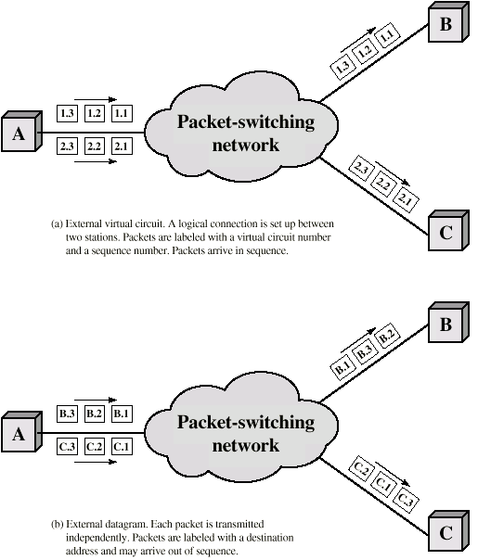
External
Virtual Circuit
And Datagram
Operation
DCC 6th Ed.,
W. Stallings,
Figure 10.4

Slide 18
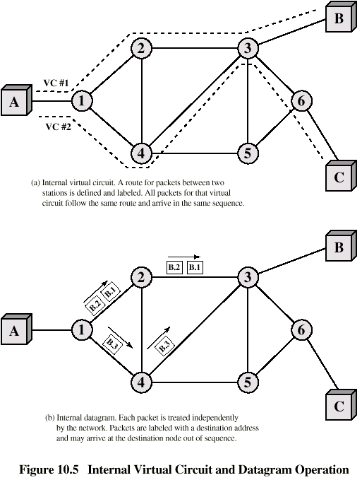
Internal
Virtual Circuit
And Datagram
Operation
DCC 6th Ed.,
W. Stallings,
Figure 10.5

Slide 19
Networking Switching Summary
Circuit-switching and message switching are now obsolete.
Store-and- forward, datagram packet switching (IP routers) dominates the Internet.
Cell switching and virtual circuits (ATM switches) still exists in ATM networks.
The external protocol abstraction to the subnet may differ from the internal subnet view.
e.g. TCP is connection-oriented protocol that runs on top of a datagram IP protocol.

