Slide 1
Asynchronous Transfer Mode (ATM)
Advanced Computer Networks

Slide 2
ATM Outline
Motivation for ATM Architecture
Design Assumptions
ATM Adaptation Layers
Old ATM Design
Revised ATM Design
AAL Details
MPLS

Slide 3
Issues Driving LAN Changes
Traffic Integration
Voice, video and data traffic
Multimedia became the ‘buzz word’
One-way batch Web traffic
Two-way batch voice messages
One-way interactive Mbone broadcasts
Two-way interactive video conferencing
Quality of Service guarantees (e.g. limited jitter, non-blocking streams)
LAN Interoperability
Mobile and Wireless nodes

Slide 4
Stallings’ “High-Speed Networks”
Backbone

Slide 5
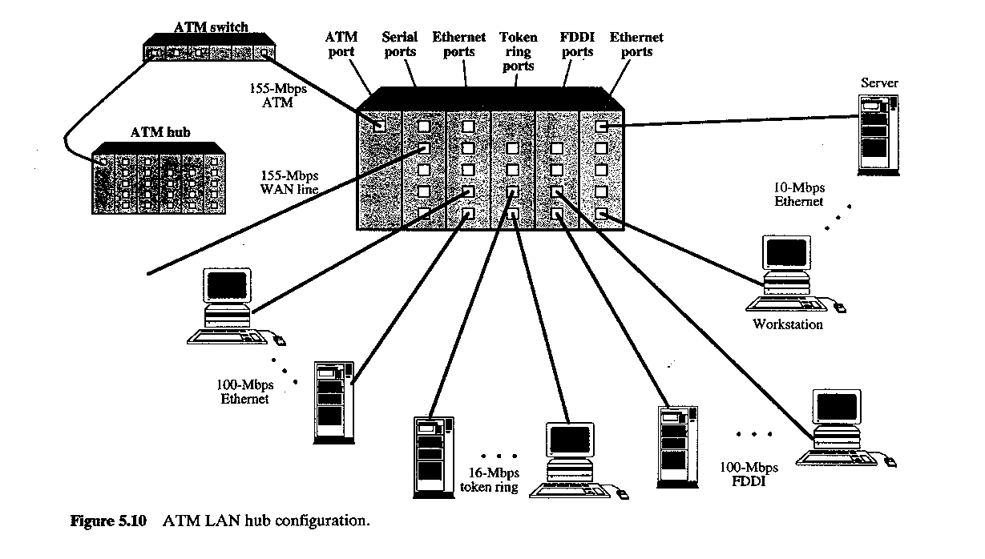
Stallings’ “High Speed Networks”

Slide 6
ATM Adaptation Layers
Voice
A/D
AAL
s_{1 ,} s₂ …
cells
Digital voice samples
Video
A/D
…
Compression
AAL
cells
picture frames
compressed frames
Data
AAL
Bursty variable-length packets
cells
Leon-Garcia & Widjaja:
Communication Networks

Slide 7
Asynchronous Transfer Mode (ATM)
Voice
Data packets
MUX
Wasted bandwidth
Images
TDM
4 3 2 1 4 3 2 1 4 3 2 1
ATM
4 3 1 3 2 2 1
Leon-Garcia & Widjaja:
Communication Networks

Slide 8
ATM
ATM standard (defined by CCITT) was widely accepted by common carriers as mode of operation for communication (particularly BISDN).
ATM is a form of cell switching using small fixed-sized packets.
Basic ATM Cell Format
5 Bytes
48 Bytes
Header
Payload

Slide 9
ATM Conceptual Model Four Design Assumptions
1. ATM network will be organized as a hierarchy.
User’s equipment connects to networks via a UNI (User-Network Interface).
Connections between provided networks are made through NNI (Network-Network Interface).
2. ATM will be connection-oriented.
A connection (an ATM channel) must be established before any cells are sent.

Slide 10
ATM Hierarchy
Private UNI
Private ATM network
Leon-Garcia & Widjaja:
Communication Networks
X
X
Private NNI
X
Public UNI
Public ATM network A
X
X
NNI
Public UNI
X
B-ICI
Public ATM network B
X
Public UNI
X
X

Slide 11
ATM Connections
two levels of ATM connections:
virtual path connections
virtual channel connections
indicated by two fields in the cell header:
virtual path identifier VPI
virtual channel identifier VCI

Slide 12
ATM Virtual Connections
Virtual Paths
Physical Link
Virtual Channels
Leon-Garcia & Widjaja:
Communication Networks

Slide 13
ATM Conceptual Model Assumptions (cont.)
3. Vast majority of ATM networks will run on optical fiber networks with extremely low error rates.
4. ATM must support low cost attachments.
This decision lead to a significant decision: to prohibit cell reordering in ATM networks.
➔ ATM switch design is more difficult.

Slide 14
UNI Cell Format
GFC (4 bits)
VPI (4 bits)
VPI (4 bits)
VCI (4 bits)
ATM cell header
VCI (8 bits)
VCI (4 bits)
PT (3 bits)
CLP (1 bit)
HEC (8 bits)
Payload (48 bytes)
Leon-Garcia & Widjaja:
Communication Networks

Slide 15
ATM Cell Switching
1
Switch
voice
67
1
…
video
67
2
5
video
25
voice
32
25
N
75
32
1
67
data
39
3
32
3
39
6
data
32
video
61
61
2
67
…
…
N
video
75
N
Leon-Garcia & Widjaja:
Communication Networks

Slide 16
Two Levels of ATM Switches
VP3
a
VP5
a
b
ATM
Sw
1
ATM
DCC
ATM
Sw
2
b
c
ATM
Sw
3
c
d
e
VP2
VP1
ATM
Sw
4
d
Sw = switch
e
Digital Cross Connect
Only switches virtual paths
Leon-Garcia & Widjaja:
Communication Networks

Slide 17
ATM Protocol Architecture
ATM Adaptation Layers (AAL) – the protocol for packaging data into cells is collectively referred to as AAL.
Must efficiently package higher level data such as voice samples, video frames and datagram packets into a series of cells.
Design Issue: How many adaptation layers should there be?

Slide 18
ATM Protocol Architecture
Management plane
Plane management
Control plane
User plane
Layer management
Higher layers
Higher layers
ATM Adaptation Layer
ATM layer
Physical layer
Leon-Garcia & Widjaja:
Communication Networks

Slide 19
ATM in the Protocol Stack
User information
User information
AAL
AAL
ATM
ATM
ATM
ATM
PHY
PHY
PHY
PHY
…
End system
Network
End system
Leon-Garcia & Widjaja:
Communication Networks

Slide 20
Original ATM Architecture
CCITT envisioned four classes of applications (A-D) requiring four distinct adaptation layers (1-4) which would be optimized for an application class:
Constant bit-rate applications CBR
Variable bit-rate applications VBR
Connection-oriented data applications
Connectionless data application

Slide 21
ATM Architecture
An AAL was further divided into:
Convergence Sublayer (CS)
manages the flow of data to and from SAR sublayer.
Segmentation and Reassembly Sublayer
(SAR)
breaks data into cells at the sender and reassembles
cells into larger data units at the receiver.

Slide 22
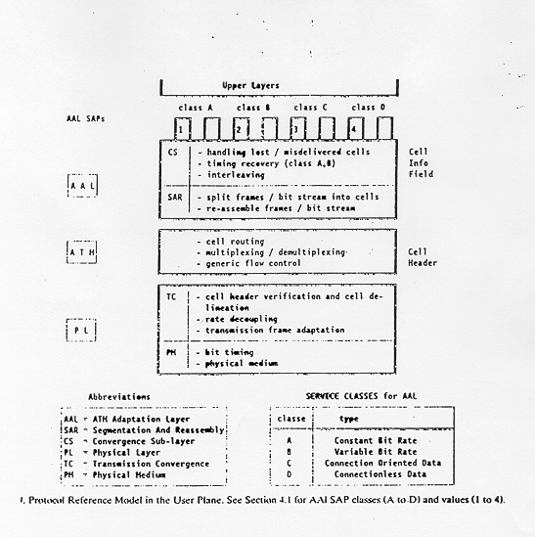
Original ATM Architecture

Slide 23
Physical Layer ATM Adjustments
ATM layer
Transmission convergence sublayer
Physical layer
Physical medium dependent sublayer
Physical medium

Slide 24
Original ATM Architecture
The AAL interface was initially defined as classes A-D with SAP (Service Access Points) for AAL1-4.
AAL3 and AAL4 were so similar that they were merged into AAL3/4.
The data communications community concluded that AAL3/4 was not suitable for data communications applications. They pushed for standardization of AAL5 (also referred to as SEAL – the Simple and Efficient Adaptation Layer).
AAL2 was not initially deployed.

Slide 25
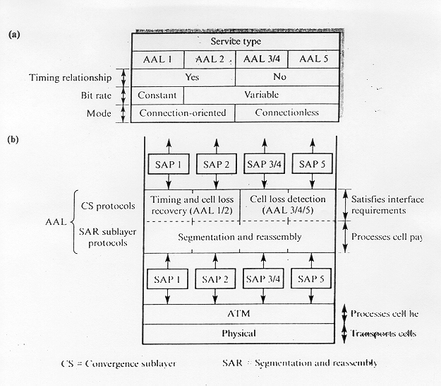
Revised ATM Architecture

Slide 26
Revised ATM Service Categories
Class | Description | Example
CBR | Constant Bit Rate | T1 circuit
RT-VBR | Real Time Variable Bit Rate | Real-time videoconferencing
NRT-VBR | Non-real-time Variable Bit Rate | Multimedia email
ABR | Available Bit Rate | Browsing the Web
UBR | Unspecified Bit Rate | Background file transfer

Slide 27
QoS, PVC, and SVC
Quality of Service (QoS) requirements are handled at connection time and viewed as part of signaling (e.g., RSVP).
ATM provides permanent virtual connections and switched virtual connections.
Permanent Virtual Connections (PVC)
permanent connections set up manually by network manager.
Switched Virtual Connections (SVC)
set up and released on demand by the end user via signaling procedures.

Slide 28
AAL 1
(b) CS PDU with pointer in structured data transfer
47 Bytes
AAL 1 Pointer
1 Byte
46 Bytes
optional
(a) SAR PDU header
CSI
Seq. Count
SNP
1 bit 3 bits 4 bits
Leon-Garcia & Widjaja:
Communication Networks

Slide 29
AAL 1
Higher layer
User data stream
b₁ b₂ b₃
…
Convergence sublayer
CS PDUs
47
47
47
SAR PDUs
SAR sublayer
H
H
H
1 47
1 47
1 47
ATM layer
H
H
ATM Cells
H
5 48
5 48
5 48
Leon-Garcia & Widjaja:
Communication Networks

Slide 30
AAL 3/4 CS and SAR PDUs
(a) CPCS-PDU format
Header
Trailer
CPI Btag BASize
CPCS - PDU Payload
Pad
AL Etag Length
1 1 2 1 - 65,535 0-3 1 1 2 (bytes) (bytes) (bytes)
(b) SAR PDU format
Header (2 bytes)
Trailer (2 bytes)
ST SN MID
SAR - PDU Payload
LI CRC
2 4 10 44 6 10 (bits) (bytes) (bits)
Leon-Garcia & Widjaja:
Communication Networks

Slide 31
AAL 3/4
Higher layer
Information
User message
Service specific convergence sublayer
Assume null
Common part convergence sublayer
Pad message to multiple of 4 bytes. Add header and trailer.
H
Information
PAD
T
4
4
Each SAR-PDU consists of 2-byte header, 2-byte trailer, and 44-byte payload.
SAR sublayer
…
2 44 2
2 44 2
2 44 2
ATM layer
…
Leon-Garcia & Widjaja:
Communication Networks

Slide 32
AAL 5
Convergent Sublayer Format
Information
Pad
UU CPI Length CRC
0 - 65,535 0-47 1 1 2 4 (bytes) (bytes)
SAR Format
ATM
Header
48 bytes of Data
1-bit end-of-datagram field (PTI)
Leon-Garcia & Widjaja:
Communication Networks

Slide 33
AAL 5
Higher layer
Information
Service specific convergence sublayer
Assume null
Common part convergence sublayer
Information
PAD
T
SAR sublayer
…
48 (0)
48 (0)
48 (1)
ATM layer
…
Leon-Garcia & Widjaja:
Communication Networks
PTI = 1
PTI = 0
PTI = 0

Slide 34
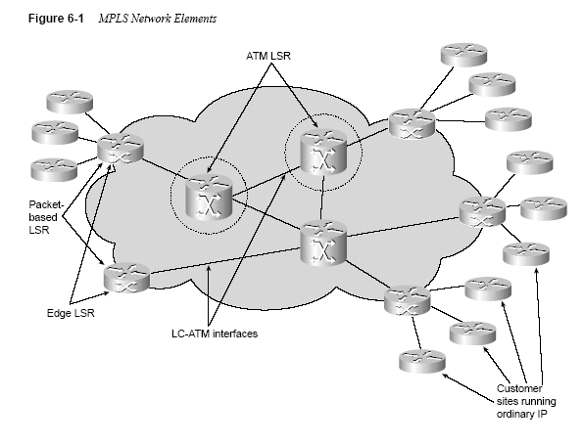
MPLS (Multi Protocol Label Switching)

Slide 35
The Nortel Networks Passport 8600 Routing Switch
designed for high-performance Enterprise, carrier, and service provider networks.
As a chassis based Ethernet switching platform, the Passport 8600 series provides wire speed L2-L7 traffic classification, filtering, forwarding and routing. Hardware based wire speed performance enables fast and efficient traffic classification, policy enforcement and filtering.
Provides wire speed L2- L7 traffic classification.

Slide 36
The Nortel Networks Passport 8600 Routing Switch
Multi-layer redundancy with five 9s reliability
Integrated intelligent bandwidth connectivity for 10/100/1000 Ethernet, ATM, PoS,10 Gig and WDM
Seamless LAN/MAN/WAN connectivity
Eight policy enabled hardware queues per port
512 Gigabits per second backplane switch capacity

Slide 37
ATM Summary
Motivation for ATM Architecture
Four Design Assumptions
ATM Hierarchy
UNI,NNI, VPI, VCI, two switch levels
Old ATM Design
Convergence Sublayer (CS), Segmentation and Reassembly Sublayer (SAR)
ATM Adaptation Layers
AAL1-4

Slide 38
ATM Summary
New ATM Design
PVC, SVC
AAL Details
AAL1, AAL3-4, AAL5
Multi-Protocol Layer Switching (MPLS)
Passport Switch

