Slide 1

Chapter 5
Link Layer and LANs
A note on the use of these ppt slides:
We’re making these slides freely available to all (faculty, students, readers). They’re in PowerPoint form so you can add, modify, and delete slides (including this one) and slide content to suit your needs. They obviously represent a lot of work on our part. In return for use, we only ask the following:
If you use these slides (e.g., in a class) in substantially unaltered form, that you mention their source (after all, we’d like people to use our book!)
If you post any slides in substantially unaltered form on a www site, that you note that they are adapted from (or perhaps identical to) our slides, and note our copyright of this material.
Thanks and enjoy! JFK/KWR
All material copyright 1996-2009
J.F Kurose and K.W. Ross, All Rights Reserved
Computer Networking: A Top Down Approach
5th edition.
Jim Kurose, Keith Ross
Addison-Wesley, April 2009.

Slide 2
Chapter 5: The Data Link Layer
Our goals:
understand principles behind data link layer services:
  error detection, correction
  sharing a broadcast channel: multiple access
  link layer addressing
  reliable data transfer, flow control: done!
instantiation and implementation of various link layer technologies

Slide 3
Link Layer
5.1 Introduction and services
5.2 Error detection and correction
5.3Multiple access protocols
5.4 Link-layer Addressing
5.5 Ethernet
5.6 Link-layer switches
5.7 PPP
5.8 Link virtualization: MPLS
5.9 A day in the life of a web request

Slide 4

Link Layer: Introduction
Some terminology:
hosts and routers are nodes
communication channels that connect adjacent nodes along communication path are links
  wired links
  wireless links
  LANs
layer-2 packet is a frame, encapsulates datagram
data-link layer has responsibility of
transferring datagram from one node
to adjacent node over a link

Slide 5
Link layer: context
datagram transferred by different link protocols over different links:
  e.g., Ethernet on first link, frame relay on intermediate links, 802.11 on last link
each link protocol provides different services
  e.g., may or may not provide rdt over link
transportation analogy
trip from Princeton to Lausanne
  limo: Princeton to JFK
  plane: JFK to Geneva
  train: Geneva to Lausanne
tourist = datagram
transport segment = communication link
transportation mode = link layer protocol
travel agent = routing algorithm

Slide 6
Link Layer Services
framing, link access:
  encapsulate datagram into frame, adding header, trailer
  channel access if shared medium
  “MAC” addresses used in frame headers to identify source, dest
    different from IP address!
reliable delivery between adjacent nodes
  we learned how to do this already (chapter 3)!
  seldom used on low bit-error link (fiber, some twisted pair)
  wireless links: high error rates
    Q: why both link-level and end-end reliability?

Slide 7
Link Layer Services (more)
flow control:
  pacing between adjacent sending and receiving nodes
error detection:
  errors caused by signal attenuation, noise.
  receiver detects presence of errors:
    signals sender for retransmission or drops frame
error correction:
  receiver identifies and corrects bit error(s) without resorting to retransmission
half-duplex and full-duplex
  with half duplex, nodes at both ends of link can transmit, but not at same time

Slide 8
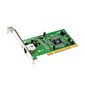
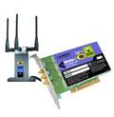
Where is the link layer implemented?
in each and every host
link layer implemented in “adaptor” (aka network interface card NIC)
  Ethernet card, PCMCI card, 802.11 card
  implements link, physical layer
attaches into host’s system buses
combination of hardware, software, firmware
host schematic
application
transport
network
link
cpu
memory
link
physical
host
bus
(e.g., PCI)
controller
physical
transmission
network adapter
card

Slide 9
Adaptors Communicating
datagram
datagram
controller
controller
sending host
receiving host
datagram
frame
sending side:
  encapsulates datagram in frame
  adds error checking bits, rdt, flow control, etc.
receiving side
  looks for errors, rdt, flow control, etc
  extracts datagram, passes to upper layer at receiving side

Slide 10
Link Layer
5.1 Introduction and services
5.2 Error detection and correction
5.3Multiple access protocols
5.4 Link-layer Addressing
5.5 Ethernet
5.6 Link-layer switches
5.7 PPP
5.8 Link virtualization: MPLS
5.9 A day in the life of a web request

Slide 11
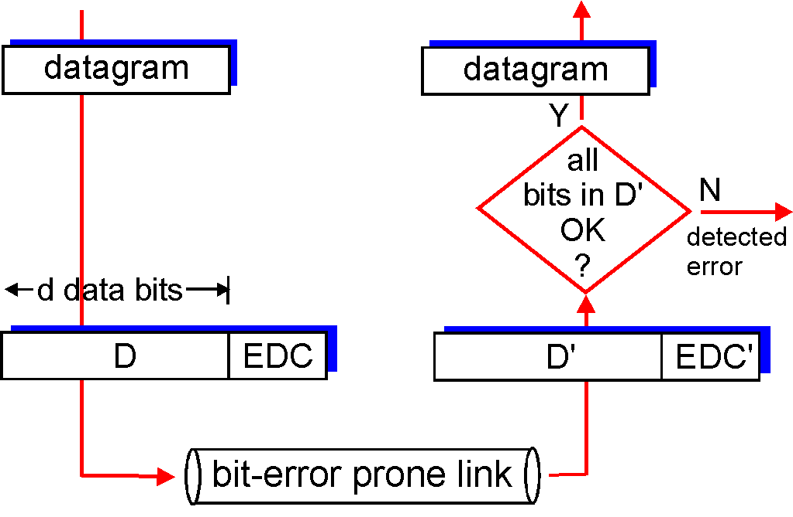
Error Detection
EDC= Error Detection and Correction bits (redundancy)
D = Data protected by error checking, may include header fields
Error detection not 100% reliable!
  protocol may miss some errors, but rarely
  larger EDC field yields better detection and correction
otherwise

Slide 12
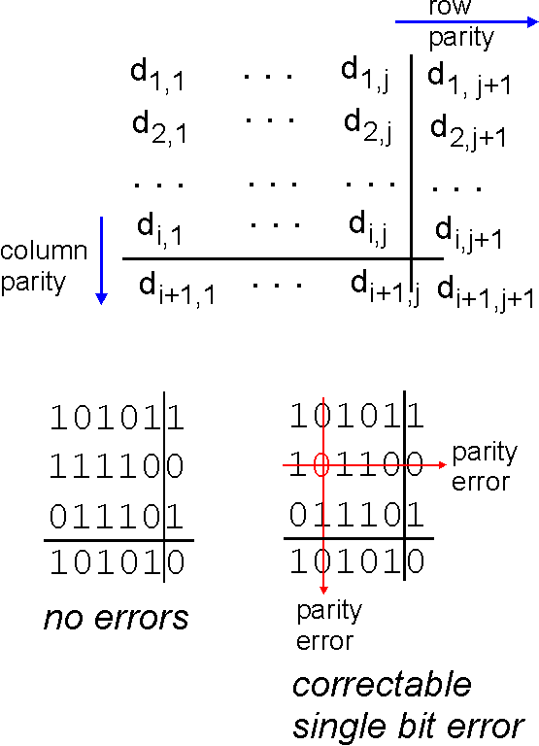
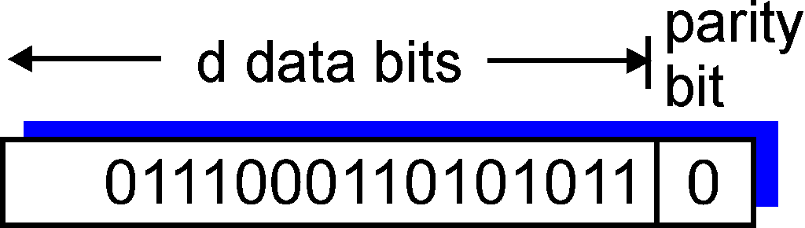
Parity Checking
Single Bit Parity:
Detect single bit errors
Two Dimensional Bit Parity:
Detect and correct single bit errors
0
0

Slide 13
Internet checksum (review)
Goal: detect “errors” (e.g., flipped bits) in transmitted packet (note: used at transport layer only)
Sender:
treat segment contents as sequence of 16-bit integers
checksum: addition (1’s complement sum) of segment contents
sender puts checksum value into UDP checksum field
Receiver:
compute checksum of received segment
check if computed checksum equals checksum field value:
  NO - error detected
  YES - no error detected. But maybe errors nonetheless?

Slide 14
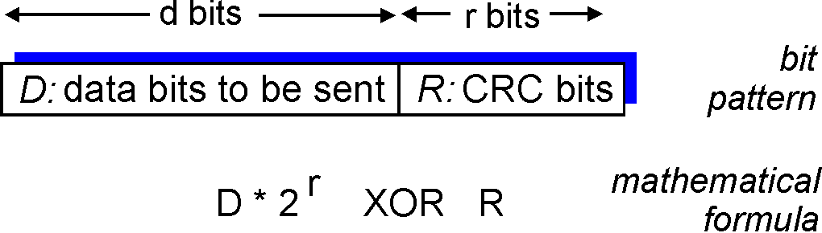
Checksumming: Cyclic Redundancy Check
view data bits, D, as a binary number
choose r+1 bit pattern (generator), G
goal: choose r CRC bits, R, such that
  <D,R> exactly divisible by G (modulo 2)
  receiver knows G, divides <D,R> by G. If non-zero remainder: error detected!
  can detect all burst errors less than r+1 bits
widely used in practice (Ethernet, 802.11 WiFi, ATM)

Slide 15
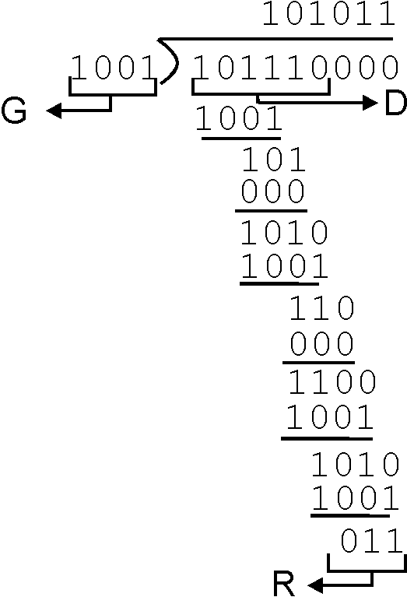
CRC Example
Want:
  D.2^{r} XOR R = nG
equivalently:
  D.2^{r} = nG XOR R
equivalently:
if we divide D.2^{r} by G, want remainder R
D.2^{r}
G
R = remainder[ ]

Slide 16
Link Layer
5.1 Introduction and services
5.2 Error detection and correction
5.3Multiple access protocols
5.4 Link-layer Addressing
5.5 Ethernet
5.6 Link-layer switches
5.7 PPP
5.8 Link virtualization: MPLS
5.9 A day in the life of a web request

Slide 17


Multiple Access Links and Protocols
Two types of “links”:
point-to-point
  PPP for dial-up access
  point-to-point link between Ethernet switch and host
broadcast (shared wire or medium)
  old-fashioned Ethernet
  upstream HFC
  802.11 wireless LAN
humans at a
cocktail party
(shared air, acoustical)
shared wire (e.g.,
cabled Ethernet)
shared RF
(e.g., 802.11 WiFi)
shared RF
(satellite)

Slide 18
Multiple Access protocols
single shared broadcast channel
two or more simultaneous transmissions by nodes: interference
  collision if node receives two or more signals at the same time
multiple access protocol
distributed algorithm that determines how nodes share channel, i.e., determine when node can transmit
communication about channel sharing must use channel itself!
  no out-of-band channel for coordination

Slide 19
Ideal Multiple Access Protocol
Broadcast channel of rate R bps
1. when one node wants to transmit, it can send at rate R.
2. when M nodes want to transmit, each can send at average rate R/M
3. fully decentralized:
  no special node to coordinate transmissions
  no synchronization of clocks, slots
4. simple

Slide 20
MAC Protocols: a taxonomy
Three broad classes:
Channel Partitioning
  divide channel into smaller “pieces” (time slots, frequency, code)
  allocate piece to node for exclusive use
Random Access
  channel not divided, allow collisions
  “recover” from collisions
“Taking turns”
  nodes take turns, but nodes with more to send can take longer turns

Slide 21
Channel Partitioning MAC protocols: TDMA
TDMA: time division multiple access
access to channel in "rounds"
each station gets fixed length slot (length = pkt trans time) in each round
unused slots go idle
example: 6-station LAN, 1,3,4 have pkt, slots 2,5,6 idle
6-slot
frame
1
3
4
1
3
4

Slide 22
Channel Partitioning MAC protocols: FDMA
FDMA: frequency division multiple access
channel spectrum divided into frequency bands
each station assigned fixed frequency band
unused transmission time in frequency bands go idle
example: 6-station LAN, 1,3,4 have pkt, frequency bands 2,5,6 idle
time
frequency bands
FDM cable

Slide 23
Random Access Protocols
When node has packet to send
  transmit at full channel data rate R.
  no a priori coordination among nodes
two or more transmitting nodes ➜ “collision”,
random access MAC protocol specifies:
  how to detect collisions
  how to recover from collisions (e.g., via delayed retransmissions)
Examples of random access MAC protocols:
  slotted ALOHA
  ALOHA
  CSMA, CSMA/CD, CSMA/CA

Slide 24
Slotted ALOHA
Assumptions:
all frames same size
time divided into equal size slots (time to transmit 1 frame)
nodes start to transmit only slot beginning
nodes are synchronized
if 2 or more nodes transmit in slot, all nodes detect collision
Operation:
when node obtains fresh frame, transmits in next slot
  if no collision: node can send new frame in next slot
  if collision: node retransmits frame in each subsequent slot with prob. p until success

Slide 25
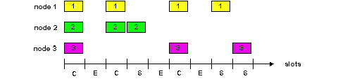
Slotted ALOHA
Pros
single active node can continuously transmit at full rate of channel
highly decentralized: only slots in nodes need to be in sync
simple
Cons
collisions, wasting slots
idle slots
nodes may be able to detect collision in less than time to transmit packet
clock synchronization

Slide 26
Slotted Aloha efficiency
Efficiency : long-run
fraction of successful slots
(many nodes, all with many frames to send)
max efficiency: find p* that maximizes
Np(1-p)^{N-1}
for many nodes, take limit of Np*(1-p*)^{N-1} as N goes to infinity, gives:
Max efficiency = 1/e = .37
suppose: N nodes with many frames to send, each transmits in slot with probability p
prob that given node has success in a slot = p(1-p)^{N-1}
prob that any node has a success = Np(1-p)^{N-1}
At best: channel
used for useful
transmissions 37%
of time!
!

Slide 27
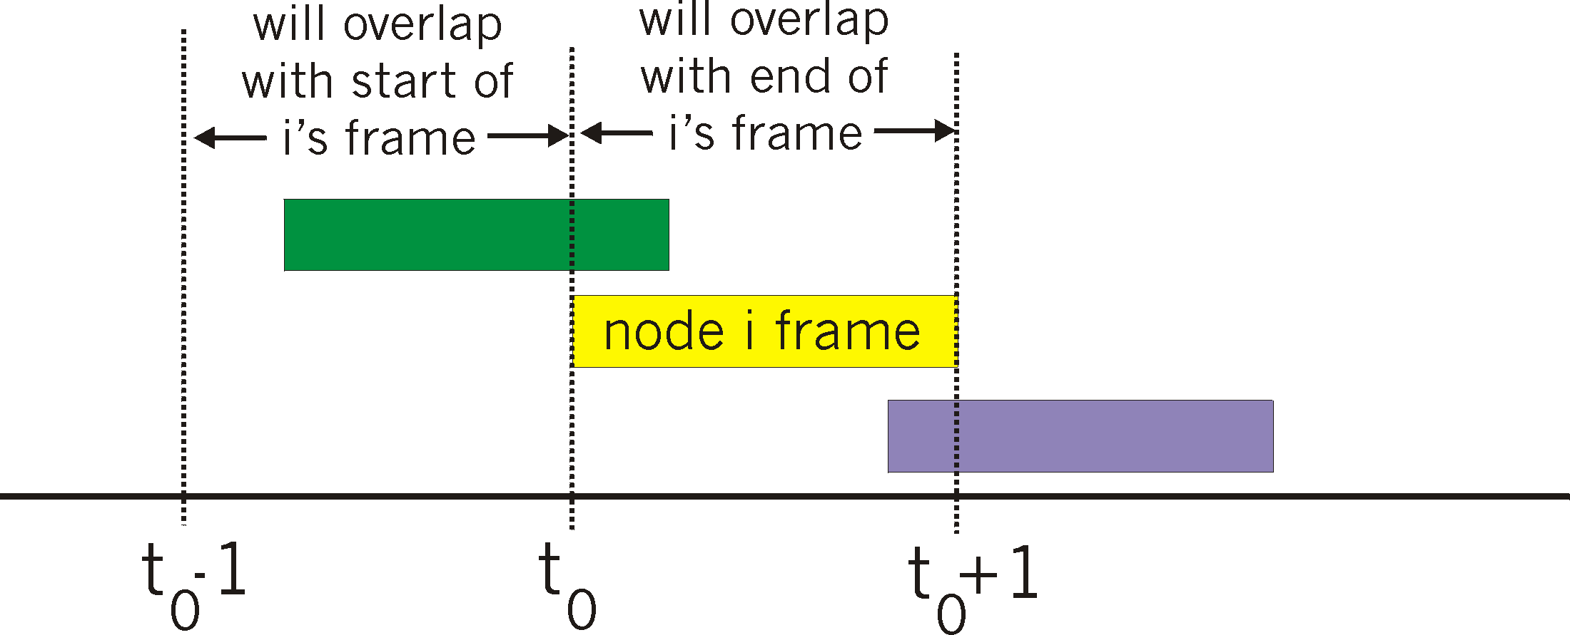
Pure (unslotted) ALOHA
unslotted Aloha: simpler, no synchronization
when frame first arrives
  transmit immediately
collision probability increases:
  frame sent at t₀ collides with other frames sent in [t₀-1,t₀+1]

Slide 28
Pure Aloha efficiency
P(success by given node) = P(node transmits) .
P(no other node transmits in [p₀-1,p₀] .
P(no other node transmits in [p₀-1,p₀]
= p . (1-p)^{N-1 .} (1-p)^{N-1}
= p . (1-p)^{2(N-1)}
… choosing optimum p and then letting n -> infty ...
^{= 1/(2e) = .18}
even worse than slotted Aloha!

Slide 29
CSMA (Carrier Sense Multiple Access)
CSMA: listen before transmit:
If channel sensed idle: transmit entire frame
If channel sensed busy, defer transmission
human analogy: don’t interrupt others!

Slide 30
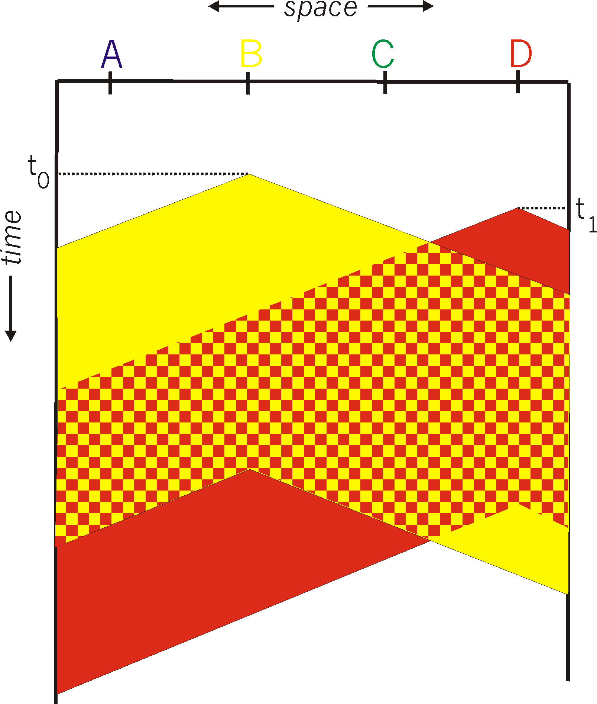
CSMA collisions
spatial layout of nodes
collisions can still occur:
propagation delay means
two nodes may not hear
each other’s transmission
collision:
entire packet transmission
time wasted
note:
role of distance & propagation delay in determining collision probability

Slide 31
CSMA/CD (Collision Detection)
CSMA/CD: carrier sensing, deferral as in CSMA
  collisions detected within short time
  colliding transmissions aborted, reducing channel wastage
collision detection:
  easy in wired LANs: measure signal strengths, compare transmitted, received signals
  difficult in wireless LANs: received signal strength overwhelmed by local transmission strength
human analogy: the polite conversationalist

Slide 32
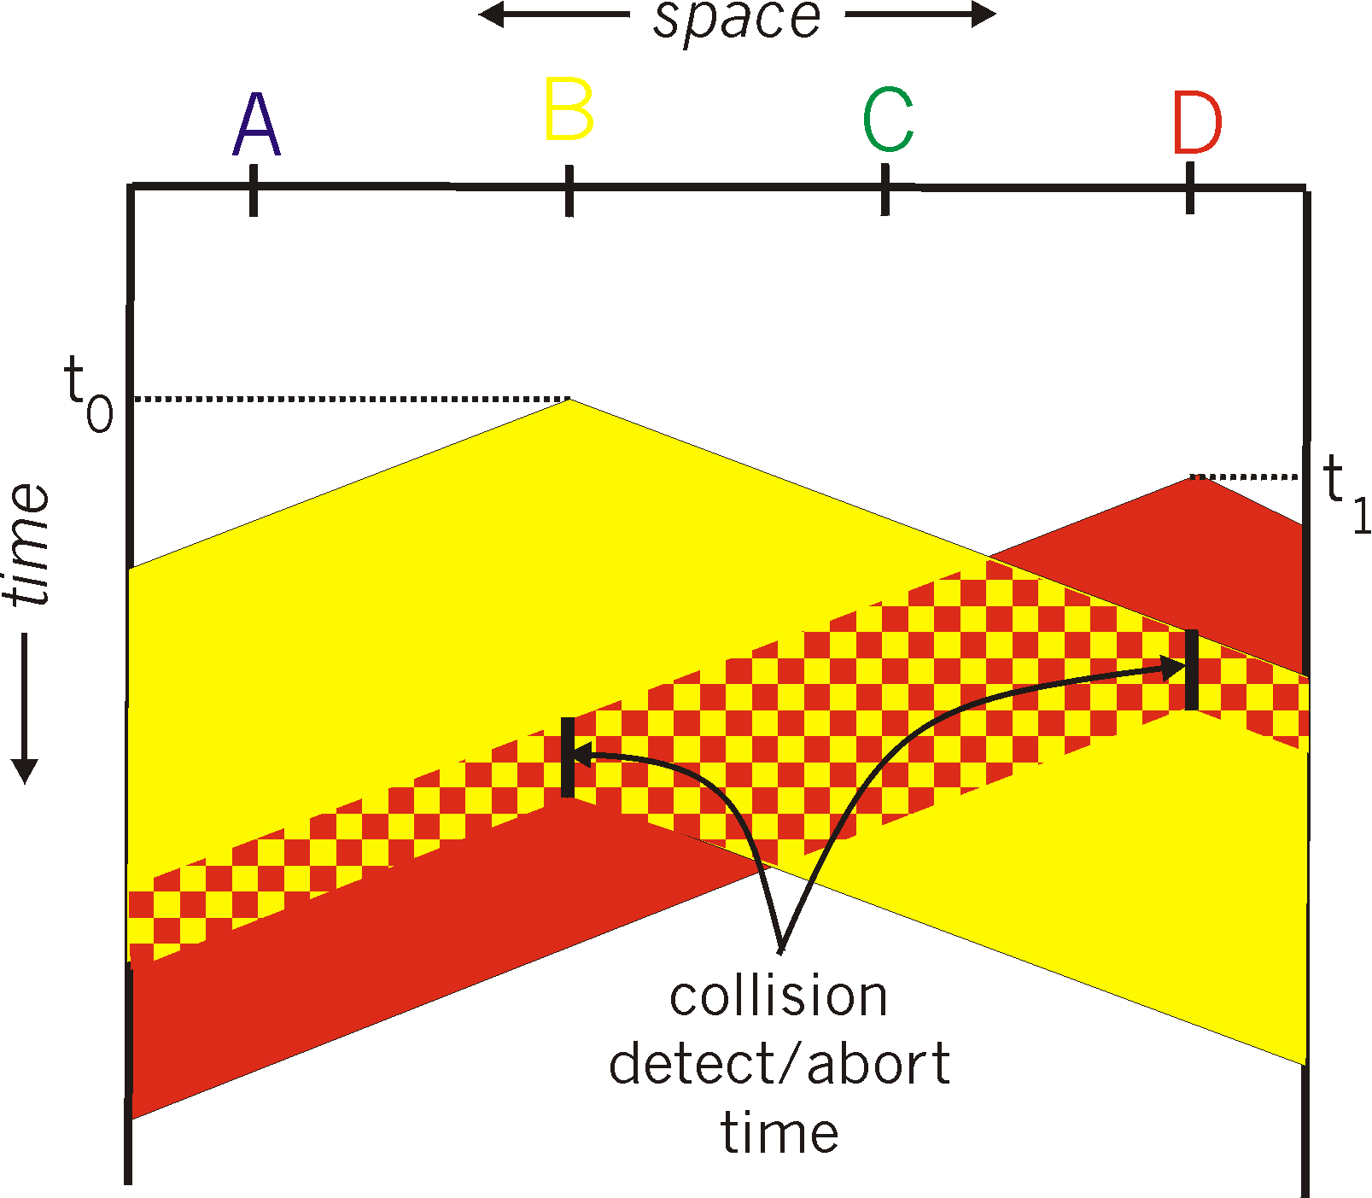
CSMA/CD collision detection

Slide 33
“Taking Turns” MAC protocols
channel partitioning MAC protocols:
  share channel efficiently and fairly at high load
  inefficient at low load: delay in channel access, 1/N bandwidth allocated even if only 1 active node!
Random access MAC protocols
  efficient at low load: single node can fully utilize channel
  high load: collision overhead
“taking turns” protocols
  look for best of both worlds!

Slide 34
“Taking Turns” MAC protocols
Polling:
master node “invites” slave nodes to transmit in turn
typically used with “dumb” slave devices
concerns:
  polling overhead
  latency
  single point of failure (master)
data
poll
master
data
slaves

Slide 35
“Taking Turns” MAC protocols
Token passing:
control token passed from one node to next sequentially.
token message
concerns:
  token overhead
  latency
  single point of failure (token)
T
(nothing
to send)
T
data

Slide 36
Summary of MAC protocols
channel partitioning, by time, frequency or code
  Time Division, Frequency Division
random access (dynamic),
  ALOHA, S-ALOHA, CSMA, CSMA/CD
  carrier sensing: easy in some technologies (wire), hard in others (wireless)
  CSMA/CD used in Ethernet
  CSMA/CA used in 802.11
taking turns
  polling from central site, token passing
  Bluetooth, FDDI, IBM Token Ring

Slide 37
Link Layer
5.1 Introduction and services
5.2 Error detection and correction
5.3Multiple access protocols
5.4 Link-Layer Addressing
5.5 Ethernet
5.6 Link-layer switches
5.7 PPP
5.8 Link virtualization: MPLS
5.9 A day in the life of a web request

Slide 38
MAC Addresses and ARP
32-bit IP address:
  network-layer address
  used to get datagram to destination IP subnet
MAC (or LAN or physical or Ethernet) address:
  function: get frame from one interface to another physically-connected interface (same network)
  48 bit MAC address (for most LANs)
    burned in NIC ROM, also sometimes software settable

Slide 39
LAN Addresses and ARP
Each adapter on LAN has unique LAN address
1A-2F-BB-76-09-AD
Broadcast address =
FF-FF-FF-FF-FF-FF
LAN
(wired or
wireless)
= adapter
71-65-F7-2B-08-53
58-23-D7-FA-20-B0
0C-C4-11-6F-E3-98

Slide 40
LAN Address (more)
MAC address allocation administered by IEEE
manufacturer buys portion of MAC address space (to assure uniqueness)
analogy:
(a) MAC address: like Social Security Number
(b) IP address: like postal address
MAC flat address ➜ portability
  can move LAN card from one LAN to another
IP hierarchical address NOT portable
  address depends on IP subnet to which node is attached

Slide 41
ARP: Address Resolution Protocol
Question: how to determine
MAC address of B
knowing B’s IP address?
Each IP node (host, router) on LAN has ARP table
ARP table: IP/MAC address mappings for some LAN nodes
< IP address; MAC address; TTL>
  TTL (Time To Live): time after which address mapping will be forgotten (typically 20 min)
137.196.7.78
1A-2F-BB-76-09-AD
137.196.7.23
137.196.7.14
LAN
71-65-F7-2B-08-53
58-23-D7-FA-20-B0
0C-C4-11-6F-E3-98
137.196.7.88

Slide 42
ARP protocol: Same LAN (network)
A wants to send datagram to B, and B’s MAC address not in A’s ARP table.
A broadcasts ARP query packet, containing B's IP address
  dest MAC address = FF-FF-FF-FF-FF-FF
  all machines on LAN receive ARP query
B receives ARP packet, replies to A with its (B's) MAC address
  frame sent to A’s MAC address (unicast)
A caches (saves) IP-to-MAC address pair in its ARP table until information becomes old (times out)
  soft state: information that times out (goes away) unless refreshed
ARP is “plug-and-play”:
  nodes create their ARP tables without intervention from net administrator

Slide 43
Addressing: routing to another LAN
walkthrough: send datagram from A to B via R
assume A knows B’s IP address
two ARP tables in router R, one for each IP network (LAN)
74-29-9C-E8-FF-55
88-B2-2F-54-1A-0F
A
E6-E9-00-17-BB-4B
222.222.222.221
111.111.111.111
1A-23-F9-CD-06-9B
222.222.222.220
222.222.222.222
111.111.111.110
B
111.111.111.112
R
49-BD-D2-C7-56-2A
CC-49-DE-D0-AB-7D

Slide 44
A creates IP datagram with source A, destination B
A uses ARP to get R’s MAC address for 111.111.111.110
A creates link-layer frame with R's MAC address as dest, frame contains A-to-B IP datagram
A’s NIC sends frame
R’s NIC receives frame
R removes IP datagram from Ethernet frame, sees its destined to B
R uses ARP to get B’s MAC address
R creates frame containing A-to-B IP datagram sends to B
This is a really important
example – make sure you
understand!
74-29-9C-E8-FF-55
88-B2-2F-54-1A-0F
A
E6-E9-00-17-BB-4B
222.222.222.221
111.111.111.111
1A-23-F9-CD-06-9B
222.222.222.220
222.222.222.222
111.111.111.110
B
111.111.111.112
R
49-BD-D2-C7-56-2A
CC-49-DE-D0-AB-7D

Slide 45
Link Layer
5.1 Introduction and services
5.2 Error detection and correction
5.3Multiple access protocols
5.4 Link-Layer Addressing
5.5 Ethernet
5.6 Link-layer switches
5.7 PPP
5.8 Link virtualization: MPLS
5.9 A day in the life of a web request

Slide 46
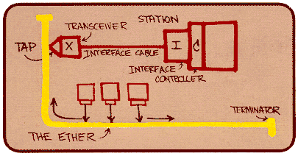
Ethernet
“dominant” wired LAN technology:
cheap $20 for NIC
first widely used LAN technology
simpler, cheaper than token LANs and ATM
kept up with speed race: 10 Mbps – 10 Gbps
Metcalfe’s Ethernet
sketch

Slide 47
Star topology
bus topology popular through mid 90s
  all nodes in same collision domain (can collide with each other)
today: star topology prevails
  active switch in center
  each “spoke” runs a (separate) Ethernet protocol (nodes do not collide with each other)
switch
bus: coaxial cable
star

Slide 48

Ethernet Frame Structure
Sending adapter encapsulates IP datagram (or other network layer protocol packet) in Ethernet frame
Preamble:
7 bytes with pattern 10101010 followed by one byte with pattern 10101011
used to synchronize receiver, sender clock rates

Slide 49
Ethernet Frame Structure (more)
Addresses: 6 bytes
  if adapter receives frame with matching destination address, or with broadcast address (eg ARP packet), it passes data in frame to network layer protocol
  otherwise, adapter discards frame
Type: indicates higher layer protocol (mostly IP but others possible, e.g., Novell IPX, AppleTalk)
CRC: checked at receiver, if error is detected, frame is dropped

Slide 50
Ethernet: Unreliable, connectionless
connectionless: No handshaking between sending and receiving NICs
unreliable: receiving NIC doesn’t send acks or nacks to sending NIC
  stream of datagrams passed to network layer can have gaps (missing datagrams)
  gaps will be filled if app is using TCP
  otherwise, app will see gaps
Ethernet’s MAC protocol: unslotted CSMA/CD

Slide 51
Ethernet CSMA/CD algorithm
1. NIC receives datagram from network layer, creates frame
2. If NIC senses channel idle, starts frame transmission If NIC senses channel busy, waits until channel idle, then transmits
3. If NIC transmits entire frame without detecting another transmission, NIC is done with frame !
4. If NIC detects another transmission while transmitting, aborts and sends jam signal
5. After aborting, NIC enters exponential backoff: after mth collision, NIC chooses K at random from
{0,1,2,…,2^{m}-1}. NIC waits K·512 bit times, returns to Step 2

Slide 52
Ethernet’s CSMA/CD (more)
Jam Signal: make sure all other transmitters are aware of collision; 48 bits
Bit time: .1 microsec for 10 Mbps Ethernet ;
for K=1023, wait time is about 50 msec
Exponential Backoff:
Goal: adapt retransmission attempts to estimated current load
  heavy load: random wait will be longer
first collision: choose K from {0,1}; delay is K· 512 bit transmission times
after second collision: choose K from {0,1,2,3}…
after ten collisions, choose K from {0,1,2,3,4,…,1023}
See/interact with Java
applet on AWL Web site:
highly recommended !

Slide 53
CSMA/CD efficiency
T_{prop} = max prop delay between 2 nodes in LAN
t_{trans} = time to transmit max-size frame
efficiency goes to 1
  as t_{prop} goes to 0
  as t_{trans} goes to infinity
better performance than ALOHA: and simple, cheap, decentralized!

Slide 54
802.3 Ethernet Standards: Link & Physical Layers
many different Ethernet standards
  common MAC protocol and frame format
  different speeds: 2 Mbps, 10 Mbps, 100 Mbps, 1Gbps, 10G bps
  different physical layer media: fiber, cable
application
transport
network
link
physical
MAC protocol
and frame format
100BASE-TX
100BASE-T2
100BASE-FX
100BASE-T4
100BASE-SX
100BASE-BX
copper (twister
pair) physical layer
fiber physical layer

Slide 55
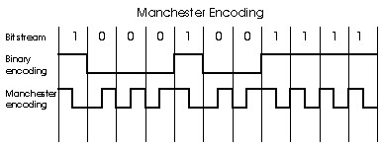
Manchester encoding
used in 10BaseT
each bit has a transition
allows clocks in sending and receiving nodes to synchronize to each other
  no need for a centralized, global clock among nodes!
Hey, this is physical-layer stuff!

Slide 56
Link Layer
5.1 Introduction and services
5.2 Error detection and correction
5.3 Multiple access protocols
5.4 Link-layer Addressing
5.5 Ethernet
5.6 Link-layer switches, LANs, VLANs
5.7 PPP
5.8 Link virtualization: MPLS
5.9 A day in the life of a web request

Slide 57
Hubs
… physical-layer (“dumb”) repeaters:
  bits coming in one link go out all other links at same rate
  all nodes connected to hub can collide with one another
  no frame buffering
  no CSMA/CD at hub: host NICs detect collisions
twisted pair
hub

Slide 58
Switch
link-layer device: smarter than hubs, take active role
  store, forward Ethernet frames
  examine incoming frame’s MAC address, selectively forward frame to one-or-more outgoing links when frame is to be forwarded on segment, uses CSMA/CD to access segment
transparent
  hosts are unaware of presence of switches
plug-and-play, self-learning
  switches do not need to be configured

Slide 59
Switch: allows multiple simultaneous transmissions
A
hosts have dedicated, direct connection to switch
switches buffer packets
Ethernet protocol used on each incoming link, but no collisions; full duplex
  each link is its own collision domain
switching: A-to-A’ and B-to-B’ simultaneously, without collisions
  not possible with dumb hub
C’
B
1
2
6
3
5
4
C
B’
A’
switch with six interfaces
(1,2,3,4,5,6)

Slide 60
Switch Table
A
Q: how does switch know that A’ reachable via interface 4, B’ reachable via interface 5?
A: each switch has a switch table, each entry:
  (MAC address of host, interface to reach host, time stamp)
looks like a routing table!
Q: how are entries created, maintained in switch table?
  something like a routing protocol?
C’
B
1
2
6
3
5
4
C
B’
A’
switch with six interfaces
(1,2,3,4,5,6)

Slide 61
Switch: self-learning
Source: A
Dest: A’
A
A A’
switch learns which hosts can be reached through which interfaces
  when frame received, switch “learns” location of sender: incoming LAN segment
  records sender/location pair in switch table
C’
B
1
2
6
3
5
4
C
B’
A’
MAC addr interface TTL
A
1
60
Switch table
(initially empty)

Slide 62
Switch: frame filtering/forwarding
When frame received:
1. record link associated with sending host
2. index switch table using MAC dest address
3. if entry found for destination
then {
if dest on segment from which frame arrived
then drop the frame
else forward the frame on interface indicated
}
else flood
forward on all but the interface
on which the frame arrived

Slide 63
Self-learning, forwarding: example
Source: A
Dest: A’
A
A A’
C’
B
frame destination unknown:
1
2
flood
6
3
A A’
A A’
A A’
A A’
A A’
5
4
destination A location known:
C
selective send
A’ A
B’
A’
MAC addr interface TTL
A
1
60
Switch table
(initially empty)
A’
4
60

Slide 64
Interconnecting switches
switches can be connected together
S₄
S₁
S₃
A
S₂
F
I
B
C
D
E
G
H
Q: sending from A to G - how does S₁ know to forward frame destined to F via S₄ and S₃?
A: self learning! (works exactly the same as in single-switch case!)

Slide 65
Self-learning multi-switch example
Suppose C sends frame to I, I responds to C
1
S₄
S₁
2
S₃
A
S₂
F
I
B
C
D
E
G
H
Q: show switch tables and packet forwarding in S₁, S₂, S₃, S₄

Slide 66
Institutional network
mail server
to external
network
router
web server
IP subnet

Slide 67
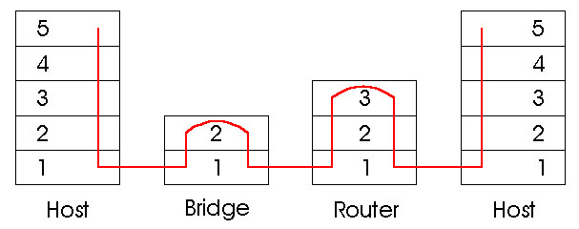
Switches vs. Routers
both store-and-forward devices
  routers: network layer devices (examine network layer headers)
  switches are link layer devices
routers maintain routing tables, implement routing algorithms
switches maintain switch tables, implement filtering, learning algorithms

Slide 68
VLANs: motivation
What’s wrong with this picture?
What happens if:
CS user moves office to EE, but wants connect to CS switch?
single broadcast domain:
  all layer-2 broadcast traffic (ARP, DHCP) crosses entire LAN (security/privacy, efficiency issues)
each lowest level switch has only few ports in use
Computer
Science
Computer
Engineering
Electrical
Engineering

Slide 69

VLANs
Port-based VLAN: switch ports grouped (by switch management software) so that single physical switch ……
Virtual Local
Area Network
1
7
9
15
2
8
10
16
…
…
Switch(es) supporting VLAN capabilities can be configured to define multiple virtual LANS over single physical LAN infrastructure.
Electrical Engineering
(VLAN ports 1-8)
Computer Science
(VLAN ports 9-15)
… operates as multiple virtual switches
1
7
9
15
2
8
10
16
…
…
Electrical Engineering
(VLAN ports 1-8)
Computer Science
(VLAN ports 9-16)

Slide 70
Port-based VLAN
router
traffic isolation: frames to/from ports 1-8 can only reach ports 1-8
  can also define VLAN based on MAC addresses of endpoints, rather than switch port
1
7
9
15
2
8
10
16
dynamic membership: ports can be dynamically assigned among VLANs
…
…
Electrical Engineering
(VLAN ports 1-8)
Computer Science
(VLAN ports 9-15)
forwarding between VLANS: done via routing (just as with separate switches)
  in practice vendors sell combined switches plus routers

Slide 71
VLANS spanning multiple switches
1
7
9
15
1
3
5
7
2
8
10
16
2
4
6
8
…
…
Electrical Engineering
(VLAN ports 1-8)
Computer Science
(VLAN ports 9-15)
Ports 2,3,5 belong to EE VLAN
Ports 4,6,7,8 belong to CS VLAN
trunk port: carries frames between VLANS defined over multiple physical switches
  frames forwarded within VLAN between switches can’t be vanilla 802.1 frames (must carry VLAN ID info)
  802.1q protocol adds/removed additional header fields for frames forwarded between trunk ports

Slide 72


802.1Q VLAN frame format
Type
802.1 frame
802.1Q frame
2-byte Tag Protocol Identifier
(value: 81-00)
Recomputed
CRC
Tag Control Information (12 bit VLAN ID field,
3 bit priority field like IP TOS)

Slide 73
Link Layer
5.1 Introduction and services
5.2 Error detection and correction
5.3Multiple access protocols
5.4 Link-Layer Addressing
5.5 Ethernet
5.6 Link-layer switches
5.7 PPP
5.8 Link virtualization: MPLS
5.9 A day in the life of a web request

Slide 74
Point to Point Data Link Control
one sender, one receiver, one link: easier than broadcast link:
  no Media Access Control
  no need for explicit MAC addressing
  e.g., dialup link, ISDN line
popular point-to-point DLC protocols:
  PPP (point-to-point protocol)
  HDLC: High level data link control (Data link used to be considered “high layer” in protocol stack!

Slide 75
PPP Design Requirements [RFC 1557]
packet framing: encapsulation of network-layer datagram in data link frame
  carry network layer data of any network layer protocol (not just IP) at same time
  ability to demultiplex upwards
bit transparency: must carry any bit pattern in the data field
error detection (no correction)
connection liveness: detect, signal link failure to network layer
network layer address negotiation: endpoint can learn/configure each other’s network address

Slide 76
PPP non-requirements
no error correction/recovery
no flow control
out of order delivery OK
no need to support multipoint links (e.g., polling)
Error recovery, flow control, data re-ordering
all relegated to higher layers!

Slide 77
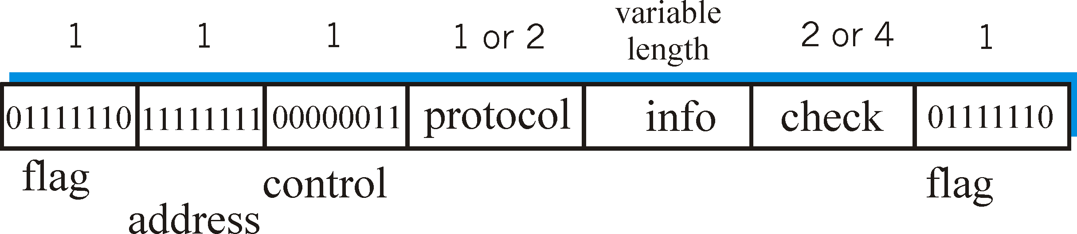
PPP Data Frame
Flag: delimiter (framing)
Address: does nothing (only one option)
Control: does nothing; in the future possible multiple control fields
Protocol: upper layer protocol to which frame delivered (eg, PPP-LCP, IP, IPCP, etc)

Slide 78
PPP Data Frame
info: upper layer data being carried
check: cyclic redundancy check for error detection

Slide 79
Byte Stuffing
“data transparency” requirement: data field must be allowed to include flag pattern <01111110>
  Q: is received <01111110> data or flag?
Sender: adds (“stuffs”) extra < 01111110> byte after each < 01111110> data byte
Receiver:
  two 01111110 bytes in a row: discard first byte, continue data reception
  single 01111110: flag byte

Slide 80
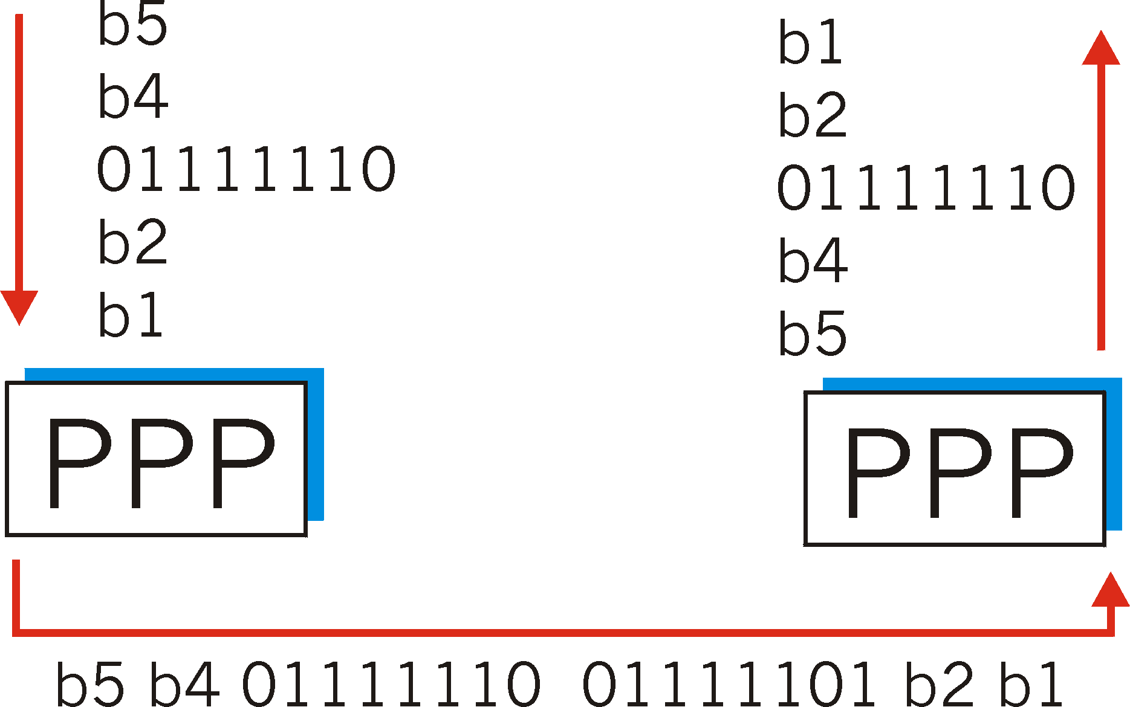
Byte Stuffing
flag byte
pattern
in data
to send
flag byte pattern plus
stuffed byte in transmitted data

Slide 81
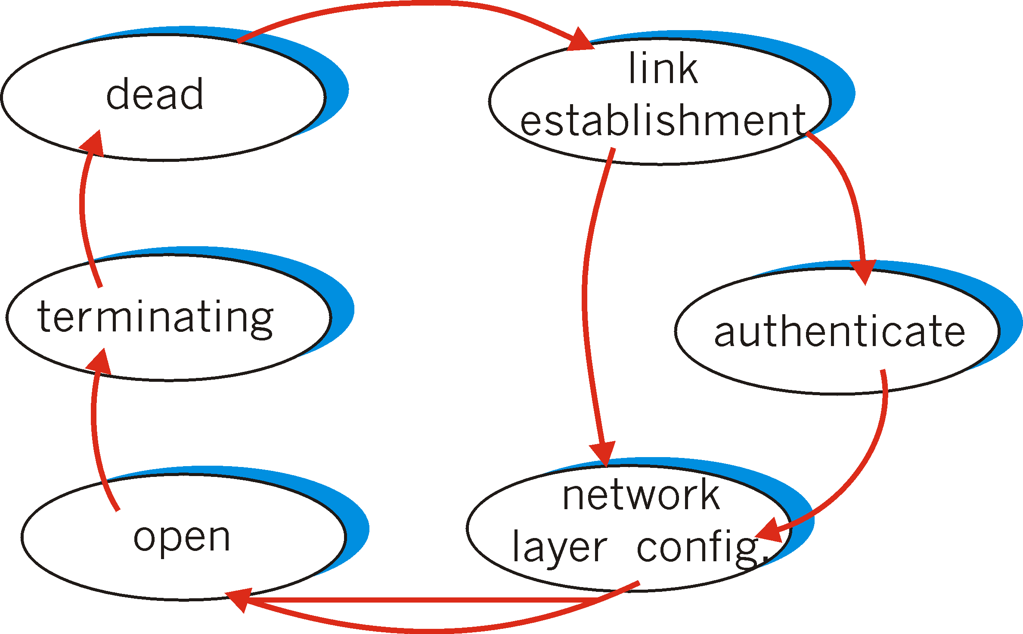
PPP Data Control Protocol
Before exchanging network-layer data, data link peers must
configure PPP link (max. frame length, authentication)
learn/configure network
layer information
  for IP: carry IP Control Protocol (IPCP) msgs (protocol field: 8021) to configure/learn IP address

Slide 82
Link Layer
5.1 Introduction and services
5.2 Error detection and correction
5.3Multiple access protocols
5.4 Link-Layer Addressing
5.5 Ethernet
5.6 Link-layer switches
5.7 PPP
5.8 Link virtualization: MPLS
5.9 A day in the life of a web request

Slide 83
Virtualization of networks
Virtualization of resources: powerful abstraction in systems engineering:
computing examples: virtual memory, virtual devices
  Virtual machines: e.g., java
  IBM VM os from 1960’s/70’s
layering of abstractions: don’t sweat the details of the lower layer, only deal with lower layers abstractly

Slide 84
The Internet: virtualizing networks
1974: multiple unconnected nets
  ARPAnet
  data-over-cable networks
  packet satellite network (Aloha)
  packet radio network
… differing in:
  addressing conventions
  packet formats
  error recovery
  routing
ARPAnet
satellite net
"A Protocol for Packet Network Intercommunication",
V. Cerf, R. Kahn, IEEE Transactions on Communications,
May, 1974, pp. 637-648.

Slide 85
The Internet: virtualizing networks
Internetwork layer (IP):
addressing: internetwork appears as single, uniform entity, despite underlying local network heterogeneity
network of networks
Gateway:
“embed internetwork packets in local packet format or extract them”
route (at internetwork level) to next gateway
gateway
ARPAnet
satellite net

Slide 86
Cerf & Kahn’s Internetwork Architecture
What is virtualized?
two layers of addressing: internetwork and local network
new layer (IP) makes everything homogeneous at internetwork layer
underlying local network technology
  cable
  satellite
  56K telephone modem
  today: ATM, MPLS
… “invisible” at internetwork layer. Looks like a link layer technology to IP!

Slide 87
ATM and MPLS
ATM, MPLS separate networks in their own right
  different service models, addressing, routing from Internet
viewed by Internet as logical link connecting IP routers
  just like dialup link is really part of separate network (telephone network)
ATM, MPLS: of technical interest in their own right

Slide 88
Asynchronous Transfer Mode: ATM
1990’s/00 standard for high-speed (155Mbps to 622 Mbps and higher) Broadband Integrated Service Digital Network architecture
Goal: integrated, end-end transport of carry voice, video, data
  meeting timing/QoS requirements of voice, video (versus Internet best-effort model)
  “next generation” telephony: technical roots in telephone world
  packet-switching (fixed length packets, called “cells”) using virtual circuits

Slide 89
Multiprotocol label switching (MPLS)
initial goal: speed up IP forwarding by using fixed length label (instead of IP address) to do forwarding
  borrowing ideas from Virtual Circuit (VC) approach
  but IP datagram still keeps IP address!
PPP or Ethernet
header
IP header
remainder of link-layer frame
MPLS header
label
Exp
S
TTL
20
3
1
5

Slide 90
MPLS capable routers
a.k.a. label-switched router
forwards packets to outgoing interface based only on label value (don’t inspect IP address)
  MPLS forwarding table distinct from IP forwarding tables
signaling protocol needed to set up forwarding
  RSVP-TE
  forwarding possible along paths that IP alone would not allow (e.g., source-specific routing) !!
  use MPLS for traffic engineering
must co-exist with IP-only routers

Slide 91
MPLS forwarding tables
in out out
label label dest interface
10 A 0
in out out
label label dest interface
12 D 0
8 A 1
10 6 A 1
12 9 D 0
R6
0
0
D
1
1
R4
R3
R5
0
0
A
R2
in out out
label label dest interface
R1
in out out
label label dest interface
6 - A 0
8 6 A 0

Slide 92
Link Layer
5.1 Introduction and services
5.2 Error detection and correction
5.3Multiple access protocols
5.4 Link-Layer Addressing
5.5 Ethernet
5.6 Link-layer switches
5.7 PPP
5.8 Link virtualization: MPLS
5.9 A day in the life of a web request

Slide 93
Synthesis: a day in the life of a web request
journey down protocol stack complete!
  application, transport, network, link
putting-it-all-together: synthesis!
  goal: identify, review, understand protocols (at all layers) involved in seemingly simple scenario: requesting www page
  scenario: student attaches laptop to campus network, requests/receives www.google.com

Slide 94

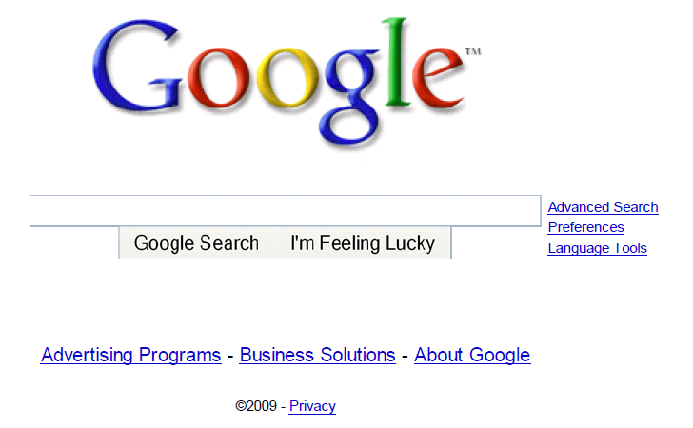
A day in the life: scenario
browser
DNS server
Comcast network
68.80.0.0/13
school network
68.80.2.0/24
web page
web server
Google’s network
64.233.160.0/19
64.233.169.105

Slide 95
A day in the life… connecting to the Internet
DHCP
DHCP
UDP
IP
Eth
Phy
connecting laptop needs to get its own IP address, addr of first-hop router, addr of DNS server: use DHCP
DHCP
DHCP
DHCP
DHCP
DHCP request encapsulated in UDP, encapsulated in IP, encapsulated in 802.1 Ethernet
DHCP
DHCP
UDP
IP
Eth
Phy
DHCP
DHCP
DHCP
DHCP
router
(runs DHCP)
Ethernet frame broadcast (dest: FFFFFFFFFFFF) on LAN, received at router running DHCP server
Ethernet demux’ed to IP demux’ed, UDP demux’ed to DHCP

Slide 96
A day in the life… connecting to the Internet
DHCP
DHCP
UDP
IP
Eth
Phy
DHCP server formulates DHCP ACK containing client’s IP address, IP address of first-hop router for client, name & IP address of DNS server
DHCP
DHCP
DHCP
encapsulation at DHCP server, frame forwarded (switch learning) through LAN, demultiplexing at client
DHCP
DHCP
UDP
IP
Eth
Phy
DHCP
DHCP
DHCP
router
(runs DHCP)
DHCP client receives DHCP ACK reply
DHCP
Client now has IP address, knows name & addr of DNS
server, IP address of its first-hop router

Slide 97
A day in the life… ARP (before DNS, before HTTP)
DNS
UDP
IP
Eth
Phy
before sending HTTP request, need IP address of www.google.com: DNS
DNS
DNS
DNS
ARP
ARP query
DNS query created, encapsulated in UDP, encapsulated in IP, encasulated in Eth. In order to send frame to router, need MAC address of router interface: ARP
ARP
ARP reply
Eth
Phy
ARP query broadcast, received by router, which replies with ARP reply giving MAC address of router interface
client now knows MAC address of first hop router, so can now send frame containing DNS query

Slide 98
A day in the life… using DNS
DNS
UDP
IP
Eth
Phy
DNS
DNS server
DNS
UDP
IP
Eth
Phy
DNS
DNS
DNS
DNS
DNS
DNS
DNS
DNS
Comcast network
68.80.0.0/13
IP datagram forwarded from campus network into comcast network, routed (tables created by RIP, OSPF, IS-IS and/or BGP routing protocols) to DNS server
IP datagram containing DNS query forwarded via LAN switch from client to 1st hop router
demux’ed to DNS server
DNS server replies to client with IP address of www.google.com

Slide 99
A day in the life… TCP connection carrying HTTP
HTTP
HTTP
TCP
IP
Eth
Phy
SYNACK
SYN
SYNACK
SYN
SYNACK
SYN
SYN
to send HTTP request, client first opens TCP socket to web server
TCP SYN segment (step 1 in 3-way handshake) inter-domain routed to web server
TCP
IP
Eth
Phy
SYNACK
SYN
SYNACK
SYN
SYNACK
SYNACK
SYN
web server responds with TCP SYNACK (step 2 in 3-way handshake)
web server
64.233.169.105
TCP connection established!

Slide 100
A day in the life… HTTP request/reply
web page finally (!!!) displayed
HTTP
HTTP
TCP
IP
Eth
Phy
HTTP
HTTP
HTTP
HTTP
HTTP
HTTP
HTTP
HTTP
HTTP request sent into TCP socket
IP datagram containing HTTP request routed to www.google.com
HTTP
HTTP
TCP
IP
Eth
Phy
HTTP
HTTP
HTTP
web server responds with HTTP reply (containing web page)
HTTP
web server
64.233.169.105
IP datgram containing HTTP reply routed back to client

Slide 101
Chapter 5: Summary
principles behind data link layer services:
  error detection, correction
  sharing a broadcast channel: multiple access
  link layer addressing
instantiation and implementation of various link layer technologies
  Ethernet
  switched LANS, VLANs
  PPP
  virtualized networks as a link layer: MPLS
synthesis: a day in the life of a web request

Slide 102
Chapter 5: let’s take a breath
journey down protocol stack complete (except PHY)
solid understanding of networking principles, practice
….. could stop here …. but lots of interesting topics!
  wireless
  multimedia
  security
  network management

