Slide 1
Introduction to Physical Layer
Computer Networks
Term B10

Slide 2
Physical Layer Outline
Definitions
Multiplexing
Transmission Media
End System Choices
Residential Configurations

Slide 3
Physical Layer Definitions
The time required to transmit a character depends on both the encoding method and the signaling speed (i.e., the modulation rate - the number of times/sec the signal changes its voltage).
baud (D) - the number of changes per second.
bandwidth (H) - the range of frequencies that is passed by a channel. The transmitted signal is constrained by the transmitter and the nature of the transmission medium in cycles/sec (hertz).
channel capacity (C) – the rate at which data can be transmitted over a given channel under given conditions.{This is also referred to as data rate (R).}

Slide 4
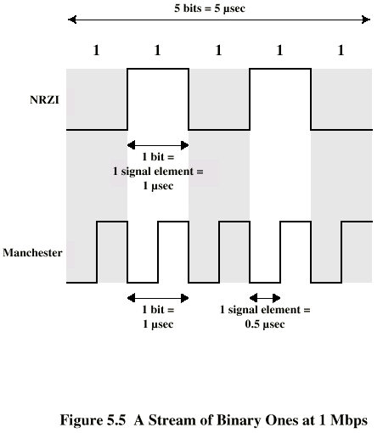
Modulation Rate
modulation rate
is doubled
DCC 6th Ed.
Stallings

Slide 5
Analog and Digital Signaling
signals:: electric or electromagnetic encoding of data.
signaling:: is the act of propagating the signal along a suitable medium.
Analog signal – a continuously varying electromagnetic wave that may be propagated over a variety of medium depending on the spectrum (e.g., wire, twisted pair, coaxial cable, fiber optic cable and atmosphere or space propagation).

Slide 6
Analog and Digital Signaling
digital signal – a sequence of voltage pulses that may be transmitted over a wire medium.
Note – analog signals to represent analog data and digital signals to represent digital data are not the only possibilities.
There is where modems and codecs come into the picture.

Slide 7
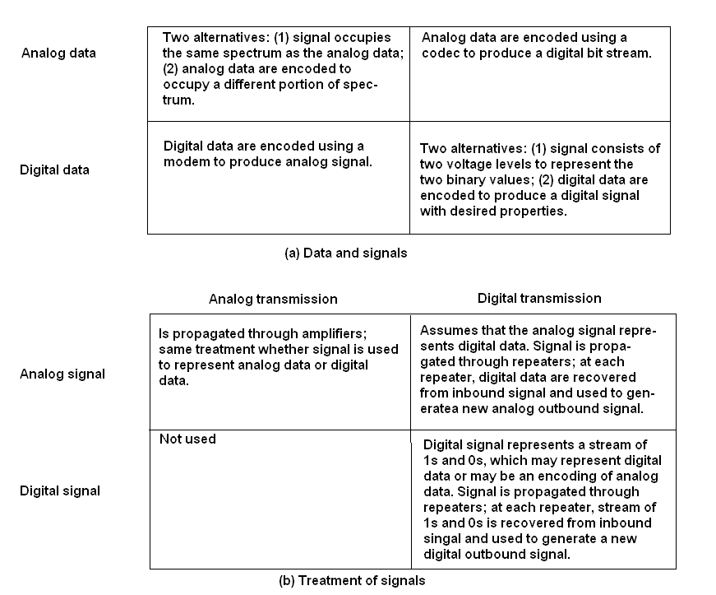
Analog vs Digital (three contexts)
codec
modem
DCC 6th Ed.
Stallings

Slide 8
Multiplexing
Multiplexing {general definition} ::
Sharing a resource over time.
(a)
(b)
A
A
A
Trunk
group
A
B
B
B
MUX
MUX
B
C
C
C
C
Leon-Garcia & Widjaja:
Communication Networks

Slide 9
Frequency Division Multiplexing (FDM) vs Time Division Multiplexing (TDM)
Example:
FDM
4 users
frequency
time
TDM
frequency
K & R
time
Notes:
Two simple multiple access control techniques.
Each mobile’s share of the bandwidth is divided into portions for the uplink and the downlink. Also, possibly, out of band signaling.
As we will see, used in AMPS, GSM, IS-54/136

Slide 10
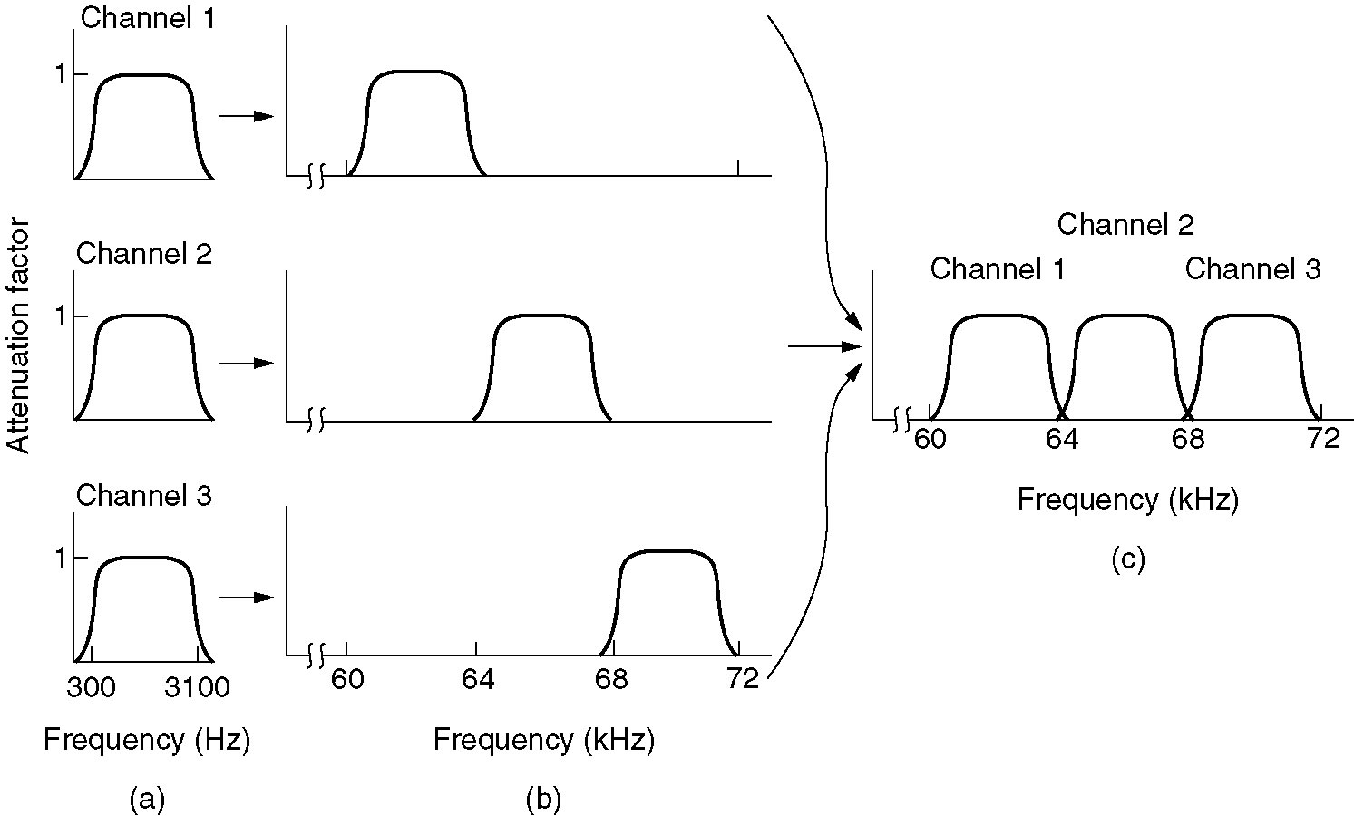
Frequency Division Multiplexing
Figure 2-31. (a) The original bandwidths. (b) The bandwidths raised in frequency. (c) The multiplexed channel.
Tanenbaum

Slide 11
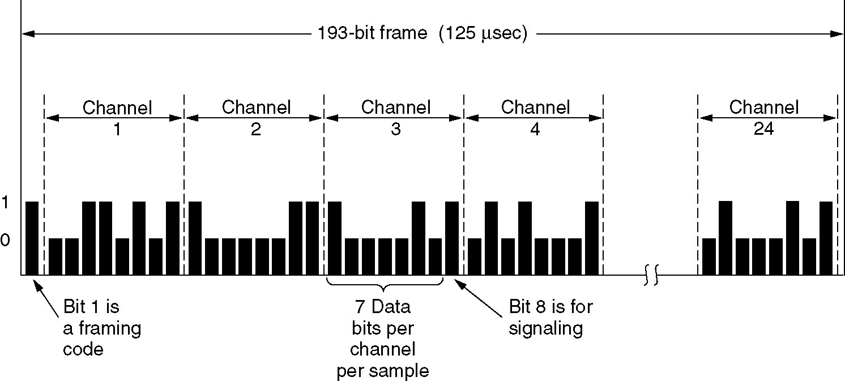
T1 - TDM Link
TDM:: each host gets a fixed slot in revolving TDM frame
TDM: each host gets same slot in revolving TDM frame
Figure 2-33.T1 Carrier (1.544Mbps)
Tanenbaum

Slide 12
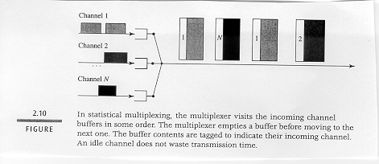
Concentrator [Statistical Multiplexing]

Slide 13
Packet Switching: Statistical Multiplexing
100 Mb/s
Ethernet
A
C
statistical multiplexing
1.5 Mb/s
B
queue of packets
waiting for output
link
D
E
Sequence of A & B packets does NOT have fixed pattern, bandwidth shared on demand ➔ statistical multiplexing.
.

Slide 14
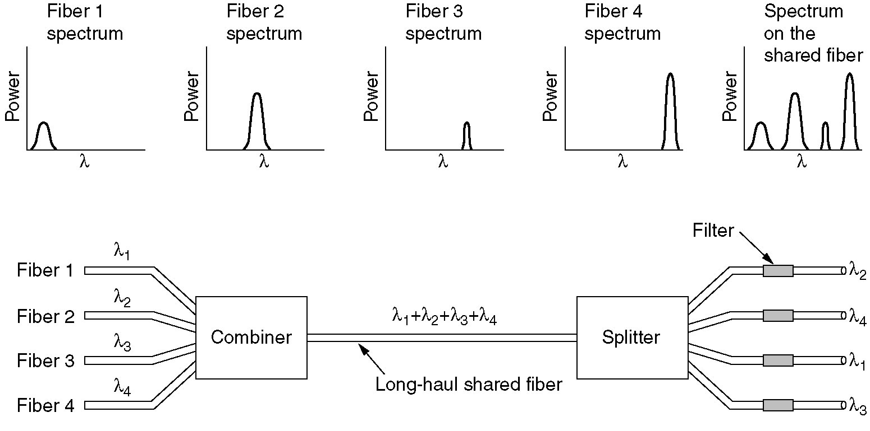
Wavelength Division Multiplexing
Wavelength division multiplexing.
Figure 2-32.
Tanenbaum

Slide 15
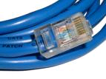
Physical Media: Twisted Pair
Bit: propagates between transmitter/receiver pairs.
physical link: what lies between transmitter & receiver.
guided media:
signals propagate in solid media: copper, fiber, coax.
unguided media:
signals propagate freely, e.g., radio.
Unshielded Twisted Pair (UTP)
two insulated copper wires
Category 3: traditional phone wires, 10 Mbps Ethernet
Category 5 : 100Mbps Ethernet
Category 5e is now standard!!

Slide 16
Physical Media: Coaxial Cable and Optical Fiber
Coaxial cable:
two concentric copper conductors
bidirectional
baseband:
single channel on cable
legacy Ethernet
broadband:
multiple channels on cable
HFC
Fiber optic cable:
glass fiber carrying light pulses, each pulse a bit
high-speed operation:
point-to-point transmission (e.g., 10’s-100’s Gps)
low error rate: repeaters spaced far apart ; immune to electromagnetic noise.

Slide 17
Physical Media: Radio Signals
Radio link types:
terrestrial microwave
e.g. up to 45 Mbps channels
LAN (e.g., Wifi)
11Mbps, 54 Mbps
wide-area (e.g., cellular)
3G cellular: ~ 1 Mbps
satellite
Kbps to 45Mbps channel (or multiple smaller channels)
270 msec end-end delay
geosynchronous versus low altitude
signal carried in electromagnetic spectrum.
no physical “wire”
bidirectional
propagation environment effects:
reflection
obstruction by objects
interference

Slide 18
Dial-up Modem
central office
telephone
network
Internet
home
PC
home dial-up
modem
ISP modem
(e.g., AOL)
Uses existing telephony infrastructure.
Home is connected to central office (analog signals).
up to 56Kbps direct access to router (often less)
Can’t surf and phone at same time: not “always on”.

Slide 19
Digital Subscriber Line (ADSL)
Existing phone line: 0-4KHz phone; 4-50KHz upstream data; 50KHz-1MHz downstream data
Internet
home
phone
DSLAM
Asymmetric DSL
telephone
network
splitter
DSL
modem
central
office
home
PC
Uses existing telephone infrastructure.
up to 1 Mbps upstream (today typically < 256 kbps)
up to 8 Mbps downstream (today typically < 1 Mbps)
dedicated physical line to telephone central office

Slide 20
Residential Access: Cable Modems
Does not use telephone infrastructure
Instead uses cable TV infrastructure.
HFC: hybrid fiber coax
asymmetric: up to 30Mbps downstream, 2 Mbps upstream
network of cable and fiber attaches homes to ISP router:
homes share access to router
unlike DSL, which has dedicated access.

Slide 21
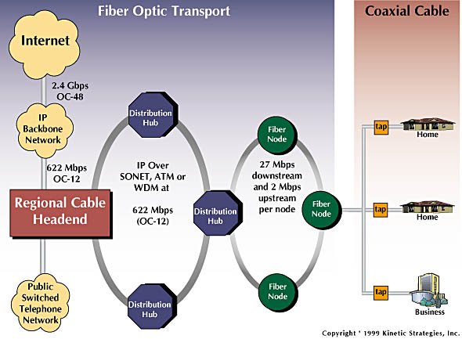
Residential Access: Cable Modems
Diagram: http://www.cabledatacomnews.com/cmic/diagram.html

Slide 22
Cable Network Architecture: Overview
Typically 500 to 5,000 homes
cable headend
cable distribution
network (simplified)
home

Slide 23
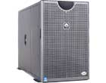
Cable Network Architecture: Overview
server(s)
cable headend
cable distribution
network
home

Slide 24
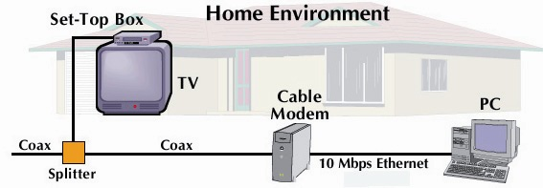
Cable Network Architecture: Overview
cable headend
cable distribution
network (simplified)
home

Slide 25
Cable Network Architecture: Overview
FDM
C
O
N
T
R
O
L
V
I
D
E
O
V
I
D
E
O
V
I
D
E
O
V
I
D
E
O
V
I
D
E
O
V
I
D
E
O
D
A
T
A
D
A
T
A
1
2
3
4
5
6
7
8
9
Channels
cable headend
cable distribution
network
home

Slide 26
Fiber to the Home
ONT
Internet
optical fibers
optical fiber
ONT
OLT
optical
splitter
central office
ONT
Optical links from central office to the home
Two competing optical technologies:
Passive Optical network (PON)
Active Optical Network (AON)
Higher Internet rates. Fiber also carries television and phone services.

Slide 27
Ethernet Internet Access
100 Mbps
Institutional
router
Ethernet
switch
To Institution’s ISP
100 Mbps
1 Gbps
100 Mbps
server
Typically used in companies, universities, etc
10 Mbs, 100Mbps, 1Gbps, 10Gbps Ethernet
Today, end systems typically connect into Ethernet switch.

Slide 28
Wireless Access Networks
Shared wireless access network connects end system to router
via base station aka “access point”.
Wireless LANs:
802.11b/g/n (WiFi): 11, 54, 200 Mbps
Wider-area Wireless Access
provided by telco operator
~1Mbps over cellular system (EVDO, HSDPA) 3G and 4G coming
next up (?): WiMAX (10’s Mbps) over wide area
router
base
station
mobile
hosts

Slide 29
Residential Networks
Typical Residential Network Components:
DSL or cable modem
router/firewall/NAT
Ethernet
wireless access point (AP)
wireless
laptops
to/from
cable
headend
cable
modem
router/
firewall
wireless
access
point
Ethernet

Slide 30
Physical Layer Summary
Definitions (analog versus digital)
Multiplexing (FDM, TDM, statistical)
Transmission Media (UTP, Coax, Fiber, Radio, Satellite)
End System Choices (Dial-Up, ADSL, Cable,Ethernet, Wireless AP, Fiber-to-the Home)
Residential Configurations

