Slide 1
Introduction to
Physical Layer
Computer Networks
Term A15

Slide 2
Physical Layer Outline
Definitions
Multiplexing
Transmission Media
End System Choices
Residential Configurations

Slide 3
Physical Layer Definitions
The time required to transmit a character depends on both the encoding method and the signaling speed (i.e., the modulation rate - the number of times/sec the signal changes its voltage).
baud (D) - the number of changes per second.
bandwidth (H) - the range of frequencies that is passed by a channel. The transmitted signal is constrained by the transmitter and the nature of the transmission medium in cycles/sec (hertz).
channel capacity (C) – the rate at which data can be transmitted over a given channel under given conditions.{This is also referred to as data rate (R).}

Slide 4
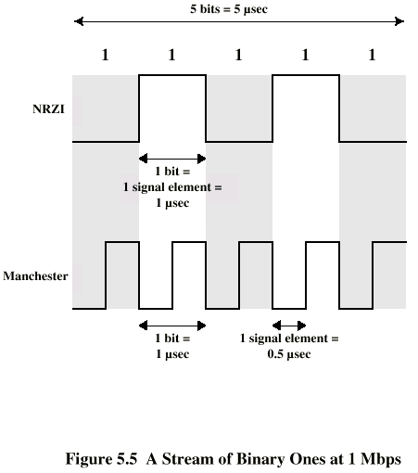
Modulation Rate
modulation rate
is doubled
DCC 6th Ed.
Stallings

Slide 5
Analog and Digital Signaling
signals:: electric or electromagnetic encoding of data.
signaling:: is the act of propagating the signal along a suitable medium.
  Analog signal – a continuously varying electromagnetic wave that may be propagated over a variety of medium depending on the spectrum (e.g., wire, twisted pair, coaxial cable, fiber optic cable and atmosphere or space propagation).

Slide 6
Analog and Digital Signaling
digital signal – a sequence of voltage pulses that may be transmitted over a wire medium.
Note – analog signals to represent analog data and digital signals to represent digital data are not the only possibilities.
There is where modems and codecs come into the picture.

Slide 7
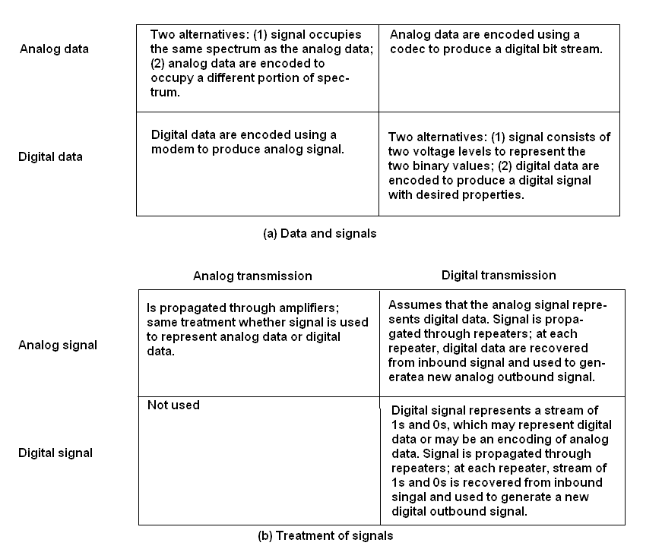
Analog vs Digital (three contexts)
codec
modem
DCC 6th Ed.
Stallings

Slide 8
Multiplexing
Multiplexing {general definition} ::
Sharing a resource over time.
(a)
(b)
A
A
A
Trunk
group
A
B
B
B
MUX
MUX
B
C
C
C
C
Leon-Garcia & Widjaja:
Communication Networks

Slide 9
Frequency Division Multiplexing (FDM) vs Time Division Multiplexing (TDM)
Example:
FDM
4 users
frequency
time
TDM
frequency
K & R
time
Notes:
Two simple multiple access control techniques.
Each mobile’s share of the bandwidth is divided into portions for the uplink and the downlink. Also, possibly, out of band signaling.
As we will see, used in AMPS, GSM, IS-54/136

Slide 10
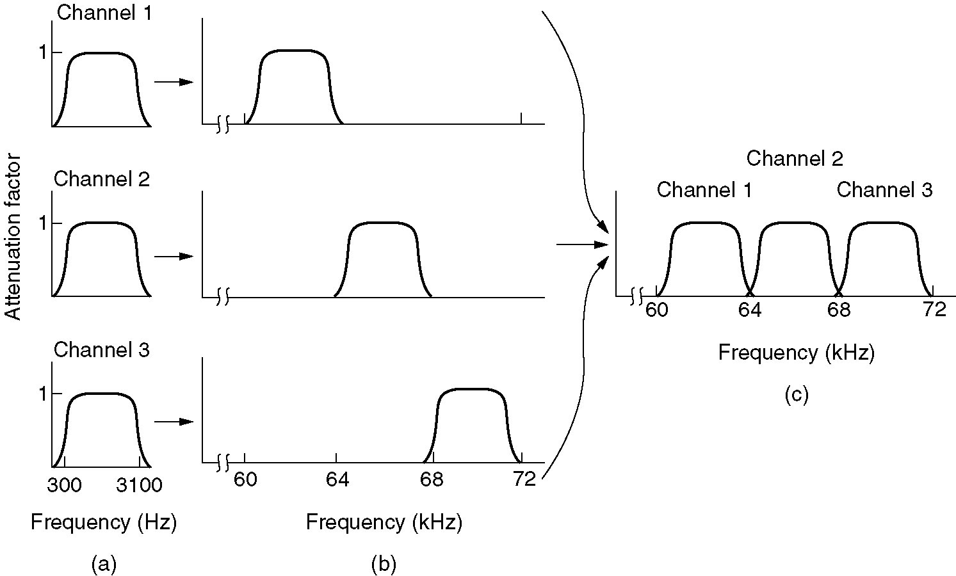
Frequency Division Multiplexing
Figure 2-31. (a) The original bandwidths. (b) The bandwidths raised in frequency. (c) The multiplexed channel.
Tanenbaum

Slide 11
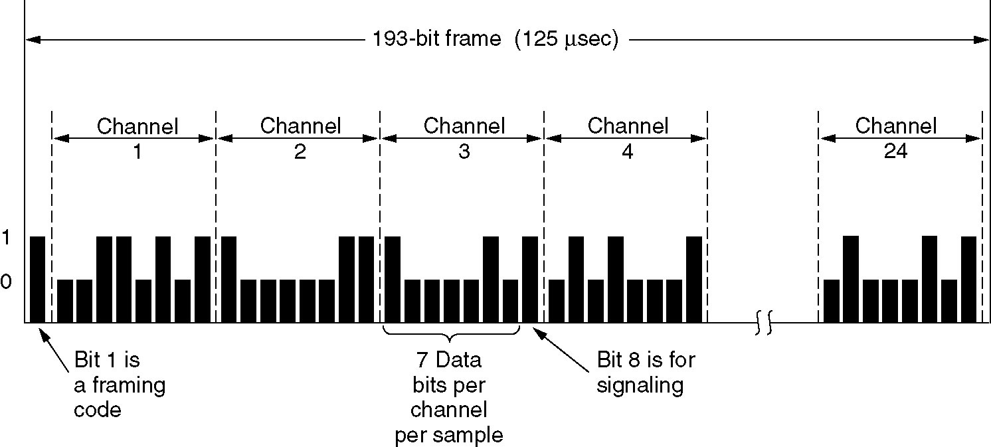
T1 - TDM Link
TDM:: each host gets a fixed slot in revolving TDM frame
TDM: each host gets same slot in revolving TDM frame
Figure 2-33.T1 Carrier (1.544Mbps)
Tanenbaum

Slide 12
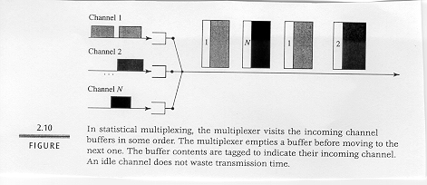
Concentrator [Statistical Multiplexing]

Slide 13
Packet Switching: Statistical Multiplexing
100 Mb/s
Ethernet
A
C
statistical multiplexing
1.5 Mb/s
B
queue of packets
waiting for output
link
D
E
Sequence of A & B packets does NOT have fixed pattern, bandwidth shared on demand ➔ statistical multiplexing.
.

Slide 14
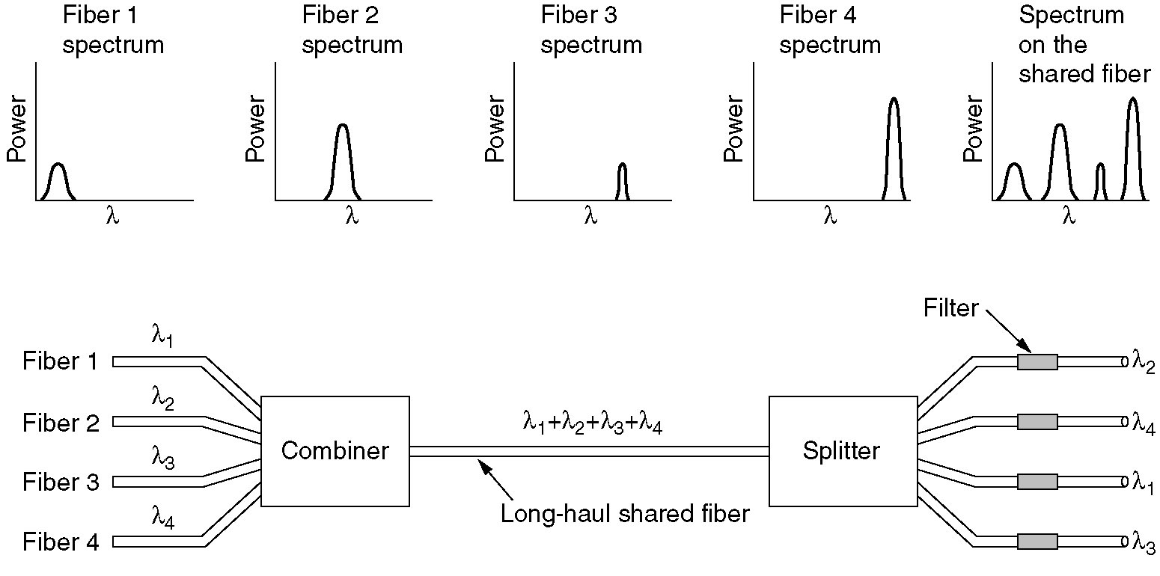
Wavelength Division Multiplexing
Wavelength division multiplexing.
Figure 2-32.
Tanenbaum

Slide 15
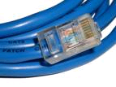
Physical Media: Twisted Pair
Bit: propagates between
transmitter/receiver pairs.
physical link: what lies between transmitter & receiver.
guided media:
  signals propagate in solid media: copper, fiber, coax.
unguided media:
  signals propagate freely, e.g., radio.
Unshielded Twisted Pair (UTP)
two insulated copper wires
  Category 3: traditional phone wires, 10 Mbps Ethernet
  Category 5 :
  100Mbps Ethernet
Category 5e is now standard!!

Slide 16
EIA/TIA 568 and ISO/IEC 11801 Wiring Grades
Grade 1 - Unshielded Untwisted wiring.
Commonly called inside wire by the Telco community.
Grade 2 - Unshielded twisted pair (UTP) derived from IBM Type 3 spec.
Category 3 - Unshielded twisted pair with 100 ohm impedance and electrical
characteristics supporting transmission at frequencies up to 16 MHz. May
be used with 10Base-T, 100Base-T4, and 100Base-T2 Ethernet. (Obsolete)
Category 4 - Unshielded twisted pair with 100 ohm impedance and electrical
characteristics supporting transmission at frequencies up to 20 MHz.
May be used with 10Base-T, 100Base-T4, and 100Base-T2 Ethernet. (Obsolete)
Category 5 - Unshielded twisted pair with 100 ohm impedance and electrical
characteristics supporting transmission at frequencies up to 100 MHz. May be used with 10Base-T, 100Base-T4, 100Base-T2, and 100Base-TX Ethernet.
May support 1000Base-T, but cable should be tested. (Superceded by Cat5e)

Slide 17
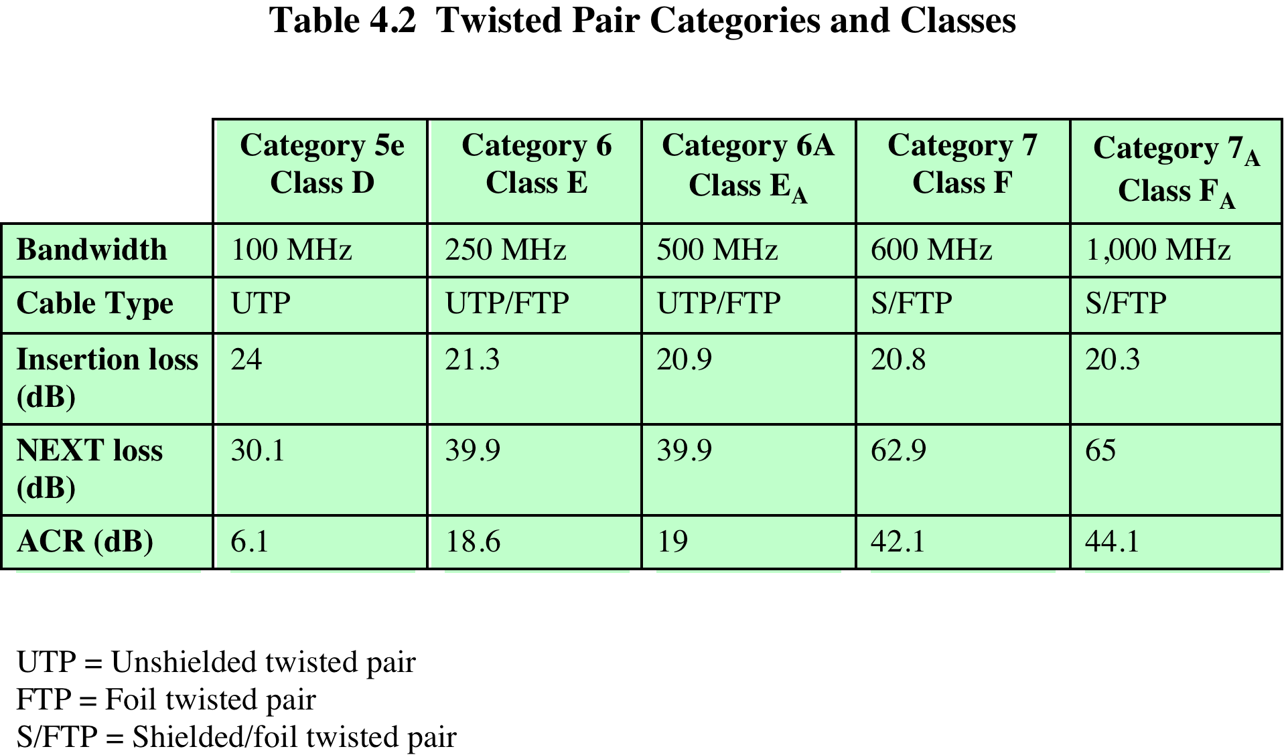
“Modern” Twisted Pair
DCC 9th Ed.
Stallings
Notes:
Categories of Twisted Pair for Data Transmission
In 1991, the Electronic Industries Association published standard ANSI/EIA/TIA-568, Commercial Building Telecommunications Cabling Standard, which specifies the use of voice- and data-grade UTP and F/UTP cabling for in-building data applications. At that time, the specification was felt to be adequate for the range of frequencies and data rates found in office environments. With continuing advances in cable and connector design and test methods, this standard has undergone a number of iterations to provide support for higher data rates using higher-quality cable and connectors. The current version is the responsibility of the Telecommunications Industry Association, and was issued in 2009 as four American National Standards Institute (ANSI) standards:
ANSI/TIA-568-C.0 Generic Telecommunications Cabling for Customer Premises: Enables the planning and installation of a structured cabling system for all types of customer premises.
ANSI/TIA-568-C.1 Commercial Building Telecommunications Cabling Standard: Enables the planning and installation of a structured cabling system for commercial buildings.
ANSI/TIA-568-C.2 Balanced Twisted-Pair Telecommunications Cabling and Components Standards: Specifies minimum requirements for balanced twisted-pair telecommunications cabling (e.g. channels and permanent links) and components (e.g. cable, connectors, connecting hardware, patch cords, equipment cords, work area cords, and jumpers) that are used up to and including the telecommunications outlet/connector and between buildings in a campus environment. This Standard also specifies field test procedures and applicable laboratory reference measurement procedures for all transmission parameters.
ANSI/TIA-568-C.3 Optical Fiber Cabling Components Standard: Specifies cable and component transmission performance requirements for premises optical fiber cabling.
The 568-C standards identify a number of categories of cabling and associated components that can be used for premises and campus-wide data distribution. An overlapping standard, jointly issued by the International Standards Organization and the International Electrotechnical Commission (IEC), known as ISO/IEC 11801, second edition, identifies a number of classes of cabling and associated components, which correspond to the 568-C categories.
The categories listed in the table are the following:
Category 5e/Class D: This specification was first published in 2000 in order to address the transmission performance characterization required by applications such as 1-Gbps Ethernet that utilize bi-directional and full four-pair transmission schemes (described in Chapter 16).
Category 6/Class E: In recent years, the majority of structured cabling specified for new buildings has been category 6/class E. This category provides a greater performance margin (also called performance headroom) than category 5e to ensure that the cabling plant could withstand the rigors of the cabling environment and still support 1-Gbps Ethernet when it was time for an application upgrade from 100-Mbps Ethernet. This category was published in 2002, with a targeted lifetime of 10 years, so its use is likely to decline rapidly in new installations.
Category 6A/Class EA: This specification is targeted at 10-Gbps Ethernet applications.
Category 7/Class F: This specification uses fully-shielded twisted pair (i.e., cabling with an overall shield and individually shielded pairs). The advantage of this category over lower grades of cabling is that the use of both an overall shield and a foil shield around individual pairs dramatically decreases internal pair-to-pair crosstalk and external alien crosstalk. This class is targeted for support of next generation applications beyond 10-Gbps Ethernet.
Category 7A/Class FA: The requirements for this class are based on class F cabling requirements. The main enhancement is to extend the frequency bandwidth to 1 GHz. This enhancement enables support of all channels of broadband video (e.g. CATV) that operate up to 862 MHz. It is likely that all fully-shielded cabling solutions specified in the near future will be class FA.
Stallings DCC9e Table 4.2 summarizes key characteristics of the various categories and classes recognized in the current standards. The table includes three key performance parameters. Insertion loss in this context refers to the amount of attenuation across the link from the transmitting system to the receiving system. Thus, lower dB values are better. The table shows the amount of attenuation at a frequency of 100 MHz. This is the standard frequency used in tables comparing various classes of twisted pair. However, attenuation is an increasing function of frequency, and the 568 standards specify that attenuation at various frequencies. In accordance with ANSI/TIA-568-C.2 and ISO/IEC 11801 2nd edition, all transmission characteristics are specified as a worst case value for a 100m length. While cabling lengths may be less than 100m, no provisions are provided in the Standards for the scaling of the specified limits. Attenuation in decibels is a linear function of distance, so attenuation for shorter or longer distances is easily calculated. In practice, as is shown in Chapter 16, distances much less than 100 m are typical for Ethernet at data rates of 1 GB and above.

Slide 18


Physical Media: Coaxial Cable and Optical Fiber
Coaxial cable:
two concentric copper conductors
bidirectional
baseband:
  single channel on cable
  legacy Ethernet
broadband:
  multiple channels on cable
  HFC
Fiber optic cable:
glass fiber carrying light pulses, each pulse a bit
high-speed operation:
  point-to-point transmission (e.g., 10’s-100’s Gps)
low error rate: repeaters spaced far apart ; immune to electromagnetic noise.

Slide 19
Physical Media: Radio Signals
Radio link types:
terrestrial microwave
  e.g. up to 45 Mbps channels
LAN (e.g., Wifi)
  11Mbps, 54 Mbps, 200Mbps
wide-area (e.g., cellular)
  4G cellular: ~ 100 Mbps
satellite
  Kbps to 45Mbps channel (or multiple smaller channels)
  270 msec end-end delay
  geosynchronous versus low altitude
signal carried in electromagnetic spectrum.
no physical “wire”
bidirectional
propagation environment effects:
  reflection
  obstruction by objects
  interference

Slide 20
Dial-up Modem
central
office
telephone
network
Internet
home
PC
home
dial-up
modem
ISP
modem
(e.g., AOL)
Uses existing telephony infrastructure.
Home is connected to central office (analog signals).
up to 56Kbps direct access to router (often less)
Can’t surf and phone at same time: not “always on”.

Slide 21
Digital Subscriber Line (ADSL)
Existing phone line:
0-4KHz phone; 4-50KHz upstream data; 50KHz-1MHz downstream data
Internet
home
phone
DSLAM
Asymmetric DSL
telephone
network
splitter
DSL
modem
central
office
home
PC
  Uses existing telephone infrastructure.
  up to 1 Mbps upstream (today typically < 256 kbps)
  up to 8 Mbps downstream (today typically < 1 Mbps)
  dedicated physical line to telephone central office

Slide 22
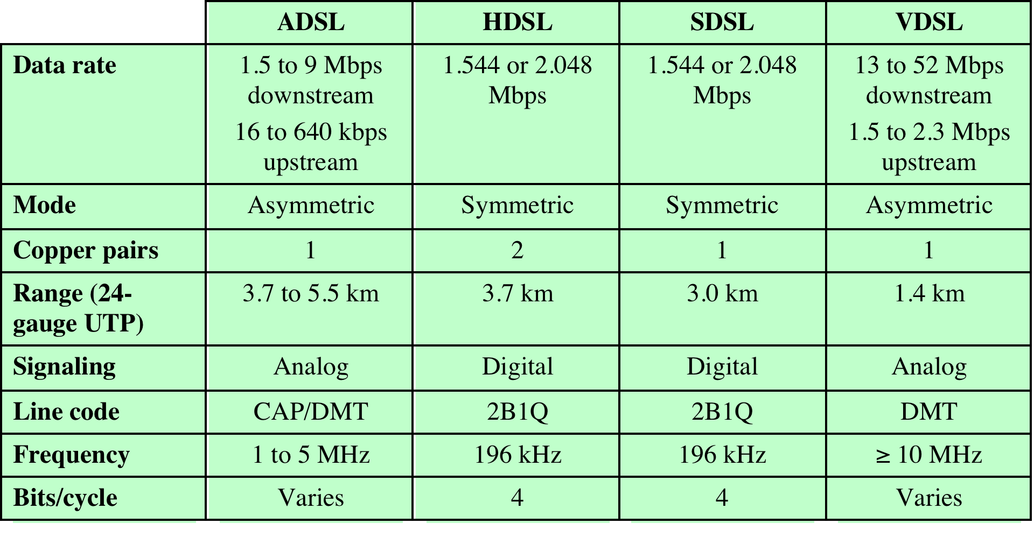
Comparison of xDSL Alternatives
DCC 9th Ed.
Stallings
Notes:
Stallings DCC9e Table 8.8 Comparison of xDSL Alternatives
UTP = unshielded twisted pair

Slide 23

VDSL
1.4 Km
twisted pair limit

Slide 24
Residential Access: Cable Modems
Does not use telephone infrastructure
  Instead uses cable TV infrastructure.
HFC: hybrid fiber coax
  asymmetric: up to 40Mbps downstream, 6 Mbps upstream
network of cable and fiber attaches homes to ISP router:
  homes share access to router
  unlike DSL, which has dedicated access.

Slide 25
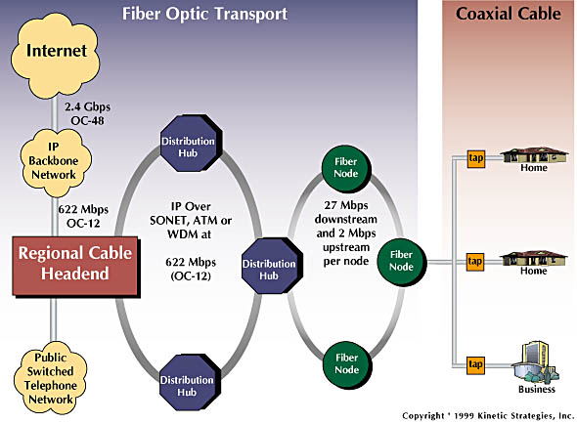
Residential Access: Cable Modems
Diagram: http://www.cabledatacomnews.com/cmic/diagram.html

Slide 26

Cable Network Architecture: Overview
Typically 500 to 5,000 homes
cable headend
cable distribution
network (simplified)
home

Slide 27
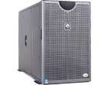
Cable Network Architecture: Overview
server(s)
cable headend
cable distribution
network
home

Slide 28
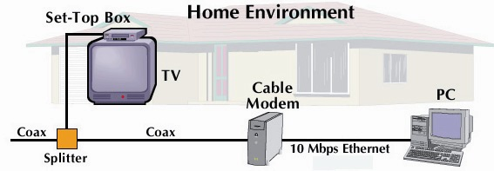
Cable Network Architecture: Overview
cable headend
cable distribution
network (simplified)
home

Slide 29
Cable Network Architecture: Overview
FDM
C
O
N
T
R
O
L
V
I
D
E
O
V
I
D
E
O
V
I
D
E
O
V
I
D
E
O
V
I
D
E
O
V
I
D
E
O
D
A
T
A
D
A
T
A
1
2
3
4
5
6
7
8
9
Channels
cable headend
cable distribution
network
home

Slide 30
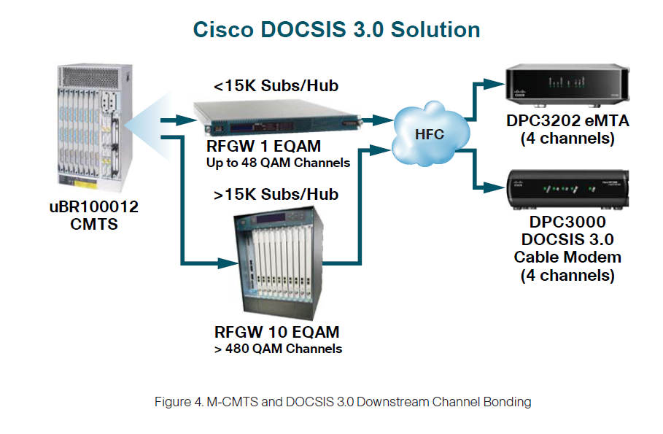
DOCSIS (Data-Over-Cable
Service Interface Specification)

Slide 31




Cable Access Networks
Internet frames,TV channels, control transmitted
downstream at different frequencies
cable headend
…
CMTS
…
splitter
cable
modem
cable modem
termination system
ISP
upstream Internet frames, TV control, transmitted
upstream at different frequencies in time slots
FDM over upstream, downstream frequency channels
multiple 40Mbps downstream (broadcast) channels (6MHz)
  single CMTS transmits into channels and received by all modem receivers.
K & R

Slide 32
DOCSIS Cable Access Networks
cable headend
MAP frame for
Interval [t1, t2]
CMTS
Downstream channel i
Upstream channel j
t₁
t₂
Residences with cable modems
Minislots containing
minislots request frames
Assigned minislots containing cable modem
upstream data frames
multiple 30 Mbps upstream channels (6.4MHz)
TDM-like upstream mini-slots
K & R

Slide 33
Fiber to the Home
ONT
Internet
optical
fibers
optical
fiber
ONT
OLT
optical
splitter
central office
ONT
Optical links from central office to the home
Two competing optical technologies:
  Passive Optical network (PON)
  Active Optical Network (AON)
Higher Internet rates. Fiber also carries television and phone services.
Verizon FIOS

Slide 34
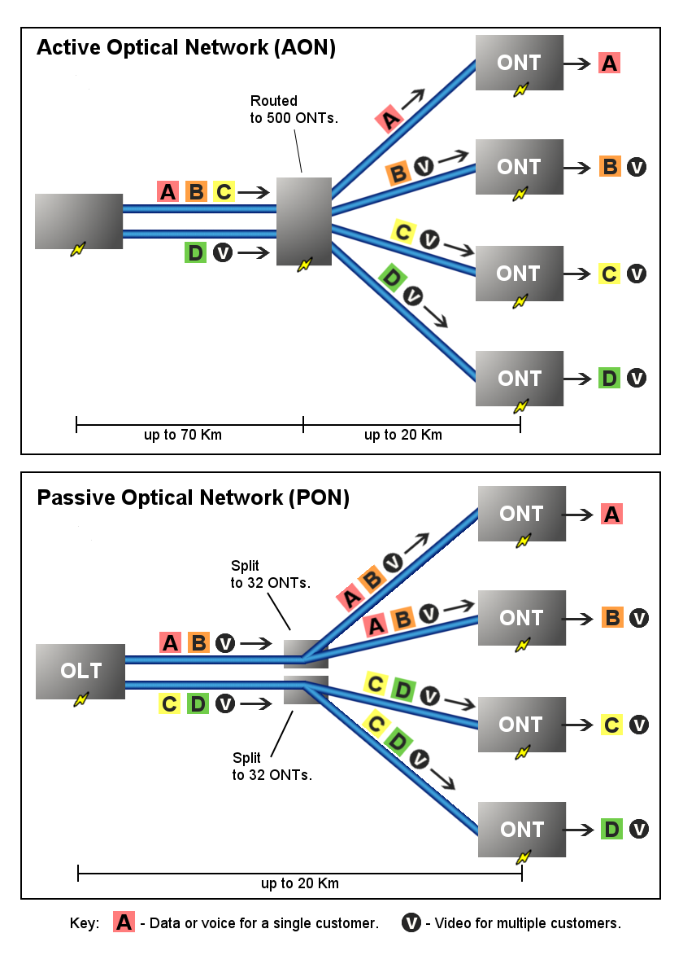
AON Active Optical Network
Uses electrical powered switches
More range
Less reliable
PON Passive Optical Network
Optical splitters do not need electrical power.
Hard to isolate failure
Transmission speed may be slower during peak hours.
Wikipedia

Slide 35
Ethernet Internet Access
100 Mbps
Institutional
router
Ethernet
switch
To Institution’s
ISP
100 Mbps
1 Gbps
100 Mbps
server
Typically used in companies, universities, etc
  10 Mbs, 100Mbps, 1Gbps, 10Gbps Ethernet
  Today, end systems typically connect into Ethernet switch.

Slide 36
Wireless Access Networks
Shared wireless access network connects end system to router
  via base station aka “access point”.
Wireless LANs:
  802.11b/g/n (WiFi): 11, 54, 200 Mbps
Wider-area Wireless Access
  provided by telco operator
  ~1Mbps over cellular system (EVDO, HSDPA) 3G and 4G LTE
  next up (?): WiMAX (10’s Mbps) over wide area
router
base
station
mobile
hosts

Slide 37
Residential Networks
Typical Residential Network Components:
DSL or cable modem
router/firewall/NAT
Ethernet
wireless access point (AP)
wireless
laptops
to/from
cable
headend
cable
modem
router/
firewall
wireless
access
point
Ethernet

Slide 38
Physical Layer Summary
Definitions (analog versus digital)
Multiplexing (FDM, TDM, statistical)
Transmission Media (UTP, Coax, Fiber, Radio, Satellite)
End System Choices (Dial-Up, ADSL, Cable,Ethernet, Wireless AP, Fiber-to-the Home)
Residential Configurations

