Slide 1
QoS Performance Analysis for CSMA/CA in IEEE802.15.5 Yon Lan, Bo Zhang and Zhicheng Chen Journal of Networks July 2014
Presenter: Bob Kinicki
Internet of Things
Fall 2015

Slide 2
Introduction
Authors argue that slotted CSMA/CA is particularly suited for WSNs where traffic is discrete or non-cyclical.
Focus is on beacon-enabled mode for IEEE802.15.4.
QoS is used constantly in this paper but the authors’ simulated application is mathematically-based with no real intuitive notion of QoS discussed.

Slide 3
IEEE 802.15.4 Frame Format
D pan
Dst EUID 64
S pan
Src EUID 64
Max 127 bytes
preamble
SFD
Len
FCF
DSN
Dst16
Src16
Fchk
Network Header
Application Data
Low Bandwidth (250 kbps), low power (1 mW) radio
Moderately spread spectrum (QPSK) provides robustness
Simple MAC allows for general use
Many TinyOS-based protocols (MintRoute, LQI, BVR, …), TinyAODV, Zigbee, SP100.11, Wireless HART, …
6LoWPAN => IP
Choice among many semiconductor suppliers
Small packets used to keep packet error rate low and permit media sharing.
Culler slide

Slide 4
Outline
Introduction
Beacon-Enabled IEEE802.15.4 and Superframe Structure
Simulation Methodology
Analysis of Simulation Results
Conclusion
Critique

Slide 5
Beacon-Enabled IEEE802.15.4
In beacon-enabled mode, communication behavior is constrained by superframe structure which is synchronized when coordinator periodically sends beacon frames.
Each sensor node’s communication process happens in the allocated slot time.

Slide 6
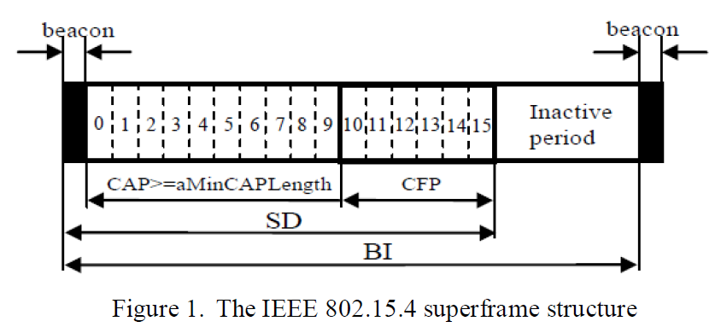
Figure 1: 802.15.4 Superframe

Slide 7
Beacon Interval (BI) and Superframe Duration (SD)
BI is defined by BO (Beacon Order).
SD is defined by SO (Superframe Order).

Slide 8
Duty Cycle (DC)
Duty cycle of beacon-enabled 802.15.4 is defined as:
Example: BO-SO = 2
DC = 2⁻² = ¼ = 25%

Slide 9
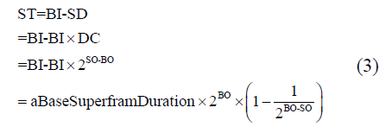
Sleep Time (ST)
For each BI, the inactive period is the node sleeping time (ST) which can be calculated as:
Hence ST is affected by the value of BO and duty cycle (i.e., BO-SO)

Slide 10
Three “What if” observations
1. BO fixed; BO-SO grows:
- ST grows and DC decreases
- E down, D up, O down
2. BO-SO fixed; BO grows:
- ST grows
- E down, D up, O down
3. BO fixed; as BO-SO increases from 0 to 14, change in ST decreases.

Slide 11
Simulation Settings
10 m x 10 m simulated area, 2.4 GHz, 250 kbps, 600 sec. duration using OPNET
Sensors deployed randomly to create star-topology. {This is very unclear!}
Power set at 1 mW, QPSK used.
No explanation of application traffic model:

Slide 12
Figure 2: OPNET Simulation

Slide 13
Figure 3: 10 Node Simulation
Large
delay
Small
duty cycle

Slide 14
Figure 4: 30 Node Simulation
Larger
delay

Slide 15
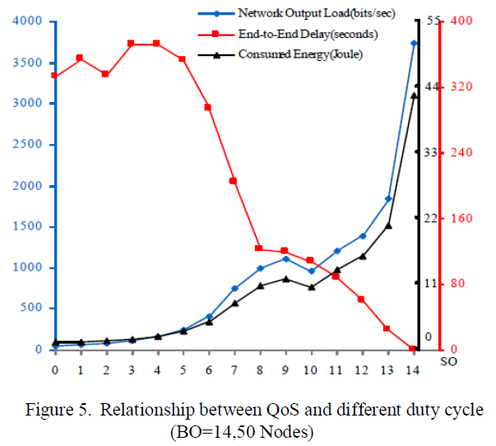
Figure 5: 50 Node Simulation

Slide 16
Simulations Varying BO
Authors want to study first “what if”:
- BO fixed; BO-SO varies
Fix the number of devices at 14. {Appears to minimize slot collisions!}
400 seconds simulated time.
Use Table II for traffic sources.

Slide 17
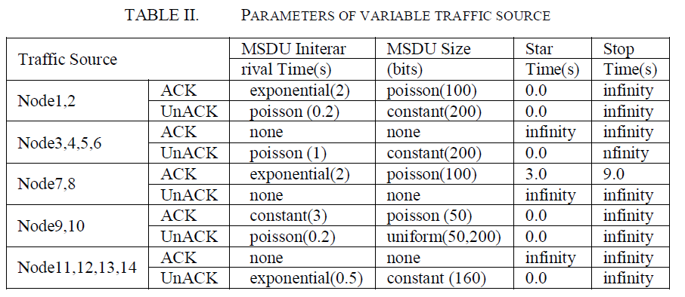
Table II
Why this traffic?

Slide 18
Figure 6: Energy vs BO
Best
performance

Slide 19
Figure 7: Output Load vs BO

Slide 20
Figure 8: Delay vs BO
Best
performance

Slide 21
Conclusions
Basically authors argue this presentation lets one see the tradeoffs in setting for beacon-enabled, slotted CSMA/CA for IEEE802.15.4

Slide 22
Critique
No justification or explanation of traffic sources.
They use QoS inappropriately – end-to-end delay never defined.
No discussion of traffic routes.
No sense of slotted collisions and no formal assignment to slots.
Why only star-topology?

