Slide 1
Mapping and Localization with RFID Technology
Matthai Philipose, Kenneth P Fishkin,
Dieter Fox, Dirk Hahnel, Wolfram Burgard
Presenter: Aniket Shah

Slide 2
Outline
Introduction
Related Work
Probabilistic Sensor Model
Mapping
Localization
Experimental Results
Conclusion

Slide 3
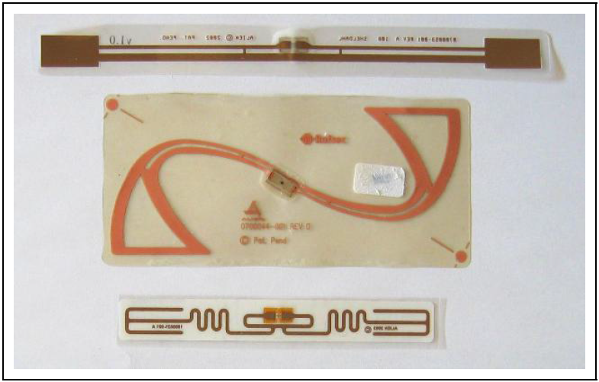
Introduction
RFID - Radio Frequency Identification; One of the methods of AIDC
Listen to broadcasts from receiver, reply with unique identifier
Paper discusses using RFID technology to enhance localization
Mobile robot equipped with laser scanner and RFID antennas used for experiment
Sensor model to detect tag position (approximate) wrt any one antenna and repeated with antennae on mobile robot
[Fig. 1]
Notes:
AIDC - Automatic Identification and Data Capture; includes barcodes, biometrics, OCR, etc

Slide 4
Introduction
Laser range data provides for map information
Monte Carlo localization used for robot pose estimation
RFID tags help reduce time and number of samples required for global localization
Paper discusses using sensor model for RFID receivers with FastSLAM to localize RFID tags
Suggests the use of these tas to detect positions of robots and people

Slide 5
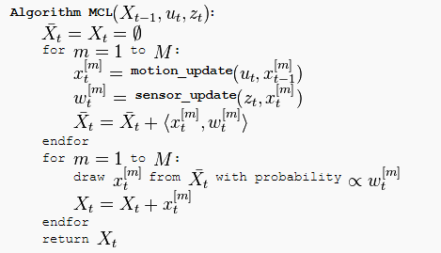
Monte Carlo localization
Input - Belief (sample), actuation and sensor data
Update motion and sensor data
Resample and calculate beliefs based on probability

Slide 6
Related Work
RFID sensors have entered the field of mobile robotics
Low-cost passive tags with long range help in navigation, localization, mapping etc
Active beacons by Kantor and Singh to provide information based on tag response time
Tsukiyama’s system does not deal with uncertainties
SLAM techniques cannot be directly applied for range or bearing or both

Slide 7
Probabilistic Sensor Model
Localization of tags based on a recursive update rule
x = tag pose, z_{1:t} = data gathered in time t, p(z_{t} | x) =likelihood of observation of z_{t} given x
Considerations while designing observation model:
false negative readings
false positive readings
[Eq. 1]
Notes:
false negative- no tag when it should be there
false positive- tag which is actually not in range or tag from wrong antenna

Slide 8
Probabilistic Sensor Model
Reasons for considerations:
Orientation of tag wrt receiver influences signal energy
Less energy might not power the chip inside the tag leading to a no-response
Shape and size of detection range depend on environment
Observation model must cover such situations and ensure minimal errors in localization
Observation model determined by counting frequency of detections of tag wrt antennae on robot
Distance varied between tag and robot to get the map
Notes:
environment factors - metals near tags, concrete walls create disturbance, detection due to reflections

Slide 9
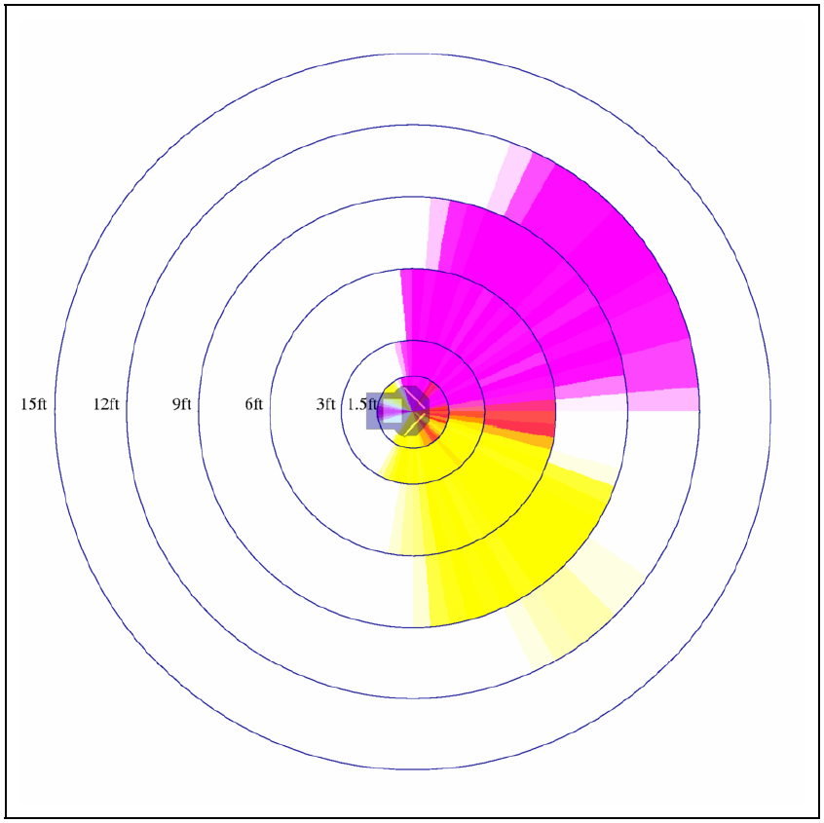
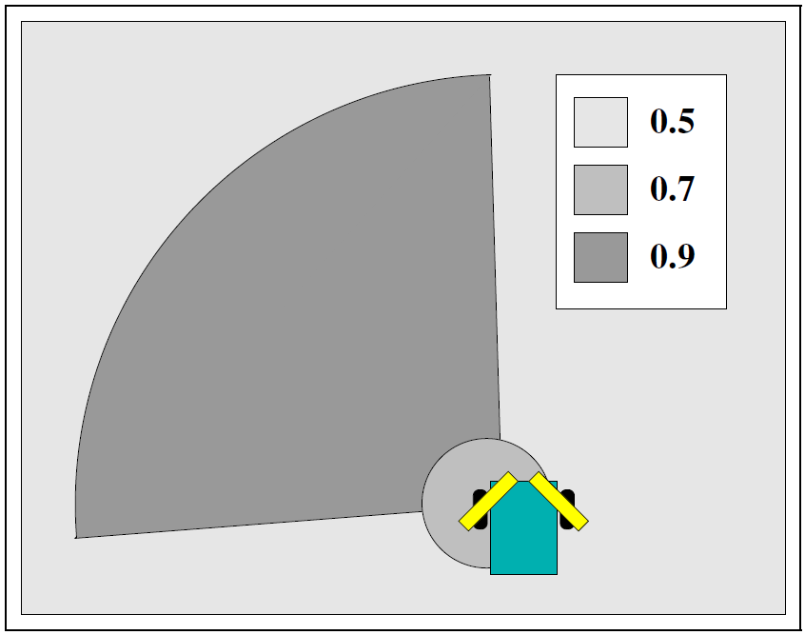
[Fig. 3]
[Fig. 4]
Notes:
Fig. 3 - Detection Field for left(pink) and right(yellow) antenna
Fig. 4 - Simplified sensor model for single antenna, arc with range of 95 deg in dir (0.9); circle for close detection(0.7); rest (0.5)

Slide 10
Mapping
First application of model is to localize tags
Two steps to learn positions:
Learn geometric structure of environment using laser range sensor
Estimate tag position based on robot path
Geometrical structure found using FastSLAM algorithm
Use map and maximum likelihood path of robot to locate tags
Apply the recursive Bayesian filtering scheme of Eq. 1
Notes:
FastSLAM algo - scan matching combined with particle filtering; scan matching converts laser readings to odometry; lower variance in the corrected odometry reduces the number of necessary resampling steps and this way decreases the particle depletion problem

Slide 11
Mapping
Pose belief of tag represented by a set of 1000 random positions uniformly distributed in a 25 m² are around robot’s current pose
Area independent of antenna
Initialization done at first detection of tag by robot
Posterior probability assigned to each tag position corresponding to true pose of tag
Posterior updated on each detection

Slide 12
Localization
Compute likelihood of observation ‘y’ during localization knowing the posterior distributions of tag positions and given robot/person at position ‘l’
r(x,l) = position of tag relative to robot given pose ‘l’ of robot and location of tag sample ‘x’, p(y | r(x,l)) = sensor model description
[Eq. 2]

Slide 13
Localization
recursive Bayesian filtering scheme:
α = normalization constant, p(l_{t} |u_{t-1}, l’_{t-1}) = probability of object to be at l_{t} give it executed movement u_{t-1} at position l’_{t-1}
Notes:
Bayesian filtering done to estimate robot/person pose

Slide 14
Localization
In Monte Carlo localization, belief of robot is a set of random samples
Each sample consists of state vector which is pose of robot and weight factor ‘w’
Weight factor provides importance of particle
Beliefs updated on two alternating steps:
In prediction step, new sample for each sample based on weight and model probability of robot’s dynamics since previous update
In correction step, new observation is integrated into sample set by bootstrap resampling
For RFID sensors, samples placed on in potential detection range of sensor
Notes:
bootstrap resampling - each sample weighed according to observation likelihood

Slide 15
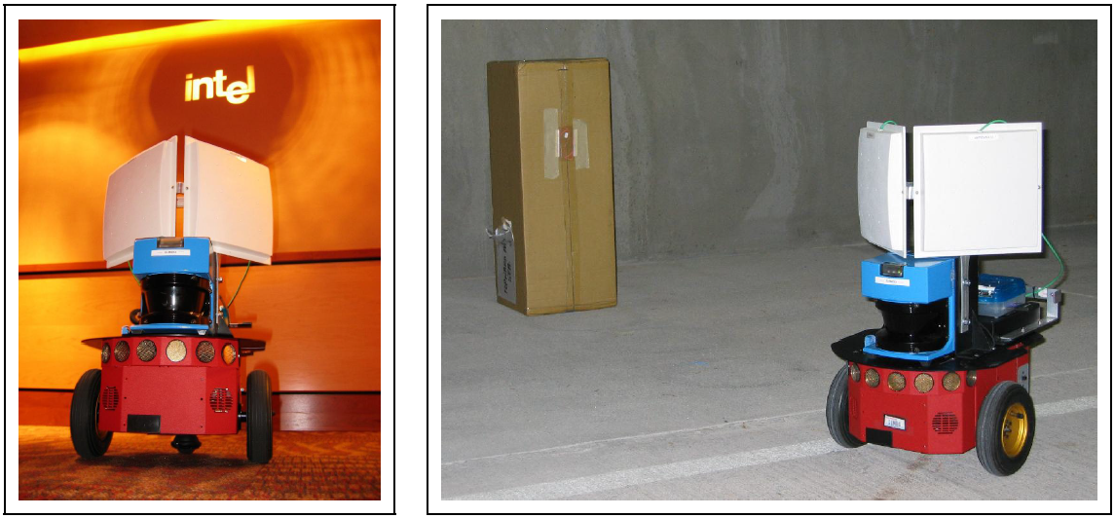
Experimental Results
Implementation and Testing done using Pioneer 2 robot with SICK LMS laser range-finder and Alien Technology’s 915 MHz RFID reader with two circularly polarized antennas
[Fig. 2]

Slide 16
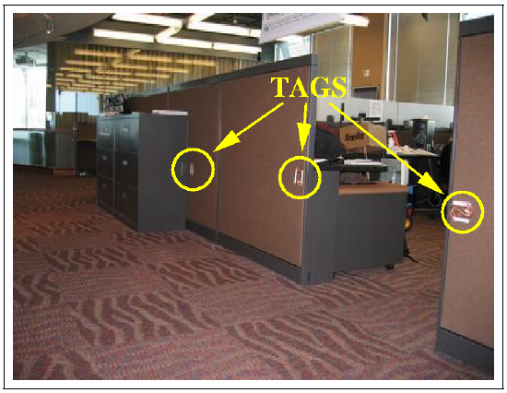
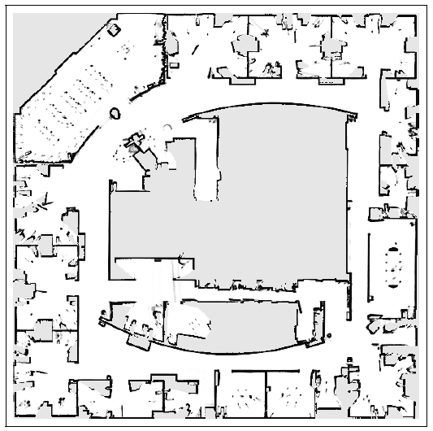
[Fig. 6]
[Fig. 7]
Notes:
Fig. 6 - 100 tags used similar to the ones shown in Fig. 1 middle
Fig. 5 - Map of Intel Research Lab Seattle using FastSLAM

Slide 17
Experimental Results
Mapping RFID tags
Trajectory estimation by FastSLAM to determine posterior of toag location
On first detection, initialize random points around robot and use uniform distribution for belief
On tag detection, update posterior probability based on likelihood of observation
Normalize belief over all samples
[Fig. 7]
Notes:
Fig. 7 - Evolution of posterior about localization of tag over time; width of circle represents probability of position; beliefs shown after 6, 17, 65 and 200 measurements

Slide 18
Experimental Results
Mapping RFID tags
Representation can handle ambiguities in which location of tag can’t be determined uniquely
Algorithm can accurately localize tags
There is noise and a several false detections
Learn position of multiple tags in environments
[Fig. 10]

Slide 19
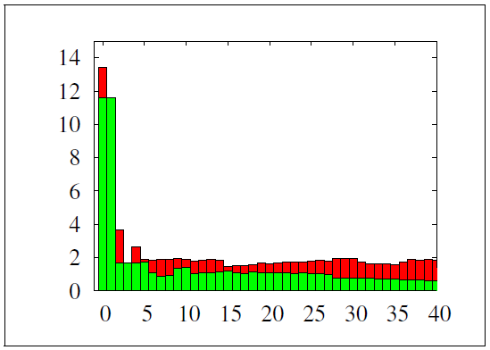
Experimental Results
Localization with RFID tags
Robot steered through environment and Monte Carlo localization applied to globally estimate position
Person localization done by ignoring odometry data and changing motion model in Monte Carlo localization
Motion model of robot replaced by Gaussian distribution centered around current pose of robot to approximate motion of person
[Fig. 9]

Slide 20
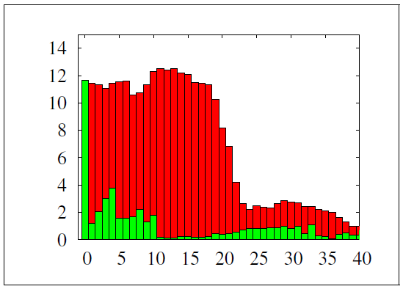
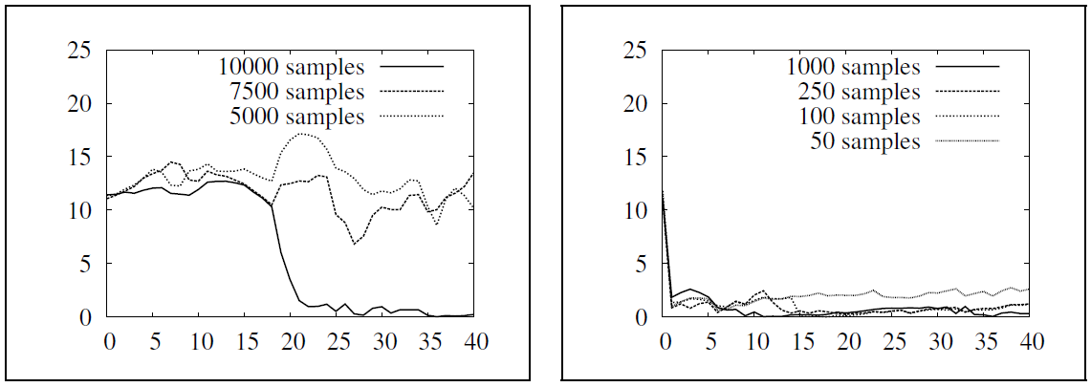
Experimental Results
Improving Global Localization with RFID tags
RFID technology can be used to improve global localization even when highly accurate sensors are used
Use of RFID sensors reduce the number of samples required
Motion model of robot replaced by Gaussian distribution centered around current pose of robot to approximate motion of person
[Fig. 11]
[Fig. 12]

Slide 21
Conclusion
Generated maps of RFID tags with mobile robots
Sensor model to compute likelihood of tag detections
Use of posteriors to localize robot/people
Showed that maps can be used to localize robots without odometry data
Reduce computational demands for localization by using RFID technology with laset scanners

Slide 22
Opinion
Good paper providing proof of concept with good experimental results
Well documented; makes it easier to re-perform and compare results
Could have explained certain algorithms and math in detail
As a panelist, I would accept this paper

Slide 23
Questions?

