Slide 1
Improving Packet Delivery Performance of Publish/Subscribe Protocols in Wireless Sensor Networks Sensors 2013, Volume 13, Issue 1
Presenter: Le Wang

Slide 2
Outline
1. Motivation and overview
2. Background
Polling Model and Publish/Subscribe Model
Publication Discipline
MQTT-S and CoQP
3. Simulation Environment
4. Evaluation
Single Hop
PDR
Discarded Publication Ratio (DPR)
Retransmitted Publication Ratio
Duplicated Publications Ratio
Multiple Hop
5. Summary

Slide 3
Motivation
MQTT-S and CoAP:
Two application protocols for Wireless Sensor Networks (WSN)
Based on UDP
Provide reliability mechanism in Application layer
Reliability Mechanism:
Defines a fixed Retransmission TimeOut (RTO).
Problems? Too long or too short?
Result in a lower Packet Delivery Ratio (PDR).
Propose an adaptive RTO:
Consists in using a Smooth Round-Trip Time (SRTT)
Multiplied by a constant parameter K

Slide 4
Background
Polling Model:
Applications send queries to sensor nodes to retrieve information.
Problem?
When an event of interest occurs, in order to react in real-time, the sensor nodes have to be queried continuously.
Waste of resources such as energy, processing and bandwidth.

Slide 5
Background
Publish/Subscribe Model
Entities:
Publisher: generate events
Subscriber: express interest in events
Subscription:
Register interest in the event
Advantages:
Decouple in time: publishers and scubscribers do not need to be actively participating in the interaction at the same time
Decouple in space: publishers and subscribers do not need to know each other
Publishers and subscribers can produce or consume events in an asynchronous way.

Slide 6
Publication Discipline
Activation: when there is a pending confirmation of a publication message, and a new publication is generated
MQTT-S publication discipline:
Discard the new publication message
CoAP publication discipline:
Discard the old publication message
An inappropriate fixed RTO will result in a higher probability of a new publication message being generated while the RTO is active. Therefore, the publication discipline will discard the publication message (Old or New).

Slide 7
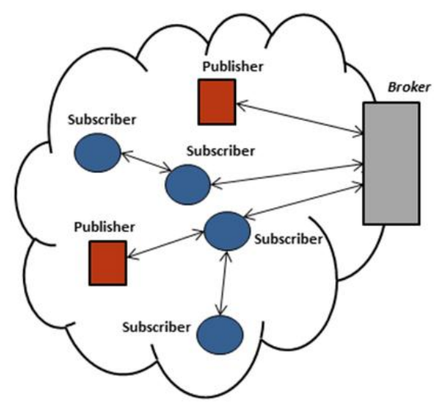
MQTT-S
Extension of the Message Queuing Telemetry Transport (MQTT) Optimized for WSN.
Components:
Broker node:
responsible for managing subscriptions as well as storing and sending publications to corresponding WSN subscriber nodes.
Publisher nodes:
generate event
Subscriber nodes:
express interest in events
Relay nodes:
for multi-hop scenario.

Slide 8
MQTT-S
Reliability:
QoS Level 0 (QoS0)
Offers a best-effort delivery service, no retransmission or Acknowledgements.
QoS Level 1 (QoS1)
Allows the retransmission of messages until Acked
Does not prevent duplicate reception
QoS Level 2 (QoS2)
Ensures the reception of message
Ensures to deliver only once to the destination by four message handshake.
Parameters for QoS1 and QoS2:
Fixed RTO: 10-15 seconds.
Retransmission number: 3-5

Slide 9
MQTT-S
Publication Discipline:
“stop and wait” mechanism for the transmissions of publication messages with QoS1 and QoS2.
A publisher node has to wait for the termination of its publication message flow with the broker node before it can start a new one.
If more than one publications are generated, publication discipline is needed.
Activity 1: Queue the new publication messages
Drawback: cost more source
Activity 2: Drop the new publication messages
Always attempts to retransmit the old publication message till receive the ACK.
Called ‘Persistent mode’ discipline

Slide 10
CoAP
Characteristics:
RESTful (Representational State Transfer)
Resources are identified by Universal Resource Identifiers (URI)
UDP based
Model:
Client/server interaction model
Request messages initiate a transaction with a server, which may send a response to the client with a matching transaction ID
Polling based: not suitable for requiring information in real-time in order to react when an event of interest occurs.
Publish/subscribe interaction model
A.k.a: Observer Model
A publisher node can send publications to a subscriber node (observer) about a event that the subscriber is interested in receiving .

Slide 11
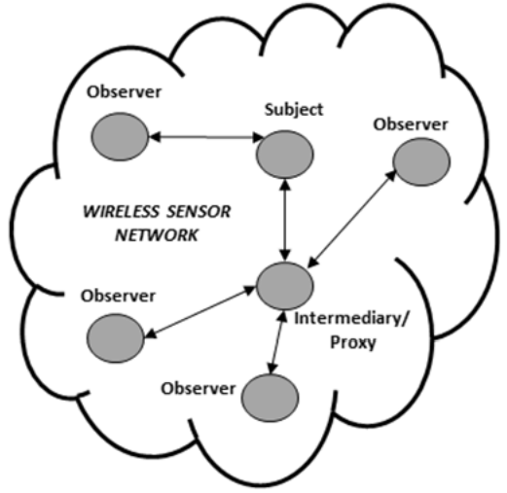
CoAP
Publish/subscribe interaction model
A subscriber constantly to observe the events by registering its interest in the event (GET request to the publisher node).
Subscription Action:
Publisher node establishes an observation relationship between the subscriber and the event.
The publisher notifies each subscriber node that has an observation relationship with the event.
Observer Model:
High scalability
Use caches and proxy nodes that multiplex the interest of multiple subscribers in the same event into a single association

Slide 12
CoAP
Reliability:
Non-Confirmable (NON) message:
Correspond to MQTT-S QoS 0
No ACK to messages
Confirmable (CON) message:
Correspond to MQTT-S QoS 1
ACK messages received
Fixed RTO
Random number between and ACK TIMEOUT constant and an ACK TIMEOUT multiplied by ACK-RANDOM-FACTOR
UnACKed messages within RTO are retransmitted
RTO is doubled (Exponential back-off mechanism)
MAX_RETRANSMIT: Maximum retransmission numbers

Slide 13
CoAP
Publication Discipline:
“stop and wait” mechanism for the transmission of CON messages. Same with MQTT-S.
Publication discipline is also needed to handle publication messages generated while the publication message flow is in progress (RTO is active)
Activity:
Stop the retransmission of old publication message
Transmit the new publication message with the number of attempts remaining from the old publication message.

Slide 14
MQTT-S and CoAP
Fixed RTO:
Too short: give rise to spurious retransmissions, waste bandwidth, energy and computation.
Too long: lead to slow or late reaction to the loss of packets, increase delay ,decrease PDR.
Suitable for deployments when RTT is close to the defined RTO value.
Not suitable for scalability and flexibility features by the publish/subscribe model on WSN.
Adaptive RTO:
Compute smoothed RTT (SRTT)
SRTT = (1 - a) x SRTT + a x RTT
Compute RTO
RTO = SRTT x K

Slide 15
Summary of Publication Discipline
Publication discipline has a direct impact on the number of discarded publication messages.
Publisher nodes discard greater number of publication msgs than broker node, because publisher is in charge of publication message generation.
Situation when not receiving ACK:
Not receive publication message, require retransmission from publisher
Received publication message, ACK is lost. Result in duplicate publication.
Limitations:
Goodness of MQTT=S/CoAP publication discipline is beyond the scope
Decrease in the number of discarded publications also depend on the publication generation rate in addition to adaptive RTO, which is beyond the control of an adaptive RTO.

Slide 16
Simulation Environment
OMNet
Goal: monitor and control acritical parameters in a warehouse through a WSN deployment.
Devices:
Publisher nodes
measure the critical parameters in the warehouse
One publisher node receives publication messages in a best-effort mode for monitoring process, i.e., MQTT-S QoS 0 / CoAP NON
Another publisher node receives publication messages in reliable mode for controlling critical parameters, i.e., MQTT-S QoS 1 / CoAP CON
Broker node:
Receive periodic signal from publisher nodes
Refer to the central node in MQTT-S or proxy node for CoAP

Slide 17
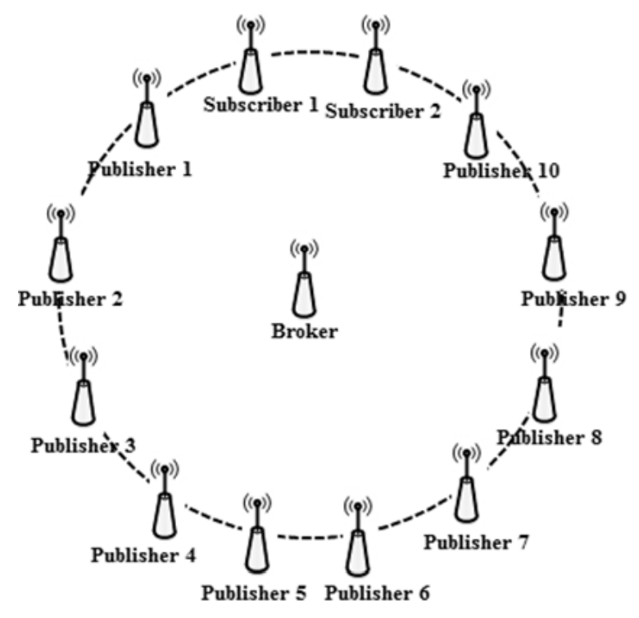
Simulation Environment
Single Hop
Subscribers and publisher nodes are place at the same distance from the broker to achieve fairness among nodes.
Multiple Hop:
Publication messages originated in publisher nodes located from more than one hop away are received through the broker node to which the subscriber nodes are connected.
Broker node subscribes on behalf of its subscriber nodes to another broker node that the publisher node with information of interest connected to.

Slide 18
Simulation Environment
Other parameters
A confidence interval with probability of 95%
A given parameter lies within the interval with a probability of 95%

Slide 19
Performance Metrics
Packet Delivery Ratio (PDR):
To evaluate the performance of the reliability mechanism of MQTT-S and CoAP, i.e., QoS x, CON/NON.
PDR = $\frac{No. of received publication messages by each subscriber}{No. of generated publication messages by all publishers}$
Duplicated publication messages are not take into account
Discarded Publications Ratio (DPR):
To evaluate the impact of the publication discipline in the PDR.
If DRP increases, PDR will decrease
DPR = $\frac{No. of Discarded publication messages (publisher or broker) }{No. of generated publication messages (publisher)}$

Slide 20
Performance Metrics
Retransmitted Publications Ratio:
To evaluate the effect of the RTO value.
Good RTO could reduce spurious retransmission.
RPR = $\frac{No. of retransmitted publication messages }{No. of sent publication messages }$
Duplicated publication messages are not take into account
Duplicated Publications Ratio:
Duplicated Publications Ratio = $\frac{No. of duplicated publication messages }{No. of received publication messages }$
In broker and subscriber node with QoS1 (MQTT-S)
In subscriber node with CON (CoAP)

Slide 21
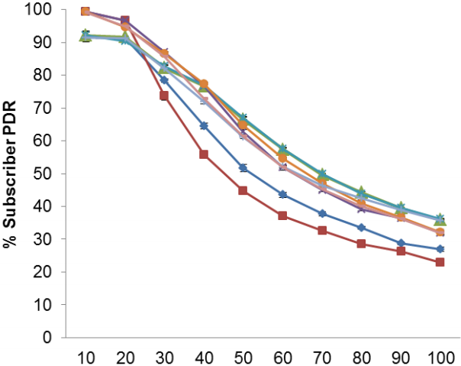
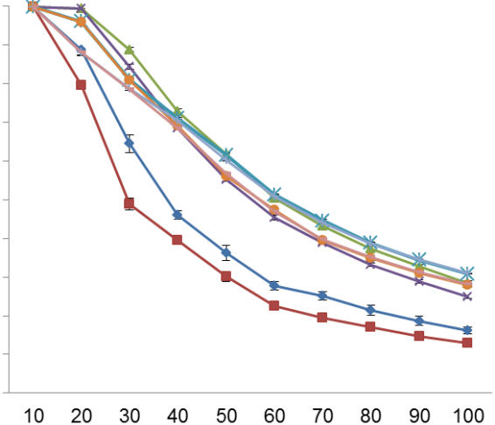
SMQTT-S: Subscriber PDR VS # of Publisher Nodes
Single Hop
# of publisher nodes increases, PDR decreases
K increases, PDR increases because spurious retransmissions are reduced
QoS 0 with K =3 has the highest PDR without MAC ACK; QoS 0 with K=2 has the highest PDR with MAC ACK
PDR of QoS 1 is lower than QoS 0 because additional msgs of QoS 1 congest faster
Recovered by MAC ACK before MQTT-S retransmission are activated
Spurious retransmissions as MQTT-S retransmission activated before MAC ACK
Without
MAC ACK
With
MAC ACK
# of Publisher Nodes

Slide 22
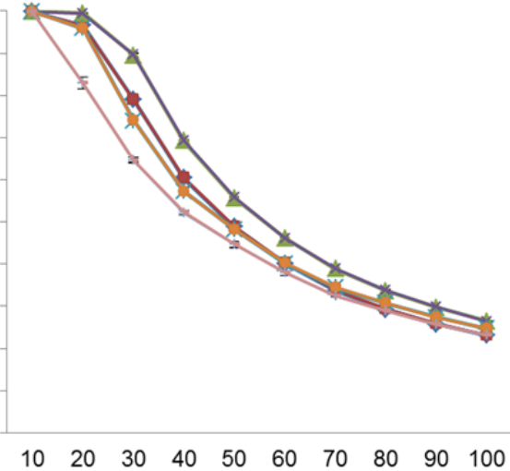
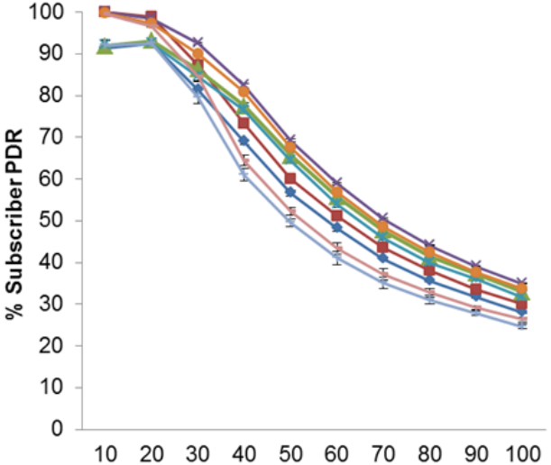
CoAP: Subscriber PDR VS # of Publisher Nodes
Single Hop
# of publisher nodes increases, PDR decreases
K =2 has the highest PDR with/without MAC ACK
MAC ACK is required for NON when # of publisher < 40; CON when # of publisher < 30.
Recovered by MAC ACK before CoAP retransmission are activated
Spurious retransmissions as CoAP retransmission activated before MAC ACK
Without
MAC ACK
With
MAC ACK
# of Publisher Nodes

Slide 23
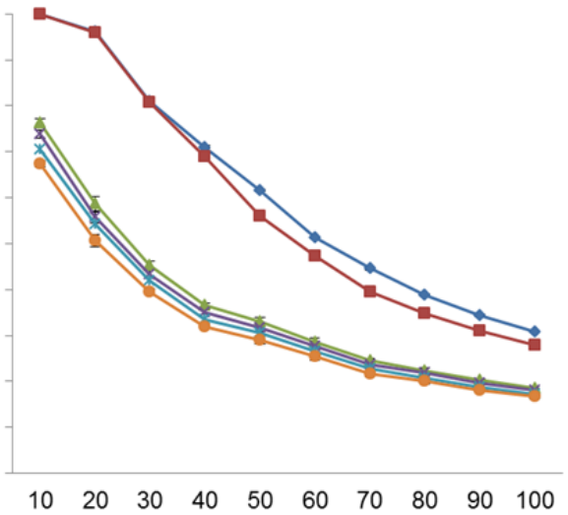
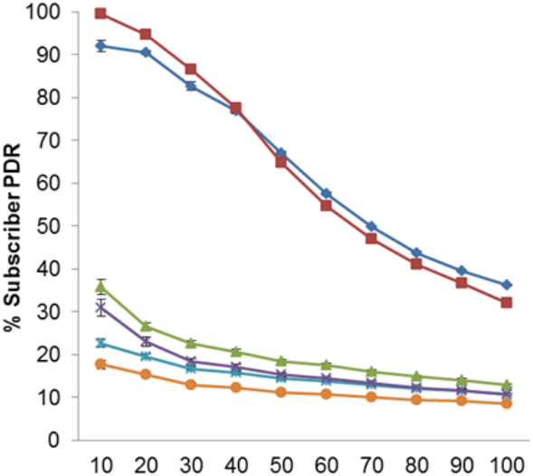
Single Hop
SMQTT-S: fixed RTO vs adaptive RTO
PDR with fixed RTO is lower than adaptive RTO, as fixed RTO cause the MQTT-S retransmission to be activated too late to recover the message losses.
QoS 0: PDR increase 64% (20 nodes) and 23% (100 nodes); QoS 1: PDR increase 76% (10 nodes) and 21% (100 nodes);
MAC ACK is not sufficient to recover the message losses.
QoS 0: PDR increase 38% (20 nodes) and 12% (100 nodes); QoS 1: PDR increase 40% (20 nodes) and 10% (100 nodes).
Without
MAC ACK
With
MAC ACK

Slide 24
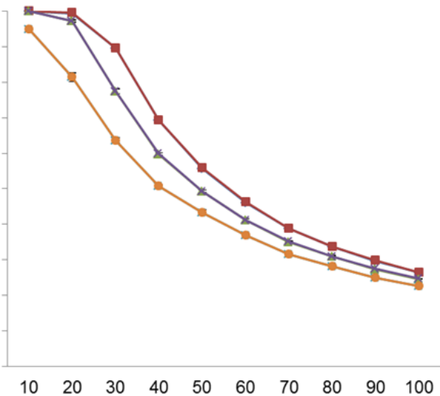
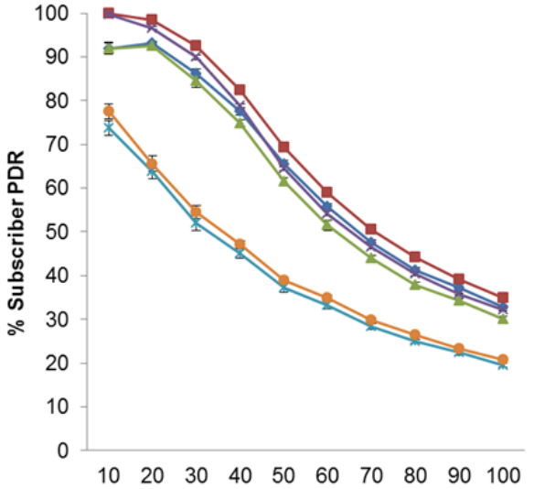
Single Hop
CoAP: fixed RTO vs adaptive RTO
Compared with Default fixed RTO
Without MAC ACK: NON: PDR increase 34% (30 nodes) and 13% (100 nodes) ;CON: PDR increase 38% (30 nodes) and 14% (100 nodes)
With MAC ACK: CON: PDR increase 38% (30 nodes) and 14% (100 nodes) ;CON: PDR increase 26% (30 nodes) and 4% (100 nodes)
Compared with RFC6298
Without MAC ACK: NON: PDR increase 5% (50 nodes) and 3% (100 nodes) ;CON: PDR increase 38% (30 nodes) and 14% (100 nodes)
With MAC ACK: CON: PDR increase 13% (30 nodes) and 1% (100 nodes) ;CON: PDR increase 26% (30 nodes) and 4% (100 nodes)
Without
MAC ACK
With
MAC ACK

Slide 25
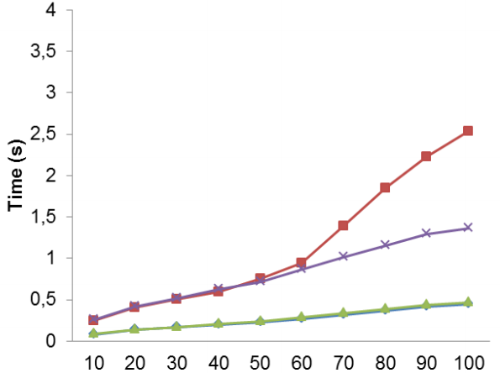
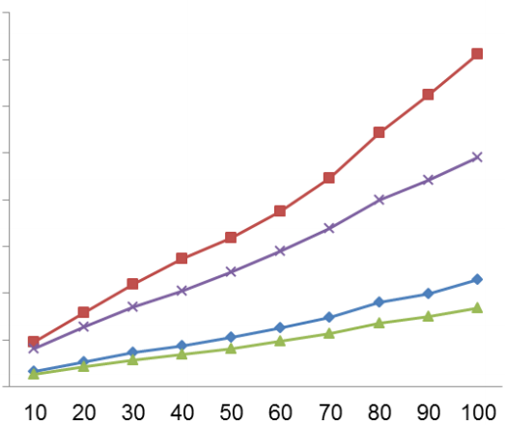
Comparison of RTT and RTO Measurements
Single Hop
MQTT-S
PUB’s RTO is higher than BK RTO after 60 nodes
More publishers are competing for access to the channel, then collision increases
The RTO therefore increases as the retransmissions are activated
Higher RTO with MAC ACK is obtained due the use of MAC ACK
Without
MAC ACK
With
MAC ACK
# of Publisher Nodes

Slide 26
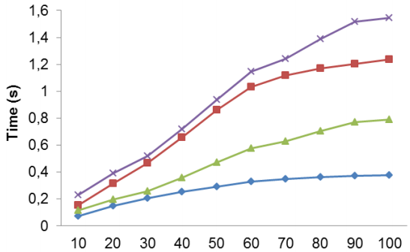
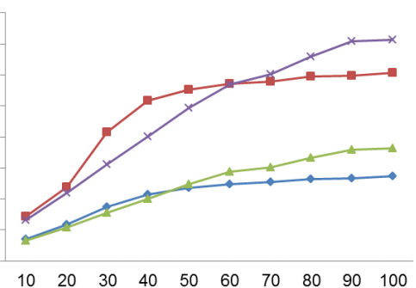
Comparison of RTT and RTO Measurements
Single Hop
CoAP
A change after 60 nodes without MAC ACK
More publishers are competing for access to the channel, then collision increases
RTO increases slow because the publication discipline of CoAP results in the cancellation of retransmissions.
A change after 40 nodes with MAC ACK because the MAC ACK causes the network congest faster.
Without
MAC ACK
With
MAC ACK
# of Publisher Nodes

Slide 27
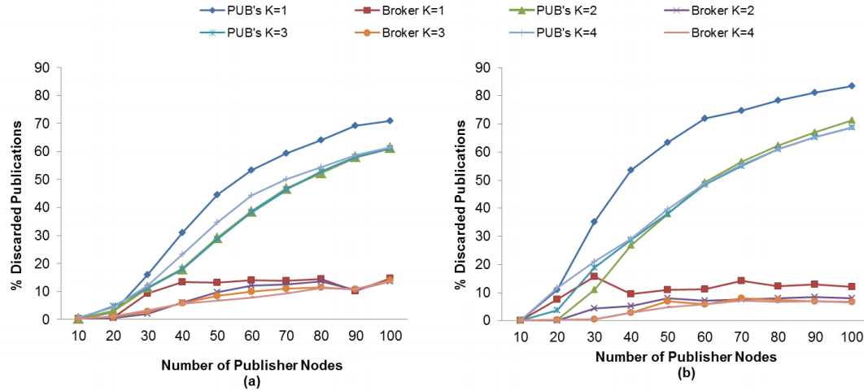
Discarded Publication Ratio (DPR)
Single Hop
MQTT-S
Publishers discard more msgs than Brokers as Publishers discard the new generated msgs and keep sending old msgs if ACK is not received.
DPR decreases as K increases, except K=4:
The retransmission of MQTT-S is activated too late to recover publication message, hence resulting higher DPR
Without MAC ACK: K=3 when lowest DPR; With MAC ACK: K=2 when lowest DPR
Without
MAC ACK
With
MAC ACK

Slide 28
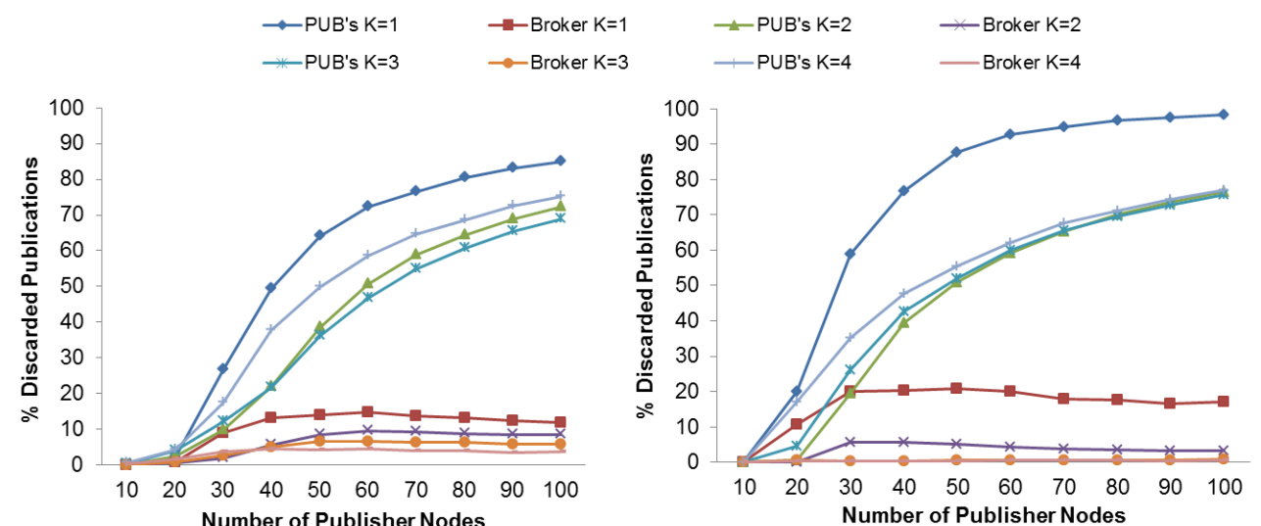
Discarded Publication Ratio (DPR)
Single Hop
CoAP
As K increases, lower DPR obtained, except K=2
Why?
Publisher nodes obtain a lower DPR without MAC ACK than with MAC ACK, as the absence of MAC ACK reduces the delay.
i.e., when RTO is active, the probability of generating a new publication is also reduced.
Without
MAC ACK
With
MAC ACK

Slide 29
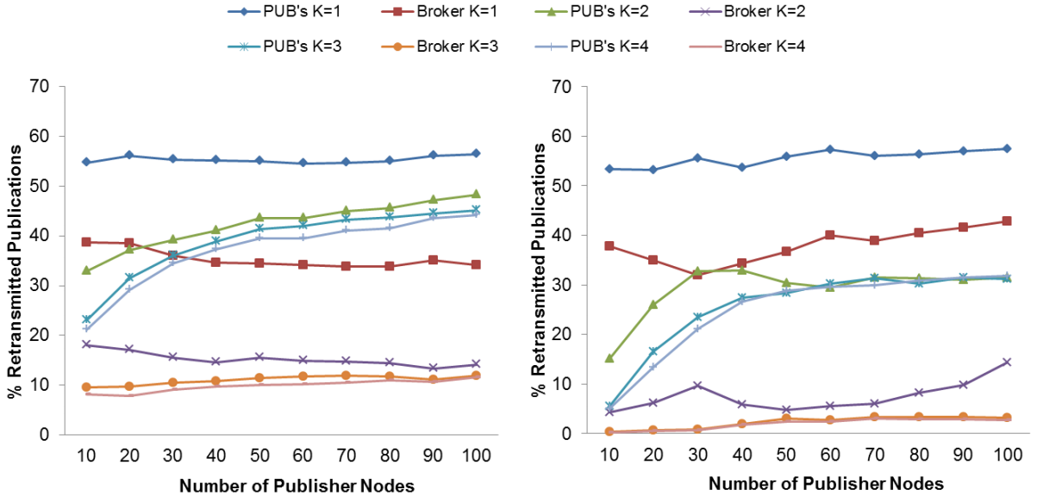
Retransmitted Publication Ratio
Single Hop
MQTT-S
Lowest retransmitted messages is obtained with K=4 with MAC ACK due to the decrease spurious retransmissions caused by application retransmissions and MAC ACK
However, the retransmissions are activated too late for packet recovery due to a larger RTO when K=4.
Therefore, K=3 is adopted.
Without
MAC ACK
With
MAC ACK

Slide 30
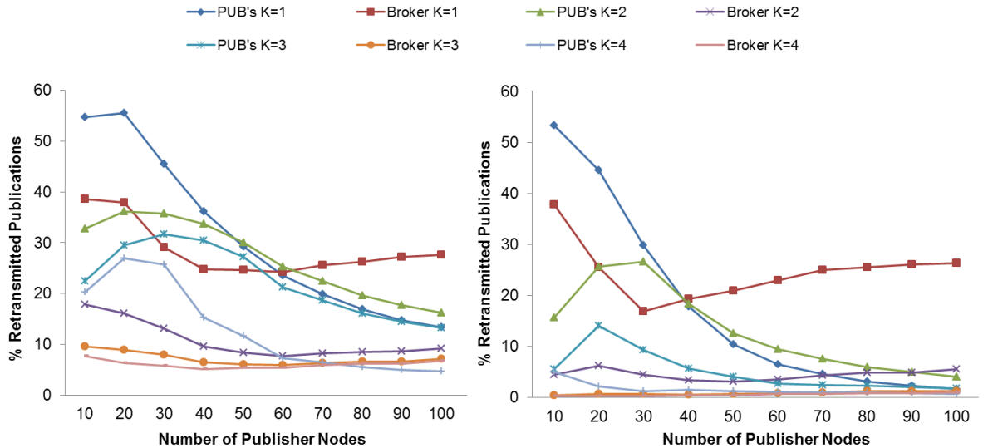
Retransmitted Publication Ratio
Single Hop
CoAP
Lowest Retransmissions when K =4, but it is not sufficient.
Based on the results from the previous experiments, K=2 is adopted.

Slide 31
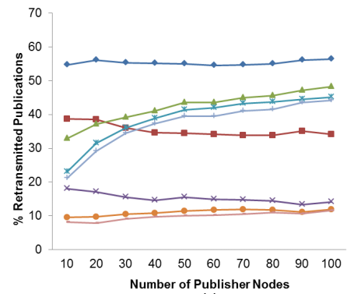
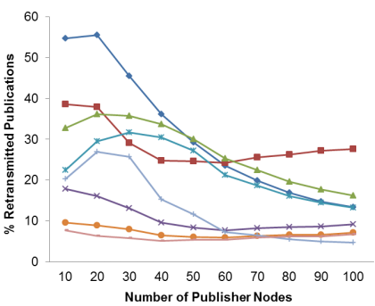
Comparison of MQTT-S with CoAP
Single Hop
Retransmitted msg ratio for CoAP is lower than MQTT-S
Because the publication discipline of CoAP always cancel the old msgs to send the new generated msgs; while MQTT-S always retransmit the old msgs.
MQTT-S
CoAP

Slide 32
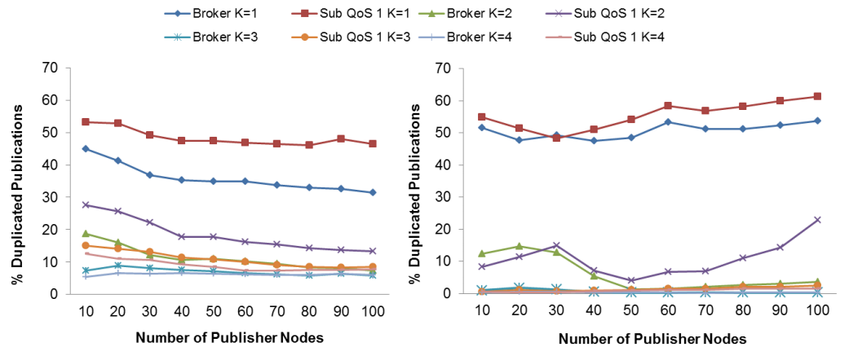
Duplicated Publications Ratio
Single Hop
MQTT-S
Duplicated msgs reduce PDR because of useless data
K increases, number of duplicated messages decreases.
K=4 with MAC ACK reaches the lowest ratio of duplicated msgs.
While K =3 for highest PDR, because MQTT-S react faster when losing msgs and consequently spurious retransmission may be produced

Slide 33
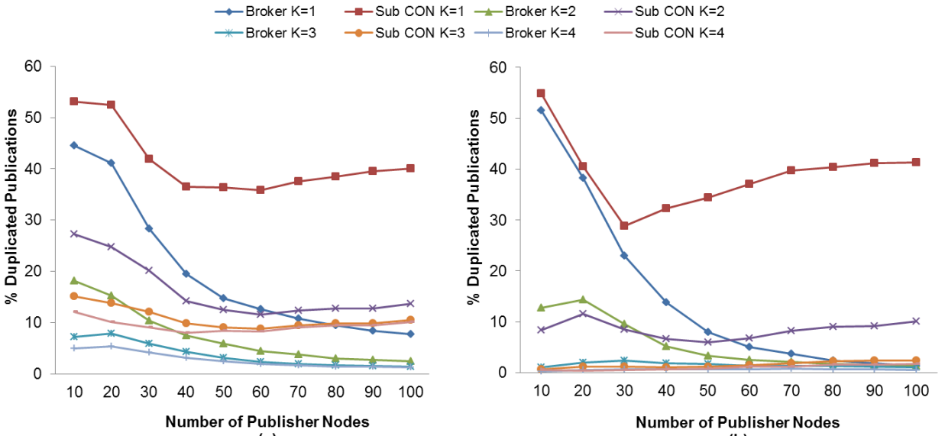
Duplicated Publications Ratio
Single Hop
CoAP
Similar with MQTT-S. Even though K=4 get the lowest duplicat msgs, K=2 get the highest PDR.
CoAP receive fewer duplicated msgs than MQTT-S because of the publication discipline.

Slide 34
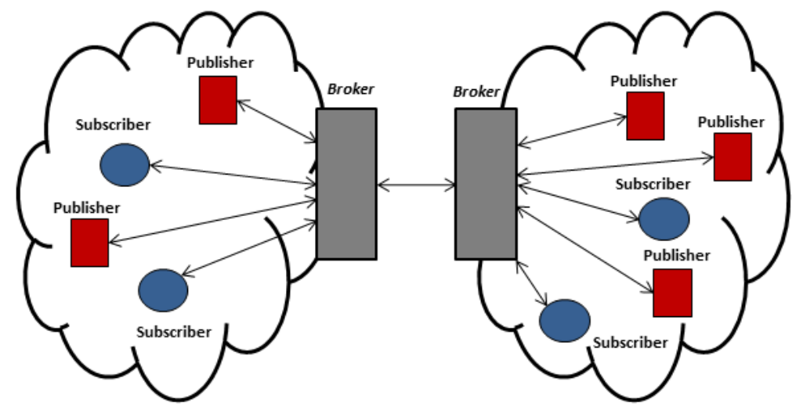
Single-Hop Extended Scenario
Single Hop Extend
QoS 1

Slide 35
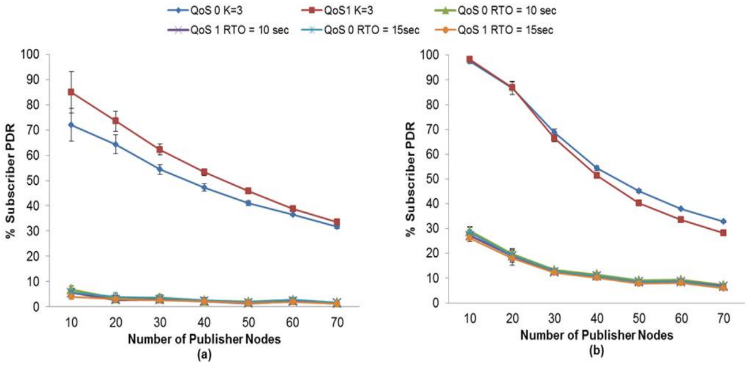
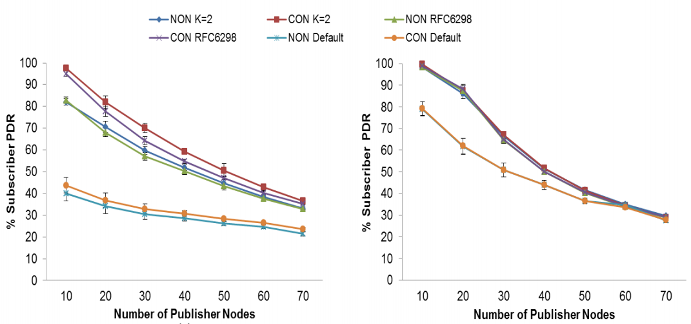
Single-Hop Extended Scenario
Single Hop Extend
MQTT-S
MQTT-S
Without
MAC ACK
With
MAC ACK
CoAP
CON
NON
Without
MAC ACK
With
MAC ACK

Slide 36
Single-Hop Extended Scenario
Single Hop Extend
MQTT-S: K=3 reach highest PDR; CoAP: K=2 reach highest PDR;
PDR is lower than in the single-hop scenario because
The second broker increases the network load and results in packet losses
Msgs between the broker nodes are sent in QoS 1, which results in more congestion
Network load with 70 nodes is similar to 100 nodes in single hop scenario, because the second broker node increase traffic. Therefore, the result are showed up to 70 publisher nodes.
MQTT-S: QoS 0 gets higher PDR with MAC ACK; QoS 1 gets highest PDR without MAC ACK. MAC ACK is required when node # < 40;
CoAP: Highest PDR is obtained without MAC ACK;
NON: MAC ACK is required when node # < 40; CON: MAC ACK is required when node # < 30;

Slide 37
Single-Hop Extended Scenario
Single Hop Extend
Retransmission Publication Ratio decreases as K increases.
K=4 gets the lower retransmission publication ratio with MAC ACK
Still adopt K=3 for MQTT-S, K=2 for CoAP, because of the highest PDR.
K increases, energy consumption decreases.
With use of the adaptive RTO of MQTT-S and CoAP consume up to 8% more energy than fixed RTO, which creates a trade-off between energy consumption and the PDR.
Max PDR by CoAP is better than MQTT-S because of the publication discipline. If PDR is the goal, choose CoAP!

Slide 38
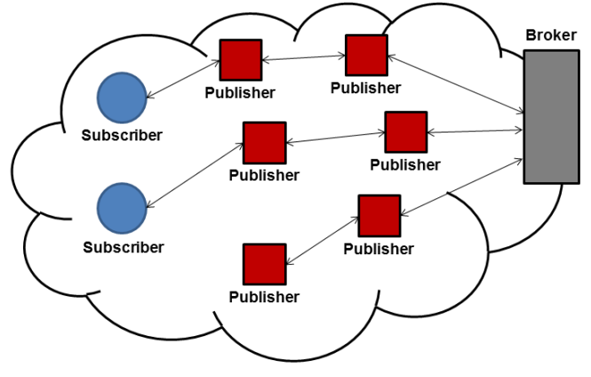
Multi-Hop Scenario
Msgs from a publisher node are routed to the broker node through multiple nodes;
The received msgs by the broker node are routed to the subscriber nodes.

Slide 39
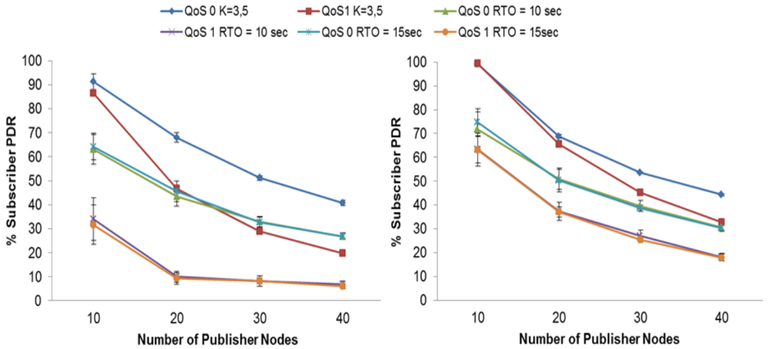
MQTT-S: PDR vs # of nodes
Multi-Hop Scenario
MQTT-S
The network load with 40 nodes is similar to 100 nodes in single-hop scenario, therefore only obtain the results up to 40 nodes.
2. K=3.5 with MAC ACK gets the highest PDR. The increase in RTT and packet losses, therefore MAC ACK is necessary to recover packets losses.

Slide 40
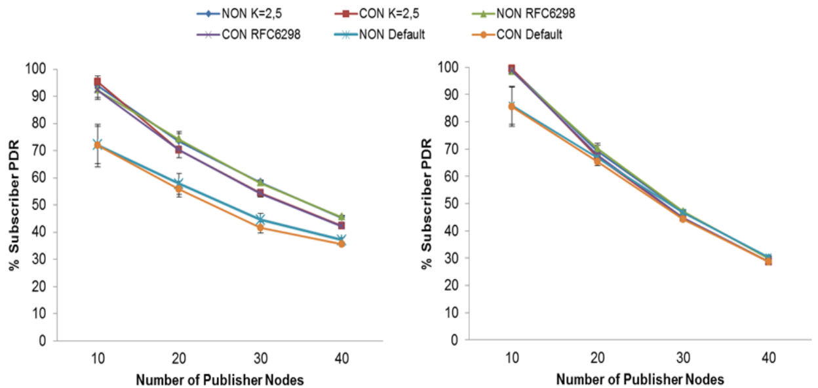
CoAP: PDR vs # of nodes
Multi-Hop Scenario
CoAP
K=2.5 gets the highest PDR without MAC ACK. Because CoAP can react properly without MAC ACK with K=2.5.
The MAC ACK leads to an increase of the message delay.

Slide 41
Summary
Evaluate three scenarios: single-hop, single-hop extended and multi-hop scenarios with parameters of fixed RTO, adaptive RTO, MAC ACK.
Result: the adaptive RTO provides an increase in PDR.
An adaptive RTO method is more suitable in order to react properly to changing network conditions.
MAC ACK is not suitable for the lowest K value, as it may bring high congestion and decrease PDR.
Non-persistent mode CoAP leads to a higher PDR than persistent mode MQTT-S due to the publication disciplines.
Future work: adapt the K value dynamically to the network conditions: duplicated publication ratio, DPR and retransmitted publication ratio.

Slide 42
Thank You!

