Slide 1
A Performance Comparison of Multi-Hop Wireless Ad Hoc Network Routing Protocols
Josh Broch, David Maltz, David Johnson,
Yih-Chun Hu and Jorjeta Jetcheva
Computer Science Department
Carnegie Mellon University
Presenter - Bob Kinicki
MOBICOM 1998
Dallas, Texas
Notes:
Today, Prof Bob Kinicki and I are going to present our paper “Application, Network, and Linklayer measurements of Streaming video over a wireless Campus Network”.
Before I start the presentation, I want to introduce the people from WPI Wireless streaming research group.
They are our group members.
Prof Claypool, prof Kiniki, Mingzhe,Huahui, and Ashishi

Slide 2
Outline
Introduction
NS-2 Simulator Environment
Ad Hoc Routing Protocols
  DSDV
  TORA
  DSR
  AODV
Simulation Methodology
Simulation Results
Conclusions

Slide 3
Introduction
Mobile Ad Hoc Networks (MANETs)
  Have useful applications
    Battlefields, mobile robots, vehicular networks (VANETs)
  Each mobile node acts both as a host but also as a router.
  Ad hoc routing protocols provide multi-hop paths through the network to any other node.

Slide 4
Outline
Introduction
NS-2 Simulator Environment
Ad Hoc Routing Protocols
  DSDV
  TORA
  DSR
  AODV
Simulation Methodology
Simulation Results
Conclusions

Slide 5
NS-2 Simulator Environment
Mobile nodes have position and velocity.
  Needed to extend simulator to model attenuation of radio waves, propagation delays, capture effects and carrier sense.
Added simulation of DCF for 802.11 MAC layer (including RTS/CTS).
Simulated nodes have 50 packet drop-tail queues for packets awaiting transmission and 50 additional packets of buffer for awaiting route discovery.

Slide 6
Outline
Introduction
NS-2 Simulation Environment
Ad Hoc Routing Protocols
  DSDV
  TORA
  DSR
  AODV
Simulation Methodology
Simulation Results
Conclusions

Slide 7
Studying Ad Hoc Routing
(circa 1998)
Authors implemented the four protocols according to specifications.
However, while simulating they made improvements:
  Broadcast ACKs deliberately jittered.
  Routing packets were inserted at the front of the queue.
  Used ‘link breakage detection’ feedback from MAC layer when packet could not be forwarded (except for DSDV).

Slide 8
Outline
Introduction
NS-2 Simulation Environment
Ad Hoc Routing Protocols
  DSDV
  TORA
  DSR
  AODV
Simulation Methodology
Simulation Results
Conclusions

Slide 9
Destination-Sequenced Distance Vector (DSDV)
DSDV is a hop-by-hop distance vector routing protocol requiring each node to periodically broadcast routing updates.
DSDV (unlike DV) is guaranteed loop free.

Slide 10
DSDV Mechanism
Each node maintains a routing table listing the next hop for each reachable destination.
Routes are tagged with a sequence number.
  Higher sequence number indicates a better route.
  Sequence number ties broken by lower metric.
Each node periodically broadcasts routing updates.
Implemented both full and incremental updates.

Slide 11
DSDV Implementation
Route updates are used to broadcast changes in the topology (i.e. broken link) and triggered by:
  Receipt of a new sequence number for a destination (the DSDV-SQ variation).
  Receipt of ONLY a new metric for a destination (DSDV).
Link layer breakage notification was not used due to a significant performance penalty.

Slide 12
DSDV-SQ Constants
All reported results in the paper use DSDV_SQ (except for section 6.2)

Slide 13
Outline
Introduction
NS-2 Simulation Environment
Ad Hoc Routing Protocols
  DSDV
  TORA
  DSR
  AODV
Simulation Methodology
Simulation Results
Conclusions

Slide 14
Temporally-Ordered Routing Algorithm (TORA)
TORA is a distributed routing protocol based on a “link reversal” algorithm.
Routes are discovered on demand.
Provides multiple routes to destination.
Designed to minimize communication overhead by localizing algorithmic reaction to topological change.
Tries to avoid the overhead of discovering new routes.

Slide 15
TORA Mechanism
Described in terms of water flowing downhill towards a destination node.
Links between routers conceptually viewed as a height.
Link is directed from the higher router to the lower router.
Height adjustments occur when topology changes.

Slide 16
TORA Mechanism
A logically separate copy of TORA exists at each node and is run for each destination.
A node needing a route to a destination broadcasts a QUERY packet containing the destination address.
Packet propagates through network until it reaches the destination or to a node having a route to the destination .

Slide 17
TORA Mechanism
Node with route to destination broadcasts an UPDATE packet listing its height with respect to destination.
Each node receiving an UPDATE sets its height greater than that of neighbor from which UPDATE was received.
The effect is to create a series of directed links from the original sender of the query to the node that generated the UPDATE.

Slide 18
TORA Mechanism
Layered on top of IMEP (Internet MANET Encapsulation Protocol) for reliable in-order delivery of all routing control messages, and link state notifications.
  Periodic BEACON / HELLO packets.
IMEP - implemented to support TORA.
  Attempts to aggregate TORA and IMEP control messages (objects) into a single packet (object block) to reduce overhead.
  Chose to aggregate only HELLO and ACK packets
Authors chose parameters through experimentation.

Slide 19
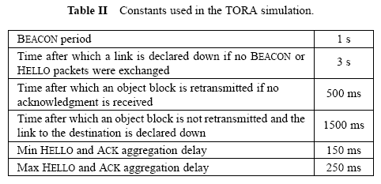
TORA Constants

Slide 20
Outline
Introduction
NS-2 Simulation Environment
Ad Hoc Routing Protocols
  DSDV
  TORA
  DSR
  AODV
Simulation Methodology
Simulation Results
Conclusions

Slide 21
Dynamic Source Routing (DSR)
DSR uses source routing rather than hop-by-hop routing with each packet carrying in its header the complete ordered list of nodes through which the packet must pass.
  Eliminates the need for the periodic route advertisement and neighbor detection packets.
  Designed specifically for multi-hop wireless
  ad hoc networks.
Two mechanisms: Route Discovery and Route Maintenance.

Slide 22
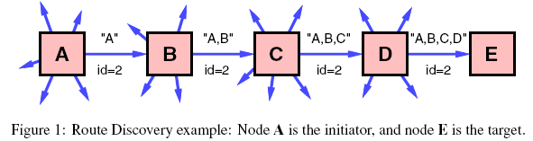
DSR Route Discovery
Route Discovery is the mechanism by which Node S wishing to send a packet to destination D obtains a source route to D.
S broadcasts a ROUTE REQUEST packet that is flooded through the network and is answered by a ROUTE REPLY packet from either the destination node or another node that knows the route to the destination.

Slide 23
DSR Route Discovery
A ROUTE REQUEST is answered by a ROUTE REPLY packet from either the destination node or another node that knows a route to the destination.
To reduce the cost of Route Discovery, each node maintains a cache of source routes learned or overhead.
The cache significantly reduce the number of ROUTE REQUESTs sent.

Slide 24
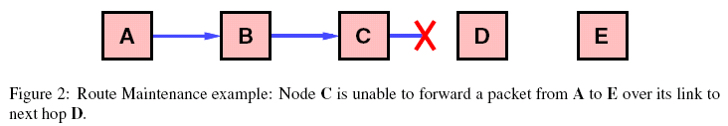
DSR Route Maintenance
Route Maintenance is the mechanism by which a packet’s sender S detects if the network topology has changed such that it can no longer use its route to the destination.
When a route is broken, S is notified with a ROUTE ERROR packet.
S can use another route in cache or invoke route discovery.

Slide 25
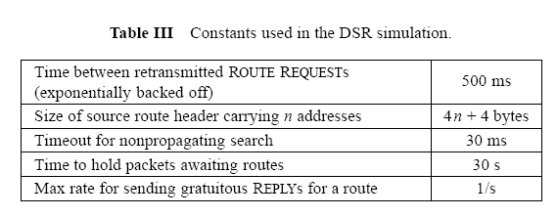
DSR Constants
DSR is bidirectional due to 802.11. This means ROUTE REPLY uses reverse path.

Slide 26
DSR Advantages/Disadvantages
Advantages: uses a reactive approach which eliminates the need to periodically flood the network with table update messages which are in the table-driven approach. The intermediate nodes also utilize the route cache information efficiently to reduce the control overhead.
Disadvantage: The route maintenance mechanism does not locally repair a broken link. Stale route cache information can produce inconsistencies during the route reconstruction phase.

Slide 27
Outline
Introduction
NS-2 Simulation Environment
Ad Hoc Routing Protocols
  DSDV
  TORA
  DSR
  AODV
Simulation Methodology
Simulation Results
Conclusions

Slide 28
Ad Hoc On-Demand Distance vector (AODV)
AODV combines DSR and DSDV
  Uses on-demand Route Discovery and Route Maintenance from DSR plus hop-by-hop routing, sequence numbers and periodic beacons from DSDV.
When S needs a route to D, it broadcasts a ROUTE REQUEST message to its neighbors , including last known sequence number for that destination.

Slide 29
AODV
ROUTE REQUEST is control-flooded until it reaches a node that has a route to the destination D and each node that forwards a ROUTE REQUEST creates a reverse route back to S.
Node that has route to D generates a ROUTE REPLY that contains number of hops to reach D and sequence number for D most recently seen.
Each node that forwards the REPLY back towards S creates a forward route to D.

Slide 30
AODV
This scheme is hop-by-hop in that each node remembers only next hop.
To maintain routes, each node periodically transmits a HELLO message. Failure to receive three consecutive HELLO messages is an indicator that the link to neighbor is down.
Alternatively, use link layer feedback (AODV-LL). Since this eliminates need for HELLO messages, only AODV-LL reported in the paper.

Slide 31
AODV
When a link goes down, any upstream node that recently forwarded packets through that link is notified via an UNSOLICITED ROUTE REPLY with an infinite metric.
Upon receiving this reply, the node must use Route Discovery to find a new route to the destination.

Slide 32
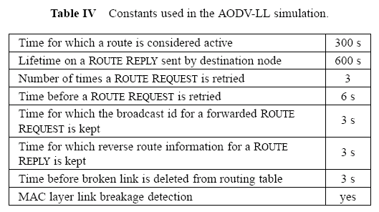
AODV-LL Constants

Slide 33
AODV Advantages/Disadvantages
Advantages: AODV routes established on demand with destination sequence numbers used to find the latest route to destination. The connection setup delay is less.
Disadvantages: intermediate nodes can yield inconsistent routes if the source sequence number is very old and the intermediate nodes have a higher but not the latest destination sequence number (stale entries). Also multiple ROUTE REPLY packets in response to a single ROUTE REQUEST packet can lead to heavy control overhead.

Slide 34
Outline
Introduction
NS-2 Simulation Environment
Ad Hoc Routing Protocols
  DSDV
  TORA
  DSR
  AODV
Simulation Methodology
Simulation Results
Conclusions

Slide 35
Simulation Methodology
Simulations focused on routing protocols ability to react to topology changes and viewing performance under a range of conditions.
50 wireless nodes in ad hoc network over a 1500m x 300m grid for 900 simulated seconds of time.
Physical characteristics meant to model WaveLAN DSSS (Note – this is old technology now!) .

Slide 36
Simulation Methodology
Simulations driven by input scenario file describing exact motion and sequence of packets originated by nodes.
210 different scenarios were pre-generated and they ran all four protocols against each scenario file.
Movement is characterized by a pause time whereby a node remains stationary for pause time seconds.

Slide 37
Simulation Methodology
At the end of pause time, the node selects a random destination and moves at a speed uniformly distributed between 0 and some maximum (1m/s or 20m/s).
Simulation alternates between pause times and movement times for each node.
10 movement patterns were generated for each pause time of 0, 30, 60, 120, 300, 600, & 900 seconds (total of 70 movement patterns for each protocol tested).
0 pause time corresponds to continuous motion.
900 second pause time is no movement.

Slide 38
Communication Model Issues
Experimented with 1, 4 and 8 packets per second and then fixed rate at
4 packets/sec.
10, 20 and 30 CBR (Constant Bit Rate) sources with peer-to-peer conversations.
Tried 64 and 1024-byte packets
  1024-byte packets caused congestion.
  Packet size fixed at 64 bytes because they wanted to factor out congestion effects.

Slide 39
Scenario Characteristics
Internal mechanism determines shortest path (in hops) assuming 250m transmission range.
Average data packet made 2.6 hops and farthest reachable node was 8 hops away.

Slide 40
Figure 1 Shortest Path Distribution

Slide 41
Table V
Link Connectivity Changes

Slide 42
Metrics
Packet Delivery Ratio :: The ratio between the number of packets originated by the application layer CBR sources and the number of packets received by the CBR sink at the final destination.
Routing Overhead :: The total number of routing packets transmitted during the simulation.
  Note, each transmission hop counts as one transmission.
Path Optimality :: The difference between the number of hops taken to reach destination and the length of the shortest path that physically existed through the network when the packet was originated

Slide 43
Outline
Introduction
NS-2 Simulation Environment
Ad Hoc Routing Protocols
  DSDV
  TORA
  DSR
  AODV
Simulation Methodology
Simulation Results (20 m/s first)
Conclusions

Slide 44
Figure 2 Packet Delivery Ratio (as a function of pause time)
DSDV does not converge
20 Sources

Slide 45
Figure 3 Routing Packets Sent (as a function of pause time)
20 Sources

Slide 46
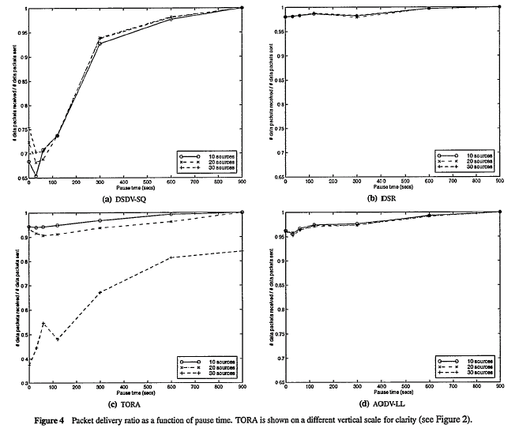
Figure 4: Packet Delivery Ratio

Slide 47
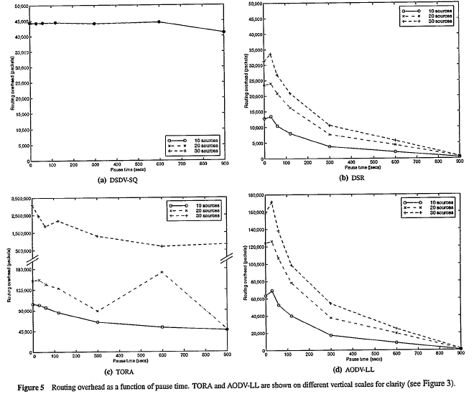
Figure 5: Routing Overhead
different
scales

Slide 48
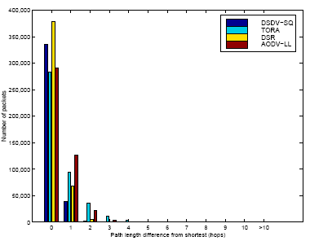
Figure 6: Path Length Excess
Results are averaged over all mobility levels.

Slide 49
Figure 7: Application Packets Sent
(as a function of pause time)
Speed = 1m/s
20 Sources

Slide 50
Figure 8: Routing Packets Sent
(as a function of pause time)
Speed = 1m/s
20 Sources

Slide 51
Figure 9 Routing Overhead
20 Sources
accounts for extra
bytes in DSR packets

Slide 52
Figure 10 Packet Delivery Ratio DSDV vs DSDV-SQ

Slide 53
Figure 11 Routing Overhead DSDV vs DSDV-SQ

Slide 54
Outline
Introduction
NS-2 Simulation Environment
Ad Hoc Routing Protocols
  DSDV
  TORA
  DSR
  AODV
Simulation Methodology
Simulation Results
Conclusions

Slide 55
Conclusions
Paper Contributions:
  Modifications to the ns-2 simulator to model 802.11 MAC layer issues.
  Detailed simulation results that compared four protocols.
Each protocol performs well in some cases and has drawbacks in others.

Slide 56
Conclusions
TORA was the worst.
DSR was the best.
DSDV-SQ performs well when load and mobility is low, poorly as mobility increases.
AODV-LL performs nearly as well as DSR, but has high overhead at high mobility levels.

Slide 57
Critique
Well written.
Good scientific method.
Comments !!

Slide 58
Acknowledgments
Thanks to
Angel Pagan and Xiang Li
for most of the figures
from the original paper.

Slide 59
A Performance Comparison of Multi-Hop Wireless Ad Hoc Network Routing Protocols
Questions ??
Notes:
Today, Prof Bob Kinicki and I are going to present our paper “Application, Network, and Linklayer measurements of Streaming video over a wireless Campus Network”.
Before I start the presentation, I want to introduce the people from WPI Wireless streaming research group.
They are our group members.
Prof Claypool, prof Kiniki, Mingzhe,Huahui, and Ashishi

