Slide 1
The Internet of Things: A survey Luigi Atzori, Antonio Iera & Giacomo Morabito Computer Networks 2010
Presenter - Bob Kinicki
Internet of Things
Fall 2015

Slide 2
Outline
Introduction
Visions
Enabling Technologies
Middleware
Applications {will be skipped here}
Open Issues
Conclusions

Slide 3
Introduction
2010 view starts with the concept of a pervasive set of objects that can interact with each other and cooperate with their neighbors to reach common goals. Authors coming from the RFID space.
IoT is expected to have high impact both positively and negatively (disruptive technologies and potential threats).
Central issues are full interoperability of interconnected devices and more smartness while guaranteeing trust, privacy and security.
Authors trying to describe different visions.

Slide 4
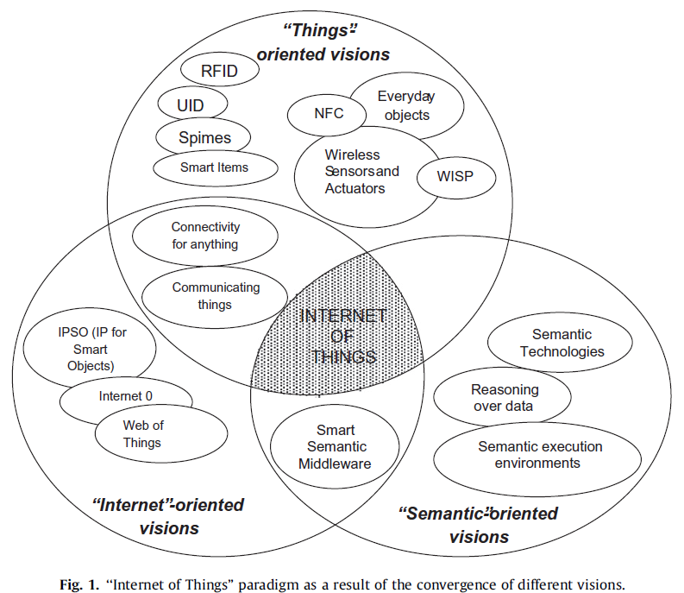
Three Visions

Slide 5
One Definition
“Internet of Things semantically means a world-wide network of interconnected objects uniquely addressable, based on standard communication protocols.”
Challenges include object unique addressing and the representation and storing of exchanged information.

Slide 6
RFID Viewpoint
EPC (Electronic Product Code)
Standards to improve object visibility (traceability and awareness of an object)
Mere object identification is NOT wide enough vision of IoT.
RFID, NFC and WSAN (Wireless Sensor and Actuator Networks) seen as “atomic elements” of IoT.

Slide 7
Things Vision
Smart items can relate to concept of a spime.
Spime:: an object that can be tracked through space and time throughout its lifetime and will be sustainable, enhanceable and uniquely identified.

Slide 8
Internet Vision
IPSO (IP for Smart Objects) Alliance promotes Internet-oriented vision and claims wise IP adaptation with IEEE802.15.4 and 6LowPAN will enable IoT automatically.
IPSO and Internet O advocate simplification of IP to make it adaptable to any object.

Slide 9
Semantic Vision
Issues involved with handling IoT object information is very challenging and modeling, reasoning and semantic execution environments and architectures will be needed to address the scalability of storing and communicating about IoT objects.

Slide 10
Enabling Technologies
Interested in the role each technology will play in the IoT.
Identification, sensing and communication
Wireless
RFID (passive, semi-passive and active)
WSNs
802.15.4 in most commercial WSNs already
Integration of these two
RSNs (RFID Sensing Networks)

Slide 11
Middleware
Layers between the technology and the application.
Some propose SOA (Service Oriented Architecture) approach for middleware
e.g., designed workflows of coordinated services which are associated with object actions.
Goal is complete, integrated approach.

Slide 12
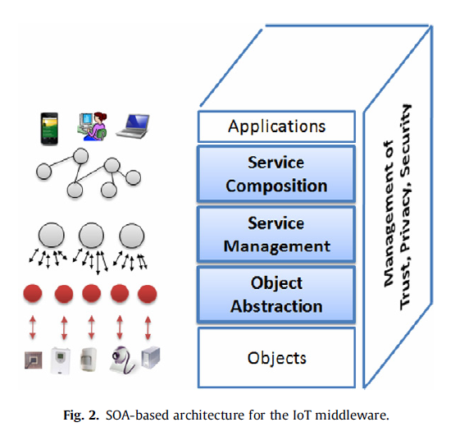
Figure 2 SOA-based Architecture

Slide 13
Service Composition
Provides functionality for the composition of services offered by objects to build applications.
Workflow languages here such as Web Service Definition Language (WSDL).

Slide 14
Service Management
Basic set of services encompass:
Object dynamic discovery
Status monitoring
Service configuration
Functionalities related to QoS and lock management.

Slide 15
Object Abstraction
Need an abstraction layer to handle heterogeneous set of objects to harmonize the access with common language and procedures.
Speak of a wrapping layer to handle:
Web interface
Second interface converts service methods into device-specific commands for communicating with objects.

Slide 16
Object Abstraction
Some propose embedded stack in devices to provide wrapping function.
However, more often direction is for a proxy which uses socket style communication with device.

Slide 17
Trust, Privacy and Security
Personal objects communicating potentially enables a surveillance system.
Hence middleware must manage trust, privacy and security.
Final Comment – Not all proposed middleware follow the model shown in Figure 2.

Slide 18
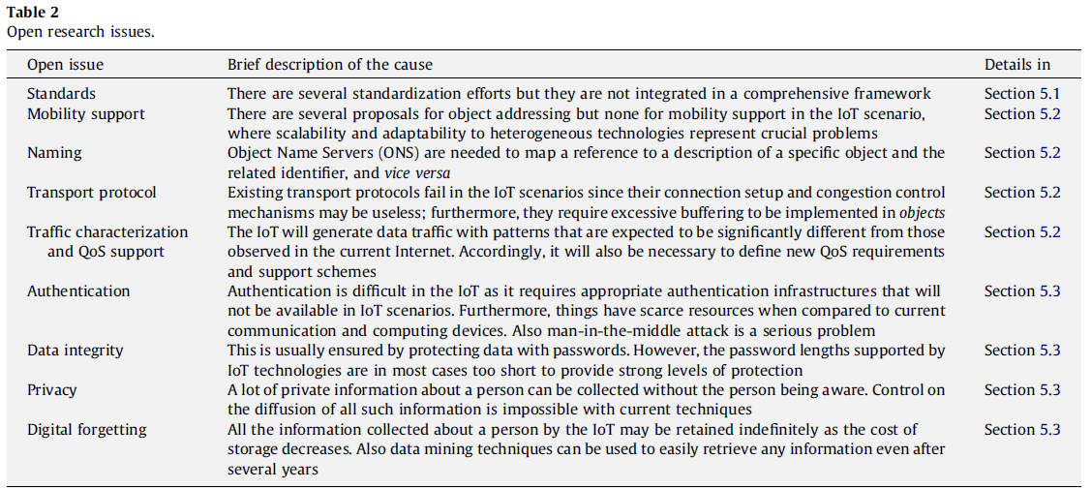
Open Research Issues

Slide 19
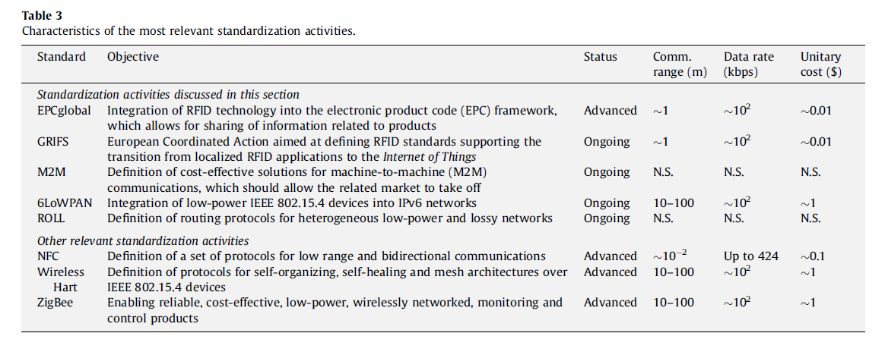
Standardization

Slide 20
Addressing and Networking
RFID tags using 64-96 bits (standardized by EPCglobal) complicates IPv6 128 bit addressing.
Integration and mapping strategies for these two addressing schemes have been proposed.
Support of mobile in IoT is important.
Suggest Mobile IP approach with home agent.

Slide 21
Addressing and Networking
Need ONS (Object Name Service) to supersede DNS.
need to associate description of specified object to a given RFID tag identifier.
Additional need for the inverse OCMS (Object Code Mapping Service).

Slide 22
Addressing and Networking
TCP not effective for IoT {maybe CoAP with REST}.
Traffic characteristics in WSNs.
Rsearch in QoS support for IoT is needed.
Some done already in QoS for M2M.

Slide 23
Security
Authentication is a major problem as current authentication procedures are not feasible in the IoT.
There are no curent solutions in the IoT space for proxy attacks and man-in-the-middle attacks.
Data integrity gets more complicated when you have unattended nodes like RFID tags.

Slide 24
Security
Cryptography solutions expend energy and bandwidth resources at both source and destination and therefore cannot be readily applied to IoT.
Some light symmetric key schemes have been proposed.

Slide 25
Privacy
Concerns about privacy protection have been a significant barrier against diffusion of the technologies involved in IoT.
Unlike the Internet where privacy problems mostly arise from active users, IoT privacy problem scenarios can threaten even for people not using any IoT service.

Slide 26
Privacy
In tracking systems, position movement of individual users needs to handled in terms of aggregate users. Namely, this motion information should not be linkable to identities.
People need to be informed about the scope of the tracking information.
Tracking info collected should be processed and then deleted (e.g., heating and lighting controls).

Slide 27
Privacy
W3C group has defined the Platform for Privacy Preferences (P3P) which provides descriptive language for preferences and policies.
Very challenging task in sensor networks e.g., surveillance cameras.
RFID tags are problematic.
Proposed privacy broker proxies do not scale.
Need for “digital forgetting”.

Slide 28
Conclusions
IoT has potential to add a new dimension to the concept of moving the interactions between people at a virtual level on the Internet.
This potential comes from enabling communication among smart objects.
Paper surveys most important aspects of IoT emphasizing current activities and challenges.

