Slide 1
The Internet of Every Thing - steps toward sustainability
David E. Culler
Professor, Computer Science Chair
University of California, Berkeley
CWSN Keynote, Sept. 26 2011

Slide 2
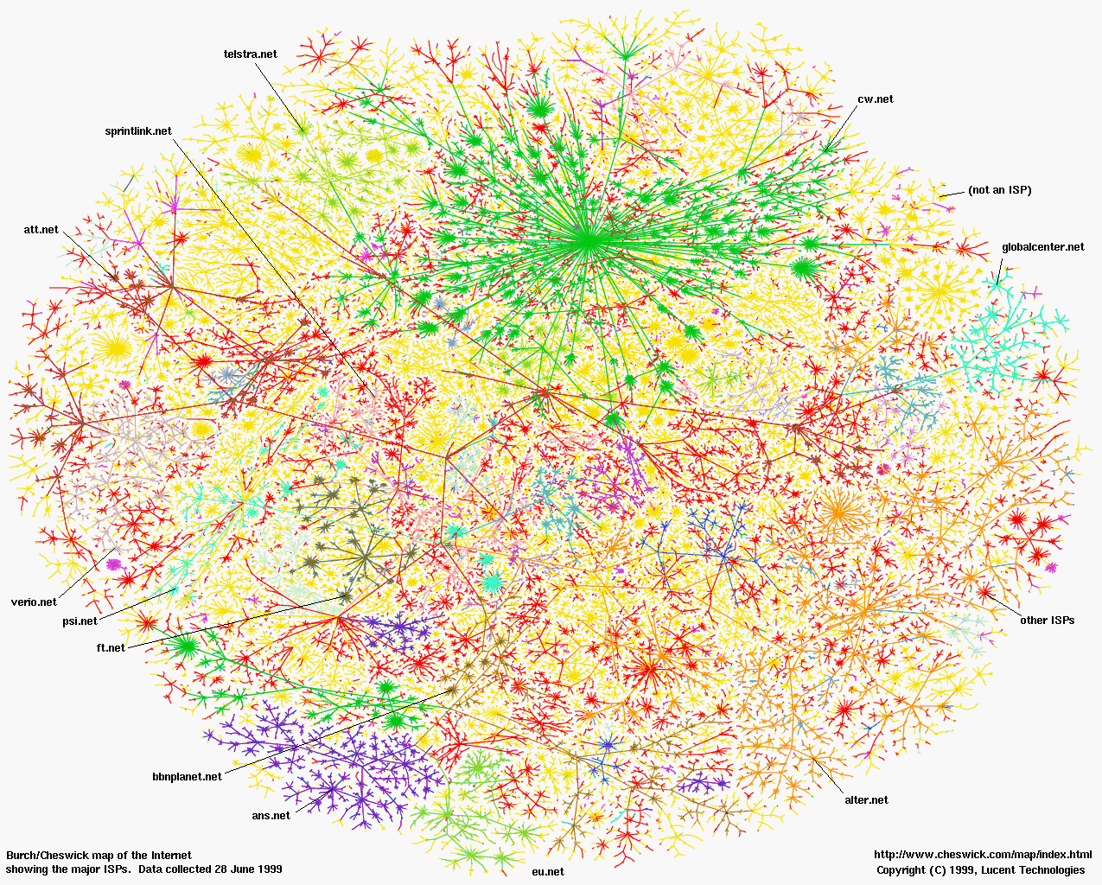

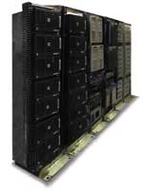

The Internet … a decade ago

Slide 3
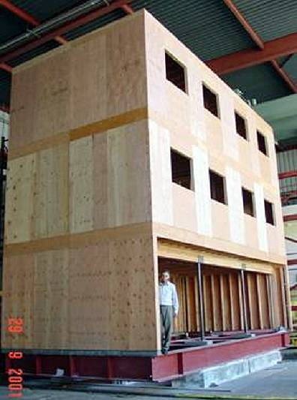
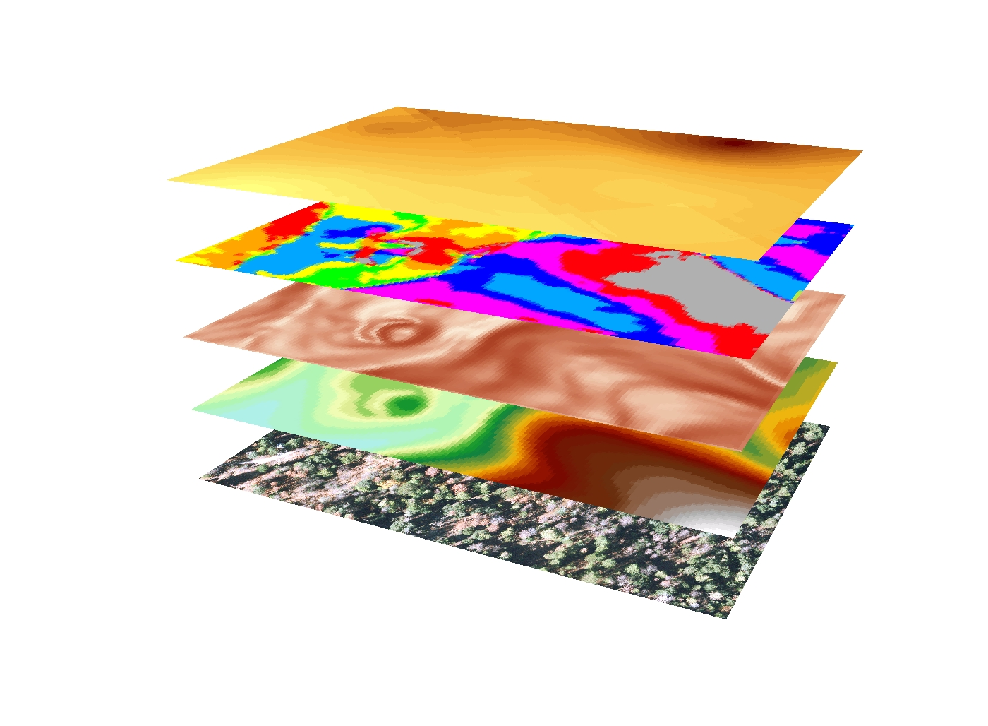
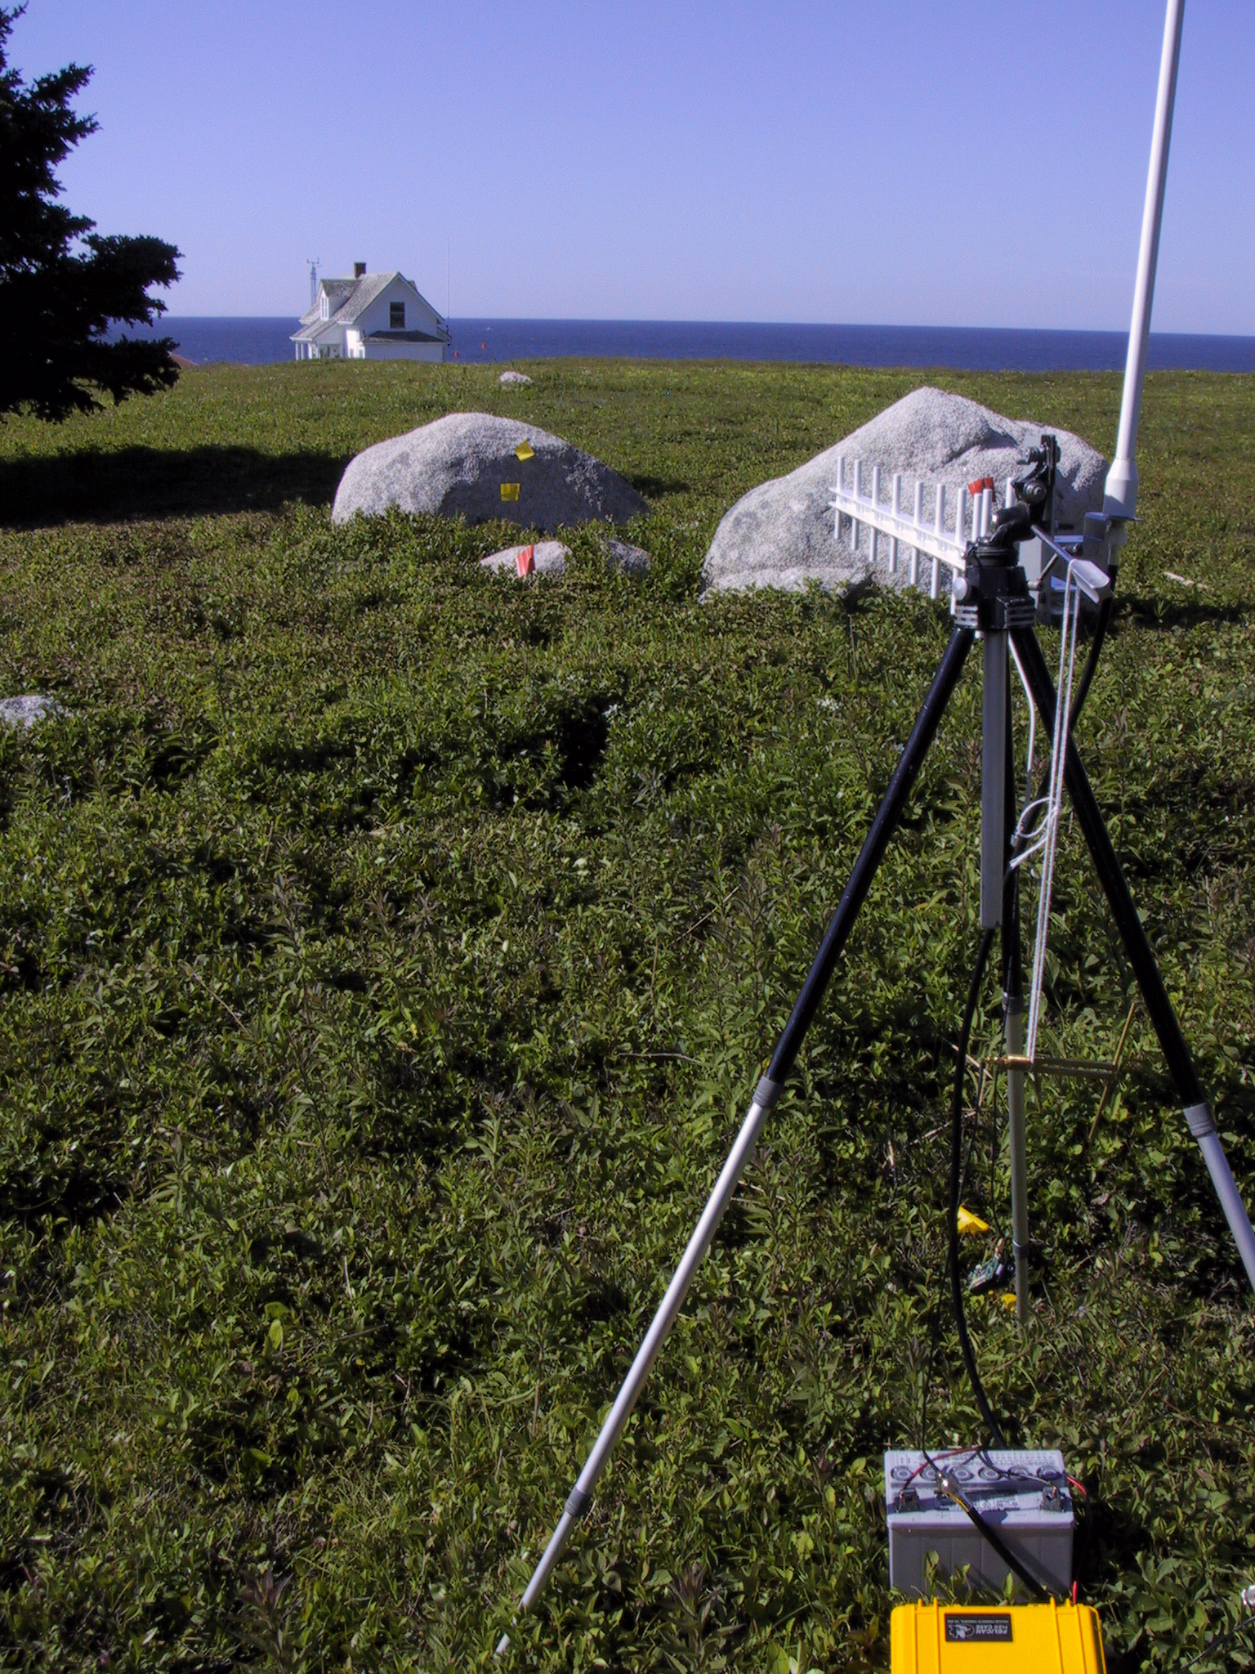
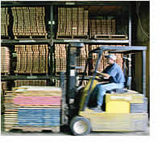
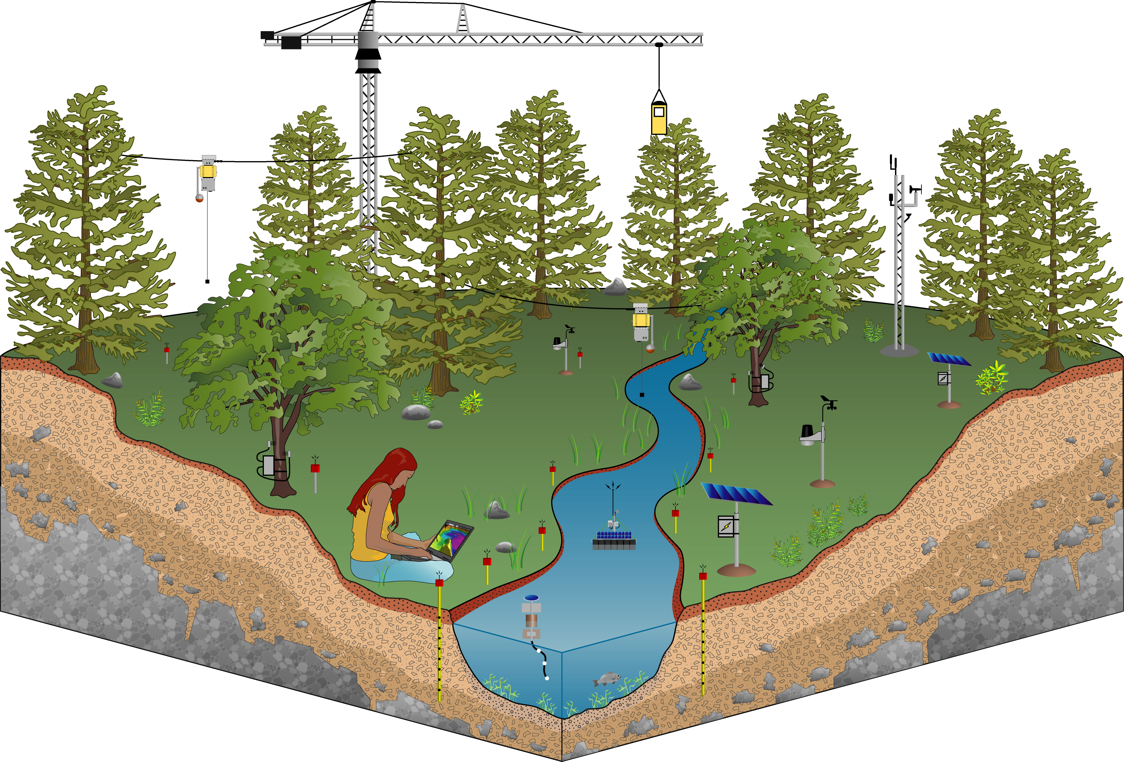
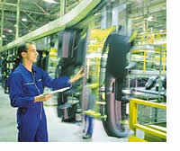

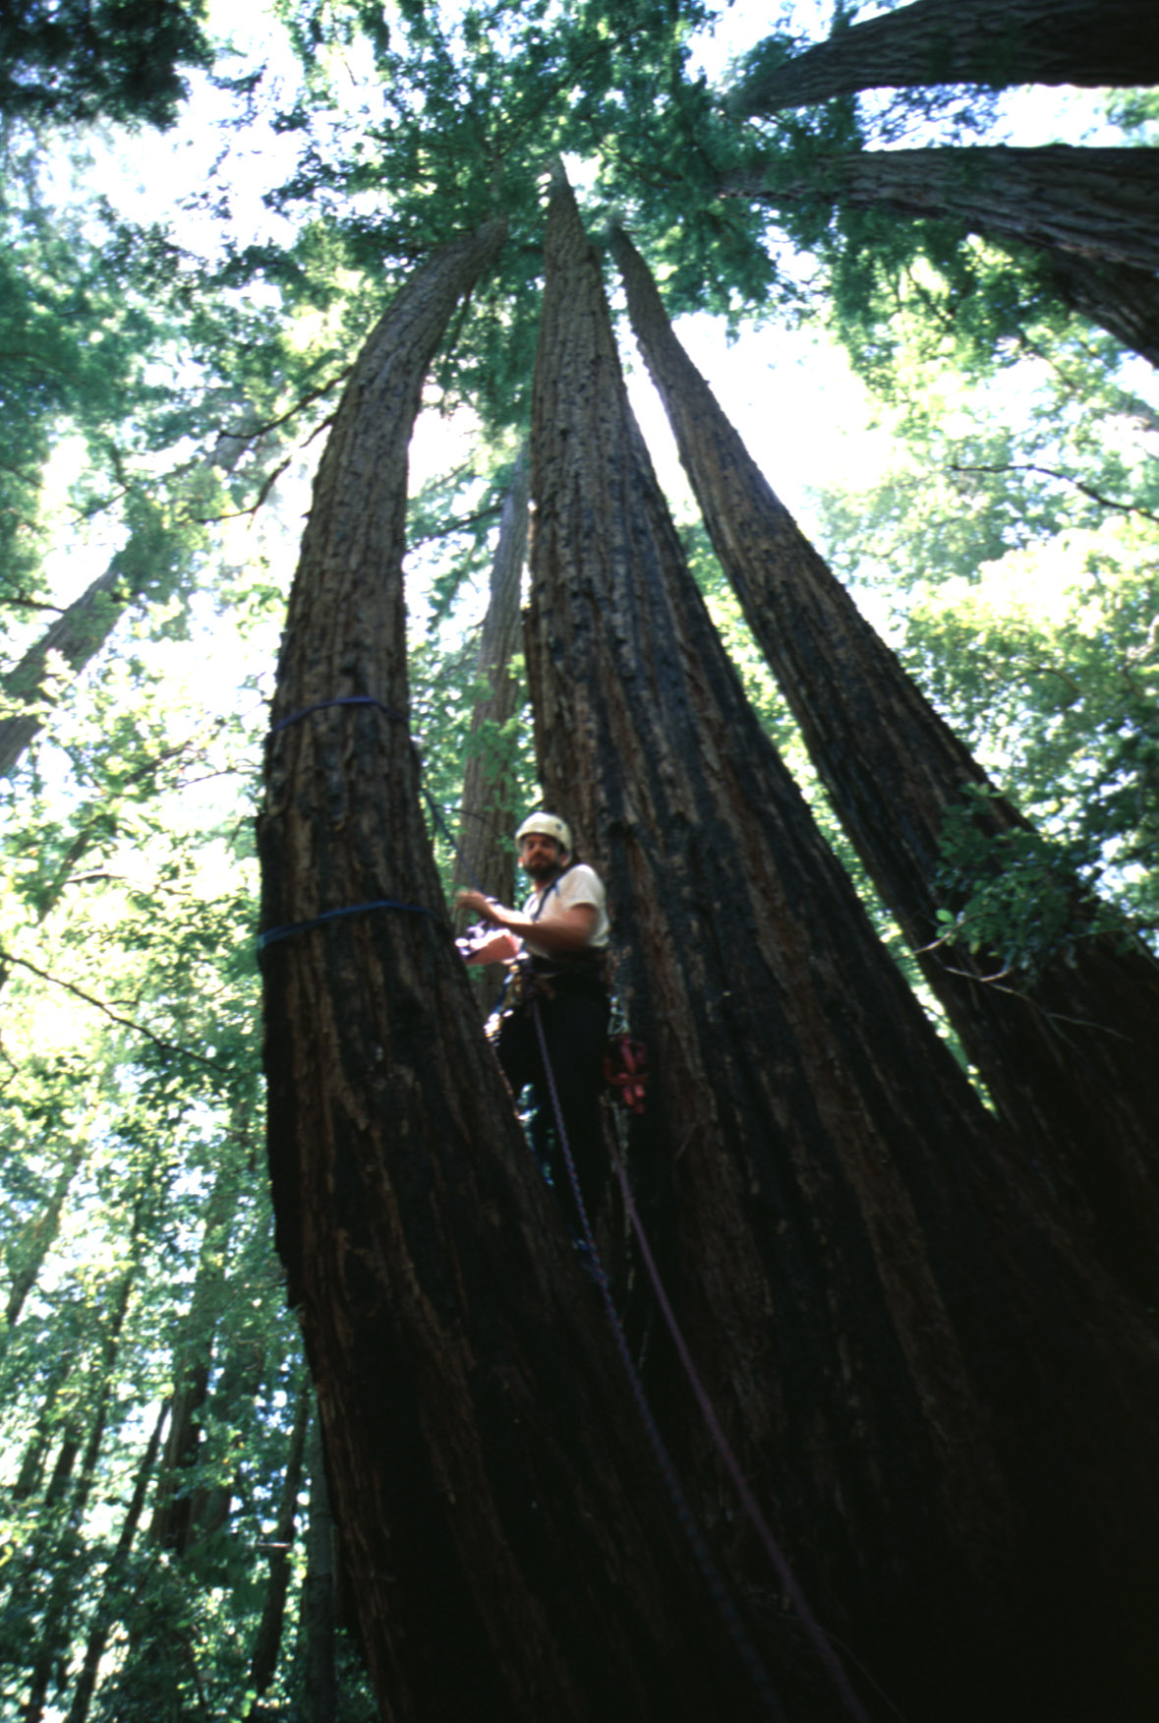
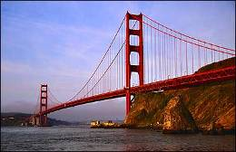
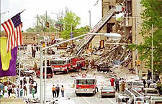
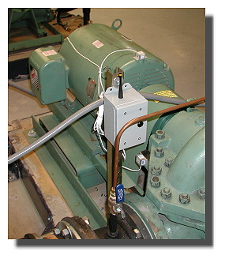
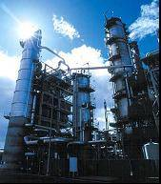
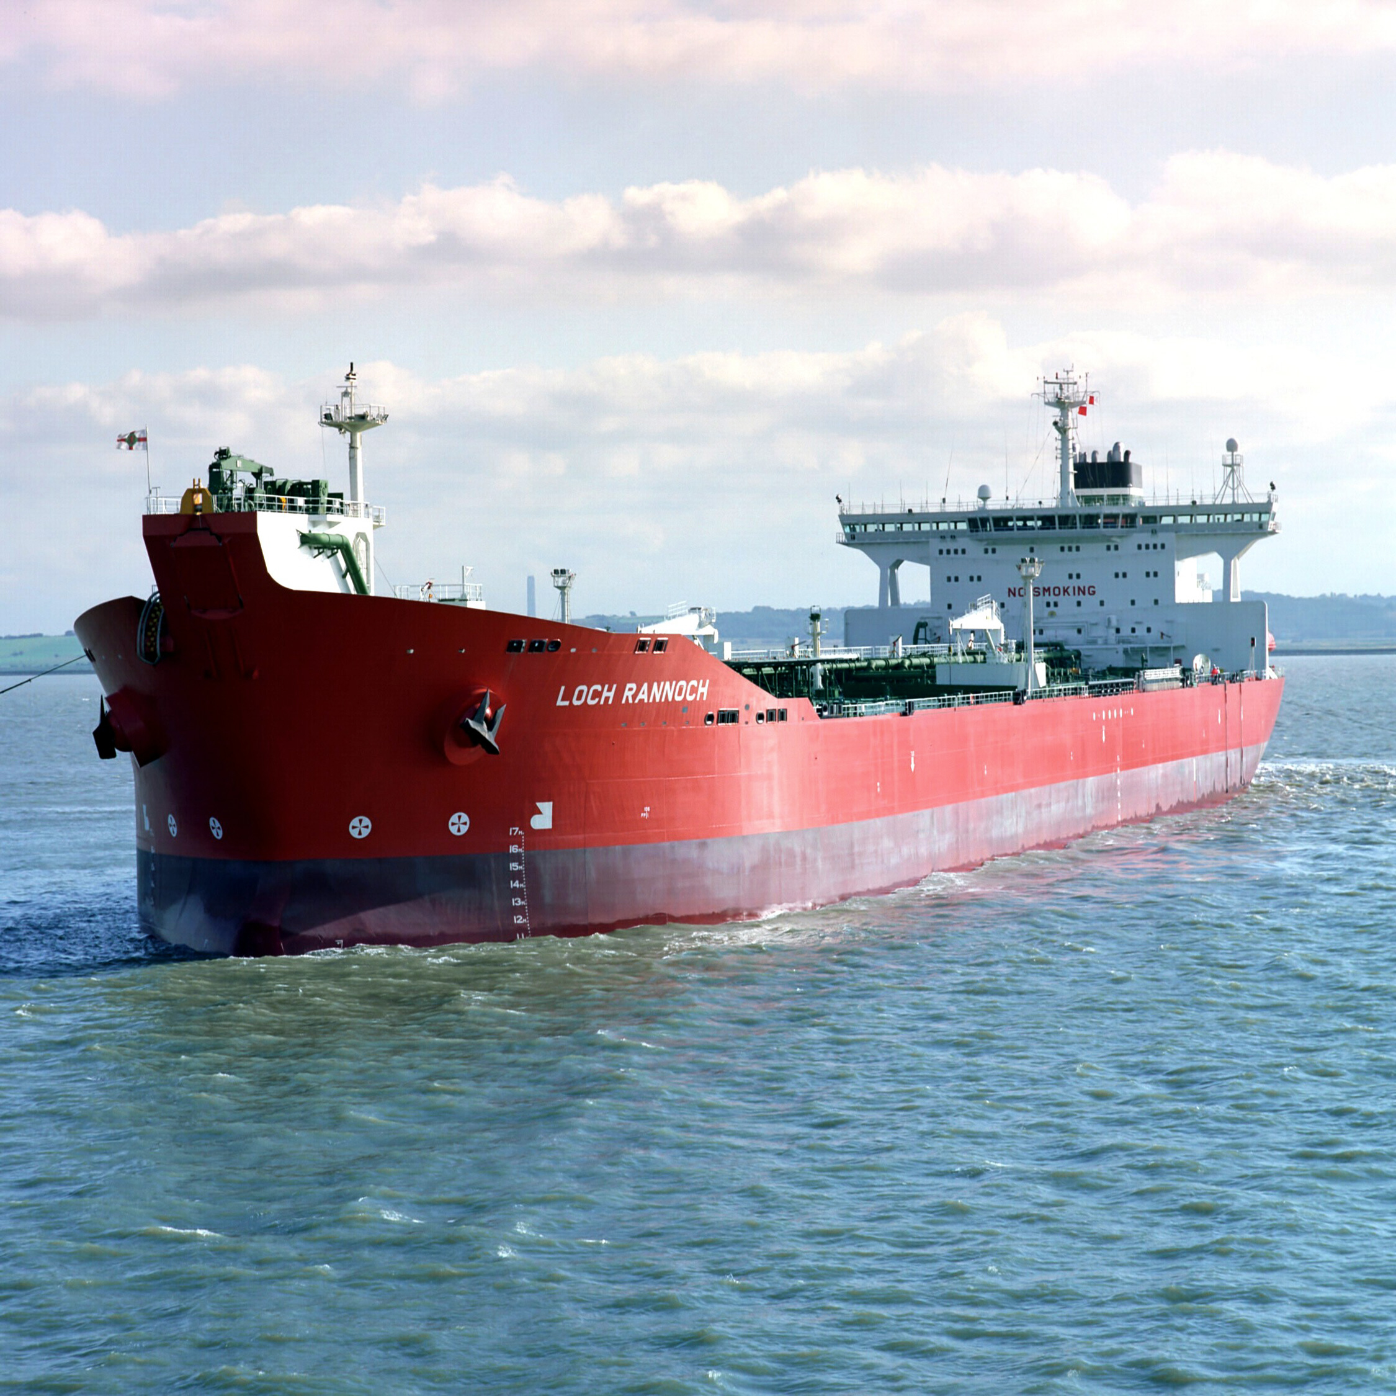

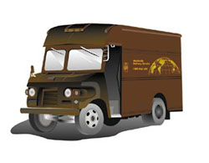
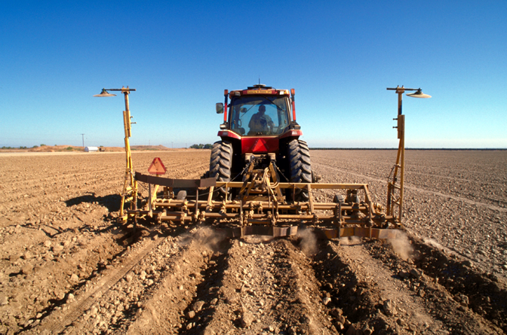


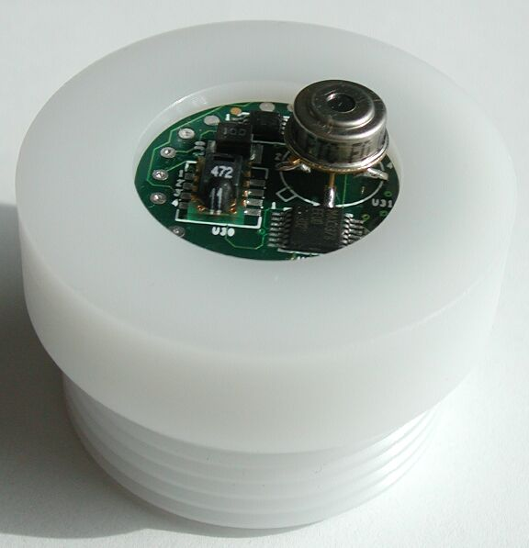
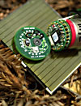
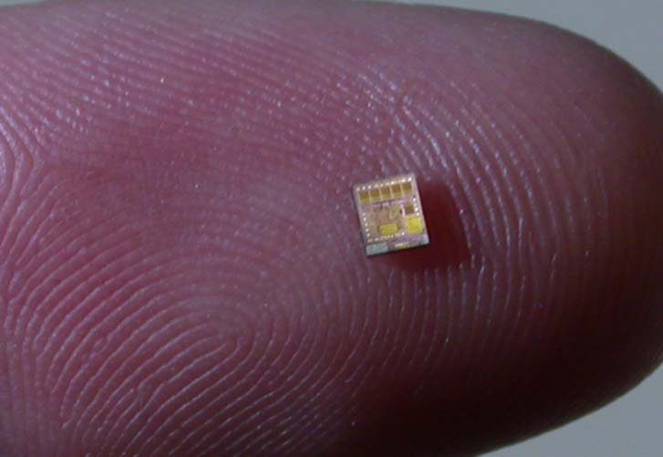

The Internet … that we envisioned

Slide 4
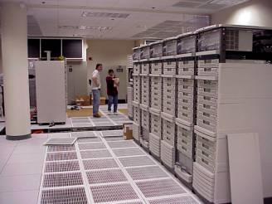
Why “Real” Information is so Important
Save Resources
Improve Productivity
Enable New Knowledge
Increase
Comfort
Enhance Safety & Security
Preventing Failures
High-Confidence Transport
Improve Food & H20
Protect Health

Slide 5
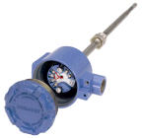




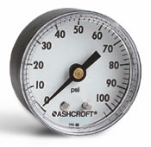


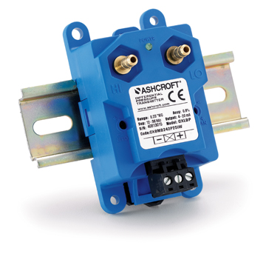
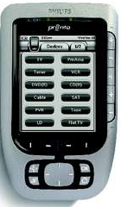
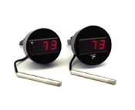




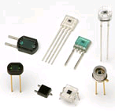
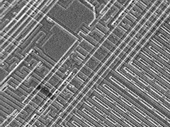
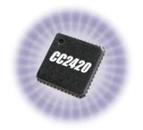


Enabling Technology
Network
Microcontroller
Flash
Storage
Radio
Communication
Sensors
IEEE 802.15.4

Slide 6
Internet Concepts: Layering…
Diverse Object and Data Models (HTML, XML, …, BacNet, …)
7: app
Application (Telnet, FTP, SMTP, SNMP, HTTP)
4: xport
Transport (UDP/IP, TCP/IP)
3: net
Network (IP)
2: link
Link
Serial
Modem
X3T9.5
FDDI
802.3
Ethernet
802.5
Token Ring
802.11
WiFi
802.15.4
???
802.3a
Ethernet
10b2
802.11a
WiFi
802.3i
Ethernet
10bT
802.11b
WiFi
ISDN
Sonet
802.3y
Ethernet
100bT
802.11g
WiFi
DSL
802.3ab
Ethernet
1000bT
802.11n
WiFi
GPRS
802.3an
Ethernet
1G bT
1: phy

Slide 7
Leading Internet Research Perspective - a decade ago
“Resource constraints may cause us to give up the layered architecture.”
“Sheer numbers of devices, and their unattended deployment, will preclude reliance on broadcast communication or the configuration currently needed to deploy and operate networked devices.”
“There are significant robustness and scalability advantages to designing applications using localized algorithms.”
“Unlike traditional networks, a sensor node may not need an identity (e.g. address).”
“It is reasonable to assume that sensor networks can be tailored to the application at hand.”
We were wrong...

Slide 8





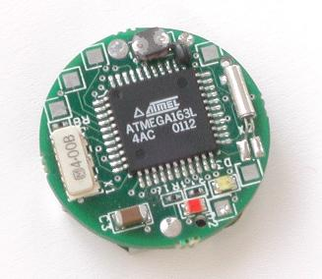
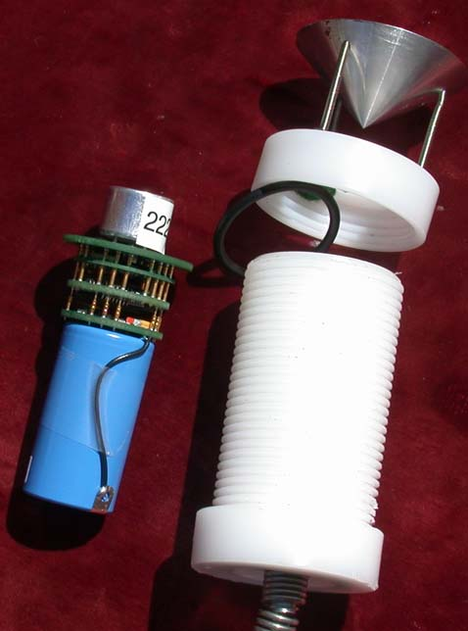
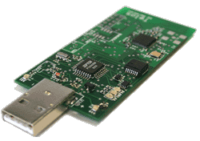
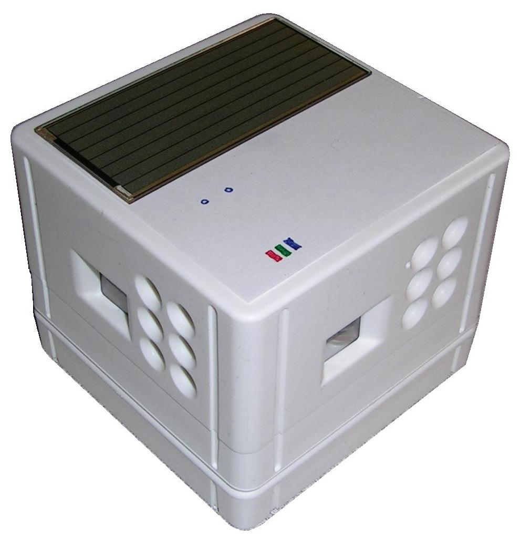

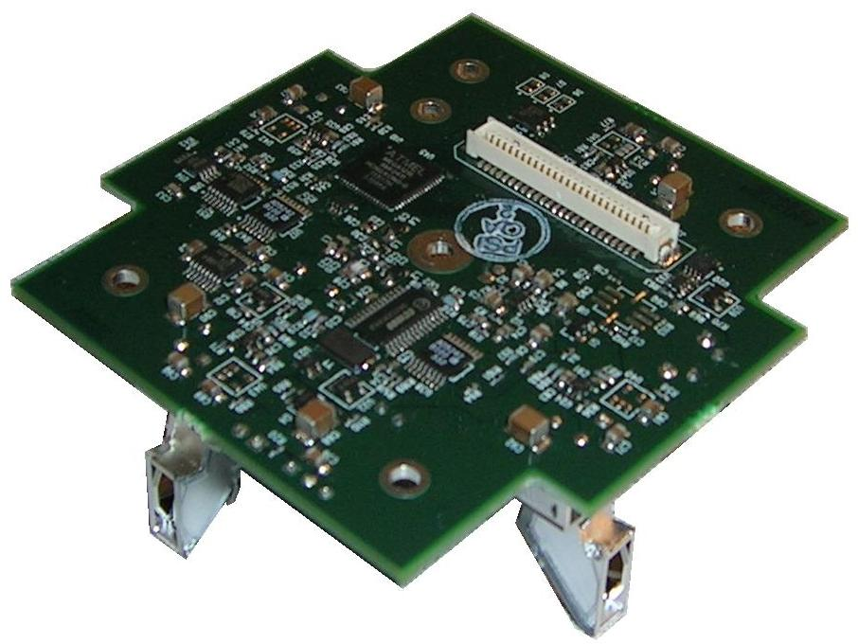
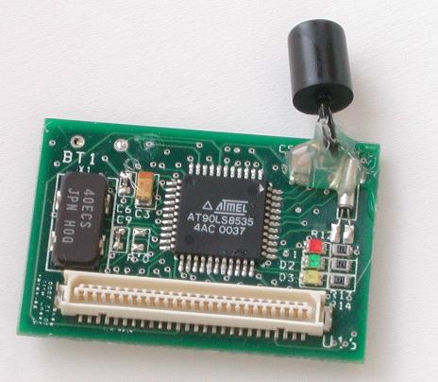
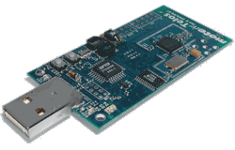
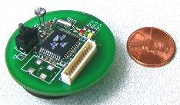
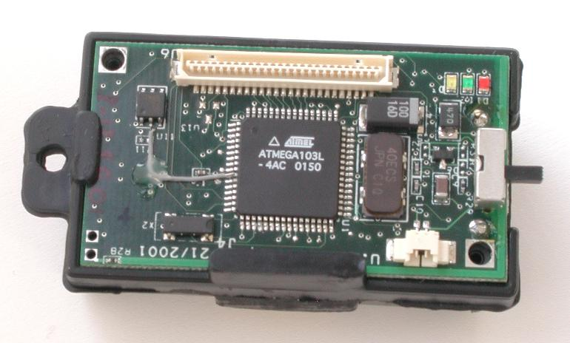
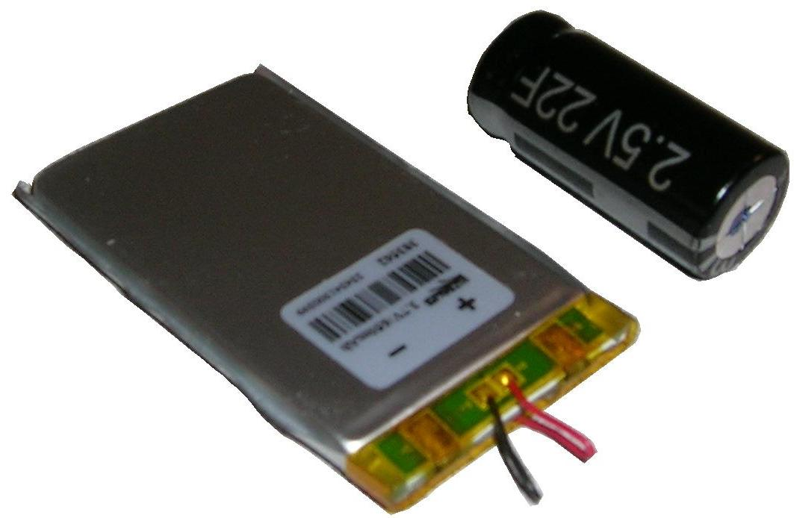
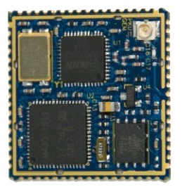
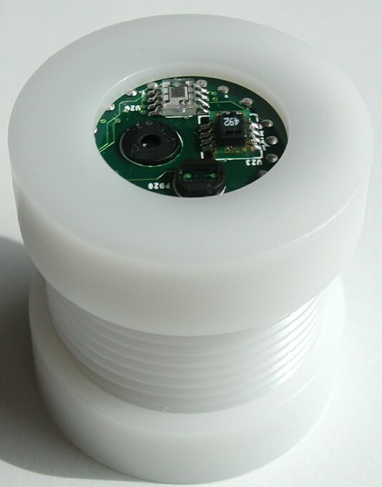














The Mote/TinyOS revolution…
zeevo BT
Intel
iMOTE
Intel
MOTE2
Intel
rene’
Intel/UCB
dot
BTNode
Intel
cf-mica
Eyes
trio
IETF RPL
SmartDust
WeC
LoWPAN/IPv6
Rene
Mica
Telos
Epic
XBOW
rene2
XBOW
mica
XBOW
cc-dot
XBOW
mica2
XBOW
micaZ
digital sun
rain-mica
Bosch
cc-mica
Dust Inc
blue cc-TI
98
99
00
01
02
03
04
05
06
07
10
11
SENSIT
Expedition
8 kB rom
½ kB ram
NEST
NSF
CENS STC
48 kB rom
10 kB ram
802.15.4
NETS/ NOSS
Cyber-Physical

Slide 9
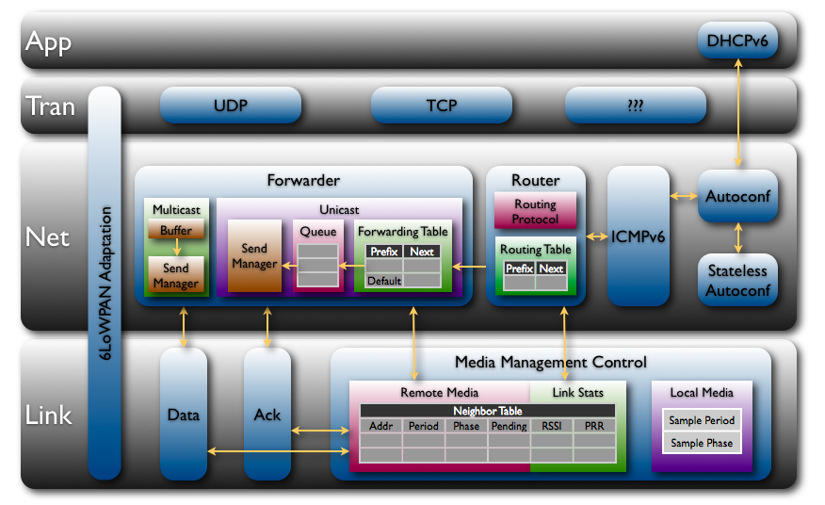

Internet of Every Thing – Realized 2008
 | ROM | RAM
CC2420 Driver | 3149 | 272
802.15.4 Encryption | 1194 | 101
Media Access Control | 330 | 9
Media Management Control | 1348 | 20
6LoWPAN + IPv6 | 2550 | 0
Checksums | 134 | 0
SLAAC | 216 | 32
DHCPv6 Client | 212 | 3
DHCPv6 Proxy | 104 | 2
ICMPv6 | 522 | 0
Unicast Forwarder | 1158 | 451
Multicast Forwarder | 352 | 4
Message Buffers | 0 | 2048
Router | 2050 | 106
UDP | 450 | 6
TCP | 1674 | 50
24038 | ROM
3598 | RAM
(including runtime)
* Production implementation on TI msp430/cc2420
Footprint, power, packet size, & bandwidth
Open version 27k / 4.6k

Slide 10
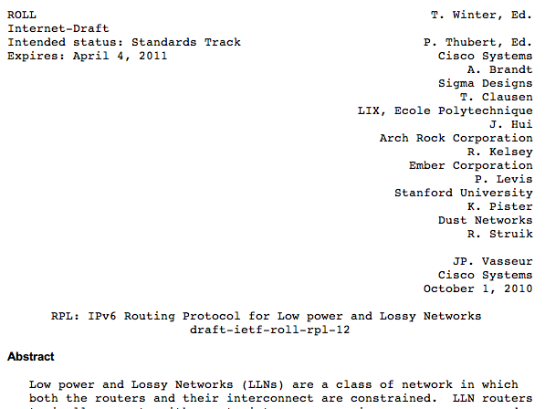
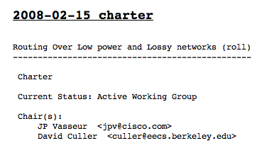




Internet of Every Thing – standardized 2010

Slide 11
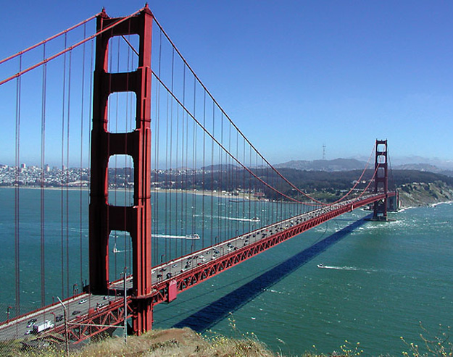
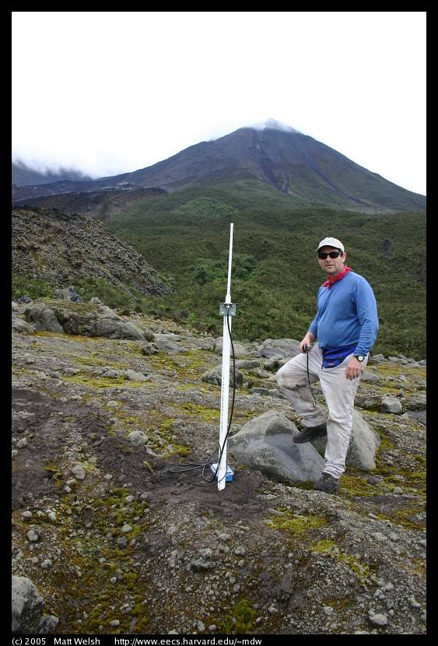
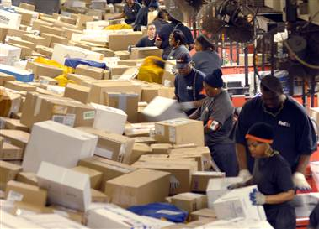

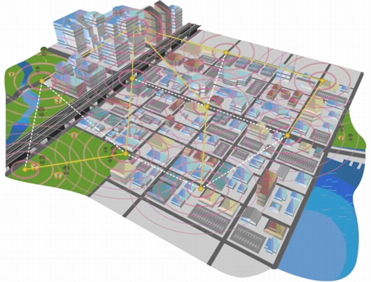
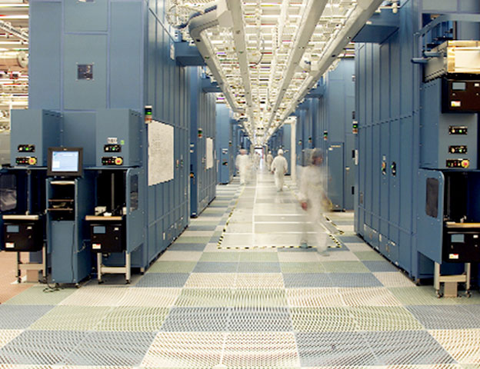
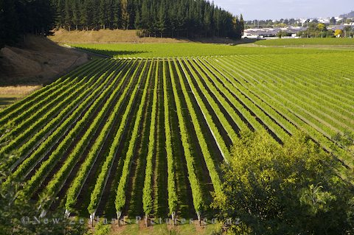
Networking in the Physical World
Networking Challenges
Application Requirements
Variable communication
  Unknown obstacles
  Variable density and loss
Constrained resources
  Limited routing state
  Limited throughput
  Limited buffering
Low power wireless
  Multihop
  Low SNR
  Small MTU
Embedding in physical space
Large numbers of nodes
Low total cost of ownership

Slide 12
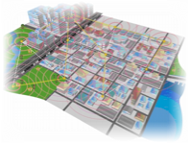










Confluence Research, Industry, and Standards
Research
Community

Slide 13
Key Research Developments
Event-Driven Component-Base Operating System
  Framework for building System & Network abstractions
  Low-Power Protocols
  Hardware and Application Specific
Idle listening
  All the energy is consumed by listening for a packet to receive
  => Turn radio on only when there is something to hear
Reliable routing on Low-Power & Lossy Links
  Power, Range, Obstructions => multi-hop
  Always at edge of SNR => loss is common
  => monitoring, retransmission, and local rerouting
Trickle – don’t flood (tx rate < 1/density, and < info change)
  Connectivity is determined by physical points of interest, not network designer.
  never naively respond to a broadcast
  re-broadcast very very politely

Slide 14



TinyOS – Framework for Innovation
Applications and Services
Over-the-air
Programming
Network
Protocols
Blocks, Logs, Files
Scheduling, Management
Streaming drivers
Link
Radio Serial
Flash
MCU, Timers, Bus,…
ADC, Sensor I/F
WSN mote platform
Wireless
Storage
Processing
Sensors
Communication Centric
Resource-Constrained
Event-driven Execution

Slide 15






















A worldwide community
Wireless Sensor Networks
SmartDust
NEST
Storage
Sensors
Wireless
Processing

Slide 16

Low Power Networking in the Real World
Applications
Network
system
architecture
Technology
Wireless
Storage
Processing
Sensors
Notes:
Now that we’ve set the context, here’s a picture of the rest of the presentation
I do
Kris does

Slide 17

A Low-Power Standard Link
 | 802.15.4 | 802.15.1 | 802.15.3 | 802.11 | 802.3
Class | WPAN | WPAN | WPAN | WLAN | LAN
Lifetime (days) | 100-1000+ | 1-7 | Powered | 0.1-5 | Powered
Net Size | 65535 | 7 | 243 | 30 | 1024
BW (kbps) | 20-250 | 720 | 11,000+ | 11,000+ | 100,000+
Range (m) | 1-75+ | 1-10+ | 10 | 1-100 | 185 (wired)
Goals | Low Power, Large Scale, Low Cost | Cable Replacement | Cable Replacement | Throughput | Throughput
Low Transmit power, Low Signal-to-noise Ratio (SNR), modest BW, Little Frames

Slide 18
Decade of Networking (sans Architecture)
Application
Transport
Deluge
Drip
Dip
GAF
SPIN
GDI
Redwoods
North Sea
Volcano
Golden Gate Bridge
Network
Drain
Flush
Broadcast Storm
TinyOS 0.6
PSFQ
RMST
CODA
FPS
Fusion
MultihopLQI
BVR
CTP
S4
MintRoute
SP
Link
WooMAC
S-MAC
Aloha PS
T-MAC
B-MAC
WiseMAC
SCP-MAC
PEDAMACS
X-MAC
1999
2000
2001
2002
2003
2004
2005
2006
2007
2008

Slide 19
The “Idle Listening” Problem
The power consumption of “short range” (i.e., low-power) wireless communications is roughly the same when
  transmitting,
  receiving,
  or simply ON, “listening” for potential reception.
  IEEE 802.15.4, Zwave, Bluetooth, …, WiFi
Radio must be ON (listening) in order receive anything.
  Transmission is rare
  Listening happens all the time
Energy consumption dominated by idle listening
Do Nothing Well

Slide 20
Communication Power – Passive Vigilance
Sleep
~10 uA
Transmit
~20 mA x 1-5 ms
[20 - 100 uAs]
I
Time
I
Time
Listen
~20 mA x * ???
Receive
~20 mA x 2-6 ms
Listen just when there is something to hear …

Slide 21
3 Basic Solution Techniques
Scheduled Listening
  Arrange a schedule of communication Time Slots
  Maintain coordinated clocks and schedule
  Listen during specific “slots”
  Many variants:
    Aloha, Token-Ring, TDMA, Beacons, Bluetooth piconets, …
    S-MAC, T-MAC, PEDAMACS, TSMP, FPS, …
Sampled Listening
  Listen for very short intervals to detect eminent transmissions
  On detection, listen actively to receive
  DARPA packet radio, LPL, BMAC, XMAC, …
  Maintain “always on” illusion, Robust
Listen after send (with powered infrastructure)
  After transmit to a receptive device, listen for a short time
  Many variants: 802.11 AMAT, Key fobs, remote modems, …
Many hybrids possible
802.15.3e

Slide 22





Routing in Low Power Wireless Networks
PAN
Classic View
  Network = Graph of routers and links
    Like a street map
  Routing is a (distributed) algorithm for finding good paths in this (slowly changing) graph
  Realized (hop by hop) by tables and addressing
But, … there is no graph
  Discover it by attempting to communicate
  Changes due to environment

Slide 23
Self-Organized Routing - nutshell
Receiver diversity through dynamic rerouting
2
2
2
2
Retrans. rate < 1/density
Neighbor table exceeds RAM
Dissem. rate < change
1
2
1
0

Slide 24

Key IPv6 Contributions
Large simple address
  Network ID + Interface ID
  Plenty of addresses, easy to allocate and manage
Autoconfiguration and Management
  ICMPv6
Integrated bootstrap and discovery
  Neighbors, routers, DHCP
Protocol options framework
  Plan for extensibility
Simplify for speed
  MTU discovery with min
6-to-4 translation for compatibility
128 bits
Prefix
IID
ICMPv6
IPv6 Base
HbH Opt
Routing
Fragment
Dst Opt

Slide 25
6LoWPAN – IPv6 over 802.15.4
UDP datagram or
TCP stream segment
…, modbus, BacNET/IP, … , HTML, XML, …, ZCL
transport header
application payload
Network packet
40 B + options
cls
flow
len
hops
NH
src IP
dst IP
net payload
16 B
16 B
Link frame
1280 Bytes MIN
?
ctrl
len
src UID
dst UID
link payload
chk
128 Bytes MAX
Large IP Address & Header => 16 bit short address / 64 bit EUID
Minimum Transfer Unit => Fragmentation
Short range & Embedded => Multiple Hops

Slide 26
6LoWPAN adaptation layer
Diverse Object and Data Models (HTML, XML, …, BacNet, …)
7: app
Application (Telnet, FTP, SMTP, SNMP, HTTP)
4: xport
Transport (UDP/IP, TCP/IP)
3: net
Network (IP)
6LoWPAN
2: link
Link
Serial
Modem
X3T9.5
FDDI
802.3
Ethernet
802.5
Token Ring
802.11
WiFi
802.15.4
LoWPAN
802.3a
Ethernet
10b2
802.11a
WiFi
802.3i
Ethernet
10bT
802.11b
WiFi
ISDN
Sonet
802.3y
Ethernet
100bT
802.11g
WiFi
DSL
802.3ab
Ethernet
1000bT
802.11n
WiFi
GPRS
802.3an
Ethernet
1G bT
1: phy

Slide 27

6LoWPAN – IP Header Optimization
Network packet
40 B
cls
flow
len
hops
NH
src IP
dst IP
net payload
Link frame
3 B
ctrl
len
src UID
dst UID
hops
chk
6LoWPAN adaptation header
Eliminate all fields in the IPv6 header that can be derived from the 802.15.4 header in the common case
  Source address : derived from link address
  Destination address : derived from link address
  Length : derived from link frame length
  Traffic Class & Flow Label : zero
  Next header : UDP, TCP, or ICMP
Additional IPv6 options follow as options

Slide 28
IP Routing Everywhere
PAN
Conventional IP link is a full broadcast domain
  Routing connects links (i.e, networks)
Many IP links have evolved from a broadcast domain to a “mesh” with emulated broadcast
  ethernet => switched ethernet
  802.11 => 802.11s
Utilize high bandwidth on powered links to maintain the illusion of a broadcast domain
802.15.4 networks are limited in bandwidth and power so the emulation is quite visible.

Slide 29

Embedded IPv6 in Concept
Structured Decomposition
Retain strict modularity
Some key cross-layer visibility
IP Link ⇒ Always On
Retain illusion even when always off
IP Link ⇒ “Reliable”
Retain best-effort reliability over unreliable links
IP Link ⇒ Broadcast Domain
IPv6 can support a semi-broadcast
link with few changes

Slide 30

Example: Autoconfiguration
Configuring Large Numbers of Interfaces
RFC 4861 – Neighbor Discovery
RFC 4862 – Stateless Addr Autoconf
RFC 3315 – DHCPv6
Existing Options
New Options
ICMPv6 Hdr
Router Adv
Prefix Info
MHop Info
Cur Hop Limit
Managed Addr Config
Other Config
Router Lifetime
Reachable Time
Prefix Length
Autonomous Config
Valid Lifetime
Preferred Lifetime
Prefix
Network ID
Sequence Number
Router Hops
Flags

Slide 31
Example: Routing with IPv6 options
Discovering Links
ICMPv6 Hdr
Router Adv
MHop Info
Default Routes
Building a Connectivity Graph
Routing Table
Prefix | Next
Low Routing Cost
High Routing Cost
Selecting the Next Hop
Routing Table
Forwarding Table
Default route
Hop-by-hop retry
Reroute on loss
Prefix | Next
Prefix | Next
Default

Slide 32
Complete Embedded IPv6 Stack
App
HTTP
Telnet
SNMP
DNS
…
DHCPv6
Tran
UDP
TCP
Net
Forwarder
Router
ICMPv6
Autoconf
Multicast
Unicast
Routing Protocol
Buffer
Queue
Send Manager
Forwarding Table
Prefix | Next
Default
Routing Table
Send Manager
Prefix | Next
Stateless
Autoconf
6LoWPAN Adaptation
Link
Data
Ack
Media Management Control
Remote Media
Link Stats
Local Media
Neighbor Table
Addr | Period | Phase | Pending | RSSI | PRR
Sample Period
Sample Phase

Slide 33
Adding up the pieces
 | ROM | RAM
CC2420 Driver | 3149 | 272
802.15.4 Encryption | 1194 | 101
Media Access Control | 330 | 9
Media Management Control | 1348 | 20
6LoWPAN + IPv6 | 2550 | 0
Checksums | 134 | 0
SLAAC | 216 | 32
DHCPv6 Client | 212 | 3
DHCPv6 Proxy | 104 | 2
ICMPv6 | 522 | 0
Unicast Forwarder | 1158 | 451
Multicast Forwarder | 352 | 4
Message Buffers | 0 | 2048
Router | 2050 | 106
UDP | 450 | 6
TCP | 1674 | 50
24038 | ROM
3598 | RAM
(including runtime)
* Production implementation on TI msp430/cc2420

Slide 34





and Power and reliability …
Data Rate Sensitivity
(Router)
Data Rate Sensitivity
(Edge)
Deployment Duty Cycle
Deployment Reliability

Slide 35
What has Changed with ROLL ?
Three routing requirements case studies
  Buildings [RFC 5867], Industrial [RFC 5673], Urban [RFC 5548], and home [RFC 5826]
  Narrow the domain, establish constraints
IETF Routing Protocol Survey
  Useful study, unpublished for political reasons
Three Initial Proposals
  HYDRO: simple merger of well-established techniques (CTP, TSMP, …)
  TD: repurpose of MANEMO proposal
  Backtrack
Design Team to produce unification: RPL
  1+ year, inter-related suite of design choices

Slide 36
Elements of RPL
Retains carefully-formed, low-complexity muti-path routing
  DAG constructed and maintained via discovery and use of links
  Roots route to/from “powered Internet”
  Multiple ‘upward’ default routes
  Source-based downward routing via reversal
    State-free: routing table at root
    State-full: tables may be in any node
Imposes some structure on DAG
  Collection of single-rooted DAGs (DODAG)
  Local-repair within constraints
  Roots may initiate global repair through seq # advance
  Avoids count-to-infinity via split-horizon emulation

Slide 37
Elements (cont)
Arbitrary point-to-point via up/down
Multiple RPL instances over common physical topology
Elaborate metric container mechanism (OF)
  Support multi-objective, constraint-based routing
  OF0 essentially shortest path (with threshold)
  MRHOF: generalization of ETX (estimated transmission cost)
Proposed lower-stretch P2P via instance formation

Slide 38
Many Important Details
Header format specifics and trade-offs
ICMPv6 ND (RA etc.) replaced with RPL ND
  DIS, DIO, DAO
Routing Security framework from the start
Limited Tolerance for Routing Inconsistency
Source routing as compact hop-by-hop option
  6MAN
Not limited to 802.15.4 or LoWPAN
  PLC
…

Slide 39
Rough Consensus and Running Code
IETF Standard requires multiple independent interoperable implementations
  Two major open-source ones already (next)
  Many commercial and research ones of varying quality
Standards bodies in transformation
  ZIGBEE has become compliance body
  802.15.4 | 6LoWPAN |RPL ipv6 | TCP/UDP | … ??
  IETF CORE developing compact http over UDP
  IEEE 802.15.4e/g wrapping up low power MAC
Lots of vested interest positioning & cruft

Slide 40



Open InterOp …
MAC Parameter
alignment
Beyond Interoperability – Pushing the Performance of Sensor Network IP Stacks, Sensys 2011

Slide 41
Opportunities and Open Problems
Quantitative Analysis and Design of WSNs in context of layered IPv6 architecture
  Objective function trade-offs, utility, table management algorithms, …
Classic issues in new context
  Transport protocol, compression, cross-layer optimization, …
Ideas set aside for lack of knowledge
  Piecewise source routing, reactive backtracking, …
“Let chaos Reign, then Rein in the Chaos”

Slide 42

The “Killer App” for WSNs
Energy and the environmental impact of extraction, use, and disposal
THE problem of the Industrial Age
We need to find Information Age solutions to THE Industrial Age Problem
=> Fundamental transformation in the architecture of the electric grid

Slide 43

















Traditional Load-Following Grid
Baseline + Dispatchable Tiers
Oblivious Loads
Generation
Transmission
Distribution
Demand

Slide 44










Towards an ‘Aware’ Energy Infrastructure
Baseline + Dispatchable Tiers
Oblivious Loads
Generation
Transmission
Distribution
Demand
Non-Dispatchable
Sources
Aware Interactive Loads
Communication
Communication

Slide 45





Aware Co-operative Grid
Availability
Pricing
Planning
Forecasting
Tracking
Market
Monitor, Model, Mitigate
  Deep instrumentation
  Waste elimination
  Efficient Operation
Shifting, Scheduling, Adaptation

Slide 46







The “Macroscope”
Observe complex interactions over time and space
Slope (Spatial Analyst)
Aspect (Spatial Analyst)
Daily Average Temperature(Geostatistical Analyst)
Elevation (Calculated from Contour Map)
Aerial Photograph (10.16cm/pixels)

Slide 47



Where to Start?
Buildings
  72% of electrical consumption (US),
  40-50% of total consumption,
  42% of GHG footprint
  US commercial building consumption doubled 1980-2000, 1.5x more by 2025 [NREL]
Where Coal is used
Prime target of opportunity for renewable supplies
Electricity source
Renewable energy consumption

Slide 48





Our Buildings
Lighting
HVAC
IT and Plug Load
PDUs, CRACs
Servers

Slide 49













Energy Transparent Building
DOP HVAC
MCL equip
Whole Bldg
MCL infra
Central vent
office HVAC
MCL vac
inst Lab 199
HVAC
servers
Lighting
Plug loads
Parking Lot

Slide 50
sMAP: Uniform Access to Diverse Physical Information
Modeling
Personal
Feedback
Continuous
Commissioning
Applications
Control
Visualization
Location
Actuation
JSON Objects
Storage
Debugging
Authentication
REST API
sMAP
Electrical
Geographical
Occupancy
Water
HTTP/TCP
Physical Information
Environmental
Actuator
…
Structural
Weather

Slide 51

















IP everywhere / Real World Web
sMAP Resources
Applications
California ISO
sMAP Gateway
sMAP
Database
sMAP
sMAP
Google PowerMeter
EBHTTP / IPv6 / 6LowPAN
Wireless Mesh Network
Weather
AC plug meter
Vibration / Humidity
Internet
Edge Router
Proxy Server
EBHTTP Translation
sMAP
sMAP
Every Building
Light switch
Temperature/PAR/TSR
sMAP
sMAP
Modbus
RS-485
Dent circuit meter
sMAP Gateway
sMAP Gateway
Cell phone
Notes:
Proxies can translate compressed JSON/HTTP to standard form,

Slide 52







DOE Misc. and Electronic Loads
LBNL Bldg 90
611 of 1200 loads

Slide 53


DOE/UCB/Siemens Auto Demand Response
Sutardja Dai Hall
www.openbms.org

Slide 54






BACNet => sMAP
Sensors,
Actuators
Controllers
Sutardja Dai Hall
Internet
Siemens P2
over RS-485
Remote
Login
sMAP
Apogee
Server
BACnet/IP
Gateway
Modem
Notes:
sMAP – homogeneous interface, higher level JSON encoding, extensible schema, human & machine readable
BACnet – fixed format, binary encoding, tunneled over IP low level

Slide 55







Personalized Automated Lighting Control
HTTP
Python
Control
Process
MySQL
Python
Django
sMAP
BACnet
Three controllable ballasts per fixture
~5 zones per floor
Gateway
Notes:
Application of smap stack

Slide 56
6,000+ Points in 1 Modern Building
1358 control settings
  Set points, Relays (lights, pumps, etc), Schedules
2291 meters/sensors
  Power (building, floor, lights, chiller, pumps, etc)
    Current, voltage, apparent, real, reactive, peak
  Temp (rooms, chilled water, hot water)
  Air volume
  Alarms, Errors
2165 control outputs
  Dampers, valves, min/max flow, fan speed, PID parameters
72 other
US: 4+ million Commercial, 110+ million Residential

Slide 57




Real Energy Savings

Slide 58


Re-Flash the HVAC …
Whole Bldg
LoCal + ActionWebs
inst Lab 199
HVAC

Slide 59
Learning-based Model Predictive Control
Mathematical model from Newton’s law of cooling
Model identified using semi-parametric regression
time constant
of room
weather
dT/dt = -k_{r}T - k_{c}u(t) + k_{w}w(t)) + q(t)
change in temperature
over time
heating from occupants
and equipment
AC cooling
Temperature:
Experimental (blue)
Simulated (red)
Heating from occupants
and equipment
(Aswani, Master, Taneja, Culler, Tomlin, Proc. of IEEE, 2011)

Slide 60

Learning-Based Model Predictive Control
Experimental LBMPC: 12.6kWh Consumed
Temperature
Control Action
Simulated Hysteresis Control: 29.7kWh Consumed (estimated)
Temperature
Control Action
  LBMPC adjusts for internal dynamics, avoids over-cooling, trades off duty cycle and switching frequency
(Aswani, Master, Taneja, Culler, Tomlin, 2011)

Slide 61

Cyber / Physical Buildings
Human-Building
Interface
Control Plan and Schedule
External
Building Integrated
Operating System
Activity/Usage
Streams
Occupant Demand
Activity Models
Multi-Objective Model-Driven Control
Pervasive Sensing
Fault, Attack, Anomaly Detect &Management
Process Loads
BMS
Physical Models
PIB
Legacy Instrumentation & Control Interfaces
Transport
Electrical
BIM
BITS
Light
HVAC
Cyber
Physical
Building

Slide 62
Conclusions
The Internet is Every Thing is Here
15 years of deep innovation and research
  Critical WSN breakthroughs
  Key IPv6 developments
Worldwide community of students, faculty, and industry
Engagement of International organizations
Fundamentally a new Scientific Instrument
Focus it on the World’s most important problem
  Energy, productivity, and the environment

Slide 63
Thank You

