Slide 1
Integration of Wireless Sensor Networks to the Internet of Things using a 6LoWPAN Gateway L.F. Schickte, C. Montez, R.de Oliveria and A.R. Pintoe Third Brazilian Symposium on Computing Systems Engineering December 2013
Presenter - Bob Kinicki
Internet of Things
Fall 2015

Slide 2
Outline
Introduction {similar to Culler slides}
6LoWPAN details {only top level}
Gateway Prototype
Experiments and Analysis
Conclusions and Critique

Slide 3
Introduction
This paper does actual experiments and NOT Cooja simulations.
Motivation for investigating 6LoWPAN with IEEE802.15.4 is these sensor nodes can be integrated with any IP network or the Internet.
Most of the results are essentially straightforward and provide little new insight.

Slide 4
IPv6 and 6LoWPAN Details
6LoWPAN must support IPv6 minimum MTU of 1280 bytes.
IEEE802.15.4 maximum frame size of 127 bytes ➔ fragmentation.
IPv6 uses 128 bits. IEEE802.15.4 uses 64 bits (full) or 16 bits (short) address.

Slide 5
6LoWPAN Adaptation Layer
Mechanisms included:
40 byte IP header compressed up to 2 bytes
Header compression of higher layers (TCP, UDP and ICMP)
IPv6 datagram fragmentation
Header and other information to optimize IEEE802.15.4 mesh and star topologies.

Slide 6
Figure 1: IPv6 Header and 6LoWPAN Compression
LOWPAN_HC1 and LOWPAN_HC2 from RFC4944 replaced by LOWPAN_IPHC and LOWPAN_NHC from RFC6282.
These fields part of the modification in RFC6282.

Slide 7
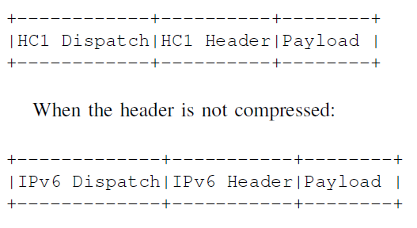
6LoWPAN Dispatch Byte
Identifies compression type in the IEEE802.15.4 frame:

Slide 8
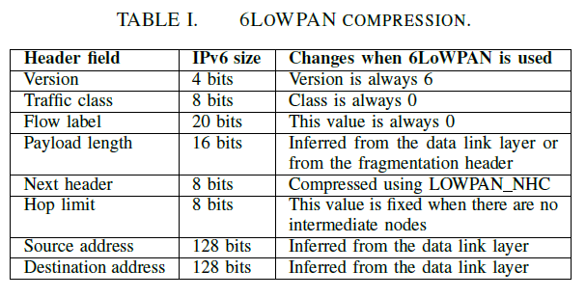
Table I

Slide 9
Prototype Development
Authors implement prototype with IEEE802.15.4 nodes and a 6LoWPAN gateway that uses an Ethernet interface to connect the nodes to the Internet.
Atmel AVR-Atmega128RFA1 with 8-bit RISC microprocessor and 2.4GHz transceiver is base for 802.15.4 radio module (includes Contiki open source OS).

Slide 10
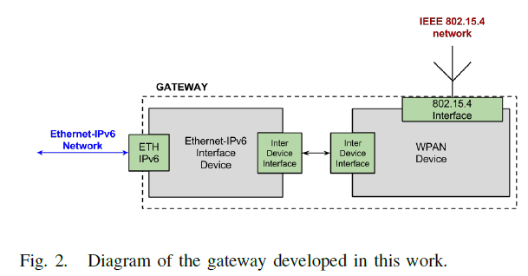
Gateway Prototype
Gateway developed by connecting one IEEE802.15.4 node to an Ethernet enabled device.

Slide 11
Prototype Details
Contiki code was optimized for low-power devices which can use wireless TCP/IP.
Note: This implies using Contiki MAC layer (either Contiki-MAC or X-MAC).
TCP/IP Contiki stack uses µIP layer validated by Cisco.
WirelessHART and Zigbee are proprietary which hinders interoperability and connectivity to devices on Ethernet.

Slide 12
Prototype Details
WPAN device based on Border Router source code in Contiki.
Gateway needs to be powered to enable handling Ethernet interface and requirement for more RAM flash memory.

Slide 13
Experiments and Analysis
Authors focus on comparing pure IPv6 versus 6LoWPAN performance only with respect to compression and fragmentation.
First results involve UDP client/server with nodes 3 feet apart.
Client sends another UDP packet after it received response. Timeouts considered an error.
UDP packet size varied from 20 bytes to 520 bytes.

Slide 14
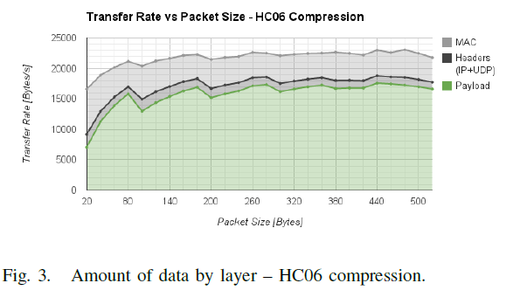
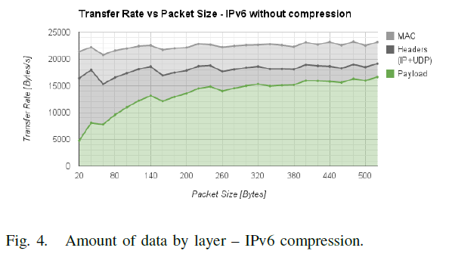
Experiments and Analysis
without
Graphs show measurements at multiple layers of µIP stack.
Results include fragmentation. Hence, compression effect is less as compression happens in only first fragment.

Slide 15
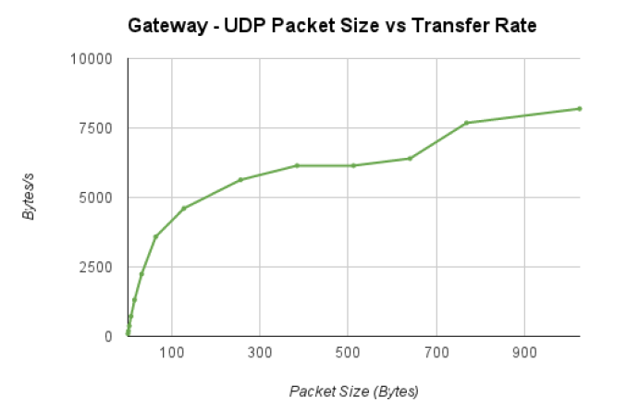
Figure 5: Gateway Transfer Rate
Details NOT
sufficient to
reproduce or
analyze.
How many
sensors?

Slide 16
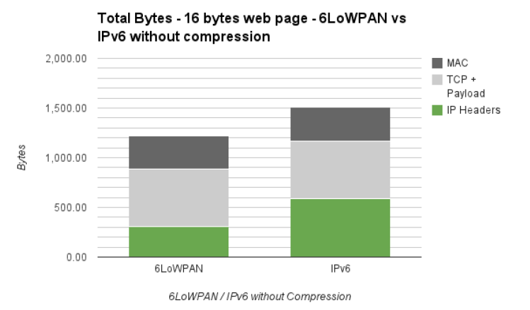
Figure 6: Compression Impact
Very small
web page ➔
best results
Headers dominate small packets ➔ compression gain higher for small packets!
Overhead reduced for larger packets.
Large page experiments impacted by available RAM.

Slide 17
Conclusions and Critique
Paper presents implementation of prototype with 6LoWPAN gateway.
Results show that compression can improve response time and data rate.
Not much here!!
Details missing in some cases.

