Slide 1
Energy Analysis of Four
Wireless Sensor Network
MAC Protocols
Brian Bates, Andrew Keating and Robert Kinicki
Worcester Polytechnic Institute
Worcester, Massachusetts
USA
ISWPC 2011
Hong Kong

Slide 2
Wireless Sensor Networks
Small embedded devices with simple hardware measure surroundings and communicate wirelessly via radio.
Used to solve a number of real-world problems:
  Periodic Monitoring
  Event Detection
  Tracking

Slide 3
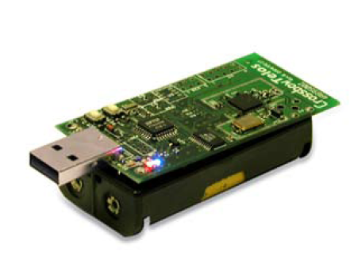
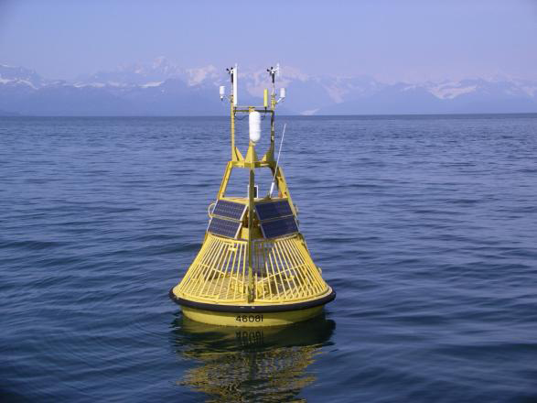
Motivation
Mote | Radio (Active) | Radio (Sleep) | CPU (Active) | CPU (Sleep)
TelosB | 23 mA | 1 μA | 1.8 mA | 5.1 μA
MicaZ | 19.7 mA | 1 μA | 8 mA | < 15 μA
Powered by two AA batteries

Slide 4
Background
Terminology
SCP-MAC
AS-MAC
Crankschaft
MLA

Slide 5
Terminology Review
Idle Listening:: Listening for a message but not receiving one.
Overhearing:: Receiving a message not intended for that sensor.
Duty Cycle:: Percentage of time the radio is on.
Wakeup Slot:: Interval of time the radio is on (receiver wakeup probe).
Wakeup Interval:: Time between wakeup slots.

Slide 6
Contention Window (CW)
Slotted, time-divided
Scenario: Two simultaneous senders
5ms
5ms
5ms
5ms
5ms
5ms
1
2

Slide 7
Contention Window (CW)
Before transmission, a CW slot is selected randomly
1
2

Slide 8
Contention Window (CW)
Node 1 senses the channel and finds it to be free.
Node 2 is still waiting for its slot to occur.
1
2

Slide 9
Contention Window (CW)
Node 1 begins transmitting
During Node 2’s slot, it senses the channel is busy.
1
2

Slide 10
Contention Window (CW)
Node 2 backs off – it has lost contention
It will try to retransmit later.
1
2

Slide 11
Terminology: Collision
Multiple senders randomly select the same CW slot
1
2

Slide 12
Sender Collision
Simultaneously sense the channel is free.
They both think they have won contention and send.
1
2

Slide 13
Sender Collision
Result: Packet loss
1
2

Slide 14
Early WSN MAC Protocols
First duty cycled MACs:
  S-MAC, T-MAC
  High duty cycles, unable to adapt to variable loads.
Low-Power Listening:
B-MAC, X-MAC
  Long preambles
  B-MAC is the only low-power MAC included in TinyOS.

Slide 15
SCP-MAC
Goal: Schedule wakeup slots to reduce the duty cycle.
All nodes share a common wakeup time.
Scheduling done through synch messages and piggybacking.
Outperforms previous MAC protocols in energy usage.
Main disadvantage is overhearing.

Slide 16
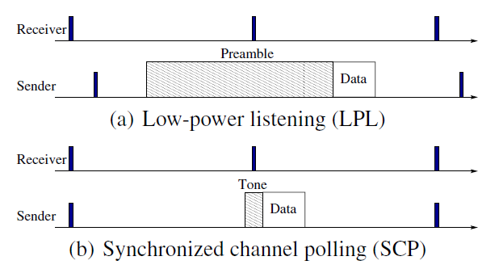
SCP-MAC vs. LPL

Slide 17
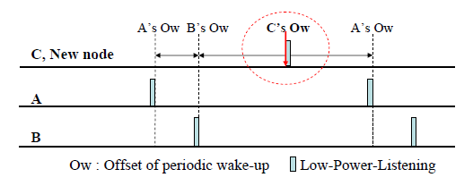
AS-MAC
Assigns unique listening time slots.
  To eliminate overhearing and keeps the duty cycle low.

Slide 18
AS-MAC
Two phases:
  Initialization
  Periodic Listening
Nodes keep track of neighbors’ wakeup schedules in a Neighbor Table.

Slide 19
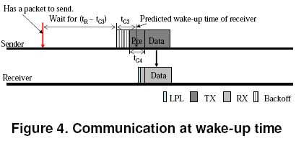
AS-MAC
Sender waits until receiver wakes up to transmit (just before).

Slide 20
AS-MAC Problem: Broadcasting
1
5
BS
2
4
3
1
2
3
4
5

Slide 21
AS-MAC Problem: Broadcasting
1
5
BS
2
4
3
1
2
3
4
5

Slide 22
AS-MAC Problem: Broadcasting
1
5
BS
2
4
3
1
2
3
4
5

Slide 23
AS-MAC Problem: Broadcasting
1
5
BS
2
4
3
1
2
3
4
5

Slide 24
AS-MAC Problem: Broadcasting
1
5
BS
2
4
3
1
2
3
4
5

Slide 25
AS-MAC Problem: Broadcasting
1
5
BS
2
4
3
1
2
3
4
5

Slide 26
Crankshaft
Goal: Reduce energy from overhearing in dense sensor networks.
Two different slot types: broadcast and unicast
  All nodes always wake up for broadcast slots.
  Nodes partitioned into unicast slots (via their address mod number of unicast slots).
Advantages: Eliminates overhearing, efficient broadcast.
Disadvantages: More idle listening with light traffic, no synchronization mechanism.

Slide 27
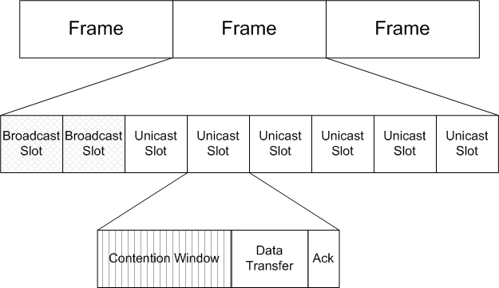
Crankshaft

Slide 28
MAC Layer Architecture (MLA)
A framework for optimized and reusable components to be leveraged across multiple MAC protocols.
Move away from monolithic MAC implementations.
Provides hardware dependent services (e.g., alarming).
Provides hardware-independent reusable components (e.g. channel polling and preamble sending).

Slide 29
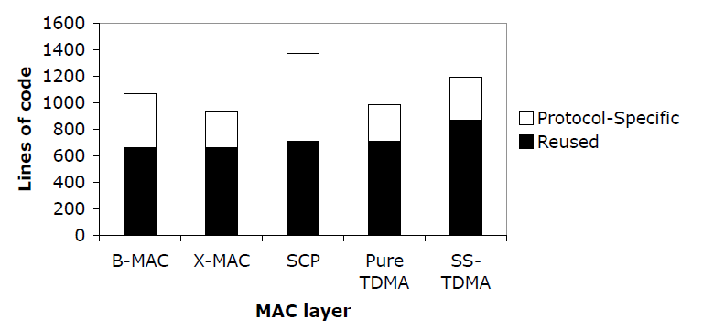
MAC Layer Architecture (MLA)

Slide 30
Research Statement
Used MLA to implement (SCP-MAC, AS-MAC, Crankshaft and BAS-MAC) on TelosB motes running TinyOS 2.1.0.
Analyzed the energy consumption of each protocol under three WSN traffic patterns (local gossip, convergecast and broadcast).

Slide 31
Methodology Overview
Hardware Selection
Oscilloscope Measurements
MAC Protocol Implementations and Validation
Parameter Selection and Initial Synchronization
Experiment Design and Data Gathering

Slide 32
Hardware Selection
Considered the Mica2, MicaZ, iMote2, and TelosB
Chose the TelosB:
  Middle of the line specs and price
  Popular in academic research
  Newer CC2420 radio
  USB Interface

Slide 33
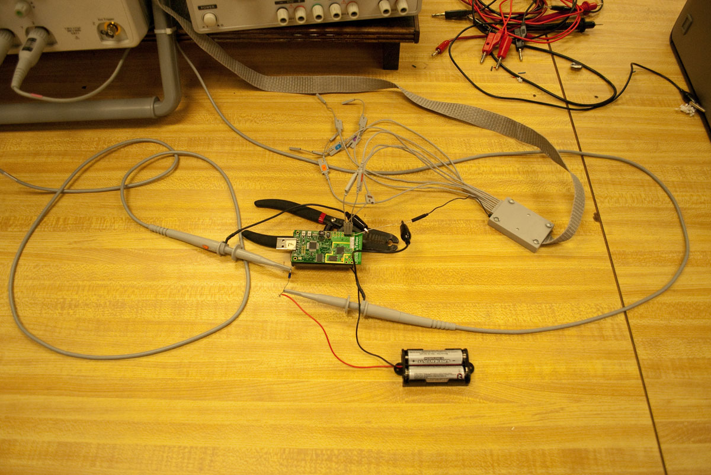
Measuring Energy

Slide 34
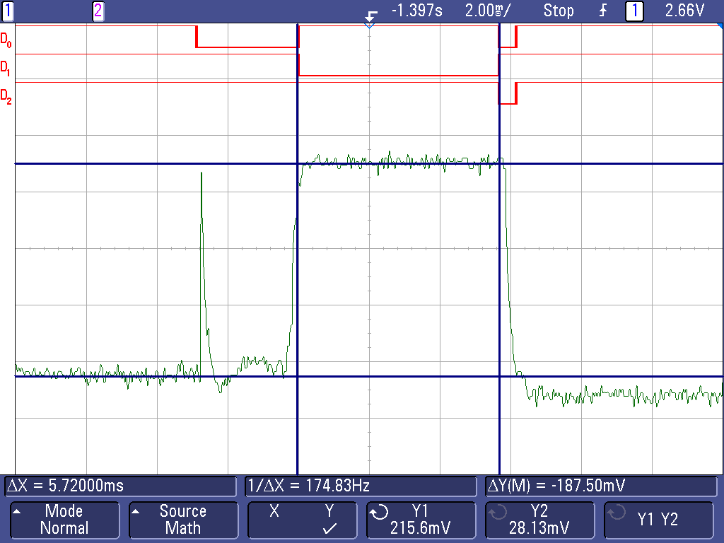
Measuring Energy

Slide 35
Measuring Energy
Radio State | Observed Current | CC2420 Datasheet Value
Stopped | 0 mA | 21 μA
Starting | 2.51 mA | N/A
Idle | 20.07 mA | 18.8 mA
Sending | 17.01 mA | 17.4 mA
Receiving | 20.22 mA | 18.8 mA
Stopping | 10.04 mA | N/A
Added hooks into radio device drivers.
Ability to measure amount of time the radio is in each state.

Slide 36
Protocol Implementations
Implemented using TinyOS version 2.1.0
  More standardized message stack than version 1.x
Leveraged the MAC Layer Architecture (MLA) framework
  Provides common MAC code for WSNs.
All four protocols were rebuilt for this frameworks.

Slide 37
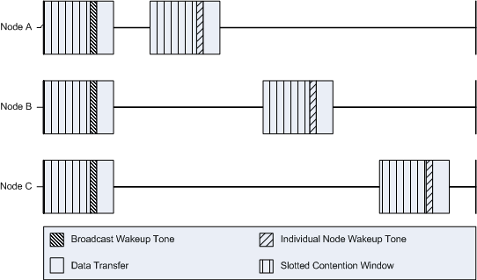
Broadcastable AS-MAC
(BAS-MAC)
Added a broadcast slot to AS-MAC

Slide 38
BAS-MAC Broadcasting
1
5
BS
2
4
3
B
1
2
3
4
5

Slide 39
Parameter Selection
Goal: Put four different protocols on a level playing field.
Standardized wakeup intervals.
Kept some parameters constant across protocols
  Contention window size and behavior
  Wakeup slot
Left synchronization out of it
  Synch costs are low compared to overall energy costs.
  Synch can be complex and time consuming (AS-MAC).

Slide 40
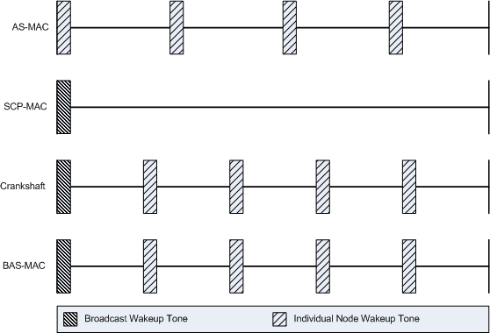
Standardizing Wakeup Intervals

Slide 41
Initialization Synchronization
Mote oscillates between two states:
  Initialization: Radio always on, awaiting a message.
  Running: Normal experimental operation
Resetting a mote changes the state.
Uses the onboard flash to hold persistent state.
User button sends reset message to all motes.

Slide 42
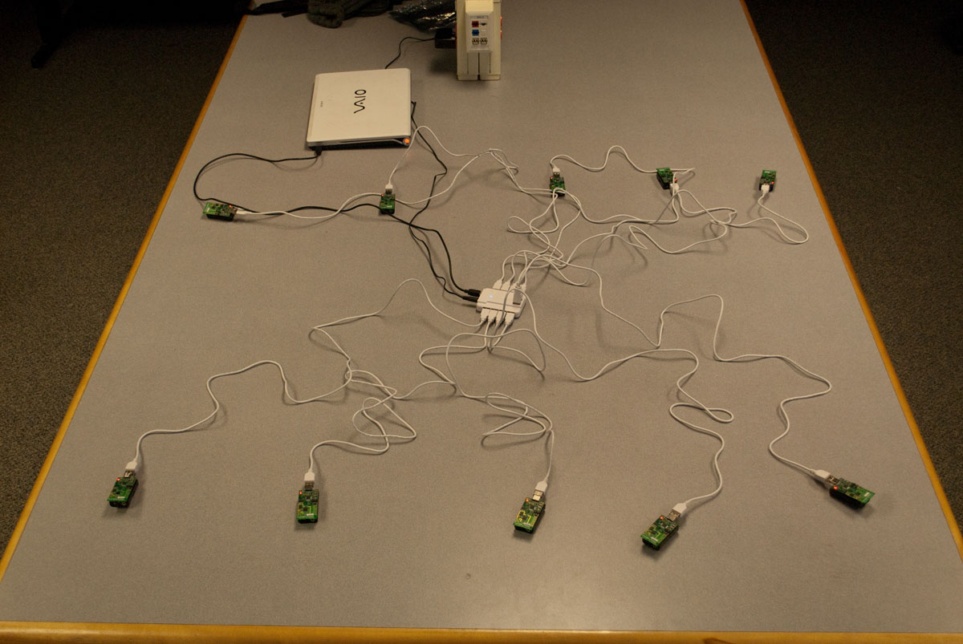
Mote Programming

Slide 43
Experiment Overview
4 MAC protocols
3 traffic patterns: local gossip, convergecast, broadcast
Small and large networks (10 node)
Fast and slow sending rates
3 minute experiments, 5 repetitions each (averages reported)
240 total experiments

Slide 44
Data Collection
Difficulties in collecting data
  Writing to serial takes time, limited storage.
  Want to get energy data from all motes.
Split experiments into phases
  Initialization
  Experiment specific behavior
  Sending information messages to central node.
Central node hooked up via USB – streams results
  Immediately available and visible on laptop.

Slide 45
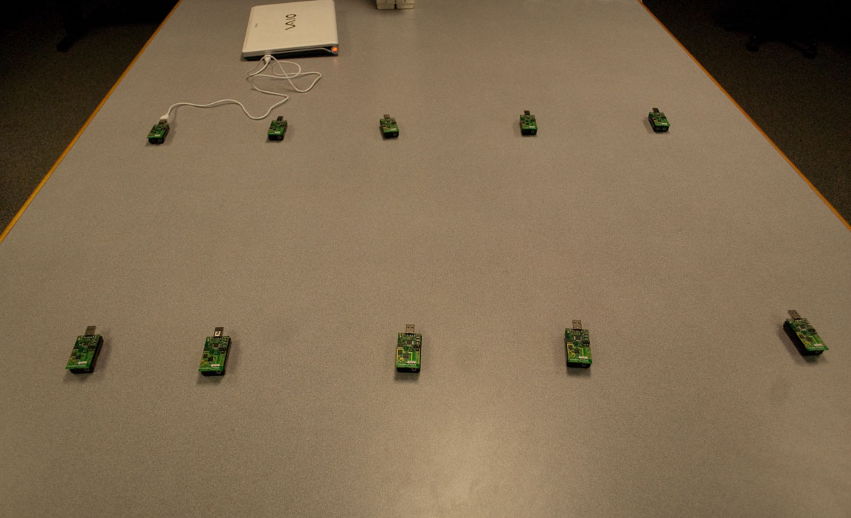
Local Gossip

Slide 46
Sender Staggering
Wakeup Interval
1
2
3
4
5

Slide 47
Sender Staggering
Wakeup Interval
1
2
3
4
5

Slide 48
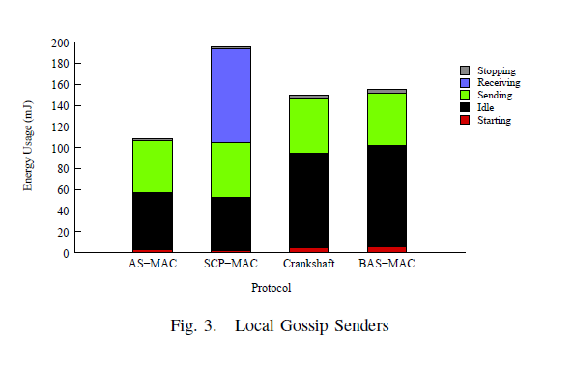
Local Gossip (Senders)

Slide 49
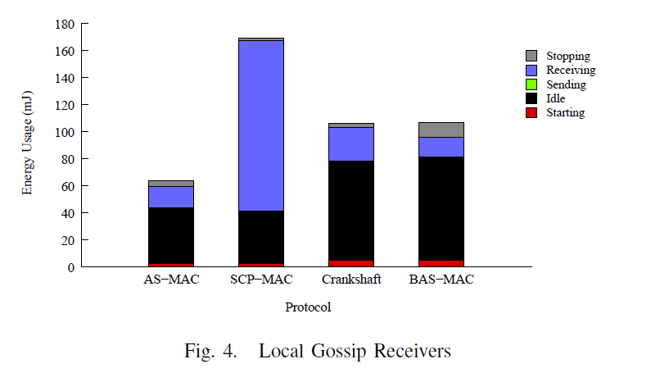
Local Gossip (Receivers)

Slide 50
Fast Local Gossip
SCP-MAC performs poorly
  Not enough wakeup slots to send all of the data.
Sending Motes
Wakeup Slot

Slide 51
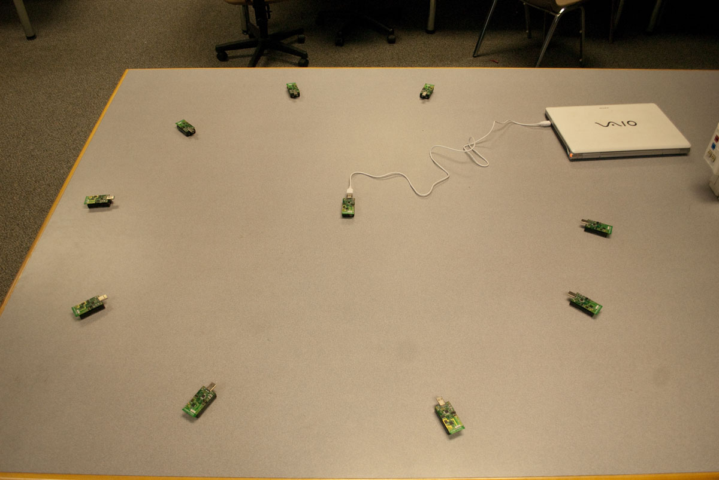
Star Topology Setup

Slide 52
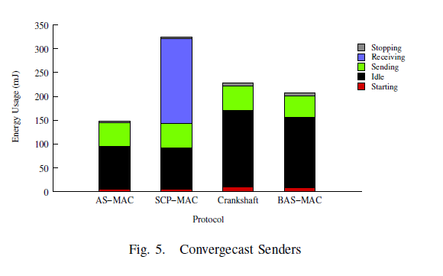
Convergecast (Leaf Nodes)

Slide 53
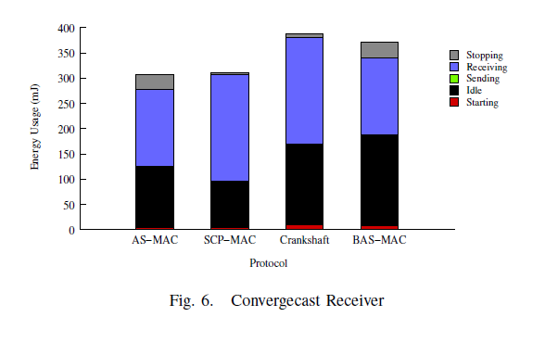
Convergecast (Base Station)

Slide 54
Broadcast
Arrange nodes in a “star” pattern.
Central mote periodically broadcasts messages to all other motes.
All nodes in radio range of one another.

Slide 55
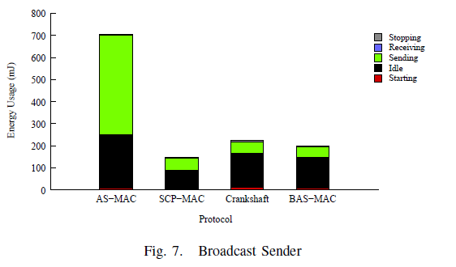
Broadcast (Base Station)

Slide 56
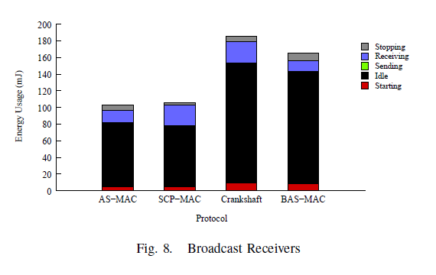
Broadcast (Leaf Nodes)

Slide 57
Conclusions
Overhearing is a significant source of energy waste.
Although sending costs less energy per unit time, the overall cost of sending a message is greater.
AS-MAC inefficiency of broadcast is an high energy consumer.
AS-MAC can be made more robust with the addition of a broadcast slot.
There is no one MAC protocol that is best in all one hop traffic scenarios.

Slide 58
Future Work
Multi Hop
Parameter Adjustments
Latency and Throughput
Transmission Power/Topology Control
Multi-channel MAC protocols

Slide 59
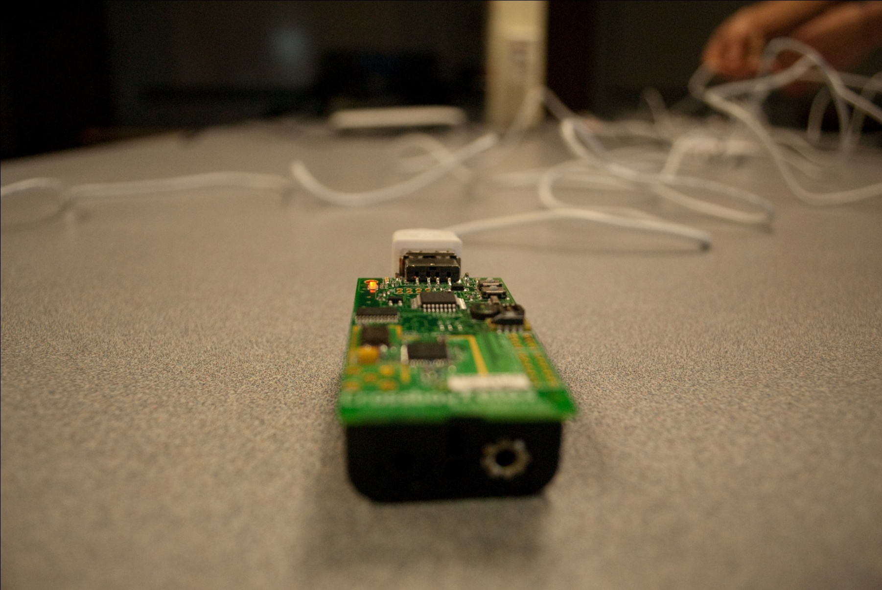
Questions?

