Slide 1
Physical Layer (Part 2) Data Encoding Techniques
Computer Networks
Spring 2012

Slide 2
Interpreting Signals
need to know:
timing of bits - when they start and end
signal levels
factors affecting signal interpretation:
signal to noise ratio (SNR)
data rate (R)
Bandwidth (B)
encoding scheme
DCC 9th Ed.
Stallings
Notes:
The tasks involved in interpreting digital signals at the receiver can be summarized by again referring to Stallings DCC9e Figure 3.16. First, the receiver must know the timing of each bit. That is, the receiver must know with some accuracy when a bit begins and ends. Second, the receiver must determine whether the signal level for each bit position is high (0) or low (1). In Figure 3.16, these tasks are performed by sampling each bit position in the middle of the interval and comparing the value to a threshold. Because of noise and other impairments, there will be errors, as shown.
What factors determine how successful the receiver will be in interpreting the incoming signal? We saw in Chapter 3 that three factors are important: the signal-to-noise ratio, the data rate, and the bandwidth. With other factors held constant, the following statements are true:
An increase in data rate increases bit error rate (BER).
An increase in SNR decreases bit error rate.
An increase in bandwidth allows an increase in data rate.

Slide 3
Data Encoding Techniques
Digital Data, Analog Signals [modem]
Digital Data, Digital Signals [wired LAN]
Analog Data, Digital Signals [codec]
Frequency Division Multiplexing (FDM)
Wave Division Multiplexing (WDM) [fiber]
Time Division Multiplexing (TDM)
Pulse Code Modulation (PCM) [T1]
Delta Modulation

Slide 4
Analog and Digital Transmissions
Figure 2-23.The use of both analog and digital transmissions for a computer-to-computer call. Conversion is done by the modems and codecs.
Tanenbaum

Slide 5
Digital Data, Analog Signals
[Example – modem]
Basis for analog signaling: constant-frequency is a continuous, signal known as the carrier frequency.
Digital data is encoded by modulating one of the three characteristics of the carrier: amplitude, frequency, or phase or some combination of these.

Slide 6
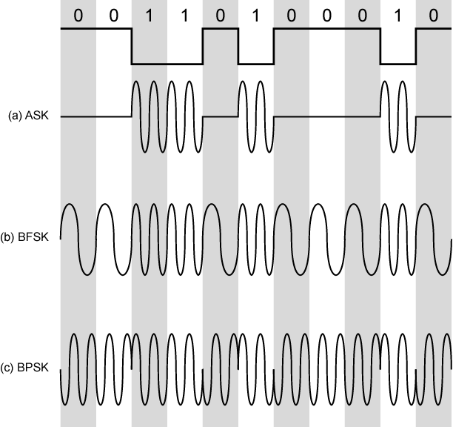
Modulation Techniques
DCC 9th Ed.
Stallings
Notes:
We mentioned that modulation involves operation on one or more of the three characteristics of a carrier signal: amplitude, frequency, and phase. Accordingly, there are three basic encoding or modulation techniques for transforming digital data into analog signals, as illustrated in StallingsDCC9e Figure 5.7: amplitude shift keying (ASK), frequency shift keying (FSK), and phase shift keying (PSK). In all these cases, the resulting signal occupies a bandwidth centered on the carrier frequency.

Slide 7
Modulation to Keying
Amplitude modulation:: Amplitude Shift Keying (ASK)
Frequency modulation::
Binary Frequency Shift Keying (BFSK)
Multiple FSK (MFSK)
More than two frequencies used ➔ signaling element represents more than one bit.
Phase modulation::
Binary Phase Shift Keying (BPSK)
Differential* PSK (DPSK)
Quadrature PSK (QPSK)
* Explained later

Slide 8
Example 5.4 MFSK
f_{c} = 250 kHz, f_{d} = 25 kHz M= 8
Frequency assignments:
f₁ = 75 kHz 000 f₂ = 125 kHz 001
f₃ = 175 kHz 010 f₄ = 225 kHz 011
f₅ = 275 kHz 000 f₆ = 325 kHz 001
f₇ = 375 kHz 010 f₄ = 425 kHz 011
B = 2Mf_{d} = 400 kHz
R = 1/T = 2Lf_{d} = 150 kbps
DCC 9th Ed.
Stallings

Slide 9
Modems
All advanced modems use a combination of modulation techniques to transmit multiple bits per baud.
Multiple amplitude and multiple phase shifts are combined to transmit several bits per symbol.
QPSK (Quadrature Phase Shift Keying) uses four phase shifts per symbol.
Modems actually use Quadrature Amplitude Modulation (QAM).
These concepts are depicted using constellation points where a point determines a specific amplitude and phase.

Slide 10
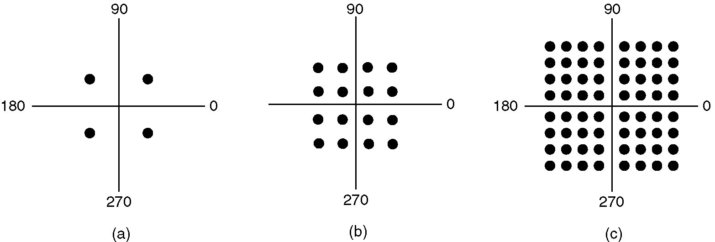
Constellation Diagrams
(a) QPSK. (b) QAM-16. (c) QAM-64.
Figure 2-25.
V = 64
v = log₂ V = 6
Tanenbaum

Slide 11
Quadrature Amplitude Modulation (QAM)
QAM (a combination of ASK and PSK) is used in ADSL and cable modems.
Example:
QAM-16 = QPSK and QASK
Idea - Increase the number of bits transmitted by increasing the number of levels used per symbol.
Example:
R_{QAM-64} = 6 R_{ASK}

Slide 12
Telephone Modems
Voice grade line ~ 3100 Hz
Nyquist ➔ no faster than 6000 baud.
Most modems send at 2400 baud.
To increase data rates, use constellations and error correction-TCM (Trellis Coded Modulation)
Namely, an error correction bit at the physical layer!!

Slide 13
Telephone Modems
V.32 (32 constellation {4 bits} + 1 check bit) 9600 bps
V.32bis (6 bits/symbol + 1 check bit) 14,400 bps
V.34 (12 bits/symbol) 28,800 bps
V.34bis (14 bits/symbol) 33,600 bps
thousands of constellation points!!
Now we run into Shannon limit based on local loop length and quality of phone lines. Since Shannon limit applies to local loop at both ends, eliminate ISP end local loop. Can now go up to 70 kbps, but now run into Nyquist theorem sampling limits.
4000 Hz (voice grade with guard bands) ➔ 8000 samples/sec. with 8 bits per sample (7 useful in US).
V.90 and V.92 provide 56-kbps downstream and
33.6-kbps and 48-kbps upstream, respectively.
Tanenbaum

Slide 14
Digital Data, Digital Signals [the technique used in wired LANs]
Digital signal:: is a sequence of discrete, discontinuous voltage pulses.
Bit duration:: the time it takes for the transmitter to emit the bit.
Issues
Bit timing (sender/receiver clock drift)
Recovery from signal inference
Noise immunity
Error detection {later}
Complexity (cost)

Slide 15
Signal Spectrum Issues
Lack of high frequency components ➔ less bandwidth needed for transmission.
DC component ➔ direct physical attachment of transmission components {bad}.
Without dc, ac coupling via transformer provides excellent electrical isolation {reduces interference}.
Concentrate transmission power in the middle of the transmission band because channel characteristics worse near band edges.

Slide 16
NRZ ( Non-Return-to-Zero) Codes
Uses two different voltage levels (one positive and one negative) as the signal elements for the two binary digits.
NRZ-L ( Non-Return-to-Zero-Level)
The voltage is constant during the bit interval.
NRZ-L is used for short distances between a terminal and modem or terminal and computer.
1 ⬄ negative voltage
0 ⬄ positive voltage

Slide 17
NRZ ( Non-Return-to-Zero) Codes
NRZ-I ( Non-Return-to-Zero-Invert on ones)
The voltage is constant during the bit interval.
NRZI is a differential encoding scheme (i.e., the information transmitted is terms of comparing adjacent signal elements.)
1 ⬄ existence of a signal transition at the beginning of the bit time
(either a low-to-high or a high-to-low transition)
0 ⬄ no signal transition at the beginning of the bit time

Slide 18
Bi–Phase Codes
Bi-phase codes – require at least one transition per bit time and may have as many as two transitions.
➔ the maximum modulation rate is twice that of NRZ
➔ greater transmission bandwidth is required.
Advantages:
Synchronization – with a predictable transition per bit time the receiver can “synch” on the transition [self-clocking].
No d.c. component.
Error detection – the absence of an expected transition can be used to detect errors.

Slide 19
Manchester Encoding
There is always a mid-bit transition {which is used as a clocking mechanism}.
The direction of the mid-bit transition represents the digital data.
Consequently, there may be a second transition at the beginning of the bit interval.
Used in 802.3 baseband coaxial cable and CSMA/CD twisted pair.
Some
textbooks
disagree
on this
definition!!
1 ⬄ low-to-high transition
0 ⬄ high-to-low transition

Slide 20
Differential Manchester Encoding
mid-bit transition is ONLY for clocking.
Differential Manchester is both differential and bi-phase.
Note – the coding convention for Differential Manchester is the opposite convention from NRZI.
Used in 802.5 (token ring) with shielded twisted pair.
* Modulation rate for Manchester and Differential Manchester is twice the data rate ➔ inefficient encoding for long-distance applications.
1 ⬄ absence of transition at the beginning of the bit interval
0 ⬄ presence of transition at the beginning of the bit interval

Slide 21
Bi-Polar Encoding
Has the same issues as NRZI for a long string of 0’s.
A systemic problem with polar is the polarity can be backwards.
1 ⬄ alternating +1/2 , -1/2 voltage
0 ⬄ 0 voltage

Slide 22
Digital Encoding Techniques
1
0
1
0
1
1
1
0
0
Unipolar
NRZ
Polar NRZ
NRZ-Inverted
(Differential
Encoding)
Leon-Garcia & Widjaja:
Communication Networks
Bipolar
Encoding
Manchester
Encoding
Differential
Manchester
Encoding

Slide 23
Analog Data, Digital Signals [Example – PCM (Pulse Code Modulation)]
The most common technique for using digital signals to encode analog data is PCM.
Example: To transfer analog voice signals off a local loop to digital end office within the phone system, one uses a codec.
Because voice data limited to frequencies below 4000 HZ, a codec makes 8000 samples/sec. (i.e., 125 microsec/sample).

Slide 24
Multiplexing
Multiplexing {general definition} ::
Sharing a resource over time.
(a)
(b)
A
A
A
Trunk
group
A
B
B
B
MUX
MUX
B
C
C
C
C
Leon-Garcia & Widjaja:
Communication Networks

Slide 25
Frequency Division Multiplexing (FDM) vs Time Division Multiplexing (TDM)
Example:
FDM
4 users
frequency
time
TDM
frequency
K & R
time
Notes:
Two simple multiple access control techniques.
Each mobile’s share of the bandwidth is divided into portions for the uplink and the downlink. Also, possibly, out of band signaling.
As we will see, used in AMPS, GSM, IS-54/136

Slide 26
Frequency Division Multiplexing
(a) Individual signals occupy H Hz
A
f
0
H
B
0
f
H
C
f
0
H
(b) Combined signal fits into channel bandwidth
A
B
C
f
Leon-Garcia & Widjaja:
Communication Networks

Slide 27
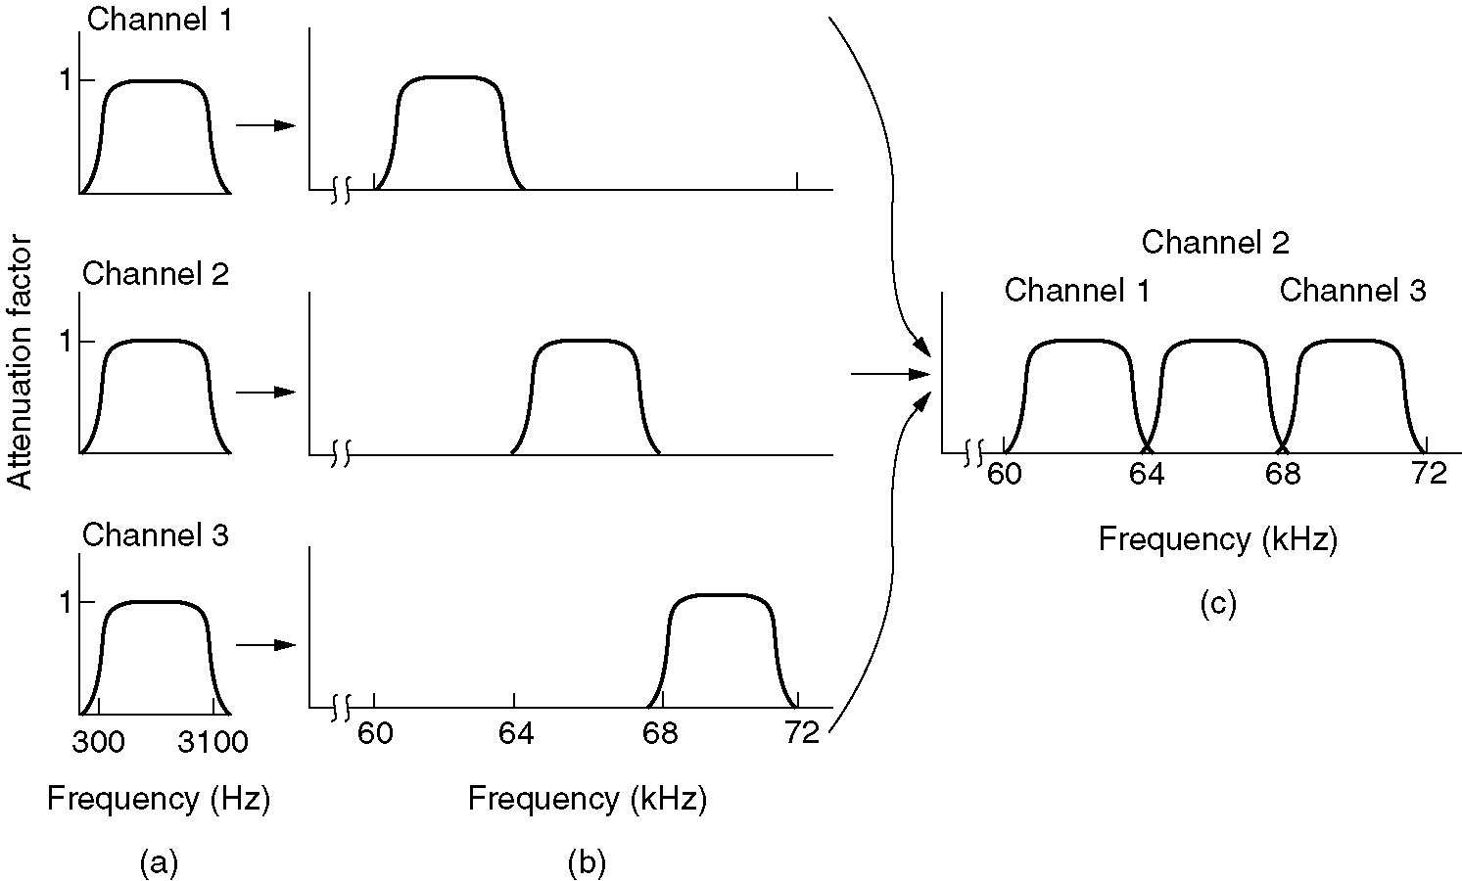
Frequency Division Multiplexing
Figure 2-31. (a) The original bandwidths. (b) The bandwidths raised in frequency. (c) The multiplexed channel.
Tanenbaum

Slide 28
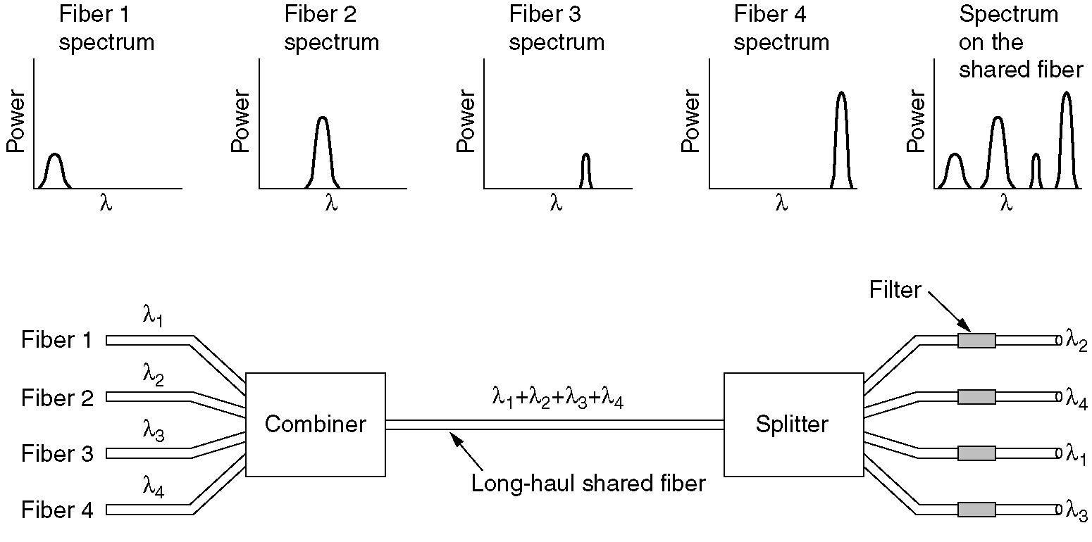
Wavelength Division Multiplexing
Wavelength division multiplexing.
Figure 2-32.
Tanenbaum

Slide 29
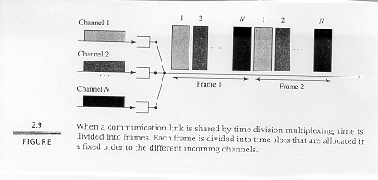
Time Division Multiplexing

Slide 30
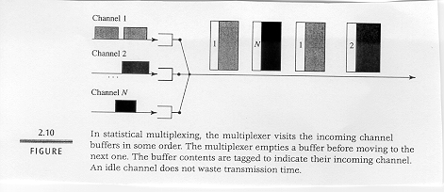
Concentrator [Statistical Multiplexing]

Slide 31
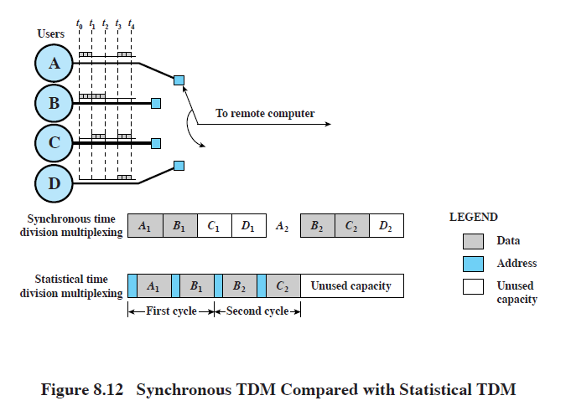
Statistical Multiplexing
DCC 9th Ed.
Stallings

Slide 32
T1 System
A
A
B
MUX
MUX
B
22
23
24
b
1
2
. . .
24
b
C
C
frame
Leon-Garcia & Widjaja:
Communication Networks

Slide 33
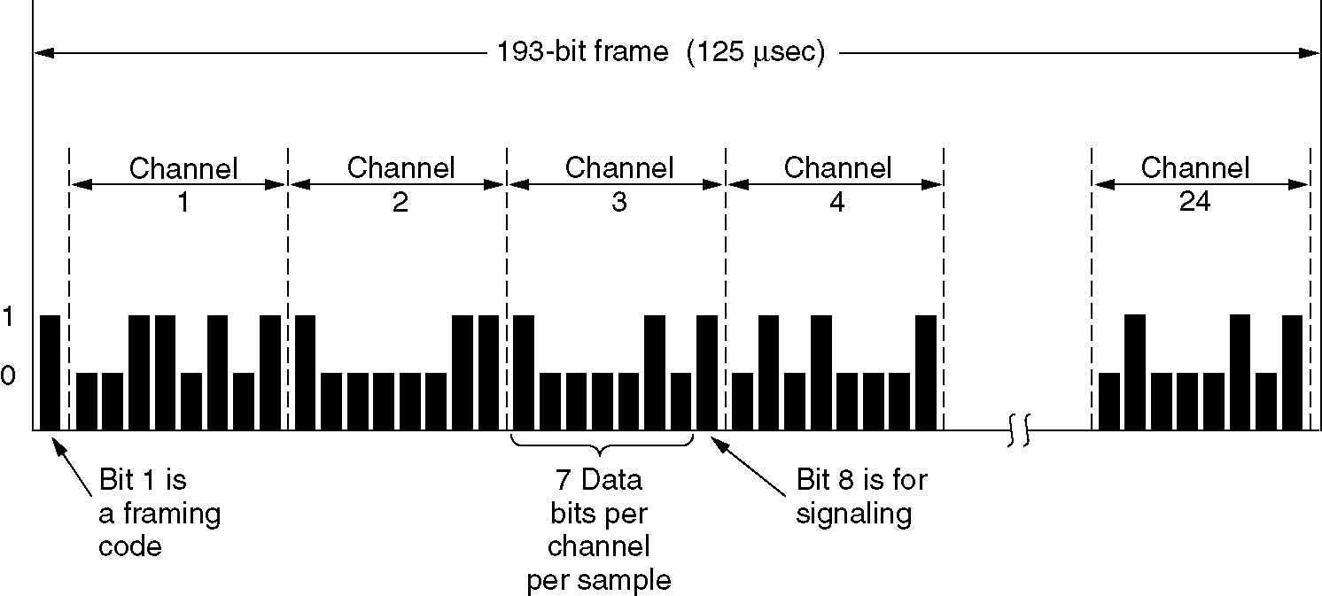
T1 - TDM Link
The T1 carrier (1.544 Mbps).
Figure 2-33.T1 Carrier (1.544Mbps)
Tanenbaum

Slide 34
Pulse Code Modulation (PCM)
T1 example for voice-grade input lines:
implies both codex conversion of analog to digital signals (PCM) and TDM.

Slide 35
Analog Data, Digital Signals
digitization is conversion of analog data into digital data which can then:
be transmitted using NRZ-L.
be transmitted using code other than NRZ-L (e.g., Manchester encoding).
be converted to analog signal.
analog to digital conversion done using a codec:
pulse code modulation
delta modulation
DCC 9th Ed.
Stallings
Notes:
In this section we examine the process of transforming analog data into digital signals. Analog data, such as voice and video, is often digitized to be able to use digital transmission facilities. Strictly speaking, it might be more correct to refer to this as a process of converting analog data into digital data; this process is known as digitization. Once analog data have been converted into digital data, a number of things can happen. The three most common are:
1. The digital data can be transmitted using NRZ-L. In this case, we have in fact gone directly from analog data to a digital signal.
2. The digital data can be encoded as a digital signal using a code other than NRZ-L. Thus an extra step is required.
3. The digital data can be converted into an analog signal, using one of the modulation techniques discussed in Section 5.2.

Slide 36
Digitizing Analog Data
DCC 9th Ed.
Stallings
Notes:
Stallings DCC9e Figure 5.15 shows voice data that are digitized and then converted to an analog ASK signal. This allows digital transmission in the sense defined in Chapter 3. The voice data, because they have been digitized, can be treated as digital data, even though transmission requirements (e.g., use of microwave) dictate that an analog signal be used.
The device used for converting analog data into digital form for transmission, and subsequently recovering the original analog data from the digital, is known as a codec (coder-decoder). In this section we examine the two principal techniques used in codecs, pulse code modulation and delta modulation. The section closes with a discussion of comparative performance.

Slide 37
Pulse Code Modulation Stages
DCC 9th Ed.
Stallings

Slide 38
Pulse Code Modulation (PCM)
Analog signal is sampled.
Converted to discrete-time continuous-amplitude signal (Pulse Amplitude Modulation).
Pulses are quantized and assigned a digital value.
A 7-bit sample allows 128 quantizing levels.

Slide 39
Pulse Code Modulation (PCM)
PCM uses non-linear encoding, i.e., amplitude spacing of levels is non-linear.
There is a greater number of quantizing steps for low amplitude.
This reduces overall signal distortion.
This introduces quantizing error (or noise).
PCM pulses are then encoded into a digital bit stream.
8000 samples/sec x 7 bits/sample = 56 Kbps for a single voice channel.
7-bit codes ➔ 128 quantization levels

Slide 40
PCM Stages
DCC 9th Ed.
Stallings

Slide 41
PCM Nonlinear Quantization
DCC 9th Ed.
Stallings

Slide 42
Delta Modulation (DM)
The basic idea in delta modulation is to approximate the derivative of analog signal rather than its amplitude.
The analog data is approximated by a staircase function that moves up or down by one quantization level at each sampling time. ➔ output of DM is a single bit.
PCM preferred because of better SNR characteristics.

Slide 43
Delta Modulation
DCC 9th Ed.
Stallings

Slide 44
Digital Techniques for Analog Data
Continue to grow in popularity because:
Repeaters used instead of amplifiers.
TDM used for digital signals (e.g. SONET).
Digital signaling allows more efficient digital switching techniques.
More efficient codes developed (e.g. interframe coding techniques for video).
Example
color TV – uses 10-bit codes
4.6 MHZ bandwidth signal yields 92Mbps.

Slide 45
Data Encoding Summary
Digital Data, Analog Signals [modem]
Three forms of modulation (amplitude, frequency and phase) used in combination to increase the data rate.
Constellation diagrams (QPSK and QAM)
Digital Data, Digital Signals [wired LANs]
Tradeoffs between self clocking and required frequency.
Biphase, differential, NRZL, NRZI, Manchester, differential Manchester, bipolar.

Slide 46
Data Encoding Summary
Analog Data, Digital Signals [codec]
Multiplexing Detour:
Frequency Division Multiplexing (FDM)
Wave Division Multiplexing (WDM) [fiber]
Time Division Multiplexing (TDM)
Statistical TDM (Concentrator)
Codex functionality:
Pulse Code Modulation (PCM)
T1 line {classic voice-grade TDM}
PCM Stages (PAM, quantizer, encoder)
Delta Modulation

