Slide 1
Network Border Patrol: Preventing Congestion Collapse and Promoting Fairness in the Internet
Celio Albuquerque, Brett J. Vickers, Tatsuya Suda

Slide 2
Outline
The Problem
Existing Solutions
Network Border Patrol
Feedback Control Algorithm
Rate Control Algorithm
Simulations and Testing
Conclusions

Slide 3
The Problem
Congestion Collapse
Poor retransmission strategies
Rise of streaming video in the early 2000s
Unfair bandwidth allocations
Differing TCP congestion algorithms
TCP ‘bias’ towards short RTT

Slide 4
Existing Solutions
Logic in the Routers
Weighted Fair Queueing
Core-stateless Fair Queuing
CHOKe
These are more complicated than FIFO
They often do not work if your goal is global max-min fairness
If at router A, flows X and Y are allocated equally, and then only X encounters a later bottleneck, X will be overallocated at A.

Slide 5
Network Border Patrol
Schematically similar to core-stateless, pushing flow classification and handling to the edge routers
Categorize routers as ingress and egress routers
Note that a single router will act as both depending on which flows are being looked at
Ingress routers separate packets into logical flows
Egress routers measure the outbound capacity for each logical flow
Ingress routers meter logical flows based on egress capacity

Slide 6
Network Border Patrol

Slide 7
Feedback Control Algorithm
Controls how the ingress and egress routers exchange packets
A feedback packet is an ICMP packet (ping packet)
In addition to exchanging flow data, they can be metered to sample internal congestion (through RTT)

Slide 8
Feedback Control Algorithm
At ingress, a router categorizes a packet into a flow.
The router increases the counter on that flow by n, where n is the size of the packet
When the counter for a flow reaches Tx , create a “forward” packet
A forward packet contains a timestamp and a list of unique identifiers for each of the N flows that the ingress router has seen for a given egress router

Slide 9
Feedback Control Algorithm
At egress, a router generates a “backward” packet every time it receives a forward packet.
A backward packet contains an associative array containing each flow and its outbound capacity.
This packet is sent back to the ingress router and is used for traffic flow management (throttling, etc)

Slide 10
Network Border Patrol

Slide 11
Rate Control Algorithm
Ingress routers use a Rate Control Algorithm to regulate the rate at which flows enter the network
TCP-like implementation with two phases: slow start and congestion avoidance
Track the RTT of the feedback packets and use the current RTT and best observed RTT in the algorithm

Slide 12
Rate Control Algorithm
Notes:
deltaRTT shows that we are currently experiencing worse round trip times than we could possibly get, meaning packets are buffering.
A flow is experiencing congestion when the network is buffering more than one flows worth of packets at each hop. (ingressRate * deltaRTT is an estimate > hops * largest packet)
This cutoff is a tradeoff between utilization and low delay (as mentioned in class)
This also throttles faster flows sooner because they hit that boundary faster.
If a flow is not experiencing congestion, the flows allowed rate is increased (doubled or incremented by a quantum depending on phase)
Since increments are a function of roundTripTime, this algorithm is friendlier to TCP flows, which are throttled by global RTT, which must necessarily be larger than in-network RTT

Slide 13
Fairness?
NBP by itself is not “fair”, it only meters a flow based on the share it can claim of its smallest bottleneck.
Thus if flows are competing for a bottleneck, they may still be treated unfairly.
Introduce a fair queueing mechanism to NBP, such as CSFQ or rainbow fair queueing.

Slide 14
Enhanced CSFQ
CSFQ cannot be easily plugged into NBP because CSFQ does not preserve the delay characteristics of true fair queueing, because it does not separate flow buffers.
This can cause problems with congestion schemes that rely on RTT to throttle without packet drops.
Instead of a single buffer, E-CSFQ uses a second, high priority buffer.
This buffer is serviced first, and is used by flows using less than their “fair” share.

Slide 15
Enhanced CSFQ
The addition of a second buffer may cause packet reordering issues, but the writers assert this should be rare, because it requires a flow to be ‘recategorized’ from low to high.
The writers say these situations should be unlikely, because it requires a flow to drastically change its flow rate, or for bandwidth to appear. This will inherently mitigate reordering because it allows the low-priority queue to be serviced more quickly.
Notes:
Is this a sound argument? A footnote on page 7 states that the authors have tested and not seen it practically occur, and have not found a situation where ECSFQ provides worse performance than CSFQ.

Slide 16
Simulations
Implemented in ns-2
Experiment one deals with the ability of NBP to prevent congestion collapse
Experement two deals with the ability of ECSFQ to provide fair allocations
Experiment three deals with scalability of NBP
Experiments were run for 100s
Notes:
Is 100s long enough?

Slide 17
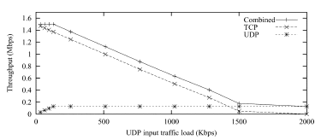
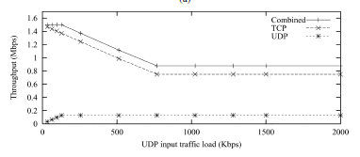
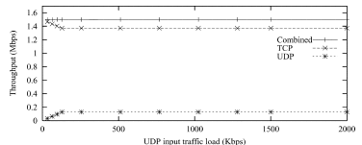
Congestion Collapse – Single Link
Notes:
With the dumbell, UL is FIFO only, congestion collapse is seen
UR is Fair queueing only, light throughput decrease
Bottom is NBP with FIFO, no congestion collapse, and UDP gets only its lowest link throughput

Slide 18
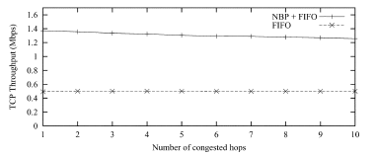
Congestion Collapse – Multi Links
Notes:
With a single TCP link and multiple crossing UDP streams, each udp stream is ideally limited to 128kbps each, linearly decreasing TCP with each added hop.

Slide 19
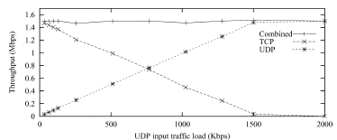
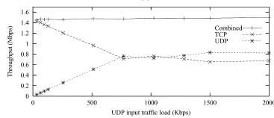
Fairness – Single Link
Notes:
Replace R2-E2 with a 10Mbps link, making ‘fair’ be 750/750.
Fifo doesn’t achieve this (UL)
NBP doesn’t achieve this (UR)
NBP and CSFQ achieves this (Bottom)

Slide 20
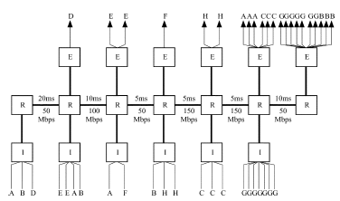
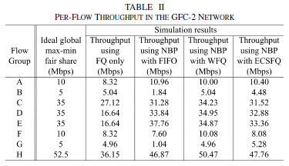
Fairness – Multi Link
Notes:
This layout is from the General Fairness Configuration designed to test traffic control algorithm fairness (22 UDP flows at 100Mb/s)

Slide 21
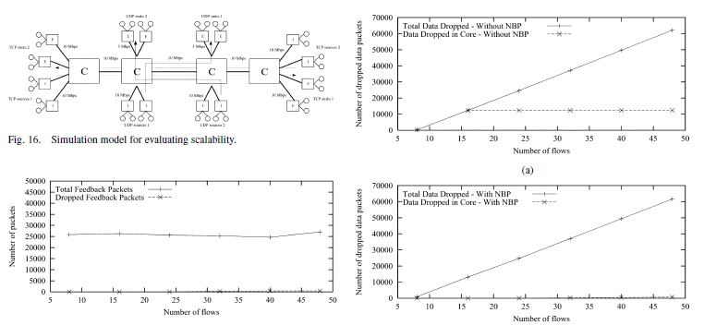
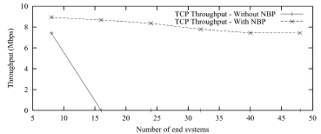
Scalability – Multiple Flows
Notes:
Two directional end-to end TCP flows, crossing UDP flows (at 5Mbps), everything else at 10Mbps
There are 4xB border routers, 4xBxF flows, where B is Border Routers per Core router and F is Flows per border router.
Feedback is independent of number of flows (overhead is constant relative to flows - feedback is generated according to number of packets admitted to the network)
NBP minimises the number of packets dropped in the core, as well, preventing congestion collapse (does this affect scalability? Is this a red herring?)
Additionally we see that throughput collapses without NBP even in this scaled scenario, so NBP hasn’t succumbed to scalability problems yet.

Slide 22
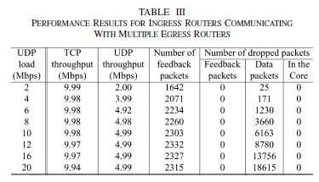
Scalability – Crossing Flows
Notes:
Ingress routers talking to multiple egress routers
Again, note that feedback packets are bounded on the speed of the network as a whole.

Slide 23
Questions
Is the out-of-order possibility really not a problem? They assert it isn’t and recommend future work to verify that assertion, but regrettably there’s no chart in the paper comparing ECSFQ and CSFQ.
Does this system work if not all subnets on a route implement it? If a router far down the line in a non-NBP subnet is the bottleneck, won’t we still get congestion collapse?

Slide 24
Raised Issues, Future Work
Flow classification overhead may become a concern, perhaps a coarser flow classification to reduce the number of macro-flows could be used.
Scalability problems may be further reduced by incorporating “trust”. “Trust” other subnets and accept their edge information, too.
NBP must be deployed over an entire edge at once.
Multicast greatly complicates the situation by breaking the “one flow->one egress” assumption.

Slide 25
Conclusion
This paper presented a possible solution to the problem of ‘congestion collapse’, the fact that fair queuing algorithms can only ‘look-backward’
NBP uses the idea of a circular communication in router coordination, rather than the one-way from ingress to core of CSFQ.
They included a large amount of experimental data to demonstrate their point.
Has scalability been fully addressed?
Notes:
It’s very hard, perhaps impossible to do a true scalability test. The writers say that a coarser flow classification

