Slide 1
Low-Power Interoperability for the IPv6 Internet of Things Adam Dunkels, Joakim Eriksson, Nicolas Tsiftes Swedish Institute of Computer Science Presenter - Bob Kinicki
Advanced Computer Networks
Fall 2014

Slide 2
Introduction
The Internet of Things is a current ‘buzz’ term that many see as the direction of the “Next Internet”.
This includes activities such as Smart Grid and Environmental monitoring.
This is a world of ubiquitous sensor networks that emphasizes energy conservation!
This paper provides an overview of the low-power IPv6 stack.

Slide 3
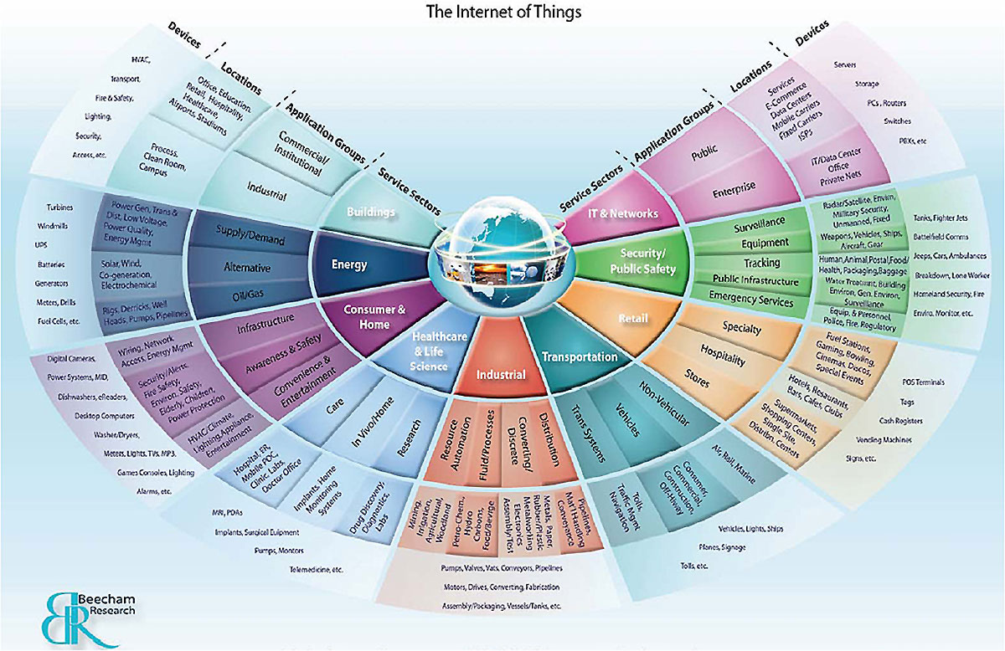
Internet of Things (IoT)

Slide 4
Steps for IoT Interoperability
1. Interoperability at the IPv6 layer
Contiki OS provides IPv6 Ready stack.
2. Interoperability at the routing layer
Interoperability between RPL implementations in Contiki and TinyOS have been demonstrated.
3. low-power interoperability
Radios must be efficiently duty cycled.
Not yet done!!

Slide 5
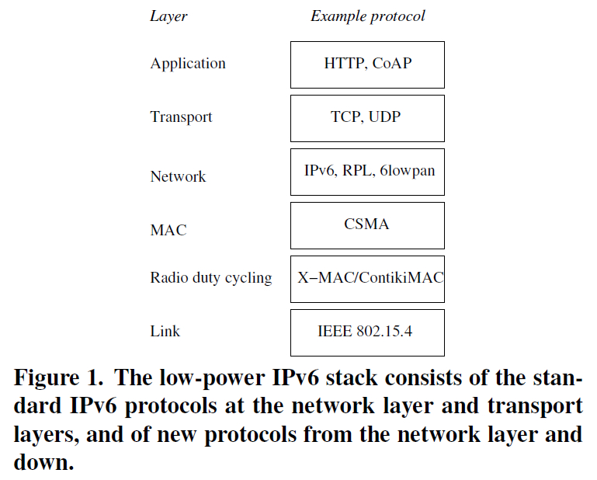
Low-Power IPv6 Stack
focus of
this paper

Slide 6
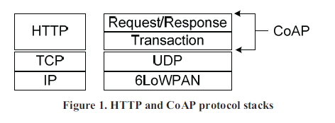
CoAP versus HTTP
Colitti et al.

Slide 7
CoAP Background [Colitti]
IETF Constrained RESTful environments (CoRE) Working Group has standardized the web service paradigm into networks of smart objects.
In the Web of Things (WOT), object applications are built on top of the REpresentationl State Transfer (REST) architecture where resources (objects) are abstractions identified by URIs.
The CORE group has defined a REST-based web transfer protocol called Constrained Application Protocol (CoAP).

Slide 8
CoAP
Web resources are manipulated in CoAP using the same methods as HTTP: GET, PUT, POST and DELETE.
CoAP is a subset of HTTP functionality re-designed for low power embedded devices such as sensors.
CoAP’s two layers
Request/Response Layer
Transaction Layer

Slide 9
CoAP
Request/Response layer :: responsible for transmission of requests and responses. This is where REST-based communication occurs.
REST request is piggybacked on Confirmable or Non-confirmable message.
REST response is piggybacked on the related Acknowledgement message.

Slide 10
CoAP
Transaction layer handles single message exchange between end points.
Four message types:
Confirmable – require an ACK
Non-confirmable – no ACK needed
Acknowledgement – ACKs a Confirmable
Reset - indicates a Confirmable message has been received but context is missing for processing.

Slide 11
CoAP
CoAP provides reliability without using TCP as transport protocol.
CoAP enables asynchronous communication.
e.g, when CoAP server receives a request which it cannot handle immediately, it first ACKs the reception of the message and sends back the response in an off-line fashion.
The transaction layer also supports multicast and congestion control.

Slide 12
COAP Efficiencies
CoAP design goals:: small message overhead and limited fragmentation.
CoAP uses compact 4-byte binary header with compact binary options.
Typical request with all encapsulation has a 10-20 byte header.
CoAP implements an observation relationship whereby an “observer” client registers itself using a modified GET to the server.
When resource (object) changes state, server notifies the observer.

Slide 13
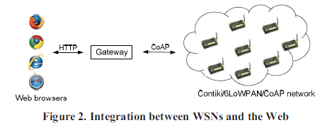
Accessing Sensor from Web Browser
Colitti et al.

Slide 14
IPv6 for Low-Power Wireless
IPv6 stack for low-power wireless follows IP architecture but with new protocols from the network layer and below.
6LowPAN adaptation layer provides header compression mechanism based on IEEE 802.15.4 standard to reduce energy use for IPv6 headers.
Also provides link-layer fragmentation and reassembly mechanism for 127-byte maximum 802.15.4 frame size.

Slide 15
IPv6 for Low-Power Wireless
IETF ROLL (Routing over Low-power and Lossy networks) group designed RPL (Routing Protocol for Low-power and Lossy networks) for routing in multi-hop sensor networks.
RPL optimized for many-to-one traffic pattern while supporting any-to-any routing.
Supporting different routing metrics, RPL builds a directed acyclic graph from the root node for routing.
Since CSMA and 802.15.4 are most common, the issue becomes the radio duty cycling layer.

Slide 16
Radio Duty Cycling Layer
To reduce idle listening, radio transceiver must be switched off most of the time.
Figures show ContikiMAC for unicast and broadcast sender {similar to X-MAC}.
ContikiMAC sender “learns” wake-up phase of the receivers.
Performance relationship between RPL and duty cycling layer yet to be studied.

Slide 17
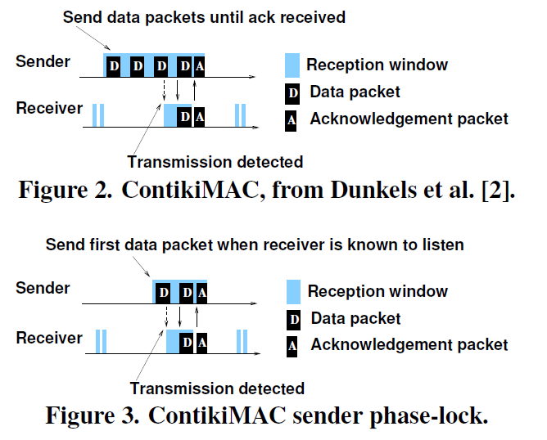
ContikiMAC Unicast

Slide 18
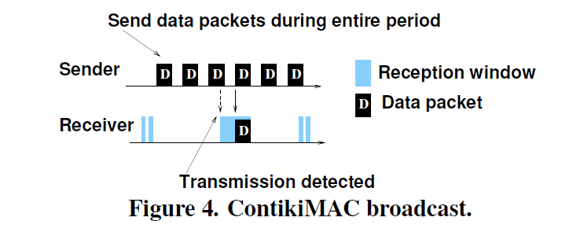
ContikiMAC Broadcast
ContikiMAC broadcast is the same as the A-MAC broadcast scheme.

Slide 19
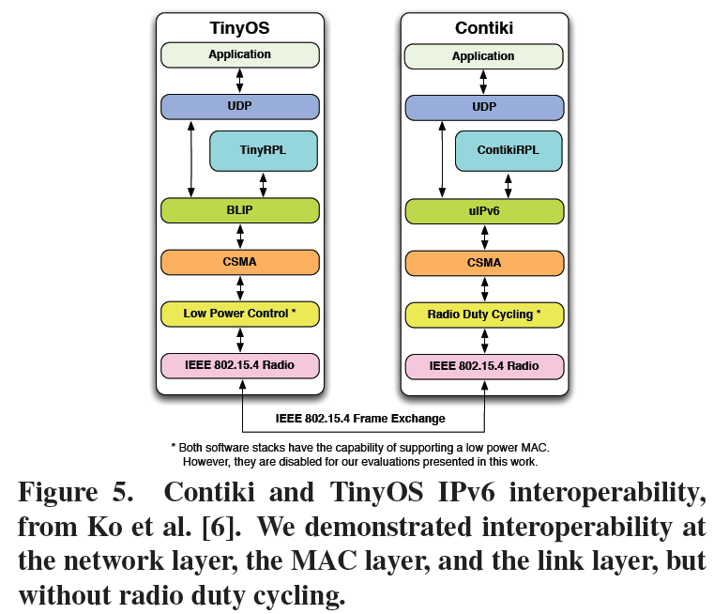
Interoperability
REST/CoAP
DTLS/UDP
IPSec/IPv6
Adding Security

Slide 20
Low-Power Interoperability
Interoperable radio duty cycling is essential!
Thus far interoperability demos have ONLY been with always-on radio layer.
Contiki simulation tool can be used to study challenges of low-power IPv6 interoperability.

Slide 21
Low-Power Interoperability
Three challenges:
1. Existing duty cycle mechanisms NOT designed for interoperability.
e.g., ContikiMAC and TinyOS BoX-MAC have no formal specifications.
2. Duty cycling is timing sensitive.
Makes testing of interoperability difficult.
3. Current testing done via physical meetings of separate protocol developers.

Slide 22
Conclusion
Attaining low-power interoperability for the Internet of Things is still an open problem because:
Existing protocols are not designed for duty cycling.
Existing duty cycling protocols are NOT designed for interoperability.

Slide 23
References
[Colitti] W. Colitti,K. Steenhaut and N. DeCaro, Integrating Wireless Sensor Networks with the Web, from Extending the Internet to Low Power and Lossy Networks (IP+SN 2011), Chicago, April 2011.

