Slide 1
Performance Comparison of Congested HTTP/2 Links
Brian Card, CS 577
12/7/2014

Slide 2
Outline
HTTP/1.1 and HTTP/2 Connections
Problem Statement
Experimental Setup
Results

Slide 3
HTTP/1.1 and HTTP/2 Connections

Slide 4
Background of HTTP
HTTP is the Hypertext Transfer Protocol, the underlying protocol of the Web
Major version of HTTP/1.1 was finalized in RFC 2616 in 1999
Why do we need a new version of HTTP?

Slide 5
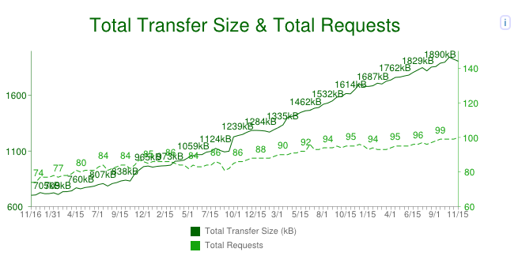
Speed!
Average website complexity is increasing!
Users expect more features and better performance at the same time!
Increasing capacity does not solve problem, latency has a significant affect on page load time

Slide 6
HTTP/1.1 – Connection Usage
HTTP/1.1 connections can request a single object at a time
But there are many objects in a webpage and some have dependencies
What happens if I want to parallelize downloads?
Need to open multiple TCP connections (usually max 6)
What happens if a less important object is downloaded first?
This is a problem
Head Of Line Blocking where a large unimportant file ‘clogs up’ the connection

Slide 7
Domain Sharding
Maximum of 6 connections per domain
Server
Client

Slide 8
Domain Sharding
Create More Domains!
Server
Server
Client
Server
Server

Slide 9
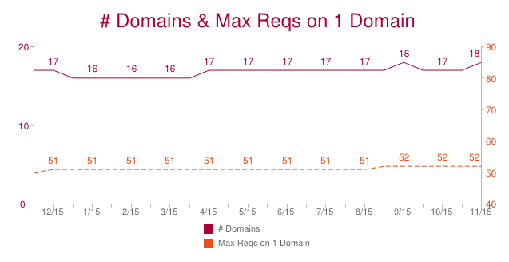
Domain Sharding
Average Number of Domains per website is 18!

Slide 10
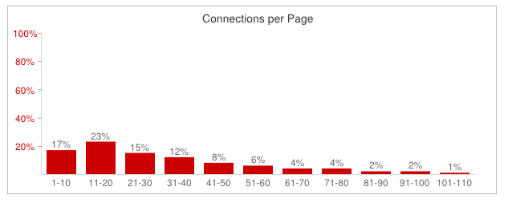
Domain Sharding
Average Number of (TCP) Connections per Page

Slide 11
Other HTTP/1.1 tricks
Inline files, (base64 encode an image, put it in CSS file)
Concatenate files (push all CSS files into a single file)
All trying to get the same amount of content to stream over a single connection or multiple simultaneous connections

Slide 12
HTTP/2 Multiplexed Streaming
Can stream multiple resources over the same connections
Resources are prioritized by specifying a dependency graph, no Head Of Line Blocking

Slide 13
HTTP/2 Multiplexed Streaming
Single TCP connection per domain
Up to 100 ‘Streams’ per TCP connection
Server
Client

Slide 14
Other features of HTTP/2
Header Compression
Binary Protocol (HTTP/1.1 is text)
Encryption Required
Server Push (Server can push resources uninitiated)

Slide 15
Problem Statement
But What About Congestion Control?

Slide 16
Congestion Control
HTTP/1.1 uses many connections
When a packet is dropped, only one connection goes into congestion avoidance
Throughput of a single connection is halved
HTTP/2 has one connection, when a packet is dropped the throughput of the entire download is halved
HTTP/2 connections may reach higher speeds faster, since new connections do not need to be created
If websites do not load faster, people won’t use HTTP/2

Slide 17
This Project
Quantify the effects of congestion control on HTTP/1.1 vs HTTP/2
Will HTTP/2 make domain sharding disappear?

Slide 18
Experimental Setup

Slide 19
Overview
Server 1
192.168.1.30
Server 2
192.168.1.31
HTTP
.
.
.
Server n
192.168.1.[n-1]
Web site hosted by multiple servers on a Virtual Machine. HTTP/1.1 and HTTP/2 servers are swapped out depending on experiment. Measure time to load page completely.
Virtual Box
Ubuntu VM

Slide 20
Setup Details
MacBook Air 10.8.5 Mountain Lion
http-server 0.7.4 (node.js)
nghttp 0.6.4 (supports draft-ietf-httpbis-http2-14)
VirtualBox 4.3.6
Ubuntu 14.04 LTS
Firefox Nightly 36.0a1
Network Link Conditioner (Late July 2012)
IP Aliasing to create multiple addresses

Slide 21
Setup Details (continued…)
http-server used as the HTTP/1.1 Server
nghttp used as the HTTP/2 server
Had to edit codebase to support multiple servers binding to different IP addresses on the same machine
Sample website is hosted by either server
Measure the time it takes to load under varying network conditions
TLS enabled on both web servers

Slide 22
Firefox Settings
Firefox network analyzer used to measure page load time
Nightly build has latest HTTP/2 support
Caching disabled:
about:config Setting | Value
network.http.spdy.enabled.http2 | true
network.http.spdy.enabled.http2draft | true
network.http.use-cache | false
browser.cache.offline.enabled | false

Slide 23
Sample Website
 | HTML | CSS | JavaScript | Images
 | 1*60KB | 1*60KB | 5*1KB | 10*1KB
 |  |  | 5*10KB | 10*5KB
 |  |  | 5*20KB | 20*20KB
 |  |  | 5*37KB | 5*40KB
 |  |  |  | 5*140KB
Total | 60KB | 60KB | 340KB | 1360KB | =1820KB

Slide 24
Sample Website (continued…)
Each file is mostly filled with comments to take up available space
Content is rendered ‘below the fold’
For sharded domains objects are distributed equally between domains
This ensures equal load between domains
In the real world, resources would typically be segregated by domains (images all on one set of domains)

Slide 25
Results

Slide 26
Results
‘Warm-up’ run used before collection results
eliminates some startup costs on servers
do not want to test implementation differences between http servers
Results are average of 3 runs

Slide 27
Varying Capacity in Ideal Conditions

Slide 28
Comparison of HTTP/2 vs HTTP/1.1

Slide 29
Comparison of HTTP/2 vs HTTP/1.1

Slide 30
Varying Capacity, 79ms of Delay

Slide 31
One Domain HTTP/2 vs 5 Domains HTTP/1.1

Slide 32
Increase In Performance for Increasing Domains in HTTP/2?

Slide 33
Loss for HTTP/1.1 and HTTP/2
Fixed Throughput at 5Mbps
Fixed Latency at 79ms
Varied Delay 1%, 2%, 5%, 10%
Last value for single domain HTTP/2 is ‘optimistic’; ran more than three runs and timeouts were occurring

Slide 34
Loss For HTTP/1.1 and HTTP/2

Slide 35
Conclusions
HTTP/2 has increased performance over HTTP/1 for non-congested links
Unclear if domain sharding will disappear with HTTP/2
Under high loss links, HTTP/2 performs significantly worse
HTTP/2 may not be ubiquitous, advantages for high bandwidth delay product links with no loss

