Slide 1
The ContikiMAC Radio Duty Cycling Protocol
Adam Dunkels
SICS Technical Report T2011:13
Presenter - Lingling Sun

Slide 2
Outline
Introduction
ContikiMAC Mechanism
Implementation of ContikiMAC
Evaluates of Energy Efficiency
Conclusion

Slide 3
Introduction
Contiki is an open source operating system for networked, memory-constrained systems with a particular focus on low-power wireless Internet of things devices. It was created by Adam Dunkels in 2002.
Radio Duty Cycling (RDC) mechanism specifies a predetermined method for communication between sleeping nodes. It allows nodes to sleep and periodically wake-up to check the medium activity.

Slide 4
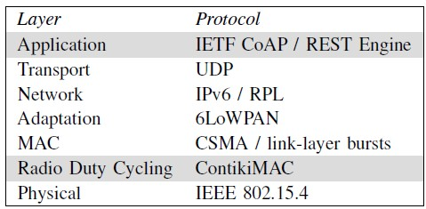
Introduction
ContikiMAC is a suitable and energy efficient RDC mechanism for sensor networks running Contiki.
Contiki Structure

Slide 5
Introduction
ContikiMAC has a power-efficient wake-up mechanism which is achieved by precise timing through a set of timing constraints.
ContikiMAC uses a fast sleep optimization to allow receivers to quickly detect false-positive wake-ups.
ContikiMAC uses a transmission phase-lock optimization to allow run-time optimization of the energy-efficiency of transmissions

Slide 6
ContikiMAC Mechanism

Slide 7
ContikiMAC Mechanism

Slide 8
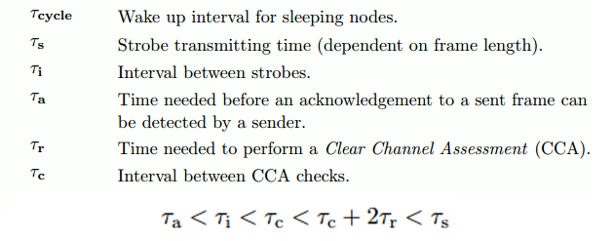
ContikiMAC Mechanism - Timing

Slide 9
ContikiMAC Mechanism – Fast Asleep

Slide 10
ContikiMAC Mechanism – Phase Lock

Slide 11
Implementation
The ContikiMAC implementation in Contiki 2.5 uses the Contiki real-time timers (rtimer) to schedule its periodic wake-ups.
The ContikiMAC wake-up mechanism runs as a protothread which performs the periodic wake-ups and implements the fast sleep optimization.
The phase-lock mechanism is implemented as a separate module from ContikiMAC which maintains a list of neighbors and their wake-up phases.
The neighbor is evicted from the list after a fixed number of failed transmissions or having no link layer ack within a fixed time.

Slide 12
Evaluation
Figure 7 shows the current draw of a ContikiMAC wake-up that did not result in any packet reception. In the lower graph, we see that the radio is turned on twice, to perform the two CCAs of the ContikiMAC wake-up.
Figure 8 shows a ContikiMAC wake-up where the second CCA detected spurious radio activity. The radio is then kept on for a while longer, until the fast sleep optimization turns off the radio.

Slide 13
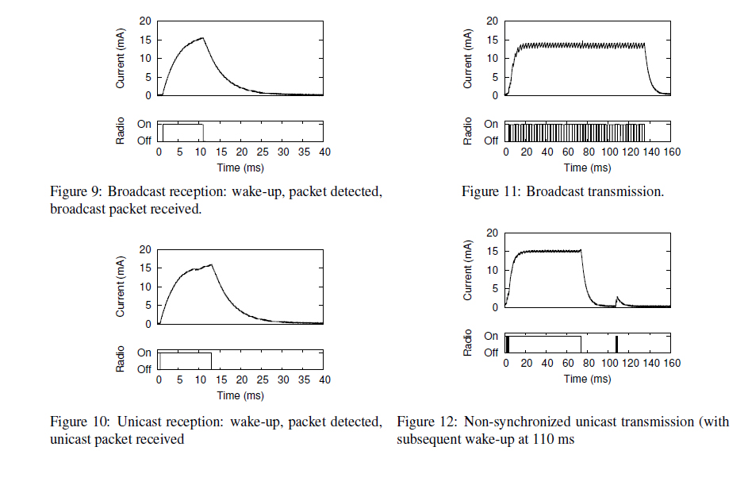
Evaluation

Slide 14
Evaluation - Micro Benchmarks

Slide 15
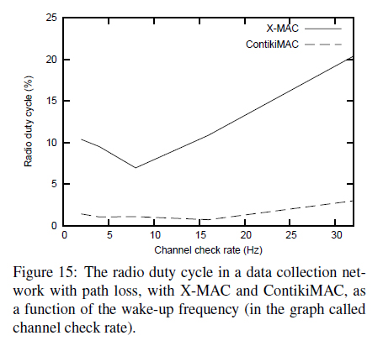
Evaluation – Power Consumption
We use the radio duty cycle: the portion of time in which the radio is on as indicator of radio power consumption
RDC choices for
MAC layer:
ContikiMAC
X-MAC
LPP
(Low-Power probing)
CX-MAC
(Compatibility X-MAC)
NULLRDC

Slide 16
Evaluation – Power Consumption
Figure 16 shows that the fast sleep and phase-lock optimizations significantly reduce power consumption.
Figure 17 shows that optimizations are more efficient in the face of loss. This is because of a phase-locked transmission being shorter than nonphase-locked transmissions, leading both to less energy being spent on transmissions and to less radio congestion.

Slide 17
Conclusion
The ContikiMAC uses a simple but elaborate timing scheme to allow its wake-up mechanism to be highly power efficient, a phase-lock mechanism to make transmissions efficient, and a fast sleep optimization to allow receivers to quickly go to sleep when faced with spurious radio interference.
The Measurements show that the energy cost of ContikiMAC mechanism is significantly lower than existing duty cycling mechanisms and that the phase-lock and fast sleep mechanisms reduce the network power consumption between 10% and 80%, depending on the wakeup frequency of the devices in the network.

Slide 18
Thank you.

