Slide 1
Compound TCP Summary (by Song, Zhang & Murari)
Advanced Computer Networks
CS577 – Fall 2013
WPI, Worcester.
Presented by Pankaj Didwania and Prof. Kinicki
Oct.8th, 2013

Slide 2
Compound TCP
Microsoft Algorithm
Introduced during Vista/2008 Server time
Addresses issues with standard TCP that fails in fast data transfer over high speed and long distance networks environments.
A combination of delay based and loss based approach is proposed in this paper.

Slide 3
Key Idea
Objective : Satisfy efficiency and TCP friendliness requirements simultaneously
Use scalable delay-based component into the standard TCP congestion avoidance algorithm
Rapid Window increase when network is under-utilized
Gracefully reduce the sending rate once the bottleneck queue is built

Slide 4
Architecture
Maintains two windows: cwnd and dwnd
win = min ( cwnd + dwnd, awnd)
cwnd: conventional congestion window, controls the loss-based component.
dwnd: new variable, controls the delay-based component.
awnd: advertised window from the receiver.

Slide 5
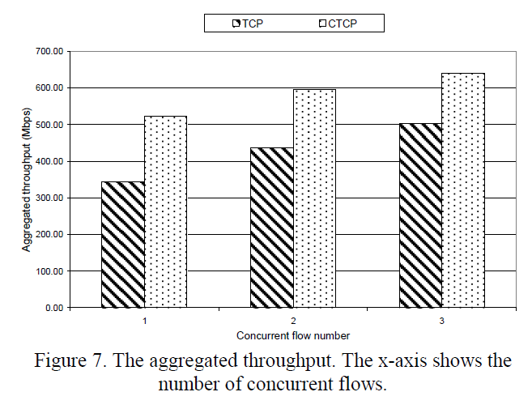
Conclusions
CTCP generally improves the throughput by 28% to 52% compared to regular TCP

Slide 6
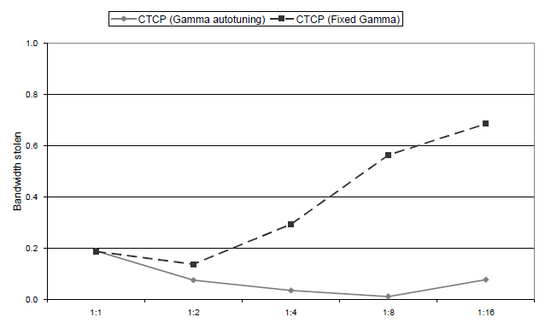
Conclusions
The bandwidth stolen of CTCP with and without gamma auto-tuning. The markers on x-axis, 1:n, mean that there are one regular flow and n CTCP flows
CS577: Compound TCP Summary
6

Slide 7
References:
Paper by Song, Zhang and Murari.
Review document : Eric Wang

