Slide 1
Towards MIMO-Aware 802.11n Rate Adaptation (Ioannis Pefkianakis, Suk-Bok Lee and Songwu Lu)
Advanced Computer Networks
CS577 – Fall 2013
WPI, Worcester.
Presented by Pankaj Didwania
Nov.5th, 2013

Slide 2
Intro…
Study of multiple-input–multiple-output (MIMO) 802.11n rate adaptation (RA) on a programmable access point (AP) platform.
Existing RA solutions offer much lower throughput than even a fixed-rate scheme.
All such RA algorithms are MIMO-mode oblivious.
They do not differentiate spatial diversity and spatial multiplexing modes.
Show that MIMO-mode aware designs outperform MIMO-mode oblivious RAs in various settings, with goodput gains up to 73.5% in field trials.

Slide 3
802.11n standard
MIMO: PHY uses multiple transmit and receive antennas to support two MIMO modes of operation.
- Spatial diversity: transmits a single data stream from each transmit antenna, leveraging the independent fading over multiple antenna links, to enhance signal diversity.
- Spatial multiplexing (SM) transmits independent and separately encoded spatial streams from each of the multiple transmit antennas to boost performance.

Slide 4
Experimental setting
Programmable AP platform which uses Atheros AR5416 2.4/5 GHz MAC/BB MIMO chipset.
AP supports SS and DS modes.
Available rates up to 130 and 300 Mb/s for 20- and 40-MHz channel operations respectively.
Frame aggregation with BlockAck (i.e., ACK for A-MPDU) feedback is supported as well.
AP has three available antennas.

Slide 5
Experimental setting…
802.11n clients used:
-Buffalo WLI-CB-AG300NH 802.11a/b/g/n wireless adapter based on Marvell 802.11n chipset
-Linksys WPC600N 802.11a/b/g/n
-Airport Extreme wireless adapters using Broadcom chipset
The results presented in this paper are from the Airport Extreme adapter, which supports up to 270-Mb/s rates.

Slide 6
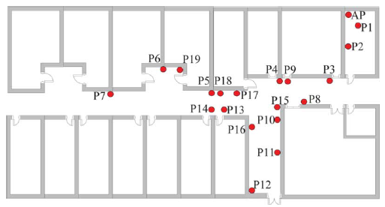
Campus Building Floor plan

Slide 7
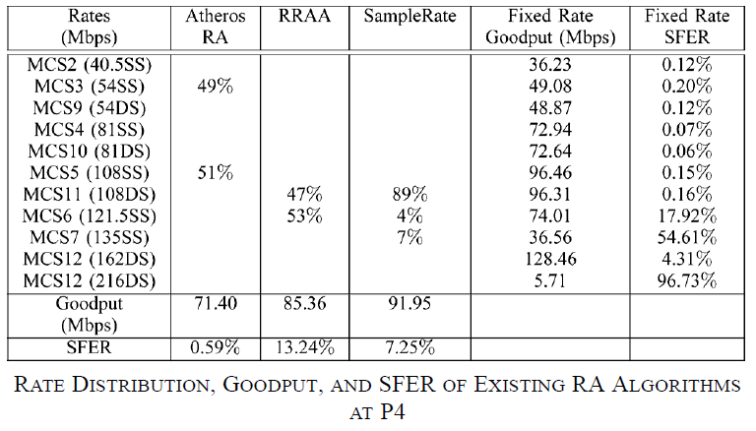
Existing Algorithms at P4
The goodput at the best fixed rate is 128.5 Mb/s, while Atheros RA gives 71.4 Mb/s, RRAA offers 85.4 Mb/s, and SampleRate gives 91.9 Mb/s. These results clearly indicate that the existing RA algorithms cannot be effectively applied in 802.11n networks.
CS577:MIMO aware 802.11n RA
7

Slide 8
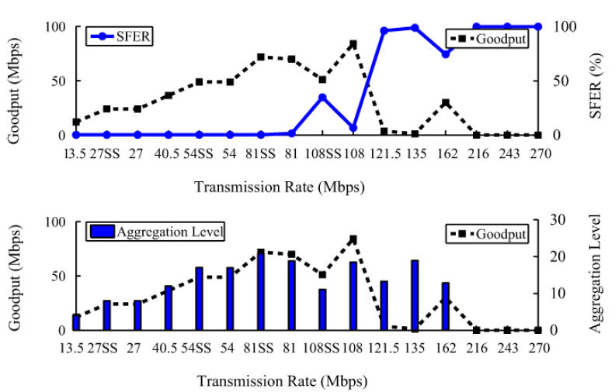
SFER versus transmission rate in 802.11n MIMO settings @P10
SFER nonmonotonicity in same cross-mode rates.

Slide 9
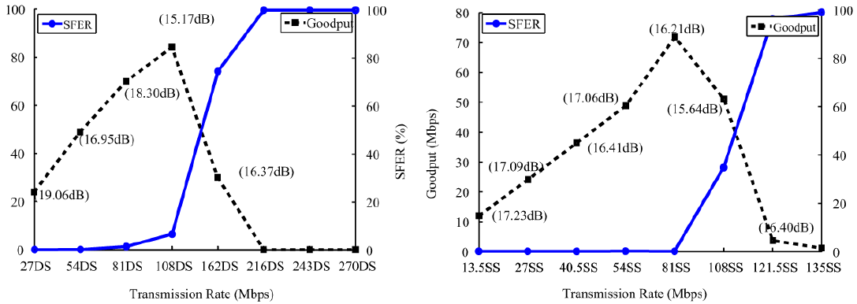
SFER versus transmission rate in 802.11n MIMO settings @P10
SFER monotonicity in DS mode (Left). SFER monotonicity in SS mode (Right).

Slide 10
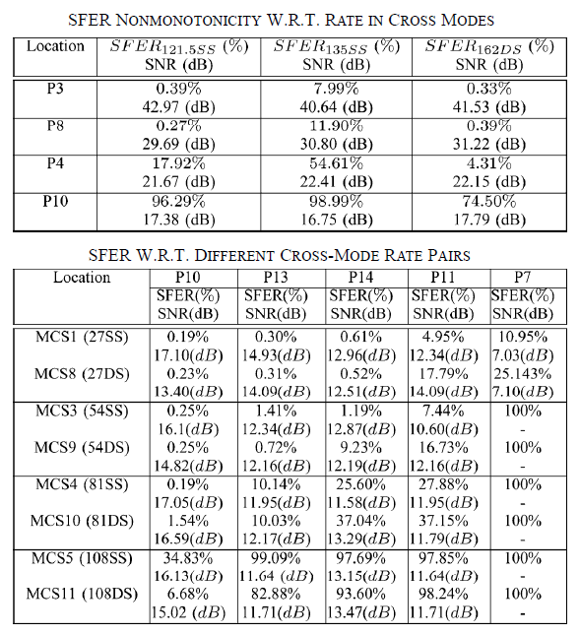
Comparison between SS and DS modes

Slide 11
SFER versus transmission rate in 802.11n MIMO settings @P10
SFER monotonicity in DS mode (Left). SFER monotonicity in SS mode (Right).

Slide 12
STUDYING MIMO CHARACTERISTICS IN 802.11n SYSTEMS
SFER (Subframe Error Rate) Nonmonotonicity in SS and DS
SS/DS Mode Selection
On Frame Aggregation

Slide 13
DESIGN
Zigzag RA: Intra- and Intermode RA
- How to decide which rates, in the same mode or across the mode, to probe.
- How to estimate the goodput based on the probing results while taking into account the effect of aggregation.
Handling Hidden Terminals
- Collision Detection
- Cost-Effective Collision Reaction

Slide 14
ALTERNATIVE DESIGNS FOR MIMO 802.11n RATE ADAPTATION
Window-Based 802.11n RA
- Sliding Window Best Rate Selection
- Best-Throughput Rate Selection
- Triggers for Window Movement
- Length of Window Movement
- Impact of Window Size:
- Adaptability Versus Probing Overhead
Other Design Options for MIMO RA

Slide 15
IMPLEMENTATION AND EVALUATION
Implementation
- Implemented MiRA in the firmware of a programmable AP platform (about 900 lines of C code)
Performance Evaluation
- With BlockAck (i.e., ACK for A-MPDU) feedback is supported as well.

Slide 16
IMPLEMENTATION AND EVALUATION contd….
1) Static Clients:
- UDP/3 3 Antennas/5-GHz Case:
- UDP/2 2 Antennas/5-GHz Case:
- TCP/3 3 Antennas/5-GHz Case:
- UDP/3 3 Antennas/2.4-GHz/40-MHz Case:
- UDP/3 3 Antennas/2.4-GHz/20-MHz Case:
- Effective Probing:
-Handling SFER NonMonotonicity:
2) Mobile Clients:
3) Setting With Hidden Terminals:
4) Field Trials:

Slide 17
IMPLEMENTATION AND EVALUATION contd….
Assessing MIMO RA Alternatives
- Window-Based RA Algorithm:
- Tuned Sample rate Algorithm:
- SNR-Based Mode Selection RA:
- RA Based on Fast MCS Feedback:

Slide 18
IMPLEMENTATION AND EVALUATION contd….

Slide 19
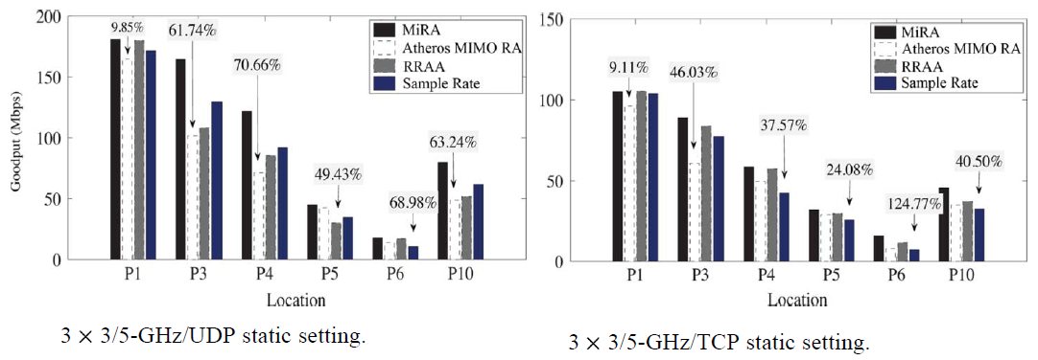
IMPLEMENTATION AND EVALUATION contd….

Slide 20
IMPLEMENTATION AND EVALUATION contd….

Slide 21
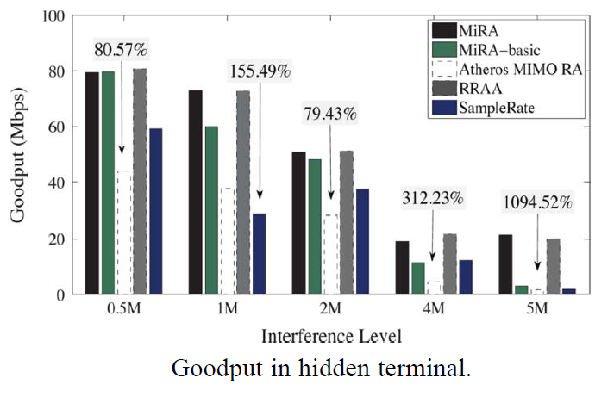
IMPLEMENTATION AND EVALUATION contd….

Slide 22
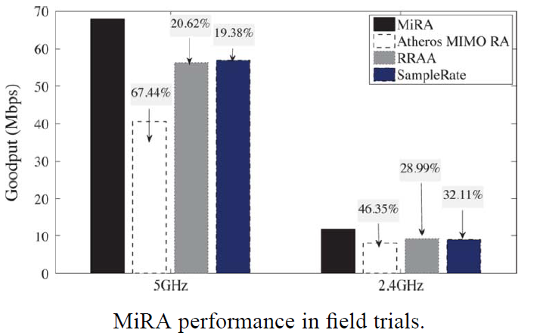
IMPLEMENTATION AND EVALUATION contd….

Slide 23
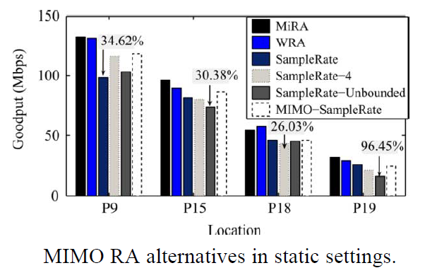
IMPLEMENTATION AND EVALUATION contd….

Slide 24
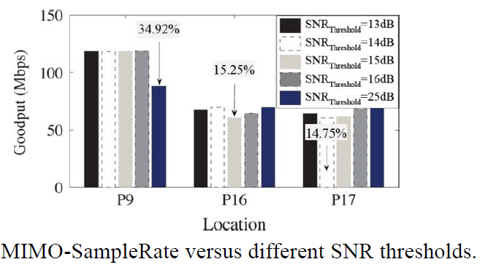
IMPLEMENTATION AND EVALUATION contd….

Slide 25
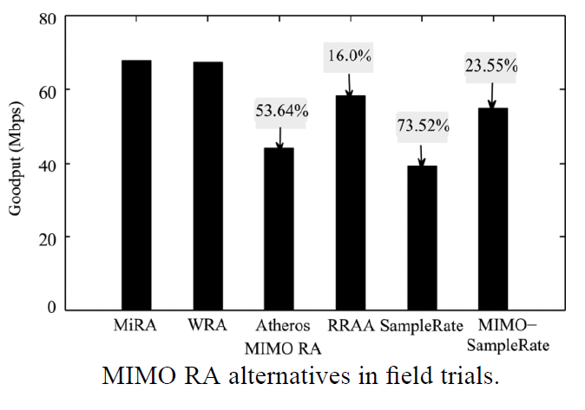
IMPLEMENTATION AND EVALUATION contd….

Slide 26
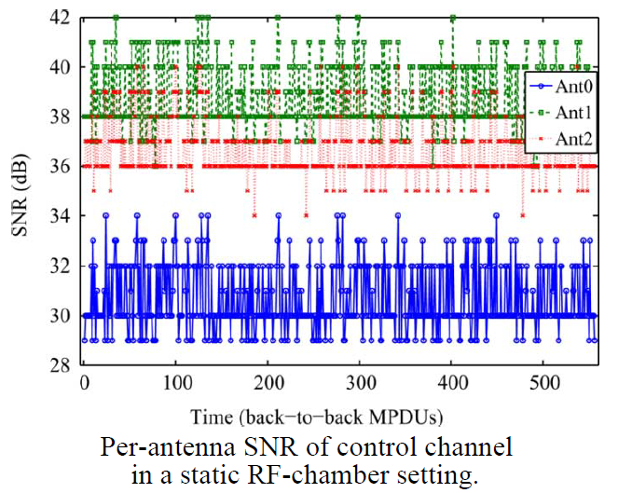
EVALUATION contd….

Slide 27
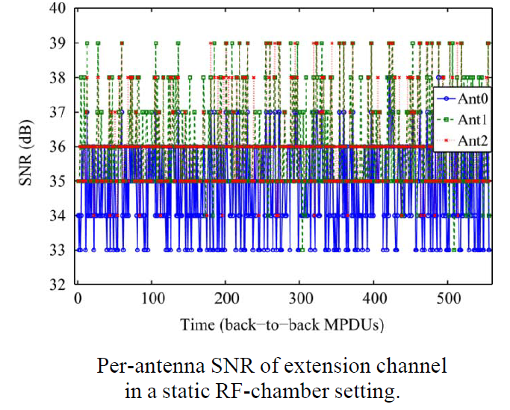
EVALUATION contd….

Slide 28
RELATED WORK
Many of the prior rate adaptation proposals target the legacy 802.11a/b/g networks or take a cross-layer approach by using PHY-layer feedback to select the best-goodput rate.
These algorithms are not designed for MIMO systems, and they do not consider MIMO modes and 802.11n frame aggregation.

Slide 29
Conclusion
Authors empirically study MIMO rate adaptation,using an IEEE 802.11n compliant, programmable AP platform.
Show that diversity-oriented SS mode and spatial multiplexing-driven DS mode exhibit different features and cannot be managed indistinctly.
Existing RA solutions do not properly consider characteristics of SS and DS, thus suffer severe performance degradation.
first propose MiRA, a new zigzag RA algorithm that explicitly adapts to the SS and DS modes in 802.11n MIMO systems.
Design and evaluate window-based and SNR-based MIMO RA solutions, experiments show clear gains of MIMO-mode-aware RAs.

Slide 30
References
Towards MIMO-Aware 802.11n Rate Adaptation by Ioannis Pefkianakis, Suk-Bok Lee, Songwu Lu.
Prof. Kinicki’s presentation from previous year at WPI.

Slide 31
Questions

