Slide 1
A Performance Comparison of Multi-Hop Wireless Ad Hoc Network Routing Protocols
Josh Broch, David A. Maltz, David B. Johnson, Yih-Chun Hu, Jorjeta Jetcheva
Presented by Qian HE (Steve)
CS 577 – Prof. Bob Kinicki

Slide 2
Outline
Introduction
Simulation Environment
Ad Hoc Network Routing Protocols
DSDV
TORA
DSR
AODV
Methodology
Simulation Results & Observations
Conclusions

Slide 3
Outline
Introduction
Simulation Environment
Ad Hoc Network Routing Protocols
DSDV
TORA
DSR
AODV
Methodology
Simulation Results & Observations
Conclusions

Slide 4
Introduction
What is ad hoc?
Ad hoc is a Latin phrase meaning "for this". It generally signifies a solution designed for a specific problem or task, non-generalizable, and not intended to be able to be adapted to other purpose.

Slide 5
Introduction
What is ad hoc network?
each mobile node operates not only as a host but also as a router
ad hoc routing protocol allows each node to discover “multi-hop” paths through the network to any other node
infrastructureless networking
dynamically establish routing

Slide 6
Outline
Introduction
Simulation Environment
Ad Hoc Network Routing Protocols
DSDV
TORA
DSR
AODV
Methodology
Simulation Results & Observations
Conclusions

Slide 7
Simulation Environment
ns
Node mobility
A realistic physical layer including:
a radio propagation model
supporting propagation delay
capture effects
carrier sense
Radio network interfaces with properties such as:
transmission power
antenna gain
receiver sensitivity
IEEE 802.11 MAC protocol using DCF

Slide 8
Some details on simulation
Attenuates the power of a signal:
1/r² at short distance
1/r⁴ at long distance
Reference distance
100 meters for outdoor
low-gain antennas 1.5 m above the ground plane
operating in the 1–2 GHz band
ARP
50 packets with drop-tail

Slide 9
Outline
Introduction
Simulation Environment
Ad Hoc Network Routing Protocols
DSDV
TORA
DSR
AODV
Methodology
Simulation Results & Observations
Conclusions

Slide 10
Ad Hoc Network Routing Protocols
Improvements to all of the protocols:
To prevent synchronization, periodic broadcasts and packets sent in ACK were jittered using a random delay uniformly distributed between 0 and 10 milliseconds.
To insure that routing information propagated in a timely fashion, routing packets were queued for transmission at the head of the network interface.
Each of the protocols use link breakage detection feedback from the 802.11 MAC (except for DSDV).

Slide 11
Outline
Introduction
Simulation Environment
Ad Hoc Network Routing Protocols
DSDV
TORA
DSR
AODV
Methodology
Simulation Results & Observations
Conclusions

Slide 12
Destination-Sequenced Distance Vector (DSDV)
DSDV is a hop-by-hop distance vector routing protocol requiring:
each node periodically broadcast routing updates
it guarantees loop-freedom (traditional DV doesn’t)
Based on the Bellman-Ford algorithm

Slide 13
DSDV
Each node maintains a routing table listing the “next hop” for each reachable destination.
DSDV tags each route with a sequence number. (the higher, the better)
Each node in the network advertises a monotonically increasing even sequence number for itself.
Each node periodically broadcasts update.

Slide 14
DSDV Implementation
Does not use link layer breakage detection.
Uses both full and incremental updates.
Trigger an update when:
receipt of a new sequence number for a destination will cause a triggered update (DSDV-SQ)
receipt of a new metric (simply DSDV).

Slide 15
Constants in DSDV

Slide 16
Outline
Introduction
Simulation Environment
Ad Hoc Network Routing Protocols
DSDV
TORA
DSR
AODV
Methodology
Simulation Results & Observations
Conclusions

Slide 17
Temporally-Ordered Routing Algorithm (TORA)
A distributed routing protocol based on a “link reversal” algorithm.
Discovers routes on demand.
Provides multiple routes to a destination.
Minimizes communication overhead by localizing algorithmic reaction to topological changes.
Route optimality is considered of secondary importance.
Longer routes are often used to avoid the overhead of discovering newer routes (what?!).

Slide 18
TORA
Start: when a node needs a route to a particular destination, it broadcasts a QUERY packet.
Propagate: QUERY packet stops at the destination or an intermediate node having a route to the destination.
Response: the recipient then broadcasts an UPDATE packet listing its height with respect to the destination.
End: each node that receives the UPDATE sets its height to a value greater than it received.

Slide 19
TORA Example
Node C requires a route, so it broadcasts a QRY
University of Luxembourg, SECAN-Lab

Slide 20
TORA Example
The QRY propagates until it hits a node which has a route to the destination
University of Luxembourg, SECAN-Lab

Slide 21
TORA Example
The UPD is also propagated, while node E sends a new UPD
University of Luxembourg, SECAN-Lab

Slide 22
TORA Example
Finally, every node gets its height
University of Luxembourg, SECAN-Lab

Slide 23
TORA
TORA can be described in terms of water flowing downhill towards a destination node through a network of tubes that models the routing state of the real network.

Slide 24
TORA Implementation
TORA is layered on top of IMEP (Internet MANET Encapsulation Protocol).
IMEP attempts to aggregate many TORA and IMEP control together into a single packet.
Each IMEP node periodically transmits a BEACON, which is answered by each node hearing it with a HELLO.
Uses ARP instead of IMEP in network layer address resolution.

Slide 25
TORA Implementation
Balance overhead and routing protocol convergence:
aggregate HELLO and ACK packets for a time uniformly chosen between 150 ms and 250 ms.
Does not delay TORA routing messages for aggregation.
* transmission delay of TORA routing messages + any queuing delay at the network interface, allows these routing loops to last long enough that significant numbers of data packets are dropped.

Slide 26
Constants in TORA

Slide 27
Outline
Introduction
Simulation Environment
Ad Hoc Network Routing Protocols
DSDV
TORA
DSR
AODV
Methodology
Simulation Results & Observations
Conclusions

Slide 28
Dynamic Source Routing (DSR)
DSR uses source routing rather than hop-by-hop routing. Each packet carries an ordered list of nodes, which the packet must pass.
intermediate nodes do not need to maintain up-to-date routing information in order to route the packets.
periodic route advertisement and neighbor detection packets are not needed.
DSR protocol consists of two mechanisms:
Route Discovery
Route Maintenance.

Slide 29
DSR - Route Discovery
Start: the source node broadcasts a REQUEST packet that is flooded through the network. (same as TORA, except the content of REQUEST).
Propagate: the destination node or another node that knows a route to the destination will answer with a REPLY. (same as TORA, except the content of REPLY).

Slide 30
DSR – Route Discovery
Request:
(source, request, {hops})
University of Luxembourg, SECAN-Lab

Slide 31
DSR – Route Discovery
Reply:
(source, request, route)
University of Luxembourg, SECAN-Lab

Slide 32
DSR - Maintenance
Detects when the topology of the network has changed:
source node is notified with a ROUTE ERROR packet.
Decides:
if an alternative route can be used.
if the Route Discovery protocol must be started to find a new path.

Slide 33
DSR Implementation
Discovers only routes composed of bidirectional links
by requiring nodes to return ROUTE REPLY messages to where ROUTE REQUEST packet came.
A node sends a ROUTE REQUEST with TTL=0. If this non-propagating search times out, it will send a propagating ROUTE REQUEST.

Slide 34
Constants in DSR

Slide 35
Outline
Introduction
Simulation Environment
Ad Hoc Network Routing Protocols
DSDV
TORA
DSR
AODV
Methodology
Simulation Results & Observations
Conclusions

Slide 36
Ad Hoc On-Demand Distance Vector (AODV)
AODV is essentially a combination of both DSR and DSDV.
It borrows the basic on-demand mechanism of Route Discovery and Route Maintenance from DSR.
It uses hop-by-hop routing, sequence numbers, and periodic beacons from DSDV.

Slide 37
AODV
Start & propagate: same as DSR, except the REQUEST contains the last known sequence number for that destination.
Response: when the REQUEST reaches a node with a route to D, it generates a REPLY that contains:
the number of hops necessary to reach D
the sequence number for D most recently seen it.
End: Each node that participates in forwarding this REPLY back toward S, creates a forward route to D by remembering only the next hop (same as DSDV).

Slide 38
AODV - Maintenance
Each node periodically transmit a HELLO message with a default rate of once per second.
Failure to receive three consecutive HELLO messages from a neighbor ?= the neighbor is down.
Alternatively, may use physical layer or link layer methods to detect link breakages.
UNSOLICITED REPLY containing an infinite metric for that destination will be sent to any upstream node that has recently forwarded packets to a destination using that link.

Slide 39
AODV Implementation
also implemented a version of AODV that we call AODV-LL (link layer), using only link layer feedback from 802.11 as in DSR.
Changed AODV implementation to use a shorter timeout of 6 seconds before retrying a REQUEST for which no REPLY has been received (RREP WAIT TIME).

Slide 40
Constants in AODV

Slide 41
Outline
Introduction
Simulation Environment
Ad Hoc Network Routing Protocols
DSDV
TORA
DSR
AODV
Methodology
Simulation Results & Observations
Conclusions

Slide 42
Methodology
The overall goal of our experiments was to measure the ability of the routing protocols to react to network topology changes while continuing to successfully deliver data packets to their destinations.

Slide 43
Methodology
50 wireless nodes, moving about over a rectangular (1500m * 300m) flat space, simulated 900 s
210 different scenario files with varying movement patterns and traffic loads
Physical radio characteristics: Lucent WaveLAN direct sequence spread spectrum radio.

Slide 44
Methodology
Movement Model
Communication Model
Scenario Characteristics
Metrics

Slide 45
Movement Model
“random waypoint” model
begins by remaining stationary for a pause time
selects a random destination
moves to that destination at a speed distributed uniformly 0~MAX
upon reaching, pauses again for a pause time
repeats from 2

Slide 46
Movement Model
7 different pause times: 0, 30, 60, 120, 300, 600, and 900 s.
70 different movement patterns, 10 for each value of pause time
2 different maximum speeds:
20 m/s
1 m/s

Slide 47
Methodology
Movement Model
Communication Model
Scenario Characteristics
Metrics

Slide 48
Communication Model
Constant Bit Rate (CBR)
sending rates of 1, 4, and 8 packets per second
networks containing 10, 20, and 30 CBR sources
packet sizes of 64 and 1024 bytes
did not use TCP (because it’s so GOOD!!)

Slide 49
Methodology
Movement Model
Communication Model
Scenario Characteristics
Metrics

Slide 50
Scenario Characteristics
An internal mechanism of the simulator calculates the shortest path between the originated packet’s sender and its destination.
The shortest path is calculated based on a range of 250m for each radio without congestion and interference.
The average hops is 2.6, and the farthest is 8.

Slide 51
Scenario Characteristics

Slide 52
Scenario Characteristics

Slide 53
Methodology
Movement Model
Communication Model
Scenario Characteristics
Metrics

Slide 54
Metrics
Packet Delivery Ratio
the ratio between the number of packets originated and number of packets received
Routing Overhead
the total number of routing packets transmitted during the simulation (each hop counts)
Path Optimality
the difference between the number of hops a packet took and the length of the shortest path

Slide 55
Outline
Introduction
Simulation Environment
Ad Hoc Network Routing Protocols
DSDV
TORA
DSR
AODV
Methodology
Simulation Results & Observations
Conclusions

Slide 56
delivery ratio - pause time
20 sources

Slide 57
overhead - pause time
20 sources

Slide 58
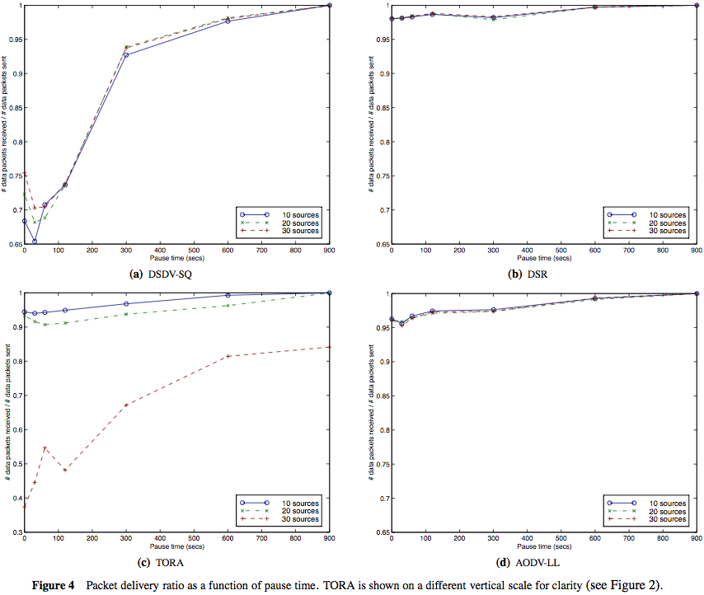
delivery ratio - pause time

Slide 59
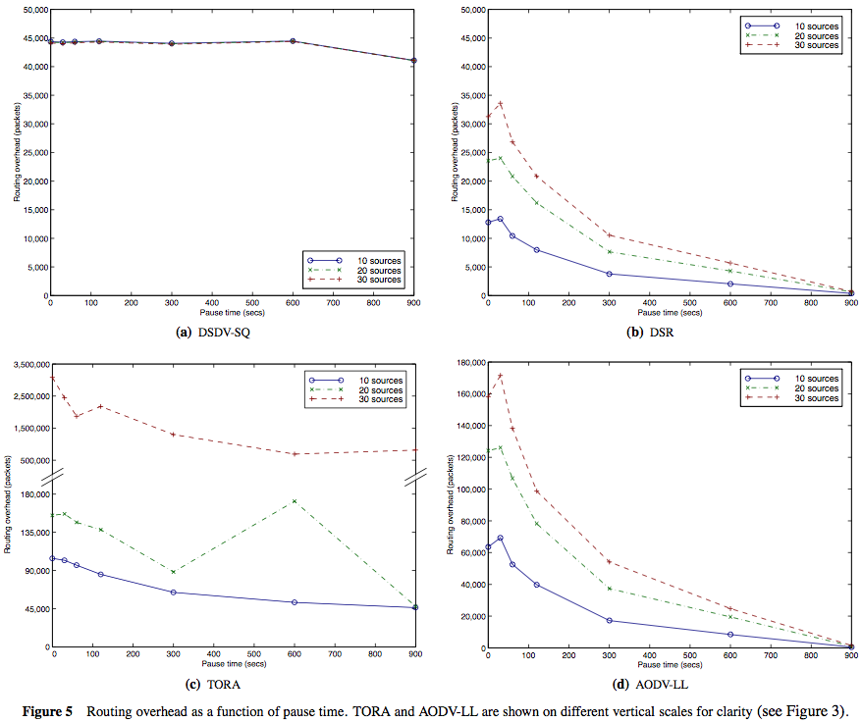
overhead – pause time

Slide 60
difference from shortest
20 sources

Slide 61
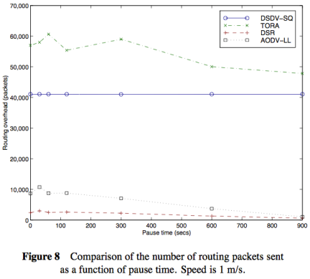
Lower Speed of Node Movement
1 m/s, 20 sources

Slide 62
Overhead in Source Routing Protocols
measured in bytes
includes the bytes of the source route header that DSR places in each packet

Slide 63
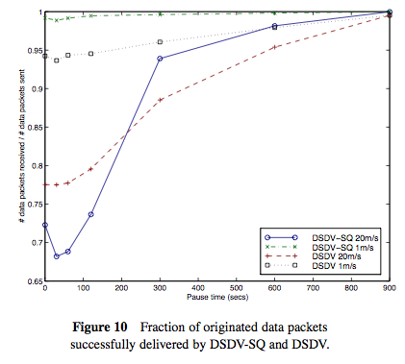
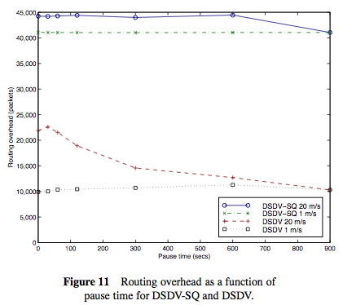
DSDV vs. DSDV-SQ

Slide 64
Outline
Introduction
Simulation Environment
Ad Hoc Network Routing Protocols
DSDV
TORA
DSR
AODV
Methodology
Simulation Results & Observations
Conclusions

Slide 65
Conclusions
This paper:
provides an accurate simulation of the MAC and physical-layer behavior of the IEEE 802.11 wireless LAN standard with modifications to the ns network simulator. (a powerful tool)
detailed packet-level simulation comparing DSDV, TORA, DSR, and AODV
Each of the protocols studied performs well in some cases yet has certain drawbacks in others.

Slide 66
Conclusions
DSDV
performs quite predictably, delivering virtually all data packets when node mobility rate and movement speed are low
failing to converge as node mobility increases.

Slide 67
Conclusions
TORA
the worst performer in routing packet overhead.
still delivered over 90% of the packets in scenarios with 10 or 20 sources.
at 30 sources, the network was unable to handle all of the traffic generated by the routing protocol and a significant fraction of data packets were dropped.

Slide 68
Conclusions
DSR
very good at all mobility rates and movement speeds.
its use of source routing increases the number of routing overhead bytes required by the protocol.

Slide 69
Conclusions
AODV
performs almost as well as DSR at all mobility rates and movement speeds.
accomplishes its goal of eliminating source routing overhead.
but still requires the transmission of many routing overhead packets and at high rates of node mobility is actually more expensive than DSR.

Slide 70
Brief Conclusions
TORA was the worst.
DSR was the best.
DSDV performs well when load and mobility is low, poorly as mobility increases.
AODV performs nearly as well as DSR, but has high overhead at high mobility levels.
Borrowed from MOBICOM 1998 Dallas, Texas

Slide 71
Q & A
Thanks

