Slide 1
Design and Evaluation of a Versatile and Efficient Receiver-Initiated Link Layer for Low-Power Wireless
Prabal Dutta, Stephen Dawson-Haggerty, Yin Chen,
Chieh-Jan (Mike) Liang, and Andreas Terzis
Presented by Lianmu Chen

Slide 2
Outline
Introduction
A-MAC Design Overview
Implementation Details
Backcast Evaluation
Macrobenchmark Evaluation
Conclusions

Slide 3
Introduction

Slide 4
A receiver-initiated MAC
Sender
Listen
P
D
Receiver
P
D

Slide 5
Benefits
Handle hidden terminals better than sender-initiated ones
Support asynchronous communication w/o long-preambles
Support extremely low duty cycles or high data rates
Support many low-power services
Wakeup
Discovery
Unicast
Broadcast
Pollcast
Anycast

Slide 6
Drawbacks
Probe (LPP) is more expensive than channel sample (LPL)
Baseline power is higher
Frequent probe transmissions
Could congest channel & increase latency
Could disrupt ongoing communications
Channel usage scales with node density rather than traffic
Services use incompatible probe semantics
Makes concurrent use of services difficult
Supporting multiple, incompatible probes increases power

Slide 7
Is it possible to design a general-purpose,
yet efficient, receiver-initiated link layer?

Slide 8
A-MAC Design Overview

Slide 9
A-MAC communication over 802.15.4
RXTX turnaround time: 192 µs
Max data packet
4.256 ms
Sender
Listen
P
A
DATA
P
Receiver
P
A
DATA
P
ACK transmission time 352 µs

Slide 10
A-MAC’s contention mechanism
Node 1
Sender
Listen
P
A
D
P-CW
BO
Node 2
Receiver
P
A
D
P-CW
D
Node 3
Sender
Listen
P
A
D
P-CW
D
Backcast
frame collision

Slide 11
A-MAC Communications
Benefits:
Save energy:
(1)only has to wait marginally longer than the radio’s RX/TX turnaround time;
(2)IEEE 802.15.4 standard, a turnaround occurs in 192 μs, nearly 20 times
faster than the 3.75 ms beacon-data turnaround time that RI-MAC requires
with its software based protocol processing
Distinguish between collisions and interference
Therefore, A-MAC is far less susceptible to interference based false alarms
than either LPL or RI-MAC.

Slide 12
Implementation Details

Slide 13
Problems
Overreacting:
-a sender will auto-ack every probe it receives, including probes from neighbors for which the
sender has no pending traffic.
Against Standards
-the IEEE 802.15.4-2006 standard specifically prohibits this behavior, any frame that is
broadcast shall be sent with its Acknowledgment Request subfield set to zero.
Mixed radio support
- because this behavior is prohibited, it enjoys somewhat mixed radio support: while the
CC2420 [34] radio and AT86RF230 [3] radio Rev A silicon both support broadcast auto-acks,
the Rev B silicon “fixes” this standards non-compliance and does not auto-ack broadcast
frames.

Slide 14
Unicast Communications
DST=0x0002
SRC=0x0001
SEQ=0x23
MAC=0x8002
MAC=0x8002
Node 1
(Sender)
Listen
P
A
D
P
Listen
P
A
D
P-CW
BO
Node 2
(Receiver)
P
A
D
P
L
P
A
D
P-CW
D
DST=0x8002
SRC=0x0002
DST=0x8002
SRC=0x0002
ACK=0x0023
FRM=0x0001
Node 3
(Sender)
MAC=0x8002
Listen
P
A
D
P-CW
D
Backcast
frame collision

Slide 15
Broadcast Communications
Broadcast Communications
A-MAC broadcast design is identical to Unicast, with an important diference: sender disables hardware address recognition but keeps hardware auto-acks enabled
In this way, sender will auto-ack every probe it receives and it will send the data packet like in the unicast case

Slide 16
Backcast Evaluation

Slide 17
Methodology
Two important metrics:
Received signal strength indicator (RSSI)
Signal strength, measured by the radio over the first eight symbols of an
acknowledgment (ACK) frame
Signal quality (LQI)
measured by the radio over the first eight symbols and is reported as a
7-bit unsigned integer that can be viewed as the average correlation
value or chip error rate (values near 100 indicate an excellent link).

Slide 18
Large scale performance
Figure 7. The effect on LQI as the number of concurrent ACKs increases from 0 to 94 in a typical indoor deployment setting. The median value of LQI falls quickly for the first six nodes and then falls slowly. Beyond approximately 30 nodes, the LQI values stabilize at approximately 100. The data suggest that even in the presence of a large number of ACK collisions, the receiver can successfully decode the ACK frame. Note the y-axis ranges from 74 to 106.
Conclusion: The statistical superposition of an increasing number of signals does not lead to destructive interference, making backcast a robust synchronization primitive.

Slide 19
Robustness to External Interference
Table 1. The effect of interference on idle listening current in an office environment using three different synchronization schemes

Slide 20
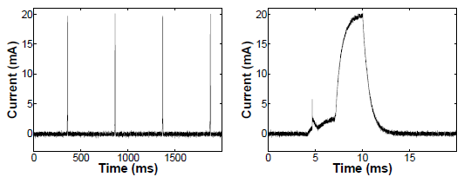
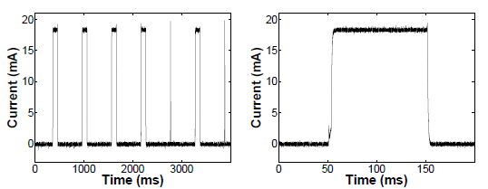
Robustness to External Interference
Figure 10. LPL preamble sampling techniques leave receivers susceptible to noisy wireless environments, such as those caused by 802.11 interference.
Figures (a) and (b) show the macroscopic and microscopic behavior of the TinyOS 2.1sampling algorithm when the channel is clear: the receiver immediately returns to sleep. Figures (c) and (d) show the macroscopic and microscopic behavior while a file transfer is in progress using a nearby 802.11 access point. Of the seven channel samples visible in this trace, five are unnecessarily lengthened due to channel noise.

Slide 21
Macrobenchmark Evaluation

Slide 22
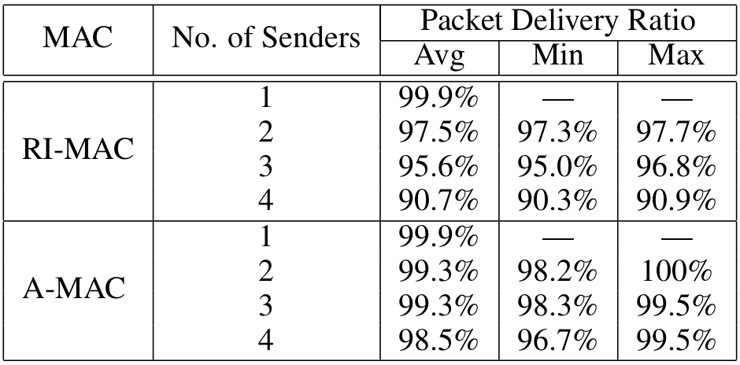
Multiple Contending Unicast Flows
Table 2 shows between one and four senders contending to transmit to a single receiver for both RI-MAC and A-MAC.

Slide 23
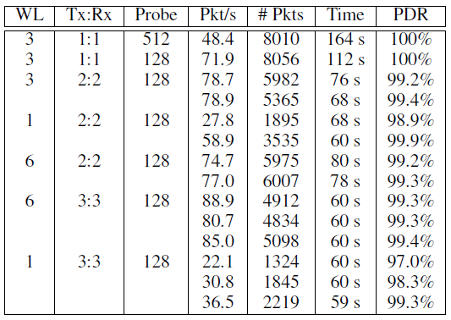
Multiple Parallel Unicast Flows
S
R
S
R
S
R
Collision
Domain
Table 3 shows A-MAC throughput and packet delivery ratio as a function of
the number of different whitelisted channels that are available for use,
the number of sender:receiver pairs transferring data concurrently,
and the receivers’ probe interval.

Slide 24
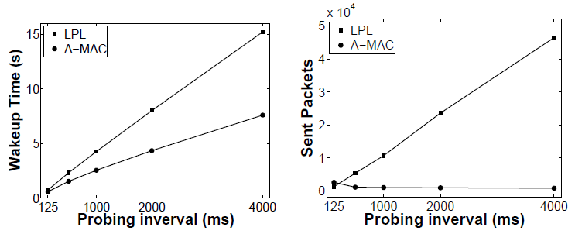
Asynchronous Network Wakeup
Faster Wakeup
Fewer Packets
LPL (Flash)
LPL (Flash)
A-MAC
A-MAC
Figure 11 shows the wakeup times of 59 nodes in a multihop
testbed across a range of sampling/probing intervals.

Slide 25
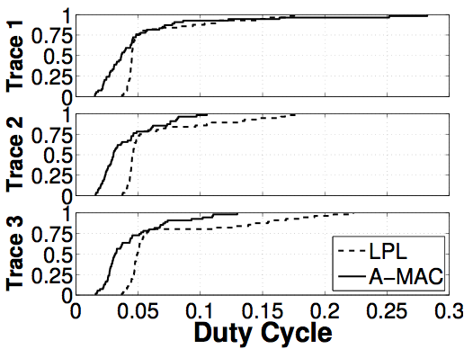
Collection Tree Protocol Performance
N = 59 Tdata = 60 s Tprobe = 500 ms
Table 4. CTP performance over LPL and A-MAC.
(a) CDF of CTP Duty Cycles

Slide 26
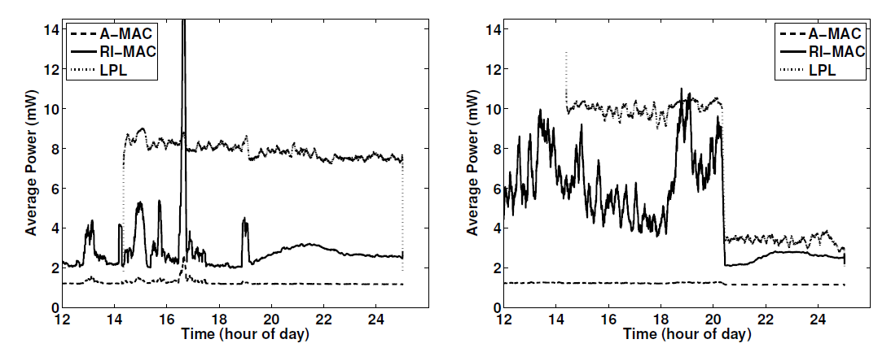
Inference Vulnerability
Channel 18
Channel 26
Sampling
Sampling
Probing
Probing
Backcast
Backcast

Slide 27
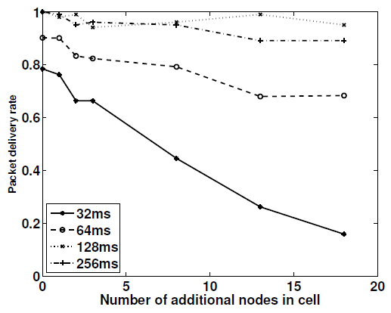
Effect of Density on Packet Delivery
Same collision domain (between 0, 1, 2, 3, 8, 13, and 18) who simply transmit probes with varying probe periods (32 ms, 64 ms, 128 ms,
and 256 ms)

Slide 28
Conclusion
Backcast provides a new synchronization primitive
Common abstraction underlying many protocols
Can be implemented using a DATA/ACK frame exchange
Works even with a 8, 12, 94 colliding ACK frames
Faster, more efficient, and more robust than LPL, LPP
A-MAC augments Backcast to implement
Unicast
Broadcast
Network wakeup
Robust pollcast
Results show
Higher packet delivery ratios
Lower duty cycles
Better throughput (and min/max fairness)
Faster network wakeup
Higher channel efficiency

Slide 29
Thank you
Questions？

