Slide 1
Understanding and Mitigating the Impact of RF Interference on 802.11 Networks Ramakrishna Gummadi ucs David Wetherall Intel Research Ben Greenstein University of Washington Srinivasan Seshan cmu
Presented by;
Andrew Keating
Murad Kaplan

Slide 2
outline
Introduction
802.11 Background
Experimental Setup
Causes and Effects of Interference
Modeling Interference Effects
Rapid Channel Hopping
Conclusion

Slide 3
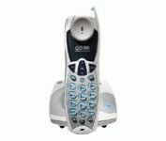
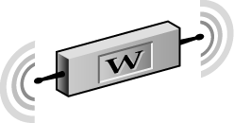
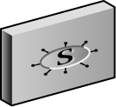
Introduction
Wireless Technology
An alternative to wired
networks in enterprises.
Enable mobility.
Provide city-wide
internet access.
Problem:
Vulnerable to RF (Radio
Frequency) interference.
Access Point
BSS
BSS
BSS

Slide 4
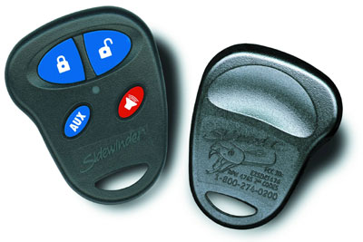
Introduction (cont’d)
Problem (who to consider)
Selfish interferers e.g. Zigbee
nodes and cordless phones.
Malicious interferers e.g.
Wireless jammers.

Slide 5
Introduction (cont’d)
Motivations:
Explore the impact of interference on 802.11 links and to develop techniques that make 802.11 more resistant to interference.
Experimental results confirm anecdotal evidence that a range of selfish and malicious interferers (802.11 waveforms, Zigbee, a wireless camera jammer, a cordless phone) cause 802.11 performance to degrade much more significantly than expected from simple SINR considerations

Slide 6
Introduction (cont’d)
Contributions:
Quantifying the extent and magnitude of 802.11’s vulnerability to interference.
Extending the SINR model to capture the limitations.
Implementing and evaluating a rapid channel hopping scheme that can withstand even multiple strong interferers in a realistic setting.

Slide 7
outline
Introduction
802.11 Background
Experimental Setup
Causes and Effects of Interference
Modeling Interference Effects
Rapid Channel Hopping
Conclusion

Slide 8
802.11 Background (cont’d)
RTS/CTS
Management Packets
PLCP
Overlapping Channels

Slide 9
802.11 Background (cont’d) RTS/CTS
Used to provide CSMA/CA control.
Avoids bandwidth loss due to collisions.
Short control messages (frames) sent to start or stop transmission.
Configurable option – RTS Threshold.
B
Request to Send (RTS)
A
Clear to Send (CTS)
C
Data
Acknowledgement
Transmit

Slide 10
802.11 Background (cont’d) Management Packets
Scanning
Station (user) Authentication and Association
Beacon Management
Power Management Mode
Probe
Sent
Beacon
Beacon
Returned

Slide 11
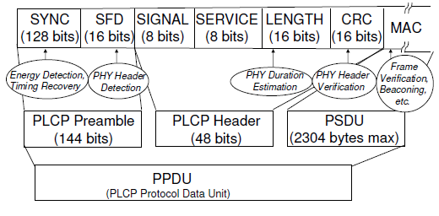
PLCP - Physical Layer Convergence Protocol
Physical Layer Convergence Protocol

Slide 12
802.11 Background (cont’d) Overlapping Channels
802.11b/g transmission occurs on one of 11 overlapping channels in the 2.4GHz North American ISM band.
2.417
2.427
2.437
2.447
2.457
2.467
5
10
4
9
14
3
8
13
2
7
12
1
6
11
2.412
2.422
2.432
2.442
2.452
2.462
2.472
2.484

Slide 13
802.11 Background (cont’d) 802.11b/g
Operates in the 2.4 GHz ISM band
14 total channels
Only 1-3 channels usable at any time
802.11b supports data rates up to 11 Mbps
Uses DSSS
802.11g supports data rates up to 54 Mbps
Similar data rates as 802.11a
Backward compatible with 802.11b
Coverage up to 100 meters (328 feet)
Most commonly implemented standard, “Wi-Fi”
Crowded frequency band

Slide 14
outline
Introduction
802.11 Background
Experimental Setup
Causes and Effects of Interference
Modeling Interference Effects
Rapid Channel Hopping
Conclusion

Slide 15
Experimental Setup (cont’d)
Client and AP
Interferers
Tests and Metrics

Slide 16
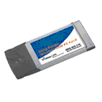
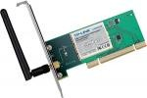
Experimental Setup (cont’d)
Client and AP
Client:
A Linux laptop equipped with 802.11 NICs
from Intersil (802.11b)
AP:
A Linux laptop with either an Intersil
PRISM 2.5 in 802.11b mode (using the
HostAP driver) or an Atheros AR5006X

Slide 17
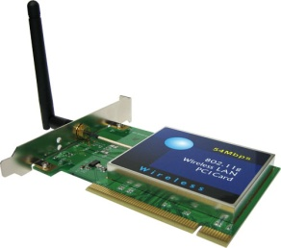
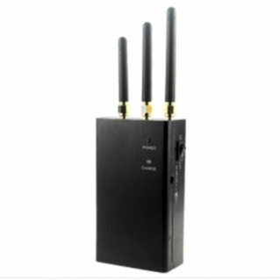
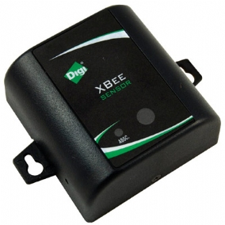
Experimental Setup (cont’d)
Interferers
Two malicious (Linux desktop with
PRISMPCI NIC and camera jammer).
Two selfish devices (a Zigbee sensor
node and a Panasonic cordless phone).

Slide 18
Experimental Setup (cont’d)
Interferers and their characteristics.

Slide 19
Experimental Setup (cont’d) Tests and Metrics
Each test consists of the client doing a one-way UDP or a TCP transfer of several megabytes between itself and a wired source or sink E through the AP.
Measure overall performance in terms of throughput and latency.
Measure kernel-level end-to-end packet transmissions and receptions at one-second intervals.
Collect many low-level 802.11 statistics at the AP and the client (number of PLCP reception errors, PHY CRC errors, MAC CRC errors, etc)

Slide 20
outline
Introduction
802.11 Background
Experimental Setup
Causes and Effects of Interference
Modeling Interference Effects
Rapid Channel Hopping
Conclusion

Slide 21
Causes and Effects of Interference
Timing Recovery Interference.
Dynamic Range Limitation.
Header Processing Interference.
Impact of Interference on 802.11g/n.
Impact of Frequency Separation.
Test with NICs from different vendors (PRISM, Atheros and Intel depending on the test) to check that these effects are not implementation artifacts.
Test with 802.11g and 802.11n to check that that these effects are not 802.11b PHY artifacts

Slide 22
Causes and Effects of Interference (cont’d)
Timing Recovery Interference
Sender clock extraction is done in the Timing Recovery module.
If this module fails to lock onto the sender’s clock, the receiver will sense energy, but not recognize it as valid modulated SYNC bits.
Since the interferer’s clock and the transmitter’s clock are unsynchronized, the Timing Recovery module at the receiver cannot lock onto the transmitter’s clock.
The receiver therefore only records energy detection events, but does not detect any packet transmissions.
Thus, packets sent by the transmitter are lost at the receiver.

Slide 23
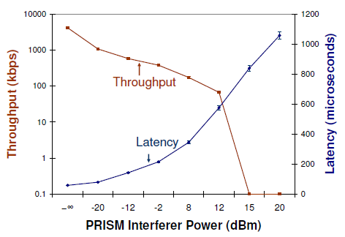
Causes and Effects of Interference (cont’d)
Timing Recovery Interference
Throughput and latency vs. interferer power caused by interference affecting timing recovery.

Slide 24
Causes and Effects of Interference (cont’d)
Dynamic Range Limitation.
Receivers need to decode packets over a very large range of signal strengths (−10dBm to −70dBm).
ADC can make the best use of the fixed-width bits that are available to represent the digital samples of the signal.
AGC samples these voltage levels during the PLCP preamble processing, and controls the gain of the RF and the IF amplifiers so that the signal samples can occupy the entire ADC range.

Slide 25
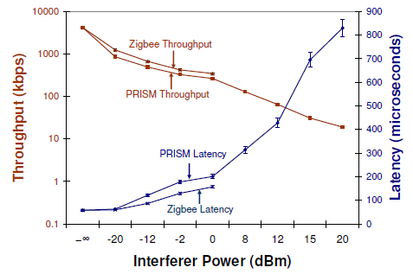
Causes and Effects of Interference (cont’d)
Dynamic Range Limitation.
Throughput and latency vs. interferer power caused by interference affecting dynamic range selection.

Slide 26
Causes and Effects of Interference (cont’d)
Header Processing Interference.
Start Frame Delimiter (SFD), this field signals to the receiver that the PLCP header is about to be sent.
Receivers are ready for the SFD pattern before it arrives.
If the receiver’s Preamble Detector module sees the SFD pattern from the interferer before it sees it from the transmitter, it starts processing the header before the actual header from the transmitter arrives at the receiver.

Slide 27
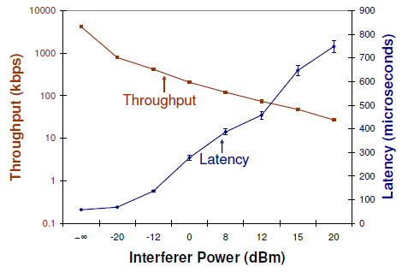
Causes and Effects of Interference (cont’d)
Header Processing Interference.
Throughput and latency vs. interferer power caused by interference affecting header processing.

Slide 28
Causes and Effects of Interference (cont’d)
Impact of Interference on 802.11g/n.
802.11g/n are different enough from 802.11b to question whether interference can decrease their link throughputs drastically as well.
802.11g does not use the Barker Correlator module, and the Demodulator module is quite different because it uses OFDM.
802.11n standard applies spatial coding techniques, which use multiple transmitter and receiver antennas. OFDM.

Slide 29
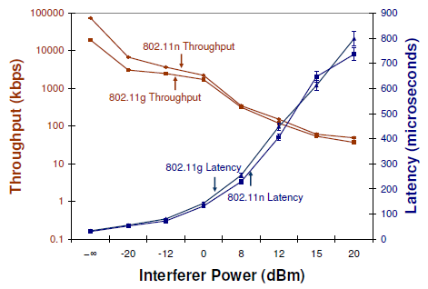
Causes and Effects of Interference (cont’d)
Impact of Interference on 802.11g/n.
Throughput and latency vs. interferer power for 802.11g/n.

Slide 30
Causes and Effects of Interference (cont’d)
Impact of Frequency Separation.
The authors expected the interference to be mitigated for two main reasons:
The sensitivity of the RF amplifiers at the receiver falls off with frequency separation.
The RF filters in the receiver remove interference power on frequencies that do not overlap the receiver’s frequencies.
The tolerance to interference suggests that channel hopping may be an effective remedy in mitigating interference.

Slide 31
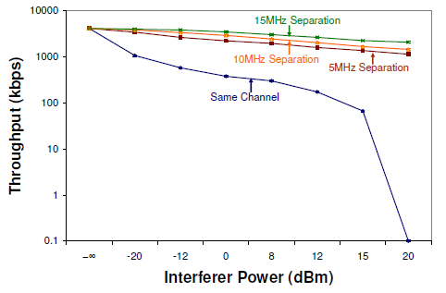
Causes and Effects of Interference (cont’d)
Impact of Frequency Separation.
Throughput and latency vs. interferer power with frequency separation.

Slide 32
outline
Introduction
802.11 Background
Experimental Setup
Causes and Effects of Interference
Modeling Interference Effects
Rapid Channel Hopping
Conclusion

Slide 33
Modeling Interference Effects
SINR is Signal to Interference plus Noise Ratio
Used by ns-2 and other network simulators
Does not account for NIC weaknesses
Authors introduce SINR plus…
Dynamic range selection limitation due to AGC
Receiver sensitivity non-linearity
Remember – these two limitations cause weak/narrow-band interferers to be very effective

Slide 34
Modeling Interference Effects (Cont’d) Signal to Interference Plus Noise Ratio
Packet x, Time t
S(x,t): Signal power
I(x,t): Interference
Nenv: Noise
This value is complex, but mainly represents the channel and antenna noise

Slide 35
Modeling Interference Effects (Cont’d) Interference Model
Interference I(.) is sum of all undesirable signals S(y, t) (both external interferers and self-interference due to multipath) that arrive at the receiver at time t:
However, line-of-sight setup eliminates multipath, so we can consider I(.) to represent instantaneous interferer power

Slide 36
Modeling Interference Effects (cont’d) Non-linearity in Receiver Sensitivity
Attenuation away from center frequency
Non-linear, thus we need to integrate interference power with receiver sensitivity over the entire frequency range [f1,f2]
R(f) is receiver sensitivity at frequency f
Channel | Lower Freq | Center Freq | High Freq
1 | 2.401 | 2.412 | 2.423
2 | 2.404 | 2.417 | 2.428
3 | 2.411 | 2.422 | 2.433
4 | 2.416 | 2.427 | 2.438

Slide 37
Modeling Interference Effects (Cont’d) Accounting for Processing Gain
To decode an 802.11b signal correctly, an SINR of at least 10dB is required
Barker coding provides an additional 10.4dB processing gain
Therefore, a signal can theoretically be -0.4dB weaker than an interferer and still be received

Slide 38
Modeling Interference Effects (cont’d) AGC Behavior
Automatic Gain Control can degrade SINR by as much as 30dB
Smax: NIC-dependent signal strength threshold
Recall the -0.4dB SINR margin with Barker coding
Thus signal cannot be demodulated unless it is 29.6dB greater than the interferer

Slide 39
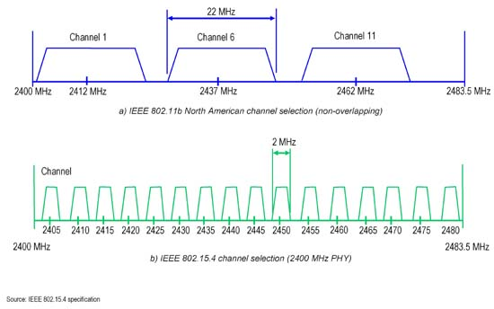
Applying the Model 802.11 and Zigbee Offset
By design, the center frequencies of Zigbee and 802.11 are always offset by at least 2 MHz

Slide 40
Applying the Model (cont’d) Narrow-band Zigbee
Signal Power: -18dBm
Zigbee Interference Power: -35dBm
At 2MHz, receiver sensitivity is 10dB below center frequency (PRISM Datasheet)
SINR = (-18) – (-35) + 10 = 27dBm
This is below the required SINR of 29.6dB, and as a result the Zigbee narrow-band interferer can cause heavy losses

Slide 41
Applying the Model (Cont’d) Ineffective 802.11 Modifications
Authors don’t “show their work” – space constraints?
Changing CCA Thresholds and Modes
Only changes transmitter behavior, while losses are also observed at the receiver
Adding Forward Error Correction
Adds 4dB coding gain for BPSK/QPSK modulations – not enough
Changing packet sizes
1500b to 100b drops SINR requirement by 4dB, but not enough to counteract interferers
Changing rates and modulations
Avoiding Barker modulations not good enough

Slide 42
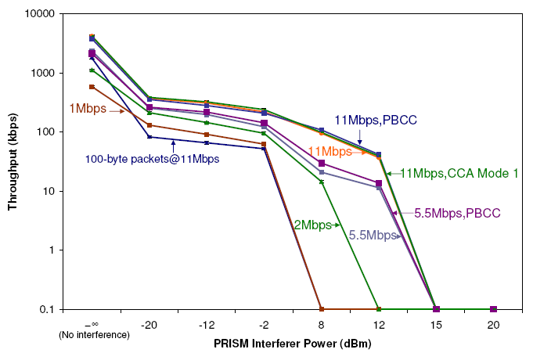
Ineffective 802.11 Modifications

Slide 43
outline
Introduction
802.11 Background
Experimental Setup
Causes and Effects of Interference
Modeling Interference Effects
Rapid Channel Hopping
Conclusion

Slide 44
Rapid Channel Hopping
Recall that separating the frequency of the receiver and interferer by > 5MHz is effective
Unless the attack jams all channels at once
Typically channel changes in 802.11 NICs only occur in response to failures, and at a slow rate
Main goals – efficiency and power to withstand even malicious interferers
Feasible – most NICs support changing channel in software quickly

Slide 45
Rapid Channel Hopping (cont’d) Design Choices
Channel switching latency (PRISM: 250us, Intel 500 us) in hardware
10ms dwell time (2.5% channel switching overhead on PRISM, 5% on Intel)
Channel hopping sequence is MD5-hashed to ensure resistance to attackers
Upon detecting link degradation, the AP begins channel hopping
Clients are disconnected, find the AP, receive MD5 seed and begin hopping themselves

Slide 46
Rapid Channel Hopping (cont’d) Adversary Design
Recall that if three successive beacons are lost, clients are disconnected for all practical purposes
Attack methodology - randomly pick a channel, disrupt for a short period, repeat
1/11 probability of successful jam (11 channels), only 0.1% success rate if assuming 100ms between beacon transmissions
Better strategy – listen on random channels and disrupt when the active channel is found

Slide 47
Rapid Channel Hopping (cont’d) Evaluation
One AP and three clients (C1-C3) and three PRISM interferers (P1-P3) – 802.11b
One of each: cordless phone, Zigbee sensor mote, wireless camera jammer
CH degrades throughput from 4.4 to 3.6 Mbit/s
Unidirectional 1500-byte packet UDP, no interference
Attributed to loss before, during and after switching channels

Slide 48
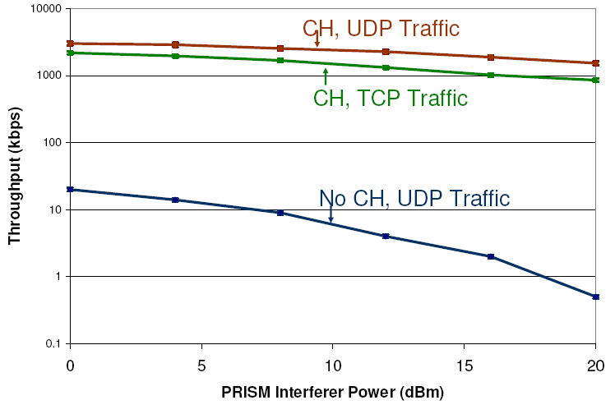
Single PRISM Interferer Throughput
Authors don’t specify which attack method used (random channel or active channel)

Slide 49
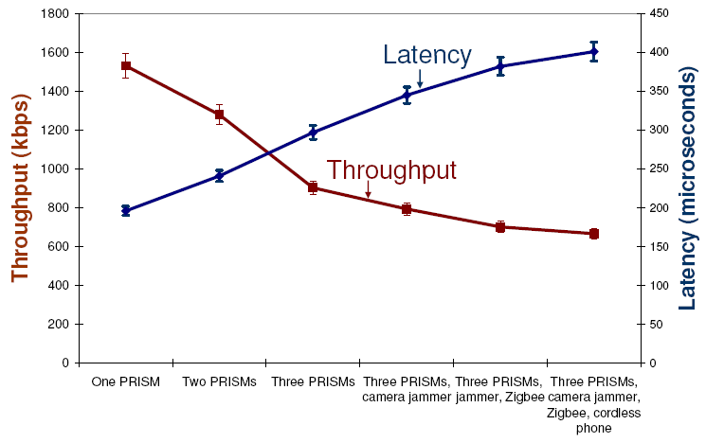
Multiple Interferers
Three PRISM interferers coordinate interference schedules so they don’t overlap

Slide 50
Related Work
RF Interference/Jamming
802.11 Denial of Service
Channel Hopping
Not an overwhelming amount of original work is actually presented in this paper

Slide 51
outline
Introduction
802.11 Background
Experimental Setup
Causes and Effects of Interference
Modeling Interference Effects
Rapid Channel Hopping
Conclusion

Slide 52
Conclusions
Even weak and narrow-band RF interference can significantly disrupt an 802.11 network
Changing 802.11 parameters is ineffective in counteracting this
Rapid channel hopping greatly improves interference tolerance
Findings are hardware-specific, and only concrete for the NICs investigated
Channel hopping is ineffective against attacks which target all channels

