Slide 1
Denial of Service Attack and Prevention on SIP VoIP
Ge Zhang, Sven Ehlert, and Thomas Magedanz
Fraunhofer Institute FOKUS, Berlin, Germany
Presented by
Murad Kaplan

Slide 2
Outline
Introduction
Background
Scope of The Attack
Testbed Setup
DNS Attacks on SIP Proxies
Non-Blocking Cache Design
Conclusion and Future Work

Slide 3
Introduction
DOS & DDOS
Why DOS on VoIP ?
Research questions

Slide 4
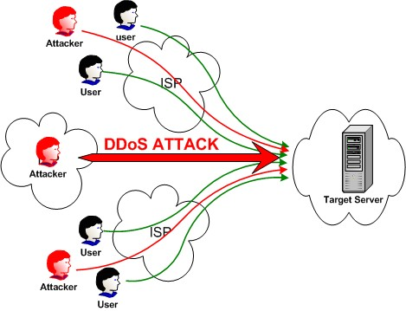
DOS & DDOS
Denial Of Service Attack

Slide 5
Why DOS on VoIP ?
Open environment.
VoIP services are based on standardized and open technologies (i.e. SIP)
Using servers reachable through the internet implemented in software and provided often over general purpose computing hardware.

Slide 6
Research questions:
How to find a proper method to mitigate the effect of DoS attack via DNS request?
Which factors of DNS cache and SIP proxy (e.g. caching replacement policy, cache entry number, parallel processes number of proxy, etc) are useful to deal with this problem?
Which kind of combination of the useful factors is the most efficient?

Slide 7
Outline
Introduction
Background
Scope of The Attack
Testbed Setup
DNS Attacks on SIP Proxies
Non-Blocking Cache Design
Conclusion and Future Work

Slide 8
Background
Session Initial Protocol (SIP)
Domain Name Server (DNS)
DNS Usage in SIP Infrastructure

Slide 9
Session Initiation Protocol (SIP)
The standard for VoIP services in the Internet and next generation networks.
Based protocol designed to establish or terminate a session between two parts.
Also, SIP is the basic protocol of the next generation IP Multimedia Subsystem

Slide 10
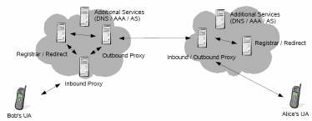
SIP Infrastructure
User Agent, Registrar, and Proxies

Slide 11
Domain Name Server (DNS)
The basis for most current internet services available today, including web and email.
completely globally distributed and managed database.
provides an essential service for Internet applications and users i.e. name resolution

Slide 12
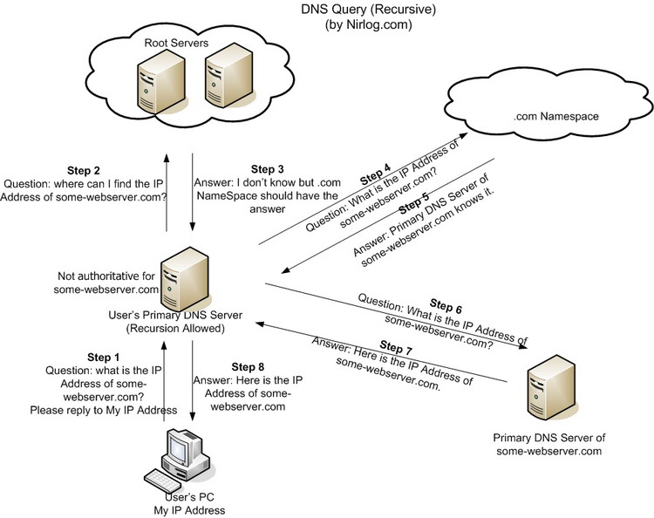
User requests a domain resolve
The DNS server knows the name mapping.
The DNS server does not know the name mapping.

Slide 13
DNS Usage in SIP Infrastructure
Many of the header fields in a SIP message contain Fully Qualified Domain Names (FQDN) that need to be resolved for further processing from a SIP entity.
To interconnect the Public Switched Telephone Network (PSTN) with a SIP network.
SIP can utilize different transport layer protocols (e.g. UDP or TLS).

Slide 14
Outline
Introduction
Background
Scope of The Attack
Testbed Setup
DNS Attacks on SIP Proxies
Non-Blocking Cache Design
Conclusion and Future Work

Slide 15
Scope of The Attack
The goal of a DoS attack is to render the service inoperable for as long as possible.
Most effective against proxies or registrars/redirectors.
The SIP DNS attack targets the DNS queries high processing time.

Slide 16
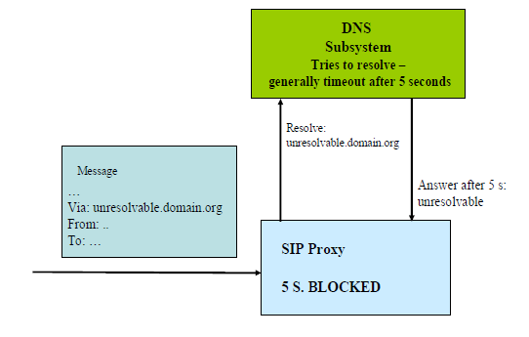
Scope of The Attack
Irresolvable domain name !!
The attacker use URI that its mapping will not be in the cache of a name server and the URI will trigger a request to an authoritative name server that has a common low response time.

Slide 17
Scope of The Attack
Two ways to construct irresolvable domain name:
Adding random host names to the left side of the address domain.
Querying different name servers and measuring reply times.
Such a message cannot easily be filtered out by a SIP server or an Intrusion Detection System.

Slide 18
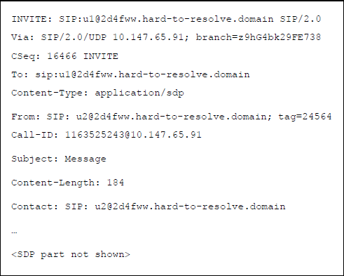
Scope of The Attack

Slide 19
Outline
Introduction
Background
Scope of The Attack
Testbed Setup
DNS Attacks on SIP Proxies
Non-Blocking Cache Design
Conclusion and Future Work

Slide 20
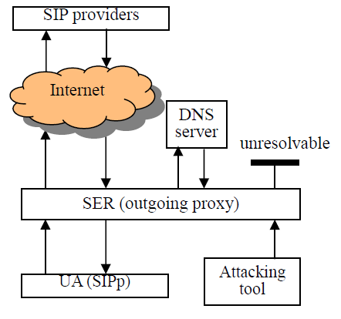
TestBed Setup
Five Main component:
SIP proxy, using SIP Express Router (SER)
Local DNS server
Self implemented Attack Tool
User Agent (UA)
External SIP Provider
The test bed was established on Pentium D double processor
machines with 1 GB RAM (Proxy, User Agent, and Attack tool) running on Linux Operating Systems, equipped with 100 M Bps internet access.

Slide 21
TestBed Setup
The SIP proxy is setup first and can be configured to have different parallel processing queues n, with 2≤n≤64.
According to SIP protocol, the UA has to REGISTER at a SIP server before it can INVITE others entities or receive INVITE messages. Therefore, REGISTER is the first essential step for the whole process and our experiments are focus on this step.
UA configured to send continuously REGISTER messages from our local network to external SIP proxies. The external SIP register addressed are given to the UA in textual representation, as such our proxy has to resolve the domain before it can forward any request.
The attacking tool is configured to send crafted messages containing hard resolvable domain names to the local outgoing SIP proxy. It is configurable by the attacking interval i seconds between two attacking messages.

Slide 22
TestBed Setup
To measure the proxy performance, UA sends out 5000 register messages and counts the number of responses (r) that local proxy can process. If we can get any kind of response from a remote SIP server, it means the domain name of the server has successfully been resolved by our proxy.
All measurements reported in the paper are the average value of 10 runs of the tests

Slide 23
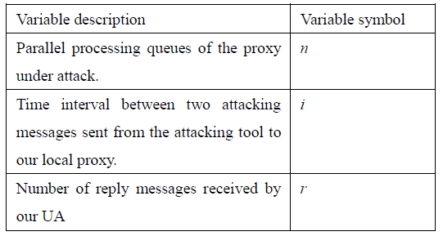
Experiment variables

Slide 24
Outline
Introduction
Background
Scope of The Attack
Testbed Setup
DNS Attacks on SIP Proxies
Non-Blocking Cache Design
Conclusion and Future Work

Slide 25
DNS Attacks on SIP Proxies
Two basic options for using DNS in a SIP proxy:
1. Synchronous DNS Implementation
SIP proxy sends a DNS request and waits for an answer, while waiting for the process that has issued the request the SIP proxy is blocked and unable to process new requests.
2. Asynchronous DNS Implementation
SIP proxy issues DNS request continuously, saving state information after every request, once the reply to the DNS request arrives or timeout expires the proxy will be notified.

Slide 26
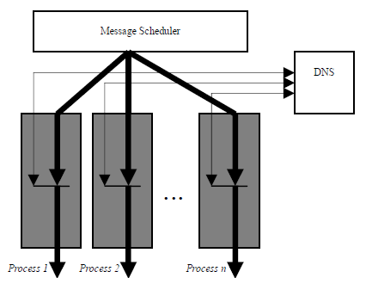
DNS and Synchronous SIP Proxies
Synchronous Scaling through Parallel Processing
Each process is responsible for parsing the message, initiating any DNS requests or requesting the execution of an application and finally forwarding the message.

Slide 27
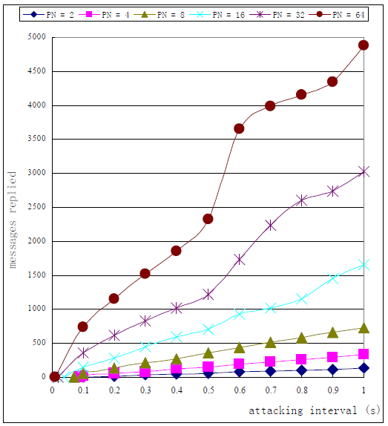
DNS and Synchronous SIP Proxies
Processing Performance
of the Local proxy for
different processing
queues n varying attacking
intervals
With few parallel processing queues
(n ≤ 8) less than 20% of all potential
messages can be processed.
Decreasing the attacking interval
down to 0.001 seconds (1000 attack
message per second), even 64
parallel processing queues are
completely starved.

Slide 28
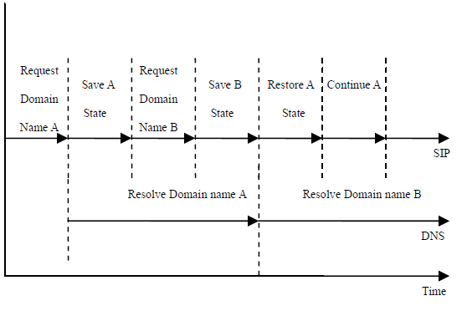
DNS and Asynchronous SIP Proxies
States of unfinished domain name resolving requests have been saved.
The implementation complexity and memory requirements increase considerably.
SIP attack launched at a SIP proxy running on a machine with 8GB of RAM all memory can be depleted in about 30 seconds

Slide 29
Outline
Introduction
Background
Scope of The Attack
Testbed Setup
DNS Attacks on SIP Proxies
Non-Blocking Cache Design
Conclusion and Future Work

Slide 30
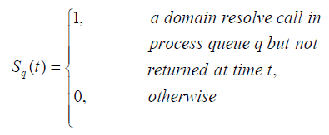
Non-Blocking Cache Design
DNS Attack Detection and Prevention (DADP)
SIP proxy is extended with a DNS cache.
Blocking threshold, to insure that a SIP proxy continues function even under DNS attack.
SIP proxy S processing messages in synchronous manner, with n parallel processes.

Slide 31
Non-Blocking Cache Design
H indicates how many processes are concurrently resolving a domain name in time t.
Proxy is blocked when H = n
Minimum operation threshold m
Whenever H ≥ R, where R = n – m, the
proxy is informed that further DNS resolve request will have a high possibility to cause a DoS due to proxy blocking. As a consequence, the proxy will not try to resolve any domain names.
Whenever H < R. Instead, the proxy assumes this address to be irresolvable, and continues its operation. As soon as H < R, the proxy will again perform DNS lookups.

Slide 32
Non-Blocking Cache Design
Implementation of DADP
The extension of SER support:
Emergency process (whenever H ≥ n-1)
Cashing both regular DNS entries (SRV, A records).
Different cache replacement policies(FIFO, LRU, LFU, TC)

Slide 33
Non-Blocking Cache Design
Performance Evaluation of DADP
10,000 SIP REGISTER messages were sent over a period of 140 seconds.
These messages contained irresolvable domain names with 10 ms delay between each message

Slide 34
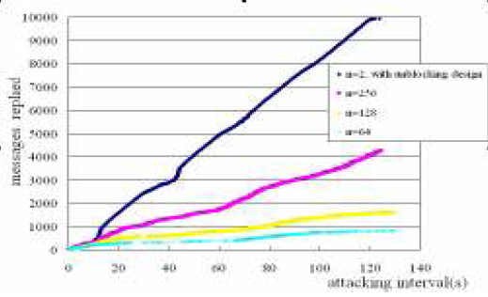
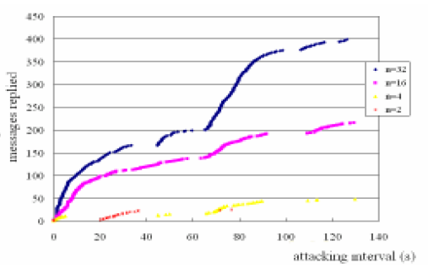
Non-Blocking Cache Design
The more parallel queues n are configured, the more messages can be processed during an attack. With the DADP deployed nearly all messages can be processed independently of n.

Slide 35
Non-Blocking Cache Design
1- Cache Replacement Policies Evaluation
Caching only successful requests.
Once the cache is filled some existing cache entries will have to be deleted in order to make room for new items.
Even a large cache entry storage can easily be allocated by an attacker with randomly generated invalid domain names.
Considering four cache replacement policies (FIFO, LRU, LFU, TC)

Slide 36
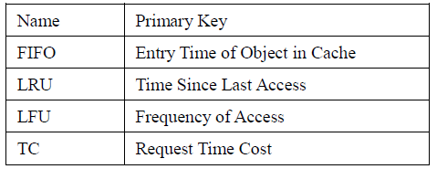
Non-Blocking Cache Design
Cache replacement policies
First-in, First-out (FIFO).
Least Recently Used (LRU).
Least Frequently Used (LFU).
Time Cost

Slide 37
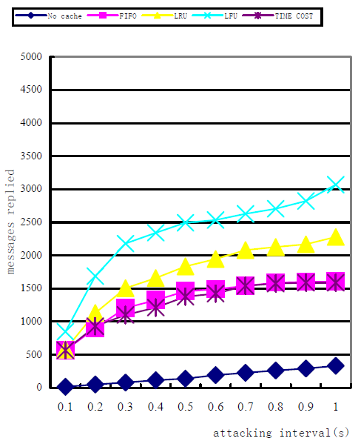
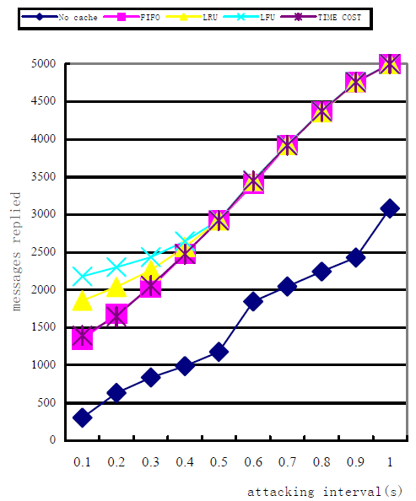
Non-Blocking Cache Design
repeated the experiment in with these four caching strategies twice, one time with n=4 parallel processing queues at the proxy and then again with n=32.

Slide 38
Non-Blocking Cache Design
2- Evaluation of Cache Entry Numbers
The relationship of caching performance in relation to caching entries e.
The number of cache entries is limited while the amount of the domain names in the real world is almost unlimited.
More cache entries will cost more memory and CPU resources to support them.

Slide 39
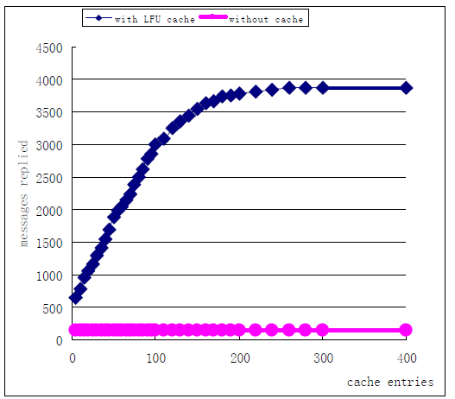
Non-Blocking Cache Design
set n=4 and i=0.5
Even with only 5 entries in the cache, the proxy still processes at least twice as much as without DADP.
More cache entries substantially increase the performance of the proxy.

Slide 40
Outline
Introduction
Background
Scope of The Attack
Testbed Setup
DNS Attacks on SIP Proxies
Non-Blocking Cache Design
Conclusion and Future Work

Slide 41
Conclusion and Future Work
Denial of Service attacks can limit SIP server operation to a large amount.
In synchronous manner, threshold can be the percentage of blocked process in SIP server.
In asynchronous manner, threshold could represent the percentage of used memory.
Use LFU, in case the used cache can not accommodate all possible DNS names.
In the future, planning how to the DADP solutions works when the attack combined with another common DNS related attack, called DNS cache poisoning 0

Slide 42
Notes
Many grammar mistakes.
All of the figures need to be named again.

Slide 43
Thanks !
Murad Kaplan

