Slide 1
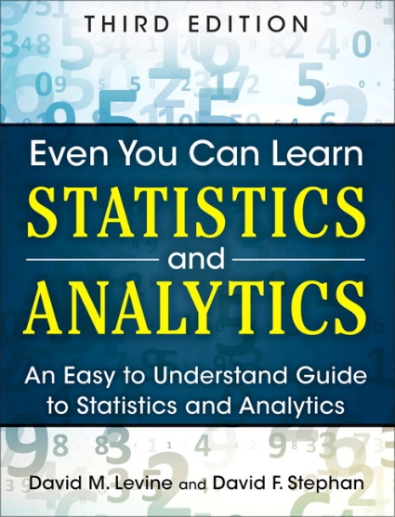
Simple Linear Regression
IMGD 2905
Chapter 10

Slide 2
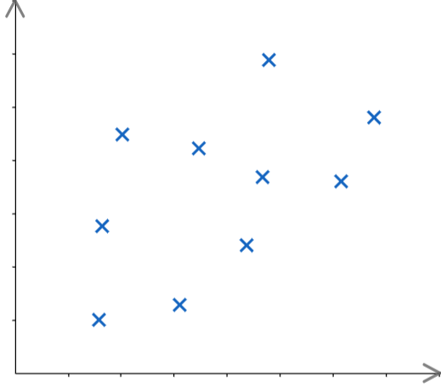
Motivation
Have data (sample, x’s)
Want to know likely value of next observation
E.g., playtime versus skins owned
A – reasonable to compute mean (with confidence interval)
B – could do same, but there appears to be relationship between X and Y!
→ Predict B
e.g., “trendline” (regression)
B
Y
A
X

Slide 3
Motivation
Have data (sample, x’s)
Want to know likely value of next observation
E.g., playtime versus skins owned
A – reasonable to compute mean (with confidence interval)
B – could do same, but there appears to be relationship between X and Y!
→ Predict B
e.g., “trendline” (regression)
B
Y
A
X

Slide 4
Motivation
Have data (sample, x’s)
Want to know likely value of next observation
E.g., playtime versus skins owned
A – reasonable to compute mean (with confidence interval)
B – could do same, but there appears to be relationship between X and Y!
→ Predict B
e.g., “trendline” (regression)
B
Y
A
X

Slide 5
Motivation
Have data (sample, x’s)
Want to know likely value of next observation
E.g., playtime versus skins owned
A – reasonable to compute mean (with confidence interval)
B – could do same, but there appears to be relationship between X and Y!
→ Predict B
e.g., “trendline” (regression)
B
Y
A
X

Slide 6
Overview
Broadly, two types of prediction techniques:
Regression – mathematical equation to model, use model for predictions
We’ll discuss simple linear regression
Machine learning – branch of AI, use computer algorithms to determine relationships (predictions)
CS 453X Machine Learning

Slide 7
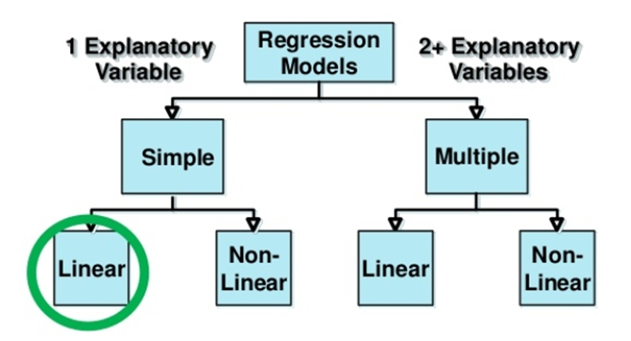
Types of Regression Models
Explanatory variable explains dependent variable
Variable X (e.g., skill level) explains Y (e.g., KDA)
Can have 1 or 2+
Linear if coefficients added, else Non-linear
Notes:
27

Slide 8
Outline
Introduction (done)
Simple Linear Regression (next)
Linear relationship
Residual analysis
Fitting parameters
Measures of Variation
Misc

Slide 9
Simple Linear Regression
Goal – find a linear relationship between to values
E.g., kills and skill, time and car speed
First, make sure relationship is linear! How?
→ Scatterplot
(c) no clear relationship
(b) not a linear relationship
(a) linear relationship – proceed with linear regression

Slide 10
Simple Linear Regression
Goal – find a linear relationship between to values
E.g., kills and skill, time and car speed
First, make sure relationship is linear! How?
→ Scatterplot
(c) no clear relationship
(b) not a linear relationship
(a) linear relationship – proceed with linear regression

Slide 11
Linear Relationship
From algebra: line in form
m is slope, b is y-intercept
Slope (m) is amount Y increases when X increases by 1 unit
Intercept (b) is where line crosses y-axis, or where y-value when x = 0
Y = mX + b
https://www.scribd.com/presentation/230686725/Fu-Ch11-Linear-Regression

Slide 12
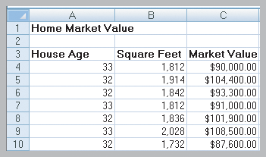
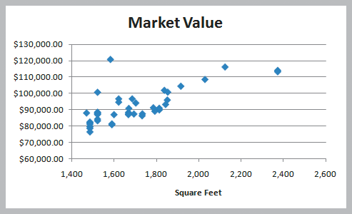
Simple Linear Regression Example
Size of house related to its market value.
X = square footage
Y = market value ($)
Scatter plot (42 homes) indicates linear trend

Slide 13
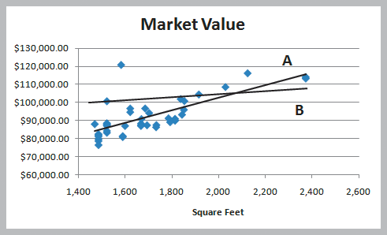
Simple Linear Regression Example
Two possible lines shown below (A and B)
Want to determine best regression line
Line A looks a better fit to data
But how to know?
Y = mX + b

Slide 14
Simple Linear Regression Example
Two possible lines shown below (A and B)
Want to determine best regression line
Line A looks a better fit to data
But how to know?
Y = mX + b
Line that gives best fit to data is one that minimizes prediction error
Least squares line
(more later)

Slide 15
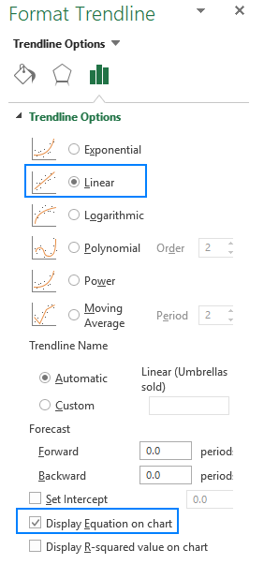
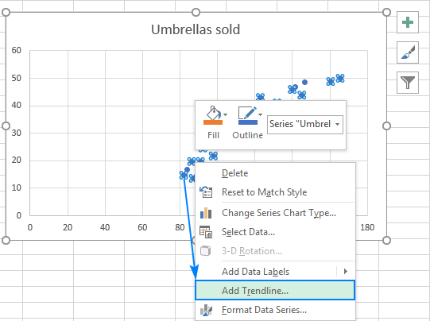
Simple Linear Regression Example Chart
Scatterplot
Right click → Add Trendline

Slide 16
Simple Linear Regression Example Formulas
=SLOPE(C4:C45,B4:B45)
Slope = 35.036
=INTERCEPT(C4:C45,B4:B45)
Intercept = 32,673
Estimate Y when X = 1800 square feet
Y = 32,673 + 35.036 x (1800) = $95,737.80

Slide 17
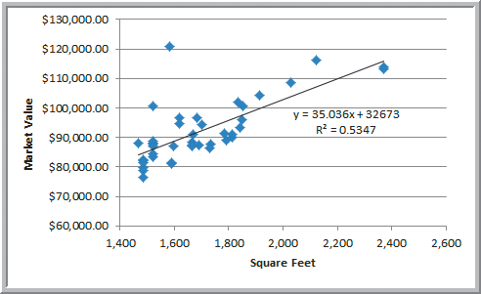
Simple Linear Regression Example
Market value = 32673 + 35.036 x (square feet)
Predicts market value better than just average
But before use, examine residuals

Slide 18
Outline
Introduction (done)
Simple Linear Regression
Linear relationship (done)
Residual analysis (next)
Fitting parameters
Measures of Variation
Misc

Slide 19
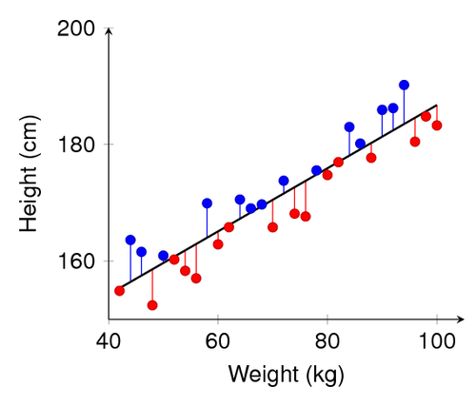
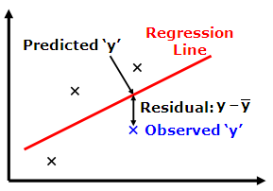
Residual Analysis
Before predicting, confirm that linear regression assumptions hold
Variation around line is normally distributed
Variation equal for all X
Variation independent for all X
How? Compute residuals (error in prediction) → Chart

Slide 20
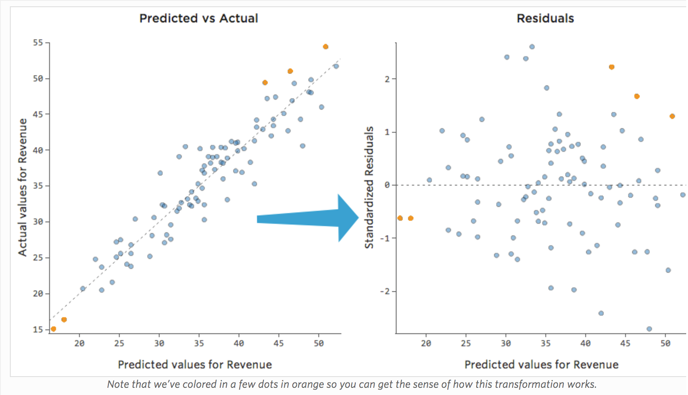
Residual Analysis
https://www.qualtrics.com/support/stats-iq/analyses/regression-guides/interpreting-residual-plots-improve-regression/

Slide 21
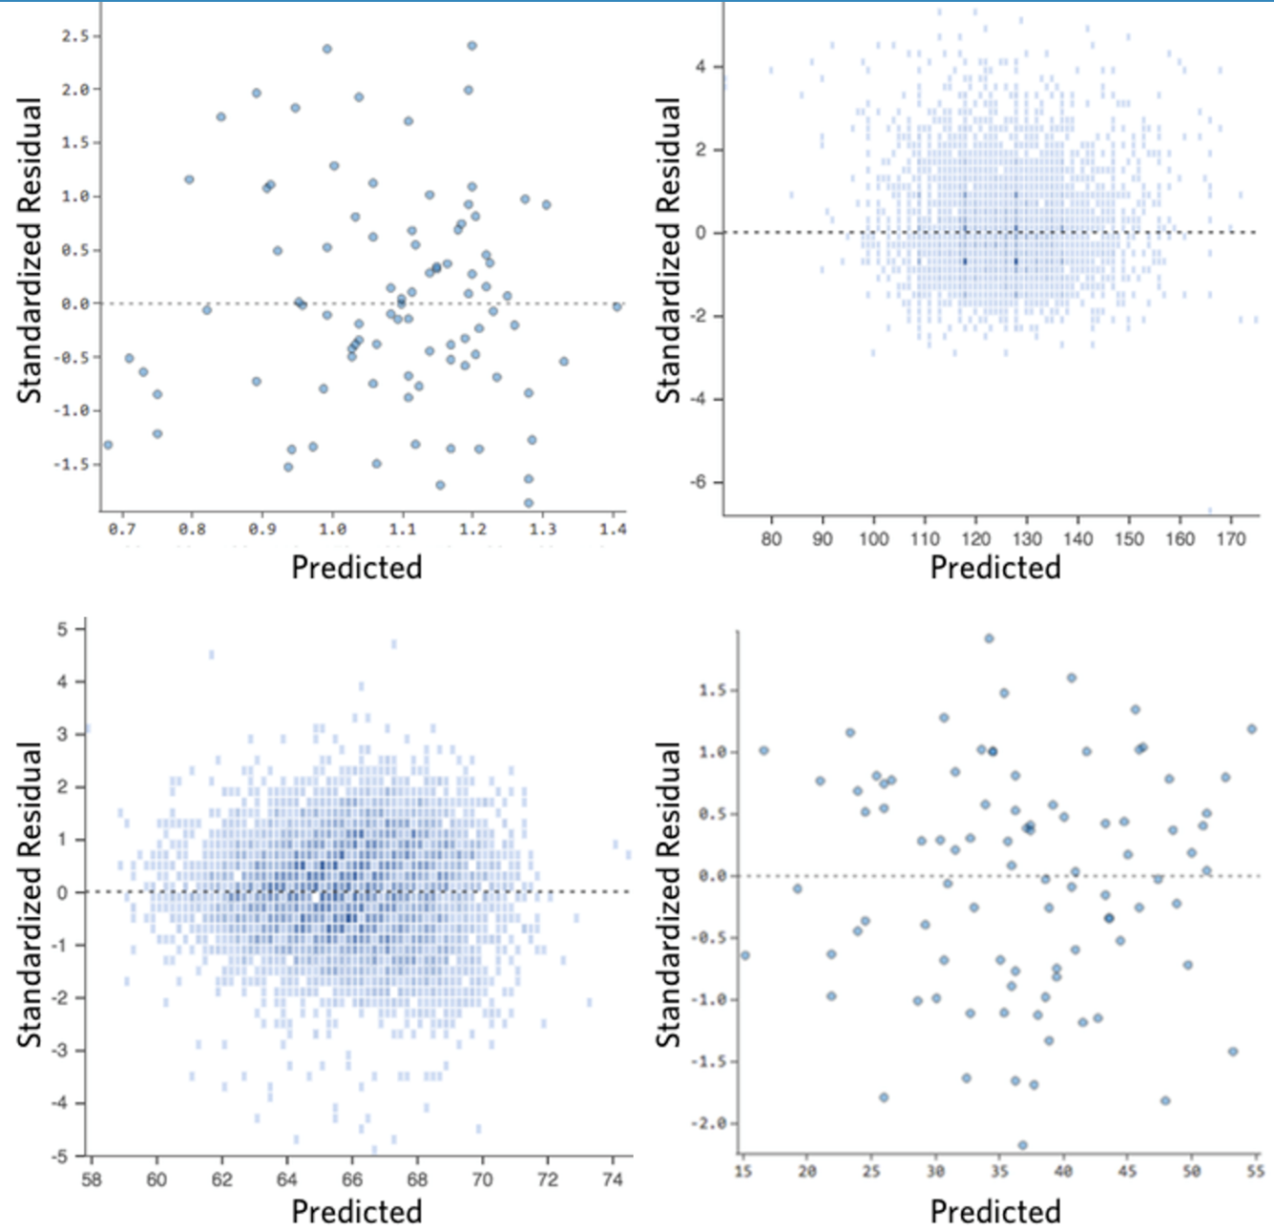
Residual Analysis – Good
https://www.qualtrics.com/support/stats-iq/analyses/regression-guides/interpreting-residual-plots-improve-regression/
Clustered towards middle
Symmetrically distributed
No clear pattern

Slide 22
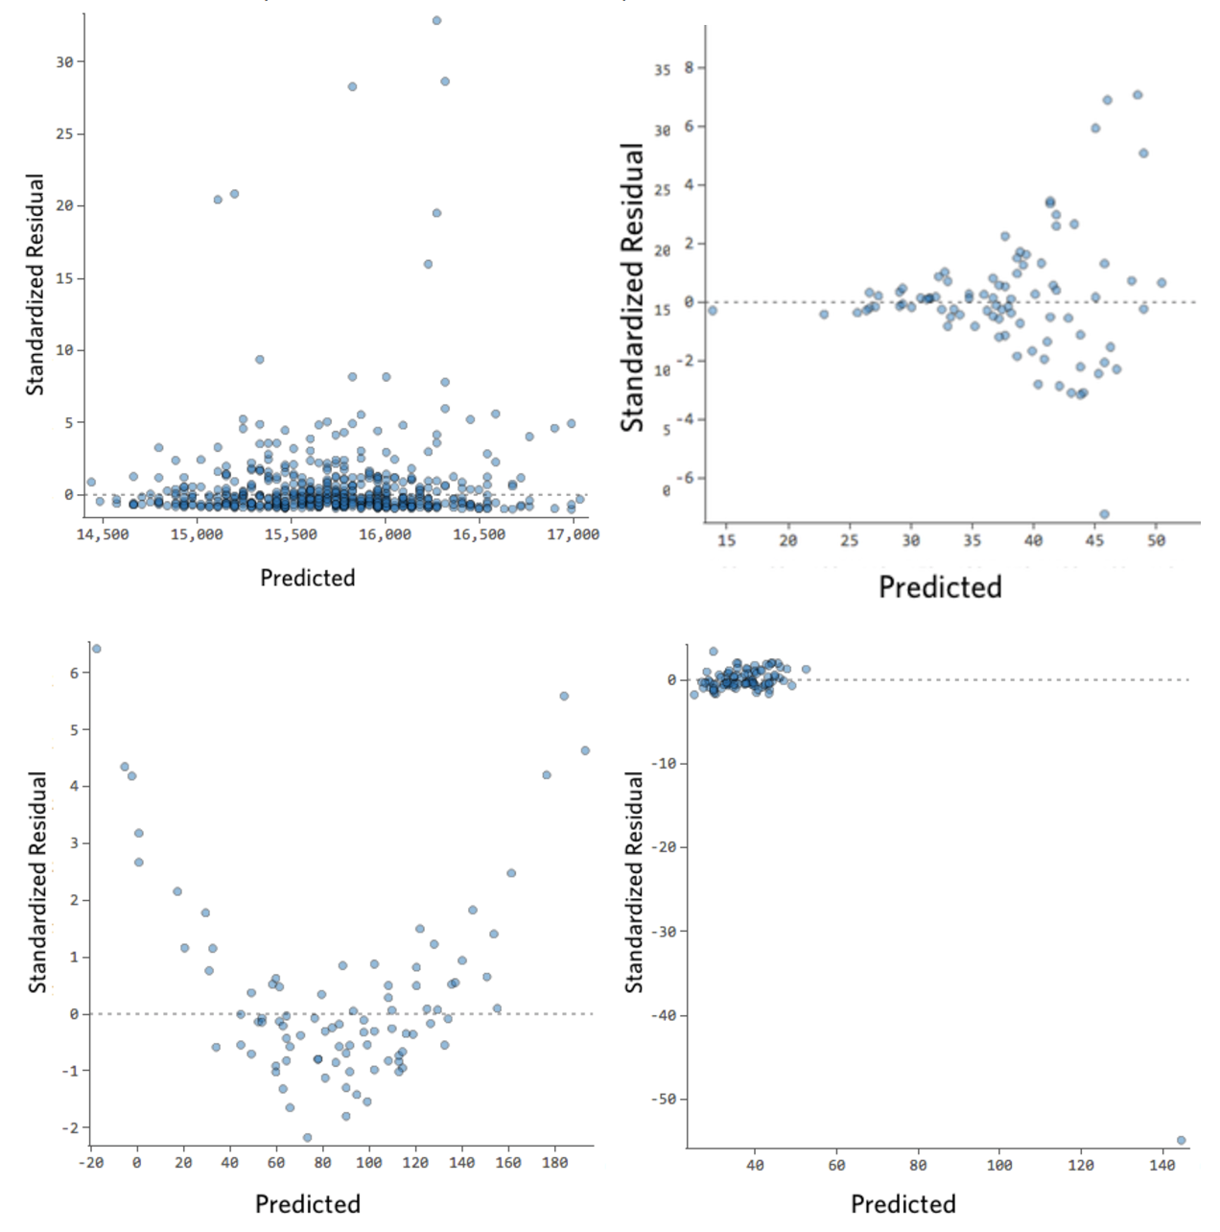
Residual Analysis – Bad
https://www.qualtrics.com/support/stats-iq/analyses/regression-guides/interpreting-residual-plots-improve-regression/
Clear shape
Outliers
Patterns
Note: could do normality test (QQ plot)

Slide 23
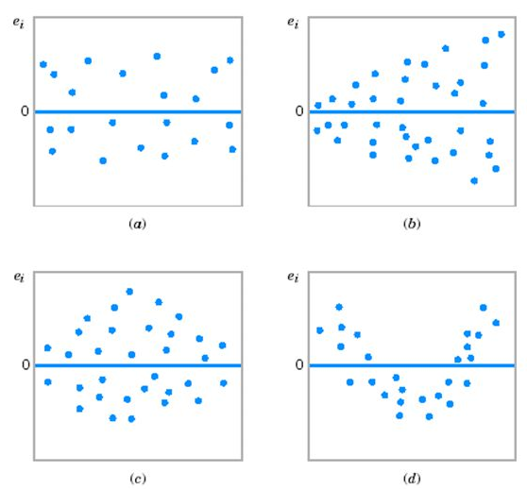
Residual Analysis – Summary
Regression assumptions:
Normality of variation around regression
Equal variation for all y values
Independence of variation
___________________
(a) ok
(b) funnel
(c) double bow
(d) nonlinear

Slide 24
Outline
Introduction (done)
Simple Linear Regression
Linear relationship (done)
Residual analysis (done)
Fitting parameters (next)
Measures of Variation
Misc

Slide 25
Linear Regression Model
Y
=
b
+
m
X
+
ε
i
0
i
i
ε_{i} = random error
Y
=
b
+
m
X
Observed value
https://www.scribd.com/presentation/230686725/Fu-Ch11-Linear-Regression
Random error associated with each observation
Notes:
35

Slide 26
Fitting the Best Line
Plot all (X_{i}, Y_{i}) Pairs
Y
60
40
20
0
X
0
20
40
60
https://www.scribd.com/presentation/230686725/Fu-Ch11-Linear-Regression

Slide 27
Fitting the Best Line
Plot all (X_{i}, Y_{i}) Pairs
Draw a line. But how do we know it is best?
Y
60
40
20
0
X
0
20
40
60
https://www.scribd.com/presentation/230686725/Fu-Ch11-Linear-Regression

Slide 28
Fitting the Best Line
Plot all (X_{i}, Y_{i}) Pairs
Draw a line. But how do we know it is best?
Y
60
Slope changed
40
20
0
X
Intercept unchanged
0
20
40
60
https://www.scribd.com/presentation/230686725/Fu-Ch11-Linear-Regression

Slide 29
Fitting the Best Line
Plot all (X_{i}, Y_{i}) Pairs
Draw a line. But how do we know it is best?
Y
Slope unchanged
60
40
20
Intercept changed
0
X
0
20
40
60
https://www.scribd.com/presentation/230686725/Fu-Ch11-Linear-Regression

Slide 30
Fitting the Best Line
Plot all (X_{i}, Y_{i}) Pairs
Draw a line. But how do we know it is best?
Y
Slope changed
60
40
20
Intercept changed
0
X
0
20
40
60
https://www.scribd.com/presentation/230686725/Fu-Ch11-Linear-Regression

Slide 31
Linear Regression Model
Relationship between variables is linear function
Population Y-Intercept
Population Slope
Random Prediction Error
Want error as small as possible
Y
=
b
+
m
X
+
ε
i
0
i
i
Dependent (response) Variable (e.g., kills)
Independent (explanatory) Variable (e.g., skill level)

Slide 32
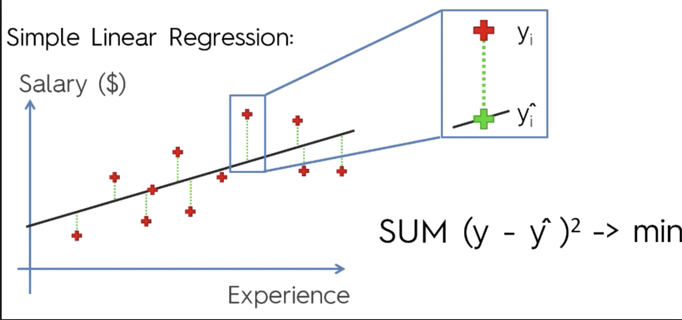
Least Squares Line
Want to minimize difference between actual y and predicted ŷ
Add up ε_{i} for all observed y’s
But positive differences offset negative ones
(remember when this happened for variance?)
→ Square the errors! Then, minimize (using Calculus)
Minimize:
Take derivative
Set to 0 and solve
https://cdn-images-1.medium.com/max/1600/1*AwC1WRm7jtldUcNMJTWmiA.png
Notes:
49

Slide 33
Least Squares Line Graphically
https://www.scribd.com/presentation/230686725/Fu-Ch11-Linear-Regression
Notes:
52

Slide 34
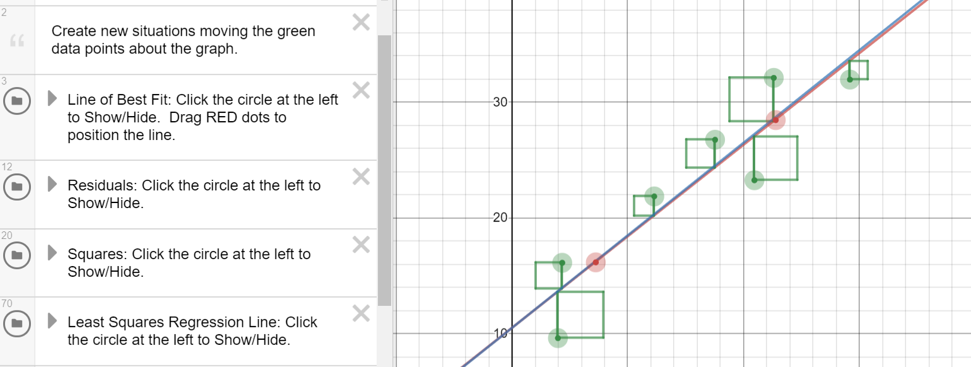
Least Squares Line Graphically
https://www.desmos.com/calculator/zvrc4lg3cr

Slide 35
Outline
Introduction (done)
Simple Linear Regression (done)
Measures of Variation (next)
Coefficient of Determination
Correlation
Misc

Slide 36
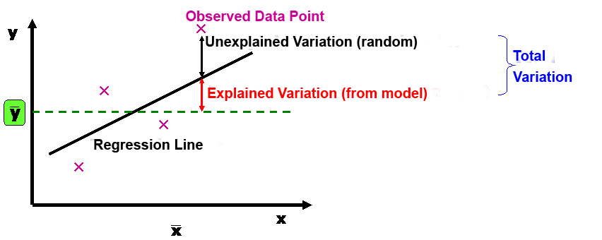
Measures of Variation
Several sources of variation in y
Error in prediction (unexplained)
Variation from model (explained)
Break this down (next)

Slide 37
Sum of Squares of Error
Dependent variable
Independent variable (x)
Least squares regression selects line with lowest total sum of squared prediction errors
Sum of Squares of Error, or SSE
Measure of unexplained variation

Slide 38
Sum of Squares Regression
Population mean: y
Dependent variable
Independent variable (x)
Differences between prediction and population mean
Gets at variation due to X & Y
Sum of Squares Regression, or SSR
Measure of explained variation

Slide 39
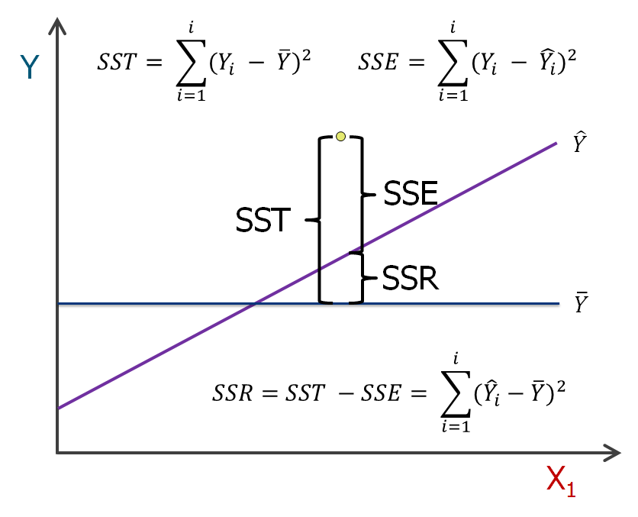
Sum of Squares Total
Total Sum of Squares, or SST = SSR + SSE

Slide 40
Coefficient of Determination
Proportion of total variation (SST) explained by the regression (SSR) is known as the Coefficient of Determination (R²)
$$R2=\frac{SSR}{SST}=1−\frac{SSE}{SST}$$
Ranges from 0 to 1 (often said as a percent)
1 – regression explains all of variation
0 – regression explains none of variation

Slide 41
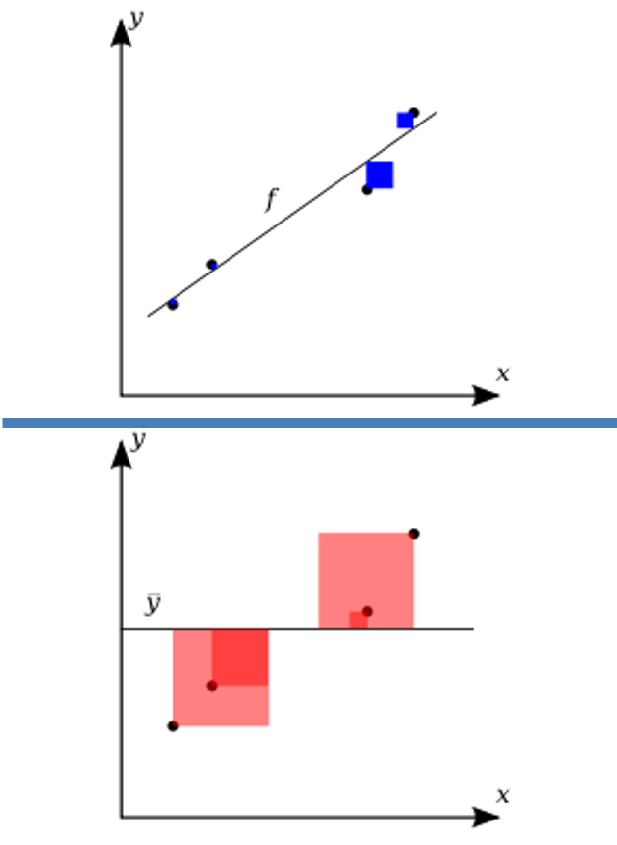
Coefficient of Determination – Visual Representation
Variation in observed data model cannot explain (error)
R² = 1 -
Total variation in observed data
https://upload.wikimedia.org/wikipedia/commons/thumb/8/86/Coefficient_of_Determination.svg/400px-Coefficient_of_Determination.svg.png

Slide 42
Coefficient of Determination Example
How “good” is regression model? Roughly:
0.8 <= R² <= 1 strong
0.5 <= R² < 0.8 medium
0 <= R² < 0.5 weak

Slide 43
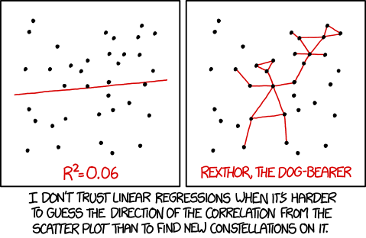
How “good” is the Regression Model?
https://xkcd.com/1725/

Slide 44
Relationships Between X & Y
Strong relationships
Weak relationships
y
y
x
x
y
y
x
x

Slide 45
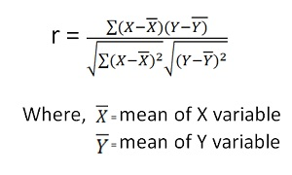
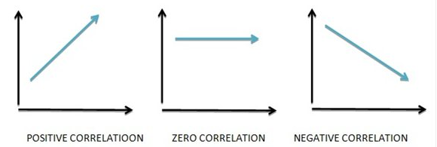
Relationship Strength and Direction – Correlation
Correlation measures strength and direction of linear relationship
-1 perfect neg. to +1 perfect pos.
Sign is same as regression slope
Denoted R. Why? R = $\sqrt{R2}$
Pearson’s Correlation Coefficient
Vary together
Vary Separately
https://www.mbaskool.com/2013_images/stories/dec_images/pearson-coeff-bcon.jpg

Slide 46
Correlation Examples (1 of 3)
y
y
y
x
x
x
r = -1
r = -.6
r = 0
y
y
x
x
r = +.3
r = +1

Slide 47
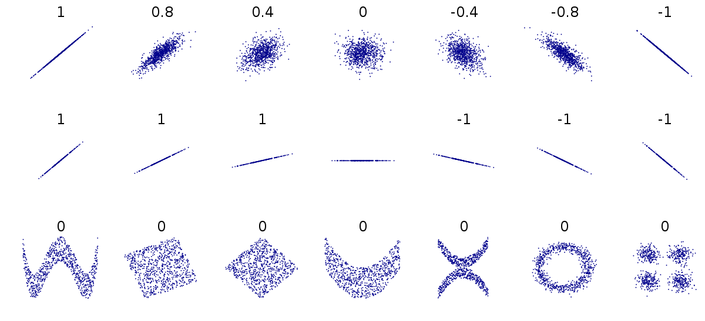
Correlation Examples (2 of 3)
https://upload.wikimedia.org/wikipedia/commons/thumb/d/d4/Correlation_examples2.svg/1200px-Correlation_examples2.svg.png

Slide 48
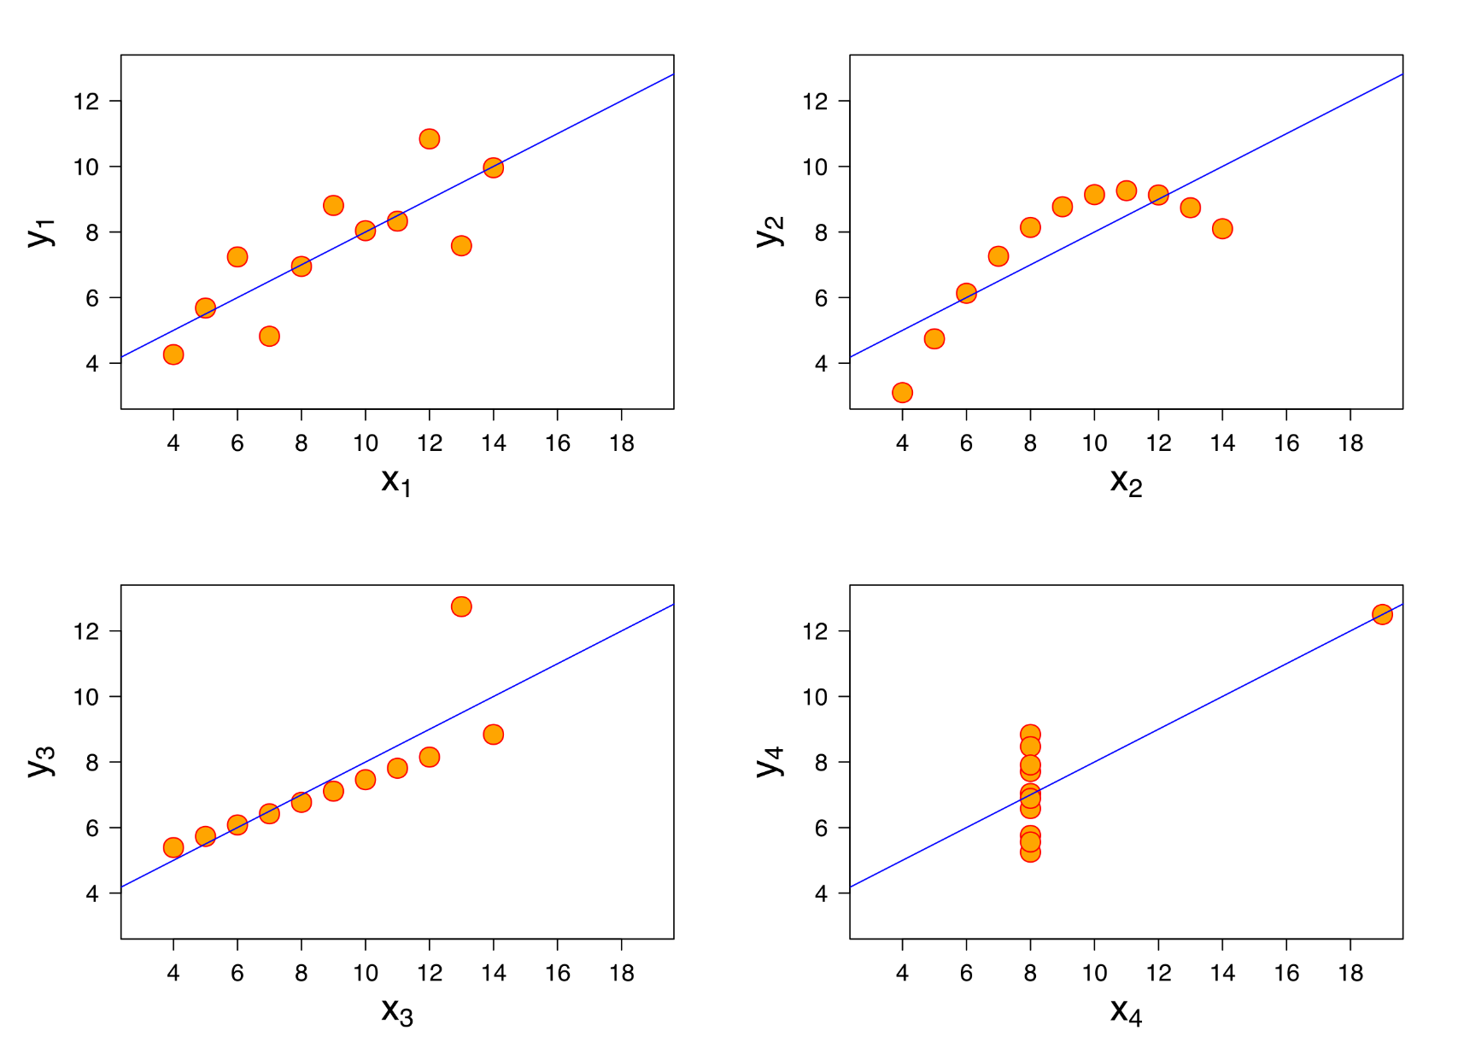
Correlation Examples (3 of 3)

Slide 49
Correlation Examples (3 of 3)
R² = 0.69
R² = 0.69
Anscombe’s Quartet
https://en.wikipedia.org/wiki/Anscombe%27s_quartet
Summary stats:
Mean_{x} 9
Mean_{y} 7.5
Var_{x} 11
Var_{y} 4.125
Model: y=0.5x+3
R² = 0.69
R² = 0.69

Slide 50
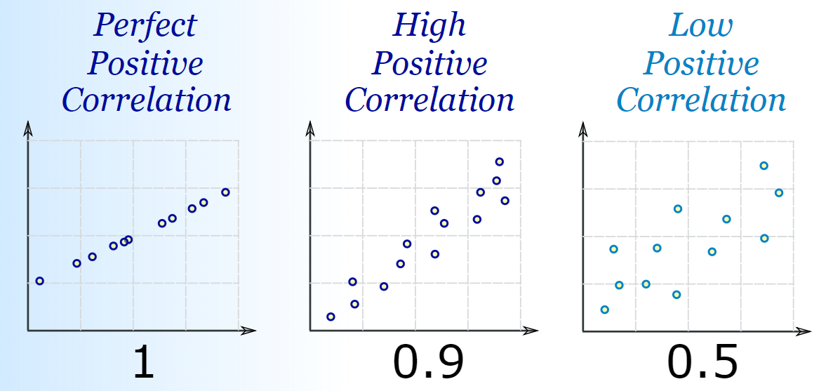
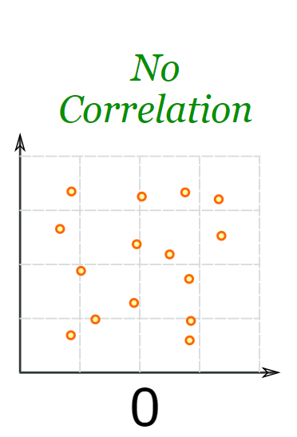
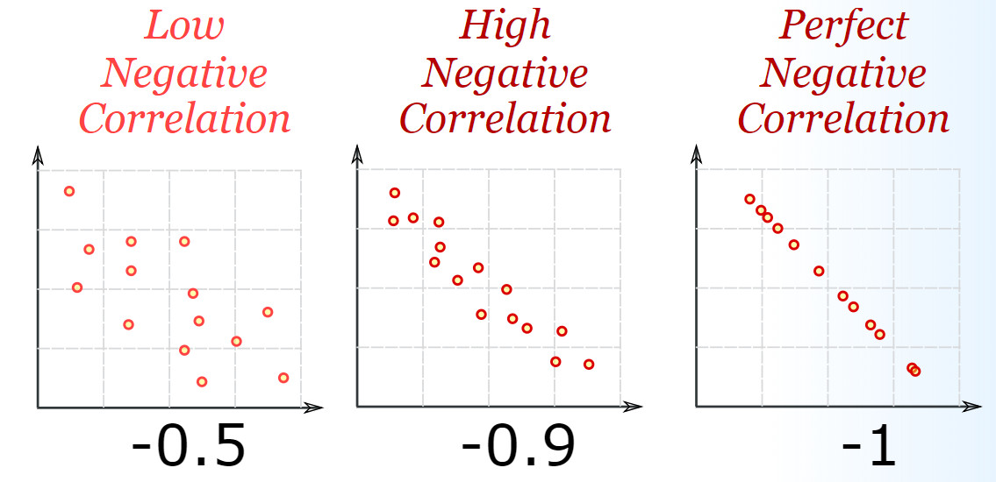
Correlation Summary
https://www.mathsisfun.com/data/correlation.html

Slide 51
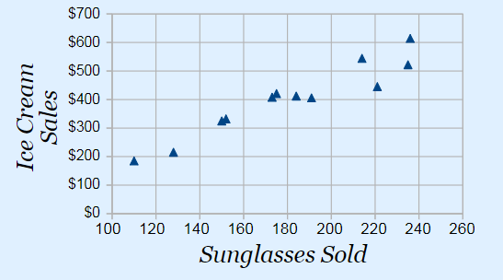
Correlation is not Causation
https://cdn-images-1.medium.com/max/1600/1*JLYI5eCVEN7ZUWXBIrrapw.png
Buying sunglasses causes people to buy ice cream?

Slide 52
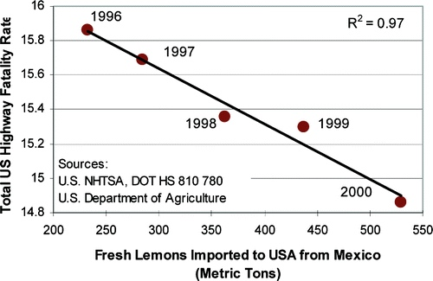
Correlation is not Causation
Importing lemons causes fewer highway fatalities?

Slide 53
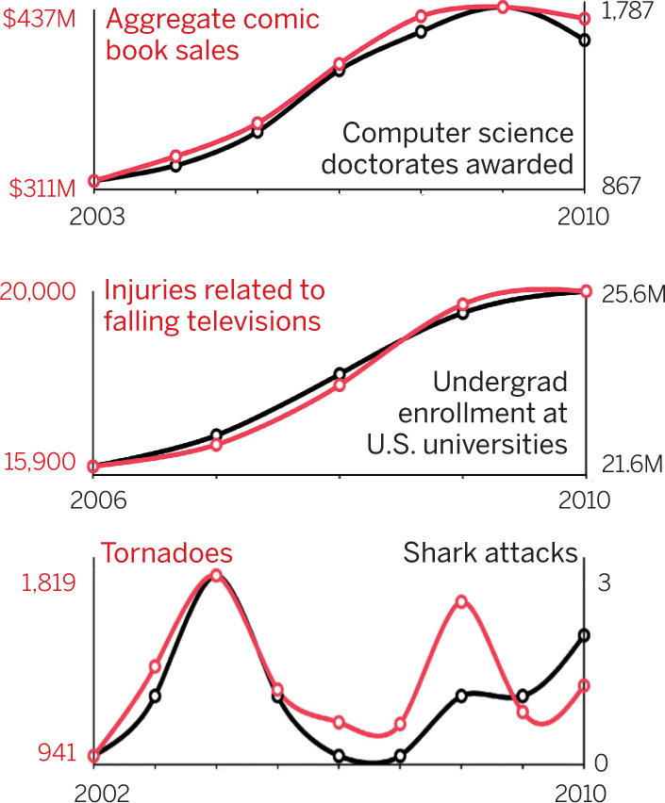
Correlation is not Causation
https://science.sciencemag.org/content/sci/348/6238/980.2/F1.large.jpg?width=800&height=600&carousel=1

Slide 54
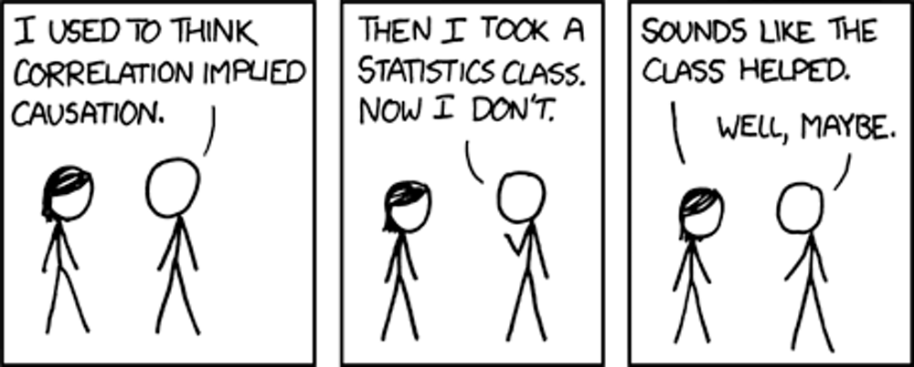
Correlation is not Causation
https://xkcd.com/552/

Slide 55
Outline
Introduction (done)
Simple Linear Regression (done)
Measures of Variation (done)
Misc (next)

Slide 56
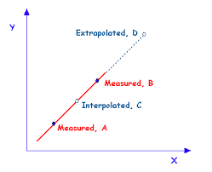
Extrapolation versus Interpolation
Prediction
Interpolation – within measured X-range
Extrapolation – outside measured X-range
https://qph.fs.quoracdn.net/main-qimg-d2972a7aca8c9d11859f42d07fce1799

Slide 57
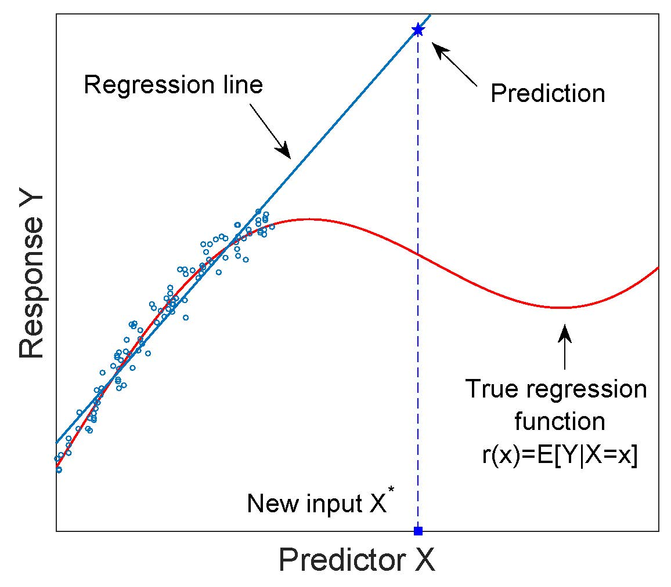
Be Careful When Extrapolating
https://i.stack.imgur.com/3Ab7e.jpg
If extrapolate, make sure have reason to assume model continues

Slide 58
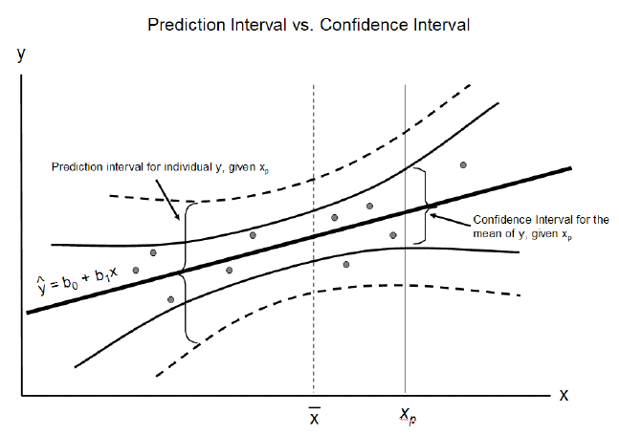
Prediction and Confidence Intervals (1 of 2)
https://cdn-images-1.medium.com/max/1600/1*vcbjVR7uesKhVM1eD9IbEg.png

Slide 59
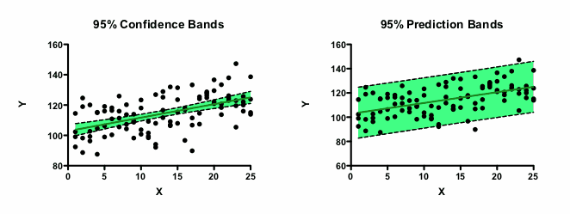
Prediction and Confidence Intervals (2 of 2)
https://www.graphpad.com/guides/prism/7/curve-fitting/reg_mostpointsareoutsideconfidencebands.png

Slide 60
Beyond Simple Linear Regression
https://medium.freecodecamp.org/learn-how-to-improve-your-linear-models-8294bfa8a731
Linear Quadratic Root Cubic
Multiple regression – more parameters beyond just X
Book Chapter 11
More complex models – beyond just
Y = mX + b

Slide 61
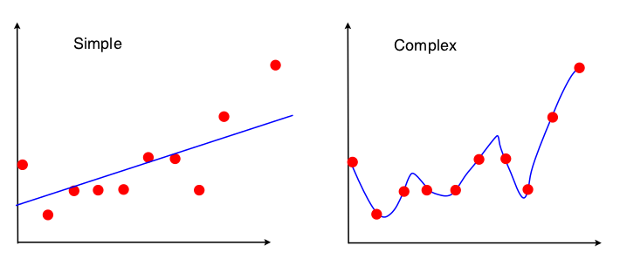
More Complex Models
y = 12x + 9
y = 18x⁴ + 13x³ - 9x² + 3x + 20
Higher order polynomial model has less error
→ A “perfect” fit (no error)
How does a polynomial do this?

Slide 62
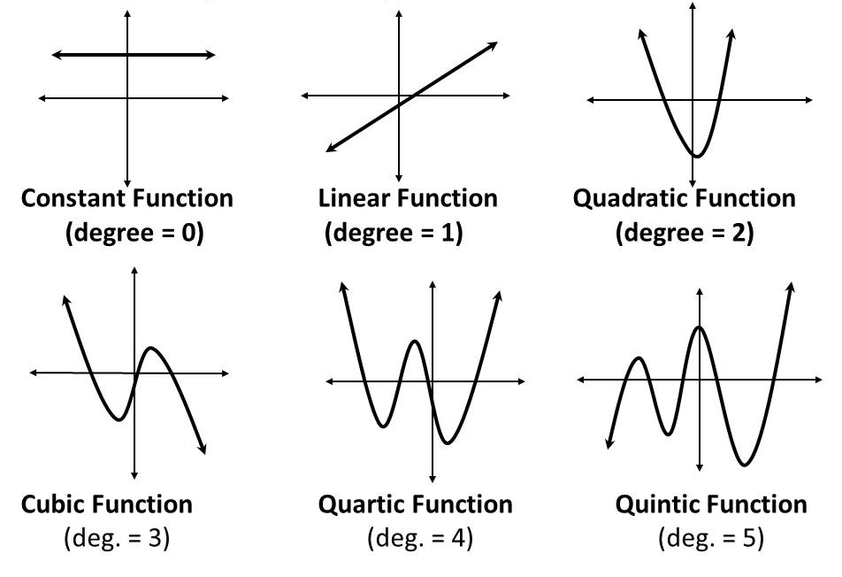
Graphs of Polynomial Functions
https://cdn-images-1.medium.com/max/2400/1*pjIp920-MZdS_3fLVhf-Dw.jpeg
Higher degree, more potential “wiggles”
But should you use?

Slide 63
Underfit and Overfit
https://i.stack.imgur.com/t0zit.png
Underfit
Just Right
Overfit
Overfit analysis matches data too closely with more parameters than can be justified
Underfit analysis does not adequately match data since parameters are missing
→ Both model do not predict well (i.e., for non-observed values)
Just right – fit data well “enough” with as few parameters as possible

