Slide 1
Testing Metrics for Password Creation Policies by Attacking Large Sets of Revealed Passwords
Matt Weir, Sudhir Aggarwal,
Michael Collins, Henry Stern
Presented by Erik Archambault

Slide 2
Background
NIST SP800-63, from 2006, presents entropy-based password strength metric
Based on Shannon’s information entropy from 1948
Goal: test NIST metric’s accuracy and conventional password policies with cracking attacks against real passwords
Data sets: RockYou.com (primary, ~32 million passwords)
Also FaithWriters.com, Singles.org, Neopets.com (assumed), PhpBB.com

Slide 3
Related Work
Torpig takeover-largest previous study on real password security
No other major results on actual security of password creation policies, e.g. the effect of password length
Also theoretical work trying to establish guessing entropy based on Shannon’s information entropy

Slide 4
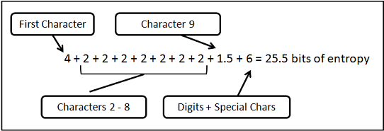
NIST Metric Rules
4 bits for first character
2 bits for 2nd-8th characters
1.5 bits for chars 9th-20th characters
1 bit for each additional character
6 extra bits for upper case and/or non-alphabetic characters
Up to 6 extra bits for blacklist check

Slide 5
NIST Metric
Rules based on Shannon’s entropy estimates
Shannon’s entropy estimates based on observations of English language strings
Entropy of subsequent characters based on knowledge of previous characters
Anticipates online attacks, with limited number and frequency of guesses
Chance of success = Number of Allowed Guesses / $2^{H(x)}$
H(x) = password entropy

Slide 6
NIST Metric
Two levels of acceptable risk:
Level 1: Chance of success = 1/1024
# of allowed guesses = $2^{H(x)}∗2^{−10}$
Level 2: Chance of success = 1/16384
# of allowed guesses = $2^{H(x)}∗2^{−14}$
Can tailor password creation policy based on level

Slide 7
Methodology
Split RockYou data set randomly into 32 even lists, 1 million passwords each
1st five lists are test set, last five are training set
RockYou set from multiple sites, no one policy affects whole set-more general
Observation: in first three lists, ~85% of passwords show 14-21.5 bits of entropy

Slide 8
Methodology
Use John the Ripper to simulate offline cracking attacks (also use short runs to compare to NIST thresholds)
Guessing rule set is simpler, slower than default
Used general base dictionary at first, later an optimized dictionary based on training data set
Assumed in all cases that attacker is aware of password creation policy
E.g. digits required, blacklist in effect

Slide 9
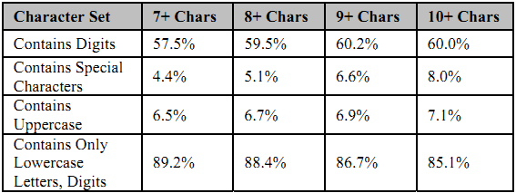
Initial Results
First test: one billion guesses, passwords grouped by length (7+, 8+, 9+, and 10+characters)
Increased length correlated with increased strength/lower cracking success
But…

Slide 10
Requiring digits
Second test: same as before, but digits required
Attack less successful against shorter passwords, oddly more successful against longer passwords
As longer passwords more likely contain digits, could have eliminated wasted guesses
Also, significantly decreased effectiveness on first 100 million guesses
Usage of digits not uniform, ‘1’ is by far the most common, in ~11% of cases
~85% of passwords with digits have them at the end or are entirely digits

Slide 11
Shorter Tests
Shorter attack: 50 thousand guesses (feasible for an online attack), with the same dictionary
Resulted in little difference based on password length
Short attack with optimized dictionary based on training set, performance similar to first test

Slide 12
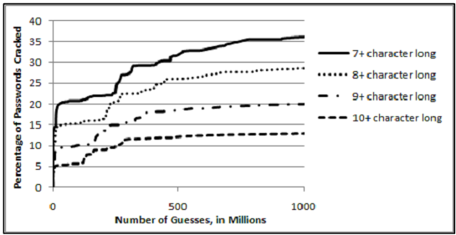
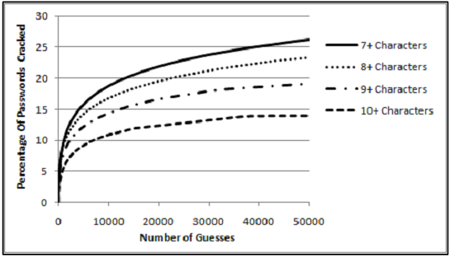

Slide 13
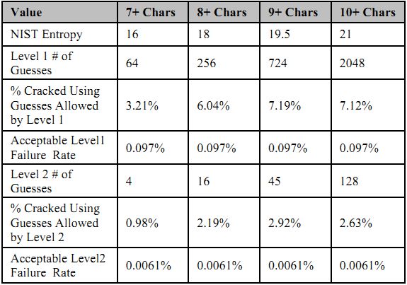
Shorter Tests
Very short attack (2000 guesses) with optimized dictionary
Still much more successful than NIST thresholds would allow or NIST metric predicts

Slide 14
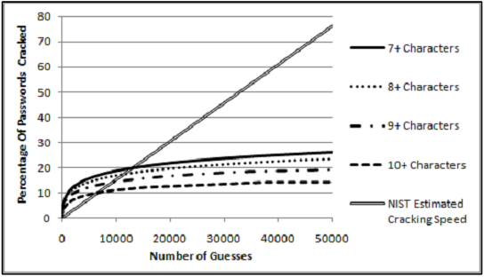
Results
Results imply blacklists are necessary
NIST paper says blacklists necessary for the entropy metric, but what about the last rule that adds entropy for blacklisting
NIST cracking speed prediction is unrealistic

Slide 15
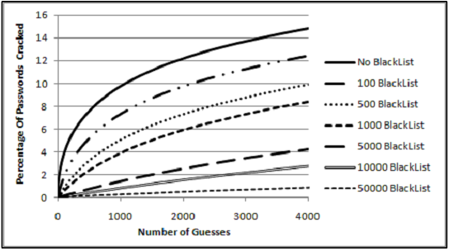
Effects of Blacklisting
Further attack tests show blacklisting to be very effective
However, attacks are still more successful than allowed by NIST’s Level 1 or 2 standards

Slide 16
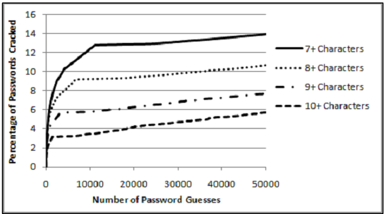
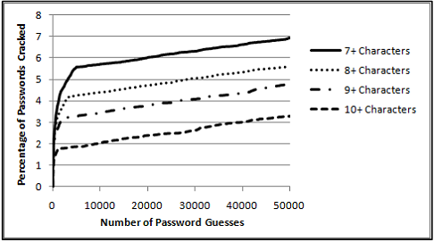
Upper Case/Special Characters
Requiring upper case or special characters decreases attack success, causes a plateau in cracking rate
Most passwords (nearly 90% of length 7) with uppercase characters follow one of two patterns
Special characters used in more varied ways

Slide 17
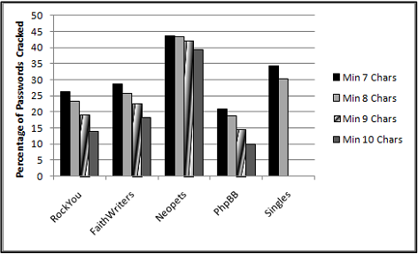
Validity of RockYou Training
Other data sets were attacked using training from RockYou set
Attacks were generally more effective against other password sets, even though trained on RockYou

Slide 18
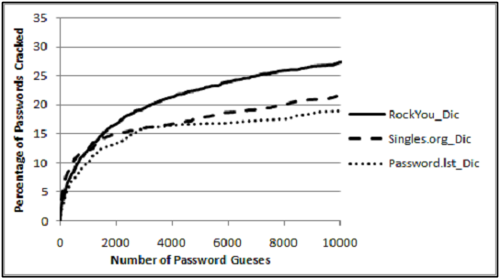
Validity of RockYou Training
Dictionary derived from RockYou training set was the most effective against FaithWriters passwords
Note Singles.org believed to have similar demographic to FaithWriters

Slide 19
Policy Suggestions
Explicit policies: clear, explicit constraints
Strong explicit policy can frustrate attacks
However, passwords can still be vulnerable based on poor user choices
External policies: user-selected base password is strengthened by system
Users tend to choose/reuse simpler base passwords
Users may also write down passwords to remember them

Slide 20
Policy Suggestions
Implicit policies: reject passwords that are too easy to guess
Rejection can be combined with other policies, e.g. an explicit policy
Assuming basis for rejection (e.g. blacklist) is accurate, reduces average guessability of passwords
Feedback can be used by attacker to improve attacks

