Slide 1
CS548 - Fall 2019 Web Mining ShowCase
Showcase by
Narges Ahani, Pascal Bakker, and Anirudh Basavraj Paramshetti
Showcasing work by
Anis Zaman, Rupam Acharyya, Henry Kautz, and
Vincent Silenzio
on
Detecting Low Self-Esteem in Youths from Web Search Data

Slide 2
References
[1] Zaman, Anis & Acharyya, Rupam & Kautz, Henry & Silenzio, Vincent. (2019). Detecting Low Self-Esteem in Youths from Web Search Data. International World Wide Web Conference
[2] Logistic Regression: Introduction to Data Mining, 2nd Edition (2019); Pang-Ning Tan, Michael Steinbach, Anuj Karpatne and Vipin Kumar; Chapter 4, Section 4.6
[3] Support Vector Machines: Introduction to Data Mining, 2nd Edition (2019); Pang-Ning Tan, Michael Steinbach, Anuj Karpatne and Vipin Kumar; Chapter 4, Section 4.9
[4] Bayesian Inference Binomial Distribution: Stigler, S. M. (1982). "Thomas Bayes' Bayesian Inference", Journal of the Royal Statistical Society, series A 145, 250-258
[5] JW Pennebaker, RJ Booth, RL Boyd, and ME Francis. (2015). Linguistic inquiry and word count: LIWC2015. Austin, TX: Pennebaker Conglomerates.

Slide 3
Introduction
Purpose: Use Google search logs (i.e., queries) to identify signs of low self esteem (LS) in individuals. LS may be associated with different aspect of mental health.
How?
Use Google search history of participants
Use health assessment survey of participants
Create a prediction model with Hybrid Bayesian Regression
Notes:
Speaker: Pascal Bakker
Talk about:
Purpose of paper. This can help identify the mental health.
How the paper addresses the problem
How the paper is different from previous papers

Slide 4
Introduction
Why use search logs instead of social media?
No self censoring
Large volume
Apply on individual level
Notes:
Speaker: Pascal Bakker
Talk about
Why search logs is better than using social media
Self Censoring: People fear of being judged
Large amount of data for each user to analyze
With individual search histories, we can determine if each user has low self esteem

Slide 5
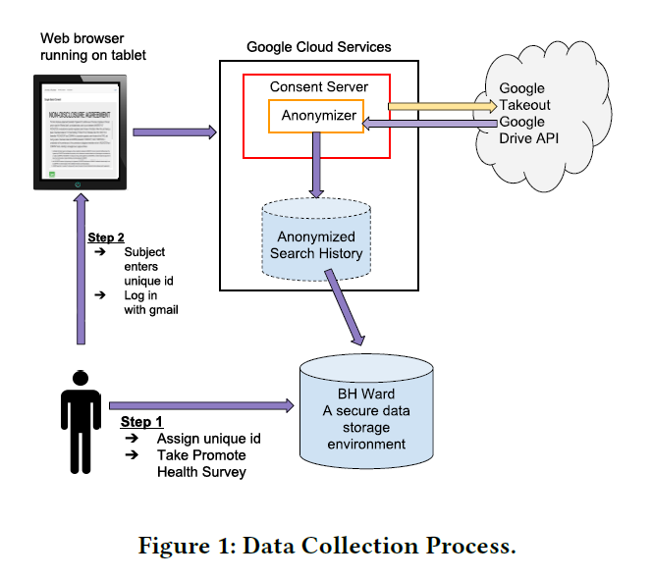
Data Collection
Recruit participants
2-month on-campus recruitment process
108 participants, 40 male and 68 females
Ask participants to take the Promote Health survey
Download Google search history for each participant through the Google Takeout platform
data is de-identified via Google’s Cloud Data Loss Prevention (DLP) API before handing it to the research team

Slide 6
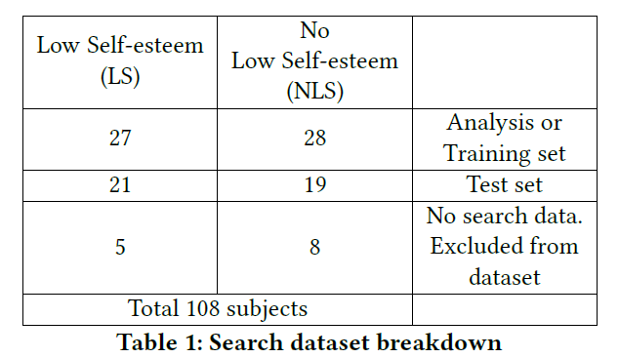
Data Collection
Through Promote Health survey, the answers to self-esteem questions were used to compute the Rosenberg Self-Esteem Scale (RSES)
53 individuals had score less than 12 (on a scale of 0-30), indicating low self-esteem (LSM) and 55 individuals had score greater than or equal to 12 indicating no sign of low self-esteem
Year | Number of students
Freshman | 38
Sophomore | 18
Juniors | 17
Seniors | 19
5th year undergraduates | 4
Graduate | 12

Slide 7
Creating Features From Search Logs (Queries)
2 Types of Features
Search Categories based features
Linguistic based features(LIWC)

Slide 8
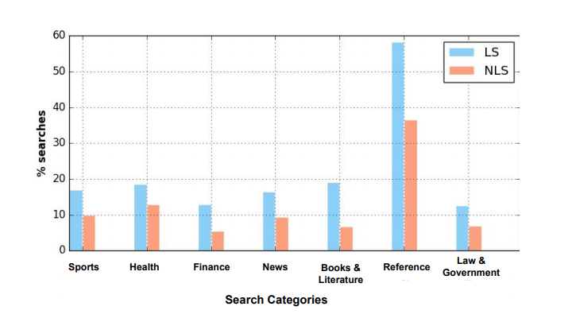
Feature Creation: Search Categories
Google Cloud NLP API Content Classification
API returns hierarchical list of categories. Take top category in list.
Search Query q -> API -> Hierarchical List “1. Arts & Entertainment, 2. Humor, 3. Funny...”
Categorize q as broad category “1. Arts & Entertainment”
Search frequency of LS vs NLS
with greatest difference
LS: Low Self Esteem
NLS: No Low Self Esteem
Note: there are 27 categories
Notes:
Speaker: Pascal Bakker
Quickly explain what the NLP API is and how it is classified

Slide 9
Data Exploration: Search Categories
Compare frequency of categories of LS/NLS users
LS more reliant on web searching for school work
LS search at higher frequency during late hours
Search frequency of LS vs NLS
with greatest difference
LS: Low Self Esteem
NLS: No Low Self Esteem
Notes:
Speaker: Pascal Bakker
LS condition consistently searched more on topics related to ‘Sports’, ‘Health’, ‘Finance’, ‘News’, ‘Books & Literature’, ‘Reference’, and ‘Law & Government’.
Low Self Esteem Very Reliant On Search for School Work
Low Self Esteem search for topics at higher frequency during late hours. Poor sleep habits

Slide 10
Feature Creation: Linguistic
LIWC - Linguistic Inquiry and Word Count
LIWC toolkit outputs proportion of words in each category
Linguistic (prepositions, adverbs, first-person singular pronouns, conjunctions)
Psychological (happy, anger, achievement, etc.)
Topical (leisure, money, etc.)
LIWC used to analyze individual search histories
Compare LS and NLS proportional word counts
Notes:
Speaker: Pascal Bakker

Slide 11
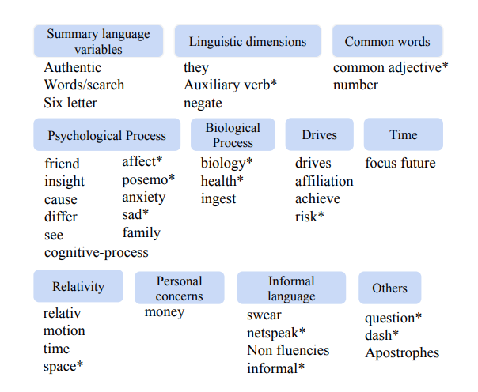
Feature Creation: Linguistic
The LIWC toolkit outputs 92 different attributes
40 of these LIWC attributes are significantly different (with p-value < 0.05) between LS and NLS subjects

Slide 12
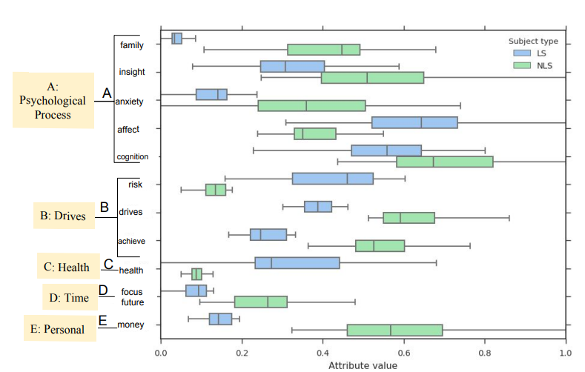
Data Exploration: Linguistic
LIWC categories that were significantly different between LS and NLS
Notes:
Speaker: Pascal Bakker
In the low self-esteem analysis, the family variable was significantly lower for almost every participant with LS condition than participants with NLS condition.

Slide 13
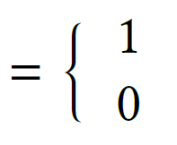
Modeling
n: Number of people
m: Number of features (i.e. search categories extracted from search history)
: Vector represents features for person Pi,
Person Pi exhibit low self-esteem
Otherwise
Two parameters to learn:

Slide 14
Modeling
Hybrid Bayesian Regression (HyBaR)
Bayesian Linear Regression
Bayesian Logistic Regression
Incorporate
Domain Knowledge
In a form of prior
Why Bayesian Regression?

Slide 15
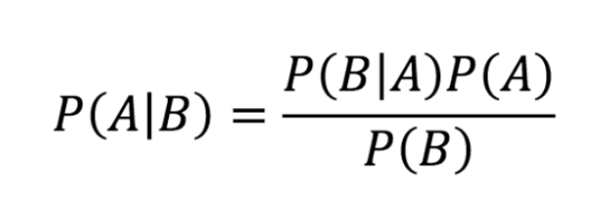
Modeling
Likelihood
Prior
Posterior
Marginal Likelihood
Bayesian Rule
Notes:
Prior : probability distribution of our parameters → this is what we believe or our domain knowledge about our parameters before any modeling

Slide 16
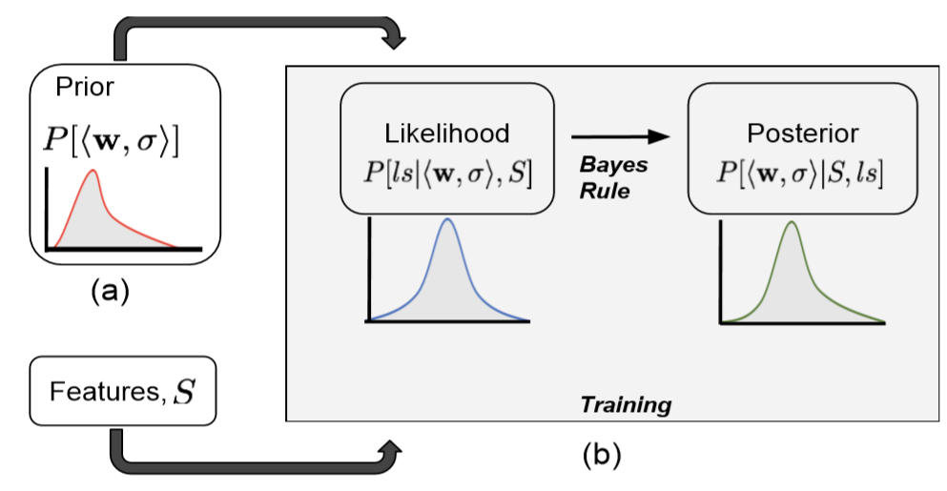
Modeling
In Summary: to get the posterior of parameters from the corresponding prior distribution and the training data likelihood.
Goal: to estimate the entire posterior distribution and sample model parameters from posterior distribution

Slide 17
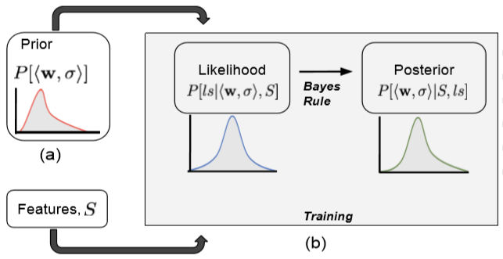
Modeling

Slide 18
Modeling
Prior for just a Uniform distribution
LIWC based features: Laplace Dist.
Why Laplace? Sparsity
Prior for
Search-Category based features:
Gaussian Dist.
Category Similarity Matrix (semantic distance between the search categories)

Slide 19
Modeling

Slide 20
Modeling
Sample several parameters from posterior distribution
Using each of those learned parameters, classify the test dataset
Record the performance of the model for each set of parameters
Report the average performance of the model on test set

Slide 21
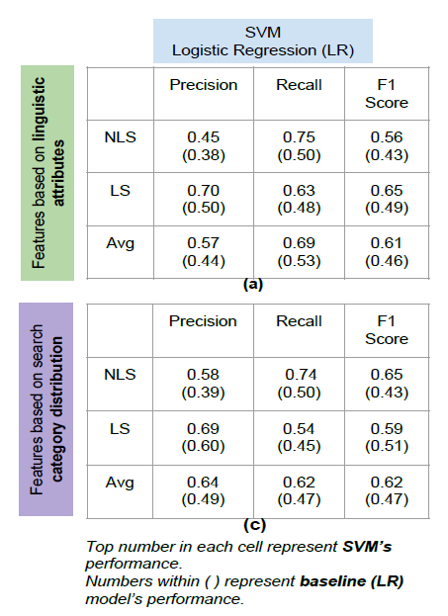
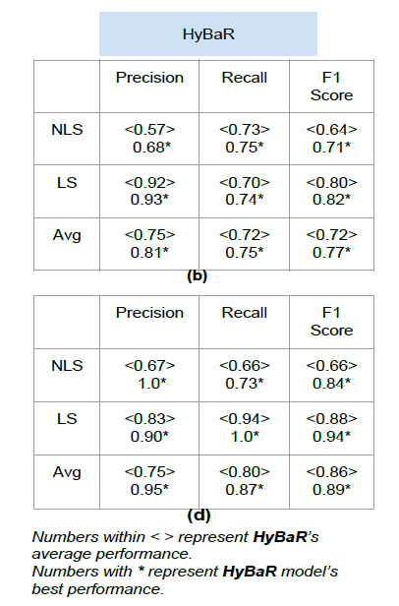
Results

Slide 22
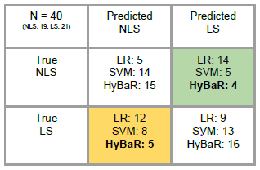
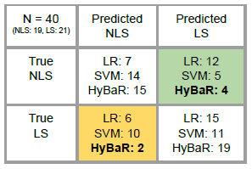
Results

Slide 23
Conclusions
Study self-esteem not on the population level (Google Trends) but on individual level (Google Takeout) for the first time
Built a system to consent, collect and anonymous individuals’ history data through Google Takeout
Created the first datasets that link search history data to clinically-used mental health survey instrument
Showed that search history data provides identifiable signals for detecting low self-esteem and high self-esteem

Slide 24
Future Work
Use both feature sets at the same time → need to collect more data
Study on more general population than only college students
Try different data source (recruitment sites)
i.e., clinics, emergency rooms, family courts,...
Consider features beyond linguistic and search categories
E.g. Time at which these searches are made, seasonality of certain type of searches. Some hypothesis:
Middle of night search → proxy for sleeplessness problem
Increase in volume of searches → withdraw from social interactions
Time and date of search → longitudinal studies on disease progression
Study other mental health phenomenon i.e. anxiety, panic disorders, suicide ideation, bipolar disorders, eating disorders, substance abuse or addiction

Slide 25
Thank you for your time!

