Slide 1
CS548 Fall 2019
Decision Trees Showcase
By Alexander Moore, Oscar Garcia
Showcasing work by Juana de Oña, Griselda López, Joaquín Abellán on
“Extracting decision rules from police accident reports through decision trees”

Slide 2
References
de Oña, Juana, López, Griselda, and Abellán, Joaquín. “Extracting Decision Rules from Police Accident Reports through Decision Trees.” Accident Analysis and Prevention 50 (2013): 1151–1160. Web. https://wpi.primo.exlibrisgroup.com/discovery/fulldisplay?docid=sciversesciencedirect_elsevierS0001-4575(12)00313-2&context=PC&vid=01WPI_INST:Default&lang=en&search_scope=MyInst_and_CI&adaptor=Primo%20Central&tab=Everything&query=any,contains,extracting%20decision%20trees%20police%20accident&offset=0
James, Gareth. An Introduction to Statistical Learning: with Applications in R. Springer, 2017.

Slide 3
Domain Motivation
Accidents worldwide cause 1.27 million deaths and 35 million annual injuries
Goal of paper is interpretable results
Special interest in rare cases: fatal crashes (6% of data)
Concerns over type-1 errors: False positives in fatal accident prediction
Notes:
Many studies have been done to try to understand factors that lead to accidents, particularly fatal or serious injury accidents.
Disproportionate interest in rare occurrences such as fatal accidents (6% of data)
Authors use a 30% holdout testing as well as cross-validation for model training to avoid type-1 errors, which are present when many pattern combinations are possible (chance of random positive result for non-authentic pattern)

Slide 4
Why Use Decision Trees?
Tree’s interpretability for road safety managers
Novel application of Decision trees to accident data
Nonparametric method: does not impart assumptions on the structure of the data that function methods do
Trees extract decision rules, which allows for conditional interaction among input data:
  If(thin roads And low-light) Then (serious injury)
Notes:
Author’s goal to determine valid, novel, useful, and understandable patterns in data.
Much easier in a tree to interpret (low light condition) AND (sharp turn) than it is for a linear combination of predictors, for both data researchers and domain experts.
Trees provide a non-parametric technique that do not impart assumptions about the data such as logit and probit models, which had been done before.
Trees extract decision rules of “If-Then” type (if thin roads THEN rollover (serious injury) likely)

Slide 5
Data Description
Data are from a set of recorded accidents in Granada, Spain
1801 data points for one-lane (each direction) highway accidents
19 variables total including target
108 Fatal accidents is small training set
‘Severity’ Categorical target with two classes:
  ‘No or Slight Injury’ (SI)
  ‘Serious Injury or Fatal Accident’ (KSI)

Slide 6
Available Features
Accident Type
Age
Weather
Safety Barriers
Cause
Weekend or Weekday
Lane Width
Lighting
Month
Number of Injuries
Occupants Involved
Paved Shoulder
Pavement Width
Pavement Markings
Gender
Shoulder Type
Sight Distance
Time of Day
Vehicle Type

Slide 7
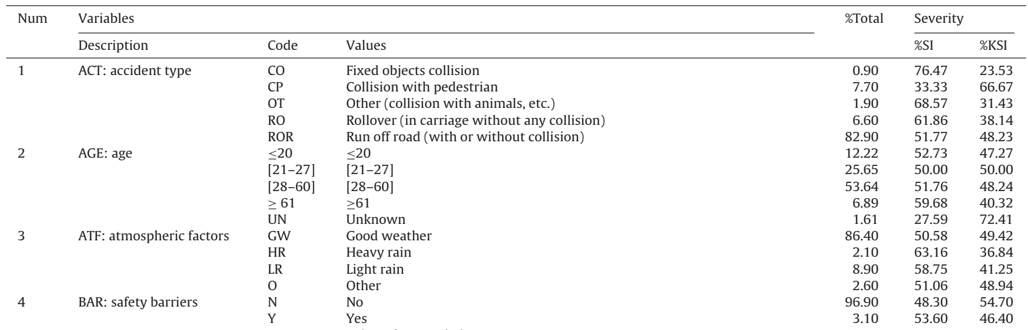
Data Codebook
Killed or
Seriously Injured
Slight Injury

Slide 8
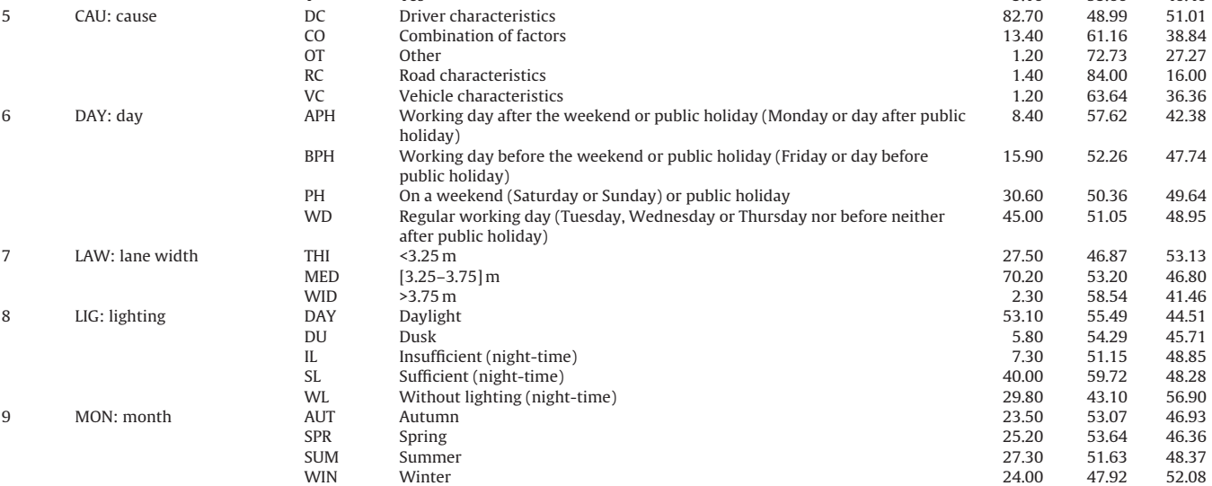
Data Codebook

Slide 9
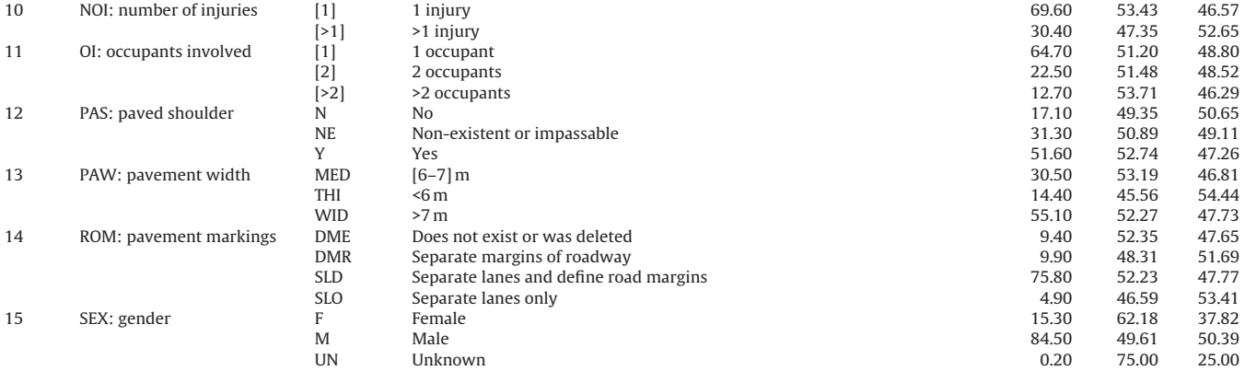
Data Codebook

Slide 10
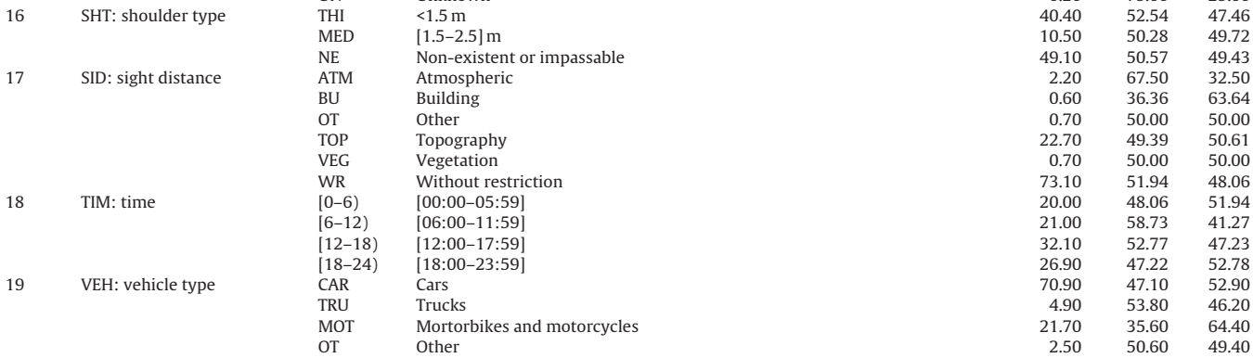
Data Codebook

Slide 11
Methods
Iterative Dichotomiser 3 (ID3)
  Similar to CART without the binary restriction
  Only functions with discrete variables
C4.5
  Utilizes Information Gain ratio instead of Information Gain
  Can deal with continuous attributes and missing values
Classification and Regression Tree (CART)
  Uses best-differentiation splits
  Only produces binary DT
All methods are trained to comparable accuracy to other accident severity research (60%)
Notes:
Methods
CART, ID3, C4.5, all trained to comparable accuracy to other research done (around 60% accuracy)
Once trained, they are inferential tools

Slide 12
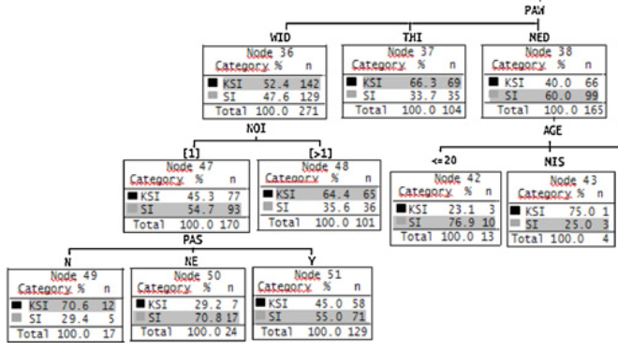
Results
PAW: Pavement Width
MED:[6-7] m
THI:<6 m
WID: >7 m
NOI: Number of Injuries
PAS: Paved Shoulder
N: No
NE: Non-existent
Y: Yes
The DT selects the target category with the highest proportion
Zoomed section of DT built with C4.5

Slide 13
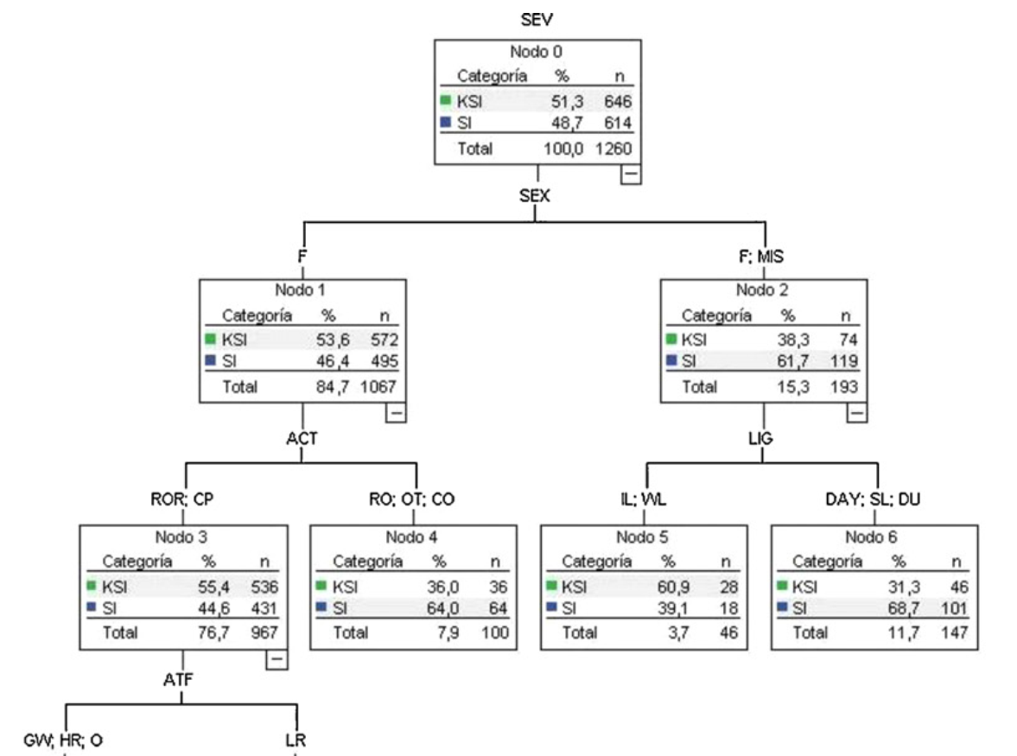
Zoomed section of DT built with CART
ACT: Accident type
CO: Fixed object collision
CP: Collision with pedestrian
OT: Other
RO: Rollover
ROR: Run off road
LIG: Lighting
DAY: Daylight
DU: Dusk
IL: Insufficient
SL: Sufficient
WL: Without lighting
ATF: Atmospheric factors

Slide 14
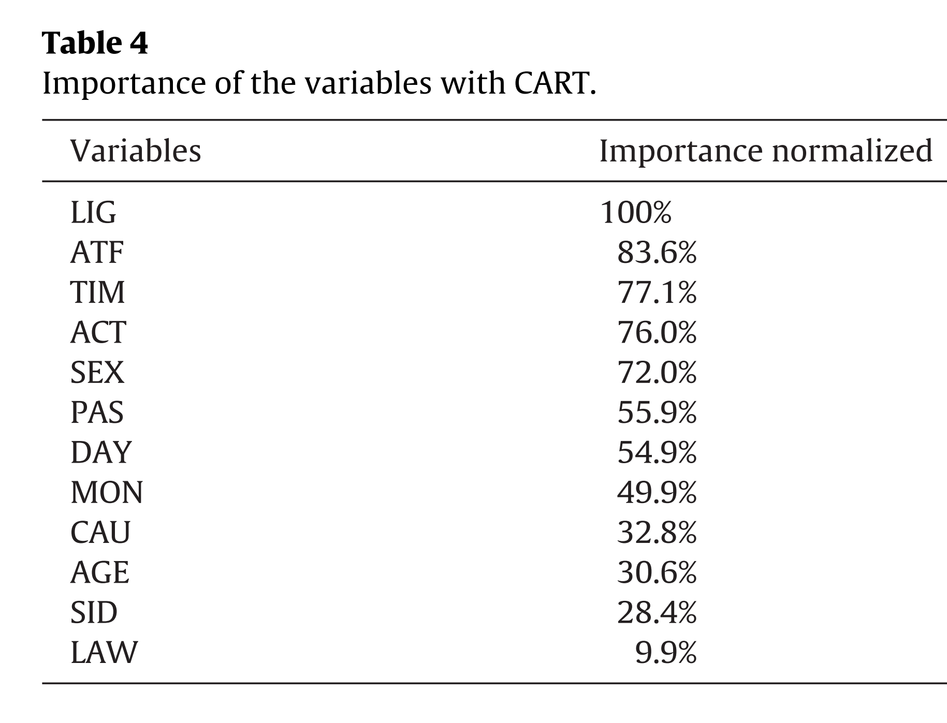
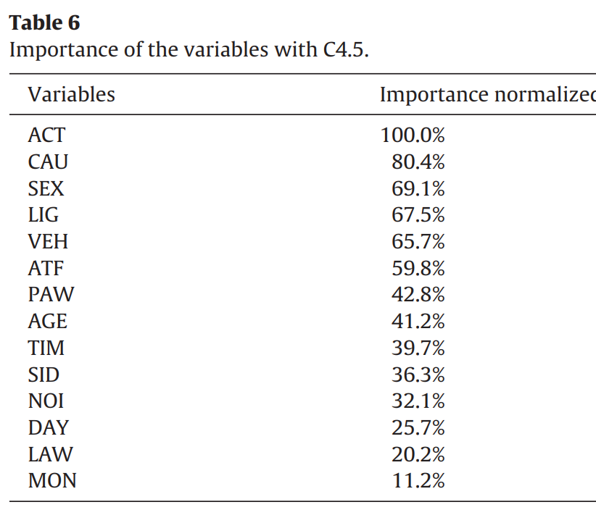
Importance of the variables

Slide 15
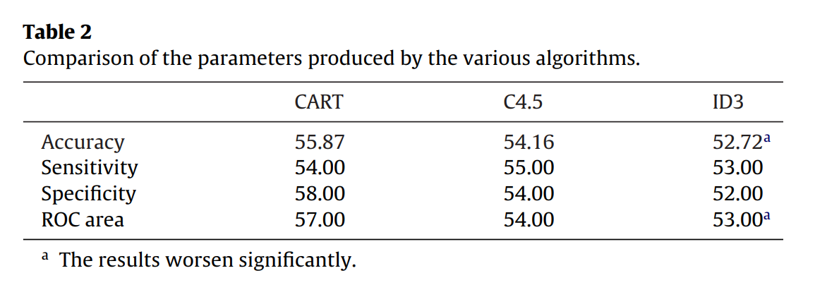
Accuracy: Percentage of cases correctly classified
Sensitivity: Percentage of true positives in all the cases classified as positive (or case A)
Specificity: Percentage of true negative in all the cases classified as negative (or case B)
ROC area: The area between the true positive curve versus the false positive curve

Slide 16
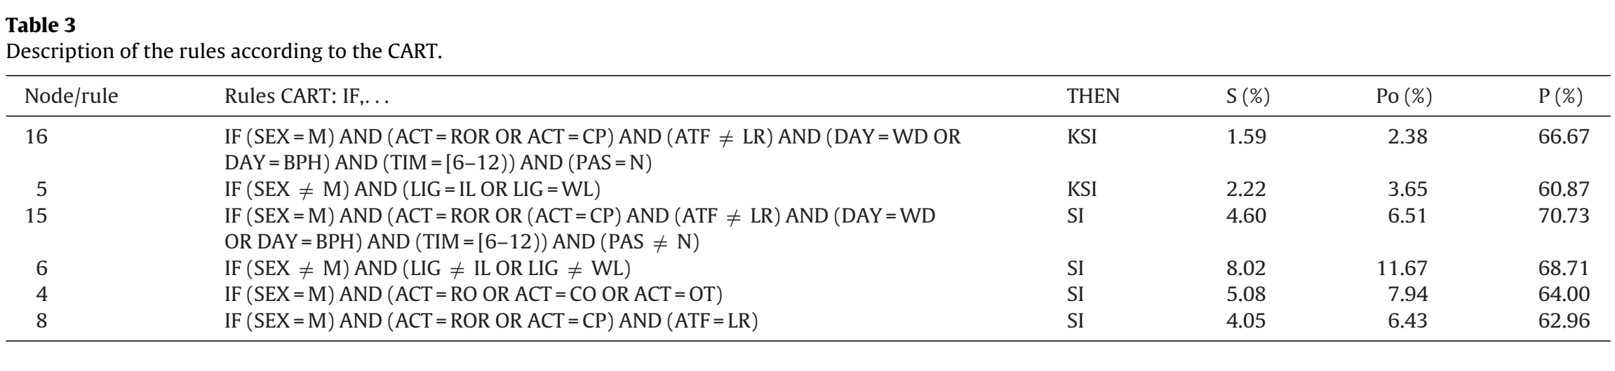
Support (S%): The percentage of the data set where consequent and antecedent of the rule appears
Population (Po%): The percentage of the data set where antecedent of the rule appears
Probability (P%): The percentage of cases where the rule is accurate
P=S/Po
(de Oña, 2012, p. 1153)

Slide 17
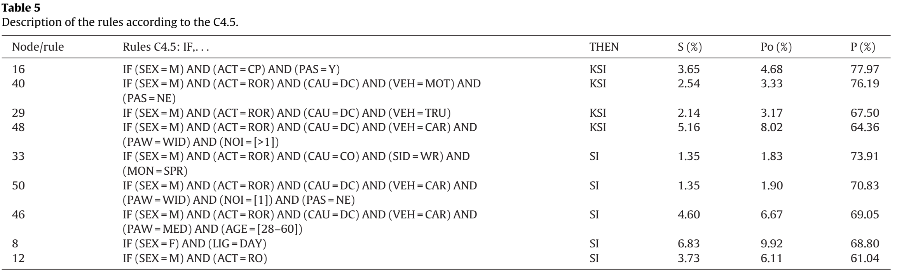
Support (S%): The percentage of the data set where consequent and antecedent of the rule appears.
Population (Po%): The percentage of the data set where antecedent of the rule appears.
Probability (P%): The percentage of cases where the rule is accurate.
P=S/Po
(de Oña, 2012, p. 1153)

Slide 18
Some Conclusions
Male drivers are the main causes of KSI crashes.
The probability of KSI increases if pedestrians are involved
When women drivers are involved in an accident, both methods predict SI when lighting exists. However, both methods predict KSI when the lighting is non-existent or insufficient . These rules are not observed for men and may indicate that women increase their risk of severity under conditions of less lighting on the road.
(de Oña, 2012, p. 1159)

Slide 19
Some Conclusions
It is impossible to analyze the influence of a specific category on severy with CART
C4.5 creates a branch for each category permitting the analysis of each category
C4.5 generates more branches than CART and therefore more rules but not all of them are useful
The importance of the variables can be extracted with both algorithms
(de Oña, 2012, p. 1159)

