Slide 1
CS548 Fall 2018 Model and Regression Trees
Showcase by Geri Dimas and Han Liu
Showcasing work by
A. Troncoso, S. Salcedo-Sanz, C. Casanova-Mateo,
J.C. Riquelme, L. Prieto
on
"Local models-based regression trees for very short-term wind speed prediction”

Slide 2
References
[1] A. Troncoso, S. Salcedo-Sanz, C. Casanova-Mateo, J. Riquelme, and L. Prieto, “Local models-based regression trees for very short-term wind speed prediction,” Renewable Energy, vol. 81, pp. 589–598, 2015.
[2]P.-N. Tan, M. Steinbach, A. Karpatne, and V. Kumar, Introduction to data mining. NY NY: Pearson, 2019.
[3]I. H. Witten, E. Frank, M. A. Hall, and C. J. Pal, Data mining: practical machine learning tools and techniques. Amsterdam: Morgan Kaufmann, 2017.
[4] M. Robnik-Sikonja, P. Savicky, M. M. Robnik-Sikonja, Package ‘corelearn’, 2018.
Notes:
Add reference for R corelearn package background

Slide 3

The Problem :
A need for methods that produce quick, accurate forecasting of short-term wind speeds in wind farms.
Every wind farm installed is required to report hourly energy predictions in most countries
Evaluation of prospective locations for new wind farm placements
To ensure stability of the whole electric system in case of large penetrating of wind energy
The Importance
https://www.iconfinder.com/icons/426577/ecol_ecology_wind_wind_energy_windmill_icon
Notes:
The importance ability predict plays: - it is required in every wind farm, can help determine ideal locations for new farms, also important to ensure stability of the whole electric system in cases of large penetrating of wind energy.

Slide 4

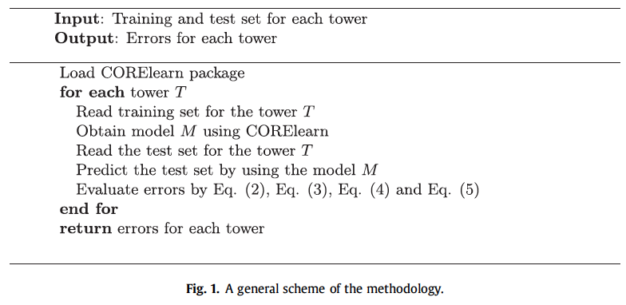
The Method:
Local models-based regression trees
http://freescrapbooks.blogspot.com/2011/05/clip-art-leaf-tree.html
Notes:
This is used create the regression trees → how it works
Chooses the model Tree with the lowest errors for each tower

Slide 5
The Models in the leaves:
 | Global Model? | Linear Model? | Differences
Model 1 (M1) | √ | √ | Constant (Mean)
Model 2 (M2) | √ | √ | Constant (Median)
Model 3 (M3) | √ | √ | Minimize the mean square error
Model 4 (M4) | √ | √ | Minimize description length principle
Model 5 (M5) | √ | √ | MSE + a greedy search
Model 6 (M6) | X | X | k-Nearest Neighbors + Mean
Model 7 (M7) | X | X | k-Nearest Neighbors + Weighted Mean
Model 8 (M8) | X | √ | Minimize locally weighted mean square error
Notes:
Define what a local model is vs. global
When we get to model 6 and 7, I will explain further what the difference between a global and local model is
Define linear model

Slide 6
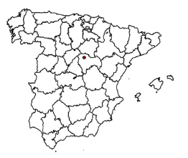
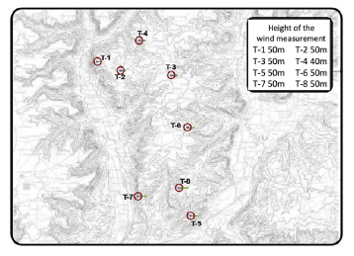
The Data:
Hourly wind speeds collected at 8 wind towers from November 2008 to November 2010
Guadalajara, Spain
239 discontinuous time series data for each tower
  70% for training
(175 TS data, 3061 records)
  30% for testing
(64 TS data, 1091 records)

Slide 7
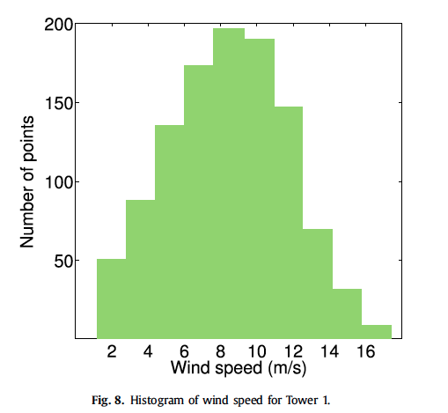
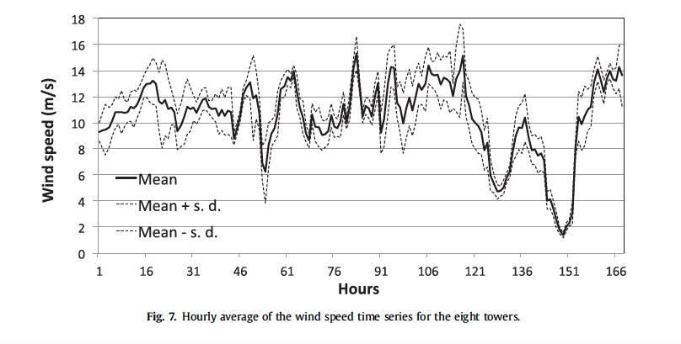
The Data
Example of wind speed distribution for tower 1
Shows hourly averages of wind speed for the 8 towers over 168 hrs in October 2010
Notes:
Data is collected Hourly from each tower -- so we have 8 TS data avaliable one for each tower from Nov 2008 to Nov 2010 the graph represents the average of the 8 together to produce the windspeed-- snippet is of approx 7 mths of data

Slide 8
The Process:
Basic Regression Tree
1. Calculate heterogeneity in class/target attribute
2. Calculate homogeneity for each of the available attributes , selecting the one with largest reduction in heterogeneity in relation to the class, this becomes root/internal node
3. Divide values on the selected attribute
4. Repeat Steps 2-4 until meet termination criteria
Notes:
Geri
The difference between our approach and the basic RT approach is we apply a different TYPE of Regression model in
Basic Regression tree process
Explain M6/M7 nearest neighbor idea
Example is breadth first search
M6/M7 - k nearest neighbor

Slide 9
The Process:
The Global Model:
The grey points are the training data
The x value we want to predict a value of y for
Y
The y value we predict using the Global Model
X
Notes:
First explain what a global model is versus a linear model in a very simplistic case
Lets say we have a 1D set of data, and want to run regression on this set of data
What a global model does is it considers the ENTIRE set of values to create a prediction
Show the first line that is “ roughly” a regression line through the data
For arguments sake lets say the line produced is accurately depicted given the points presented.
What a global model does is takes into consideration all of the points in the data set when forecasting the y prediction of a x value.
Ex: Lets say we are trying to predict the y valeu for the value ( depicted by square) on X---->
2. Now a Local model differs by only taking into consideration the

Slide 10
The Process:
The Local Model:
K Nearest Neighbor Local Model
The grey points are the training data
The x value we want to predict a value of y for
Y
The k nearest neighbors for our x value in the x space
Where y =4
The y value we predict using the Local Model
If K=1
X
So we predict y=4
Notes:
Now the local model can be described as follows:
In this paper they choose to use two local type models: K- nearest neighbors and Weighted K-nearest neighbor
EXAPLIN the difference between weighted and not

Slide 11
The Process:
The Local Model:
K Nearest Neighbor Local Model
Average of K nearest neighbors=(4+5+9)/3
=6
The grey points are the training data
The x value we want to predict a value of y for
Y
y=9
y=5
The k nearest neighbors for our x value in the x space
y=4
The y value we predict using the Local Model
If K=3
X
So we predict y=6
Notes:
Now the local model can be described as follows:
In this paper they choose to use two local type models: K- nearest neighbors and Weighted K-nearest neighbor
EXAPLIN the difference between weighted and not

Slide 12
The Process:
Using Nearest Neighbor Algorithm in Regression Trees
Given a test data instance, follow the branch of the tree that corresponds to the test instance until you get to the leaf. Then:
1. Find the k nearest neighbors of the test instance among the data instances of the training set that belong to the leaf
2. Calculate the mean the target values of these k nearest neighbors and output this mean as the prediction value
Notes:
Geri
Basic Regression tree process
Explain M6/M7 nearest neighbor idea
Example is breadth first search
M6/M7 - k nearest neighbor

Slide 13
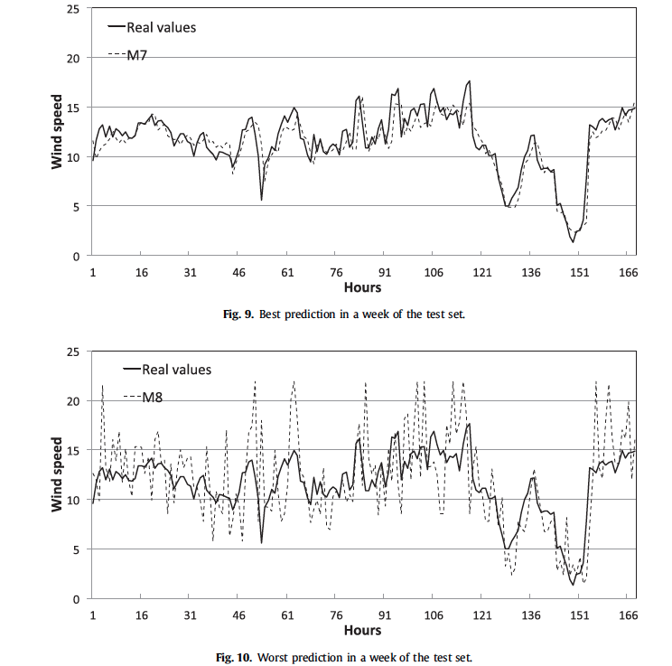
Experiment Results: Model Evaluation and Comparison
 | Performance (MSE in m/s) | Speed(Learning time in seconds) | Speed(Forecasting time in seconds)
Model 1 | 1.421 | 0.017 | 0.000
Model 2 | 1.427 | 0.016 | 0.000
Model 3 | 1.398 | 0.022 | 0.000
Model 4 | 1.398 | 0.034 | 0.001
Model 5 | 1.373 | 0.019 | 0.000
Model 6 | 1.326 | 0.055 | 0.001
Model 7 | 1.326 | 0.056 | 0.001
Model 8 | 2.788 | 0.076 | 0.004
 | Performance (MSE in m/s) | Speed(Learning time in seconds) | Speed(Forecasting time in seconds)
Model 1 | 1.421 | 0.017 | 0.000
Model 2 | 1.427 | 0.016 | 0.000
Model 3 | 1.398 | 0.022 | 0.000
Model 4 | 1.398 | 0.034 | 0.001
Model 5 | 1.373 | 0.019 | 0.000
Model 6 | 1.326 | 0.055 | 0.001
Model 7 | 1.326 | 0.056 | 0.001
Model 8 | 2.788 | 0.076 | 0.004
Notes:
Han
These regression models are used in the leaf nodes

Slide 14
Alternative Non- RT Methods: Comparison
 | Performance (MSE in m/s) | CPU time ( in seconds)
M6 | 1.326 | 0.055
M7 | 1.326 | 0.056
SVM | 1.358 | 511.437
MLP | 1.368 | 17.773
CART | 1.465 | 0.016
 | Performance (MSE in m/s) | CPU time ( in seconds)
M6 | 1.326 | 0.055
M7 | 1.326 | 0.056
SVM | 1.358 | 511.437
MLP | 1.368 | 17.773
CART | 1.465 | 0.016
Notes:
Geri

Slide 15
Conclusion
Regression trees based on local models (in particular M6, M7) are a powerful methodology for predicting wind speeds
Regression Tree algorithms are favorable in comparison to other methods in terms of prediction errors on the testing data
In addition Regression Trees have overall low computational times, which prove to be beneficial given the short-term nature of wind speeds

Slide 16
Thank you!
Questions?

