Slide 1
Node Removal From BST
Source: http://www.algolist.net/Data_structures/Binary_search_tree/Removal

Slide 2
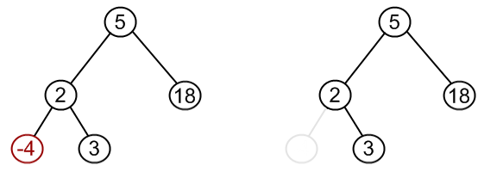
Removing -4 From This Tree

Slide 3
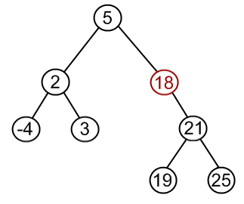
Removing 18 From This BST

Slide 4
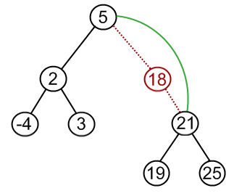
Removing 18 From This BST
18 has only one child, so just elevate that child.

Slide 5
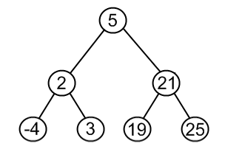
Removing 18 From This BST
18 has only one child, so just elevate that child.

Slide 6
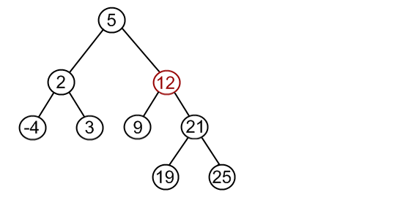
What If Removed Node in BST Has Two Children?
Say we wanted to remove 12. We want the leftmost node to its right to be its replacement.

Slide 7
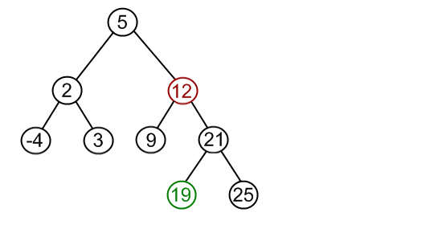
What If Removed Node in BST Has Two Children?
19 is the leftmost node to the right of 12. It is also the smallest number that is larger than 12 in the tree (this is why it is leftmost).

Slide 8
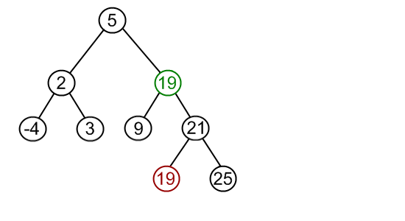
What If Removed Node in BST Has Two Children?
Rather than thinking of it as removing and rearranging nodes, think of it as copying and deleting the old node.
Copy 19’s data into 12’s spot.

Slide 9
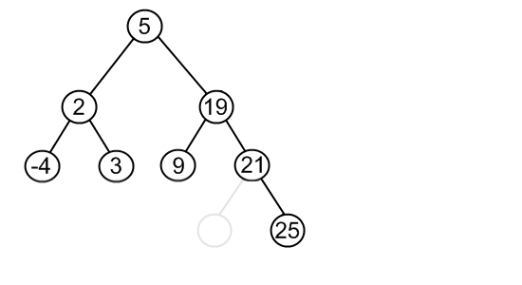
What If Removed Node in BST Has Two Children?
Lastly, remove that 19 that we copied.

Slide 10
How This Looks In Java
public class BinarySearchTree {
…
public boolean remove(int value) {
if (root == null)
return false;
else {
if (root.getValue() == value) {
BSTNode auxRoot = new BSTNode(0);
auxRoot.setLeftChild(root);
boolean result = root.remove(value, auxRoot);
root = auxRoot.getLeft();
return result;
} else {
return root.remove(value, null);
}
}
}
}
public class BSTNode { …
public boolean remove(int value, BSTNode parent) {
if (value < this.value) {
if (left != null)
return left.remove(value, this);
else
return false;
} else if (value > this.value) {
if (right != null)
return right.remove(value, this);
else
return false;
} else {
if (left != null && right != null) {
this.value = right.minValue();
right.remove(this.value, this);
} else if (parent.left == this) {
parent.left = (left != null) ? left : right;
} else if (parent.right == this) {
parent.right = (left != null) ? left : right;
}
return true;
}
}
public int minValue() {
if (left == null)
return value;
else
return left.minValue();
}
}

Slide 11
Interactive Visualization
https://www.cs.usfca.edu/~galles/visualization/BST.html

