Slide 1
Using the Eclipse Debugger

Slide 2
Why use the debugger?
The debugger can show you what values are in variables and what objects exist at a current point in time in your code.
With the simple arithmetic that you’ve been doing in your previous homeworks, the debugger doesn’t seem too necessary.
However once you move onto working with trees and more complicated structures, the debugger will be incredibly useful.

Slide 3
How to Place Breakpoints

Slide 4
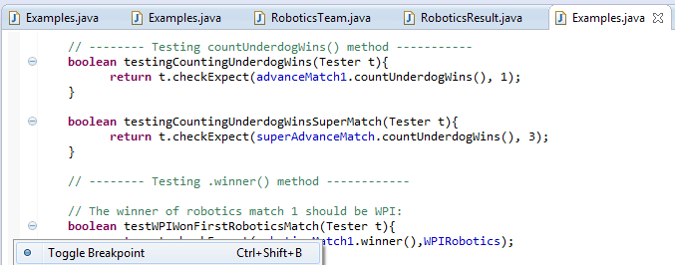
Right click to the left of the line of code where you want the breakpoint (click in the light gray bar) and click “Toggle breakpoint” to create a breakpoint.

Slide 5
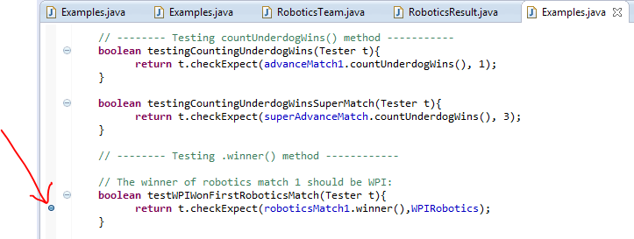
Congratulations! You are now the proud owner of your very own breakpoint! Next, how to run debug mode…

Slide 6
How do I actually use the breakpoints?

Slide 7
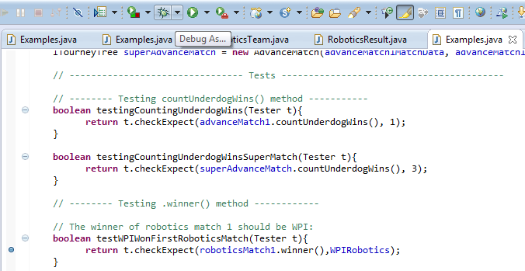
Rather than using the green “run” button, you’re going to run the code in debug mode with the debug button:

Slide 8
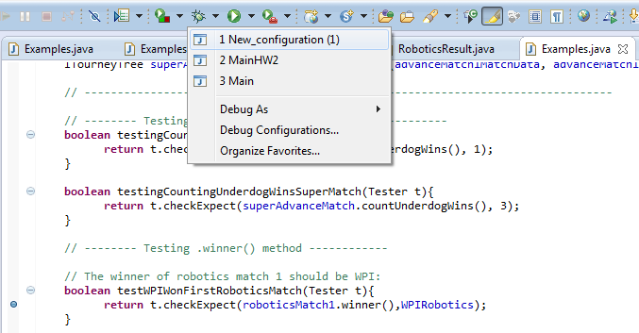
Remember how you had to click the arrow to the right of the “run” button and set up configurations to get it to run the tester’s main? Click the arrow to the right of the debug button, and select the configuration you made. If you want to make sure you have the right configuration, you can click “Debug Configurations” which will bring up a window that looks very similar to the Run Configurations window. In that window, be sure that you have the right project name and that tester’s main is selected.

Slide 9
The green-highlighted line shows where you currently are when stepping through your code.

Slide 10
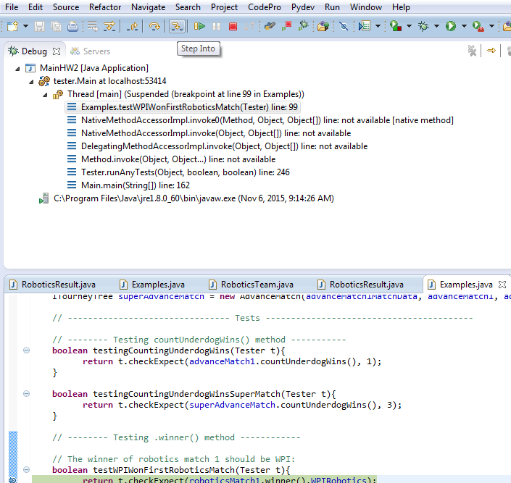
Click the yellow arrow that is the “step into” button to step into this line of code and see what happens when the line is run.

Slide 11
Recall that this is where we were before we clicked “step into:” Clicking “step into” has now brought us here: We are now in the winner method, which was the method that was called in our previous line that we were at. Now, what’s going on here? What does “results.determineWinner()” actually do? Let’s step into it! Click “step into” again.

Slide 12
Clicking “step into” again now takes you to the determineWinner helper method within the RoboticsResult class: The first thing that the determineWinner method does is call a helper method that I named “teamFinalScore.” If you want to see what this method does, click “step into” again.

Slide 13
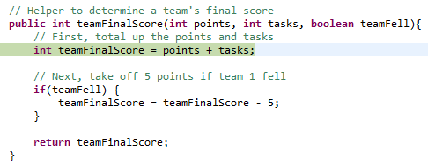
If I click “step into,” this takes me into the teamFinalScore helper that I made to calculate a team’s score. As you can see, this method is going to add up the points and tasks values passed into the method, and then if the teamFell boolean is true, it will subtract 5 from the team’s final score.

Slide 14
Now you could click “Step into,” but since there are no new methods being called, so you can either click that or “Step Over” which will take you to the next line.
As a reminder, this is the “Step Into” button that we were using before, and it is to the right of the “Step Over” button.

Slide 15
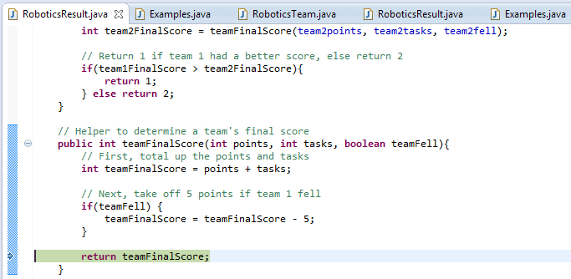
Now we’ve stepped to the line that says “return teamFinalScore”. But what is this teamFinalScore? It’s an integer, but what integer value is inside of it?

Slide 16
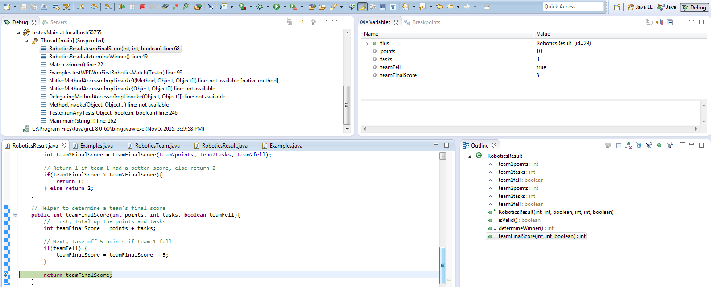
Now, see the “variables” tab? This will show you what value is inside of each variable! Let’s look closer at this.

Slide 17
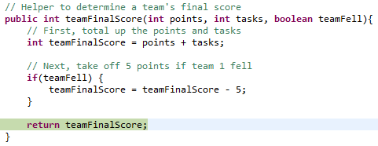
Currently we have five variables. We have “this,” which is a RoboticsResult. This is the object that you’re inside of right now. We have “points,” which is the “int points” we passed into the teamFinalScore method. This has a value of 10 right now. We have “tasks,” which is the “int tasks” that we passed into the teamFinalScore method. This has a value of 3. We have the boolean “teamFell” that we passed into the teamFinalScore method, which is true. Lastly, we have “teamFinalScore,” the value we will be returning (see the line highlighted in green). After doing our calculations, the teamFinalScore that we will be returning is 8, as you can see in the “Variables” tab above. Now click “step over” or “step into.” Both will do the same thing at this point.

Slide 18
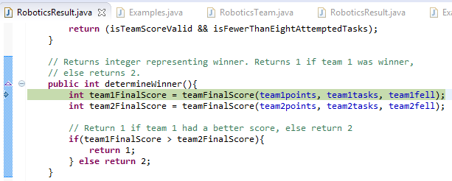
We’re back here now! The debugger just showed you all of the steps that occur in the line highlighted in green below, the method teamFinalScore. Hit “step over” one more time…

Slide 19
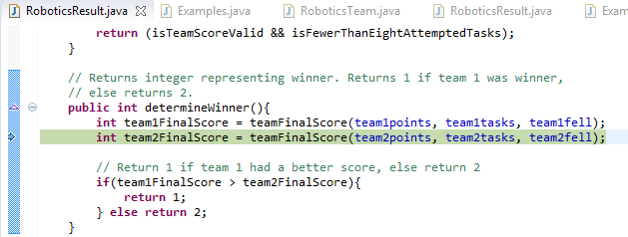
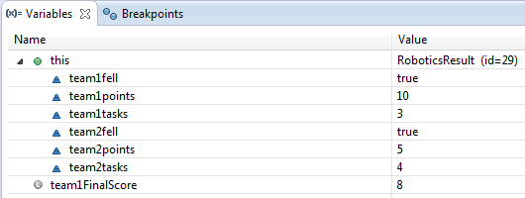
You’re now on the next line, and if you look in the “Variables” tab, you can see the calculated value of the integer team1FinalScore, which is 8!

Slide 20
Ta-da! There are the basics of using the debugger in Eclipse.

Slide 21
One last thing: How to disable and how to delete breakpoints?

Slide 22
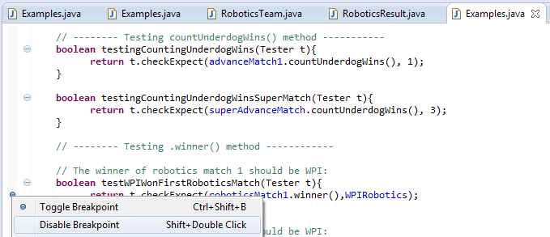
To hide the breakpoint (so your code won’t stop here when you’re stepping through it with the debugger) but still keep it there, right click and select “Disable breakpoint”:
It should now look like this:

Slide 23
To completely delete the breakpoint, right click and select “Toggle breakpoint” again. This will remove it completely.

