Slide 1
Contextual, Flow-Based Access Control with Scalable Host-based SDN Techniques
Curtis R. Taylor,
Douglas C. MacFarland, Doran R. Smestad, and Craig A. Shue
INFOCOM
April 13, 2016

Slide 2
Roadmap
Background and Motivation
Traditional network limitations
SDN networks limitations
Addressing limitations
Host-based SDN
Threat model
Security policy using host-context
Testing scalability
Future Directions
Summary

Slide 3
Traditional Networks
Legacy
Switch
Legacy
Switch

Slide 4
Software-defined Networking
Software-defined networking (SDN)
Logically centralized network control
Write policy here
Enforce policy here
SDN switch

Slide 5
Transitioning to SDN
Replace legacy switches with OpenFlow switches
Cost
Scalability [1-2]
Lacks host operating context
Context can help ascertain whether traffic is malicious or not
[1] R. Curtis, J. C. Mogul, J. Tourrilhes, P. Yalagandula, P. Sharma, and S. Banerjee, “Devoflow: Scaling flow management for high-performance networks,” in Proceedings of the ACM SIGCOMM 2011 Conference, ser. SIGCOMM ’11. New York, NY, USA: ACM, 2011.
[2] M. Kuzniar, P. Peresini, and D. Kostic, “What you need to know about sdn flow tables,” in Lecture Notes in Computer Science (LNCS), no. EPFL-CONF-204742, 2015

Slide 6
SDN Network
I want to determine if this is malicious traffic!
What if I knew the application name, binary path and user ID?
OpenFlow
Controller
Rules | Actions | Stats
flow₁ | drop | …
OpenFlow
Switch
OpenFlow
Switch
flow₂ | … | …
… | … | …

Slide 7
Scaling SDN with Host Context
Our approach
Push SDN functionality to end-hosts
Centralized control of the network for situational awareness
Helps address scalability
End-hosts are already maintaining connection related information
Incorporate contextual information
More powerful network policies

Slide 8
Towards Host-based SDN
OpenFlow
Controller
SDN
Controller
OpenFlow
Switch
OpenFlow
Switch
Legacy
Switch
Legacy
Switch
SDN
Agent
SDN
Agent
SDN
Agent
SDN
Agent

Slide 9
Threat Model
User-level adversaries
Trusted Operating System
Assumption AV applications have
Least user privilege
Virtualization techniques with trusted hypervisor
No Physical Attacks
Adversary cannot use “bump-in-the-wire” techniques

Slide 10
Host-based SDN with Context
Uses SDN agents to send new flows to a controller
Controller can approve/deny/modify flows
Gain traditional network 5-tuple and host context
user ID
primary group ID
application path
application arguments
Process ancestry
Plugins for arbitrary information
[srcIP, dstIP, srcPort, dstPort, protocol]

Slide 11
Security Enhanced Policies
#s₁=HTTP server, s₂ SSH server
clients= [c₁,c₂]
servers= [s₁,s₂]
#Rules
[src=in(clients) ∧ dst=s₁ ∧ dport = 80]: allow;
[src=in(clients) ∧ dst=s₂ ∧ dport = 22]: allow;
# Default
[]: drop; # Default-off: by default drop flows
# New policy arguments using context
users = [crtaylor, cshue]
browser_path = [/bin/firefox, /bin/chrome]
browser_opts = [‘--no-javascript’];
ssh_path= [/bin/ssh]
server_path = [/sbin/apache2, /sbin/sshd]
# New policy arguments using context
users = [crtaylor, cshue]
browser_path = [/bin/firefox, /bin/chrome]
browser_opts = [‘--no-javascript’];
ssh_path= [/bin/ssh]
server_path = [/sbin/apache2, /sbin/sshd]
∧ user=(crtaylor)
∧ app=in(browser_path)
∧ opts=in(browser_opts)
∧ server_app=(/sbin/apache2)
∧ user=(crtaylor)
∧ app=in(browser_path)
∧ opts=in(browser_opts)
∧ server_app=(/sbin/apache2)
∧ user=(cshue)
∧ app=in(ssh_path)
∧ server_path=(/sbin/sshd)
∧ user=(cshue)
∧ app=in(ssh_path)
∧ server_path=(/sbin/sshd)

Slide 12
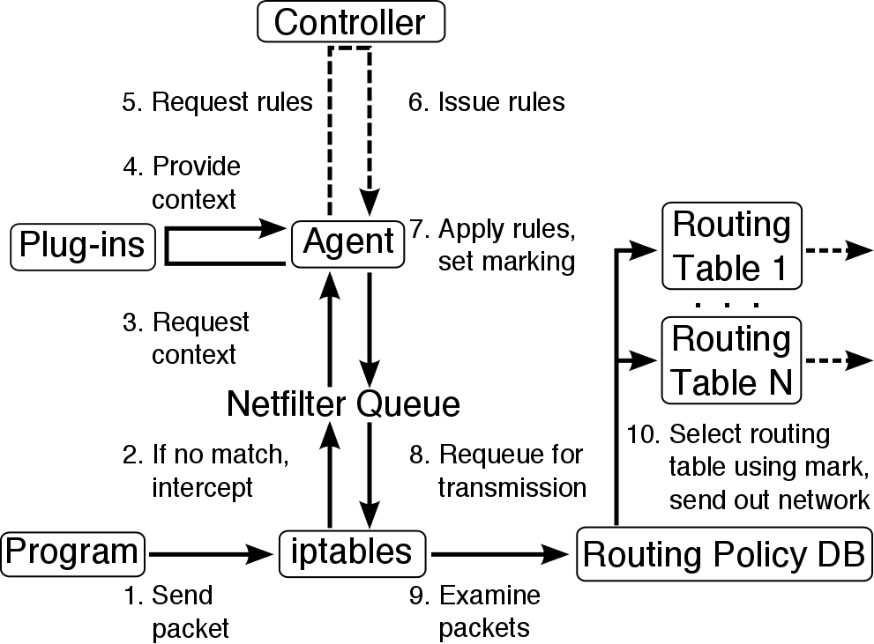
Implementation

Slide 13
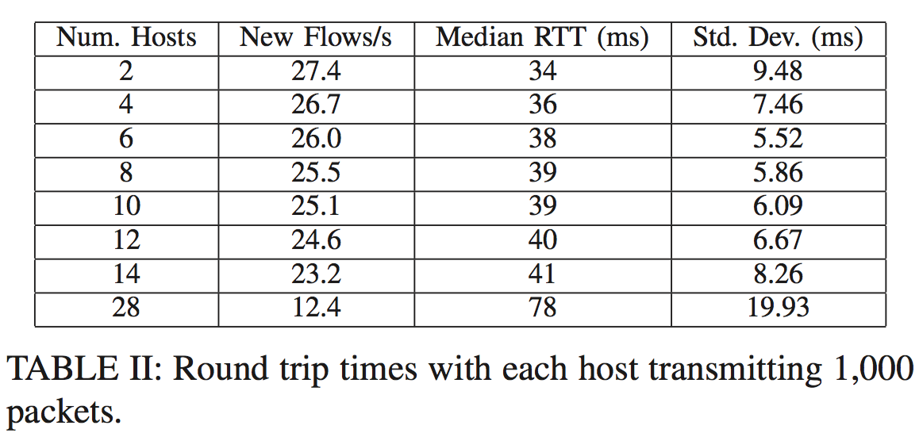
Testing Scalability
KVM virtual network (14 cores, 64GB RAM)
ovs-benchmark to generate 1,000 flows/second on each host, pairwise
Flow rate ~8x higher than observed by Ethane¹
RTT heavily influenced by reactive context gathering
[1] M. Casado, M. J. Freedman, J. Pettit, J. Luo, N. McKeown, and S. Shenker, “Ethane: Taking control of the enterprise,” SIGCOMM Comput. Commun. Rev., vol. 37, no. 4, pp. 1–12, Aug. 2007.

Slide 14
Future Directions
OpenFlow integration (lessons learned)
Developing contextual policies inspired by large scale deployment
GUI integration

Slide 15
Summary
Introduced host-based SDN
SDN functionality enabled by host-agent
Agent gathers context set via plugins
For example, process name, execution path, etc.
Scalability is achieve by pushing flow state from switches to hosts
Partial deployment
Traditional network can immediately begin partial deployment of host-based SDN on select hosts

Slide 16
Questions
¿?

