Slide 1

Game Input with Delay - A Model for the Time to Select a Target with a Mouse
Shengmei Liu
Mark Claypool
Worcester Polytechnic Institute
Notes:
Hi my name is Shengmei. I’m a Ph.D. student in computer science at WPI, an engineering school
near Boston, Massachusetts. My research area focus on latency and gaming.
I did this work with my advisor, professor Mark Claypool.
Today I’ll present our paper: Game Input with Delay - A Model for the Time to Select a Target with a Mouse .

Slide 2

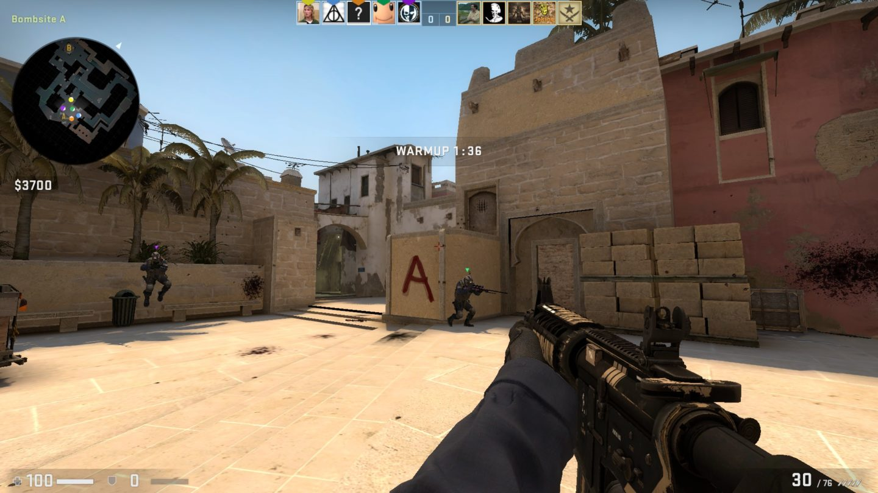
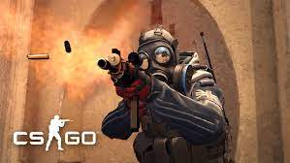


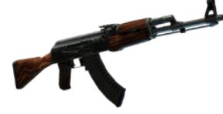
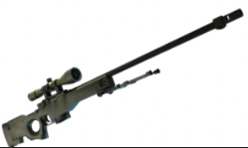
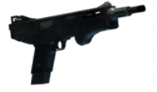
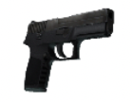
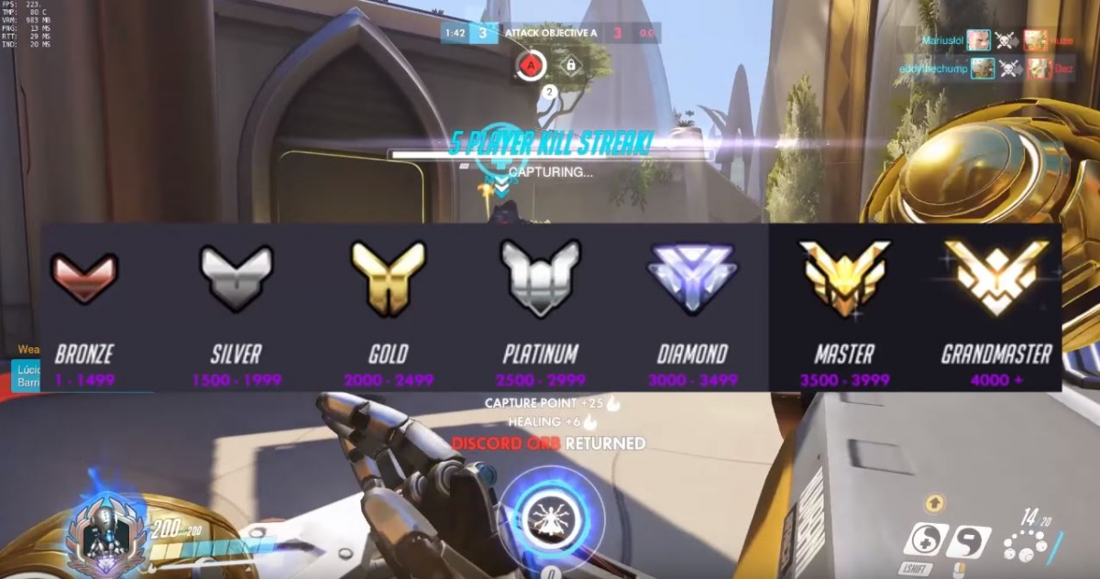
Motivation
FPS games
…..
Weapons
…..
Player skills
…..
0
100
200
300
(ms)
…..
Latencies
Low
Moderate
High
Notes:
First let’s talk about motivation. First person shooter is one of the most popular game genre, and it’s lucrative and very sensitive to latency.
We want to evaluate player performance in FPS games, however, there are too many different games, many types of weapons, and more importantly, different skill groups of players, and latency values. There are too many games and system configurations. It’s not possible to study all the conditions one by one. We want to find a way to study the impact of latency on FPS gamers without iterating all the conditions?

Slide 3
Motivation
FPS Gaming Actions
Reaction
Navigation
Selection
Data
Models
Simulations
Analysis of Performance in FPS game
Notes:
Our approach is to look at the building blocks for FPS games. The building blocks are the atomic gaming actions. There are mainly 3 of them, reaction, which is players’ ability to react to stimulus, navigation, which is players ability in avatar movement, and selection, which is players ability in selecting the moving targets. We want to study the 3 gaming actions, collect data and then build models for them. With the models, we can simulate conditions in fps games. With the simulations, we can evaluate and analyze player performance in FPS games.
With this work, we are focusing on selection action.
We built models for the distribution of time to select with player skill, latency, and target speed from existing user study data.
The model is then used for some simulations where player response times are selected from a range of possible values based on the model.

Slide 4
Methodology
Select prior user study data
Build model
Incorporate skill into model
Use models in simulations
Analyze data
Notes:
The Methods to study such area are to setup experiments, but that is the user
study which is expensive, time consuming. So we select prior user study data. We then analyze the data and build models with latency and target speed from it. Then we incorporate skill into the model. Finally, we use the models for simulations.

Slide 5
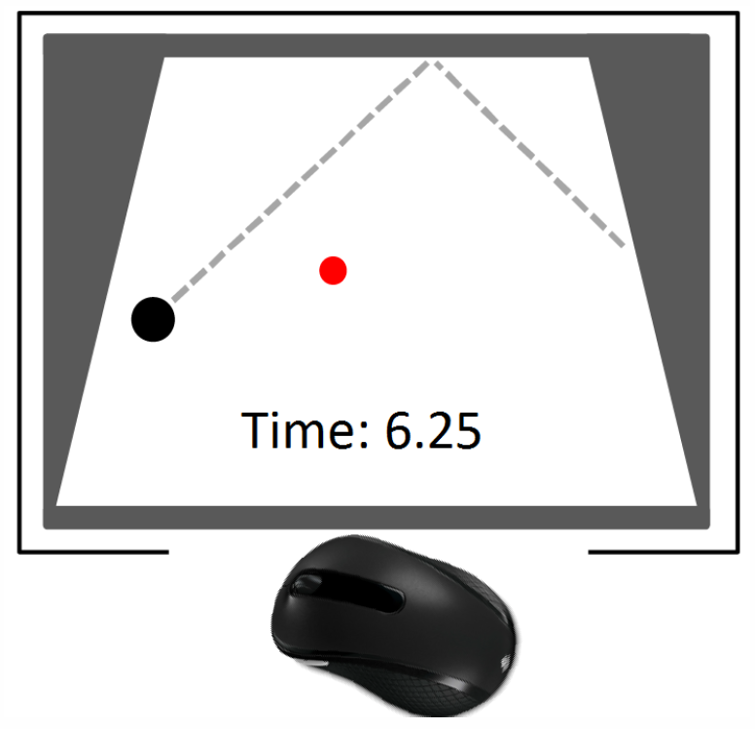
Puck Hunt - the Game of Moving Target Selection
[Claypool et al. 2017 ]
Time to select puck with mouse (elapsed time)
Number of clicks
Parameters:
- Target speed
- Delay
5 iterations
167 trials
Model the distribution of elapsed time
based on speed and delay
Notes:
The game in the studies was puck hunt, it’s a game similar to duck hunt, where players select the moving targets on the screen, we then record time to select puck with mouse which is elapsed time, and number of clicks. The game difficulty parameters are target speed and delay. Each player plays 5 iterations of each difficulty condition. Each player plays 167 trails in total.
With the data, we want to Model the distribution of target selection times based on speed and delay.

Slide 6
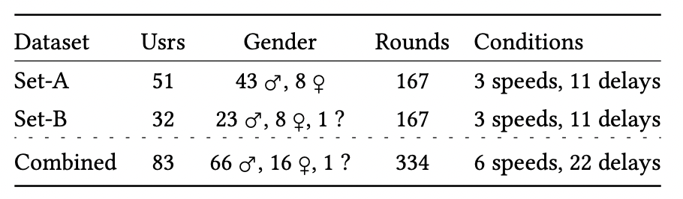

Datasets
Shengmei Liu, Mark Claypool, Bhuvana Devigere, Atsuo Kuwahara, and Jamie Sherman. 'Git Gud!' - Evaluation of Self-Rated Player Skill Compared to Actual Player Performance,
In Proceedings of the ACM Annual Symposium on Computer-Human Interaction in Play (CHI PLAY), (Work In Progress), Virtual Conference, November 2-4, 2020.
Notes:
For datasets, we have two datasets from two prior user studies. In total we have 83 users where 66 are males, 16 are females and 1 prefer not to say. In the demographic questionnaire, all users are asked about the gender, age, and self-rated score as a gamer. Players with self-rated score from 1-3 are classified as low skill player, and a score 4 or 5 is considered high skill player. The mean self-rating was about 3.9, showing a slight skew of “high ability”. According to our pervious work at the bottom, self-rated score is a good indicator for actual player skill. We have 24 low skill players, and 59 high skill players.

Slide 7
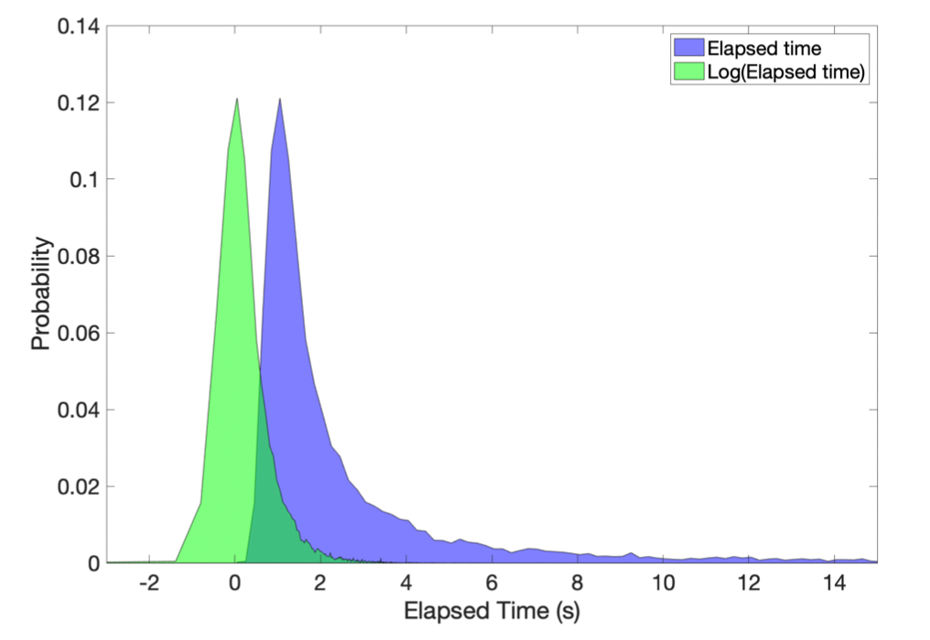
Probability Distribution of Elapsed Time
Notes:
This figure shows the probability distribution of all elapsed times from the user studies. The x-axis is the elapsed time and the y-axis is the probability. The blue region, the distribution of all elapsed times, appears log-normal, which makes sense since human actions are impacted by many individual factors that, when put together, have an exponential distribution. We take the logarithm of the elapsed time to obtain a probability distribution in the green region that appears normal. The probability distribution of elapsed time at each difficulty level follows this pattern as well.

Slide 8

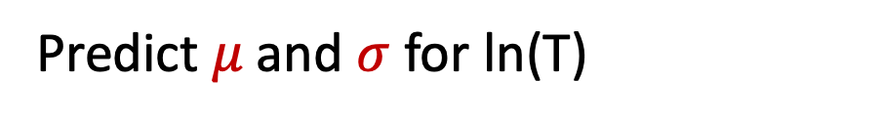
Multivariate Multiple Regression
skill
𝜇
Speed
$$σ$$
Delay
Predict 𝜇 and $σ$ for ln(T)
Notes:
Based on the distributions above, we conducted a multivariate multiple regression. It takes player skill, target speed and delay values to predict the mean and std dev for logarithm of elapsed time. With the models predicting mean and standard deviation for ln T, given speed, delay and skill, the normal distribution with the predicted mean and standard deviation can be used to generate a distribution of logarithmic elapsed times, taking the exponent to get the elapsed time.

Slide 9
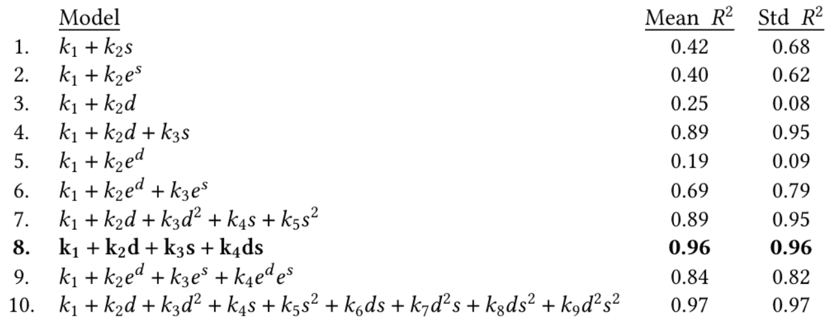
Comparative Models
T = 𝝱₀ + 𝝱₁d + 𝝱₂s + 𝝱₃d s
d standardized delay, s standardized speed
Notes:
To find the model best fit our data, we tried 10 models. While model 10 has the highest 𝑅2 for both mean and standard deviation, it is only slightly higher than model 8 while having significantly more terms (9 versus 4). Thus, we propose predicting mean and standard deviation for the log of the elapsed time with model 8, where d is standardized delay, s is standardized speed and all the betas are constant values.

Slide 10
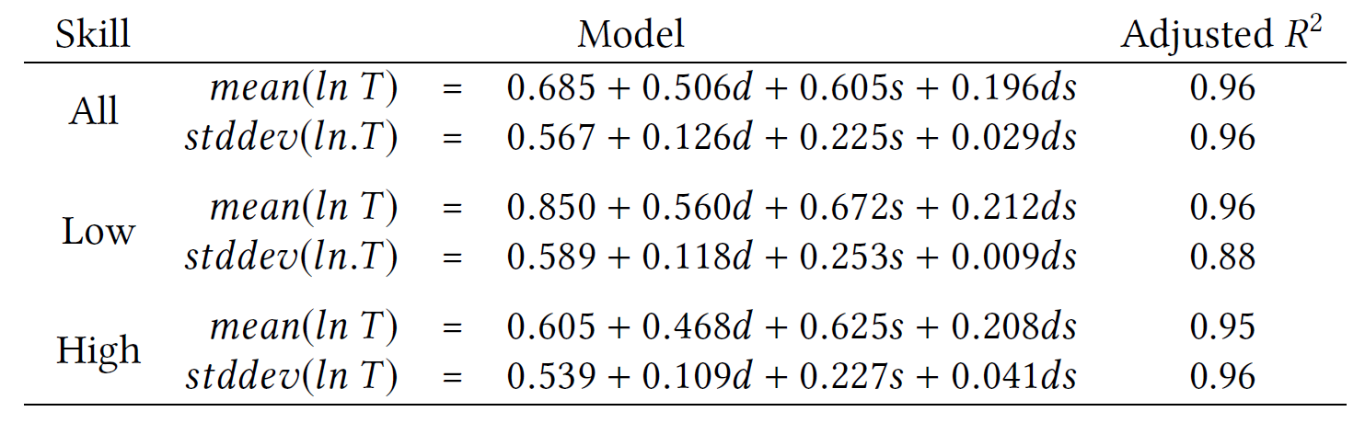
Models
Accurate models that can be used for distributions of response times
Notes:
Here are the resulting models. The first row if for all players, the second row is for low skill players, and the last row is for high skill players. All the models fit the data well with high adjusted R2.
We can see that these are Accurate models that can be used for distributions of response times.
.

Slide 11

Model Fit
Density
All data
All skills
Models have high fidelity to empirical data
Can use for analytical modeling and simulation (next)
Notes:
This figure shows the model generated data compared to the actual data. The x- axis is the elapsed time in seconds, and the y-axis is the probability density. The blue shape is the probability distribution of the elapsed time for the empirical data, and the red shape is generated from the model. Our model has excellent fit for the data with 𝑅2 at 0.99 and RMSE at 0.03.
We can learn that the models have high fidelity to empirical data and it can be used for analytical modeling and simulation.

Slide 12
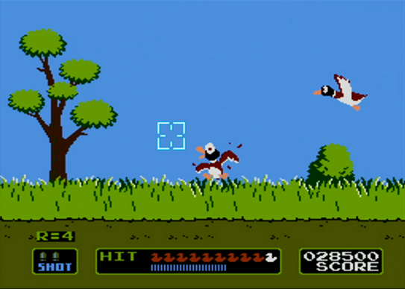
Simulation
Two players
Selection Game
Each with a delay and speed
Each player plays one round
Shorter elapsed time wins
Player1
Player2
Notes:
For simulations, we simulate a game, where there are two players playing a target selection game like duck hunt. The players may of different skill levels, and they might play under different target speed and delay. The player with shorter elapsed time wins.
With simulations, we don’t need to actually build a game to test the gaming conditions. Given speed, delay and player skill, we will randomize an elapsed time from the distribution of each player. We compare the elapsed time of the two players and get the winner. We can simulate 100 thousand rounds for a testing condition in only seconds.

Slide 13
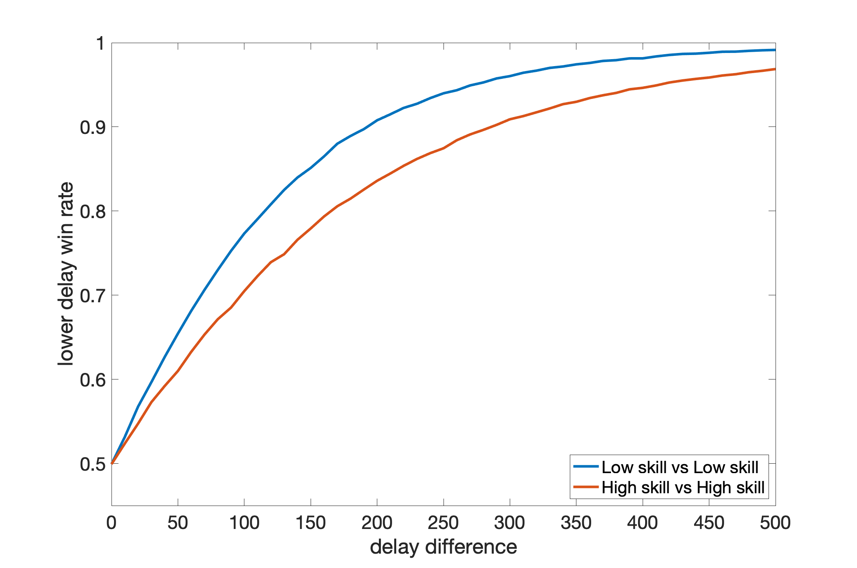
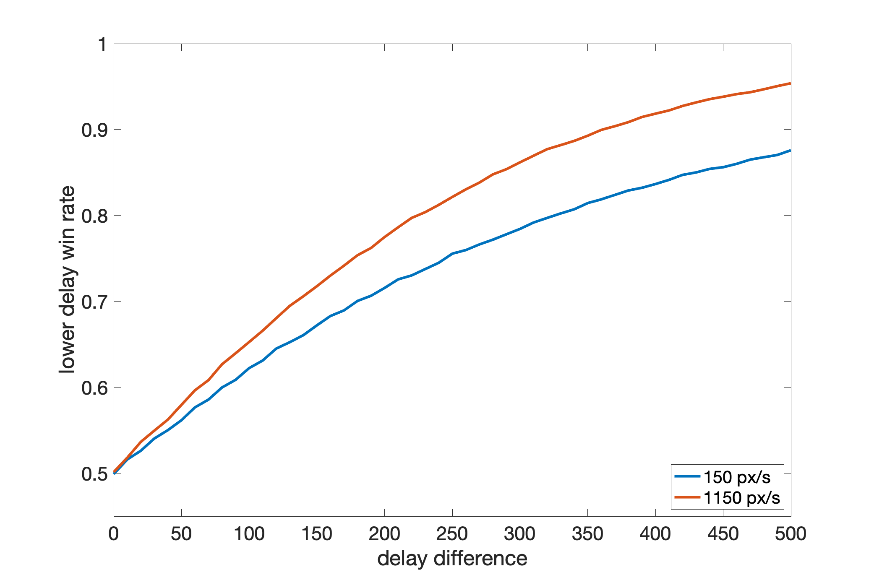
Win rate vs delay -- skill
Simulation Analysis
Win rate vs delay -- speed
Notes:
Here are some simulation analysis. In the graph on the left, The x-axis is the delay difference for the two players, and the y-axis is the win rate of the player with lower delay. The blue line is games with two low skill players, while the orange line is games with two high skill players. From the figure, even modest delay differences of 100 ms makes it about 50% harder for the delayed player to win. The blue line increases faster than the orange line, indicating delay impacts the games with higher skill players less.
The graph on the right depicts how delay impacts win rate with different target speeds. This simulation is the same as before, but both players are of average skill and the target speed varies. The axis are as the graph on the left. The blue line is games with slow target speeds of 150 px/s, while the orange line is games with fast target speeds of 1150 px/s. The orange line increases faster than the blue line, indicating delay impacts player performance more for higher target speeds

Slide 14
Conclusion
Contributions
Take-aways
Data processing and analysis
Analytic model for the distributions of player elapsed times for target selection
Simulations for player performance with several different configurations and delays
Even delays of only 100ms make it about 50% harder to win.
High skill players are less affected by delay than low skill players.
Delay affects players more for faster targets.
Notes:
Next part is conclusion. Our contributions include Data processing and analysis, Analytic model for the distributions of player elapsed times for target selection, and simulations for player performance with several different configurations and delays
Here are some of our take-aways from our simulations. Even delays of only 100ms make it about 50% harder to win. High skill players are less affected by delay than low skill players on selection task. Delay affects players more for faster targets.

Slide 15
Future Work
User studies on navigation
Build models
Combine the models of navigation and selection
Simulate FPS games
Notes:
Future work could design and conduct user studies to gather data on the effects of delay on other atomic actions, like navigation. Data from these studies could be modeled as in this paper, and those models can be combined with our models of target selection to simulate the effects of delay for a richer set of games. For example, the navigation models could be used in conjunction with our models of target selection to simulate shooting actions, allowing study of the effects of delay for the many commercial shooter games that have not been evaluated.

Slide 16
Game Input with Delay - A Model for the Time to Select a Target with a Mouse
Shengmei Liu
Mark Claypool
Worcester Polytechnic Institute
Notes:
Thanks for your attention on the work!

Slide 17

Facts of latency and interactivity
Latency as low as 1-2 ms can be perceived by humans
Latency around 50 ms is known to affect performance in mouse-based pointing tasks

Slide 18


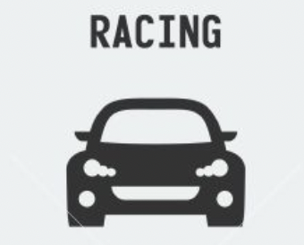

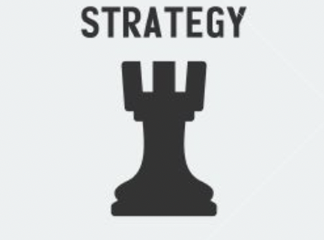
Motivation
Game genres
…..
More games
…..
Player skills
…..
0
100
200
300
(ms)
…..
Local latencies
Gaming system
Normal PCs
Console, TV, etc.
0
100
200
300
(ms)
…..
Network latencies
Good
Moderate
Other
…..
Notes:
Need to evaluate across games and system configurations.
Methods are to setup experiments, but that is the user
study - expensive, time consuming.

Slide 19
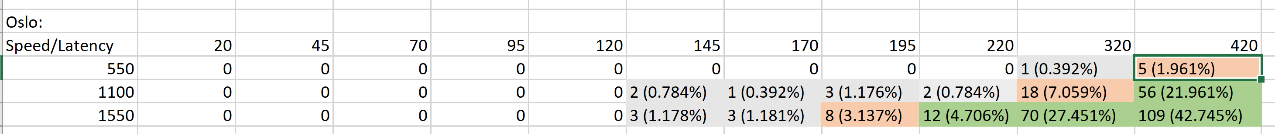
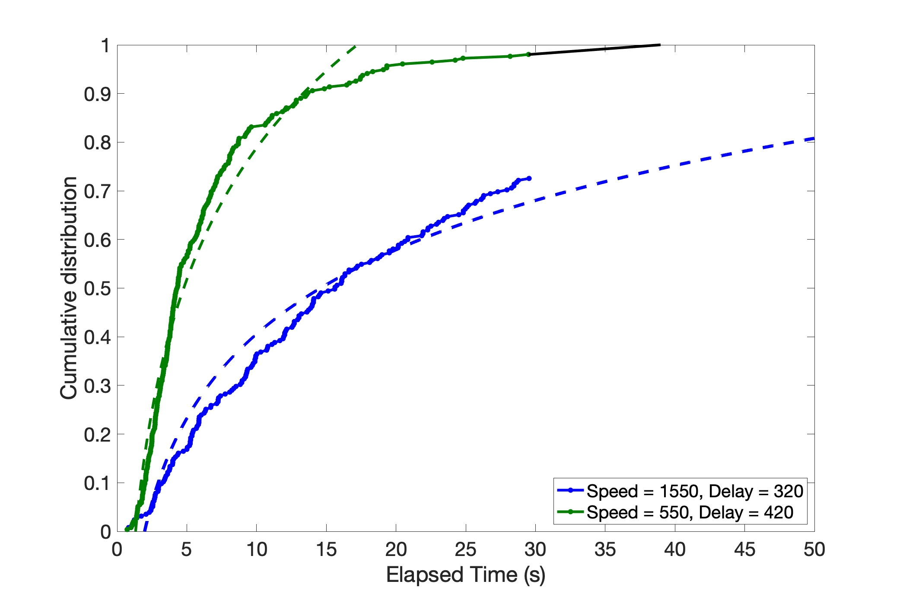
Data preprocessing
Elapsed time > 30s?
Gray: don’t do anything.
Orange: make linear regression from CDF using last 5 non 30 points, and evenly take points from it.
Green: randomly generate points from existing CDF models.
Notes:
For the gray part, there are just few points that there is no need to to anything to them,
For the orange and green part, there are lots of points there that we cannot ignore.
We have a graph here , where x axis is , y axis is….
For the green part, the data look like the yellow line on the rightmost. And we took use of existing CDF models, randomly generate points from greater than 30 part.
For the yellow part, the data look like the orange line in the middle. The existing CDF models didn’t get to 30. So we make linear regression from CDF using last 5 non 30 points, and evenly take points from it

Slide 20
Data Preprocessing
Don’t do anything.
Make linear regression from CDF using last 5 non 30 points, and evenly take points from it.
Randomly generate points from existing CDF models.
Elapsed time > 30s?
Notes:
For the gray part, there are just few points that there is no need to to anything to them,
For the orange and green part, there are lots of points there that we cannot ignore.
We have a graph here , where x axis is , y axis is….
For the green part, the data look like the yellow line on the rightmost. And we took use of existing CDF models, randomly generate points from greater than 30 part.
For the yellow part, the data look like the orange line in the middle. The existing CDF models didn’t get to 30. So we make linear regression from CDF using last 5 non 30 points, and evenly take points from it

