Slide 1
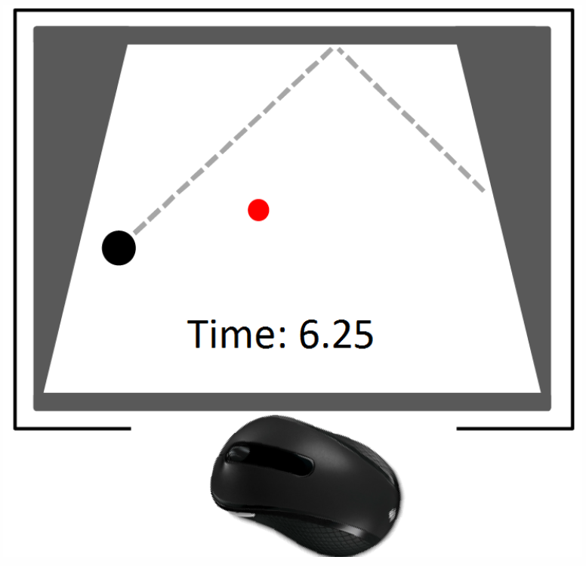
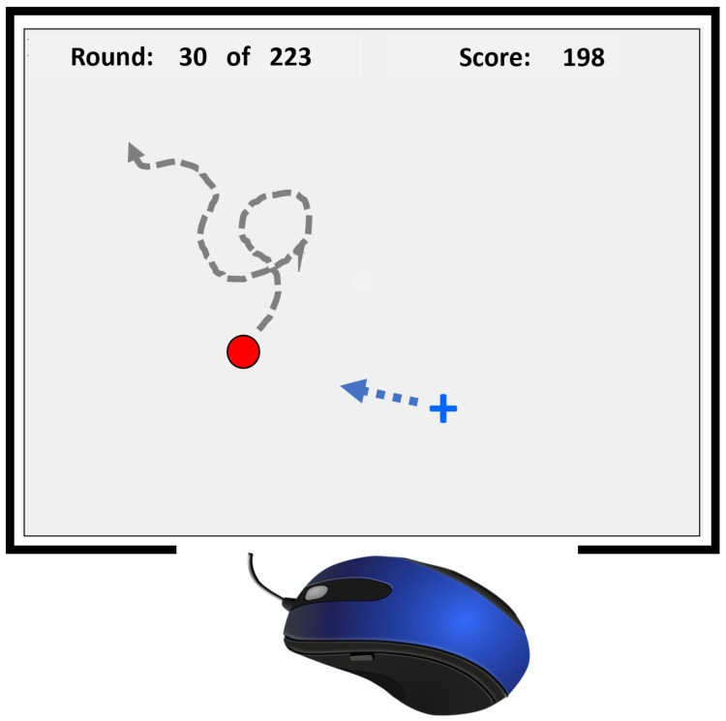
Datasets – Moving Target Selection with Delay
Shengmei Liu, Mark Claypool, Andy Cockburn, Carl Gutwin, Ragnhild Eg, Kjetil Raaen
Puck Hunt
Juke!
Juke!

