Slide 1
Reducing Per-flow Memory Use in TCP SEARCH
May 30, 2025
Maryam Ataei
Mark Claypool
Jae Chung
Feng Li
Benjamin Peters
Amber Cronin
The 26th IEEE International Symposium on a World of Wireless, Mobile and Multimedia Networks (WoWMoM)

Slide 2
TCP Slow Start Overview
During slow start: TCP congestion window is doubling for each RTT
Packet loss happen Exit slow start: Exit late (After loss)
Idea: Exit after reaching capacity and before loss
HyStart is introduced (Linux default)
HyStart over satellite network Too early exit (Before capacity)
Slow Start
Packet loss
Congestion Avoidance
Congestion Window
Exit
Capacity
Exit
Time
Goal: Introduce an algorithm to exit at chokepoint : Exit after reaching the capacity and before loss.

Slide 3
Outline
TCP Slow start Overview
SEARCH Algorithm
Reduce Memory Use
Performance Evaluation
Conclusion and Future work

Slide 4
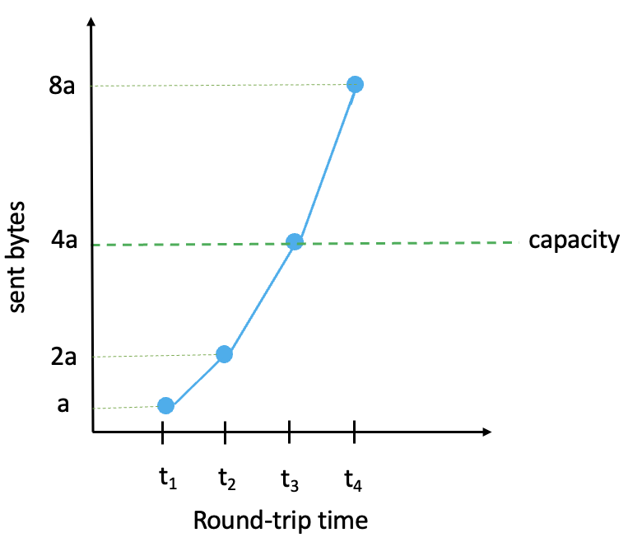
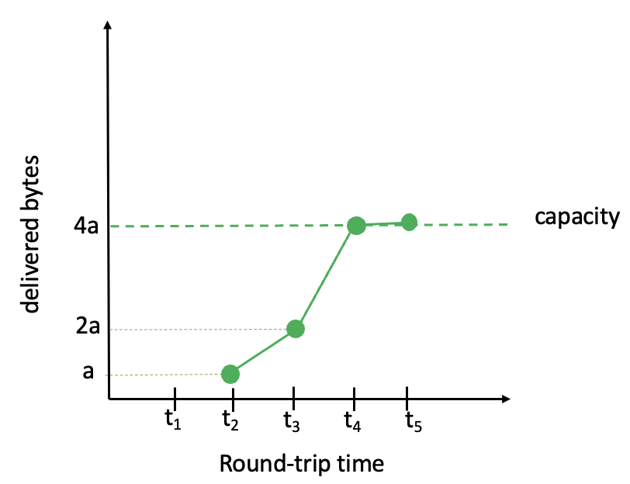
SEARCH Overview
capacity
2 × delivered bytes_1RTT before =
curr_delv
prev_delv
normalized diff = $\frac{ \text{2 }\text{prev}\text{_}\text{delv}\text{ – }\text{curr}\text{_}\text{delv}}{\text{2 }\text{prev}\text{_}\text{delv}}$
threshold
difference
0
if (normalized diff $≥$ threshold):
exit from slow start
t₁
t₂
t₃
t₄
t₅
Round-trip time

Slide 5
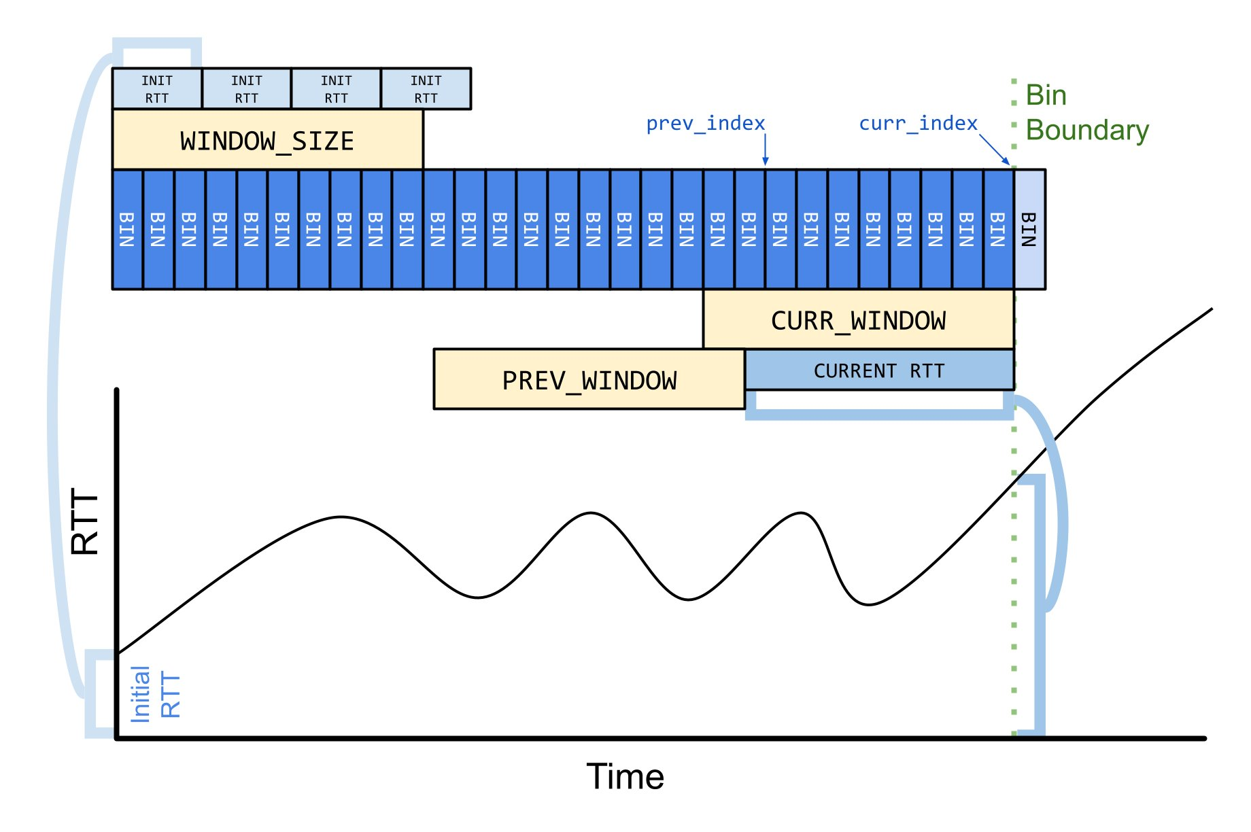
SEARCH Overview
SEARCH adds memory per flow to TCP to track delivery bytes.
With a lot of flows, memory scales poorly.^{[1, 2]}
Based on normalized difference calculation:
SEARCH needs only relative, not exact, values.
We reduce memory by :
normalized diff = $\frac{ \text{2 }\text{prev}\text{_}\text{delv}\text{ – }\text{curr}\text{_}\text{delv}}{\text{2 }\text{prev}\text{_}\text{delv}}$
normalized diff = $\frac{ \frac{\text{2}\text{a}}{\text{C}} \text{–} \frac{\text{b}}{\text{C}}}{\frac{\text{2}\text{a}}{\text{C}}}$
dynamic bit-shifting
[1] A. Shieh, A. C. Myers, and E. G. Sirer, “A Stateless Approach to Connection-oriented Protocols,” ACM Transactions on Computer Systems (TOCS), vol. 26, no. 3, pp. 1–50, 2008.
[2] Cloudflare, “Unbounded Memory Usage by TCP for Receive Buffers, and How We Fixed It,” 2023. [Online]. Available: https://tinyurl.com/ybhjp66s
Notes:
Relative values can be preserved with less precision. To compress bins

Slide 6
Outline
TCP Slow start Overview
SEARCH Algorithm
Reduce Memory Use
Performance Evaluation
Conclusion and Future work

Slide 7
Bit Shifting
u32 bin[TOTAL_BINS]; // array of bins
u32 bin_duration_us; // duration of each bin
u32 bin_end_us; // end time of latest bin
s32 curr_idx; // total number of bins
7

Slide 8
Bit Shifting
Reduce number of bits for each bin
u32 bin[TOTAL_BINS]; // array of bins
u32 bin_duration_us; // duration of each bin
u32 bin_end_us; // end time of latest bin
s32 curr_idx; // total number of bins
u32 → u8
u8 scale_factor; // divisions by 2 (shifts)
280
280
scale factor
÷$2^{1}$
÷ 2
1
10
20
30
40
100
125
140
140
8

Slide 9
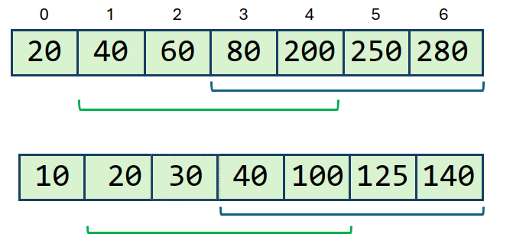
Error with Reduced Bits Per Bin​
norm = $\frac{\text{2 × }\text{previous} \text{window}\text{ − }\text{current} \text{window}}{\text{2 × }\text{previous} \text{window}}$
With u32 bins:
Current window = 280 - 60 = 220 bytes
Previous window = 200 - 20 = 180 bytes
norm = 360 – 220 / 360 = 0.39
With u8 bins (after bit-shifting):
Current window = 140 - 30 = 110 bytes
Previous window = 100 - 10 = 90 bytes
norm = 180 – 110 / 180 = 0.39
9

Slide 10
Outline
TCP Slow start Overview
SEARCH Algorithm
Reduce Memory Use
Performance Evaluation
Conclusion and Future work

Slide 11
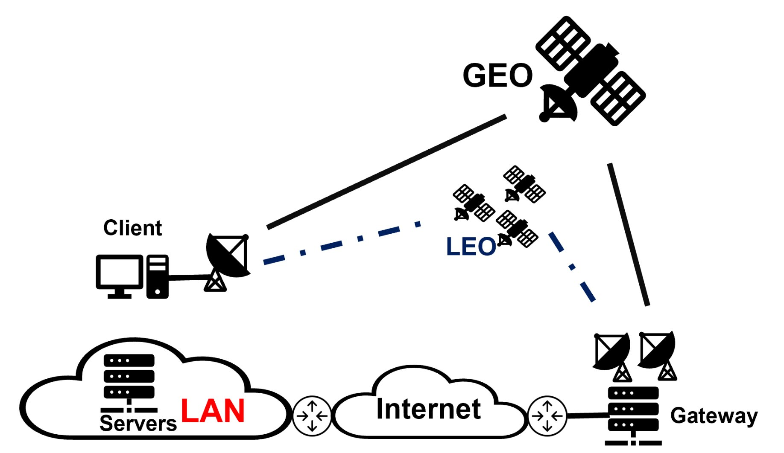
Satellite Testbed
Setup:​
Client: Linux machine (Ubuntu 20.04 and Linux kernel version 5.4.0) via Viasat-2 satellite terminal​
Server: Linux machine (Mint 20.3 and Linux kernel version 5.10.79)
RTT: ~600 ms​
Capacity: ~150 Mb/s​
PEP disabled​
Download Details:​
45 Iperf3 TCP Downloads.​
Duration: 45 seconds.​
Test schedule: 24 hours.
11

Slide 12
Case Study
C E L
C L E
C E L
12
12
Notes:
we probably do not go down to u4

Slide 13
Summary Table
Bin Size | Early (%) | Late (%) | Chokepoint (%)
U32 4.4 22.2 73.4
U16 4.4 22.2 73.4
U8 4.4 22.2 73.4
U4 4.4 25.0 70.6
13

Slide 14
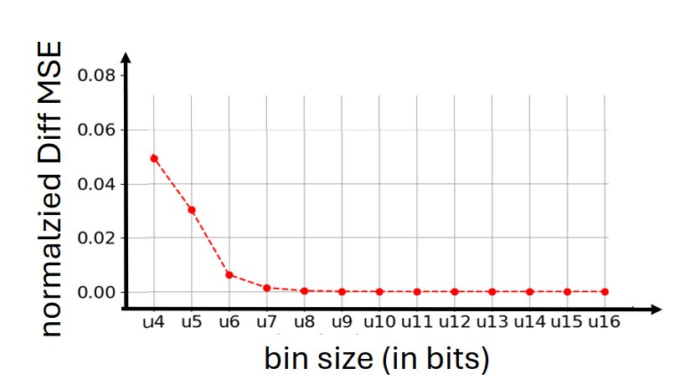
Error with Reduced Bits Per Bins ​
14

Slide 15
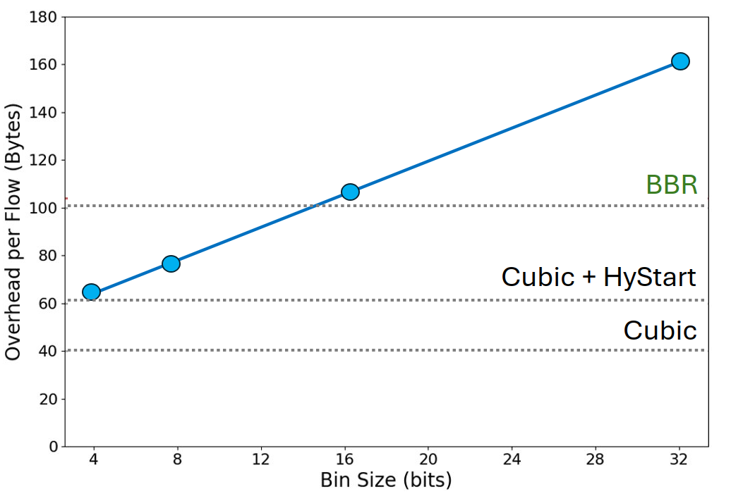
Per-flow memory overhead
15
Notes:
100 Bytes is threshold for linux

Slide 16
Conclusion
Proposed Solution
Apply bit-shifting to compress delivered byte values in bins.
Scale all stored + incoming values dynamically.
Preserve relative accuracy for comparing delivery trends.
Evaluation Highlights
Replace u32 with u16 even u8 bins.
Minimal accuracy loss and Major memory savings.

Slide 17
Future Work
SEARCH in other stacks.
Evaluate on other networks: WiFi, 5G, LEO, RTT variants.
Use SEARCH to report chokepoint bitrate to application.

Slide 18
Thank you for your attention!
Reducing Per-flow Memory Use in TCP SEARCH
May 30, 2025
Jae Chung
Feng Li
Benjamin Peters
Maryam Ataei
Mark Claypool
Amber Cronin
The 26th IEEE International Symposium on a World of Wireless, Mobile and Multimedia Networks (WoWMoM)

Slide 19
Appendix

Slide 20
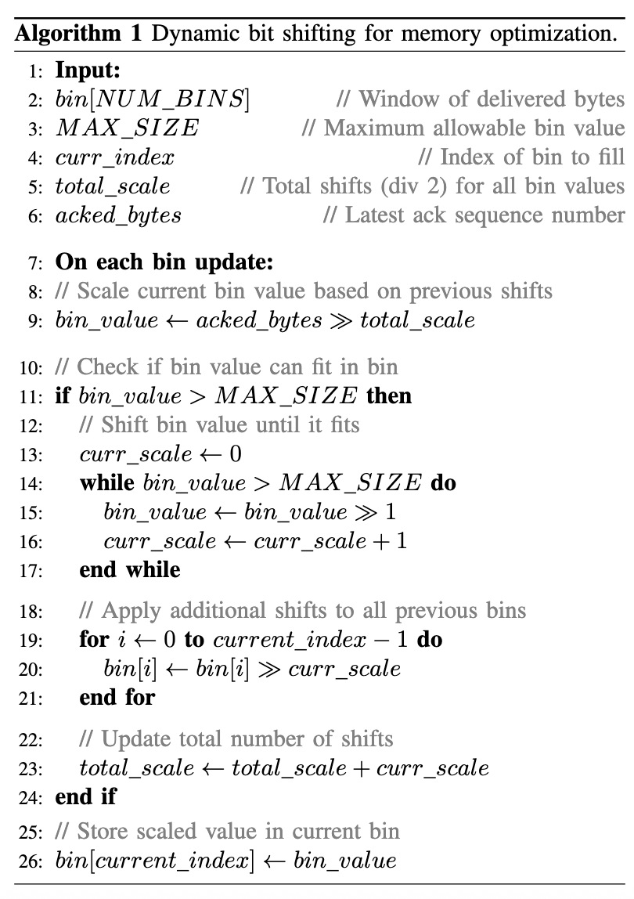
Dynamic bit shifting Algorithm
20

Slide 21
SEARCH Overview
curr_delv
prev_delv
8a
diff = 2 prev_delv – curr_delv
delivered bytes
capacity
4a
normalized diff = diff / 2 prev_delv
2a
a
if (normalized diff $≥$ threshold):
exit from slow start
t₁
t₂
t₃
t₄
t₅
t₆
Round-trip time
Notes:
access to server side data

Slide 22
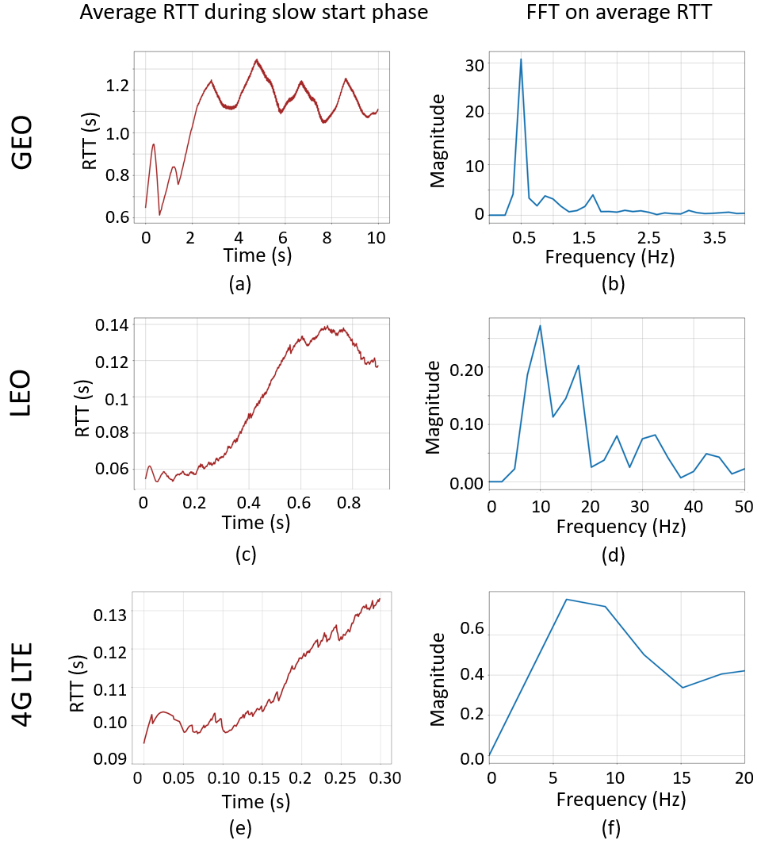
Window size analysis
Calculate Window Size from RTT Frequency Characteristics by FFT analysis:
Periodic cycle = 1/ Primary peak in FFT
Window size = Periodic cycle / min_rtt
Viasat: min_rtt = 600 ms primary pick = 0.5 Hz
Window size = 2 / 0.6 ≈ 3.33 RTTs
Starlink: min_rtt = 30 ms primary peak = 10 Hz
Window size = 0.1 / 0.03 ≈ 3.33 RTTs
LTE: min_rtt = 60 ms primary peak = 6 Hz
Window size = 0.17 / 0.06 ≈ 2.8 RTTs
Default window size = 3.5 × min RTT

Slide 23
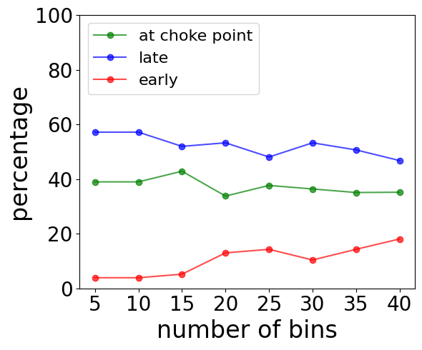
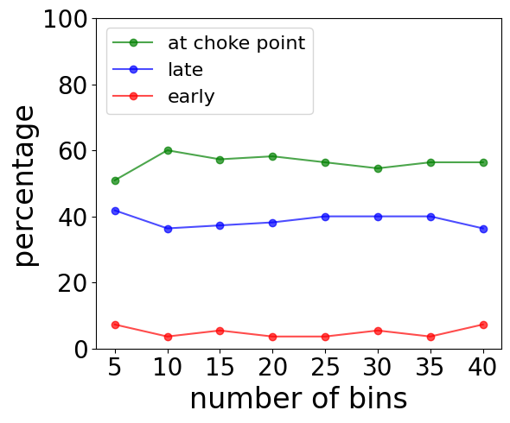
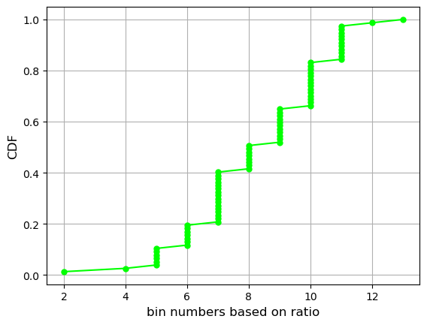
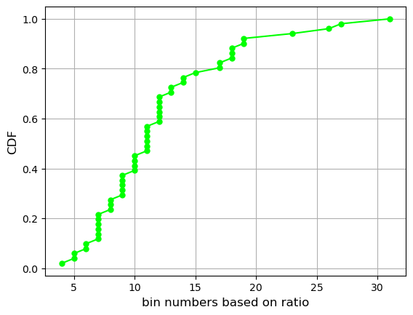
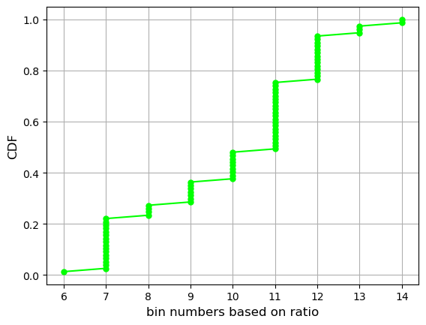
Number of window bins and additional bins
Viasat
Starlink
LTE
Default number of bins = window bins + extra bins = 25
Use the ratio of Max RTT during slow start / initial RTT
1.0
0.8
0.6
0.4
0.2
0.0
1.0
0.8
0.6
0.4
0.2
0.0
1.0
0.8
0.6
0.4
0.2
0.0
CDF
CDF
CDF
6 7 8 9 10 11 12 13 14
2 4 6 8 10 12
5 10 15 20 25 30
Number of extra bins
Number of extra bins
Number of extra bins

Slide 24
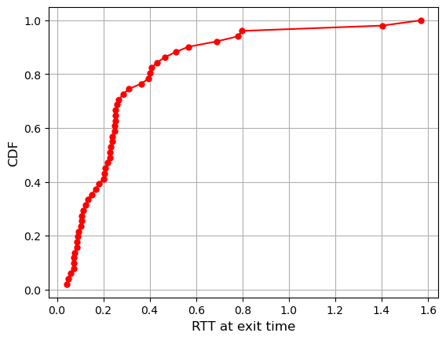
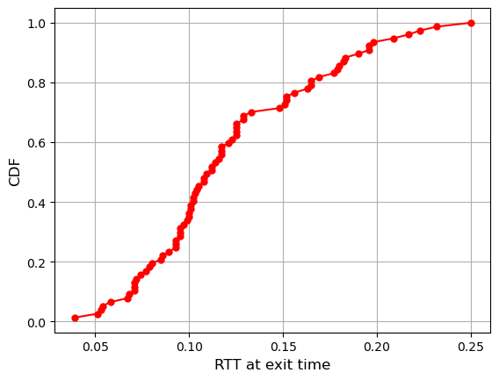
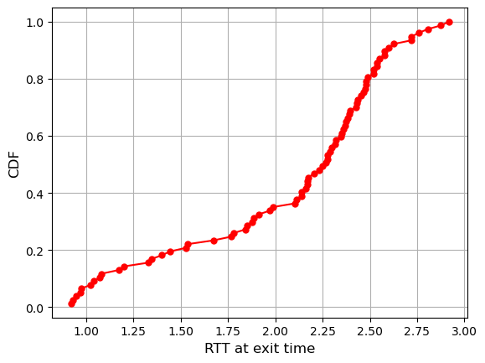
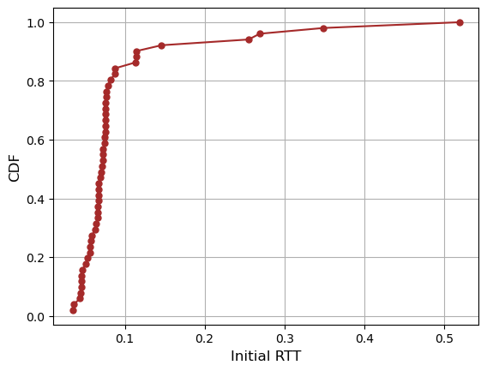
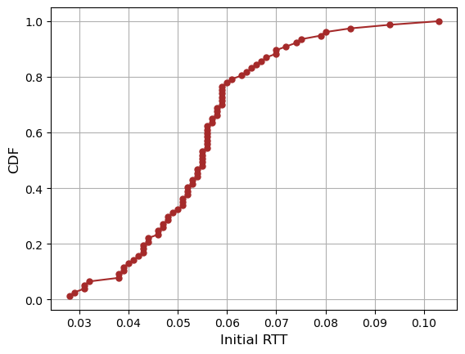
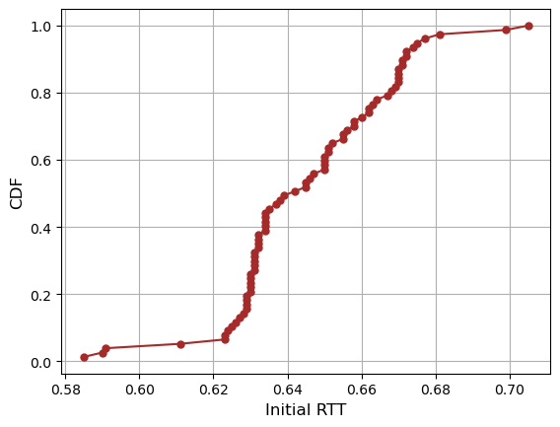
Number of window bins and additional bins

Slide 25
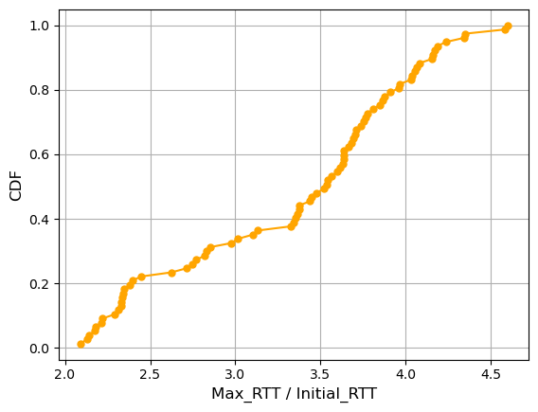
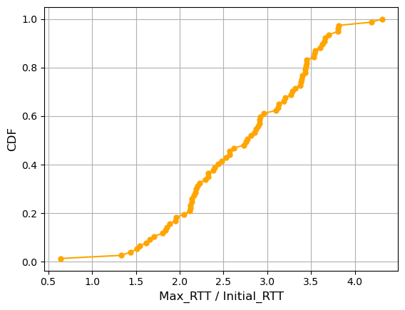
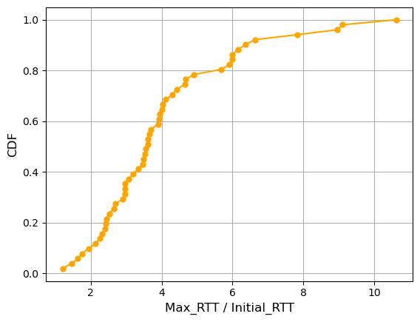
Number of window bins and additional bins
Viasat
Starlink
LTE

Slide 26
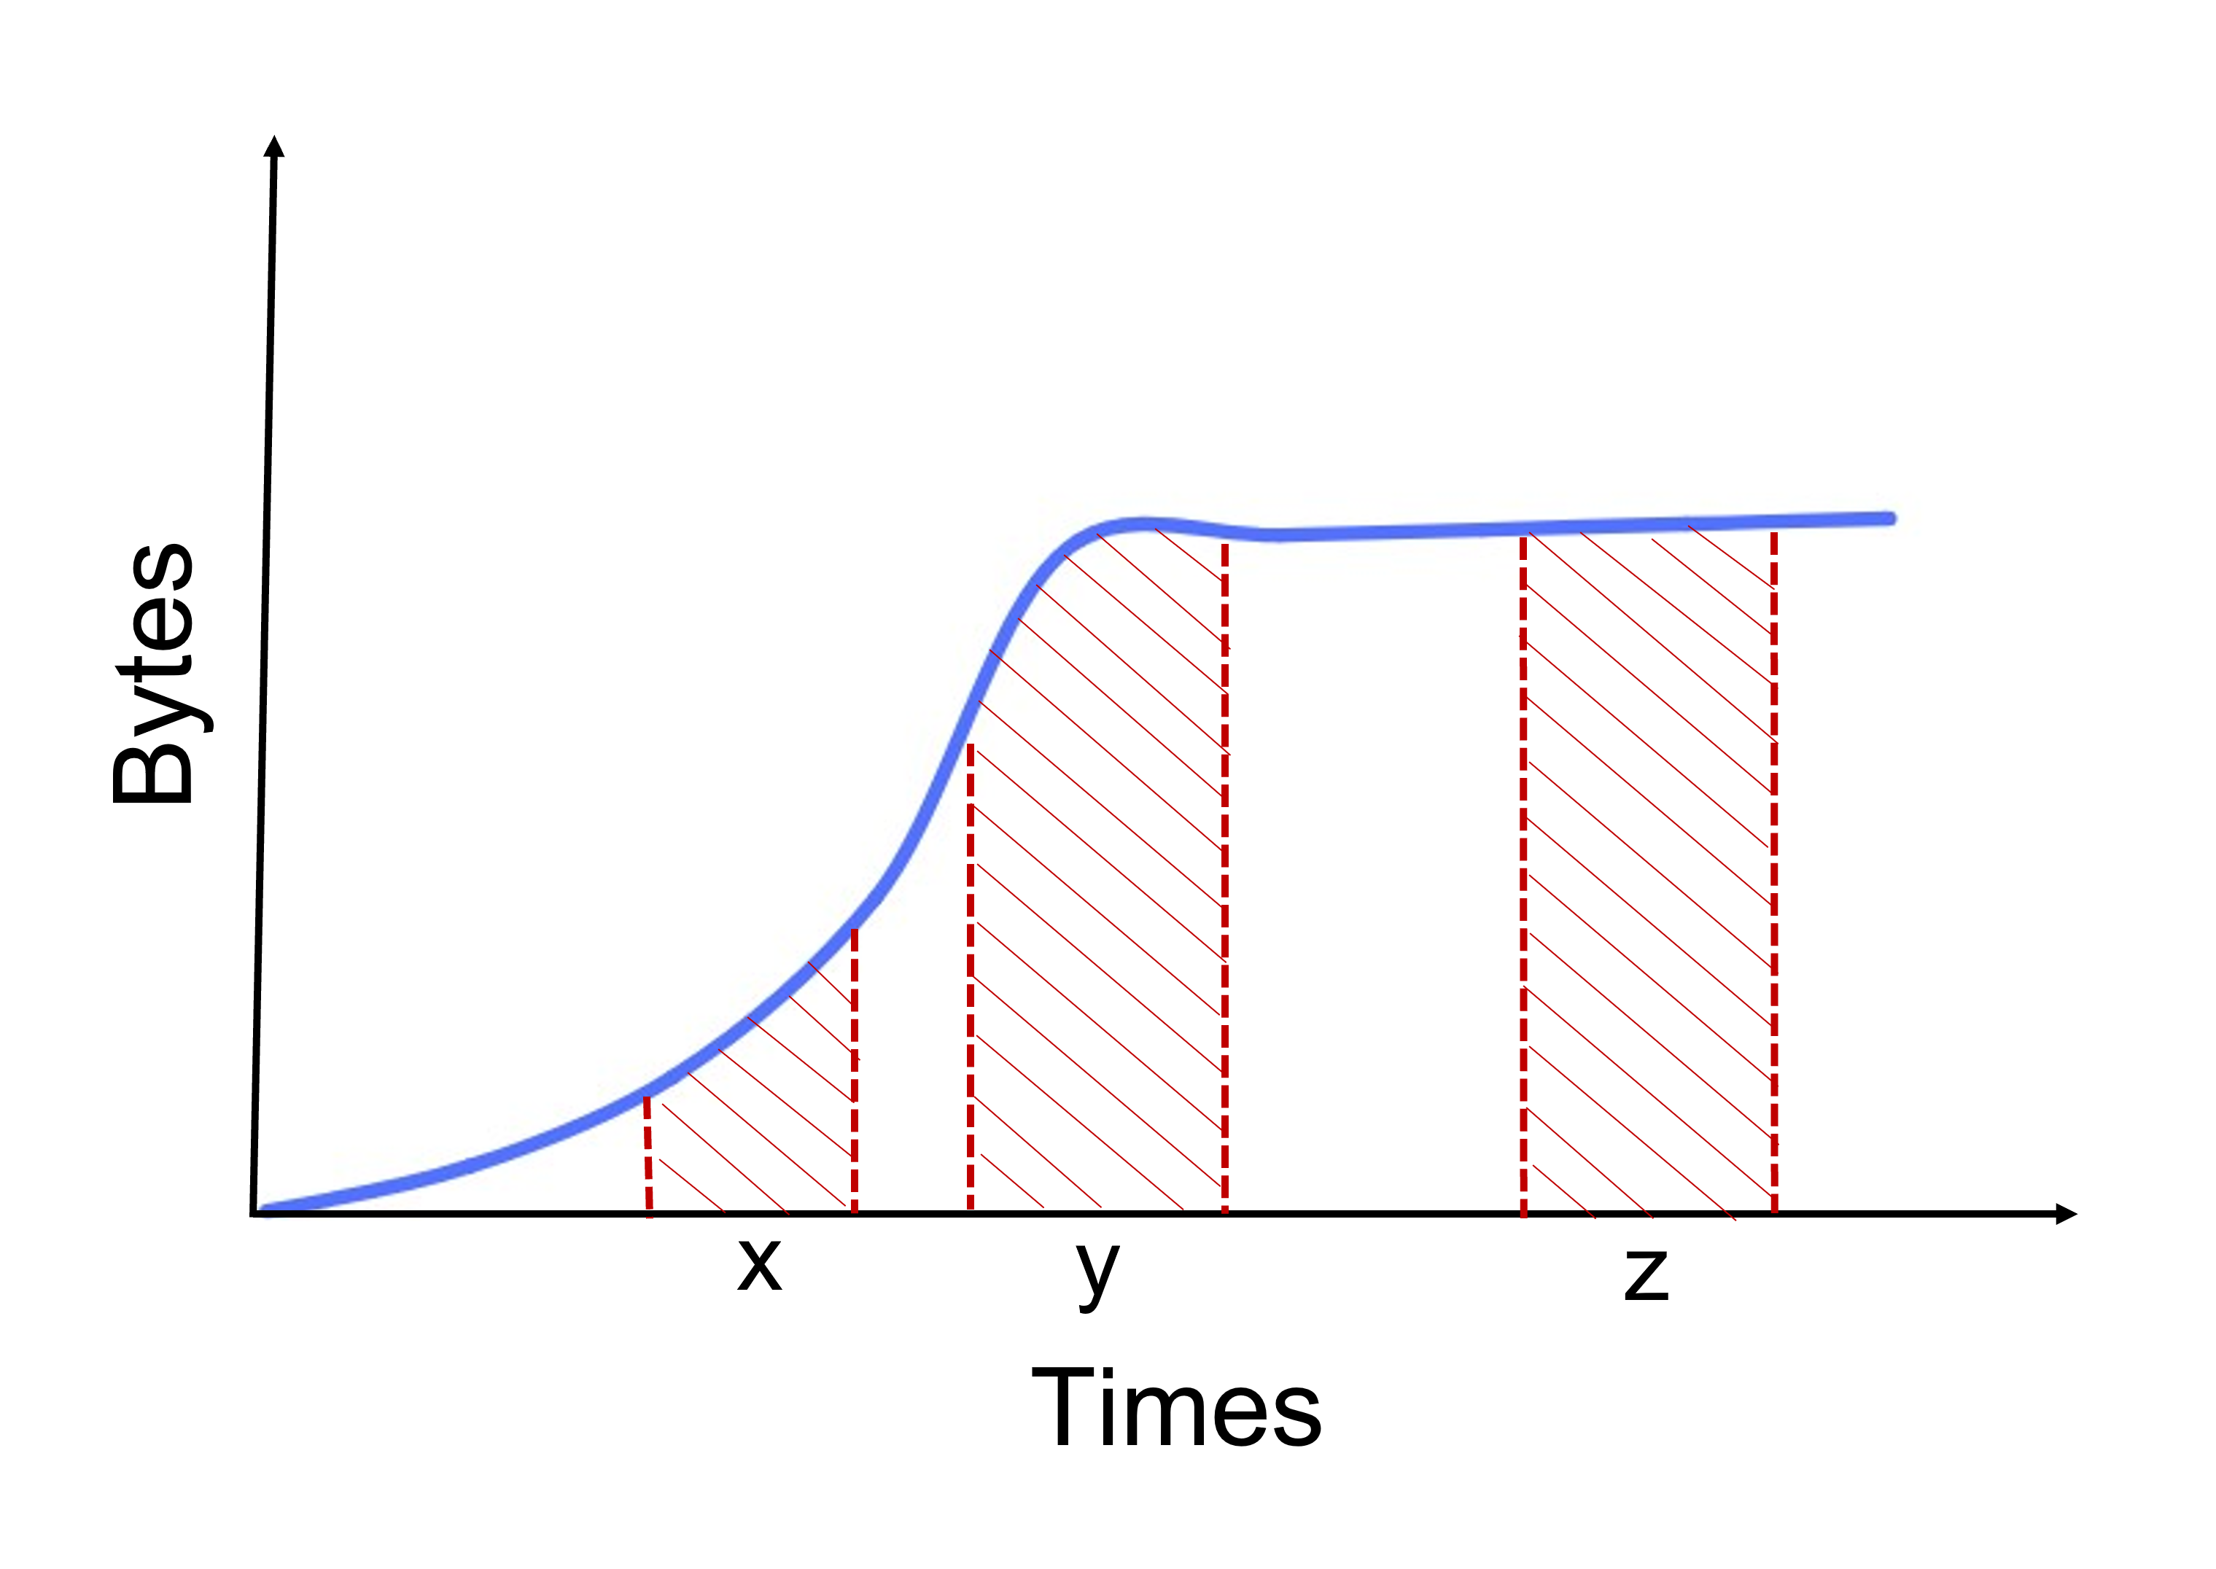
Threshold analysis
X: The window is in the initial growth period:
$$\int_{a}^{b}{2^{x}}dx={\left[\frac{2^{x}}{ln⁡(2)}\right]}_{a}^{b}$$
Y: Capacity is reached in this area:
$$\int_{f}^{g}{2^{x}}dx+\int_{h}^{i}{2^{c}}dx={\left[\frac{2^{x}}{ln⁡(2)}\right]}_{f}^{g}+2^{c}. (h −i)$$
Z: The capacity has been reached:
$$\int_{d}^{e}{2^{c}}dx=2^{c}. (e −d)$$

Slide 27
Threshold analysis
X: r < c (where r is the round, c is the capacity round):
2^{x}, 2^{x+1}, …, 2^{r-1}, 2^{r} ….
W
prev_delv = ${\left[\frac{2^{x}}{ln⁡(2)}\right]}_{r−1−w}^{r−1}$ curr_delv = ${\left[\frac{2^{x}}{ln⁡(2)}\right]}_{r−w}^{r}$
r
C after window
Y: (r –w) < c < r:
2^{x}, 2^{x+1}, …, 2^{c}, 2^{c} …
w
prev_delv = ${\left[\frac{2^{x}}{ln⁡(2)}\right]}_{r−1−w}^{c}+2^{c}. ((r −1−c)$ curr_delv = ${\left[\frac{2^{x}}{ln⁡(2)}\right]}_{r−w}^{c}+2^{c}. ((r−c)$
r
C
within window
Z: c < (r – w) :
…. 2^{c}, 2^{c}, …, 2^{c}, 2^{c}
w
prev_delv = $2^{c}. ((r −1) −(r−1−w))$ curr_delv = $2^{c}. (r−(r−w))$
r
C before window

Slide 28
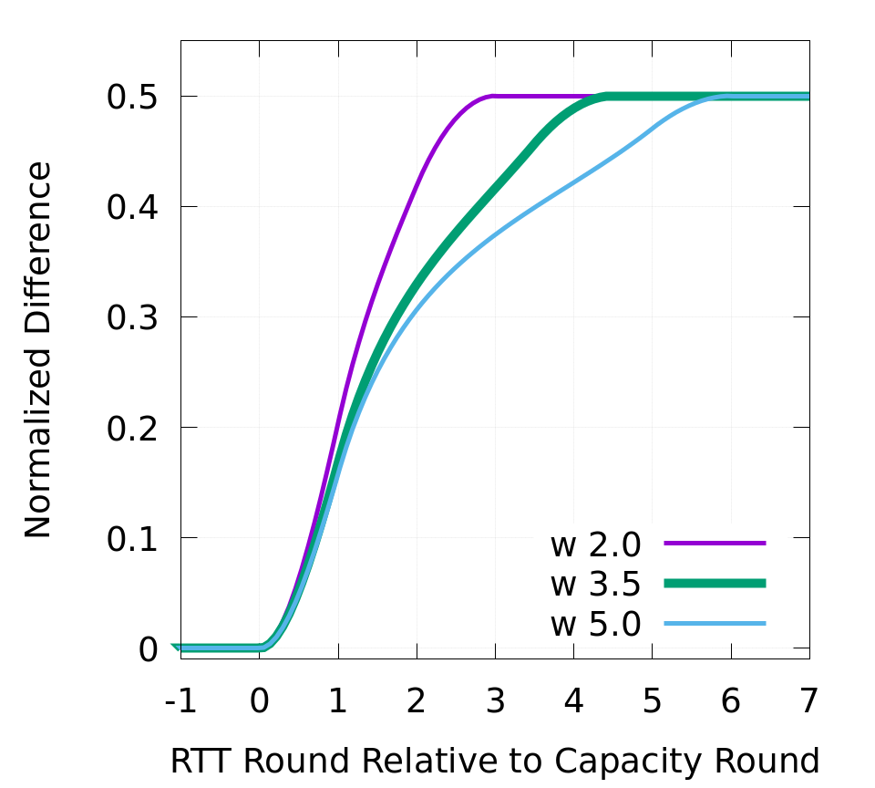
Threshold analysis
X
Y
Z
Default window size = 0.35

Slide 29
SEARCH Overview
capacity
8a
4a
delivered bytes
2a
a
t₁
t₂
t₃
t₄
t₅
t₆
Round-trip time
curr_delv
prev_delv
diff = 2 prev_delv – curr_delv
threshold
normalized diff = diff / 2 prev_delv
difference
0
if (normalized diff $≥$ threshold):
exit from slow start
t₁
t₂
t₃
t₄
t₅
Round-trip time

Slide 30
SEARCH Overview
Maintains sliding window, 3.5 × initial RTT.
Need to keep historical data to compute prev_window .
Total of 25 bins, each storing ACKed bytes for a fixed interval.
curr_window and prev_window identified by bin indices.
prev_window offset by 1 RTT from curr_window.

