Slide 1
Improving QUIC Slow Start Performance with SEARCH
Amber Cronin*, Maryam Ataei Kachooei*,
Jae Chung†, Feng Li†,
Benjamin Peters†, Mark Claypool*
* Worcester Polytechnic Institute, † Viasat

Slide 2
Why study QUIC?
2012: Google begins development of a modern replacement for TCP
2021: QUIC codified by IETF with RFC9000
2023: QUIC carries ~30% of web traffic [Cloudflare]
Benefits over TCP:
Faster protocol encryption setups (by RTTs)
Multiple streams per connection
Avoids middlebox ossification by use of UDP
Satellite link fixes (PEPs) no longer function

Slide 3
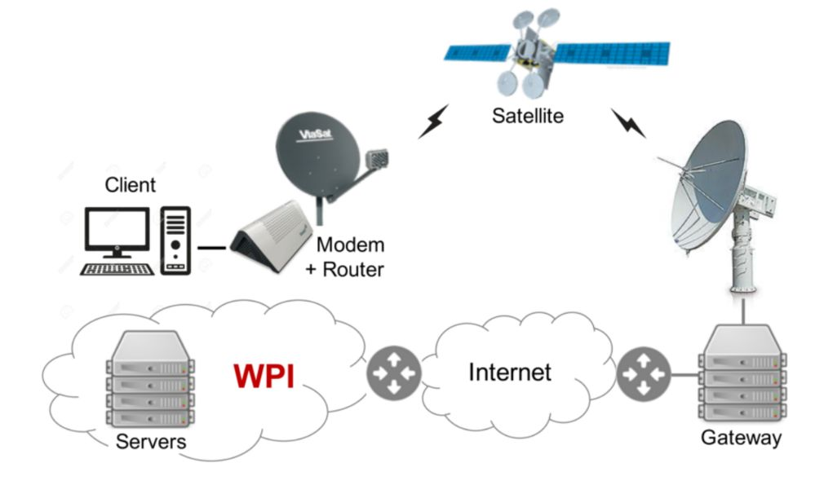
Satellite Links
GEO links: High bandwidth, high latency
600 ms RTT @ 144 Mbps
Bandwidth Delay Product (BDP) = BW x RTT = 10.8 MB
Queues, Queues, Queues
In practice, RTTs reach 1000+ ms
BDP = 18+ MB
HyStart unstable

Slide 4
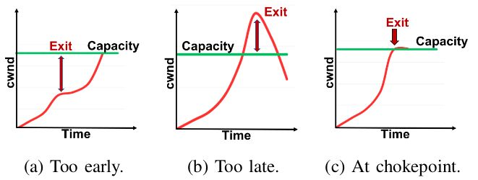
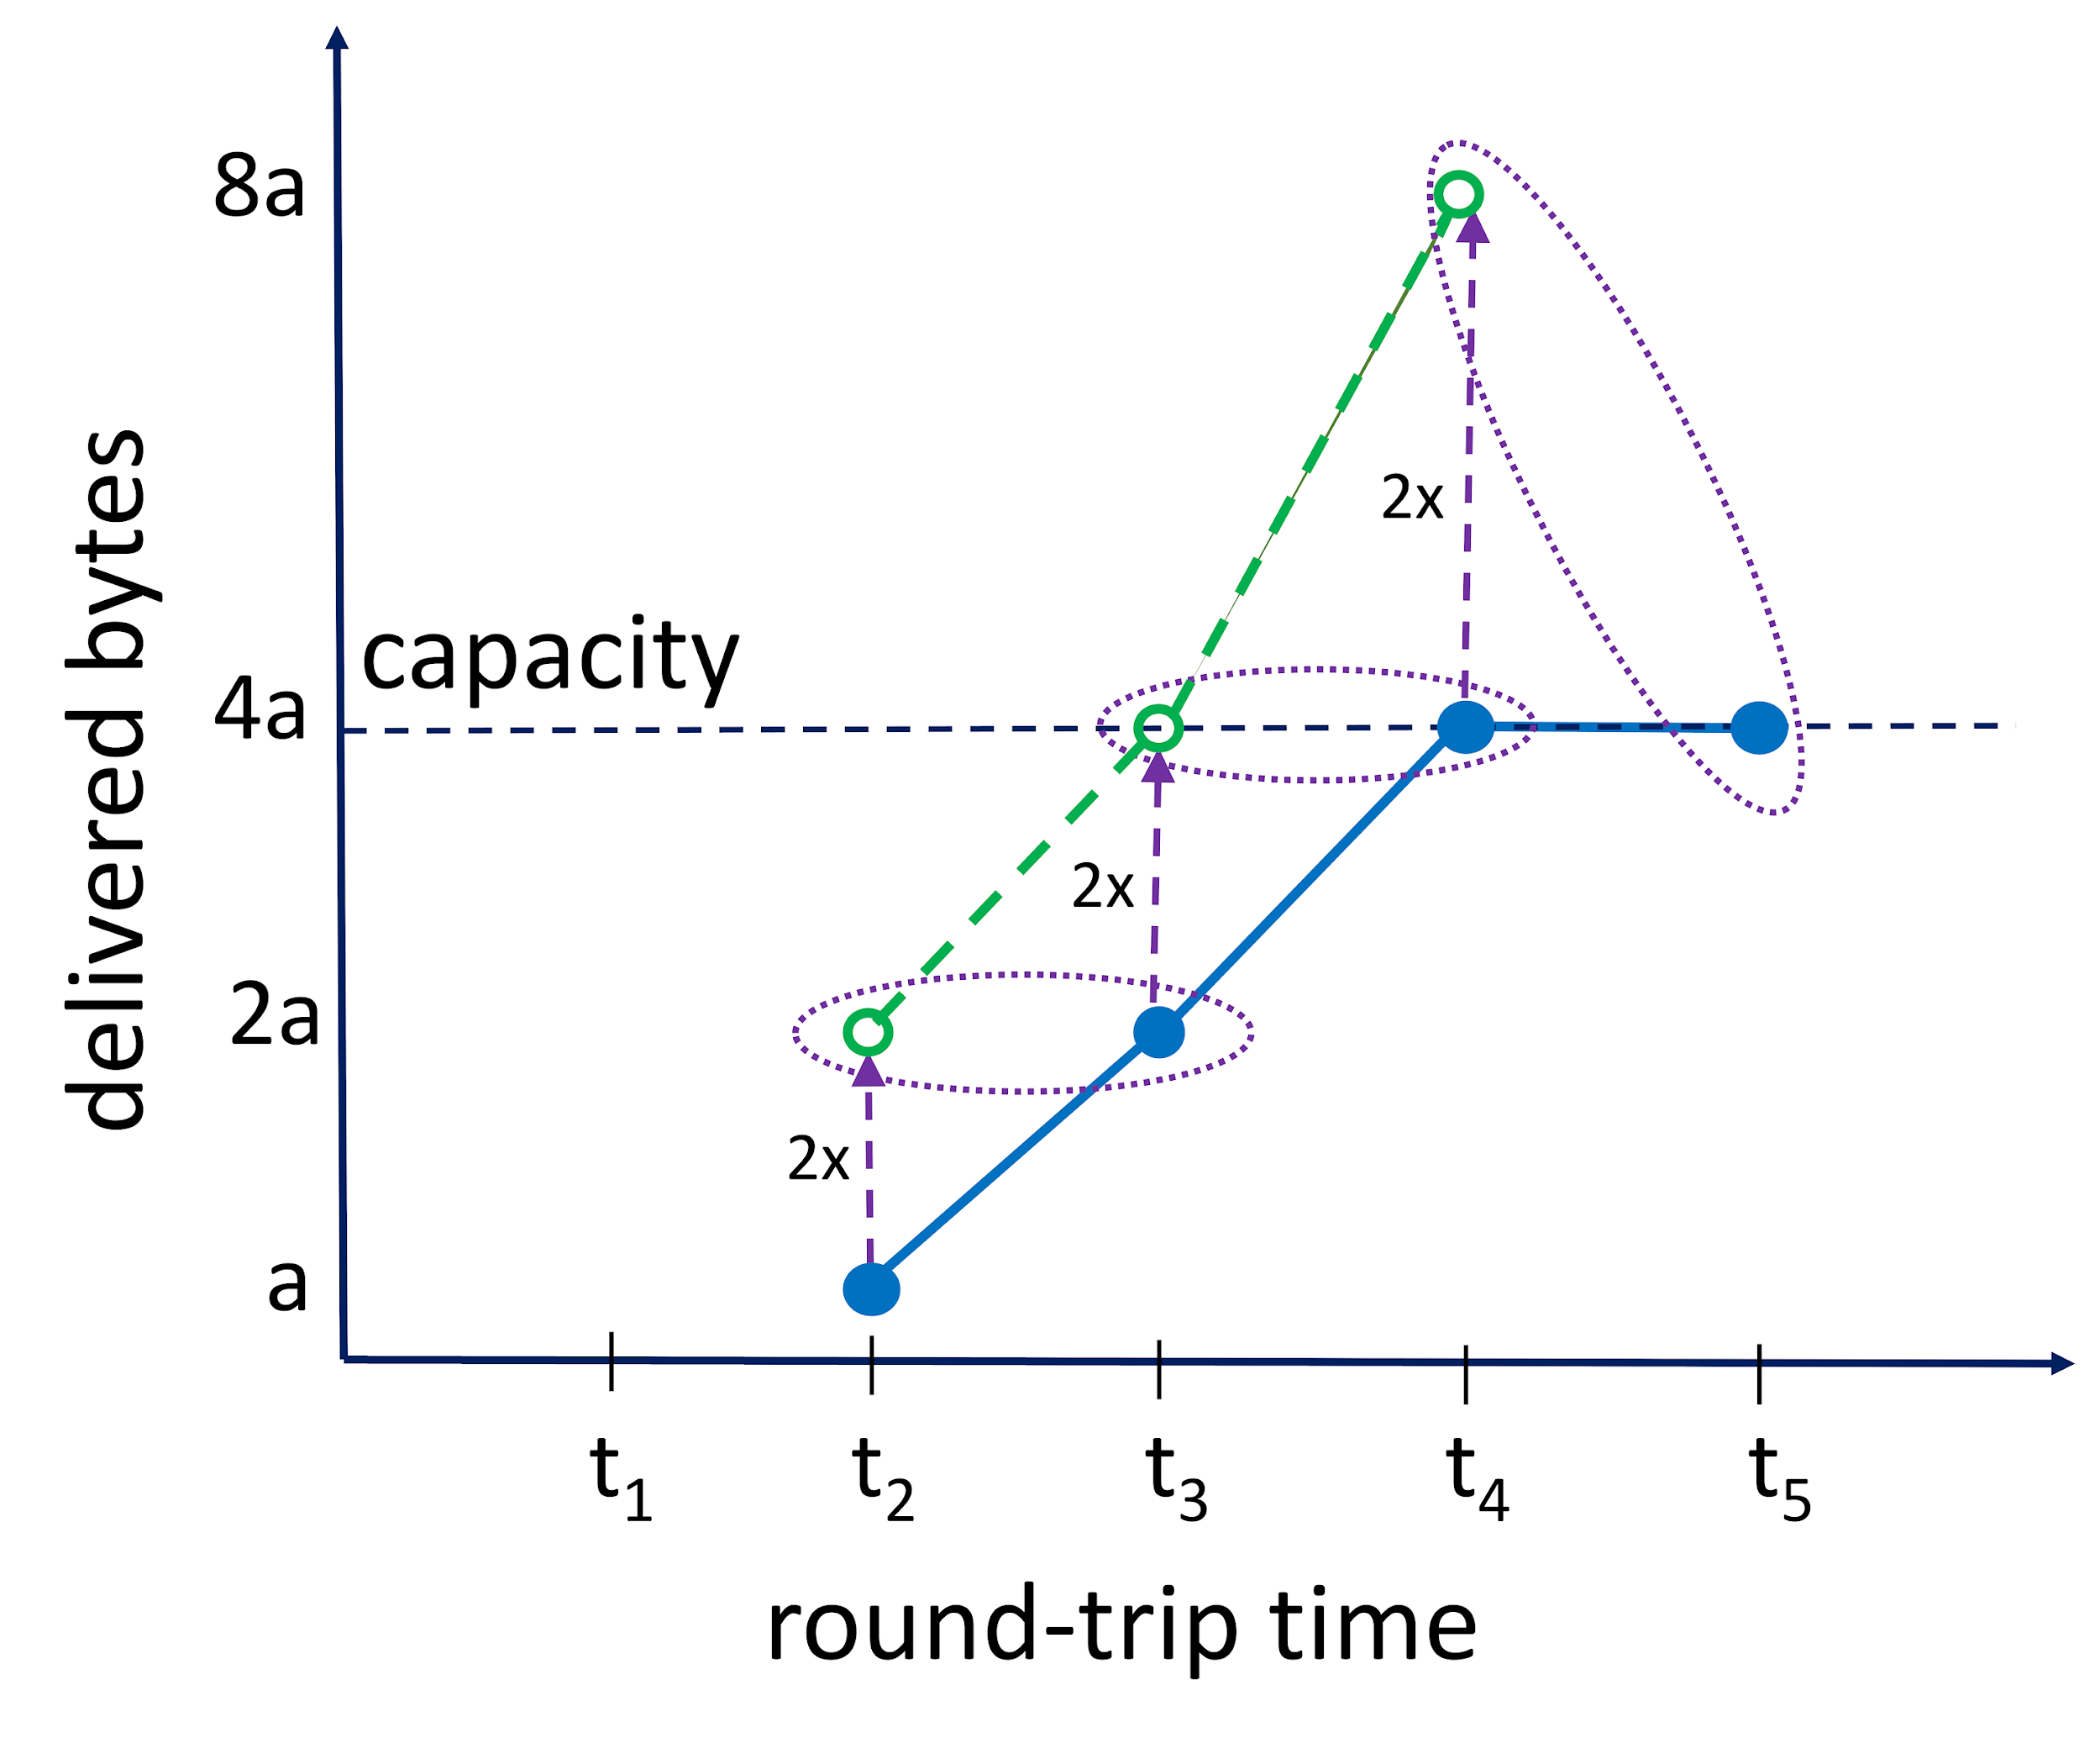
The SEARCH Algorithm
Track the delivery rate rolling average to reduce the impact of noise on link capacity detection

Slide 5
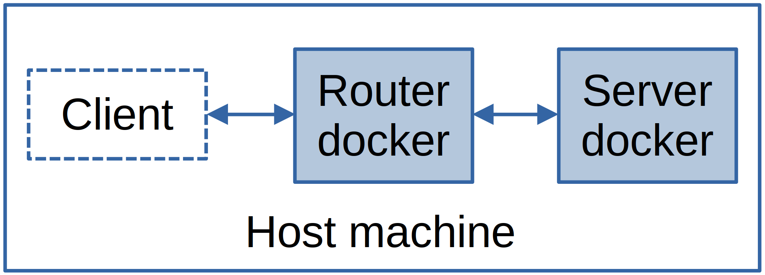
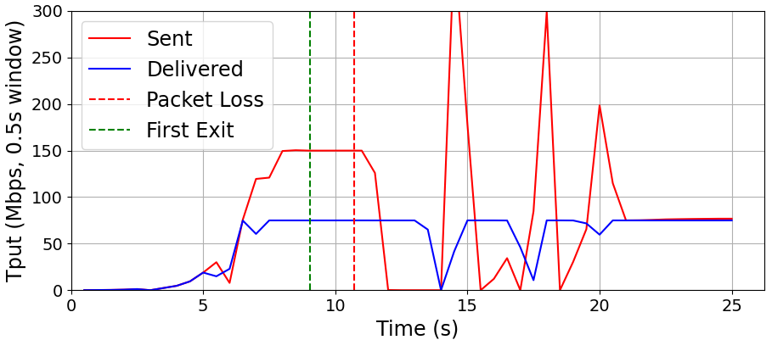
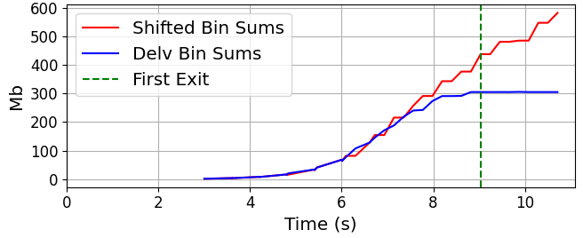
Initial Tests
QUIC implementation: Quicly
Testbench: Qperf (with modifications)
Before:
Congestion controller limited by MAX_DATA transmissions...
After:

Slide 6
Data Gathering
Two runs over the satellite platform
20 hours
24 hours
Server set to 150Mbps limit
Dataset makeup

Slide 7
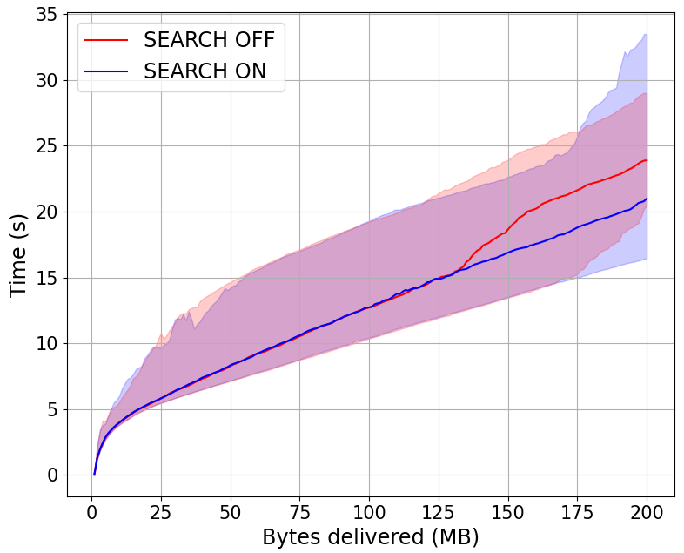
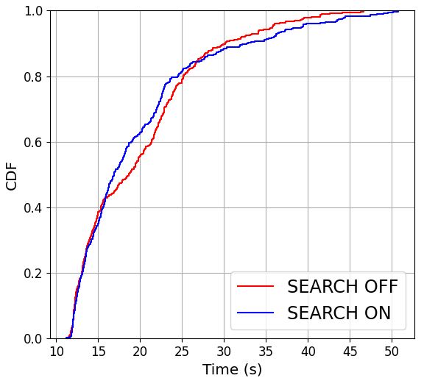
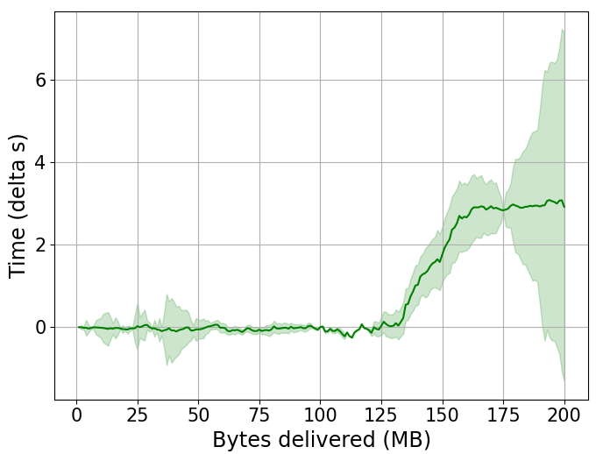
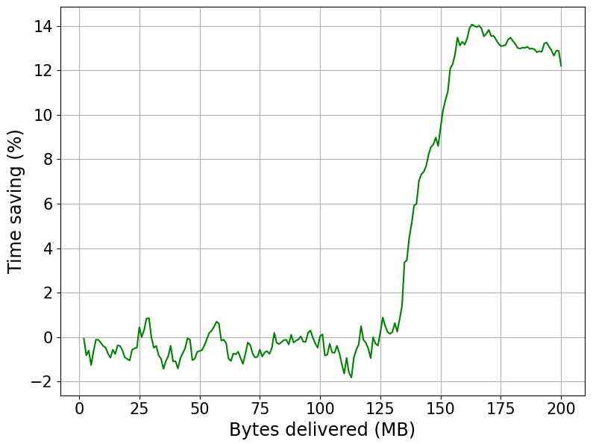
Results
SEARCH improves median goodput
3 second, or 14% improvement over base case

Slide 8
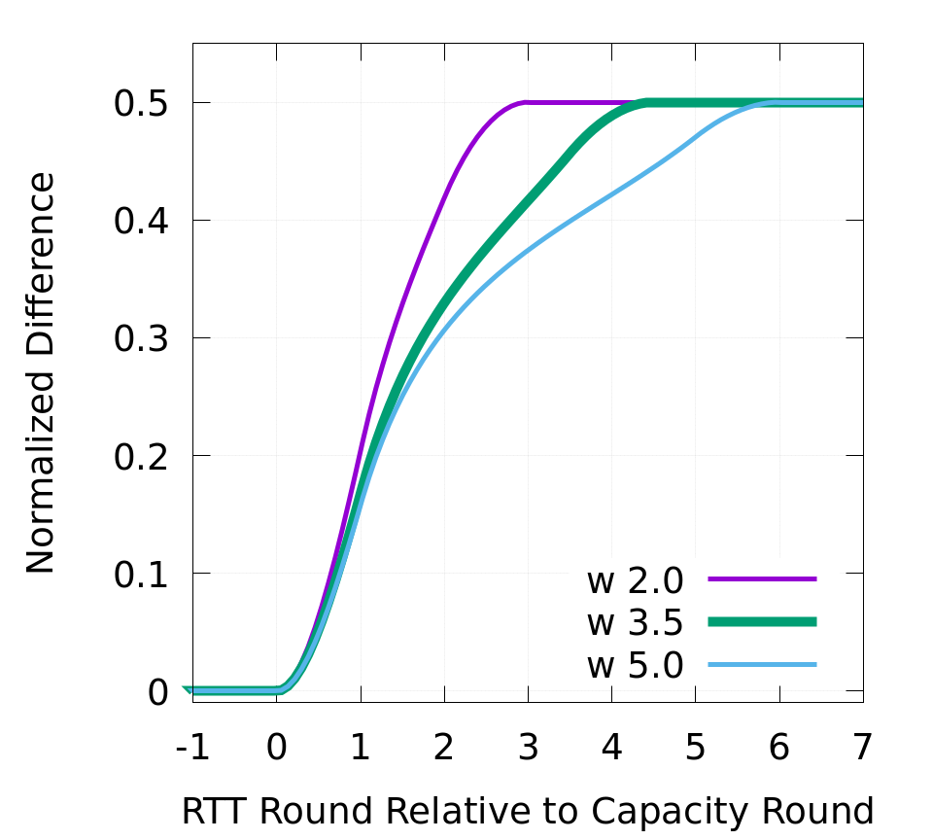
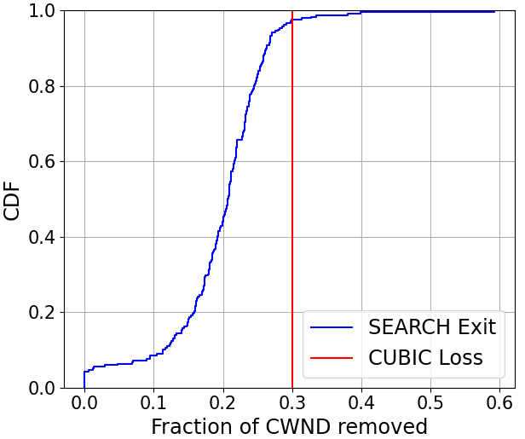
Congestion Window Modification
Tracking data on link capacity
Theoretical proofs of SEARCH detection (1.96 RTTs)
= Direct knowledge of link capacity
Dataset makeup

Slide 9
Summary
Extended existing QUIC implementation with SEARCH
Showed SEARCH improves QUIC’s goodput by 3 seconds (14%)
Showed SEARCH detects chokepoint and exits before loss
Tested on a commercial satellite platform

Slide 10
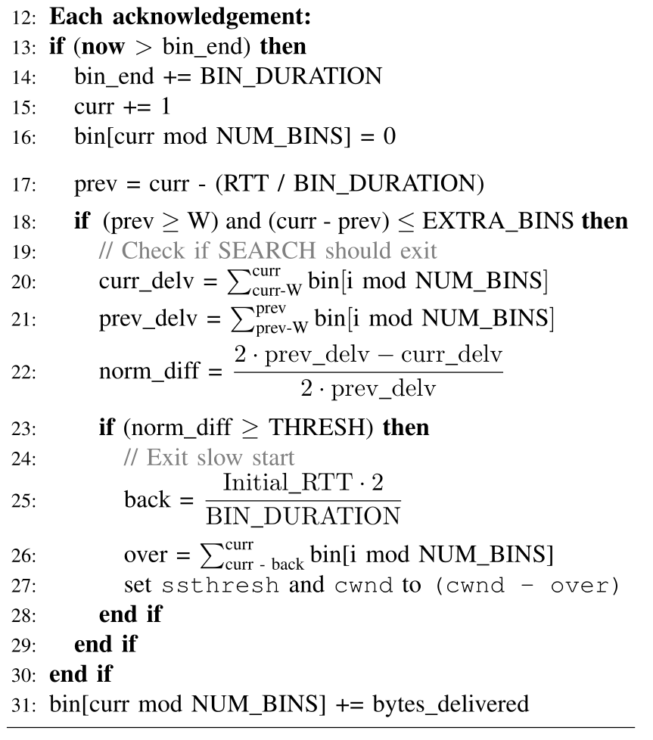
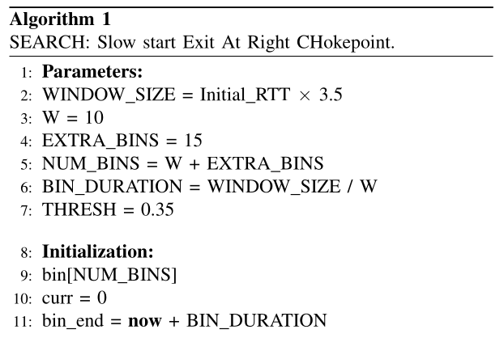
SEARCH

